Slide 1

The FY 2015 Executive Budget:
Responsible. Progressive. Honest.

Slide 2
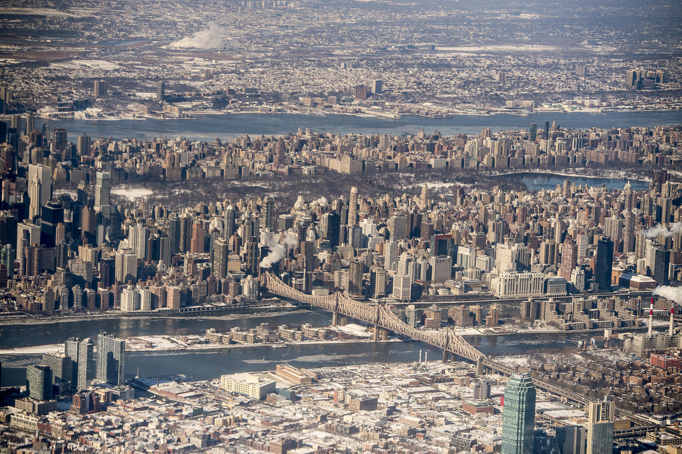
The budget builds on the foundation established in the Preliminary Budget and signals a new direction for our city based on the choices and values that have driven this Administration.
This budget is fiscally responsible.
This budget is progressive.
This budget is honest.

Slide 3
This budget is fiscally responsible.
  Since Day 1, we’ve identified short and long term risks and a serious structural deficit. This budget makes real progress:
  City and MLC agree to secure health care savings of $3.4
  billion, plus $1 billion from the health stabilization fund, from
  FY15-FY18. These savings are enforceable by arbitration.
  The Labor Reserve now reflects the UFT pattern of a 10%
  increase over 7 years.

Slide 4
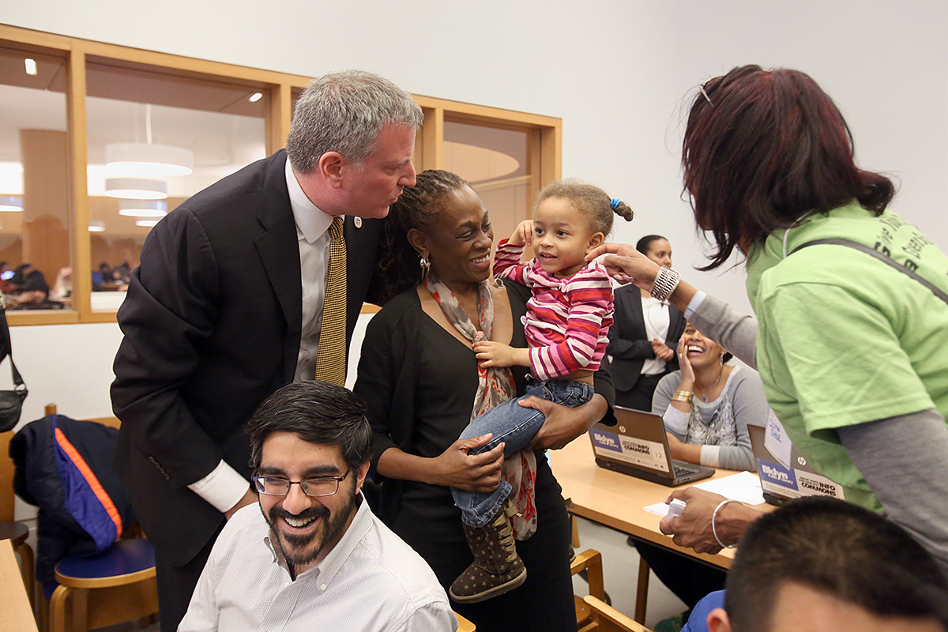
  The City secured critical commitments from the state and federal governments.
State Funding:
      Universal Pre-K
      Largest school aid increase in years
      After School Programs
Federal Funding:
      Medicaid Waiver

Slide 5
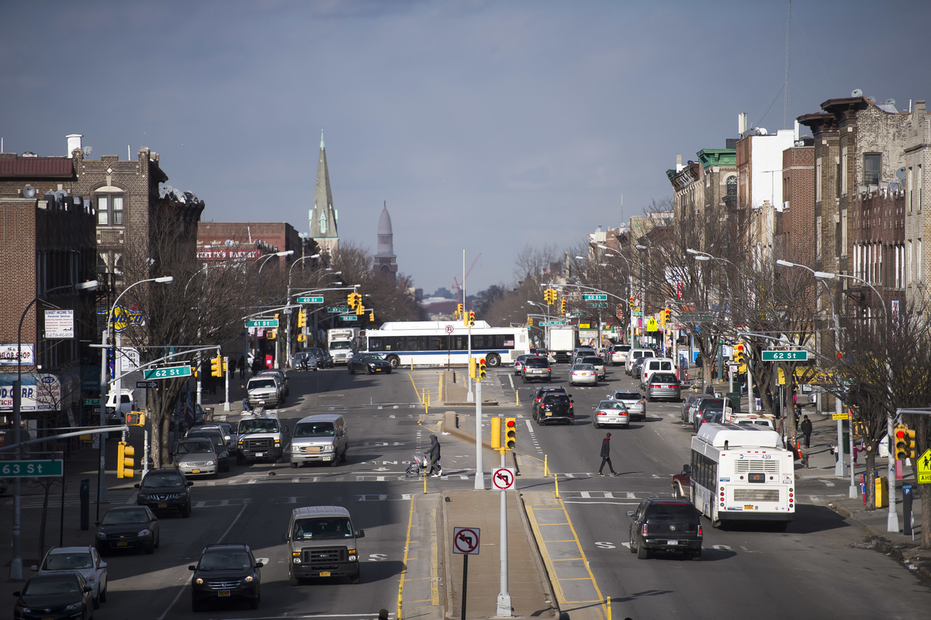
Economic Update
We’re fortunate to have a stronger economy.
But it’s clear that the benefits have not been shared by all New Yorkers.
While we have addressed many concerns, we still must recognize the risks ahead.

Slide 6
GDP Growth Will Increase Modestly in 2014, Before Climbing Above Three Percent in 2015 (Consistent with National Consensus Forecasts)
f = forecast
Source: U.S. Bureau of Economic Analysis, U.S. Bureau of Labor Statistics, NYC OMB

Slide 7
Gross City Product Finally Exceeded Pre-Recession Peak Levels in 2013
Forecast
f = forecast
Source: U.S. Bureau of Economic Analysis, NYC OMB

Slide 8
New York City’s Job Growth Has Come From a Variety of Industries – But Many Industries are Still Lagging
Source: NY State Department of Labor

Slide 9
Construction Activity Reflected by Building Permits Remains Below Pre-Recession Levels
Forecast
f = forecast
Source: U.S. Census Bureau, NYC OMB

Slide 10
The Unemployment Rate for Both the City and the Nation has Declined Since Hitting a Peak During the Recession
7.8%
6.6%

Slide 11
Since 1994, the Top 1% Have Increased Their Share of Income by Half, Growing From 23% to 36% Of All Income Earned in New York City
1994 Tax Year
2011 Tax Year

Slide 12
Percent of New Yorkers Struggling Economically Has Increased Over the Last Five Years– with 46% At or Near Poverty According to the NYC CEO Poverty Rate
Percent of Population
2008
2010
2012
Source: American Community Survey Public Use Micro Sample as augmented by CEO.

Slide 13
The Current Recovery Has Lasted 58 months, Matching The Average Length of U.S. Expansions
Source: NBER. Bar represented in red denotes current expansion.

Slide 14
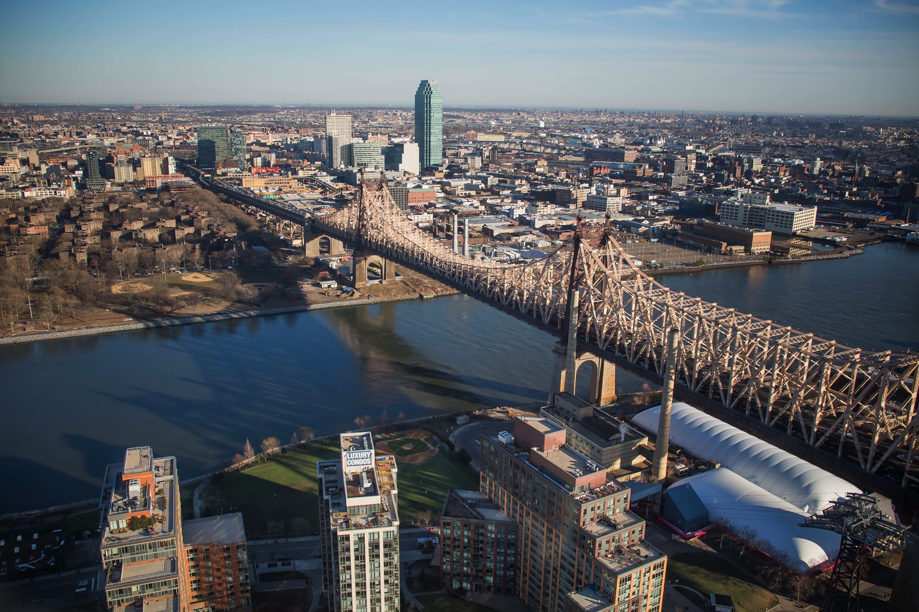
  Financial Plan Overview

Slide 15
  Executive Budget is balanced for FY2014 & FY2015
  - Financial plan estimates now reflect the UFT pattern of a 10% increase over seven years.
  - This removes one of the major Financial Plan uncertainties.
  Executive Budget, like the Preliminary Budget, realistically acknowledges significant risks:
  - Recognizes continued federal uncertainty, including still-unmet Sandy recovery needs and future federal sequestration.
  - Even with the Medicaid Waiver and much-needed funds it provides, many local hospitals are still struggling.
  - While we’re five years into a recovery, economic events out of our control can undermine progress.
  - Cautious on revenue growth, as we see consequences of over-estimating revenues in NJ and other places.
In a very short period, we have addressed serious financial and management issues that had been ignored – with no property tax increase.

Slide 16
We Continue to Face Multi-Billion Dollar Budget Gaps in the Out Years of the Financial Plan. However, These Out Year Gaps are Below Historical Averages.
We will take the necessary actions to maintain budget balance through all years of the Financial Plan.
$3,748
8.7%
$3,041
7.6%
$ in Millions
$2,197
3.9%
2016
Year 3
2017
Year 4
2018
Year 5
Note: Historical averages are based on Executive Budgets FY 2003 to FY 2014 for the 3rd year to 5th year of the financial plan.
Percentages represent budget gaps as a percent of city funds revenue.

Slide 17
We’re taking major steps toward addressing NYC’s fiscal health.
Strengthening our economy by addressing income inequality
  Providing major education opportunities from pre-K to middle school to college
  Dramatically expanding affordable housing over next 10 years
  Increasing and extending paid sick leave coverage for over half a million more New Yorkers
Prioritizing our infrastructure and establishing clear and affordable capital commitments
Process will continue with every agency ahead of Ten Year Capital Plan in January 2015

Slide 18
This budget is progressive.
Begins to implement an agenda that:
Invests in our children
Creates economic opportunity
Dramatically expands affordable housing
Protects the most vulnerable
Makes New York City safer

Slide 19

  Investing in NYC’s Children

Slide 20
High-Quality Full-Day Universal Pre-K
  Investing $300 million in FY2015 to fund 53,000 seats; $340 million in FY2016 to fund 73,000 seats
  NYC is building a high-quality full-day universal pre-K program to ensure all four-year-old are set up for long-term success
  6 hours & 20 minutes a day of pre-K instruction, free to families
  Expectations for instruction focused on providing children with a solid foundation of skills and knowledge
  Family engagement establishes strong partnerships from the beginning
  Program data informs ongoing monitoring and improvements
  Workforce development ensures all pre-K programs have the capacity to provide quality services

Slide 21
High-Quality Full-Day Universal Pre-K
Seats
36,500 seats already set through enhancements of existing and new spaces
Thousands more to be selected by the end of the month
Expansion continues to reach target of 53,000 full-day seats
Teachers
1,200 certified teachers have already applied to DOE – 53% more than this time last year
An additional 1,100 applications were received from individuals with elementary certification interested in teaching at a CBO
CUNY certification support will certify up to 400 teachers by September 2015

Slide 22
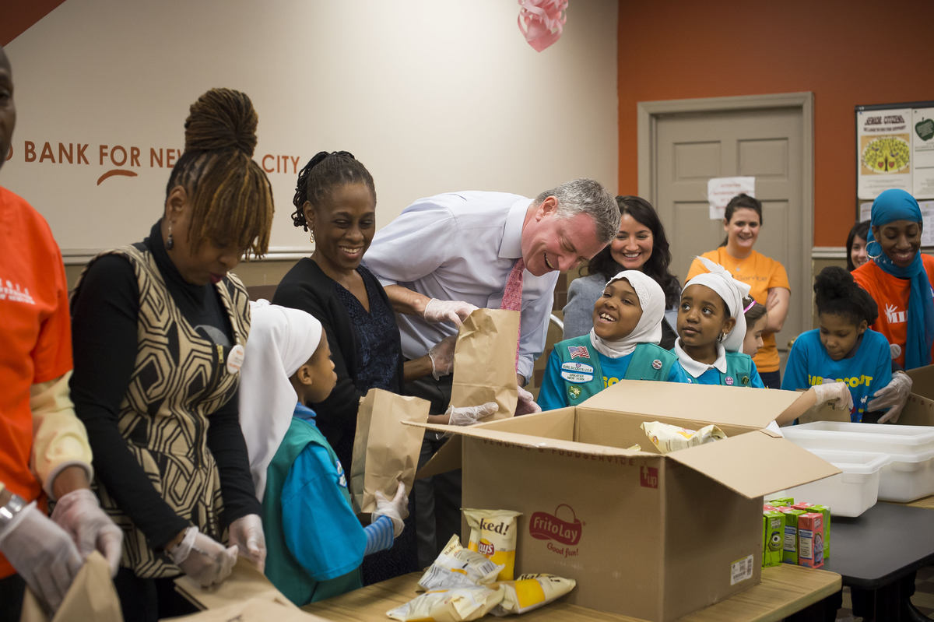
Middle School Afterschool Programs
Unprecedented investment of $145 million to fund 34,000 new seats, to serve nearly 100,000 children in FY2015.
Expanding summer programs by over 17,000 new seats, to serve 33,000 children in FY2015.

Slide 23
Moves Forward Additional Key Education Priorities
Reduces overcrowding & use of trailers
Expands arts education
Invests $20 million in FY15 - growing to $50 million in out years - to expand STEM programs at CUNY community colleges for 5,000 students in Year 1.

Slide 24
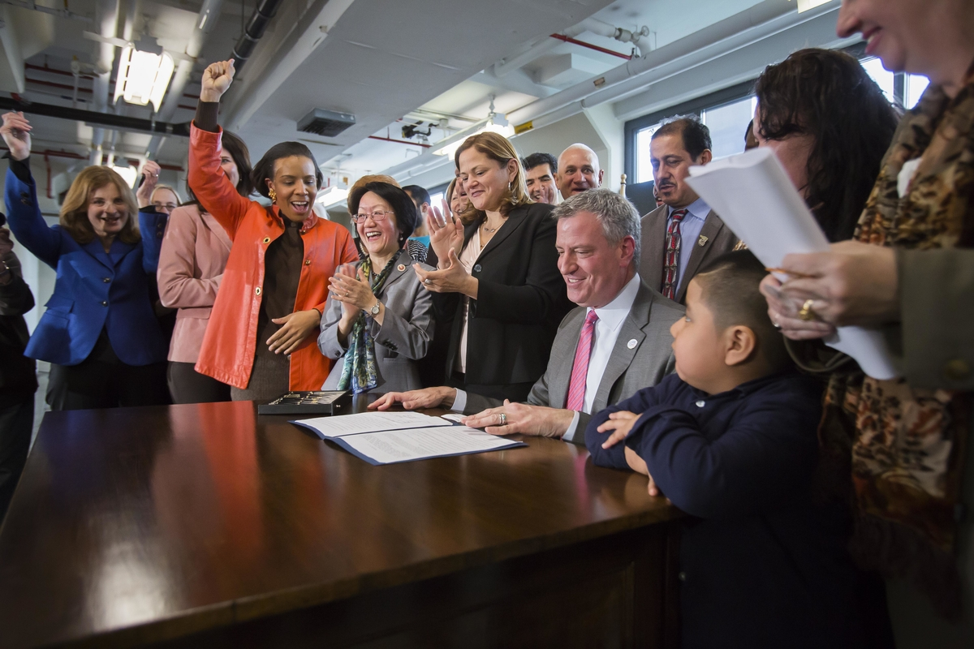
  Creating Economic Opportunity

Slide 25
Creates Jobs & Protects Small Businesses
  Reduces arbitrary and overly punitive DOH and DCA fines:
    Total fine revenues projected to decline from $859 million in FY2012 to $789 million in FY2015 – an 8% decrease. This includes a reduction of 44% in DOH fines and 21% in DCA fines from FY2012 to FY2015.
    Mayor’s Office of Operations and OMB conducting a comprehensive review of fees and fines, including an expanded focus on addressing obsolete, burdensome, and inequitable violations.
  Implements and enforces Paid Sick Leave
  Develops manufacturing jobs at Brooklyn Army Terminal

Slide 26
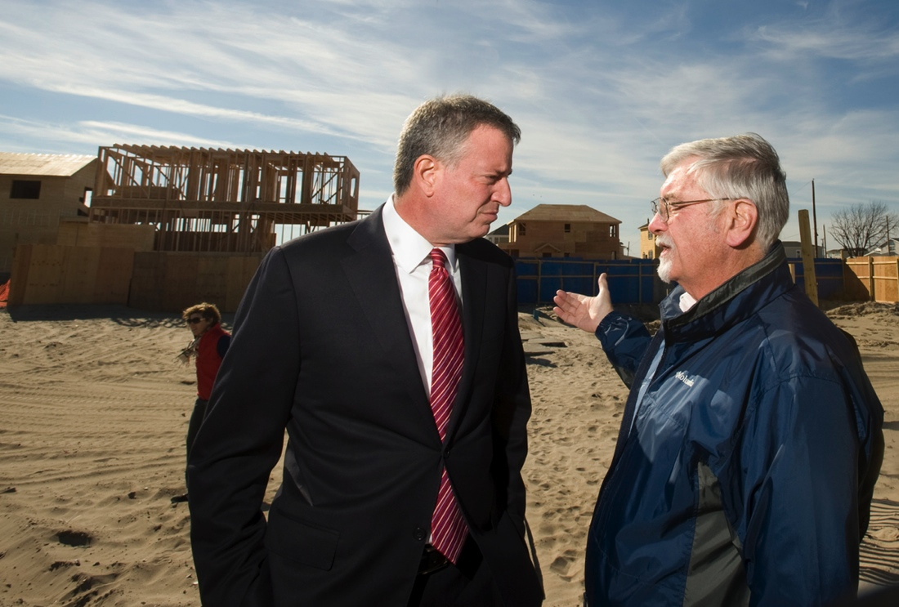
Overhauls Sandy Recovery Efforts
Invests in Build It Back to expedite relief
Engages communities to create local jobs
Provides financial relief to residents:
  Water bill relief
  Property tax relief
  Building fee relief

Slide 27
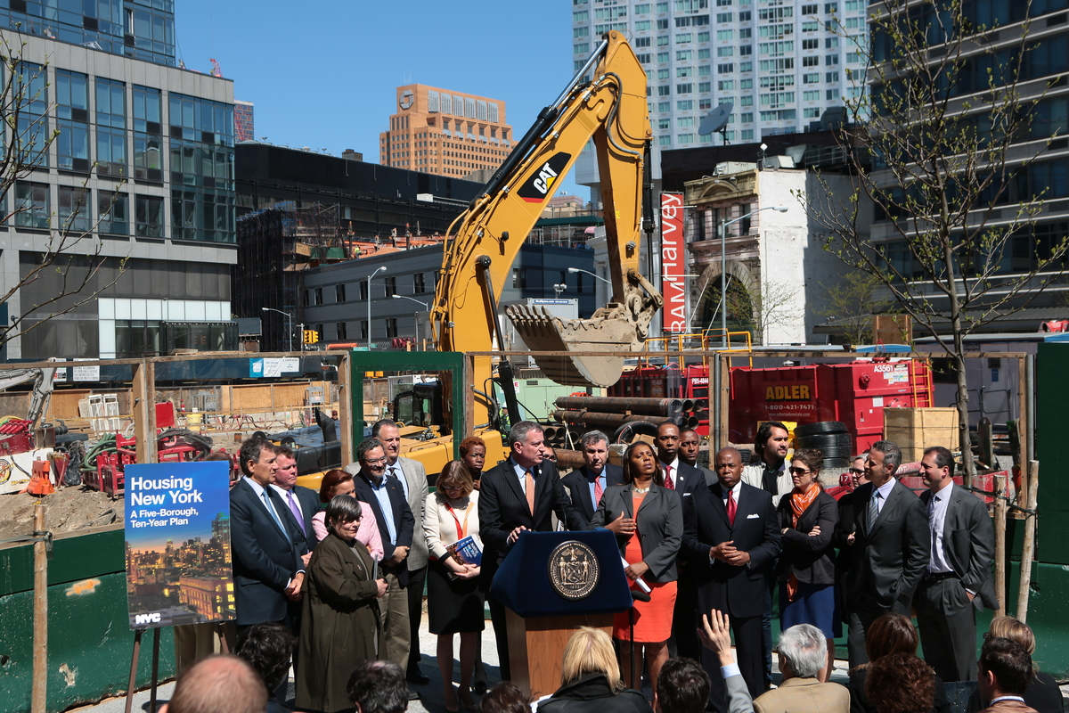
  Dramatically Expanding Affordable Housing

Slide 28
Housing New York: A Five-Borough, Ten-Year Plan
  $41 billion capital investment over 10 years to build or preserve 200,000 units of affordable housing.
  Serves wide range of households, from middle- to very low-income.
  Adds staff and inspectors, vital to protecting affordability and tenant rights.
  Creates approximately 194,000 construction jobs and 7,100 permanent jobs.
  Financial Relief for NYCHA
    Provides additional $70 million in relief to NYCHA to address the backlog of repairs and enhance security.

Slide 29
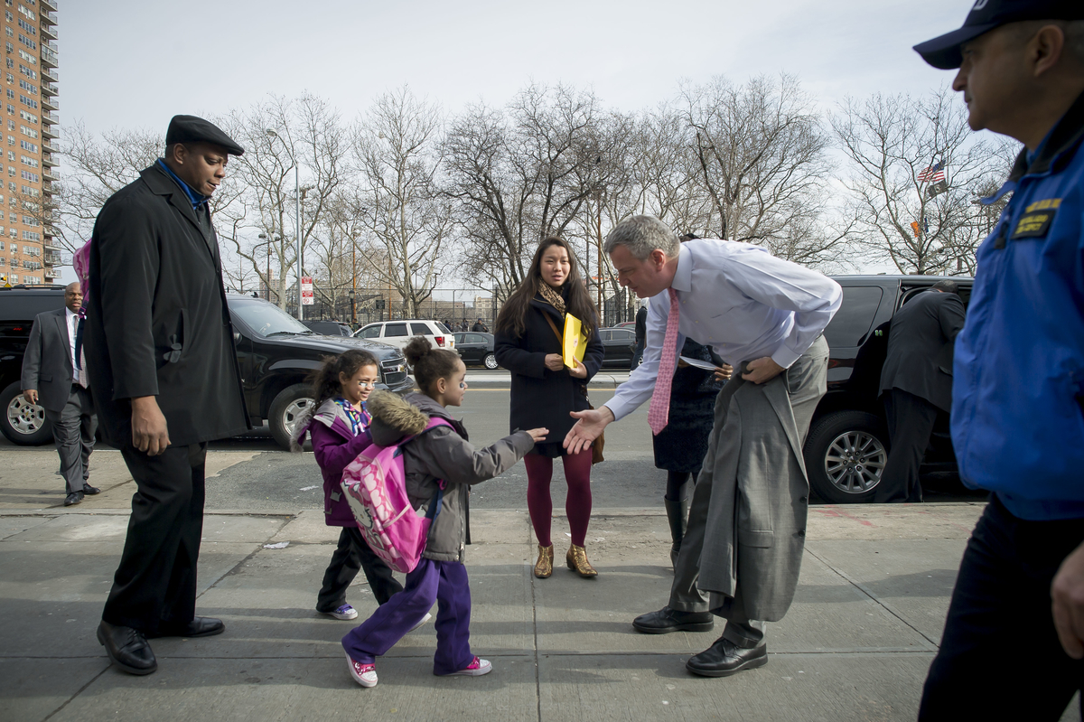
  Protecting the Most Vulnerable

Slide 30
Prevents and Reduces Homelessness
Fully funds HASA 30% rent cap for low-income New Yorkers with HIV/AIDS.
Consolidates anti-eviction legal services.
Begins a multi-year proposal to implement a new Working Families Subsidy Program, working with the State.
Targeted use of NYCHA units and Project Based Section 8 apartments for homeless families.
Achieves shelter savings by reducing rates and working with the State to reinvest in permanent solutions.

Slide 31
Protects Children and Youth
  Implements Child Protective Reform Plan to provide greater oversight of high-risk cases and children under court-ordered supervision.
  Finished conversion of Auburn Street Shelter ahead of schedule; Catherine Street Shelter in process.
  Provides shelter security enhancements.
  Funds 100 new crisis shelter beds for runaway and homeless youth, including 24 beds for LGBT youth.

Slide 32
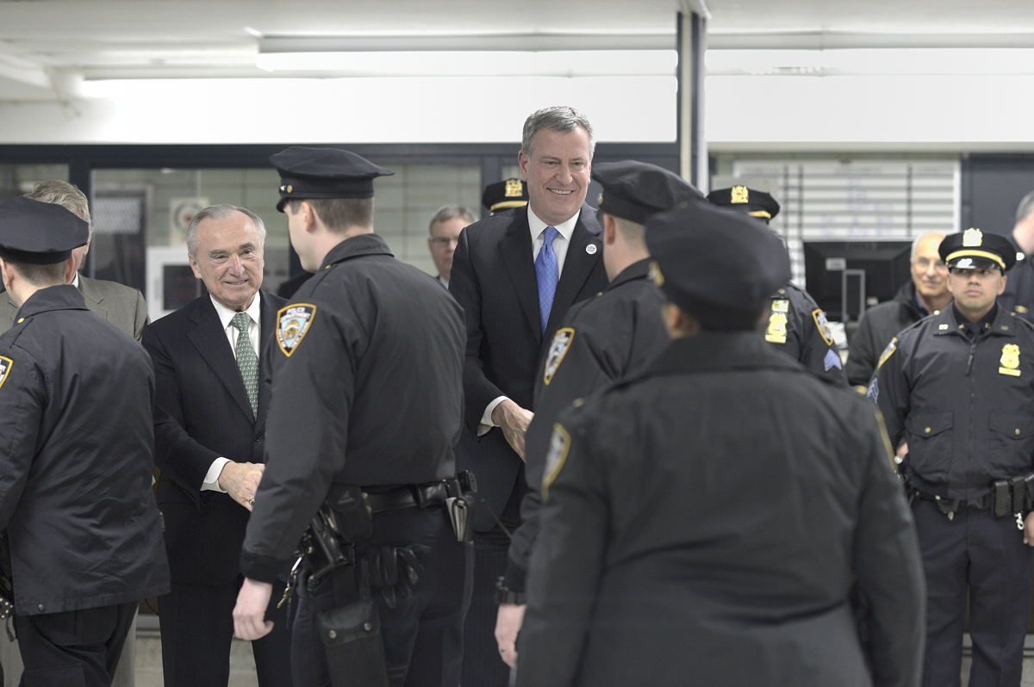
  Making New York City Safer

Slide 33
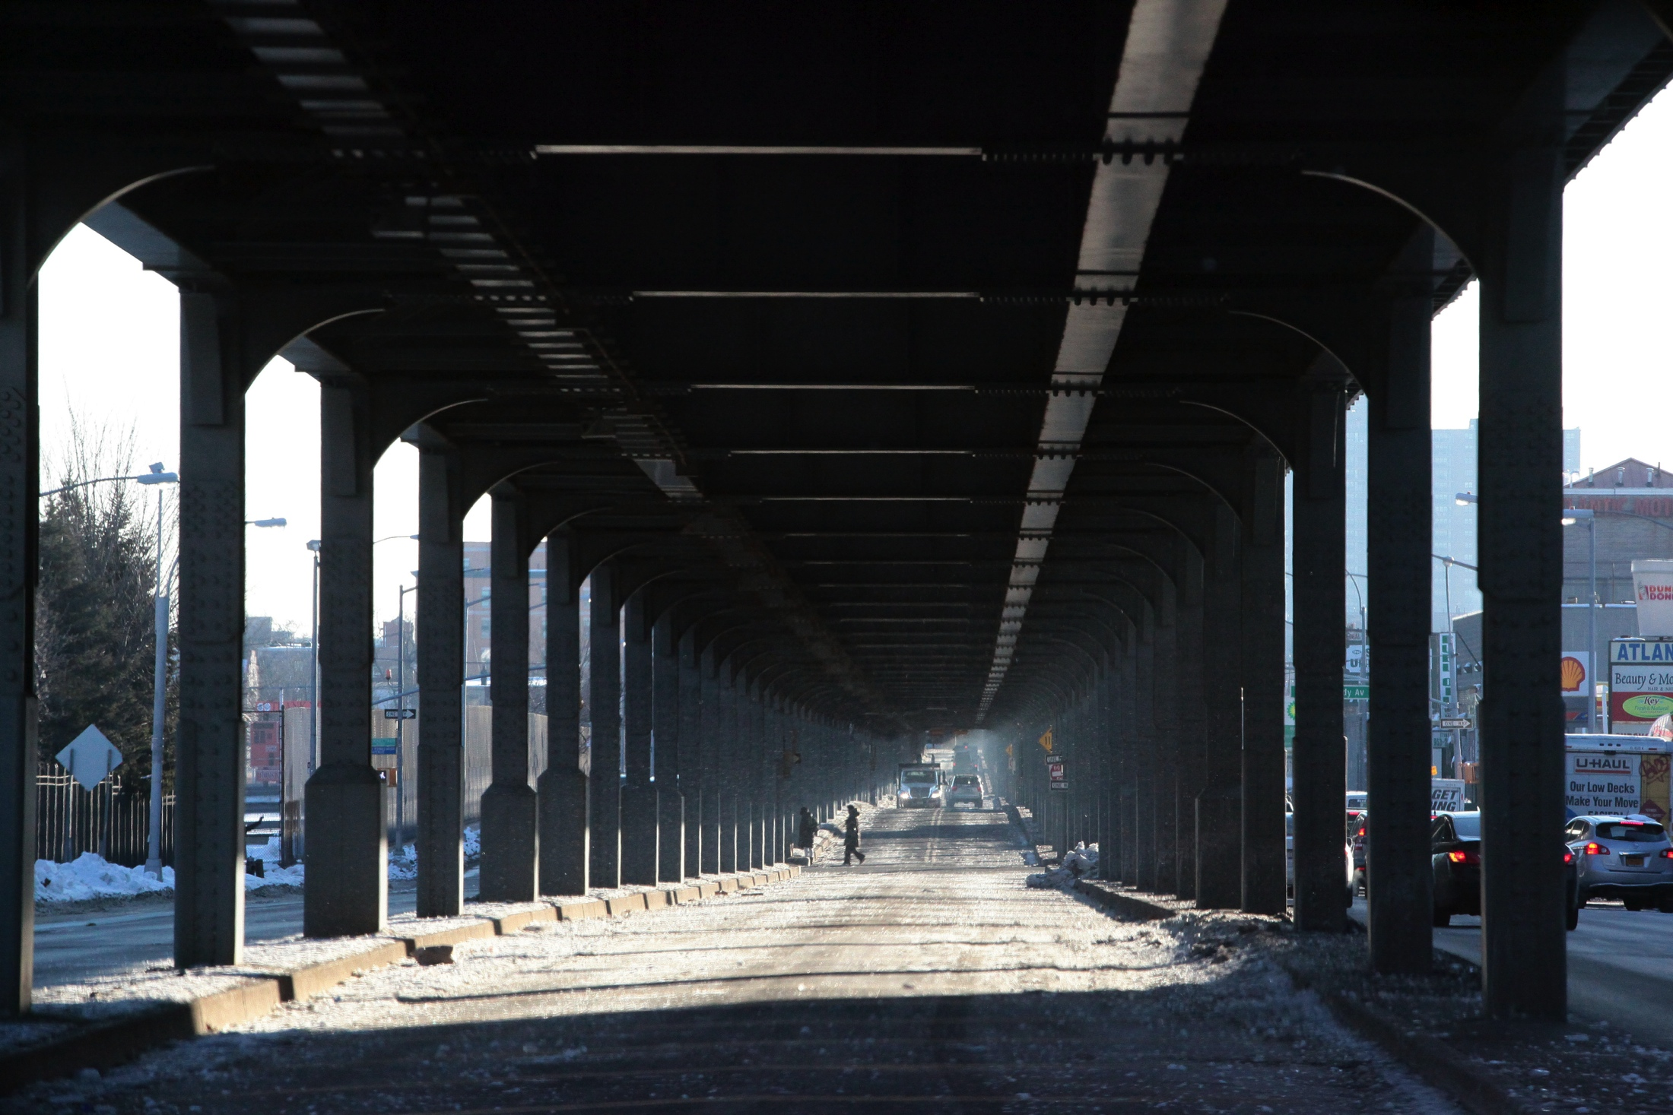
  Implements Vision Zero
  $28.8 million for DOT initiatives, such as speed cameras, slow zones, and intersection redesigns.
  $13 million for NYPD traffic enforcement.
  $1.1 million for TLC safety squad ad campaign.
  Increasing road resurfacing investment by $49 million in FY2015, for a total of $226 million, to resurface 1,000 lane miles in FY2015.
  Prioritizing investment in bridges by allocating an additional $346 million for bridge rehab.
  $110 million over next three years to rehab two NYPD precincts and construct a new 40th Precinct in the South Bronx.
  Invests in public safety and infrastructure

Slide 34
This budget is honest.
Reforms the budget process to end the budget dance and move forward shared priorities with the City Council.
  Continues funding allocated in the November Plan to ensure continuity of community services.
  Restoration of 20 fire companies in the Preliminary Budget
  $6 million for anti-gun violence initiatives
  $8.5 million for Summer Youth Employment Program
  $1 million for HPD’s Alternative Enforcement Program
  $2.6 million to expand senior case management

Slide 35
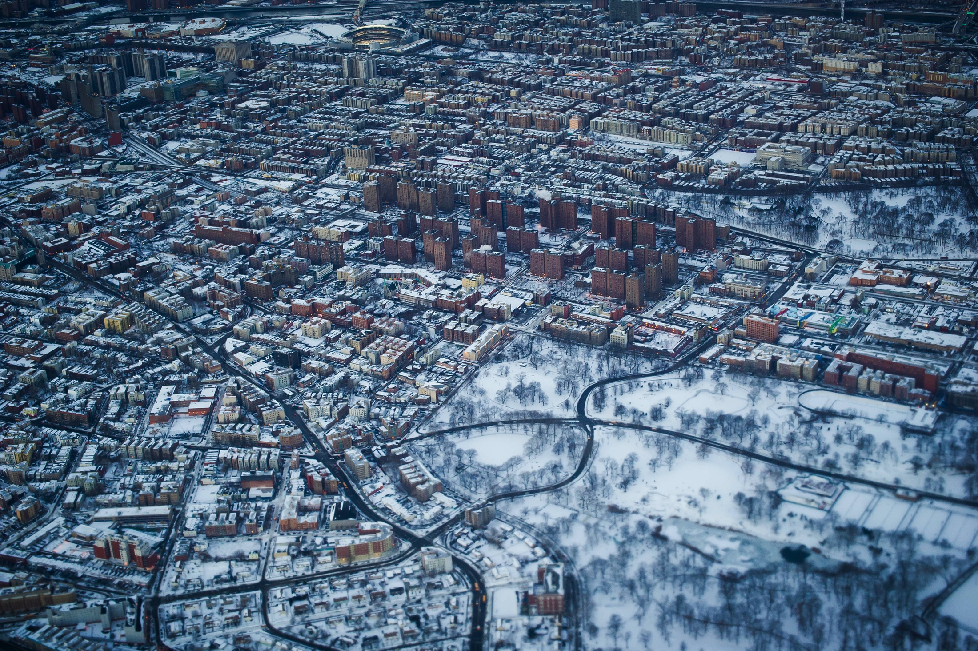
Accounts for severe weather costs this past winter
Adds $75 million to FY 2014 ($40 million in Executive Budget;
$35 million in Preliminary Budget)
Makes adjustments to the snow budget in out years to be more realistic about the cost of snow removal

Slide 36

Executive Capital Plan
Right-sizing the capital plan as a step toward a more honest and realistic timeframe for accomplishing our goals, ahead of the Ten Year Plan in January 2015.

Slide 37
Executive Capital Commitments FY 2014 – FY2018
Total - $48.9 Billion in All Funds
Environmental Protection $9.2
Bridges & Highways $6.7
Sanitation $1.3
15%
Mass Transit $0.5
20%
Schools
24%
Education $13.2
Government
Operations
26%
10%
10%
Housing & Economic Dev. $5.1
Administration of Justice $2.6
Other City Services $10.3
Parks $2.6 Public Buildings $1.0
Technology $2.3 Social Services $0.6
Health & Hospitals $1.7 Fire $0.6
Cultural & Libraries $1.5
*$ in Billions

Slide 38

Debt Service Remains Under 15% of Tax Revenues After the
FY 2014 – 2018 Executive Budget Capital Plan, Which Includes the Mayor’s New Affordable Housing Program
Actual
Plan
Percent of Tax Revenue
Fiscal Year
Note: Excludes Water & Sewer, BARBs, STAR debt service

Slide 39

  Revenue and Expense Changes

Slide 40
City Funds Revenue and Expenses
 |  |  |  |  | ($ in Millions)
 |  |  |  |  | FY 2014 | FY 2015 | FY 2016 | FY 2017 | FY 2018
Revenue |  |  |  |  | $53,501 | $53,790 | $55,905 | $57,745 | $59,180
Expenses:
Controllable Agency Expenses |  |  |  |  | $25,033 | $24,629 | $25,317 | $25,906 | $27,496
Non-Controllable Expenses |  |  |  |  | 28,974 | 31,493 | 32,785 | 33,868 | 34,924
Total Expenses |  |  |  |  | $54,007 | $56,122 | $58,102 | $59,774 | $62,420
Surplus / (Deficit) |  |  |  |  | ($506) | ($2,332) | ($2,197) | ($2,029) | ($3,240)
 | Prior Year Prepayment - Benefit |  |  |  | 2,838 | 2,332 | - - - | - - - | - - -
 | Current Year Prepayment - (Cost) |  |  |  | (2,332) | - - - | - - - | - - - | - - -
Net Impact of Prepayments |  |  |  |  | $506 | $2,332 | $ - - - | $ - - - | $ - - -
Gap To Be Closed |  |  |  |  | $ - - - | $ - - - | ($2,197) | ($2,029) | ($3,240)

Slide 41
City Funds Changes to FY 2014 - FY 2018
Since the February 2014 Financial Plan
 |  |  | City Funds ($ in Millions)
 |  |  |  | FY 2014 | FY 2015 | FY 2016 | FY 2017 | FY 2018
Gap to be Closed – February 2014 Financial Plan |  |  |  | $ - - - | $ - - - | ($1,059) | ($530) | ($370)
Revenue Changes - Increase/(Decrease)
 | Tax Revenue Forecast |  |  | $1,214 | $95 | $10 | ($94) | ($165)
 | Miscellaneous Revenues |  |  | 33 | 183 | 36 | 11 | (11)
 | Subtotal Revenue Changes |  |  | $1,247 | $278 | $46 | ($83) | ($176)
Expense Changes - Increase/(Decrease)
 | New Initiatives |  |  | $20 | $248 | $181 | $197 | $141
 | Technical Adjustments and Other Agency Expense Changes |  |  | 115 | 228 | 194 | 226 | 395
 | Pensions |  |  | (52) | 24 | (4) | (6) | (6)
 | Debt Service Savings |  |  | (4) | (30) | (52) | (41) | 15
 | Re-estimate of Prior Years' Expenses |  |  | (400) | - - - | - - - | - - - | - - -
 | Reduce FY 2014 General Reserve |  |  | (100) | - - - | - - - | - - - | - - -
 | Net Cost of Labor Settlement |  |  | 1,106 | 370 | 865 | 1,040 | 2,149
 | Subtotal Expense Changes |  |  | $685 | $840 | $1,184 | $1,416 | $2,694
FY 2014 Prepayment of FY 2015 |  |  |  | (562) | 562 | - - - | - - - | - - -
Gap to be Closed - May 2014 Financial Plan |  |  |  | $ - - - | $ - - - | ($2,197) | ($2,029) | ($3,240)

Slide 42
Controllable Agency Expenses
May 2014 Financial Plan
City Funds - $ in Millions
 |  |  | FY 2014 | FY 2015 | FY 2016 | FY 2017 | FY 2018
Uniformed Forces
 | Police Department |  | $4,382 | $4,451 | $4,376 | $4,377 | $4,378
 | Fire Department |  | 1,606 | 1,557 | 1,533 | 1,514 | 1,477
 | Department of Correction |  | 1,085 | 1,058 | 1,057 | 1,056 | 1,056
 | Department of Sanitation |  | 1,432 | 1,461 | 1,515 | 1,494 | 1,494
Subtotal: Uniformed Forces |  |  | $8,505 | $8,527 | $8,481 | $8,441 | $8,405
 |  | Year-to-Year |  | $22 | ($46) | ($40) | ($36)
 |  | Change: |  | 0.3% | (0.5%) | (0.5%) | (0.4%)
Health and Welfare
 | Social Services |  | $549 | $592 | $581 | $571 | $570
 | Children's Services |  | 877 | 876 | 886 | 886 | 886
 | Homeless Services |  | 486 | 467 | 466 | 476 | 476
 | Health and Mental Hygiene |  | 635 | 645 | 639 | 639 | 639
 | HHC Subsidy |  | 78 | 81 | 81 | 81 | 81
Subtotal: Health and Welfare |  |  | $2,625 | $2,661 | $2,653 | $2,653 | $2,652
 |  | Year-to-Year |  | $36 | ($8) | $ - - - | ($1)
 |  | Change: |  | 1.4% | (0.3%) | 0.0% | (0.0%)
Other Agencies
 | Housing Preservation & Development |  | $67 | $53 | $52 | $52 | $52
 | Environmental Protection |  | 1,042 | 1,099 | 1,069 | 1,010 | 992
 | Finance |  | 248 | 243 | 241 | 241 | 241
 | Transportation |  | 460 | 493 | 490 | 494 | 494
 | Parks and Recreation |  | 301 | 309 | 307 | 308 | 307
 | Citywide Administrative Services |  | 230 | 232 | 224 | 223 | 223
 | All Other Mayoral |  | 3,332 | 2,674 | 3,380 | 3,899 | 5,441
Subtotal: Other Agencies |  |  | $5,680 | $5,103 | $5,763 | $6,227 | $7,750
 |  | Year-to-Year |  | ($577) | $660 | $464 | $1,523
 |  | Change: |  | (10.2%) | 12.9% | 8.1% | 24.5%
Education
 | Department of Education |  | $7,111 | $7,181 | $7,266 | $7,427 | $7,584
 | CUNY |  | 608 | 637 | 642 | 646 | 593
Subtotal: Education |  |  | $7,719 | $7,818 | $7,908 | $8,073 | $8,177
 |  | Year-to-Year |  | $99 | $90 | $165 | $104
 |  | Change: |  | 1.3% | 1.2% | 2.1% | 1.3%
Elected Officials
 | Mayoralty |  | $71 | $68 | $68 | $68 | $68
 | All Other Elected |  | 433 | 452 | 444 | 444 | 444
Subtotal: Elected Officials |  |  | $504 | $520 | $512 | $512 | $512
 |  | Year-to-Year |  | $16 | ($8) | $ - - - | $ - - -
 |  | Change: |  | 3.2% | (1.5%) | 0.0% | 0.0%
Total Controllable Agency Spending |  |  | $25,033 | $24,629 | $25,317 | $25,906 | $27,496
 |  | Year-to-Year |  | ($404) | $688 | $589 | $1,590
 |  | Change: |  | (1.6%) | 2.8% | 2.3% | 6.1%
Note: Excludes the impact of prepayments

Slide 43
Non-Controllable Expenses
May 2014 Financial Plan
City Funds - $ in Millions
 |  |  | FY 2014 | FY 2015 | FY 2016 | FY 2017 | FY 2018
Non-Controllable Expenses
 | Pensions |  | $8,113 | $8,195 | $8,284 | $8,385 | $8,562
 |  | Year-to-Year |  | $82 | $89 | $101 | $177
 |  | Change: |  | 1.0% | 1.1% | 1.2% | 2.1%
 | Fringe Benefits ⁽¹⁾ |  | $6,908 | $7,349 | $7,976 | $8,501 | $9,035
 |  | Year-to-Year |  | $441 | $627 | $525 | $534
 |  | Change: |  | 6.4% | 8.5% | 6.6% | 6.3%
Employee-Related Costs |  |  | $15,021 | $15,544 | $16,260 | $16,886 | $17,597
 |  | Year-to-Year |  | $523 | $716 | $626 | $711
 |  | Change: |  | 3.5% | 4.6% | 3.8% | 4.2%
 | Medicaid |  | $6,272 | $6,353 | $6,322 | $6,322 | $6,322
 |  | Year-to-Year |  | $81 | ($31) | $ - - - | $ - - -
 |  | Change: |  | 1.3% | (0.5%) | 0.0% | 0.0%
 | Re-estimate of Prior Years’ Expenses |  | ($400) | $ - - - | $ - - - | $ - - - | $ - - -
 | General Reserve |  | $50 | $600 | $600 | $600 | $600
 | All Other ⁽²⁾ |  | $2,523 | $2,589 | $2,655 | $2,768 | $2,850
 |  | Year-to-Year |  | $66 | $66 | $113 | $82
 |  | Change: |  | 2.6% | 2.5% | 4.3% | 3.0%
Subtotal |  |  | $23,466 | $25,086 | $25,837 | $26,576 | $27,369
 |  | Year-to-Year |  | $1,620 | $751 | $739 | $793
 |  | Change: |  | 6.9% | 3.0% | 2.9% | 3.0%
Debt Service |  |  | $5,508 | $6,407 | $6,948 | $7,292 | $7,555
 |  | Year-to-Year |  | $899 | $541 | $344 | $263
 |  | Change: |  | 16.3% | 8.4% | 5.0% | 3.6%
Total Non-Controllable |  |  | $28,974 | $31,493 | $32,785 | $33,868 | $34,924
 |  | Year-to-Year |  | $2,519 | $1,292 | $1,083 | $1,056
 |  | Change: |  | 8.7% | 4.1% | 3.3% | 3.1%
Excludes the impact of prepayments.
⁽¹⁾ Includes Health Insurance, Welfare Funds, Social Security Contributions, Worker's Compensation, Unemployment Insurance, Annuity Contributions, Uniform Allowance, and Disability Benefits Insurance.
⁽²⁾ Includes Public Assistance, Judgments & Claims, Indigent Defense Services, Contractual, Criminal Justice and Water & Sewer for City Facilities.

Slide 44
Fiscal Year 2014
May 2014 Financial Plan
 |  |  | $ in Millions
 |  |  | Personal Service Costs |  |  |  |  | Other Than Personal Service Costs
 |  | AGENCY | Salaries & Wages | Fringe Benefits | Pensions | PS Subtotal |  | Agency OTPS | PA, MA & Other Mandates |  | Debt Service | OTPS Subtotal | Gross Total All Funds (Includes Intra-City) | Net Total All Funds (Excludes Intra-City) | City Fund Total
UNIFORMED AGENCIES
 | Police Department |  | $4,308 | $1,887 | $2,542 | $8,737 |  | $579 | $ - - - |  | $122 | $701 | $9,438 | $9,207 | $8,796
 | Fire Department |  | 1,661 | 663 | 1,074 | 3,398 |  | 272 | - - - |  | 127 | 399 | 3,797 | 3,795 | 3,380
 | Department of Correction |  | 937 | 454 | 376 | 1,767 |  | 137 | - - - |  | 168 | 305 | 2,072 | 2,072 | 2,043
 | Department of Sanitation |  | 853 | 379 | 295 | 1,527 |  | 578 | - - - |  | 290 | 868 | 2,395 | 2,391 | 2,341
 | Subtotal |  | $7,759 | $3,383 | $4,287 | $15,429 |  | $1,566 | $ - - - |  | $707 | $2,273 | $17,702 | $17,465 | $16,560
HEALTH AND WELFARE
 | Administration for Children's Services |  | $411 | $145 | $70 | $626 |  | $2,429 | $ - - - |  | $ - - - | $2,429 | $3,055 | $3,009 | $1,023
 | Department of Social Services |  | 740 | 347 | 139 | 1,226 |  | 1,064 | 7,744 |  | 99 | 8,907 | 10,133 | 10,126 | 7,816
 | Department of Homeless Services |  | 124 | 47 | 20 | 191 |  | 923 | - - - |  | - - - | 923 | 1,114 | 1,111 | 549
 | Department of Health and Mental Hygiene |  | 377 | 126 | 68 | 571 |  | 1,078 | - - - |  | 46 | 1,124 | 1,695 | 1,679 | 842
 | Health and Hospitals Corporation ⁽¹⁾ |  | - - - | 29 | - - - | 29 |  | 197 | - - - |  | 173 | 370 | 399 | 282 | 243
 | Subtotal |  | $1,652 | $694 | $297 | $2,643 |  | $5,691 | $7,744 |  | $318 | $13,753 | $16,396 | $16,207 | $10,473
EDUCATION
 | Department of Education |  | $9,428 | $3,561 | $3,095 | $16,084 |  | $6,972 | $ - - - |  | $1,347 | $8,319 | $24,403 | $24,165 | $13,726
 | City University |  | 513 | 105 | 67 | 685 |  | 300 | - - - |  | 60 | 360 | 1,045 | 1,008 | 736
 | Subtotal |  | $9,941 | $3,666 | $3,162 | $16,769 |  | $7,272 | $ - - - |  | $1,407 | $8,679 | $25,448 | $25,173 | $14,462
OTHER AGENCIES |  |  | $2,414 | $851 | $440 | $3,705 |  | $6,126 | $ - - - |  | $2,921 | $9,047 | $12,752 | $11,682 | $8,496
ELECTED OFFICIALS |  |  | $478 | $143 | $84 | $705 |  | $112 | $ - - - |  | $ - - - | $112 | $817 | $812 | $719
MISCELLANEOUS BUDGET |  |  | $1,370 | $ - - - | $ - - - | $1,370 |  | $ - - - | $2,829 | ⁽²⁾ | $292 | $3,121 | $4,491 | $4,491 | $3,662
DEBT SERVICE COSTS (Unallocated) |  |  | $ - - - | $ - - - | $ - - - | $ - - - |  | $ - - - | $ - - - |  | $88 | $88 | $88 | $88 | $35
RE-ESTIMATE OF PRIOR YEARS’ EXPENSES |  |  | $ - - - | $ - - - | $ - - - | $ - - - |  | ($400) | $ - - - |  | $ - - - | ($400) | ($400) | ($400) | ($400)
 |  | TOTAL - ALL FUNDS ⁽³⁾ | $23,614 | $8,737 | $8,270 | $40,621 |  | $20,367 | $10,573 |  | $5,733 | $36,673 | $77,294 | $75,518
 |  | TOTAL - CITY FUNDS ⁽³⁾ | $15,473 | $6,908 | $8,113 | $30,494 |  | $9,161 | $8,844 |  | $5,508 | $23,513 |  |  | $54,007
Less: Prepayments |  |  | $ - - - | $ - - - | $ - - - | $ - - - |  | $64 | $ - - - |  | $442 | $506 | $506 | $506 | $506
 |  | Total After Prepayments | $23,614 | $8,737 | $8,270 | $40,621 |  | $20,303 | $10,573 |  | $5,291 | $36,167 | $76,788 | $75,012 | $53,501
⁽¹⁾ Only reflects funding appropriated in the City's Budget.
⁽²⁾ Includes subsidies to the MTA, General Reserve, Judgments and Claims, Indigent Defense Services and Other Contractual Services.
⁽³⁾ Excludes the impact of prepayments.

Slide 45
Fiscal Year 2015
May 2014 Financial Plan
 |  |  | $ in Millions
 |  |  | Personal Service Costs |  |  |  |  | Other Than Personal Service Costs
 |  | AGENCY | Salaries & Wages | Fringe Benefits | Pensions | PS Subtotal |  | Agency OTPS | PA, MA & Other Mandates |  | Debt Service | OTPS Subtotal | Gross Total All Funds (Includes Intra-City) | Net Total All Funds (Excludes Intra-City) | City Fund Total
UNIFORMED AGENCIES
 | Police Department |  | $4,296 | $1,962 | $2,467 | $8,725 |  | $341 | $ - - - |  | $143 | $484 | $9,209 | $8,979 | $8,890
 | Fire Department |  | 1,586 | 664 | 1,071 | 3,321 |  | 170 | - - - |  | 145 | 315 | 3,636 | 3,634 | 3,373
 | Department of Correction |  | 915 | 478 | 371 | 1,764 |  | 129 | - - - |  | 182 | 311 | 2,075 | 2,075 | 2,047
 | Department of Sanitation |  | 827 | 395 | 292 | 1,514 |  | 625 | - - - |  | 397 | 1,022 | 2,536 | 2,533 | 2,486
 | Subtotal |  | $7,624 | $3,499 | $4,201 | $15,324 |  | $1,265 | $ - - - |  | $867 | $2,132 | $17,456 | $17,221 | $16,796
HEALTH AND WELFARE
 | Administration for Children's Services |  | $411 | $155 | $69 | $635 |  | $2,479 | $ - - - |  | $ - - - | $2,479 | $3,114 | $3,024 | $1,063
 | Department of Social Services |  | 749 | 357 | 142 | 1,248 |  | 1,105 | 7,874 |  | 119 | 9,098 | 10,346 | 10,335 | 8,046
 | Department of Homeless Services |  | 121 | 50 | 21 | 192 |  | 831 | - - - |  | - - - | 831 | 1,023 | 1,022 | 533
 | Department of Health and Mental Hygiene |  | 369 | 128 | 66 | 563 |  | 1,019 | - - - |  | 57 | 1,076 | 1,639 | 1,636 | 865
 | Health and Hospitals Corporation ⁽¹⁾ |  | - - - | 32 | - - - | 32 |  | 179 | - - - |  | 178 | 357 | 389 | 291 | 251
 | Subtotal |  | $1,650 | $722 | $298 | $2,670 |  | $5,613 | $7,874 |  | $354 | $13,841 | $16,511 | $16,308 | $10,758
EDUCATION
 | Department of Education |  | $9,615 | $3,652 | $3,252 | $16,519 |  | $7,592 | $ - - - |  | $1,583 | $9,175 | $25,694 | $25,474 | $14,324
 | City University |  | 530 | 161 | 69 | 760 |  | 238 | - - - |  | 62 | 300 | 1,060 | 1,044 | 770
 | Subtotal |  | $10,145 | $3,813 | $3,321 | $17,279 |  | $7,830 | $ - - - |  | $1,645 | $9,475 | $26,754 | $26,518 | $15,094
OTHER AGENCIES |  |  | $2,397 | $878 | $450 | $3,725 |  | $4,716 | $ - - - |  | $3,309 | $8,025 | $11,750 | $10,633 | $8,894
ELECTED OFFICIALS |  |  | $475 | $146 | $84 | $705 |  | $104 | $ - - - |  | $ - - - | $104 | $809 | $805 | $743
MISCELLANEOUS BUDGET |  |  | $835 | $ - - - | $ - - - | $835 |  | $ - - - | $3,437 | ⁽²⁾ | $373 | $3,810 | $4,645 | $4,645 | $3,782
DEBT SERVICE COSTS (Unallocated) |  |  | $ - - - | $ - - - | $ - - - | $ - - - |  | $ - - - | $ - - - |  | $117 | $117 | $117 | $117 | $55
RE-ESTIMATE OF PRIOR YEARS’ EXPENSES |  |  | $ - - - | $ - - - | $ - - - | $ - - - |  | $ - - - | $ - - - |  | $ - - - | $ - - - | $ - - - | $ - - - | $ - - -
 |  | TOTAL - ALL FUNDS ⁽³⁾ | $23,126 | $9,058 | $8,354 | $40,538 |  | $19,528 | $11,311 |  | $6,665 | $37,504 | $78,042 | $76,247
 |  | TOTAL - CITY FUNDS ⁽³⁾ | $15,320 | $7,349 | $8,195 | $30,864 |  | $9,309 | $9,542 |  | $6,407 | $25,258 |  |  | $56,122
Less: Prepayments |  |  | $ - - - | $ - - - | $ - - - | $ - - - |  | $ - - - | $ - - - |  | $2,332 | $2,332 | $2,332 | $2,332 | $2,332
 |  | Total After Prepayments | $23,126 | $9,058 | $8,354 | $40,538 |  | $19,528 | $11,311 |  | $4,333 | $35,172 | $75,710 | $73,915 | $53,790
⁽¹⁾ Only reflects funding appropriated in the City's Budget.
⁽²⁾ Includes subsidies to the MTA, General Reserve, Judgments and Claims, Indigent Defense Services and Other Contractual Services.
⁽³⁾ Excludes the impact of prepayments.

Slide 46
Changes Between FY 2014 and FY 2015
May 2014 Financial Plan
 |  |  | $ in Millions
 |  |  | Personal Service Costs |  |  |  |  | Other Than Personal Service Costs
 |  | AGENCY | Salaries & Wages | Fringe Benefits | Pensions | PS Subtotal |  | Agency OTPS | PA, MA & Other Mandates |  | Debt Service | OTPS Subtotal | Gross Total All Funds (Includes Intra-City) | Net Total All Funds (Excludes Intra-City) | City Fund Total
UNIFORMED AGENCIES
 | Police Department |  | ($12) | $75 | ($75) | ($12) |  | ($238) | $ - - - |  | $21 | ($217) | ($229) | ($228) | $94
 | Fire Department |  | (75) | 1 | (3) | (77) |  | (102) | - - - |  | 18 | (84) | (161) | (161) | (7)
 | Department of Correction |  | (22) | 24 | (5) | (3) |  | (8) | - - - |  | 14 | 6 | 3 | 3 | 4
 | Department of Sanitation |  | (26) | 16 | (3) | (13) |  | 47 | - - - |  | 107 | 154 | 141 | 142 | 145
 | Subtotal |  | ($135) | $116 | ($86) | ($105) |  | ($301) | $ - - - |  | $160 | ($141) | ($246) | ($244) | $236
HEALTH AND WELFARE
 | Administration for Children's Services |  | $ - - - | $10 | ($1) | $9 |  | $50 | $ - - - |  | $ - - - | $50 | $59 | $15 | $40
 | Department of Social Services |  | 9 | 10 | 3 | 22 |  | 41 | 130 |  | 20 | 191 | 213 | 209 | 230
 | Department of Homeless Services |  | (3) | 3 | 1 | 1 |  | (92) | - - - |  | - - - | (92) | (91) | (89) | (16)
 | Department of Health and Mental Hygiene |  | (8) | 2 | (2) | (8) |  | (59) | - - - |  | 11 | (48) | (56) | (43) | 23
 | Health and Hospitals Corporation ⁽¹⁾ |  | - - - | 3 | - - - | 3 |  | (18) | - - - |  | 5 | (13) | (10) | 9 | 8
 | Subtotal |  | ($2) | $28 | $1 | $27 |  | ($78) | $130 |  | $36 | $88 | $115 | $101 | $285
EDUCATION
 | Department of Education |  | $187 | $91 | $157 | $435 |  | $620 | $ - - - |  | $236 | $856 | $1,291 | $1,309 | $598
 | City University |  | 17 | 56 | 2 | 75 |  | (62) | - - - |  | 2 | (60) | 15 | 36 | 34
 | Subtotal |  | $204 | $147 | $159 | $510 |  | $558 | $ - - - |  | $238 | $796 | $1,306 | $1,345 | $632
OTHER AGENCIES |  |  | ($17) | $27 | $10 | $20 |  | ($1,410) | $ - - - |  | $388 | ($1,022) | ($1,002) | ($1,049) | $398
ELECTED OFFICIALS |  |  | ($3) | $3 | $ - - - | $ - - - |  | ($8) | $ - - - |  | $ - - - | ($8) | ($8) | ($7) | $24
MISCELLANEOUS BUDGET |  |  | ($535) | $ - - - | $ - - - | ($535) |  | $ - - - | $608 | ⁽²⁾ | $81 | $689 | $154 | $154 | $120
DEBT SERVICE COSTS (Unallocated) |  |  | $ - - - | $ - - - | $ - - - | $ - - - |  | $ - - - | $ - - - |  | $29 | $29 | $29 | $29 | $20
RE-ESTIMATE OF PRIOR YEARS’ EXPENSES |  |  | $ - - - | $ - - - | $ - - - | $ - - - |  | $400 | $ - - - |  | $ - - - | $400 | $400 | $400 | $400
 |  | TOTAL - ALL FUNDS ⁽³⁾ | ($488) | $321 | $84 | ($83) |  | ($839) | $738 |  | $932 | $831 | $748 | $729
 |  | TOTAL - CITY FUNDS ⁽³⁾ | ($153) | $441 | $82 | $370 |  | $148 | $698 |  | $899 | $1,745 |  |  | $2,115
Less: Prepayments |  |  | $ - - - | $ - - - | $ - - - | $ - - - |  | ($64) | $ - - - |  | $1,890 | $1,826 | $1,826 | $1,826 | $1,826
 |  | Total After Prepayments | ($488) | $321 | $84 | ($83) |  | ($775) | $738 |  | ($958) | ($995) | ($1,078) | ($1,097) | $289
⁽¹⁾ Only reflects funding appropriated in the City's Budget.
⁽²⁾ Includes subsidies to the MTA, General Reserve, Judgments and Claims, Indigent Defense Services and Other Contractual Services.
⁽³⁾ Excludes the impact of prepayments.

Slide 47
Five Year Financial Plan Revenues and Expenditures as Required by Law
May 2014 Financial Plan
(All Funds - $ in Millions)
Revenues |  | FY 2014 | FY 2015 | FY 2016 | FY 2017 | FY 2018
Taxes
 | General Property Tax | $19,969 | $20,679 | $21,714 | $22,603 | $23,478
 | Other Taxes | 27,116 | 27,149 | 28,323 | 29,285 | 30,214
 | Tax Audit Revenue | 860 | 709 | 709 | 709 | 709
 | Subtotal: Taxes | $47,945 | $48,537 | $50,746 | $52,597 | $54,401
Miscellaneous Revenues |  | 7,347 | 7,063 | 6,994 | 6,986 | 6,622
Unrestricted Intergovernmental Aid |  | - - - | - - - | - - - | - - - | - - -
Less: Intra-City Revenue |  | (1,776) | (1,795) | (1,820) | (1,823) | (1,828)
Disallowances Against Categorical Grants |  | (15) | (15) | (15) | (15) | (15)
 | Subtotal: City Funds | $53,501 | $53,790 | $55,905 | $57,745 | $59,180
Other Categorical Grants |  | 900 | 761 | 837 | 832 | 828
Inter-Fund Revenues |  | 538 | 527 | 513 | 513 | 513
Federal Categorical Grants |  | 8,303 | 6,377 | 6,333 | 6,310 | 6,299
State Categorical Grants |  | 11,770 | 12,460 | 12,904 | 13,401 | 13,953
 | Total Revenues | $75,012 | $73,915 | $76,492 | $78,801 | $80,773
Expenditures
Personal Service
 | Salaries and Wages | $23,614 | $23,126 | $23,860 | $24,346 | $25,750
 | Pensions | 8,270 | 8,354 | 8,445 | 8,546 | 8,723
 | Fringe Benefits | 8,737 | 9,058 | 9,722 | 10,444 | 11,240
 | Subtotal: Personal Service | $40,621 | $40,538 | $42,027 | $43,336 | $45,713
Other Than Personal Service
 | Medical Assistance | 6,365 | 6,447 | 6,415 | 6,415 | 6,415
 | Public Assistance | 1,379 | 1,428 | 1,407 | 1,413 | 1,413
 | All Other ⁽¹⁾ | 23,146 | 22,364 | 22,818 | 23,307 | 23,860
 | Subtotal: Other Than Personal Service | $30,890 | $30,239 | $30,640 | $31,135 | $31,688
Debt Service ^{(1),(2)} |  | 5,733 | 6,665 | 7,242 | 7,582 | 7,840
FY 2013 Budget Stabilization & Discretionary Transfers ⁽¹⁾ |  | (2,838) | - - - | - - - | - - - | - - -
FY 2014 Budget Stabilization ⁽²⁾ |  | 2,332 | (2,332) | - - - | - - - | - - -
General Reserve |  | 50 | 600 | 600 | 600 | 600
 | Subtotal | $76,788 | $75,710 | $80,509 | $82,653 | $85,841
Less: Intra-City Expenses |  | (1,776) | (1,795) | (1,820) | (1,823) | (1,828)
 | Total Expenditures | $75,012 | $73,915 | $78,689 | $80,830 | $84,013
Gap To Be Closed |  | $ - - - | $ - - - | ($2,197) | ($2,029) | ($3,240)
⁽¹⁾ Fiscal Year 2013 Budget Stabilization and Discretionary Transfers total $2.807 billion, including GO of $2.727 billion, net equity contribution in bond refunding of $16 million, and subsidies of $64 million. In addition, the Fiscal Year 2012 Budget Stabilization included $31 million for prepayment of Fiscal Year 2014's debt service.
⁽²⁾ Fiscal Year 2014 Budget Stabilization totals $2.332 billion, including GO of $970 million and TFA of $1.362 billion.

