Slide 1


R3
PASSPort Overview

Slide 2
Purpose & Agenda
Purpose
  Obtain familiarity with key steps needed to process Contract Actions in PASSPort.
  Inform the Status of your Contracts
  Review and plan for next steps on Contracts
Agenda
  Overview of document requests/approvals, document uploading and review of contract authoring.
  Hands-on Demo
  Questions

Slide 3
PASSPort^{R3} Overview
PASSPort enables both competitive and targeted procurement as well as contract management. PASSPort brings greater transparency for all stakeholders and generates comprehensive packages for registration.
Using one platform to formally document needs for goods and services promotes accuracy and efficiency in approvals, increases transparency in the process, and removes the need to rely on paper.

Slide 4
PASSPort^{R3} Overview
Processing Contracts through PASSPort began for RFP contracts in March 2021.
  Unregistered Contracts (Inflight actions)
  Renewals
  Amendments
  NAEs
  New Contracts
Accessing PASSPort can only be done through the City’s Network.
  Log-on remotely and access PASSPort using your desktop icon shortcut.
  OR
  https://passport-buyer.cityofnewyork.us/.
Username is your DYCD email address and Password is the same you use to access your desktop computer.

Slide 5
Indirect Rate Amendment
Procurement will request the following documents which will show up as “Required” on the Provider's end.
Note: The provider may not have all the documents at the time of document request.
  Budget Detail
  Tax Affirmation

Slide 6
Indirect Rate Amendment
Procurement will request the following documents which will show up as “Required” on the Provider's end.
Note: The provider may not have all the documents at the time of document request.
  Budget Detail
    Paper Budget: If processed outside of HHS during FY'20, the provider will submit a paper budget by uploading to PASSPort for program's review and approval.
    HHS Budget: If budget was processed using HHS, the provider will complete the budget directly in HHS for DYCD review and approval. The Provider will upload the approved budget in the Vendor Documents section of PASSPort.

Slide 7
Indirect Rate Amendment
Procurement will request the following documents which will show up as “Required” on the Provider's end.
Note: The provider may not have all the documents at the time of document request.
  Tax Affirmation
    A one-page document, also known as Affirmation page, which the provider needs to complete and sign. Should be emailed to providers with the instruction to complete and upload in the Vendor Documents section of PASSPort

Slide 8
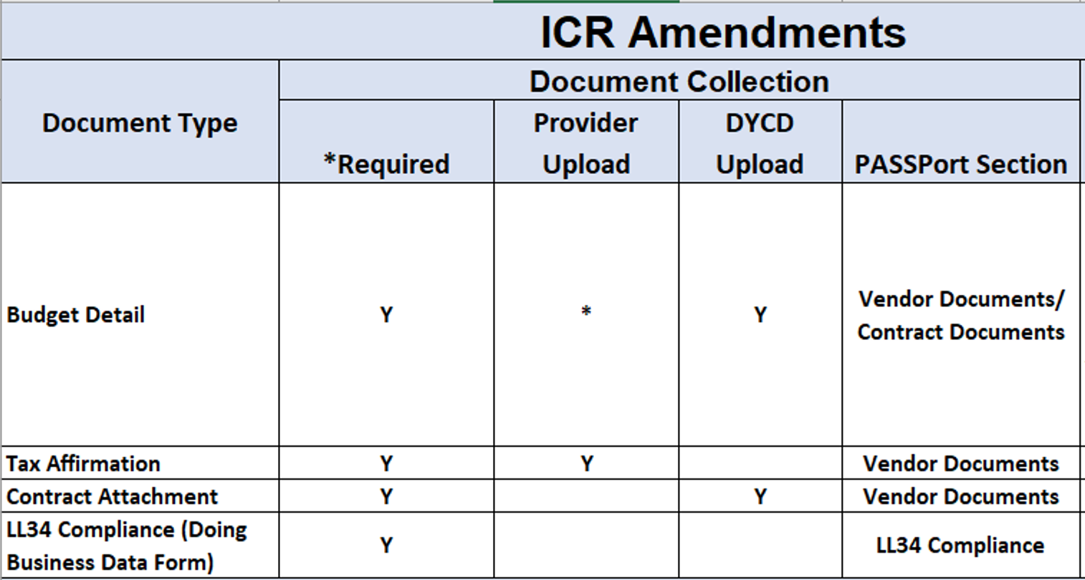
PASSPort^{R3} Overview
ICR Document Request

Slide 9
General Amendment (Non-ICR Amendments)
Procurement will request the following documents which will show up as “Required” on the Provider's end.
Note: The provider may not have all the documents at the time of document request.
  Budget Detail
  Scope of Work
  Tax Affirmation

Slide 10
General Amendment (Non-ICR Amendments)
Procurement will request the following documents which will show up as “Required” on the Provider's end.
Note: The provider may not have all the documents at the time of document request.
  Budget Detail
    HHS Budget: Complete budget directly in HHS for DYCD review. Upon DYCD’s approval, the provider will upload approved budget in the Vendor Documents section of PASSPort

Slide 11
General Amendment (Non-ICR Amendments)
Procurement will request the following documents which will show up as “Required” on the Provider's end.
Note: The provider may not have all the documents at the time of document request.
  Scope of Work
    Provider will complete their workscope in DYCDConnect. Upon approval, the provider will upload the approved workscope in the Vendor Documents section

Slide 12
General Amendment (Non-ICR Amendments)
Procurement will request the following documents which will show up as “Required” on the Provider's end.
Note: The provider may not have all the documents at the time of document request.
  Tax Affirmation
    A one-page document, also known as Affirmation page, which the provider needs to complete and sign. Should be emailed to providers with the instruction to complete and upload in the Vendor Documents section of PASSPort

Slide 13
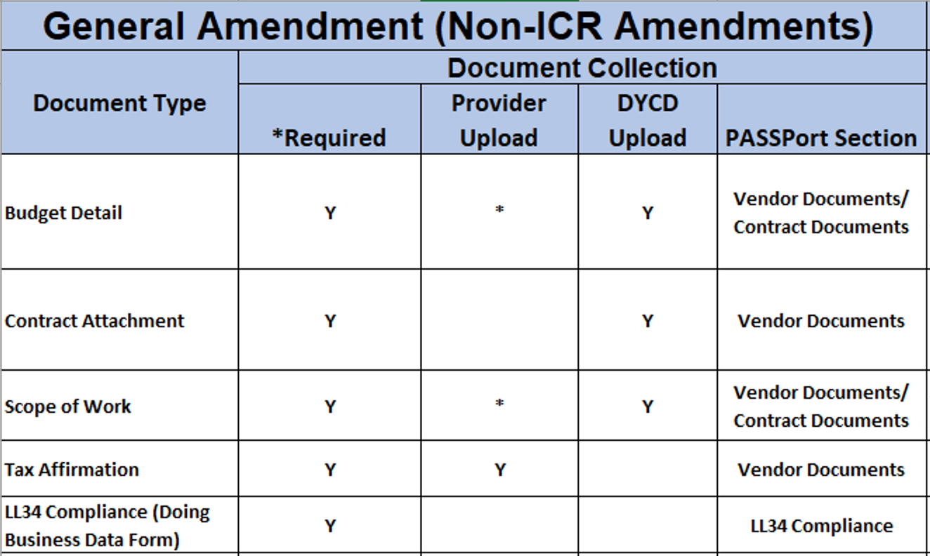
PASSPort^{R3} Overview
General Amendment (Non-ICR Amendment)
Document Request

Slide 14
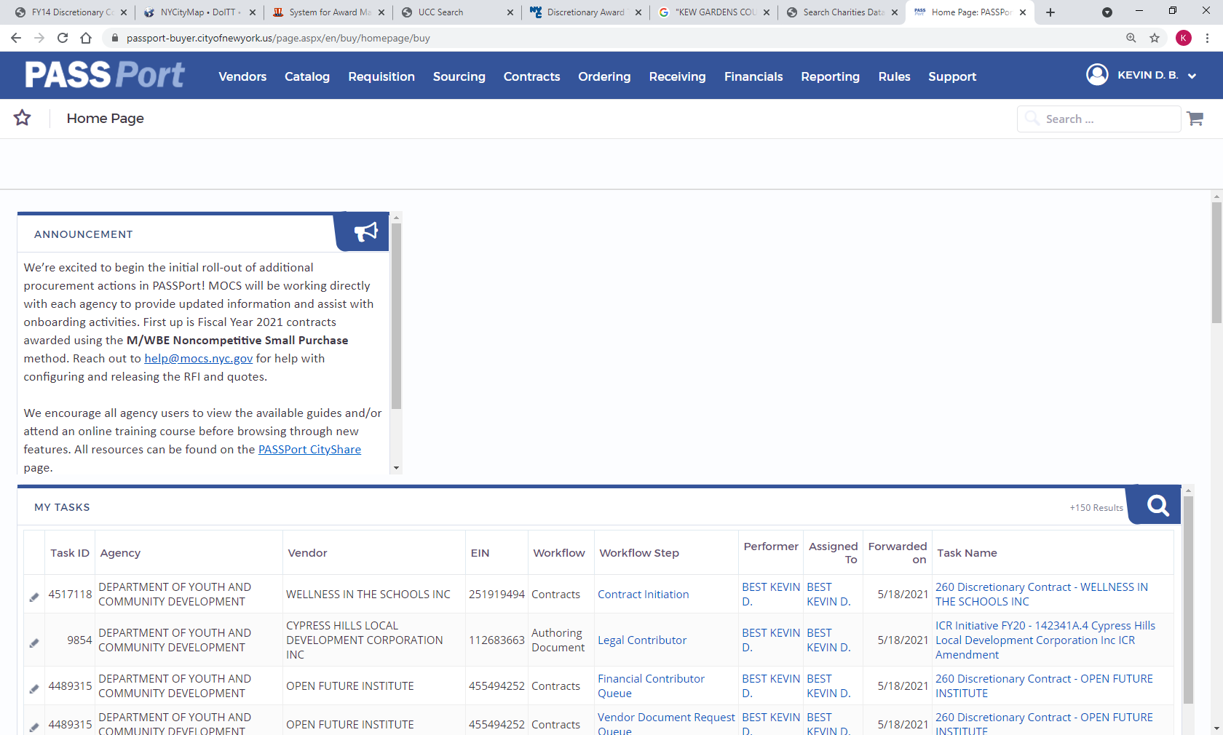
PASSPort^{R3} Overview
Viewing your Contract

Slide 15
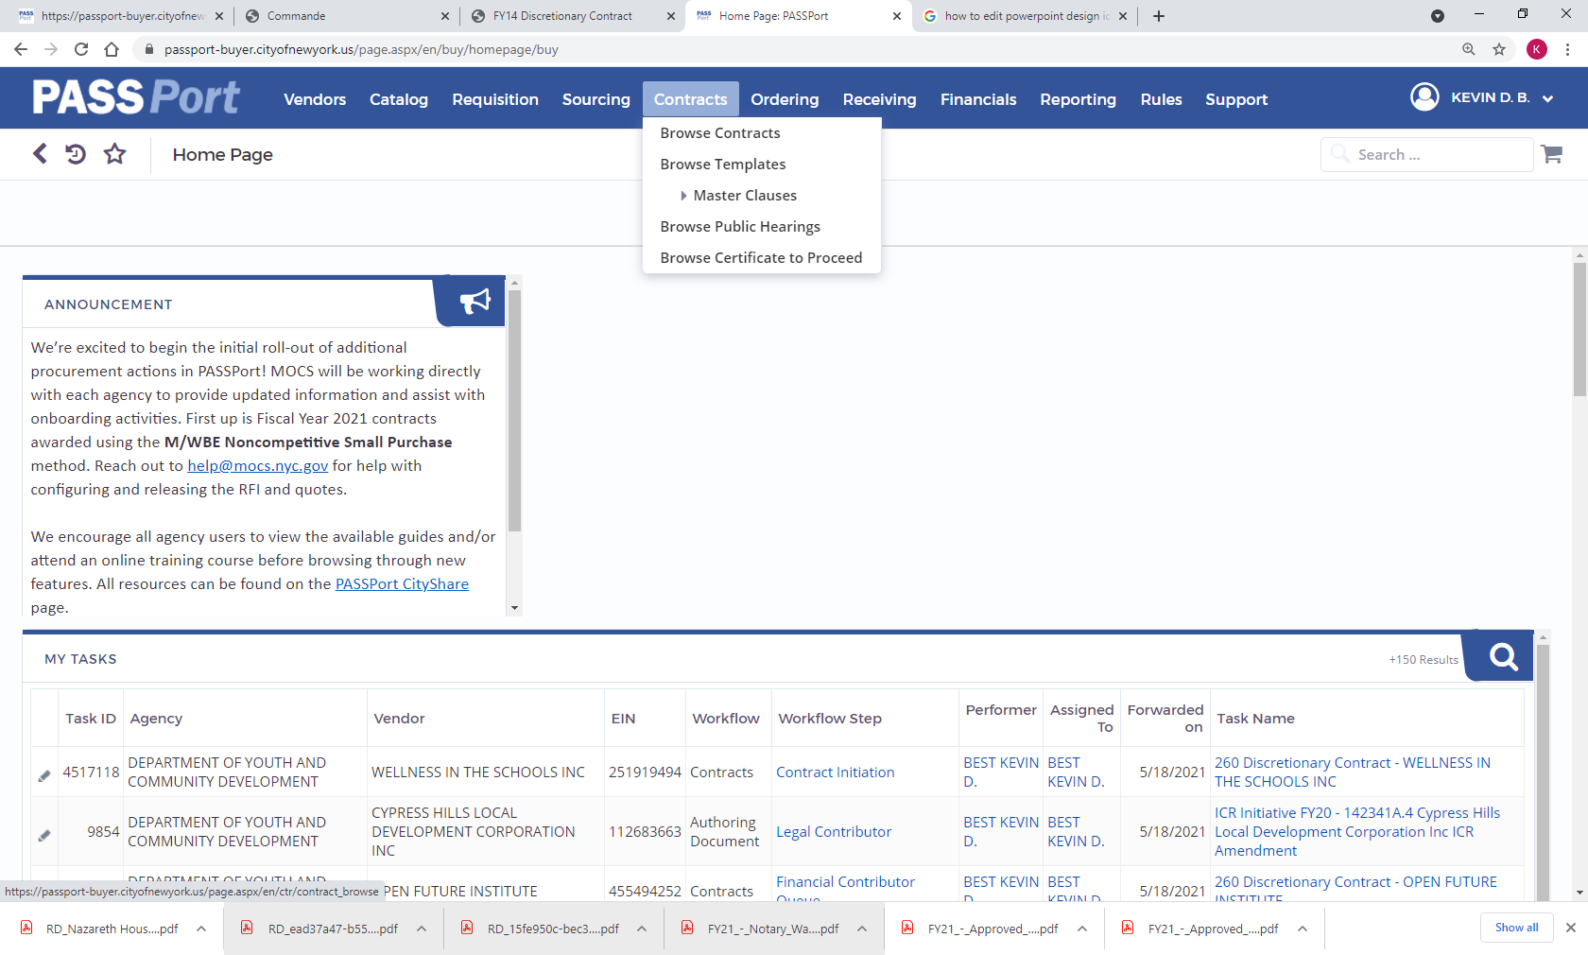
PASSPort^{R3} Overview
Viewing your Contract

Slide 16
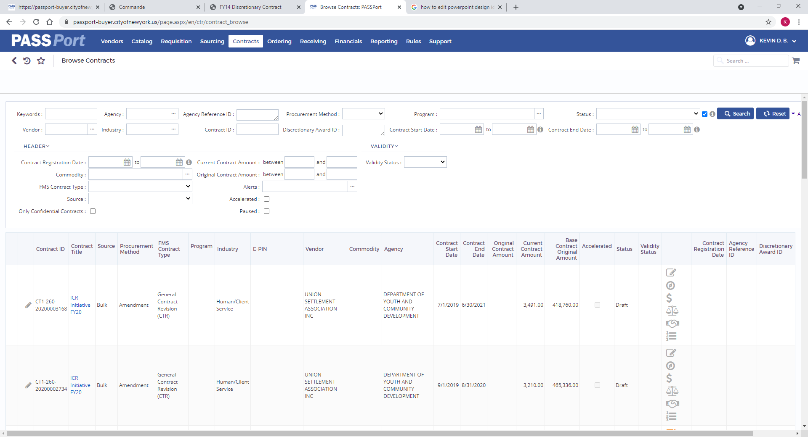
PASSPort^{R3} Overview
Viewing your Contract

Slide 17
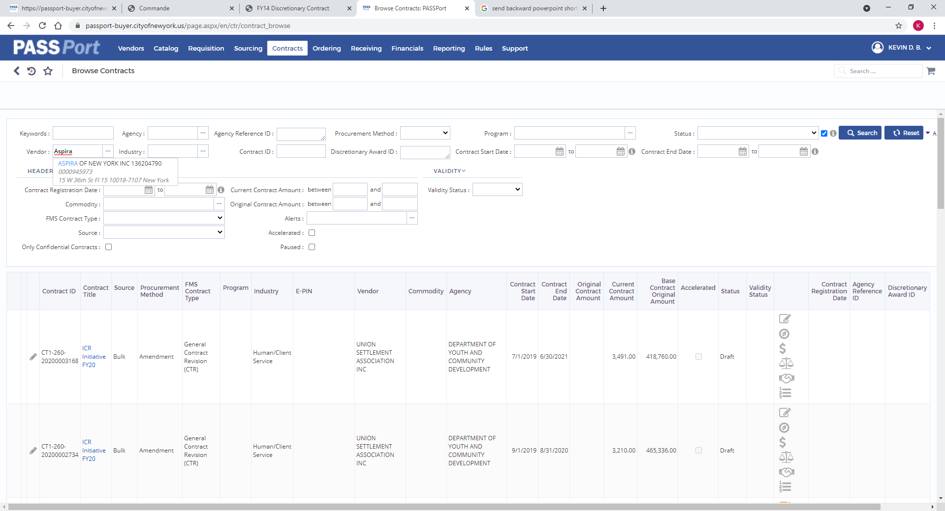
PASSPort^{R3} Overview
Viewing your Contract

Slide 18
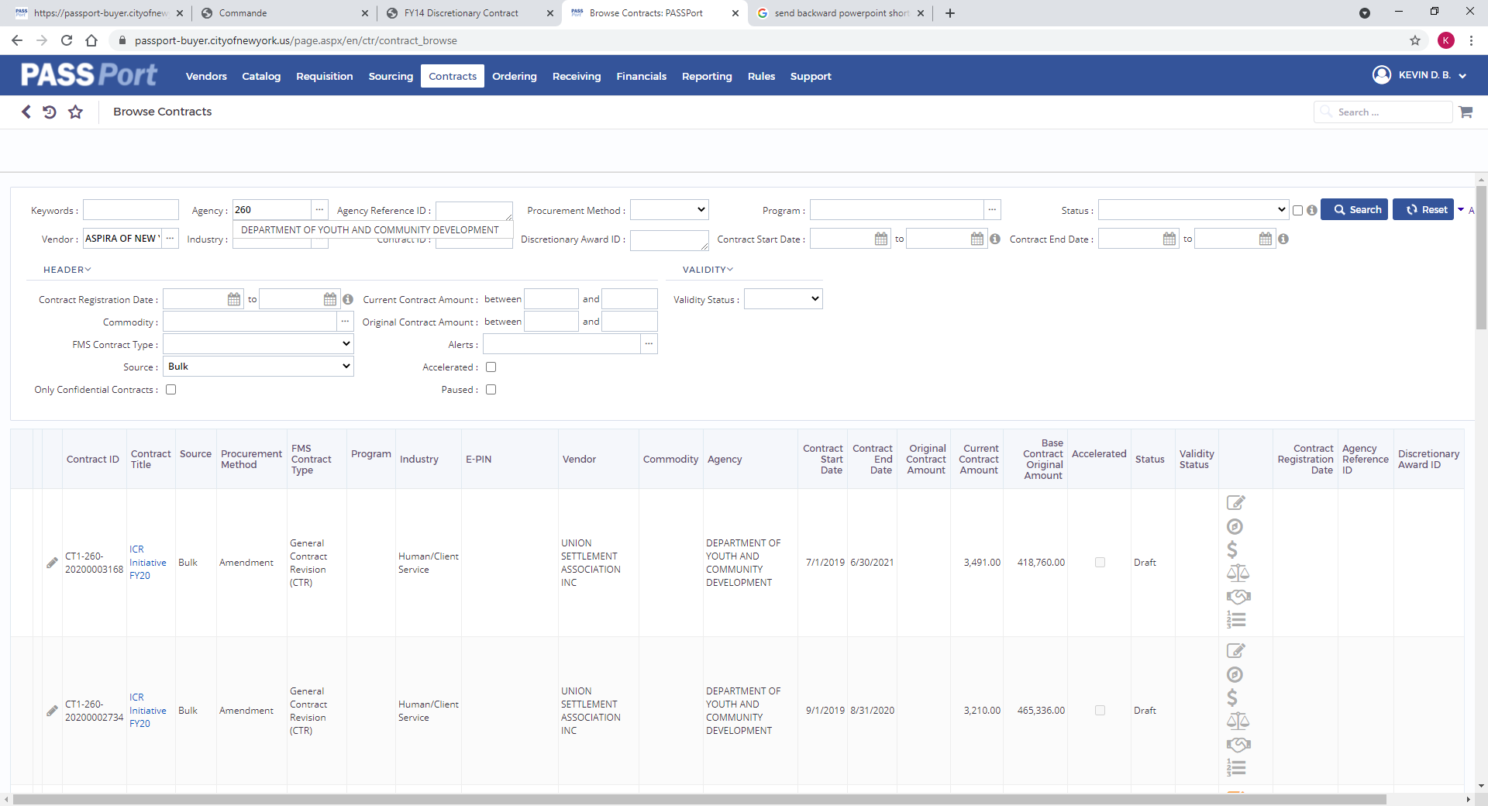
PASSPort^{R3} Overview
Viewing your Contract

Slide 19
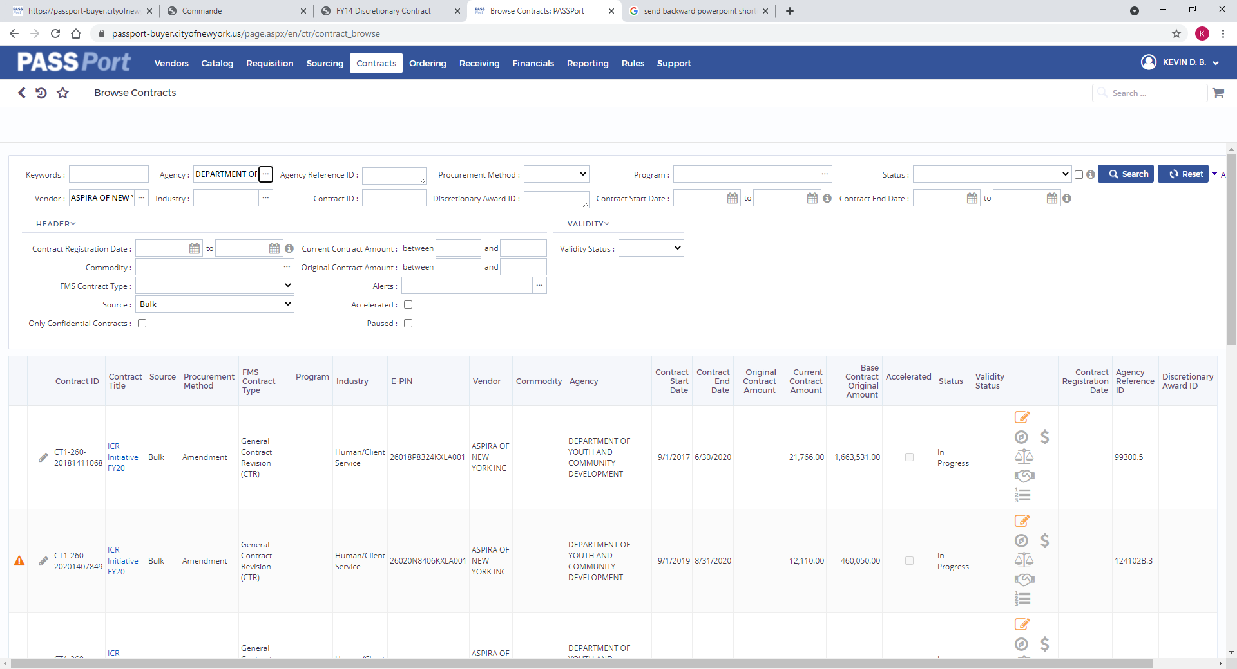
PASSPort^{R3} Overview
Viewing your Contract

Slide 20
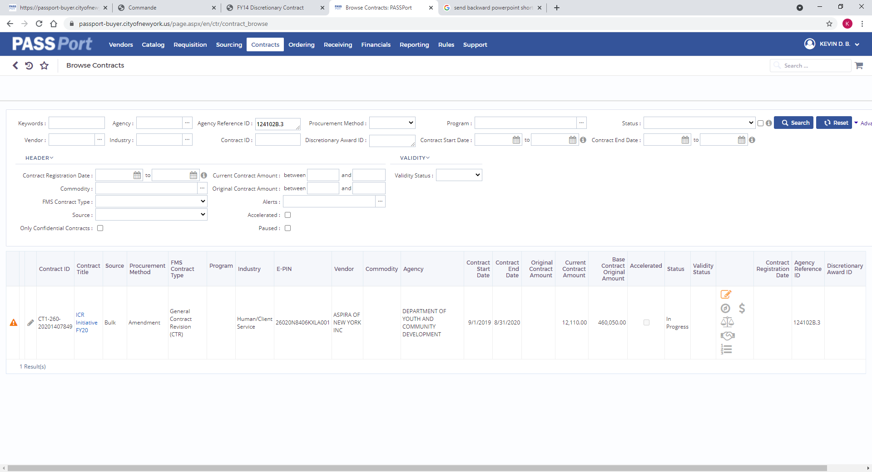
PASSPort^{R3} Overview
Viewing your Contract

Slide 21
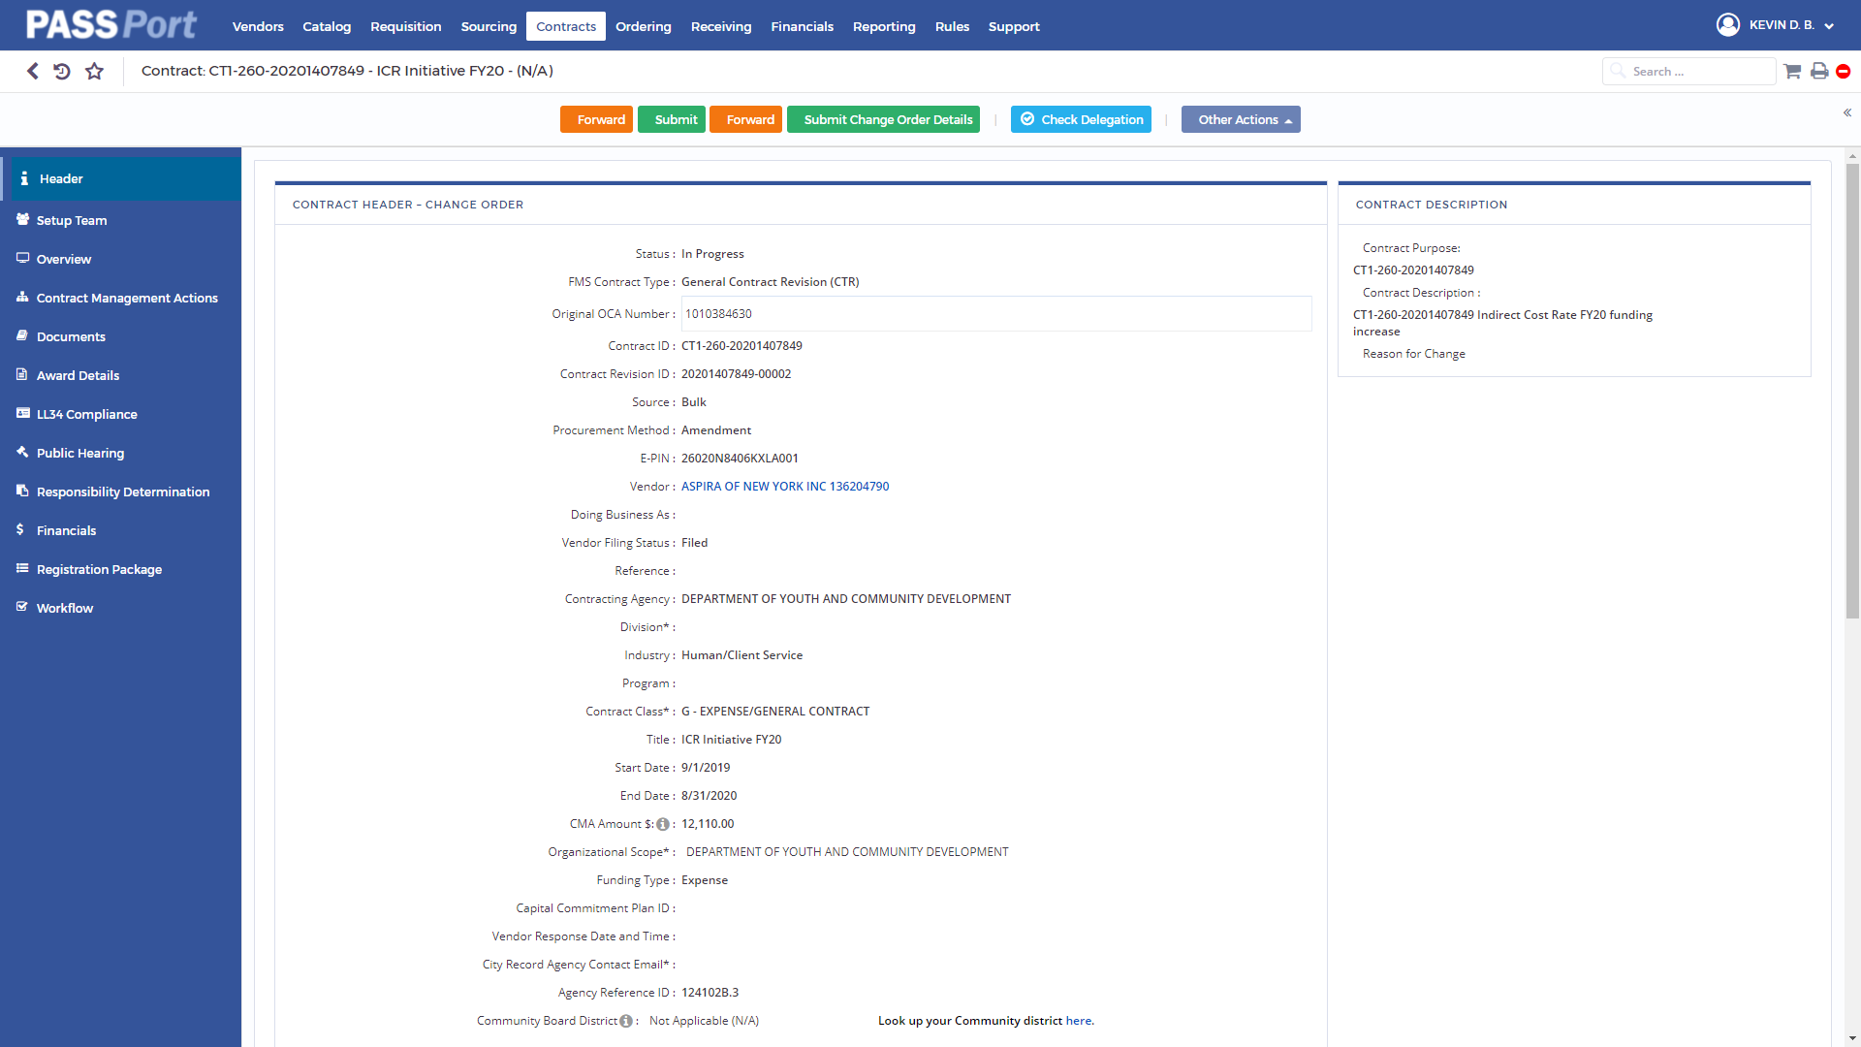
PASSPort^{R3} Overview
Viewing your Contract

Slide 22
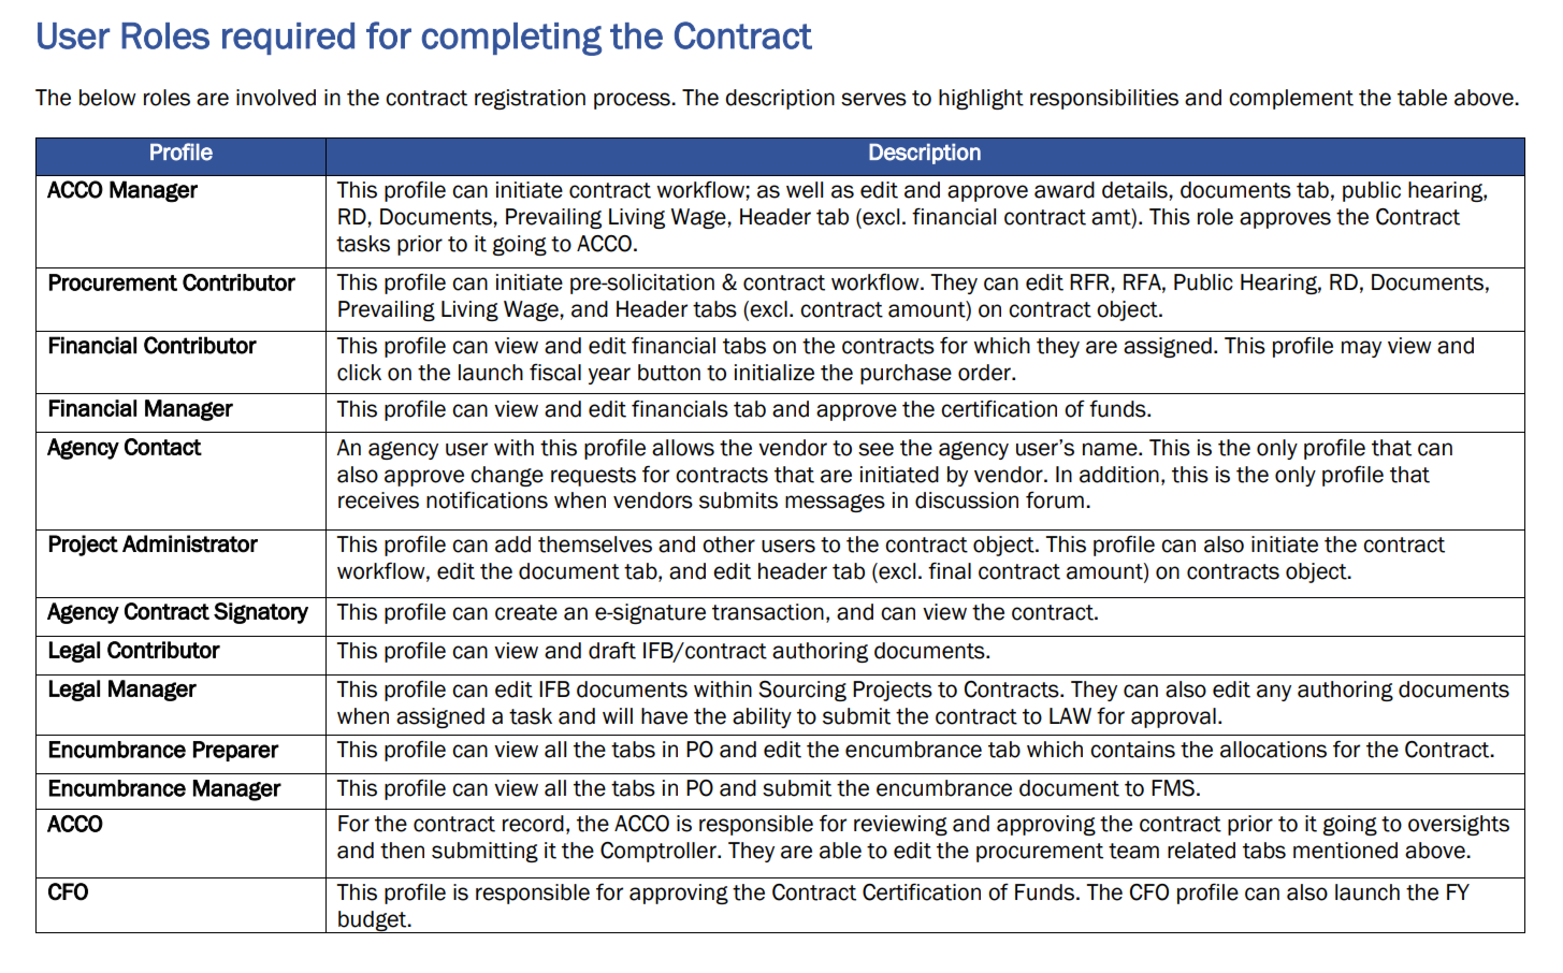
PASSPort^{R3} Overview
Viewing your Contract

Slide 23
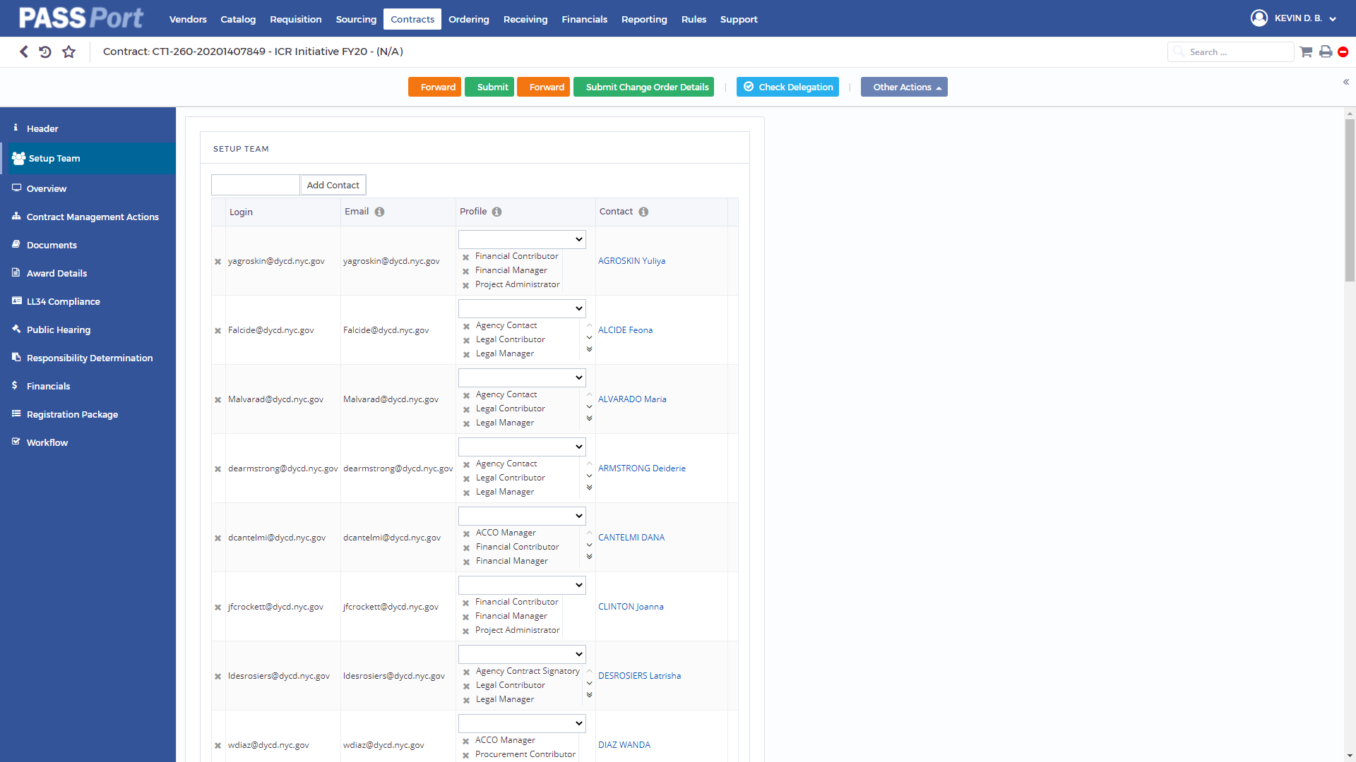
PASSPort^{R3} Overview
Viewing your Contract

Slide 24
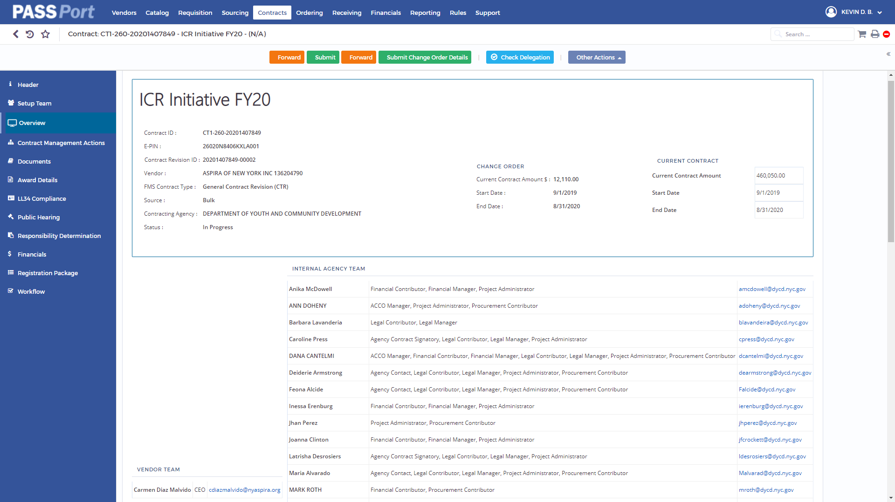
PASSPort^{R3} Overview
Viewing your Contract

Slide 25

PASSPort^{R3} Overview
Viewing your Contract

Slide 26
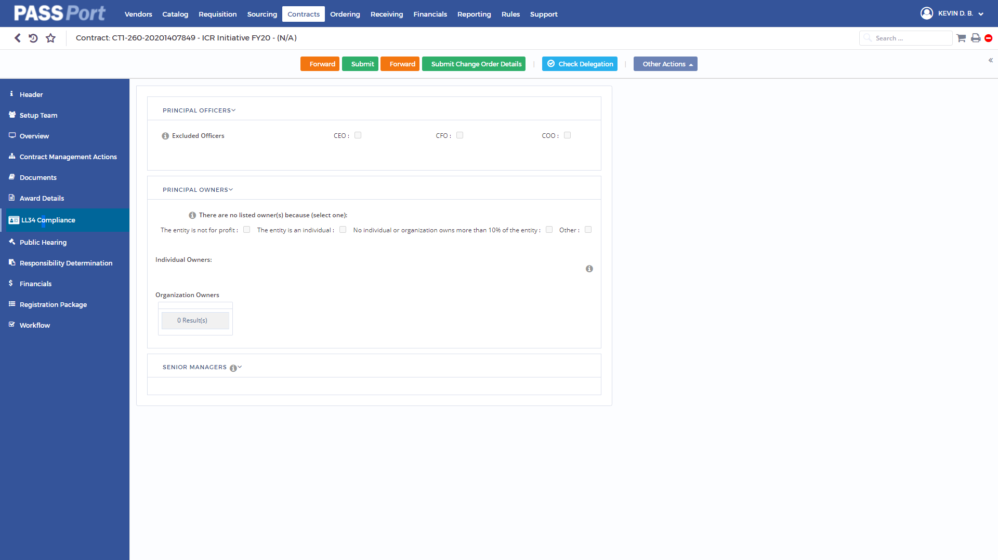
PASSPort^{R3} Overview
Viewing your Contract

Slide 27
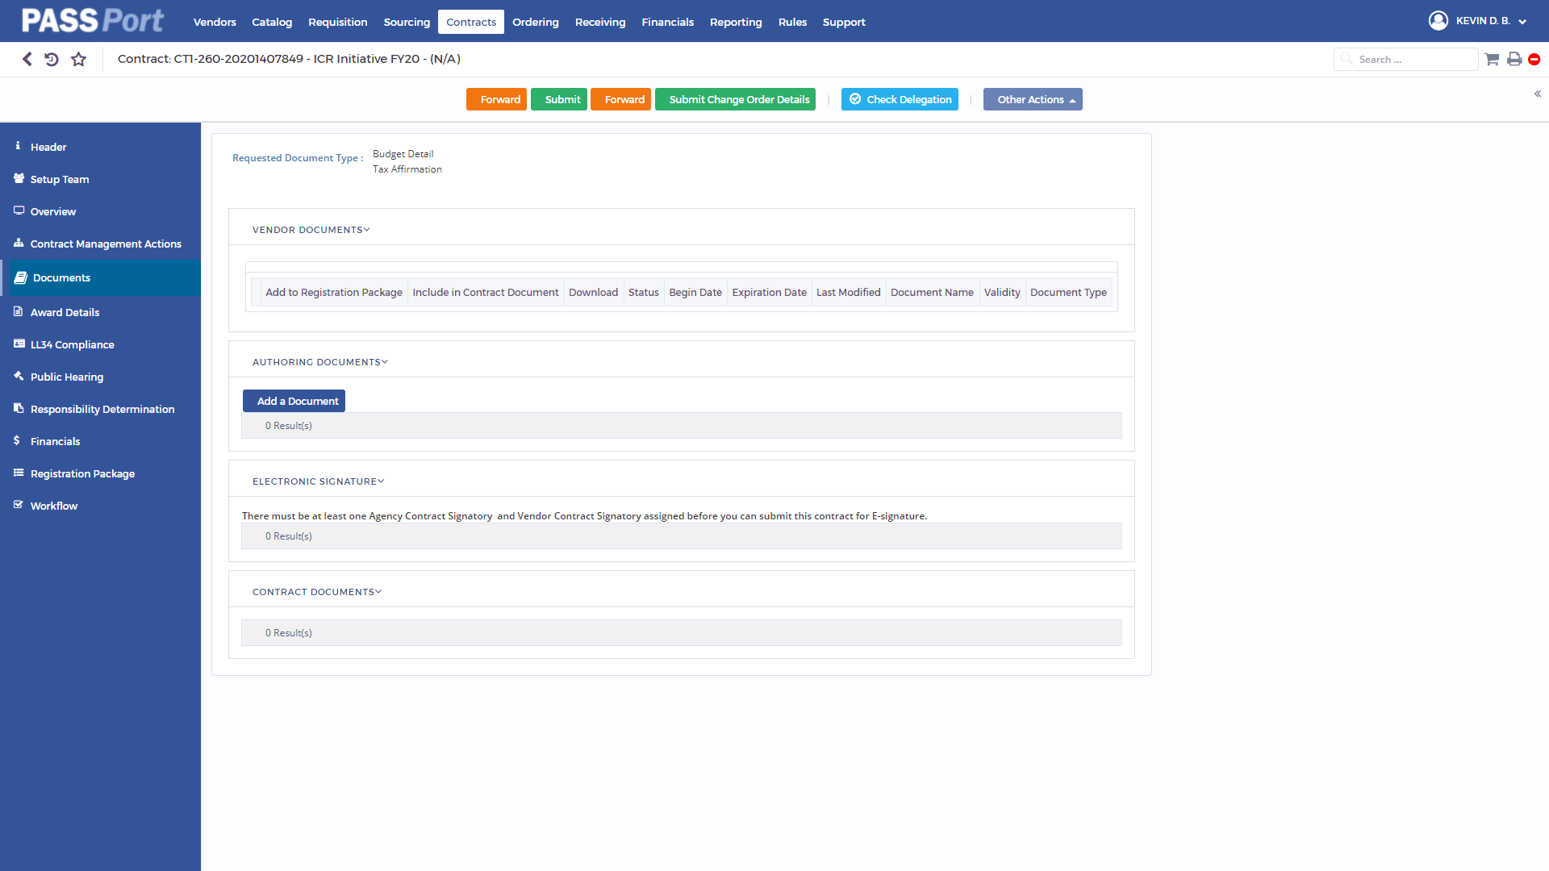
PASSPort^{R3} Overview
ICR Document Request

Slide 28
PASSPort^{R3} Overview
Authoring Document

Slide 29

PASSPort^{R3} Overview
Authoring Document

Slide 30
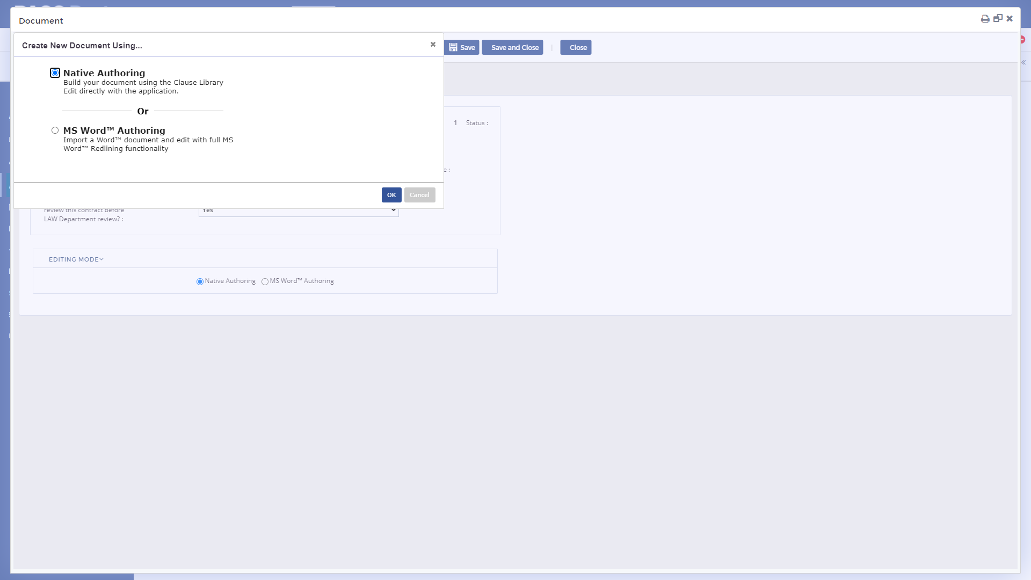
PASSPort^{R3} Overview
Authoring Document

Slide 31
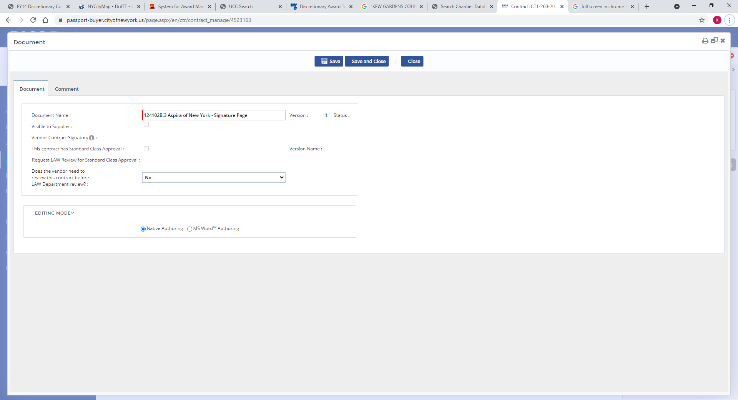
PASSPort^{R3} Overview
Authoring Document

Slide 32
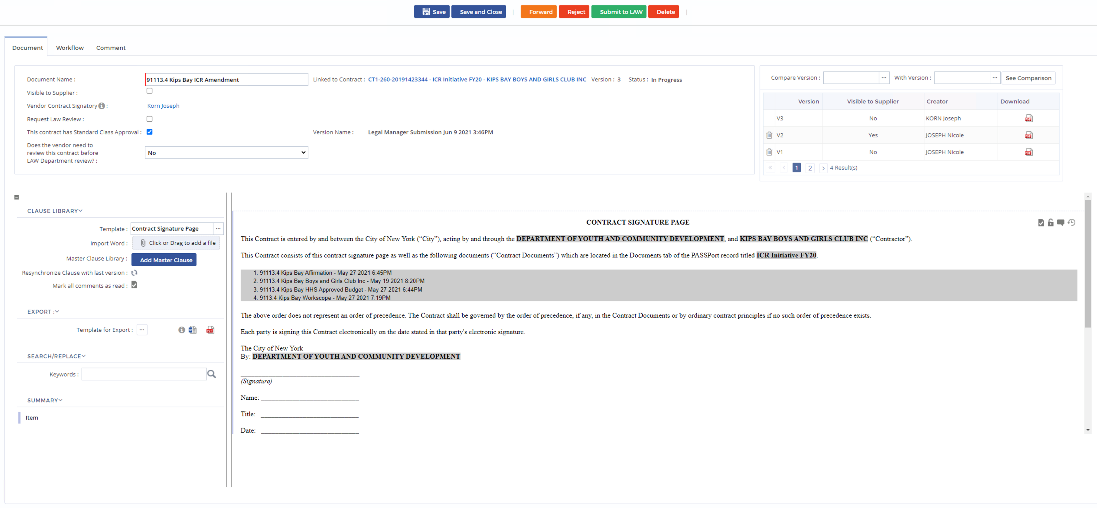
PASSPort^{R3} Overview
Authoring Document

Slide 33
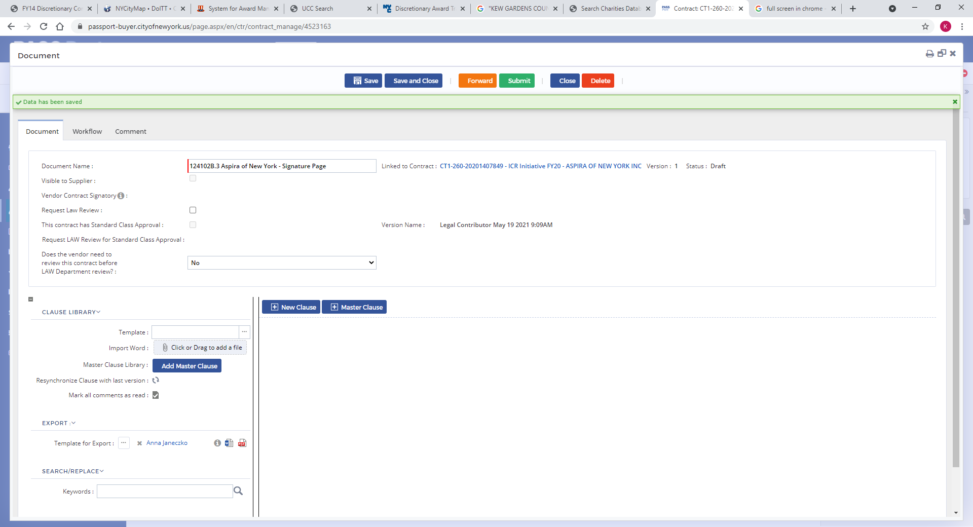
PASSPort^{R3} Overview
Authoring Document

Slide 34
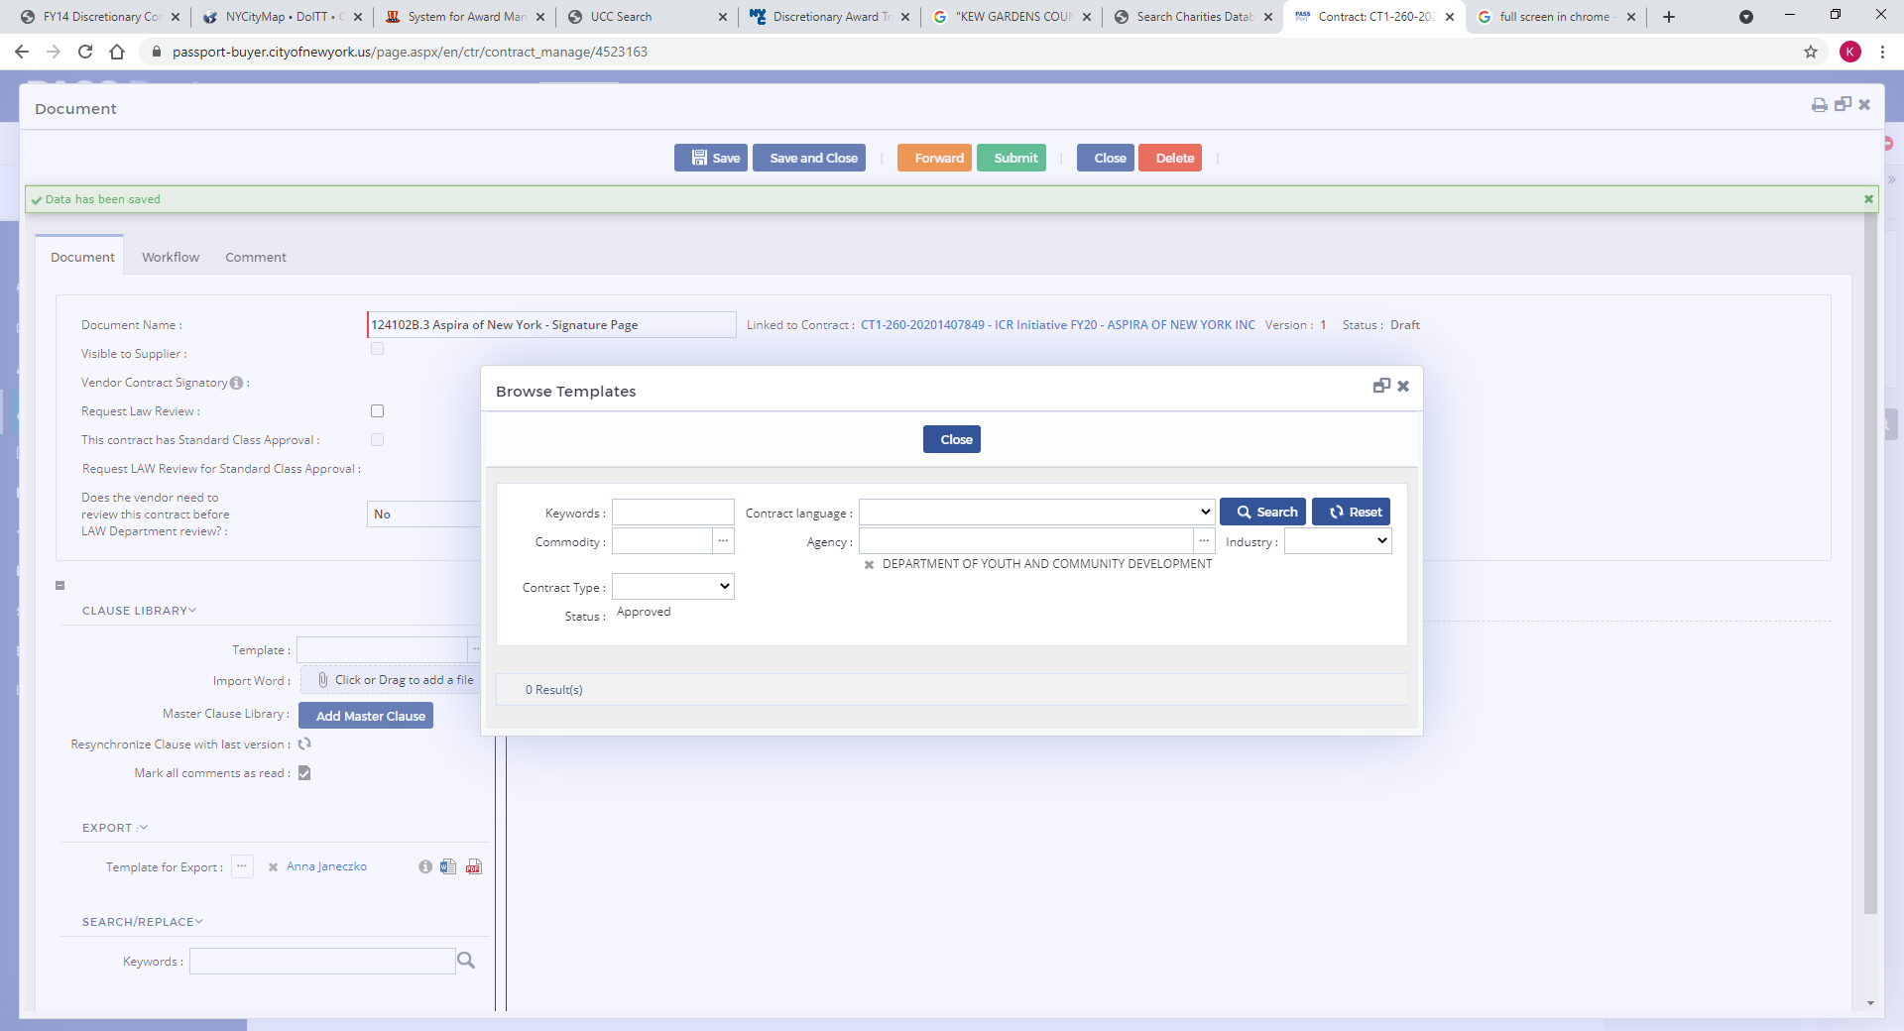
PASSPort^{R3} Overview
Authoring Document

Slide 35
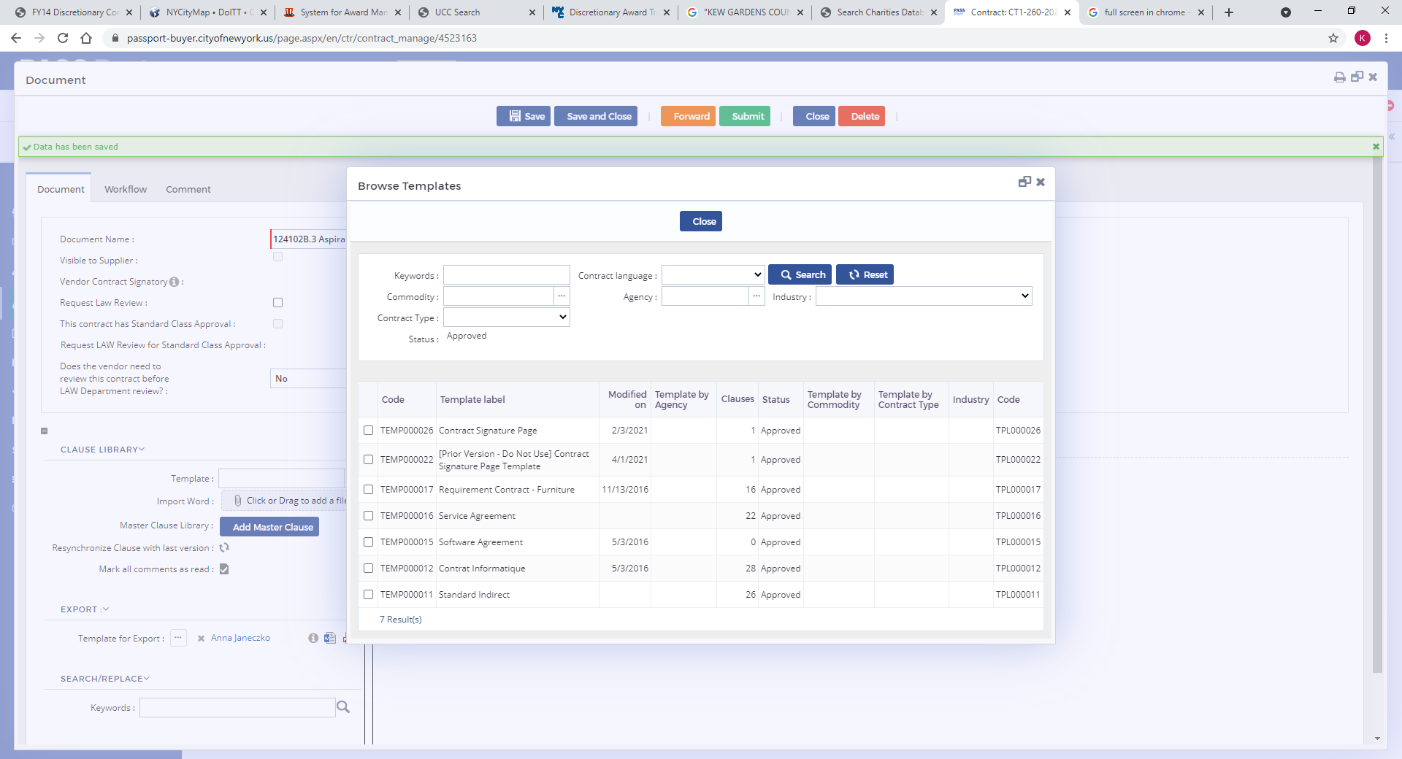
PASSPort^{R3} Overview
Authoring Document

Slide 36
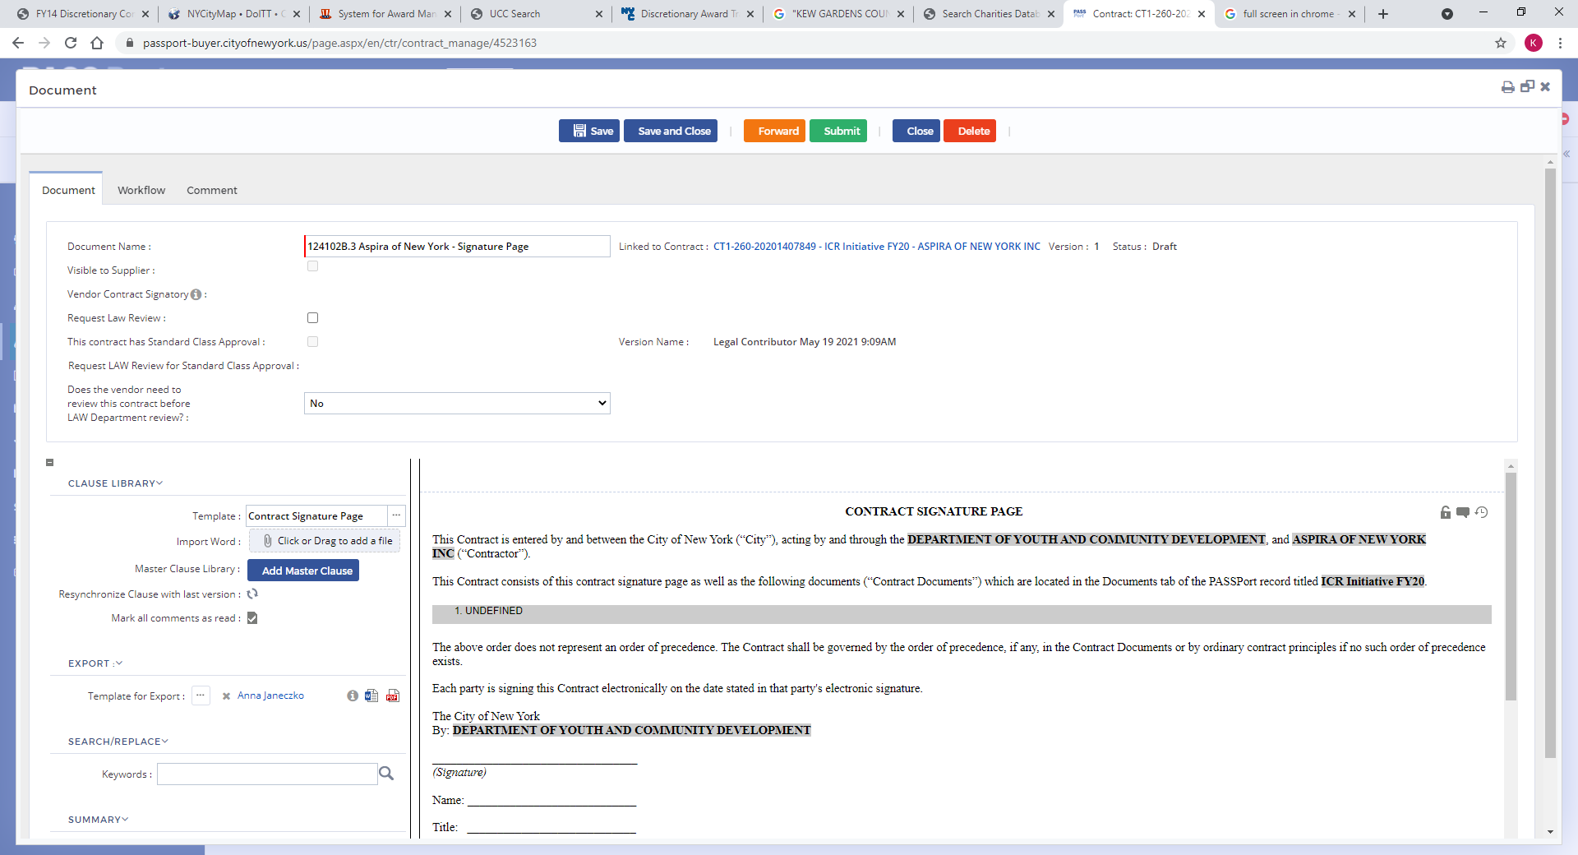
PASSPort^{R3} Overview
Authoring Document

