Slide 1
Beacon Community Center with ACS Prevention Programs
Pre-Proposal Conference

Slide 2

Notes:
Back drop…..
3-Quotes…….Amalie

Slide 3
Welcome & Agenda
Welcome and Panel Introduction
RFP Timeline/Requirements
HHS Accelerator
Beacon Community Center Overview
NYC Department of Education
NYC Administration for Children’s Services
Post Award Requirements
Important Information
Question and Answer Session

Slide 4
RFP Timeline/Requirements
Proposal Due Date: May 31, 2017 at 2:00PM
Minimum requirements for this RFP:
  A proposal must be submitted under RFP EPIN 26017I0004 (ACS program) as well as RFP 26017I0003 (Beacon program) for the same site location/school DBN number.
  A signed School Partnership Agreement (Attachment H) must be submitted with the proposal.
  If a proposal fails to meet the above minimum requirements, it will be deemed non-responsive and will not be further considered.

Slide 5
RFP Timeline/Requirements
Award Announcement: Summer of 2017
Anticipated Contract Term: September 1, 2017 – June 30, 2020
  (with an option to renew for up to three additional years)
  Questions: Must be received by May 24, 2017 RFPquestions@dycd.nyc.gov

Slide 7
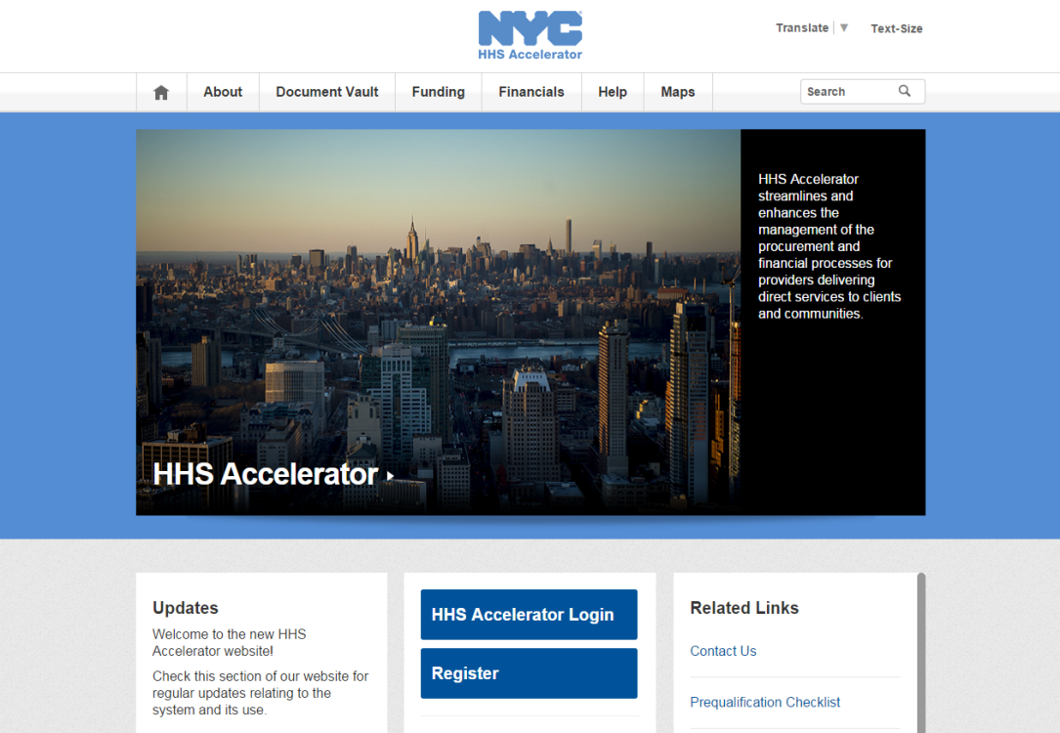
PROPOSING IN HHS ACCELERATOR
The HHS Accelerator System was launched to simplify and improve the competitive contract process for Health and Human Service providers.
Agencies publish all Request for Proposals (RFP) Documents in the HHS Accelerator System.
Prequalified providers approved for relevant Services are “Eligible to Propose” and can submit proposal(s) after RFPs are released.
Providers must submit proposals through the HHS Accelerator System by the proposal due date and time (2 pm).
Need Help?
Contact info@hhsaccelerator.nyc.gov

Slide 8
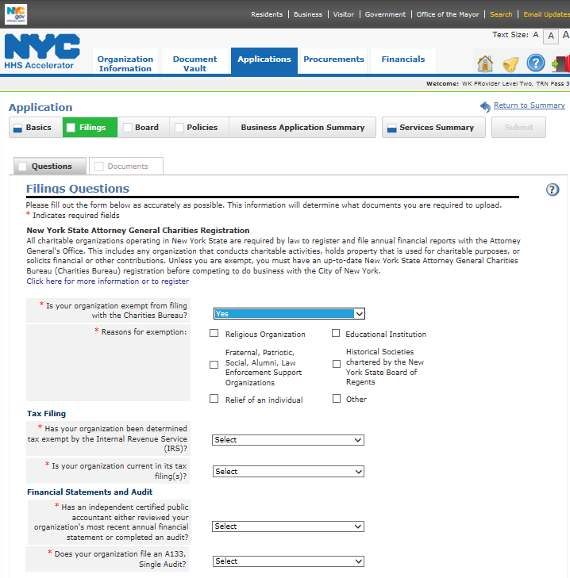
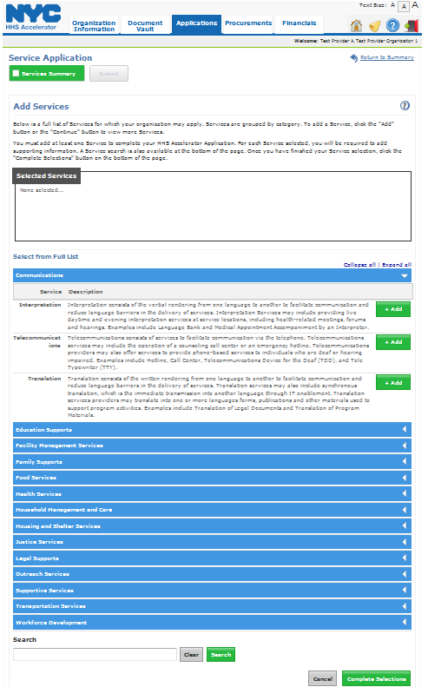
PREQUALIFICATION APPLICATION
Eligibility is determined through a two-part prequalification Application.
Business Application
Service Application
Establish corporate identity
Confirm annual regulatory filings
Board structure and policies.
Browse and search the Client and Community Services Catalog to select services
Establish track record of service delivery.
1
Box turns blue to indicate
completion.
3
Options to demonstrate
service record:
  Contract/
  Grant
  Key Staff Resume
  Statement.
2
*Indicates required field.

Slide 9
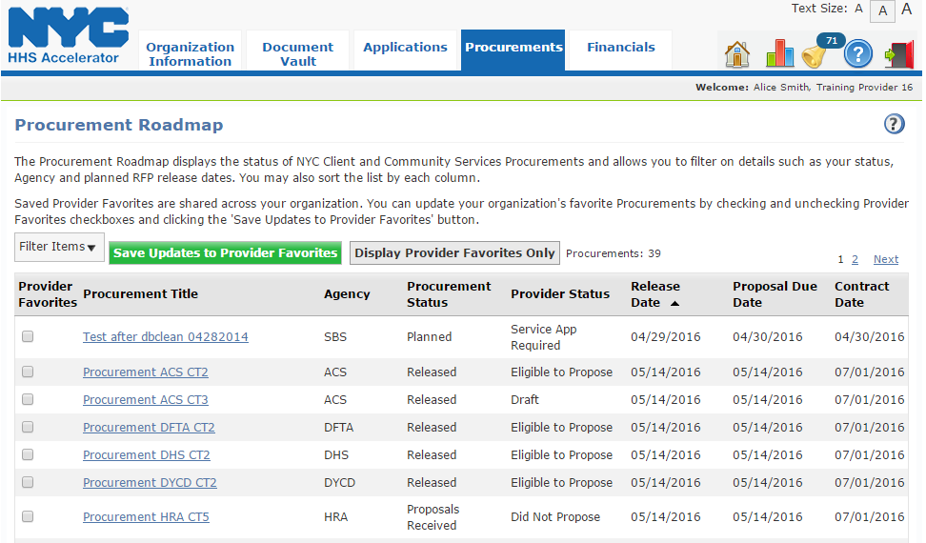
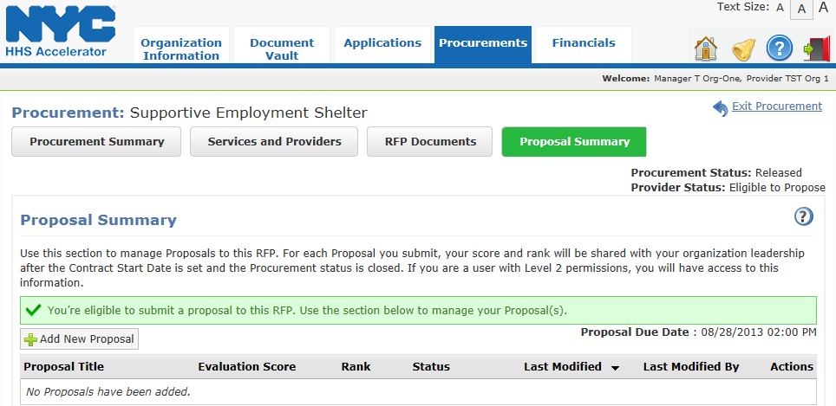
COMPETING FOR FUNDING
Click the “Procurement Title” link to access the Proposal Summary tab.
3
Click “Add New Proposal” to begin your response to the RFP.

Slide 10
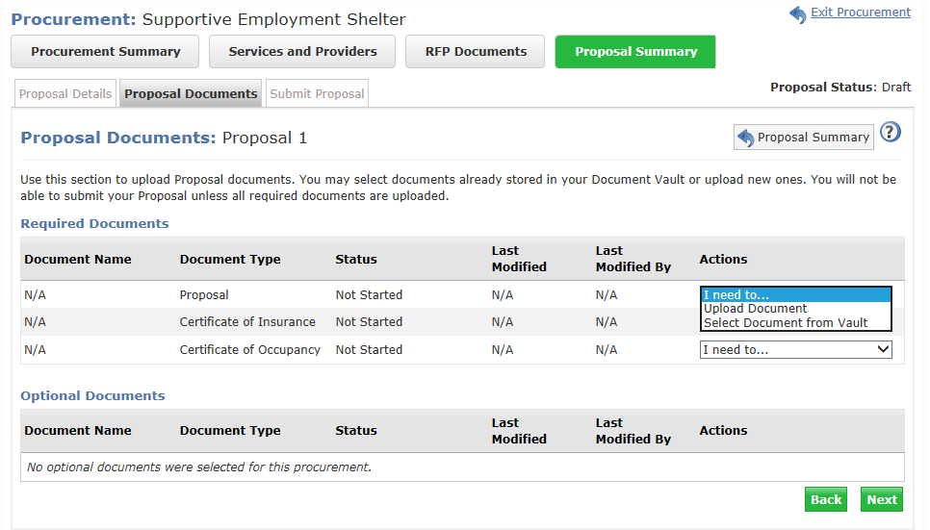
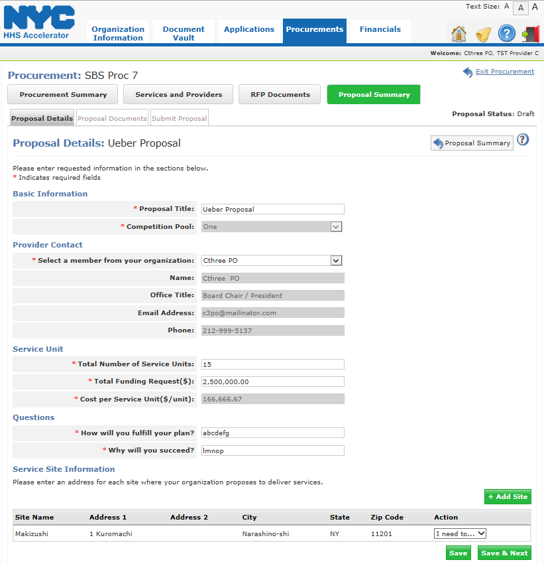
PROPOSAL DETAILS & DOCUMENTS
Review the Proposal Submission Instructions in the RFP for guidance.
Proposal Details
Proposal Documents
Enter a “Provider Contact” who is responsive.
Select the correct Competition Pool, where applicable.
Enter the location where the program will be implemented..
Upload all the “Required Documents” by using the Actions drop-down list.
2

Slide 11
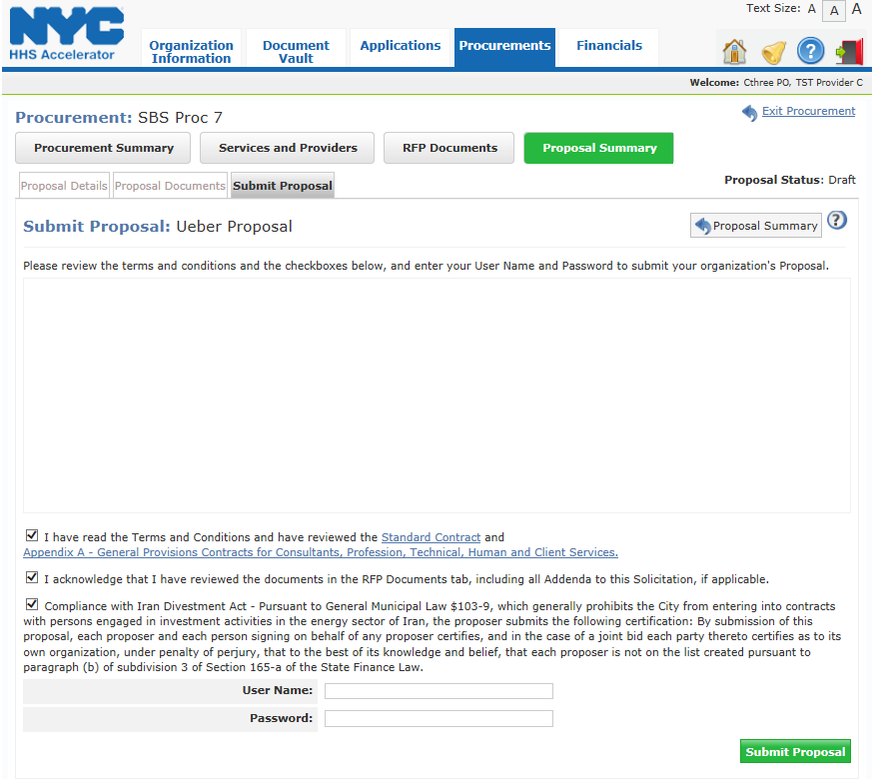
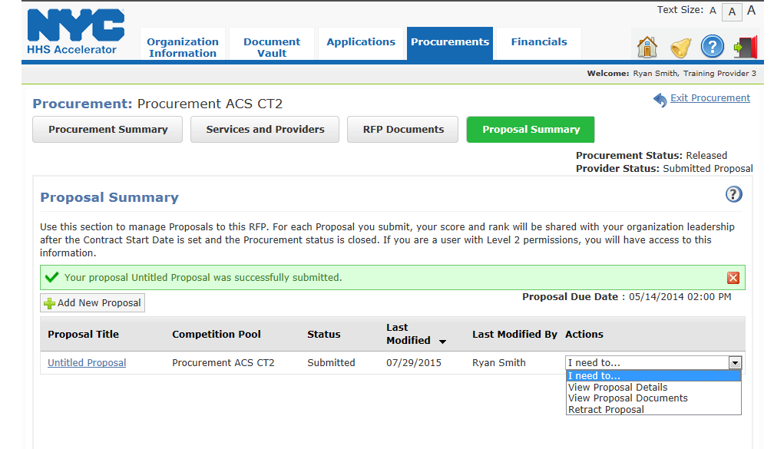
SUBMITTING A PROPOSAL
Proposals must be submitted by 2 pm on the due date in the system.
Submit Proposal
Proposal Status
Check off the attestation boxes, enter your “User Name” and “Password” and click the “Submit Proposal” button.
Once your proposal has been submitted, your organization’s status will change from Draft to Submitted.
2

Slide 12
Beacon Community Center Overview
Pre-Proposal Conference

Slide 13


Beacon Community Center
Beacons represent a unique convergence of youth and community development, aiming, in particular, to keep youth out of harm’s way while simultaneously strengthening local communities through an integrated range of services, provided in an educational environment, and tailored to community needs.
The de Blasio Administration has committed $6.2 million in FY’18 and out to establish new beacon programs in underserved communities. Sites selected were based on two primary analysis: (1) Youth Population by Borough and (2) in partnership with NYC DO E identifying schools with limited to no services.
This RFP is informed by DYCD’s mission and vision to alleviate the effects of poverty by drawing on the strengths of individuals and communities, promoting synergy among programs and providers, and creating a culture that supports community-building efforts.
Notes:
Administration has committed to a significant increase in funding for the Beacon initiative, with goals that are closely aligned with Mayoral priorities of equity and opportunity in the areas of education, health and well-being, empowered residents and neighborhoods, and personal and community safety

Slide 14
Program Goals
Promote positive development by providing safe environments, supportive relationships, high expectations, family engagement and intergenerational activities.
Trusted, neighborhood hub that helps community members access services, strengthens community bonds, and fosters a sense of belonging.
Provide opportunities for all participants to develop skills, increase personal and family well being.
Strengthen community life by expanding partnerships, tapping into City’s resources, encouraging residents to participate in neighborhood activities and connecting community resources to the Beacon.
Support student engagement in school, including among students with chronic absenteeism.
Ensure participants and community members are viewed as potential contributors to the Beacon and the community, are enlisted to help identify local needs, and engaged in the ongoing development of Beacon programs.

Slide 15

Program Services
Three types of program activities:
  Drop-In: Recreational, self-directed and one-time services/consultations. Activities are not structured in scope but can be used as a vehicle to recruit and engage youth/adults in regularly scheduled activities.
  Planned: Designed to offer participants a chance to pursue passions, explore interests, acquire knowledge and develop skills. Activities must have clear purpose and objectives.
  Community Events: Designed to reflect the interests and needs of the community. Beacons must provide a minimum of three events per year, including one on health.
Core Activity Areas:
  Education
  Community Building/Leadership
  Health: Healthy Living/Healthy Relationships/Physical Fitness
  Employment and Financial Security
  Recreation and Enrichment
Notes:
Types of Activities
Drop-In: open gym, teen lounge, one-off informational sessions.
Planned activities: clearly articulated learning goals and skill gains…typically follow curriculum or set of lesson plans and require regular attendance.
Community events: include but not limited to community service/beautification day, open house to market and recruit.
Core Area:
Education: academic support, literacy classes, vocational training, HS/College application, resume writing, etc.
Community Building/Leadership: civic engagement, service learning
Health: sports, yoga, nutrition, mentoring, etc.
Employment: career opportunities, internships, financial literacy, etc.
Recreation: arts projects, book clubs, theatre groups, dance, etc.

Slide 16
Program Services: Outcomes
Outcomes
Participant satisfaction with Beacon services. Indicator: 80% of respondents to participant satisfaction surveys.
Beacon makes all necessary external and, if applicable, internal referrals to address needs. Indicator: Responses to the participant satisfaction survey confirm necessary referrals were made.
Social and Emotional Learning. DYCD anticipates introducing an SEL outcome based survey tool that will assess motivation, self-awareness and decision making.
Notes:
DYCD anticipates administering costumer service satisfaction surveys:
Where we are looking for….
80% respondents indicating satisfaction of services.
That Beacons are making internal/external referrals to address needs.
And to assess participant motivation, self-awareness and decision making through the use of a Social Emotional Learning outcome based survey tool.

Slide 17

Staffing Structure
Key staff positions: Beacon Director, Outreach coordinator, and other staff who provide regular and substantial direct services to youth and adults.
    Full-Time Beacon Director with a Bachelor’s Degree or Higher, with a minimum of five years of relevant experience. Responsibilities include but not limited to:
    Overall responsibility for administration of program
    Coordinate with the principal of host school and other community stakeholders
    Represent the program at school leadership meetings
    Work with staff to ensure quality activities
*Resource Coordinator
Responsible for coordinating and making referrals, serve as liaison with other units of the contractor’s organization, as well as external partners, i.e. co-locators/sub-contractors.
Outreach Coordinator
Must be familiar with neighborhoods and are trusted by local youth. This person would engage youth who would otherwise not be enticed to enroll in the program, but stand to benefit the most from its services. As well as work with chronically absent youth, identified as part of the Beacon goals.
* Could be assigned to Director

Slide 18
Staffing Structure
Please note that the staffing plan must comply with staff-to-participant ratios for children 5 to 13 years required under the New York State SACC Regulations. In addition,
Staff at all levels will …
  Be familiar with the neighborhood
  Have the necessary language skills to effectively communicate with and serve non-English-speaking participants.
  Sensitive to the diverse languages, cultures, traditions, lifestyles, family structures, and sexual orientations and gender identities of participants and will integrate that knowledge into their service delivery.
  Linguistic and communication skills to be able to reach out and interact with newcomers to the City in positive ways and respond effectively to their needs.
  The necessary knowledge and literacy and numeracy skills to provide appropriate assistance.
  Have experience delivering project-based activities that successfully engage teens and young adults.
  Have the experience and managerial skills needed to provide, lead, and coordinate the activities for adults.

Slide 19
Program Expectations: Approach
Strength-based Frameworks:
  Positive Youth Development (PYD)
  Social and Emotional Learning (SEL)
  Youth Leadership
Safe, Welcoming and Inclusive Environment
  The contractor would have protocols for staff behavior and effective training and supervision to ensure the environment is friendly and supportive and everyone is treated with dignity and respect, starting from the very first encounter with program staff.
Family Engagement
  Family engagement comprises three critical elements: Communication (i.e., strong and positive family interactions); Participation (i.e., families access the services they need); and Mutually-beneficial partnerships (i.e., family members assume leadership roles and take shared responsibility for outcomes).
Notes:
DYCD expects all the programs it supports to recognize and value the strengths and capacities of individuals and communities.
PYD is an assets-based approach that fosters healthy development and resilience by offering a safe environment, a sense of belonging, and authentic opportunities for participants to be heard and effect change in their lives.
SEL involves intentional development of key skills including self-awareness, self-management, social awareness, relationships and responsible decision-making. Youth Leadership builds on SEL competencies by adding a focus on action (using skills learned to effect change), and reflection (reinforcing lessons learned, building confidence, responding to new challenges).

Slide 20
Annual Target Population/Service Levels
Age Category | Activity Type | Number | Enrollment Criterion
Youth, under 22 years | Drop-In and planned activities | 600 | 3 Visits
Adults 22 years and older | Drop-In and planned activities | 100 | 1 Visit
Adults and Youth, any age | Community Events | 500 | 1 Event
Total |  | *1,200
Of the 600 youth under 22 years, DYCD expects Beacons to enroll at least 100
  elementary, 100 middle school students and 100 high school-age youth.
Adult Services: Services would reflect their specific needs and interests.
Please note: The 1,200 are annual enrollment requirements and inclusive of Summer and School Year services.
Notes:
The Beacon would provide activities and services for school-age youth, families, and adults ages 22 years and older, including seniors.
Points:
These are annual figures and are inclusive of summer services.
The school year concentrated population for youth services is 200.

Slide 21

Target Population/Service Levels: School Year Dosage Requirements
At least 100 must reflect the grade levels of the host school.
The other 100 can represent any other grade level and/or the community.
200 meet dosage requirement

Slide 22
Target Population/Service Levels: School Year Dosage Requirements
School Year – Intensive Participation Levels - 200
Grade/Age | Measure | Target | 200 Total
Elementary (K-5) | Average Daily Attendance | 80% | #
Middle (6-8) | Hours of Beacon activity | 150 hours per participant per school year | #
High School Age (9 -12) and out of school youth through age 21 | Hours of Beacon activity | 100 hours per participant per school year | #
School Year (36 Weeks)
Minimum Hours per Week | Operating Schedule | Total School Year Operating Hours
42 hours over 6 days (Mon-Fri and Sat or Sun) | Weekdays Start: End of the school day End: No later than 10pm Weekends To be negotiated with host school | 1,512
Notes:
Depending on school grade level and community need, CBOs will identify population to serve.
At least 15 school closing days during the school year program is expected to operate for 10 hours a day, from 8am – 6pm, for a total of 150 hours. Provider selects days according to community needs.
Another item that needs to be flagged during contract negotiations.

Slide 23
Target Population/Service Levels: Summer Operating Hours
Proposers must choose one of the three options set out below. Under all three options, the Beacon must offer a summer camp program for at least some elementary grade students.
Summer (7 weeks) Proposers must select an option
 | Minimum Hours Per Week | Operating Schedule | Total Summer Hours | Minimum Enrollment Requirements
Option I | Mon-Fri 70 hrs. Weekend 7 hrs. Total: 77 hrs. | 8am – 10pm Sat or Sun 3pm-10pm | 539 | 175 participants
Option II | 64 hrs. per week | Flexible | 448 | 225 participants, including at least 50 youth under 22
Option III | Mon-Fri 50 hrs. | 8am – 6pm | 350 | 275 participants, including at least 100 youth under age 22
Note the following:
Option I: Enrollment contributes to annual minimum enrollment for the Beacon 1,200
Option II: This would raise the annual minimum enrollment for the Beacon to 1,250
Option III: This would raise the annual minimum enrollment for the Beacon to 1,300
Notes:
All programs expected to operate 8am – 6pm
Option I: Enrollment contributes to annual minimum enrollment for the Beacon 1,200
Option II: This would raise the annual minimum enrollment for the Beacon to 1,250….Flexible evening hours.
Option III: This would raise the annual minimum enrollment for the Beacon to 1,300

Slide 24

Community Partnerships
It is anticipated that proposer has strong community connections and sound knowledge of services in the neighborhood.
Contractor would have a minimum of three community partnerships.
Community Partnership Agreements must be submitted along with the proposal.
Each Beacon must have an Advisory Council that meets at least four times a year.
To ensure that middle and high school-age youth have meaningful leadership opportunities, the Beacon would either ensure youth are adequately represented on the Advisory Council or establish a separate Youth Advisory Council.
Reminder: Agreements must include description of services, type of services that will be provided and description of process for making referrals if the partnership involves referrals.
Notes:
If the contractor is a multi-service organization, community connections may include other unites, divisions or programs operated by the contractor’s own organization.
Partnership may include ongoing referrals, joint projects, and co-location of services and sub-contracts.
Advisory Council primary role is to contribute to the assessment of community needs.

Slide 25
Agenda
Welcome and Panel Introduction
RFP Timeline/Requirements
HHS Accelerator
Beacon Community Center Overview
NYC Department of Education
NYC Administration for Children’s Services
Post Award Requirements
Important Information
Question and Answer Session

Slide 26

Office of Community Schools at the Department of Education
The Office of Community Schools supports schools to work with Community Based Organizations (CBOs) to become places where children have opportunities to learn, gain skills, create joy and have experiences that ignite curiosity and allow children to discover their passions and talents.

Slide 27


Community Partnership:
School/CBO
A positive and productive relationship between the Beacon and its host schools is fundamental to program success.
School Partnership Agreement (SPA) is a minimum requirement for the RFP.
Principals will need to sign off on a School Partnership Agreement (SPA) and proposals will not be considered without the principal’s signature. Principal’s have the option of signing multiple SPAs – each of the proposals will be considered. The proposal with the highest score will be awarded a Beacon contract.
The Office of Community Schools has worked with DYCD to prioritize and strengthen relationships in this new RFP – for instance, the host school Principal and CBO leadership will be expected to work collaboratively in defining and establishing Beacon Director expectations including but not limited to being part of the hiring process. Additional items include but are not limited to:
  Principal identifying a liaison from his/her staff to facilitate ongoing communication.
  Beacon Director being part of school governance structure.
  Established regularly scheduled meetings with Principal or designee.
  Identifying allocated space including but not limited to classrooms and resources.
Note: The partnership between the proposed provider and the school/community must be clearly described and demonstrated in the proposal.
Notes:
The school partnership will ensure alignment between the Beacon program and other services at the host school and in the surrounding neighborhood.

Slide 28
Principles for Effective School / CBO Partnerships
Planning
Plan collaboratively from the start
Gather key stakeholders (parents, community members, school leadership team, participants, etc.) to develop and clarify the program vision
Involve the school principal in the selection of the Beacon Director
Clarify roles and responsibilities of both school and CBO staff
Programming
Set ground rules
Start small and build gradually
Share decision-making
Prepare team members to work together
Make adjustments to the program as needed and keep lines of communication open with all stakeholders

Slide 29

ACS Beacon Prevention
NYC Administration for Children’s Services
Division of Prevention Services | Dr. Jacqueline Martin, Deputy Commissioner

Slide 30
NYC Administration for Children's Services
Division of Prevention Services
The ACS Division of Prevention Services oversees a continuum of services that support children and families throughout New York City. ACS delivers preventive services that are child centered and family-focused, community-based, and culturally competent to address the individual needs of the child and the needs of the family members residing with the child, while recognizing the socio-economic realities which impact their daily lives to reduce the need for foster care.
Scope of ACS Prevention Services
  200+ programs delivered by 56 community based non-profits
  11 evidence-based and promising practice models
  The number of children served by ACS preventive services has grown from 39,400 in 2011 to 45,000 in 2016.

Slide 31
NYC Administration for Children's Services
Division of Prevention Services
Purpose of Prevention Services
To provide services when a family is in need of help
To strengthen families
To help keep families together and prevent foster care placement
To support families when children return from foster care
To prevent child abuse and neglect
Prevention Programs Offer
Help with family crisis
In Home Family counseling
Support groups for parents and youth
Referrals and help accessing programs such as public assistance, education, mental health, domestic violence, child care and Head Start programs, substance abuse, prenatal assistance, vocational services and other benefits.
Concrete services such as: Childcare, beds and cribs, extermination and interpreter services
Housing Subsidy and Homemaking Services

Slide 32
ACS Beacon Prevention
Overview
The ACS Beacon Prevention programs provide preventive services to families with youth at risk of foster care placement in a manner which ensures the safety of the youth and preserves, supports, and strengthens the family, when appropriate.
The ACS Beacon Prevention programs are family-focused and reflect the culture of the community in which the families reside. They are designed to help families make positive changes in their lives that reduce the risk of children being placed in foster care.
This integration of community-based prevention programs at Beacon sites strengthens, enriches and expands ACS services designed to preserve families.

Slide 33
ACS Beacon Prevention
Goals and Objectives
Prevent child abuse and neglect;
Reduce the number and percentage of placements into foster care for youth receiving preventive services;
Reduce the number and percentage of youth who are the subject of subsequent abuse and neglect reports;
Serve youth and their families in their neighborhood of origin;
Promote the optimal health, well-being, and development of youth; and
Strengthen families.

Slide 34
ACS Beacon Prevention
Service Model
The ACS Beacon Prevention programs:
Provide preventive services to families with youth at risk of foster care placement in a manner which ensures the safety of the youth and preserves, supports, and strengthens the family, when appropriate.
Are family-focused and reflect the culture of the community.
Are designed to help families make positive changes in their lives that reduce the risk of children being placed in foster care.
This integration of community-based prevention programs at Beacon sites strengthens, enriches and expands ACS services.

Slide 35
ACS Beacon Prevention
Core Service Areas
Social Work Services and Advocacy
Alcohol and Substance Abuse
Domestic Violence
Health/Mental Health Services
Parenting Skills
Housing and Housing Subsidies
Education, Employment, and Job Training Services

Slide 36
ACS Beacon Prevention
Program Expectations: Outreach
Preventive services are designed to avert the need for foster placement of children in families at risk of abuse or neglect. The target population for the ACS Beacon Prevention Program would, primarily, be families with no prior involvement with the child welfare system or ACS child protection services.
The contractor would receive referrals from the Beacon program, other Beacon programs, the Beacon host school and other local schools, other units of the contractor’s organization, and ACS primary prevention programs and community partnership programs.
The contractor would reach out to referred youth and families to ensure family participation and retention in Preventive Programs.

Slide 37
ACS Beacon Prevention
Program Expectations: Services
The design and delivery of all preventive services would be family-focused and inclusive of the needs and culture of the community. Services would address the individual needs of the youth and the family members residing with the youth.
The contractor would:
  provide preventive services to families with youth at risk of foster care placement in a manner which ensures the safety of the youth and seeks to preserve, support and strengthen the family, when appropriate.
  employ a holistic approach to child welfare services and engage in on-going efforts to bring about the necessary changes in service delivery culture. A holistic approach is defined as addressing all the needs families may have.
  provide support services and counseling to at risk youth and families within their own neighborhood or as close to their own neighborhood as possible, unless inappropriate.
  ensure that culturally and linguistically competent services are provided through a staff that is representative of the community served and fluent in the languages spoken by participating youth and family members. To the extent possible, the contractor would also recruit and hire appropriately qualified staff from the community served.

Slide 38
ACS Beacon Prevention
Program Expectations: Accessibility
Participants would have access to all services in the Beacon.
The contractor would operate during hours that reflect the needs of the youth and families to be served, including after school and evening availability.
The contractor would assess the language needs and communication skills of each youth and family to be served and provide services consistent with those needs to optimally serve the youth and families.
The contractor would make services accessible to youth with physical disabilities, including but not limited to, TDD service, large print informational reading materials, and establishing referral protocols to programs serving families with member(s) with a disability.
The contractor would assist each parent in obtaining appropriately supervised child care services.

Slide 39
ACS Beacon Prevention
Program Expectations: Staffing
ACS Beacon Prevention program would have a full-time director and the following additional staff: a supervisor, intake workers, case planners, and other professional staff, parent aides, childcare workers, and paraprofessionals.
Each program is expected to maintain staffing in accordance with the ACS “Preventive Services Quality Assurance Standards and Indicators”- see http://www1.nyc.gov/site/dycd/about/news-and-media/publications.page.

Slide 40
ACS Beacon Prevention
Changes in new RFP
Summary of changes to ACS Beacon Prevention in new RFP:
Increased Support from ACS: The ACS Division of Prevention Services (DPS) will provide ACS Beacon Prevention Program contractors with the following new resources:
  A Beacon Prevention Liaison within DPS to help support ACS Beacon Prevention Program engage families, develop meaningful collaborative relationships with host schools, and build community referrals to the program.
  Training from ACS on the Center for the Study of Social Policy’s Strengthening Families Protective Factors Framework in order to help guide case practice to support family stability and well-being in the context of community and primary prevention.
  Inclusion in DPS Community Prevention initiatives focused on building collaboration at the neighborhood level among providers serving similar target populations.

Slide 41
Agenda
Welcome and Panel Introduction
RFP Timeline/Requirements
HHS Accelerator
Beacon Community Center Overview
NYC Department of Education
NYC Administration for Children’s Services
Post Award Requirements
Important Information
Question and Answer Session

Slide 42
Post Award Requirements
Public Assistance Hiring Commitment Rider
Responsibility Determination
Notice for Proposer Subcontractor Compliance

Slide 43
Agenda
Welcome and Panel Introduction
RFP Timeline/Requirements
HHS Accelerator
Beacon Community Center Overview
NYC Department of Education
NYC Administration for Children’s Services
Post Award Requirements
Important Information
Question and Answer Session

Slide 44
IMPORTANT INFORMATION
NYC Liability Insurance Requirement
Commercial General Liability
  $1 million per occurrence and $2 million aggregate;
Motor Vehicle Liability (if applicable)
  $5 million per occurrence;
Workers’ compensation
An original certificate of insurance naming the City of New York, together with its officials and employees, as an additional insured.
DYCD will not be able to proceed with processing an awarded contract until it has obtained proof of the necessary insurance coverage.

Slide 45
IMPORTANT INFORMATION
DYCD encourages MWBE participation and recommends the utilization of certified MWBEs
Transcript, presentation and attendance rosters will be posted to DYCD website for viewing

Slide 46
Wrap Up
QUESTIONS
RFPquestions@dycd.nyc.gov

