Slide 1


MOPD Task Force
Quarterly Meeting: June 23rd 2017
www.nyc.gov/mopd

Slide 2
Today’s Agenda
Welcome: Commissioner Victor Calise
MOPD Updates
Partner Updates: (Red Cross, DOHMH, NYCHA, DoITT, ORR, GOSR, DFTA)
NYCEM Updates: (Summer Heat, Advance Warning System)

Slide 3



MOPD Updates
Official Launch: Inclusive Design Guidelines (IDG)
AccessibleNYC
Disability Pride Parade July 9th

Slide 4



MOPD Updates
Nation ADA Symposium in Chicago
Philadelphia OEM: EPIC 3. NYPD NCO Program

Slide 5
Task Force – New Vision
Name: MOPD Disaster Resilience and Resource Network
Goal:
  Quarterly meetings
  Information sharing both between partners and the public
  Developing MOPD Inclusive Emergency Management webpage
Membership and participation

Slide 6
Mayor’s Office for People with Disabilities
Recovery Task Force
Greater New York Region

Slide 7
Agenda
Introduction to Greater New York Region
Training Initiatives
  Everyone is Welcome
  Care Assistant Fundamentals Training
Processes
  Shelter Surveys
  C-MIST
  Centers for Independent Living
Greater New York Region

Slide 8
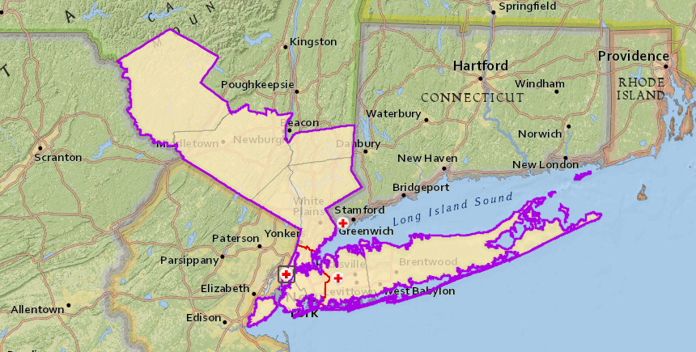
Greater New York Region
Three chapters
  Greater New York: Bronx, Kings, New York, Queens, Richmond
  Long Island: Nassau, Suffolk
  Metro New York North: Orange, Putnam, Rockland, Sullivan, Westchester & Greenwich, CT
Greater New York Region

Slide 9

Reasonable Accommodation
The way we ask questions of clients
Assisting with printed materials and forms
Sharpening our listening and feedback skills
Durable medical equipment
Placement of cots
Supply of stable cots
Providing a quiet room
Providing appropriate meals and snacks
Providing fragrance-free products
Greater New York Region
Notes:
Explain: To provide for requests and/or requirements for reasonable accommodation of individuals, we may need to make modifications to rules, policies, practices, and procedures. We should be ready to provide reasonable accommodations.
Let’s see what these modifications could include.
Changing or adapting the way we ask questions of clients. We may need language assistance, such as translators or assistive technology to help us communicate effectively. We need to have a good understanding of the cultures that exist in our local communities and develop partnerships to assist with communication.
Assisting with printed materials and forms by reading them aloud, and filling in answers.
Sharpening our listening and feedback skills so that we thoroughly understand the client’s needs.
Providing shelter residents with durable medical equipment, such as hospital beds, privacy screens, O2 Concentrators, shower chairs, and increased square footage area in the shelter.
Placing cots for shelter residents with electrically dependent equipment close to a power source.
Placing client cots close to a bathroom and/or the feeding area as requested.
Planning to obtain a supply of raised, stable cots (including bariatric cots), to be placed against a sturdy wall for those who must transfer from a wheelchair, or for whom a standard cot does not otherwise meet their needs.
Providing a quiet room or space for individuals who may need low stimulation, such as individuals with autism spectrum disorder, developmental and cognitive disabilities, dementia, Alzheimer’s, and individuals with mental health, safety or significant health maintenance needs, including post-surgical or end-of-life care.
Providing appropriate meals and snacks. For people with diabetes, having low sugar and low carbohydrate options, and for those with specific dietary needs, having low-salt or allergen-free options, such as food that does not contain tree-nuts, soy, or gluten. A “nut-free” area should be provided in the shelter environment with clear signage labelling it as such. Shelter staff will need to monitor this area to keep it clear of nut-free products.
Providing fragrance-free paper products, cleaning products, and soap if a client requests a fragrance free environment. Honor client requests when they ask to move to an area away from individuals wearing perfumes, colognes, or clothing with heavily scented detergents.
Next Slide

Slide 10
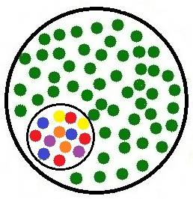

Integration, Inclusion – What’s It Mean?
Integration:
Incorporating access and functional needs support into all disaster services, with an end goal of…
Inclusion:
Being a part of the whole community by being welcomed, and feeling that you belong
Greater New York Region
Notes:
Explain: So, how do we ensure everyone’s welcome and receiving the same Red Cross services?
Advance Slide
We do it by ensuring that integration and inclusion are a part of all Red Cross services, so that disaster clients feel they are welcome and that they belong.
Advance Slide
Integration means incorporating access and functional needs support into all disaster services with an end goal of inclusion. Inclusion means being a part of the whole community by being welcomed and feeling that you belong.
It also means that we are providing the client with access and functional needs, including those with disabilities, a way for self-determination; which is the ability for individuals to determine for themselves what accommodations, if any, they need.
Next Slide

Slide 11
Care Assistant Fundamentals
Purpose
To prepare all disaster responders and partners to safely assist people with Disabilities and other Access and Functional needs access and utilize Red Cross facilities and services while promoting the independence of the clients served.
Goal is to maintain and promote client independence
Standard Precautions
Mobility Assistance
Transferring Assistance
Feeding Assistance
Observation of clients
Greater New York Region

Slide 12
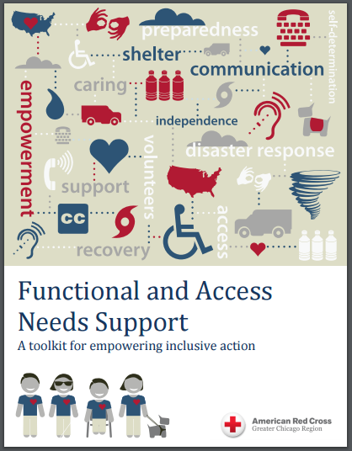
Toolkits and Job Tools
Senior Services
Children
Autism
Service Animals
Mental Illness
Mobility Disabilities
Wheelchair Transfers
Cognitive Disabilities
Communication Aids
Limited English Proficiency
Deaf and Hard of Hearing
Blind and Low Vision
Evacuating Wheelchair Users
Brain Injuries/Seizure Disorders
Greater New York Region

Slide 13
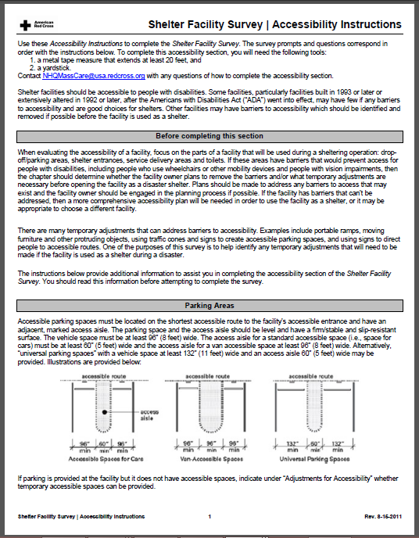
Shelter Surveys
Parking areas
Facility entrance
Routes to service delivery areas
Ramps
Restrooms
Showers
Eating areas
Assessment
Greater New York Region

Slide 14
C-MIST Worksheet
C = Communication – You can help improve residents’ communication by providing: large print, Braille, translators, readers, sign language interpreters, pen and paper, replacement eyeglasses, and replacement hearing aids.
M = Maintaining Health– Daily medical needs you can help to meet include: special diet care, wound care, replacement medication, durable medical equipment, diabetes management, oxygen supplies, storage of refrigerated medication, prenatal support, access to quiet rooms, mental health care, and infection control.
I = Independence – You can support individuals’ independence by providing: wheelchairs, walkers, canes, crutches, equipment for bathing, equipment for toileting, cribs, bariatric cots, power sources for electric devices, and service animal accommodations.
S = Services, Support, and Self-Determination – You can provide for support, special services, and self-determination needs by: identifying caregivers, assigning qualified shelter volunteers to provide personal assistance, contacting local agencies, coordinating childcare, coordinating age appropriate activities, and providing equal access to resources.
T = Transportation – You can assist with special transportation needs by: coordinating transportation to dialysis, coordinating transportation to medical appointments, transporting residents to the emergency room, and transporting residents to alternative housing.
Greater New York Region

Slide 15
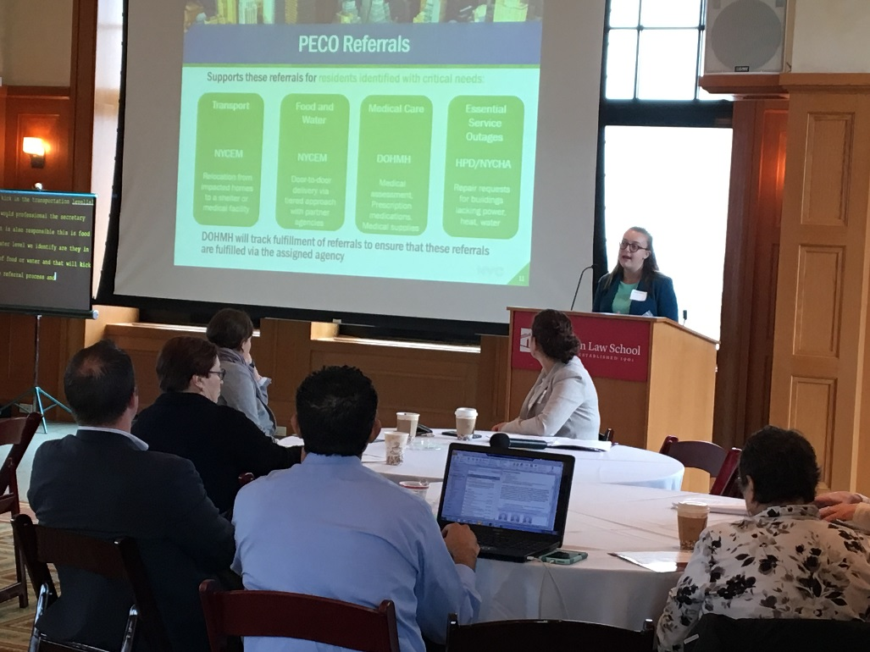
PECO Community Input Sessions
30 organizations participated in three community input sessions
Participants received 10 procedures on interacting with residents with disabilities and access or functional needs
Major themes validated need for shared leadership with community partners in planning and response

Slide 16
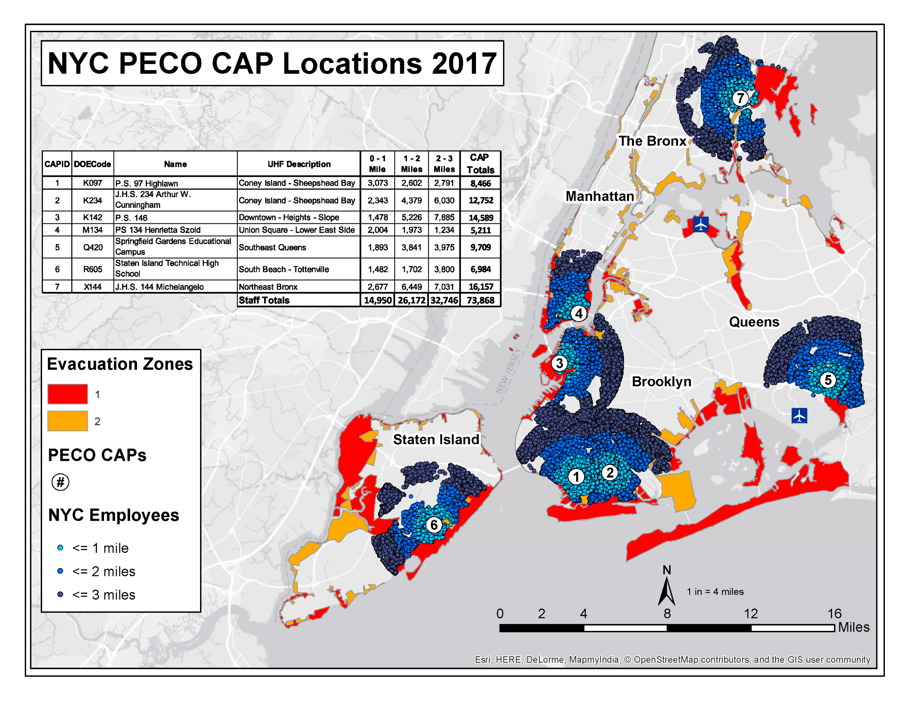
The Potential Field Structure and Scale of PECO
Notes:
The primary source of canvassers will be city employees who have volunteered to work on canvassing teams.
We contacted large pools of employees that live within a few miles of our pre-identified canvassing assembly points (so that they can more easily report if transit is down).
After describing the difficult nature of the work, we asked them if they would be willing to work on canvassing teams, and they said “Yes.”
We supplement these staff with volunteers from established volunteer agencies.
Each CAP is managing up to 20 teams
440 canvassing staff at 1 Canvassing Assembly Point (CAP)

Slide 17
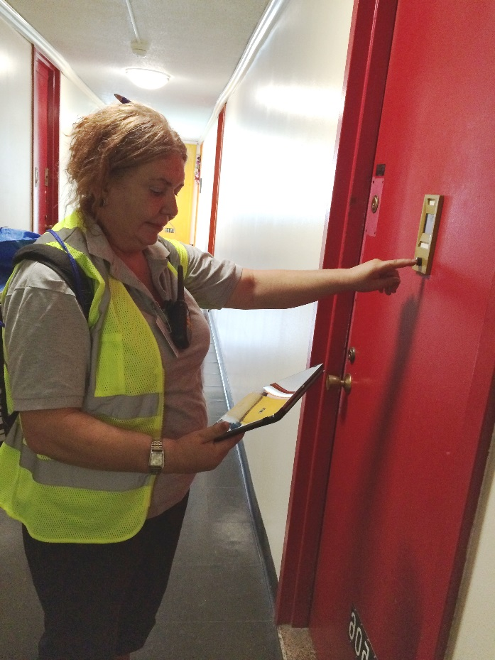
PECO Training
Goal to train 2,000 volunteer canvassers this summer
  Comprised of DOHMH staff, City agency staff, and MRC volunteers
New 3.5 hour training curriculum kicking off this afternoon

Slide 18

NYC Housing Authority
Redesigning annual recertification process including “on the fly” registration
Redesign public postings to advise on emergency protective measures (EPMs)
More efficient public communication support tool
Integrate disability and access and functional needs advisor or advisory panel into planning and operations

Slide 19

DoITT Text-to-911
Interim Text-to-911 to go live in early 2018
DoITT commences Next Generation 911 Project:
  IP-based system that will be able to accept 911 messages via text, images and more

Slide 20
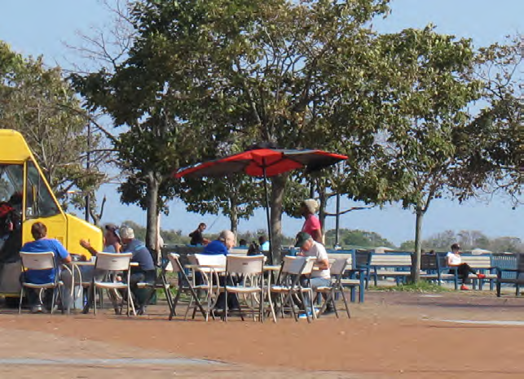
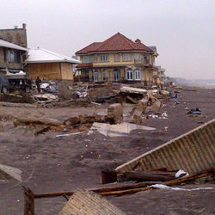
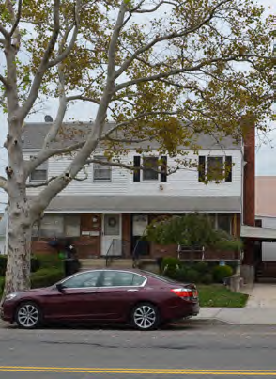
NYS Governor’s Office of Storm Recovery
Community Reconstruction program and NY Rising Community Centers

Slide 21
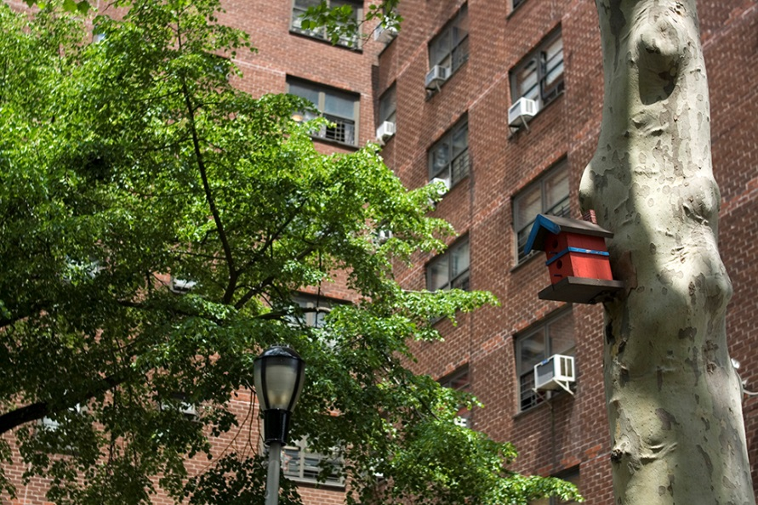

Cool Neighborhoods NYC
MOPD Sandy Recovery Task Force
June 23, 2017
Kizzy Charles-Guzman
Mayor’s Office of Recovery & Resiliency

Slide 22
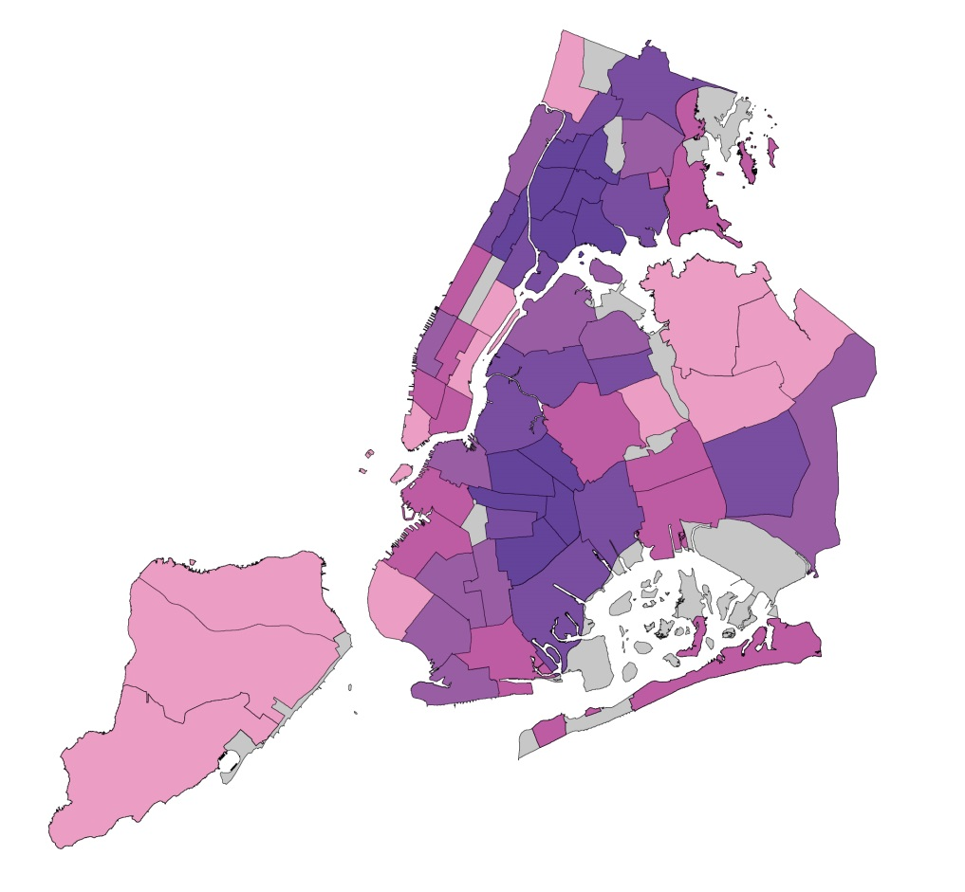
Climate Change/Extreme Heat Threat
Heat kills more New Yorkers than any other extreme weather event, with certain neighborhoods at higher risk.
Heat Vulnerability Index (HVI) for
New York City Community Districts
Top Tier Heat Vulnerable Neighborhoods
CD 316 | Brownsville, Ocean Hill
CD 203 | Morrisania, Crotona Park East
CD 202 | Hunts Point, Longwood
CD 201 | Melrose, Mott Haven, Port Morris
CD 206 | East Tremont, Belmont
CD 303 | Bedford Stuyvesant
CD 110 | Central Harlem
CD 304 | Bushwick
CD 205 | University Hts., Fordham, Mt. Hope
CD 317 | East Flatbush, Rugby, Farragut
Also, there are vulnerable populations living in all of the city’s neighborhoods
Low vulnerability
Low-moderate vulnerability
Moderate vulnerability
Moderate-high vulnerability
High vulnerability
Notes:
Extreme heat kills more New Yorkers than any other extreme weather event, and leads to an average of 450 heat-related emergency department visits, 150 hospital admissions, 13 heat-stroke deaths, as well as 115 deaths from natural causes exacerbated by extreme heat.
The New York City Panel on Climate Change (NPPC) projects up to a 5.7°F increase in average city temperatures and a doubling of the number of days above 90°F by the 2050s.

Slide 23
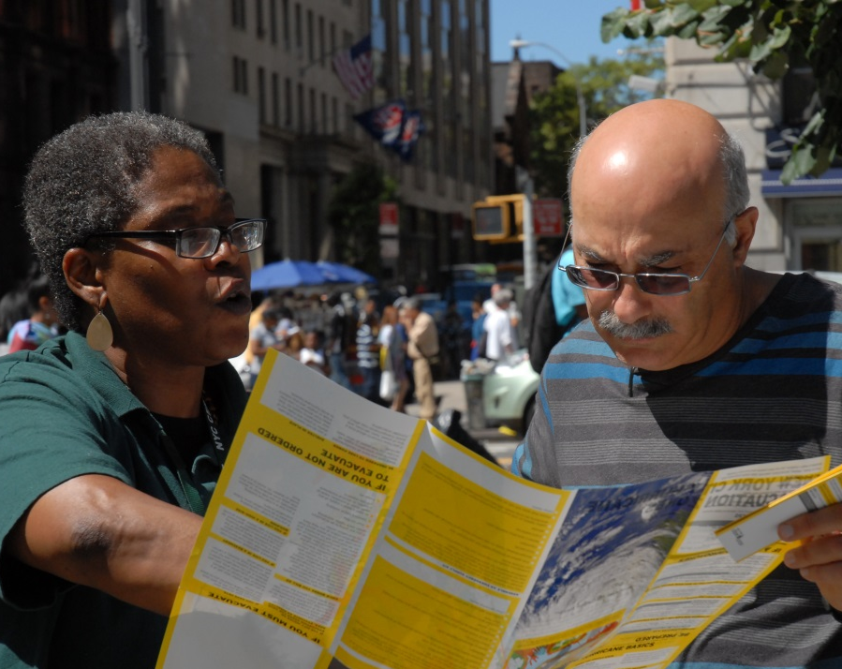
Our Resilient City: Neighborhoods
With OneNYC, city neighborhoods will be safer by strengthening community, social and economic resiliency
INITIATIVES
  Strengthen community organizations
  Improve emergency preparedness & planning
  Support small businesses & commercial corridors
  Ensure that workforce development is a part of resiliency investments
  Mitigate the risks of heat
Notes:
The strengthening of social networks and planning within a community are critical to enhancing resiliency. This can entail building relationships with neighbors as well as the availability of adequate neighborhood gathering and resource centers.

Slide 24

Cool Neighborhoods NYC
A comprehensive strategy to mitigate and adapt to extreme heat and rising temperatures
INITIATIVES
Targeted tree plantings
Targeted NYC ºCool Roofs
Be a Buddy NYC
Home Health Aide trainings
Partnering with news reporters
Collecting innovative data
Notes:
Launching Be a Buddy NYC: The City is launching a two-year, multi-stakeholder pilot to promote community cohesion. Through partnerships with community-based organizations, Be a Buddy NYC will develop and test strategies for protecting at-risk New Yorkers from the health impacts of extreme heat in the South Bronx, Central Brooklyn, and Northern Manhattan.
Partnering with home health aides: The City, in partnership with three home care agencies, will promote heat and climate-health information and engage home health aides as key players in building climate resiliency. The agencies will use their continuing education curriculum to educate nearly 8,000 home health aides on climate-related risks and to recognize and address early signs of heat-related illness.
Partnering with news reporters: The City will host a workshop and will conduct outreach to health and medical reporters and meteorologists to improve the way that New Yorkers receive crucial information about heat and the protective actions they need to take to stay safe indoors, and to encourage caregivers and social contacts to check on vulnerable neighbors, friends and family.
Collecting innovative data: The City will invest in the collection of baseline neighborhood-level temperature information to assess current risk, more effectively target new initiatives in the most heat-vulnerable neighborhoods, and in the long-term, provide baseline data to accurately measure the impact of interventions.

Slide 25



NYC Department for the Aging
Partners in extreme heat – Cooling Centers
THRIVE NYC
Elder Abuse and Caregiver Survey

Slide 26
NYC Emergency management UPdate
Heat Plan
DAFN COOrdinator Training

Slide 27

NYC Heat Plan
Summer 2017

Slide 28
Heat Plan Triggers
Activation Criteria
Predicted HI of 100° F or higher for one day or more, or Predicted HI of 95° F or higher at any point for two consecutive days or more
Excessive Heat Considerations Criteria
Predicted HI of 105° F for any duration, or Predicted HI of 95° F for four days or more
Heat Emergency Steering Committee
Triggered by Heat Advisory issuance
Provides situational awareness
Gather agency specific data and concerns
Discuss near-term and medium-term planning issues

Slide 29
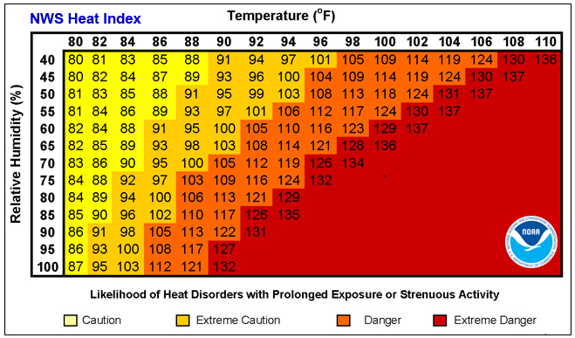

Heat Index and NWS Heat Products
Product | Description
Heat Advisory | Issued within 24 hrs of onset of either of the following conditions: - HI of at least 100° F but less than 105° F for any period of time - Maximum HI of 95° F or higher for two consecutive days
Excessive Heat Watch | Issued when HI is forecast to reach or exceed 105° F for at least 2consecutive hrs in the next 24-48 hrs
Excessive Heat Warning | Issued when HI is forecast to reach or exceed 105° F for at least 2 consecutive hrs within the next 24 hrs

Slide 30


Heat Plan
Operational Strategy 1: NYC Advance Warning System
Operational Strategy 2: Cooling Centers
Operational Strategy 3: Homeless Outreach
Operational Strategy 4: Excavation Safety Alert (Power Disruption Plan and other Infrastructure Protection)
Operational Strategy 5: Spray Cap Program

Slide 31
Heat Plan
Operational Strategy 1: NYC Advance Warning System
Heat alerts are delivered via e-mail to agencies and organizations that have developed trusted relationships with their clients
    Agencies and organizations can tailor communication and support to their client’s specific needs
  1,000 + Organizations
Messages are developed in consultation with the Department of Health and Mental Hygiene and geared toward service provider organizations
Conference Calls are held with pre-identified umbrella service agencies

Slide 32













Heat Plan
Operational Strategy 2: Cooling Centers
Protocols for opening air-conditioned facilities (DFTA senior centers and community centers) to the public
  Operate during daytime hours
  Free and open to the public, air-conditioned facilities
    Libraries, Senior Centers, Recreation Centers Centers
    Run by 8 partner agencies: NYPL, QPL, BPL, DFTA, DYCD, NYCHA, Parks, Salvation Army
  550 facilities available for summer of 2017, find nearest location through:
    311
    Cooling Center finder on Emergency Management website
  Extended Hours – may be considered when forecast of HI 100°F for more than two consecutive days
  Parks may extend pool hours and coordinate with NYPD for increased security

Slide 33







Heat Plan
Operational Strategy 3: Homeless Outreach
DSS, MTA, Parks and Rec, DSNY, 311
Focus on priority list of clients at high risk for heat-related illness:
  Those in vehicles, 65+ yrs, chronic conditions, substance abuse, etc.
DHS Code Red
Level 1: HI reaches 95°F for 6 consecutive hours
Priority list contacted once per Code Red Period
Level 2: NWS issues Heat Advisory
(HI reaches 95-99° F for at least 2 consecutive days or 100-104°F for any length of time)
Priority list contacted twice per period
Level 3: NWS issues Excessive Heat Warning
(HI reaches or exceeds at least 105 °F for at least 2 consecutive hours within the next 24 hours)
Priority list contacted twice per shift

Slide 34

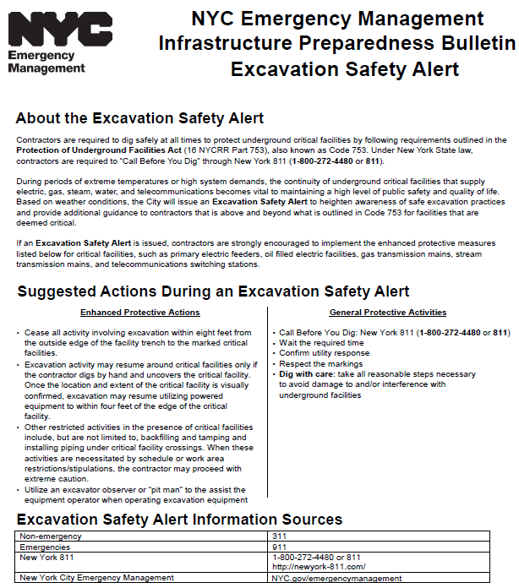
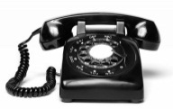

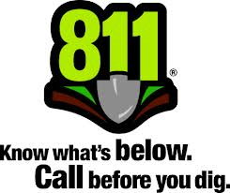












Heat Plan
Operational Strategy 4: Excavation Safety Alert (ESA)
NYC issues an Excavation Safety Alert (ESA) during heat emergencies to heighten awareness of safe excavation practices to protect the integrity of the underground critical facilities
Call 811 two days prior to digging
Wait the required time
Confirm utility response
Respect the markings
Dig with care: Take all reasonable steps necessary to avoid damages to underground facilities

Slide 35




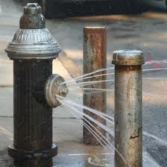
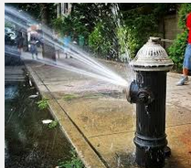

Heat Plan
Operational Strategy 5: Spray Cap Program
Fire hydrants are often illegally opened and used as sprinkler creating drop in system water pressure
FDNY distributes hydrant spray caps to the public
Applicants (+18 yrs old) can complete request form from FDNY firehouses
NYPD may request that FDNY install and turn on locked hydrants in sensitive location
DEP installs custodian locking devices on hydrants which require custodian hydrant wrench to open (FDNY and DEP have these wrenches)
Con Ed may request assistant to unlock hydrants (DEP, FDNY)

Slide 36
Important Emergency Management Issues
Facilitate issuance of Excavation Safety Alert
Confirm homeless outreach efforts with agency partners (Parks, DSNY)
Monitor hydrants, water pressure, and water levels (DEP)
Supply spray caps (DEP, FDNY)
Assess need to extend pool hours (Parks)
Consider increased garbage pick-ups due to food spoilage (DSNY)
Vet resource requests for generators, water, fuel, ice, light towers
Monitor system stability and report partial/full disruptions
Monitor feeder outages, multiple contingencies, next-worst contingencies, voltage reductions, load shedding, ETRs
Assist in dissemination of information about voluntary load reduction
Voltage reduction strategy may impact NYCHA elevators
Impacts on sensitive customers – status of LSEs, hospitals, nursing homes, dialysis centers, seniors, DAFN

Slide 37
Disability and access and functional needs coordinator Training

Slide 38

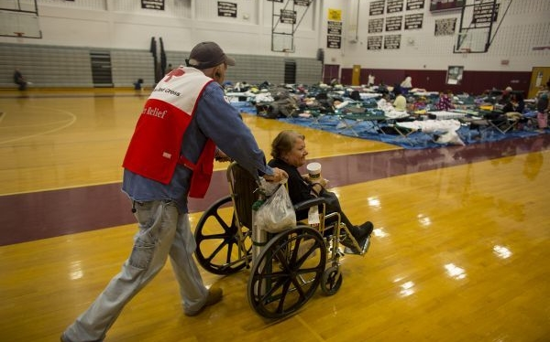
KEY ACCESSIBILITY AND NONDISCRIMINATION CONCEPTS
.
Self-determination
“Case by Case” assessment
Equal opportunity to benefits
Inclusion
Integration
Physical and programmatic access
Equal access
Effective communication
Modifications
No charge

Slide 39
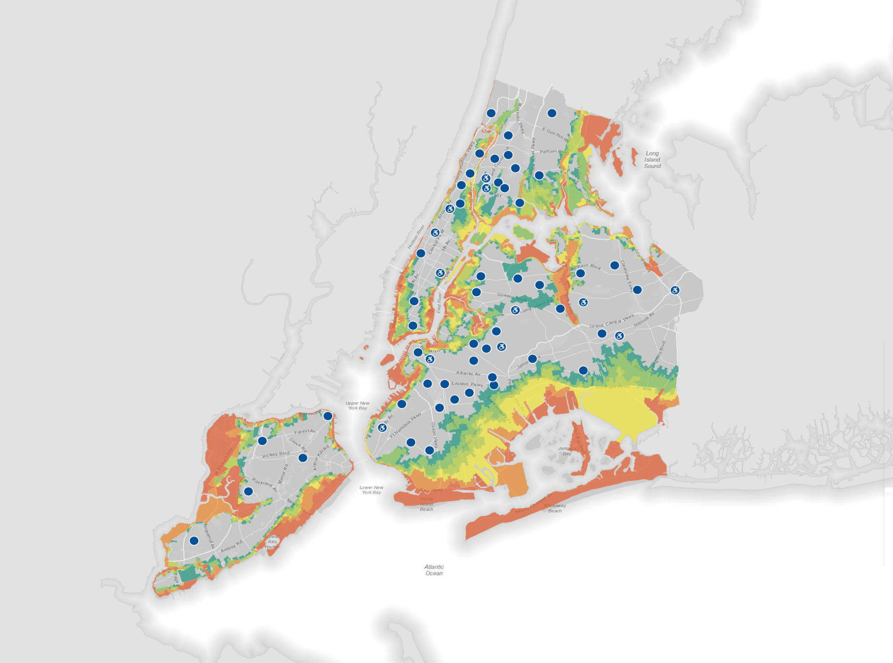

NYC Emergency Shelter System
2.99 million residents within 6 EVAC zones
3.4 million housing units in NYC
1.3 million units lie within 6 EVAC zones
605,000 resident capacity in the shelter system
800,000 residents (estimated) with a disability or other access/functional need
Notes:
Working Group Updates

Slide 40
Service Center Plan
Centralizes economic and social service programs provided by governmental, non-profit, and faith-based organizations
Provides a single facility with all necessary services and latest information:
  Economic relief
  Mental health and spiritual care
  First official contact point for most; can transition into recovery services
Past activations: Katrina DASC, Post-Sandy Restoration Centers, East Harlem Resident Services Center, St. Marks, Elmhurst
Notes:
Working Group Updates

Slide 41
Contacts & Questions
New York City Emergency Management
Chris Pagnotta
718-422-8922
cpagnotta@oem.nyc.gov
Mayor’s Office for People With Disabilities
Eli Fresquez
212-788-2505
jfresquez@cityhall.nyc.gov
Mayor’s Office for People With Disabilities
Christian Valle
212-341-3961
cvalle@cityhall.nyc.gov

Slide 42

Thank You For Attending
Stay Cool this summer

