Slide 1
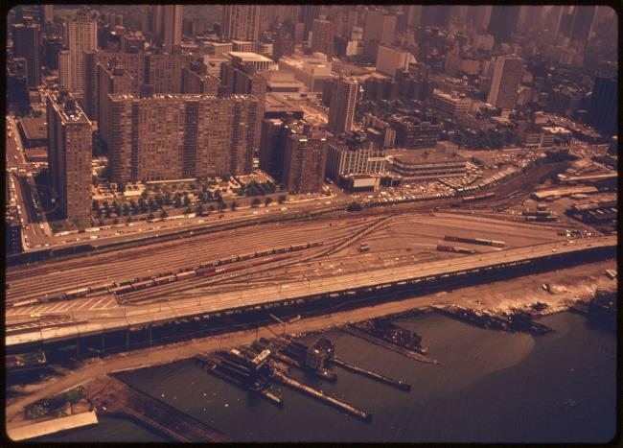
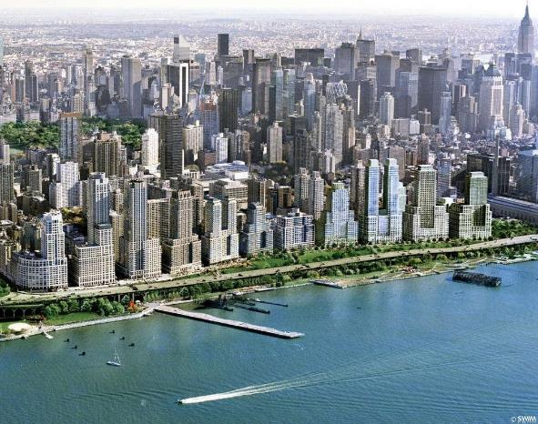
Riverside South and Riverside Center:
A 40-Year Upper West Side Development Story
Ethel Sheffer, FAICP
November 18, 2020

Slide 2
Summary of Presentation
A Description and Analysis of the Development Proposals, Failures, Successes, Politics
An Analysis of Riverside South Development: Process, Approvals, and the Completed Project (1990s)
Community Opposition, Negotiation, Approvals, Planning
Riverside Center - The Completed last segment of Riverside South (2009-)
A 40 year plus development—success? Planning lessons? Community engagement, negotiations, successes?
Notes:
Keep this slide? Edit it if kept.

Slide 3
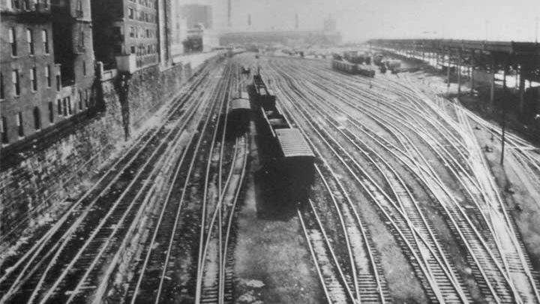

The Site
75-acre Penn Yards Site from 59th-72nd streets along the Hudson River
Notes:
The Site - Formerly rail and freight yard owned by Penn Central (formerly NY Central and Pennsylvania Railroad) which became defunct in the 1960s, because of bankruptcy and decline of industrial uses, Yards abandoned and lying idle in early 1970s.

Slide 4
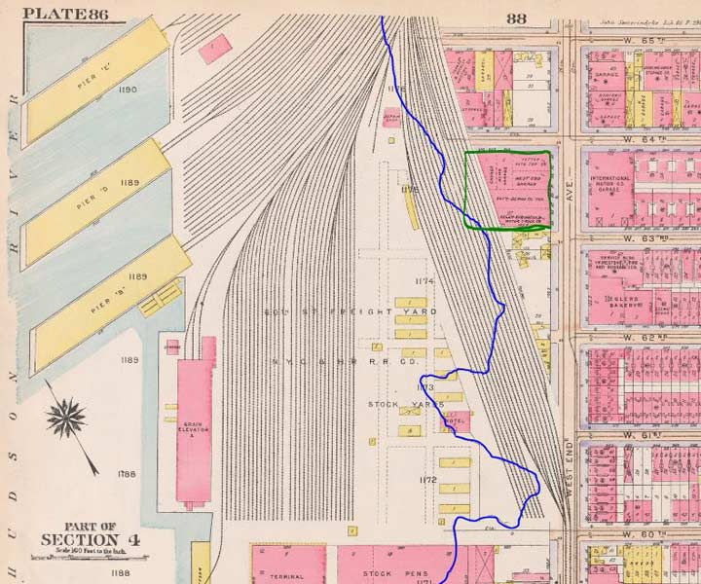
60th Street Freight Yard
Notes:
This 1916 Bromley atlas shows how close the railroad once approached West End Avenue.
Add to this one image some bullets on the building of the rail yards from 19th to 30th c.
Sending separately –brief bullet points on this history

Slide 5
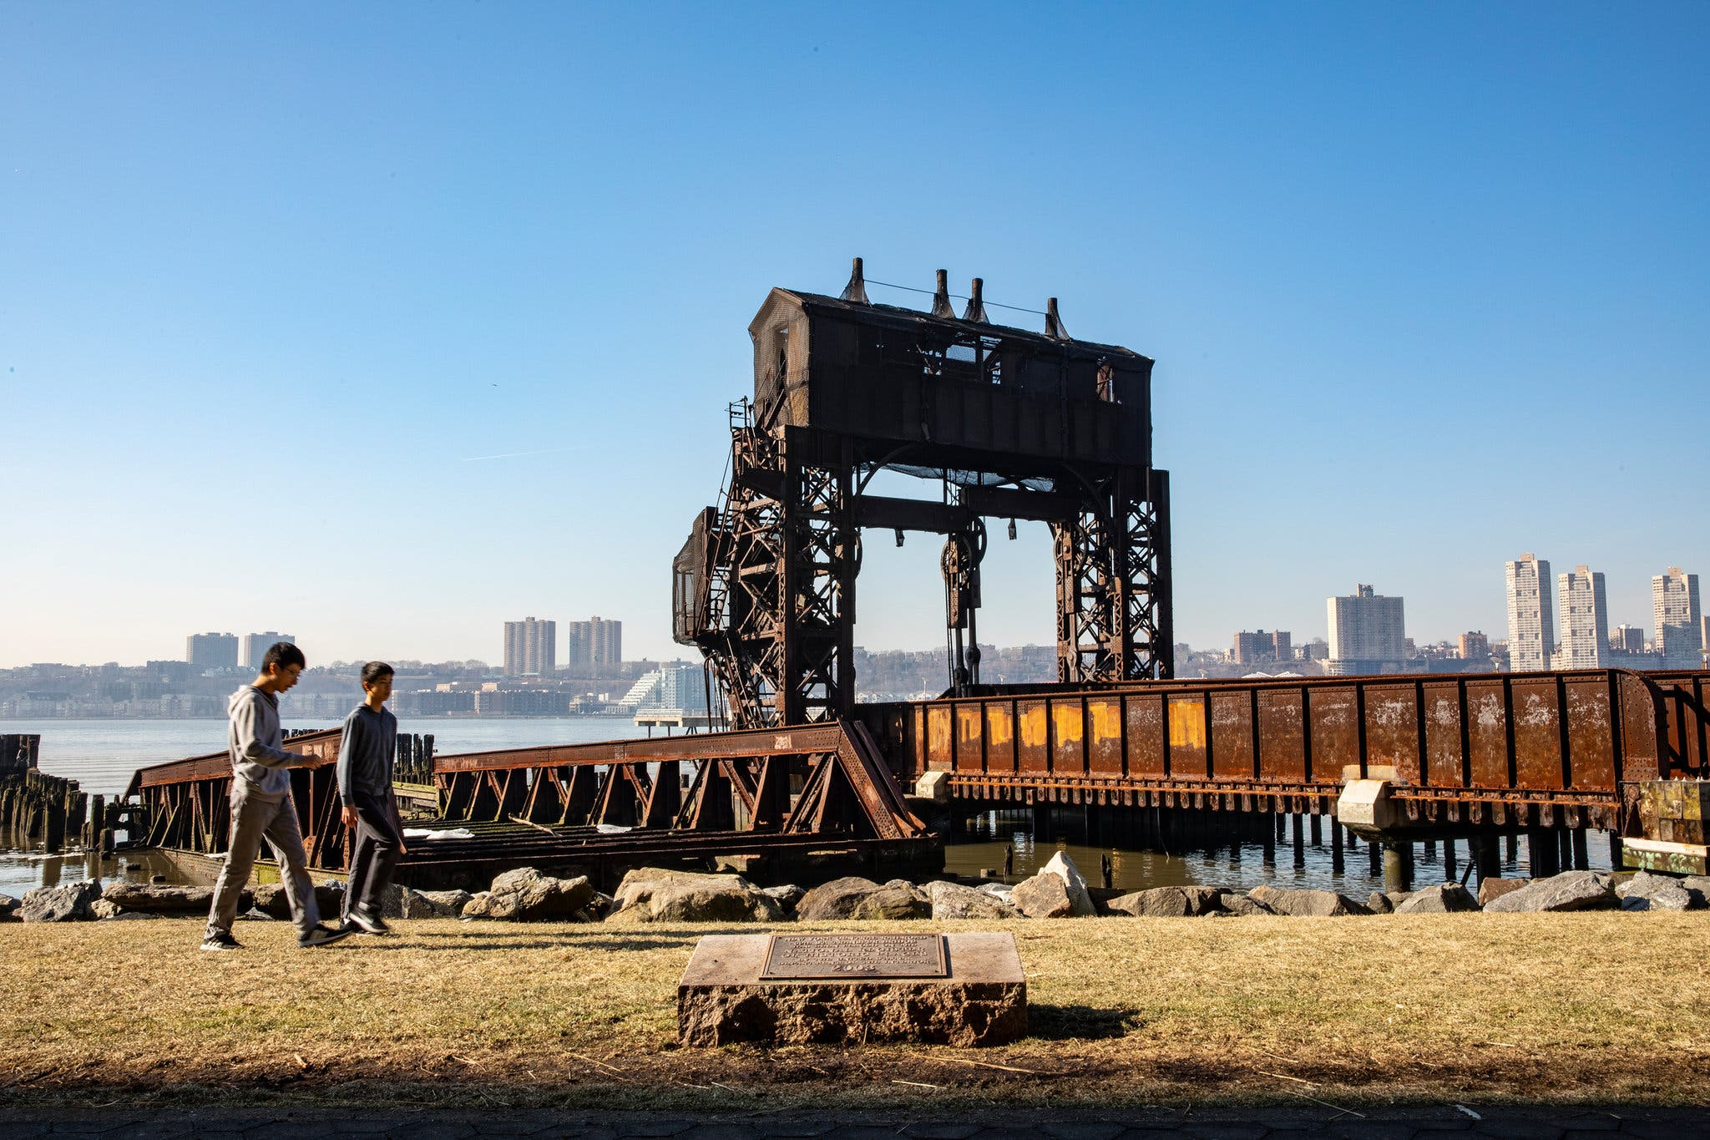
The 69th Street Transfer Bridge (Gantry)
Notes:
New York Central Railroad 69th Street Transfer Bridge
U.S. National Register of Historic Places. 69th Street Transfer Bridge, May 2007
LocationHudson River W of the West Side Highway bet. W 66th and 70th Sts, Manhattan, New York City, New York StateBuilt1911NRHP reference No.03000577Added to NRHPJune 26, 2003
The 69th Street Transfer Bridge, part of the West Side Line of the New York Central Railroad, was a dock for car floats which allowed the transfer of railroad cars from the rail line to car floats which crossed the Hudson River to the Weehawken Yards in New Jersey. Its innovative linkspan design kept the boxcars from falling into the river while being loaded.^{[1]}
After it fell into disuse, it was in danger of being torn down and removed, but around the year 2000, during renovations of Riverside Park, following the example of Gantry Plaza State Park, it became a prominent feature of the park. It was listed on the National Register of Historic Places in 2003.^{[2]}
Similar facilities are in use between 65th Street Yard in Brooklyn and Greenville Yard in Jersey City by the New York New Jersey Rail, LLC, which still operates car floats across Upper New York Bay.
As of October 2014, the New York City Department of Parks is in the design phase of a project to reconstruct, restore and adaptively reuse the 69th Street Transfer Bridge.^{[3]}
^{Add photo of stone embankment?}

Slide 6
Early Development Proposals
1964 Litho City – Kelly & Gruzen – A housing development for 15,000 people, including a pier, heliport and 21-acre park, over Penn Central Rail Yards, which were still in use.
1974 Robert Moses Alternative – A park plan, similar to Riverside South, based on moving the highway east and down to grade. Included 1,200 housing units;, NYS DOT rejected because of cost and Blumenthal Amendment that buried highway might alter Riverside Park.
1975 Trump Organization I – Gruzen & Partners – A housing development again based on moving the highway east and down to grade but with the housing east of the highway.
1977 Trump Organization II – Gruzen & Partners – A housing development with the same program as the 1975 proposal, but with highway remaining in outboard location.
1982 Lincoln West – The Gruzen Partnership/Rafael Vinoly – A 7.3 million square foot development with 4,300 housing units and commercial development. Highway was left in current location. *(Rezoning and Public Approval)
1986 Television City – Murphy/Jahn – A 16.5 million square foot development with 7,600 housing units, 1.5 million square foot commercial tower (world’s tallest building), 152 stories and 17 story TV studio.
1990 Trump City – Alex Cooper – A 14.5 million square foot development with 7,600 housing units, 3.7 million square foot of office space, a luxury hotel, 1.5 million square foot retail, 875,000 sq. ft. in super-regional shopping mall, the world’s tallest building reduced to 136 stories.
Notes:
Penn Central sells; move to (early) proposals for new uses

Slide 7
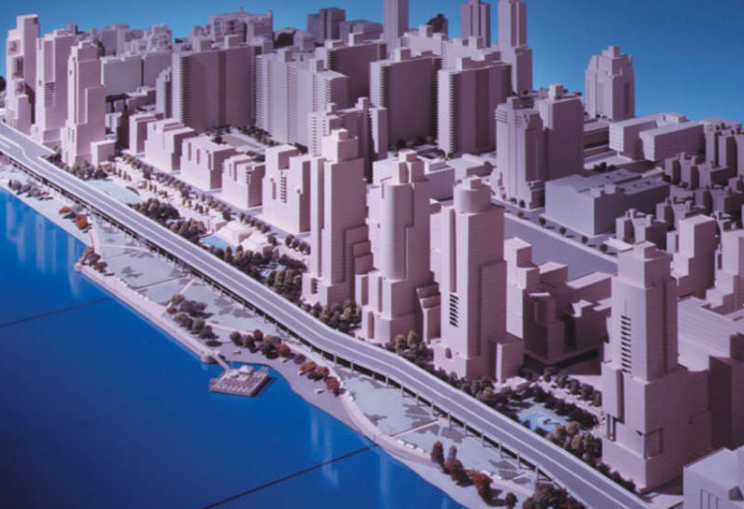
Lincoln West, 1980-84
The Macri Group, an Argentine company, bought the property in partnership with investor Abe Hirschfeld in 1979, who had been given purchase option by Penn Central
The initial proposal was for 4,850 units spread across 8 towers and a number of other smaller buildings, a 500-room hotel, and 1 million sf of commercial and office space
September , 1982, Board of Estimate approves the rezoning of site from industrial/manufacturing to residential/commercial uses in 1982, final approval of 4,300 units, 7.3 million sf and retail and commercial uses (hotel gets eliminated and floor area reduced during ULURP)
Community Board 7 engages several legal and technical consultants bringing it into conflict and negotiation with Department of City Planning; community opposition and lawsuit against the proposal; CB7 disapproves the proposal in ULURP
Notes:
give a sense of how many years it has been under review; unusual process; rezoning; community feedback (opposition and board of estimates), design guidelines//(image, reproduce cover or title page of West Side Futures)
CB 7 continues negotiation with DCP and developer and creates MOU on design guidelines and process, height, distribution of bulk importance and access of waterfront park, and developer agrees to privately funded and maintenance of public park (a precedent)

Slide 8
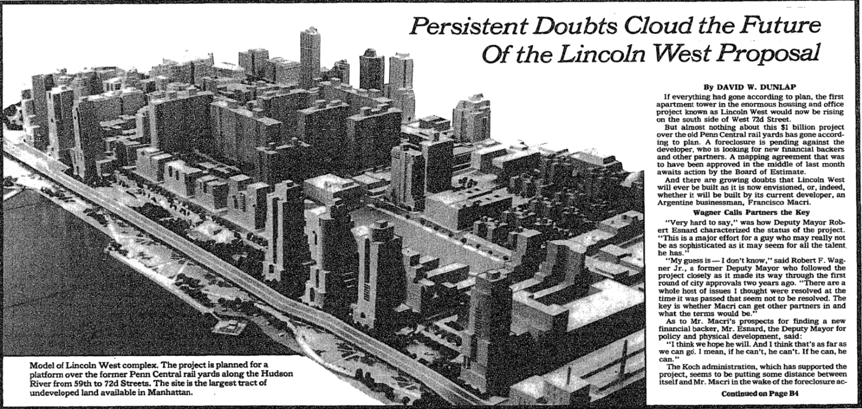
Lincoln West, 1980-84
Community groups bring suit on density, inadequate environmental alternatives, procedural criticisms; delay for 18 months until Court of Appeals rules against the community groups, and in favor of the plan moving forward
Another issue raised by Jerrold Nadler, “TOFC” or transfer point for trailers between railroad cars and highway trucks; another ULURP, and TOFC eliminated, manufacturing declared incompatible with developing housing, and need for new investments
CB 7 attempts to continue negotiation with DCP and developer and creates MOU on design process; also Board continues long-range planning process later into the 1980s with 1987 West Side Futures planning study of the district and of the Penn Yards site
Long delays of the process, financial difficulties of developer, results in loss of the option and Lincoln West is never built

Slide 9
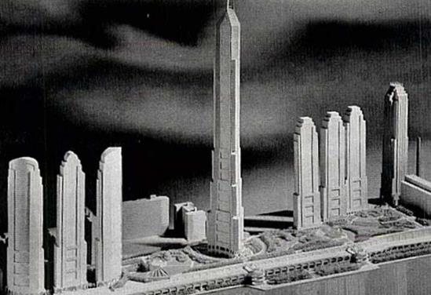
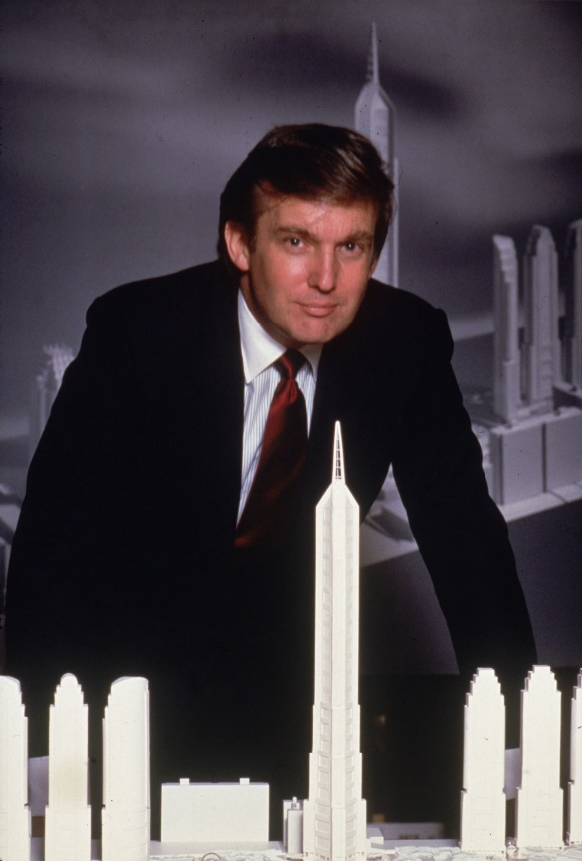
Television City, Trump City 1985-87, 1990
Trump gains ownership of the rail yard site in 1985 for $100 million.,
Later variation of this proposal, designed by Alex Cooper for 14 million sf, 7,600 apartments and regional shopping mall, does not go forward
Major opposition from community, civic groups and Mayor Koch who states opposition to size, tax abatements and zoning waivers
Banks begin to restructure financing for Trump organization for potential new smaller plan after failures of these plans
Notes:
Quotes of bickering between Mayor Koch. Alex Cooper (excellent reputation) ; NBC withdraws from the proposal
What gets attempted
NOTE: Television City rests upon alleged plan that NBC moving from Rockefeller center, to create a who new studio (mention it, but later the implications result in a different plan)

Slide 10
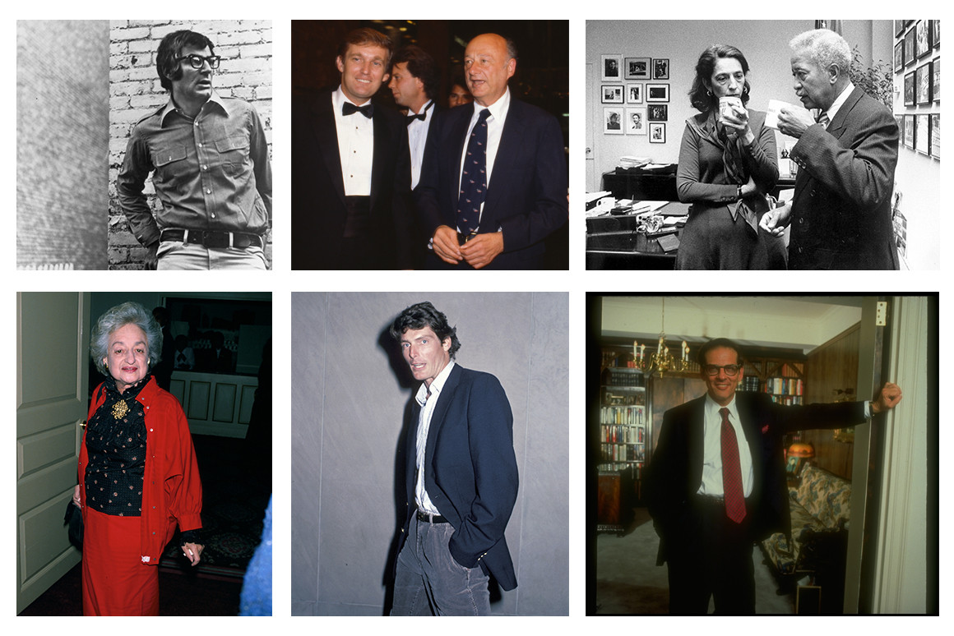
Community Opposition and the Beginning of Civic Collaboration
Trump City and TV City were stopped by opponents on Upper West Side and within government (Koch, Nadler) who all opposed the size and design of these proposals and Trump himself; Koch refuses public funding and tax abatements and supports NBC to stay in Rockefeller Center
In 1990, banks restructured Trump’s 2 billion dollar loan and deferred payment on another 200 million dollar loan
Banks and continued political and community opposition, and celebrity opposition to Trump’s mega plans encourage Trump to join with previous celebrity and civic opponents, “converted enemies to allies”, and civics propose smaller, more “popular” plan
The 6 civic organizations become partners with Trump and the proposed development changed to Riverside South
Notes:
Among the Upper West Side Resistance Top row, left-right: journalist David Halberstam; Mayor Ed Koch, with Donald Trump; local political leader Ruth Messinger, with Mayor David Dinkins. Bottom: writer Betty Friedan; actor Christopher Reeve; author Robert Caro.

Slide 11
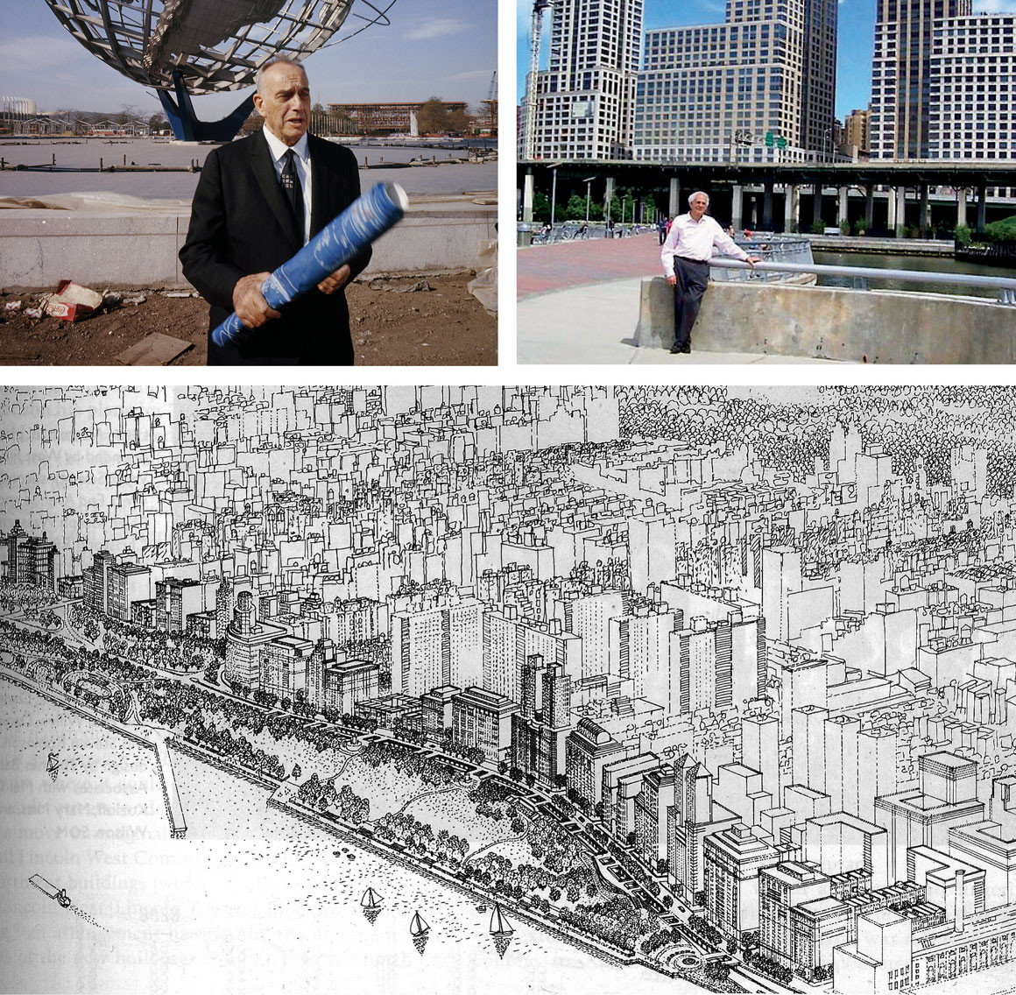
Riverside South Planning Corporation, and the Willen-Gutman Sketch, RSPC Initial Plan
In 1991, Trump organization joins with group of civic organizations to form Riverside South Planning Corporation (RSPC) to develop criteria for the site
RSPC included: Municipal Art Society, Regional Plan Association, The Parks Council, the Riverside Park Fund, Westpride, Natural Resources Defense Council and New York League of Conservation Voters
Based on a “civic” alternative plan prepared by Daniel Gutman, an environmental planner and Paul Willen, an architect
Proposed a 23-acre park (extending Riverside Park south) and removing the Westside Highway, relocating east to grade and buried
This would create a curved Riverside Blvd above grade the relocated highway, with the park sloping down to the river;
A new ULURP proposal
Notes:
Attractive proposal and garnered much support; Sponsored by the good groups and Trump accepts the former opposition to become his partners and to win approval
But, and reference charrette, this sketch depicts 6 million sf and Trump proposes more than 8 million
This sketch proposal extended Riverside Drive, created a 25-acre park, lowered heights of new buildings. However, the Charrette pointed out that the sketch showed a smaller project (6.2million sf than Trump had been proposing and less than what had been approved for LW)
With a voluntary agreement between RSPC and the Trump Organization.
Unique that a group of the most honored, excellent organizations in NY – Municipal Arts Society, RPA – challenged the project, and created the RSPC with the major goal to reduce the density and look ahead suggesting plan for NY’s future – make a wonderful park and get rid of the highway
Important– use the willwn, Gutman sketch in Slde 12 in this photo instead of this one

Slide 12
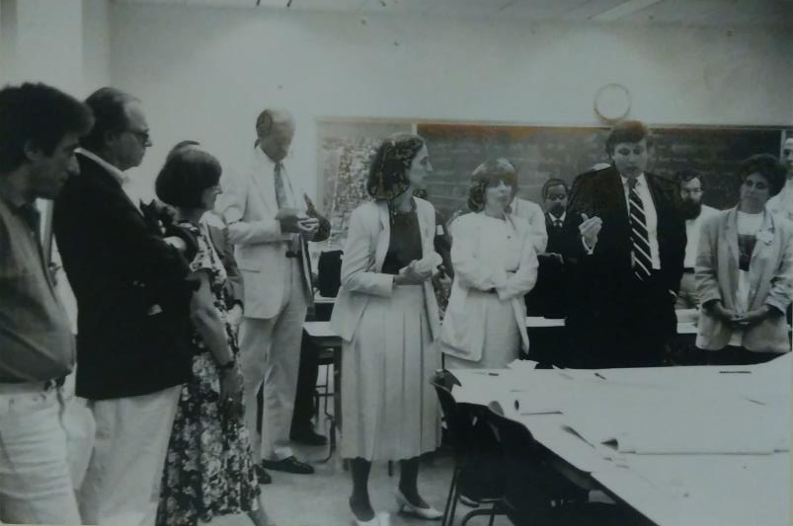
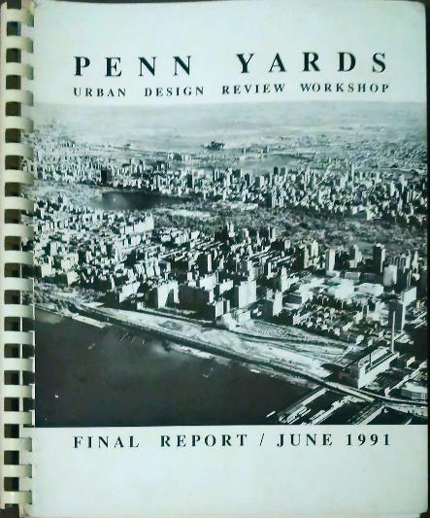
Manhattan CB7, Manhattan Borough President Planning Charrette, organized by Lance Jay Brown (1991)
Notes:
RM (borough president) tries and help the community ; community opposition to the size of the project and the lack of affordability in the housing units (strains on the subway and infrastructure); RSPC/Trump on way to approval, but RM funds this extraordinary effort; team from outside NY; fix the images!

Slide 13
Riverside South Charrette
The charrette strongly informed MCB7’s ultimate resolution and report on the 1992 ULURP. Key points were:
6.9 million SF for the entire site, including 5.5 million SF residential
20% affordable housing
Mapped public streets
25-acre mapped public park, including provision for active recreation uses
Partial developer funding for the West 72nd Street and West 66th Street IRT subway stations as mitigation for transit impacts
Disapproval of any superblock on the site between West 59th and West 61st Streets
Disapproval of the then-proposed TV studio use and any potential large-scale retail mall on the site between West 59th and West 61st Streets
3,500 parking spaces for the entire site, primarily for residents
Need for a public school
Variety of concerns expressed about infrastructure and impacts of the project
General support for the relocation of the highway, but “only to the extent that the 80% Federal and 20% New York State shares do not diminish funds for other transportation projects, both highway and mass transit, planned for New York City.”
Notes:
Community was disapproving of the civics
This was an unprecedented and stunning effort by Community Board

Slide 14
City Council Approval, 1992
The City Council’s ultimate approval of Riverside South included these major elements, memorialized in the Riverside South Restrictive Declaration:
General Large-Scale District, including 15 development parcels A-O) with a maximum of 7,899,951 SF (vs. 8.3 million requested in the application and 6.9 million recommended by MCB7), including a mix of residential, community facility, office, cinema, retail.
Sites L,M,N, maximum 1,690,00 sf, including residential , office, retail, possible studio; any changes to approved uses would require a new ULURP
Maximum 5,700 residential units for the entire site
A minimum of 12% of the number of housing units to be built by the developer as affordable, with provision for efforts to be made to meet the desired goal of 20% affordable units of the total number of units, if government programs were available
Developer to construct Riverside Boulevard from West 72nd to West 59th Streets
Mapped public waterfront park of 21.5 acres, with another 4 acres of accessible open space inland
Two alternatives for the waterfront park (i.e., with the Miller Highway in place and with the Miller Highway relocated below grade)
Developer funding for part of the costs for the rehabilitation of the West 72nd Street and West 66th Street IRT subway stations
Maximum 3,500 parking spaces for the entire site
Space to be set aside for a public school, but no specific provisions for design or funding
Money for 72nd Street subway station
Notes:
Civics //park . LMN lots takes until 2010. Claire Schulmanan]. List of developers
Charette – Community had help of architects, and formed basis of CB7 ULURP

Slide 15
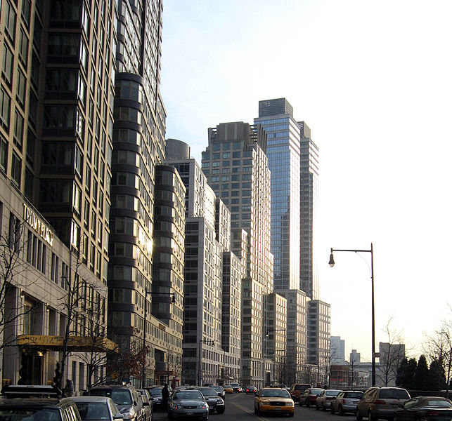
The Long Construction and Development Story, 1994-2010
A depressed NYC real estate market in the early 1990s, and resolution of a variety of litigations based on community opposition, delays the start of construction until 1997
Trump sells controlling interest of the project to a consortium of Hong Kong - investors called Waterfront Associates in June 1994. This joint venture finally put in motion the largest private development project in New York City history at that point.
Trump remains public face, but he is not in control
The name “Trump Place” is placed on three buildings but later removed in 2016
During the next years, Chase Bank sells the remaining parcels to Extell and Carlyle Group, which develop several condo buildings on the site, including the Avery, the Rushmore; Rental buildings are sold to Equity Residential, estimated 8-10,000 residents in 2012
Most buildings house high end apartments and residents: for many years retail spaces are not developed and remain empty
$0 Riverside Boulevard and separate entrances for affordable housing residents

Slide 16
The Long Construction and Development Story, 1994-2010
Overall, the project consists of 19 apartment buildings and the area begins to be called “Riverside Boulevard” after its main street and long , narrow shape.
6,691,505 SF total development
4,492 residential units (projection includes Building K) of the 5,700 maximum units originally approved
583 affordable units (i.e. 13% of units up to 2010 so far) , see map
2,611 parking spaces
,
Notes:
Make sure to emphasize the complexity of developers, exchanges being made

Slide 17
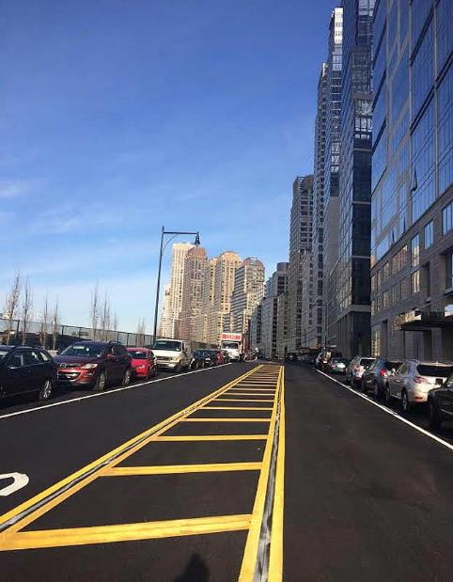
Riverside Drive

Slide 18
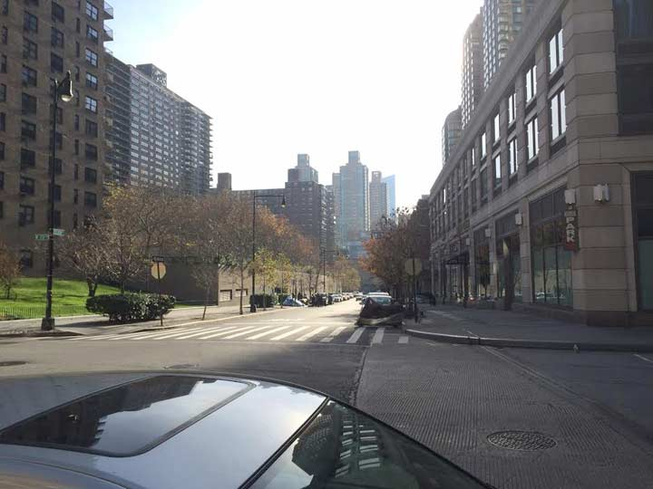
Freedom Place

Slide 19
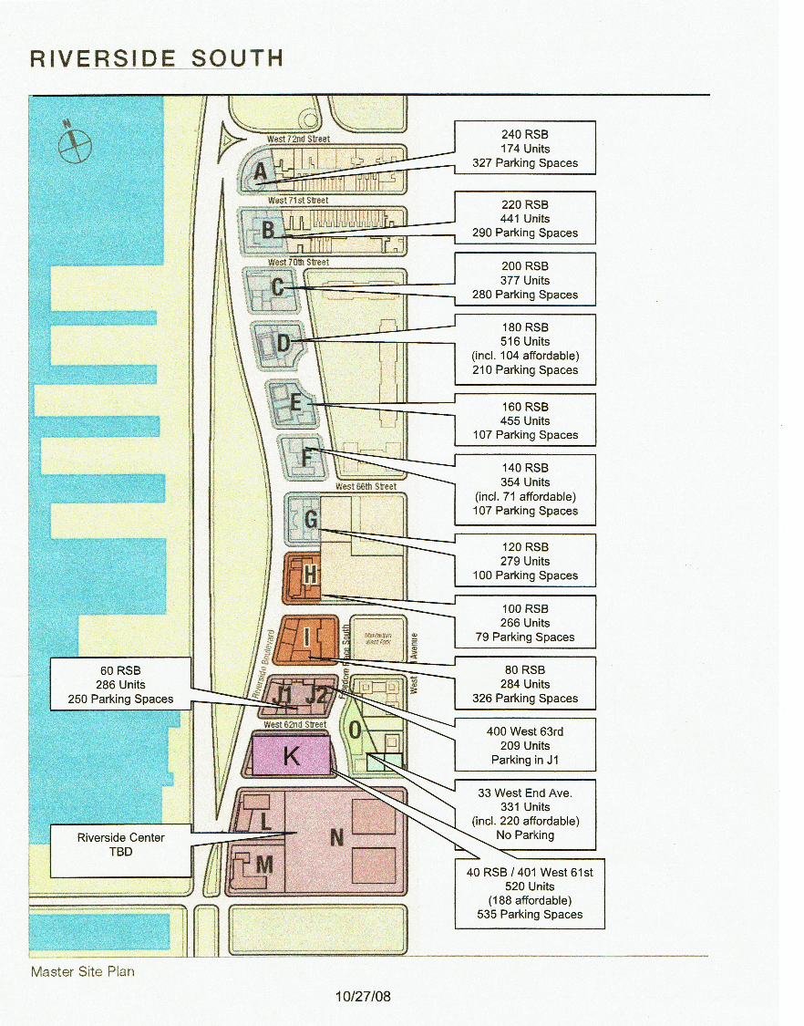
Approved Site Plan
L, M, & N buildings require another ULURP
Final master plan (with SOM) is approved without television studios (59-61st southern L, M & N block tbd)
Final total project size was 6.1 million SF + 1.8 million possible SF on the southern blocks
Project is built over the course of the following 10+ years
Extell acquires several properties as part of the approval
583 affordable units as of 2009, 13%
40 Riverside Boulevard and separate entrances , “poor doors”
Collegiate School , Building K, and off site affordable housing
Notes:
Proposed a largely residential plan of 8,300,000 sf, public waterfront park to be paid for by the developer, and eventually funds for the 72nd St, subway station, 12% of the units for affordable
LMN (Riverside Center) not approved/built until 2011/2012

Slide 20
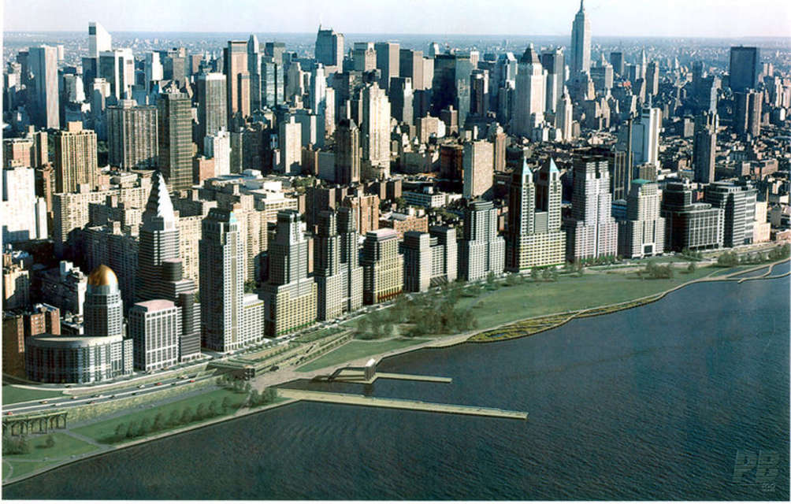
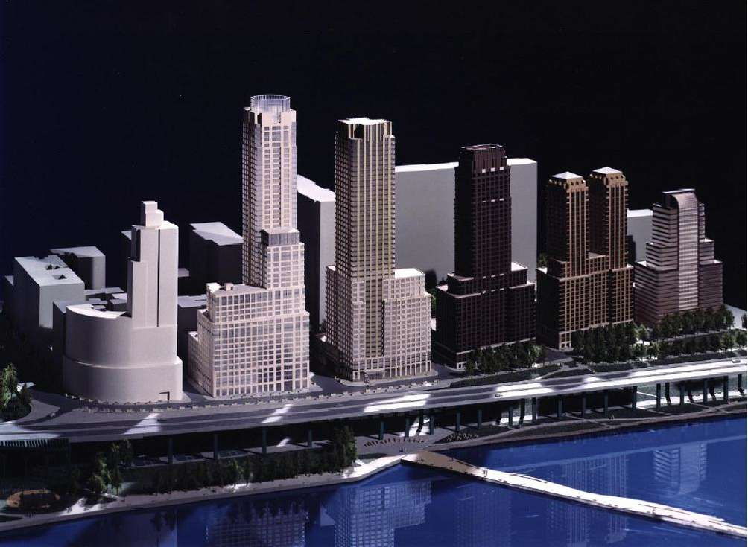
Design Guidelines and the Buildings
SOM’s proposal was intended to evoke Central Park West 1992
But that is not what ultimately was built…
Costas Kondylis becomes the master architect for the development and changes occur in the completed buildings
Notes:
SOM = Skidmore Owens Merrill

Slide 21
Riverside South Park
Largest public park developed in decades and significant addition since Central Park
Built on private land paid for and maintained by developers, turned over to City; Restrictive Declarations; Riverside South Planning Corporation and agreement with NYC Parks Department; Designed by Thomas Balsley and Associates,
Begun 2001,six phases of construction, over 20 years
Park designed to be built and connected to Manhattan street grid
Passive and active uses and access to river via variety of levels

Slide 22
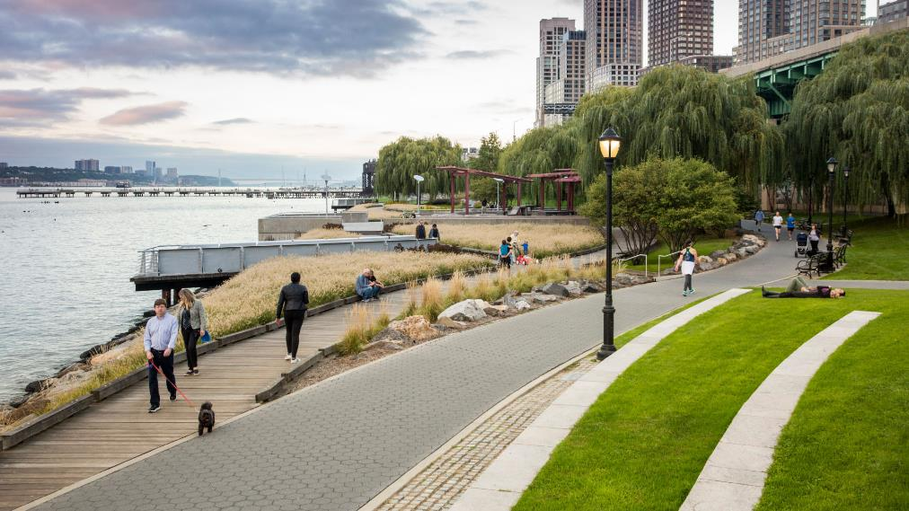
Riverside Park

Slide 23
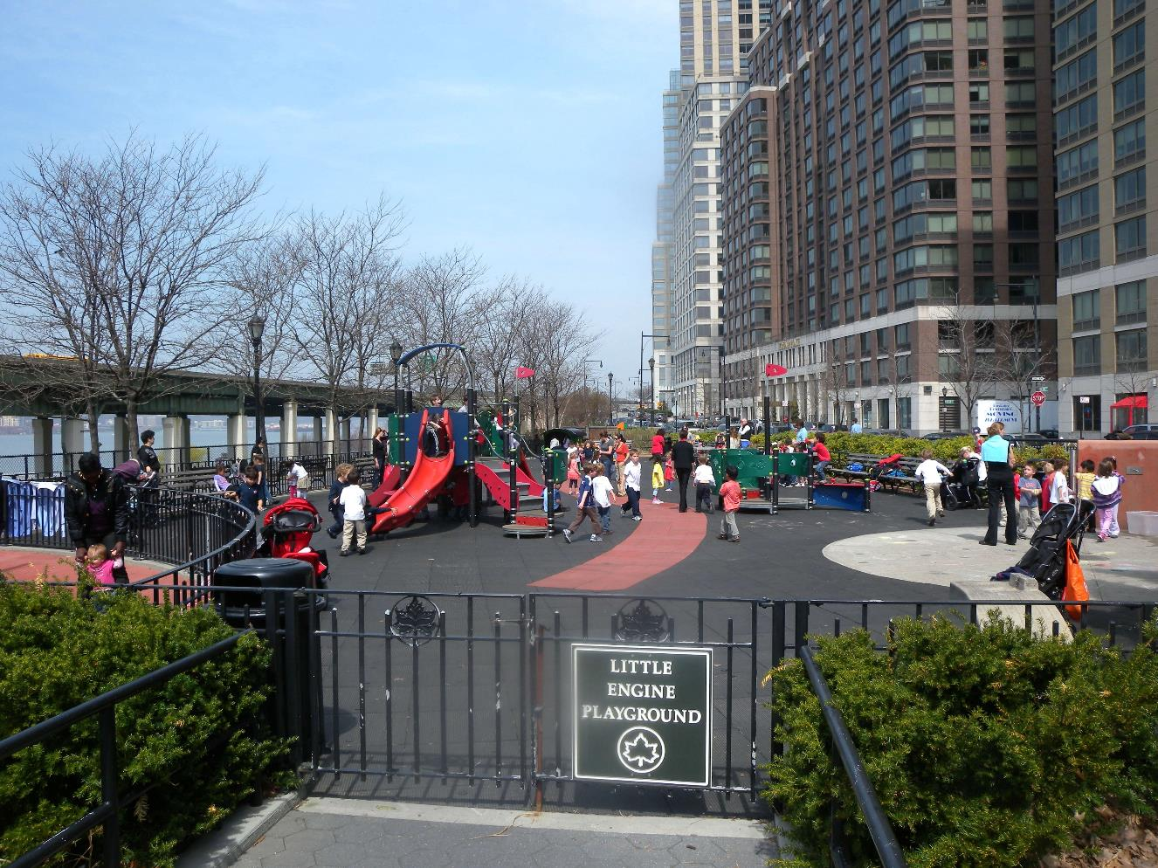
Riverside Park

Slide 24
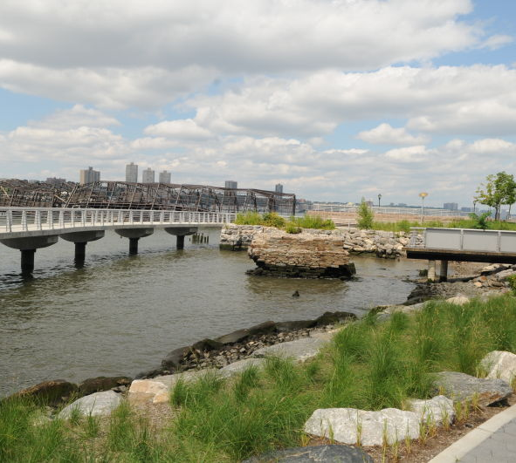
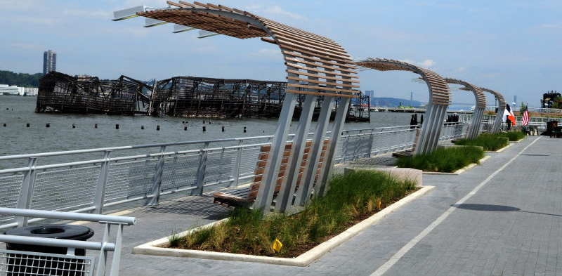
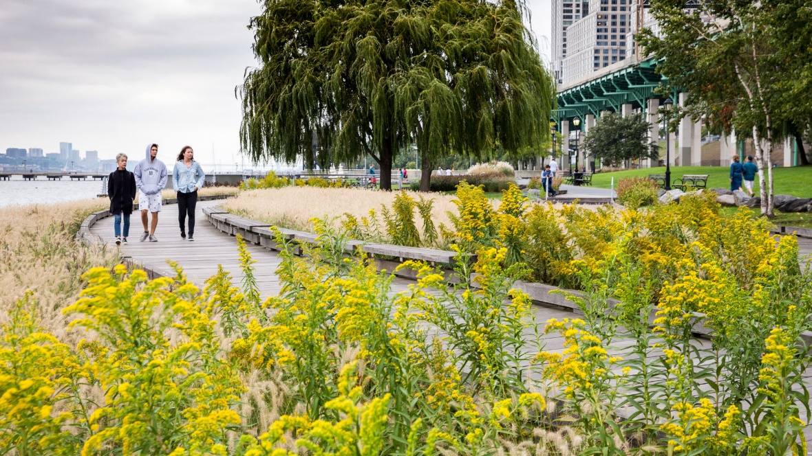

Slide 25
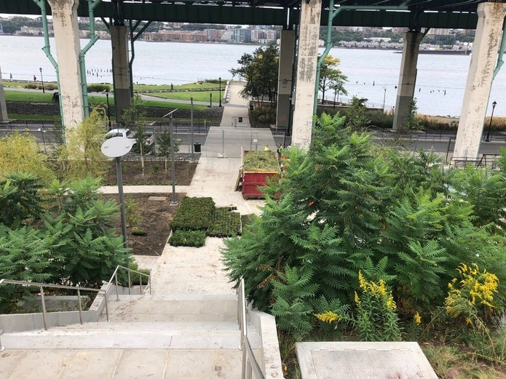

Slide 26
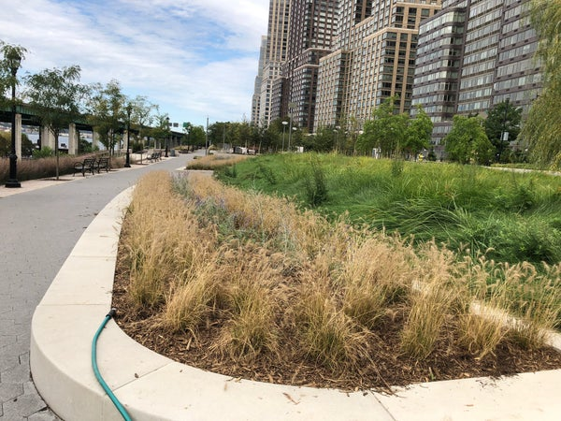

Slide 27
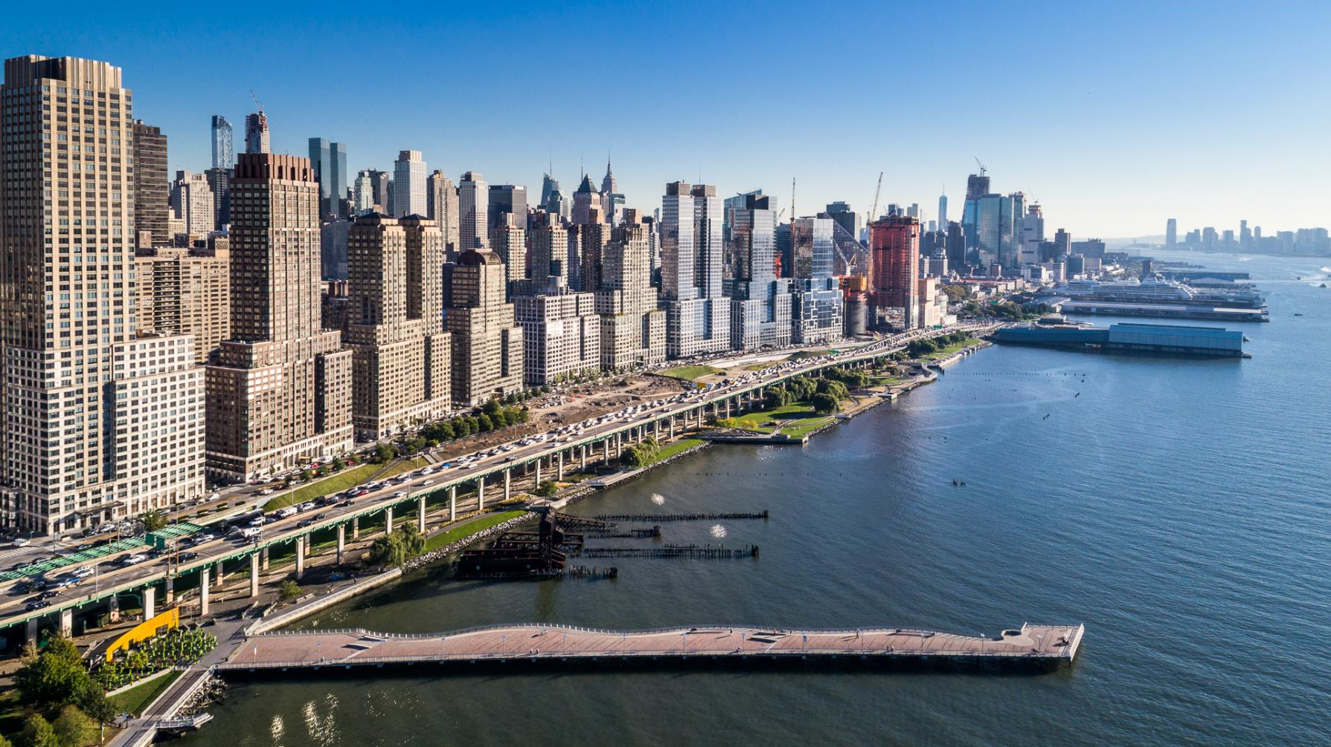
Riverside South, Riverside Park

Slide 28
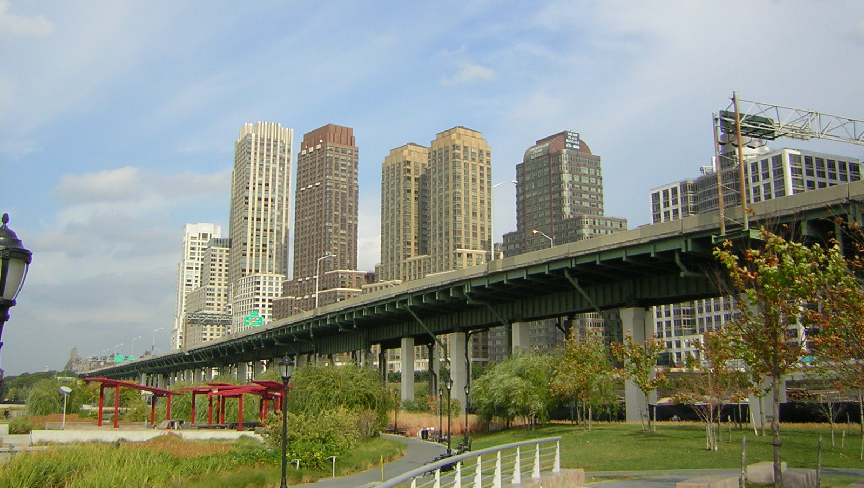
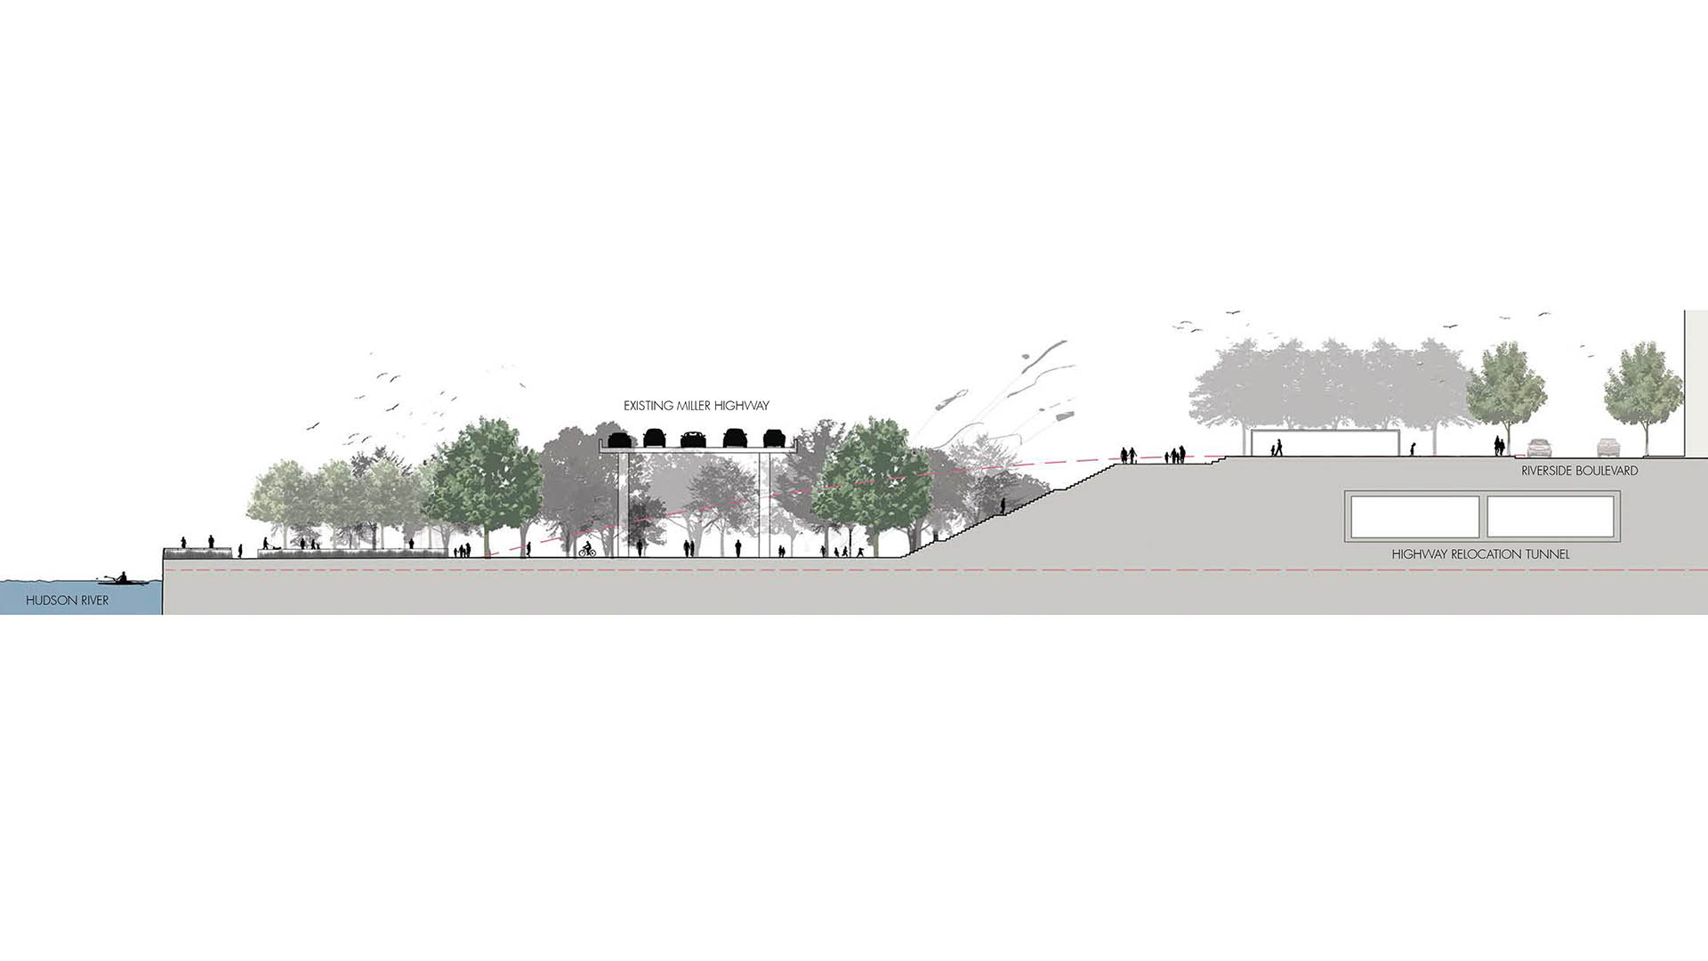
Miller Highway Relocation
Agreement between the developer and the civic organizations (RSPC) to bury the highway was never legally enforceable.
The Federal Highway Administration in 2001 approved the plan for relocating the highway to grade, enclosing it in a tunnel under the new Riverside Boulevard.
Federal monies for the relocation never materialize.
In 2006, Extell begins construction of the northbound lanes between 61st and 65th Streets but it remains unfinished.Balsley redesigns park into 3 distinct experiences. The NYS DoT and Federal Highway Adminsitration has refused to allocate any funds for the relocation of the highway.
Notes:
Riverside South starts

Slide 29
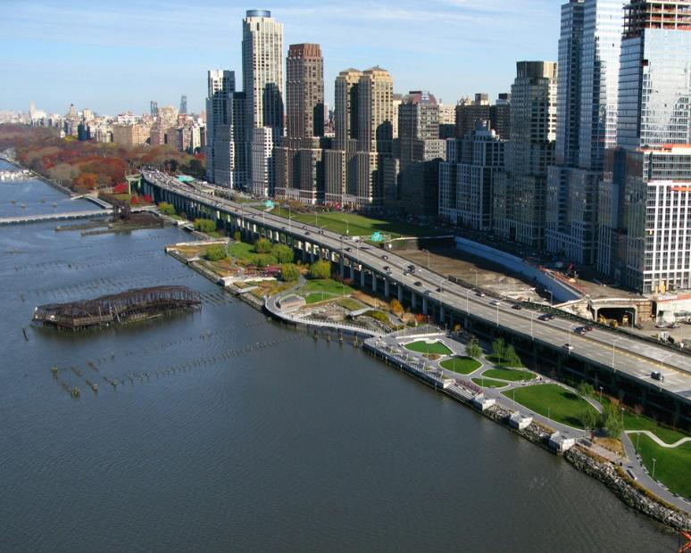
Miller Highway Relocation
Notes:
NOTE: The accompanying text is in the document called “RSC_RSPC”

Slide 30
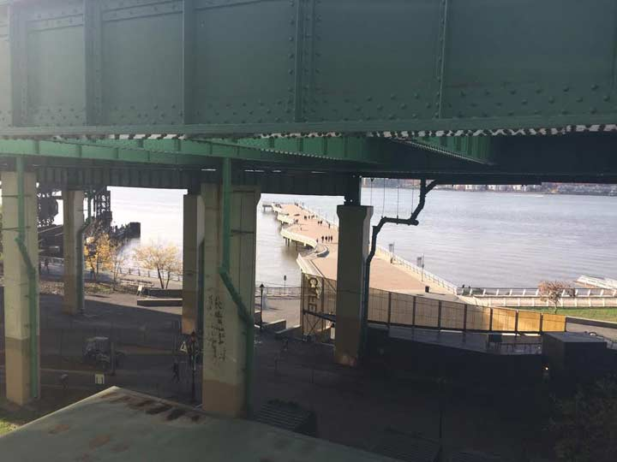
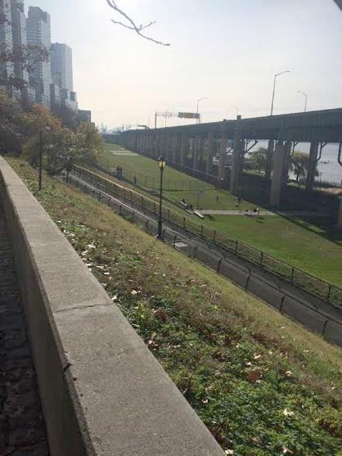
Miller Highway Relocation

Slide 31
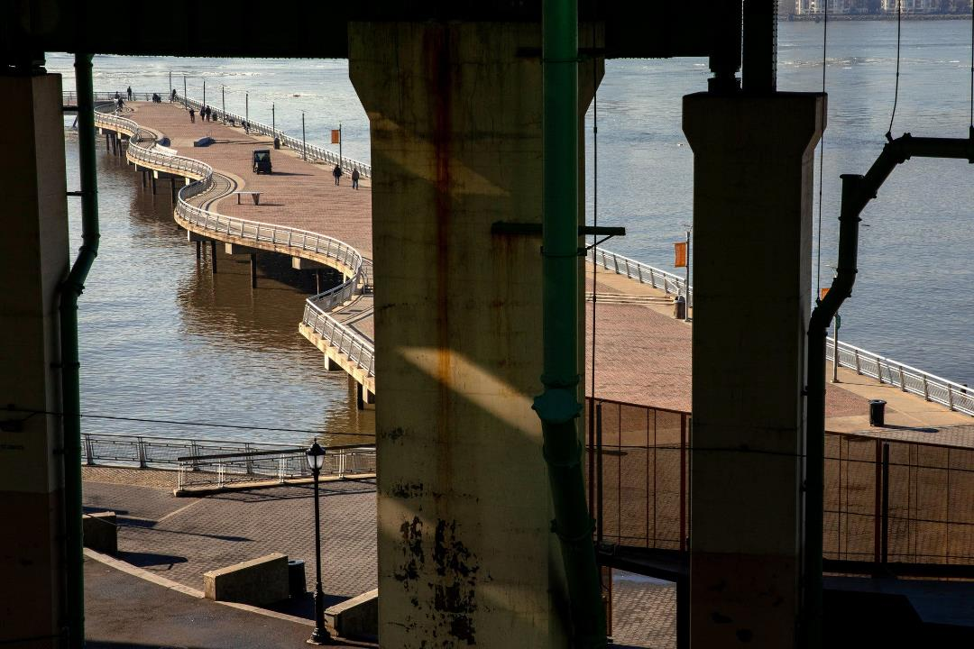

Slide 32
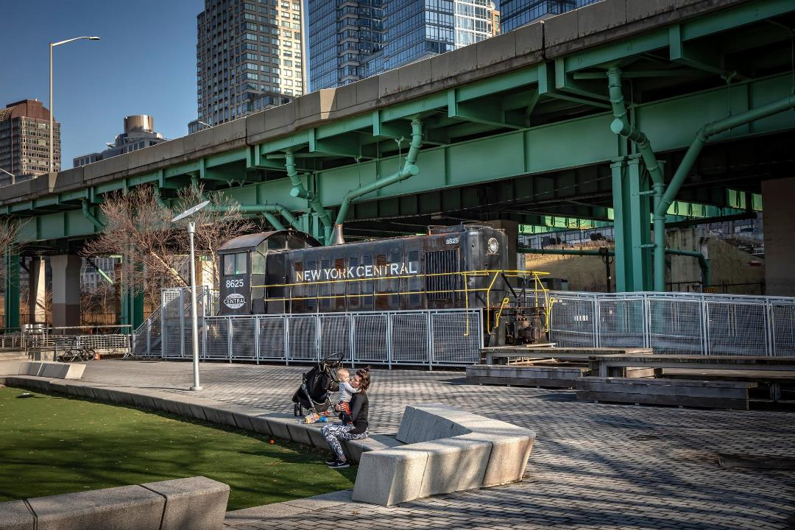

Slide 33
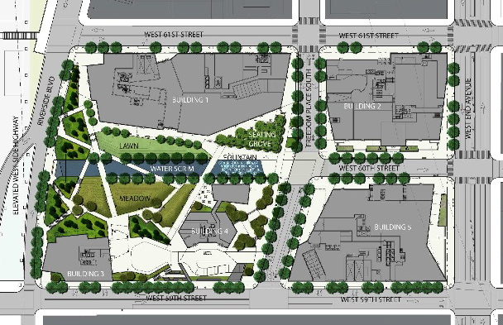
A New ULURP (2009), Extell and Riverside Center
Extell’s Application:
Luxury Condos and Retail
3.1 Million Square Feet
5 Buildings / 6 Towers
2500 - 3000 Residential Units
1800 Parking Spots
20% Affordable Housing (of FAR)
2.75 acres of publicly accessible open space
On-site public elementary school
No Television Studio

Slide 34
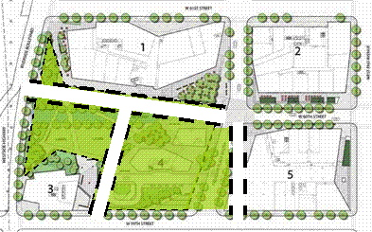
Site Plan Comparison
PROPOSED EXTELL PLAN:
PROPOSED MCB7 MODIFICATIONS:
• Elevated on a platform
• Limited/truncated circulation
• Fragmented/over-shadowed open space
• Enclosed and private-seeming
• Extend 60th St. through the site
• Make public space open, sunny, useful and visible from the sidewalks
• Remove/reconfigure Building #4

Slide 35
CB7 Critique Prior to Approval

Slide 36
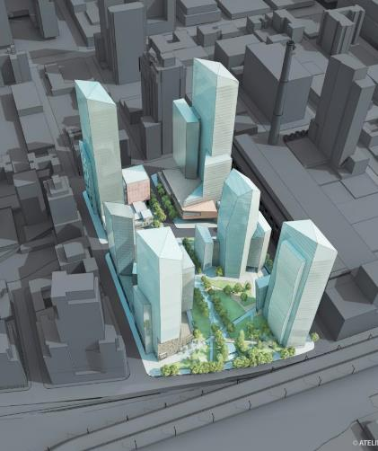
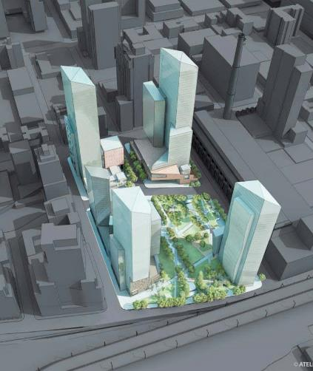



Proposed vs. Modified
Extell Portzamparc Proposal
Community Board Vision

Slide 37
ULURP Process
MCB7– Disapproved with conditions, Extensive Report, Public Hearings 7/22/10. Vote: 36-2-0-0.
Manhattan Borough President – Disapproved with conditions, 8/31/10. Supported MCB7 recommendations.
City Planning Commission – Approved, 10/27/10, with some objections to project density and size of school. Incorporated many MCB7/MBP recommendations:
Adjusted heights to accommodate powerhouse plume (<100K SF)
Required 20% permanent inclusionary housing
Improved 59th Street (design and uses)
Reduced parking (1800 to 1260)
Agreed to WMBE standards of employment
Agreed to Construction Oversight Task Force
Requested Extell to dialogue with MCB7 regarding open space

Slide 38
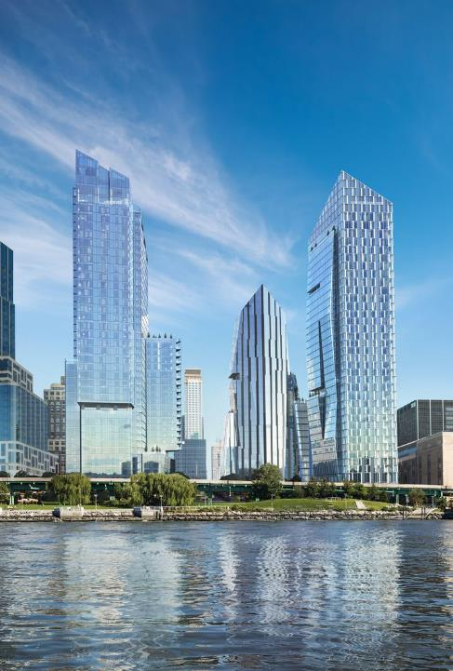
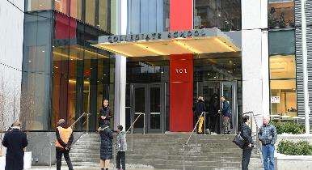
City Council Approval: Riverside Center & Waterline Square
City Council focuses primarily on the project’s affordable housing, parking, and construction of a new school
Gale Brewer focuses on affordable housing to be included on-site but that is not completely approved
Extell agrees to increase size of school and to build 135,000 SF of affordable housing on-site
City Council increases parking to 1500 spaces
2010 City Council approval
Notes:
Speak about the politics of it

Slide 39
Waterline Square and New Ownership
Extell & Carlyle sell parcels L, M & N to GID Development Group
GID acquires for $676 million in 2015, and secures $2.3 billion to develop Waterline Square
“For the first time ever, that Far West Side neighborhood along the Hudson River, from 59th to 72nd, will now be cohesive”, James Linsley, President of GID, who started his career working on Trump Place said he is finally able to see the full potential of the site…come to fruition.”
Notes:
James Linsley, who developed Trump Place, says he is able to see full potential, and now the neighborhood is cohesive

Slide 40
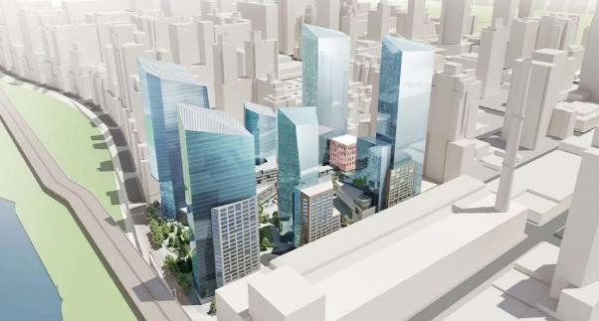
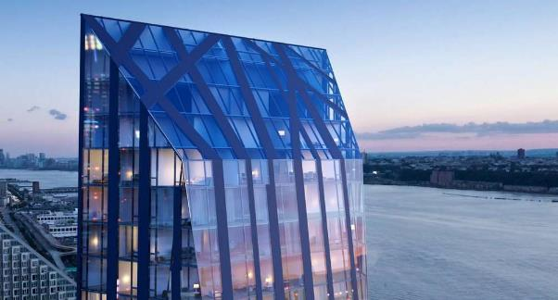
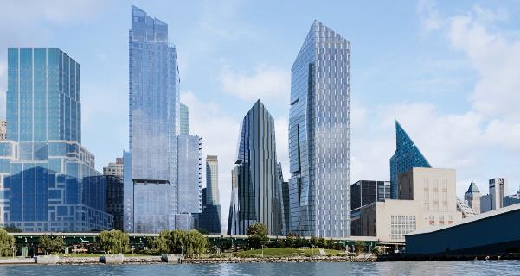
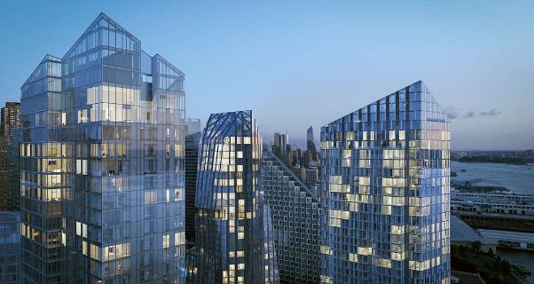
Notes:
Starchitects

Slide 41
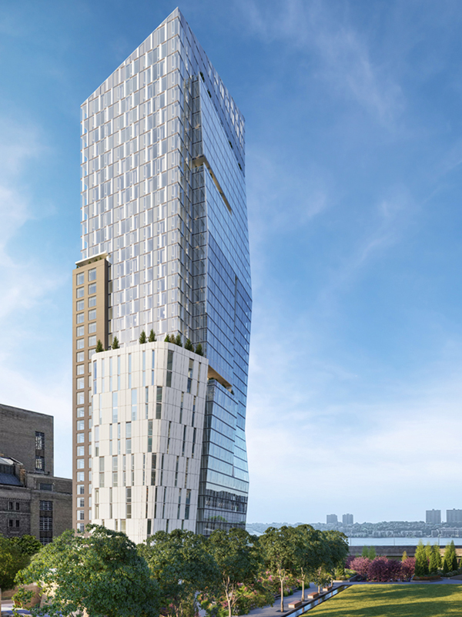
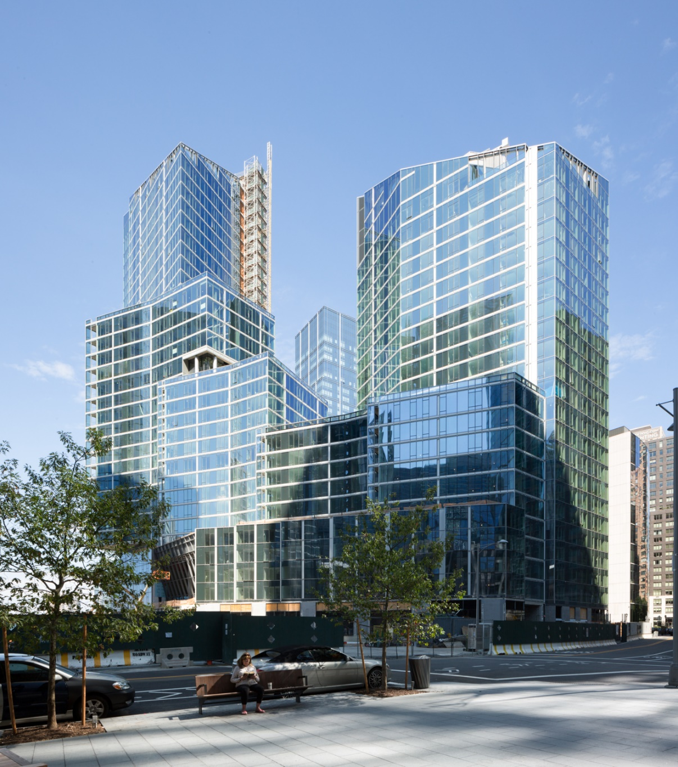
What Has Been Built: Waterline Square
Notes:
1 Waterline Square – Richard Meier
2 Waterline Square (400 West 61st) – Kohn Pederson Fox
3 Waterline Square (10 Riverside Blvd.) – Rafael Vinoly

Slide 42
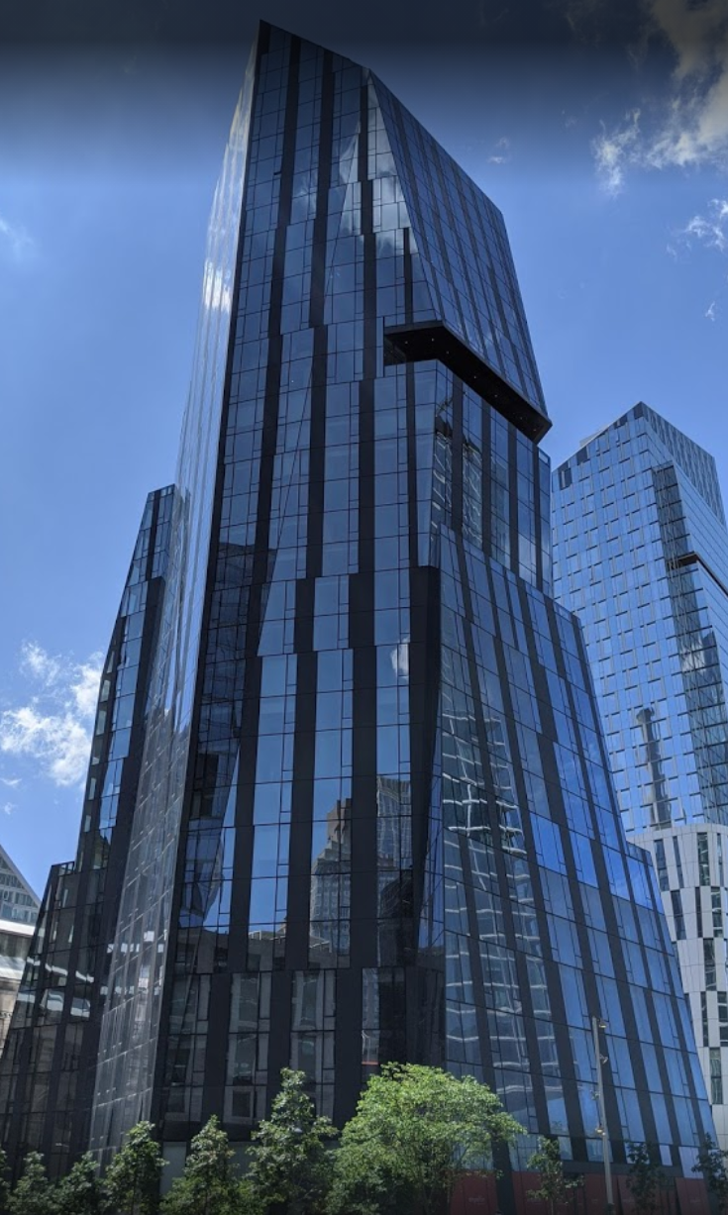
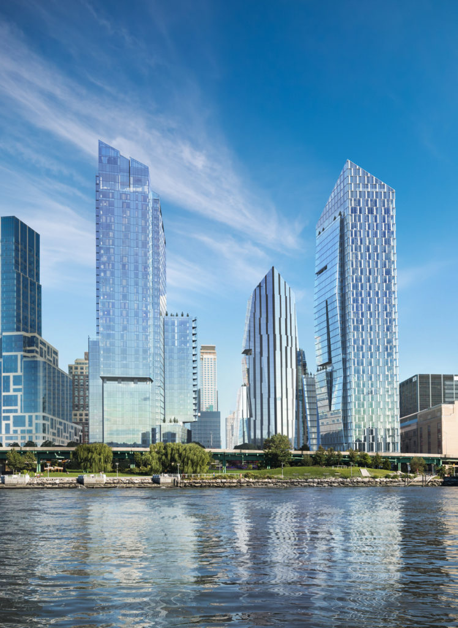
Notes:
1 Waterline Square – Richard Meier
2 Waterline Square (400 West 61st) – Kohn Pederson Fox
3 Waterline Square (10 Riverside Blvd.) – Rafael Vinoly

Slide 43
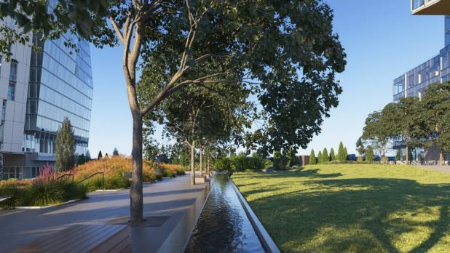
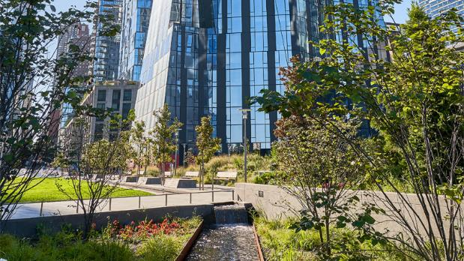

Slide 44


Slide 45


Slide 46


Slide 47
Thoughts, lessons, questions
Ron Shiffman spoke of “the planning vacuum that unfortunately exists in New York City.” The civic organizations, he said, had accomplished “what the city should have done years ago – plan in the public interest.”
“Riverside South is a partial glimpse of a public world at a time when there isn't a public world." - Linda Davidoff
“Riverside South should never have been approved. Trump is building a city within a city, and its out of character with the rest of our neighborhood. Our position is not anti-development but you do have to oppose things that are not right for a certain area”. Madelaine Polayes, Coalitioon for a Livable West Side
“I have no intention of arousing community opposition. Let’s meet and cooperate. But give me what I have a right to, which is a fair return.,, – Charles Moerdler, developer not involved in Riverside South
Over the years, MCB7 began to welcome development at this site and seeks to strike a balance between private incentives and public needs, local concerns and city growth, short-term advantages and long-term impacts, and most of all, between what is viable and what is truly visionary.(anonymous CB7 member)
Notes:
So different from Riverside South (and the Westside); got great praise that it was finally completed, but the criticisms of the process

Slide 48
Thoughts, lessons, questions, continued
Extractions, amenities, basic agreements among all parties on goals , design
Community boards and negotiation; and “community engagement”
Planning by government with all parties?? How, when, technical help, resources and community participation and “planning”?
Development, profits, public benefits?
Neighborhoods vs. City growth? Benefits?
Planning, diversity, equity, for UWS in this new, “challenging” time

