Slide 1
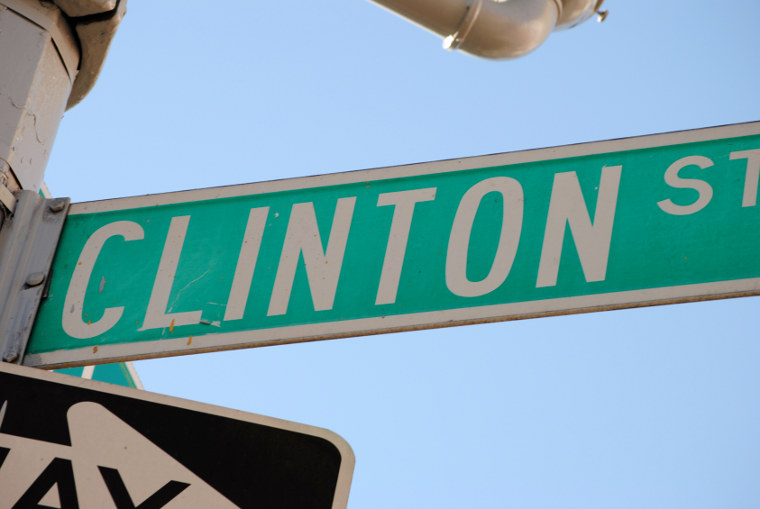
Retail Diversity in Community Board 3: Clinton Street
Isabelle Adams
Alison Cole
Diana Federico
Alanna Korpus
Stephanie Miranda
Kelsey Smith

Slide 2
Intro to CB3
Community Board 3 has many residential areas. They were historically first stopping places for immigrants and were homes to working families. CB3 allows buildings to combine residential and commercial use.
Much of this area has become a playground catering to those from outside the neighborhood who come to visit eating and drinking places. These restaurants and bars can pay very inflated rents--and landlords therefore hold storefronts empty until they can rent to one of these businesses.

Slide 3
Local bars and restaurants serving the community are among the businesses that have been displaced along with mom and pop shops that serve the residential community.
Clinton street in particular is a C1 overlay that traditionally held small businesses serving the Latino community.
Typical retail uses include grocery stores, restaurants and beauty parlors, catering to the immediate neighborhood; which we found all of on Clinton St.

Slide 4
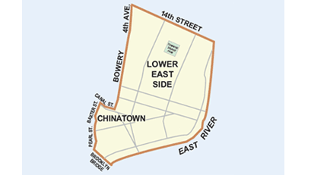
Community Board 3

Slide 5
Problem
As time progresses Community Board 3 is experiencing a change from a residential area with many small “mom and pop” shops to an area filled with restaurants and bars and an active night life.
The major concerns:
Has this influx of bars and restaurants imposed a negative effect on the inhabitants of the community?
Has the quality of life of residents remained unchanged among a changing community?
Are small business owners struggling to keep their businesses alive and fearful for the future of their companies?

Slide 6
Goal & Methodology
Goal:
Formulate solutions that will benefit residents as well as business owners to better the quality of life in Community Board 3, focusing on Clinton Street.
Methodology:
Field Surveys:
Small Business owners
Residents
We compiled the data provided from the surveys and compared to come up with final conclusions and analysis

Slide 7
How Long Have Businesses Been Located on Clinton Street

Slide 8
How Many Employees do these businesses have?

Slide 9
Do the Businesses Find Vacant Storefronts to be a Problem?

Slide 10
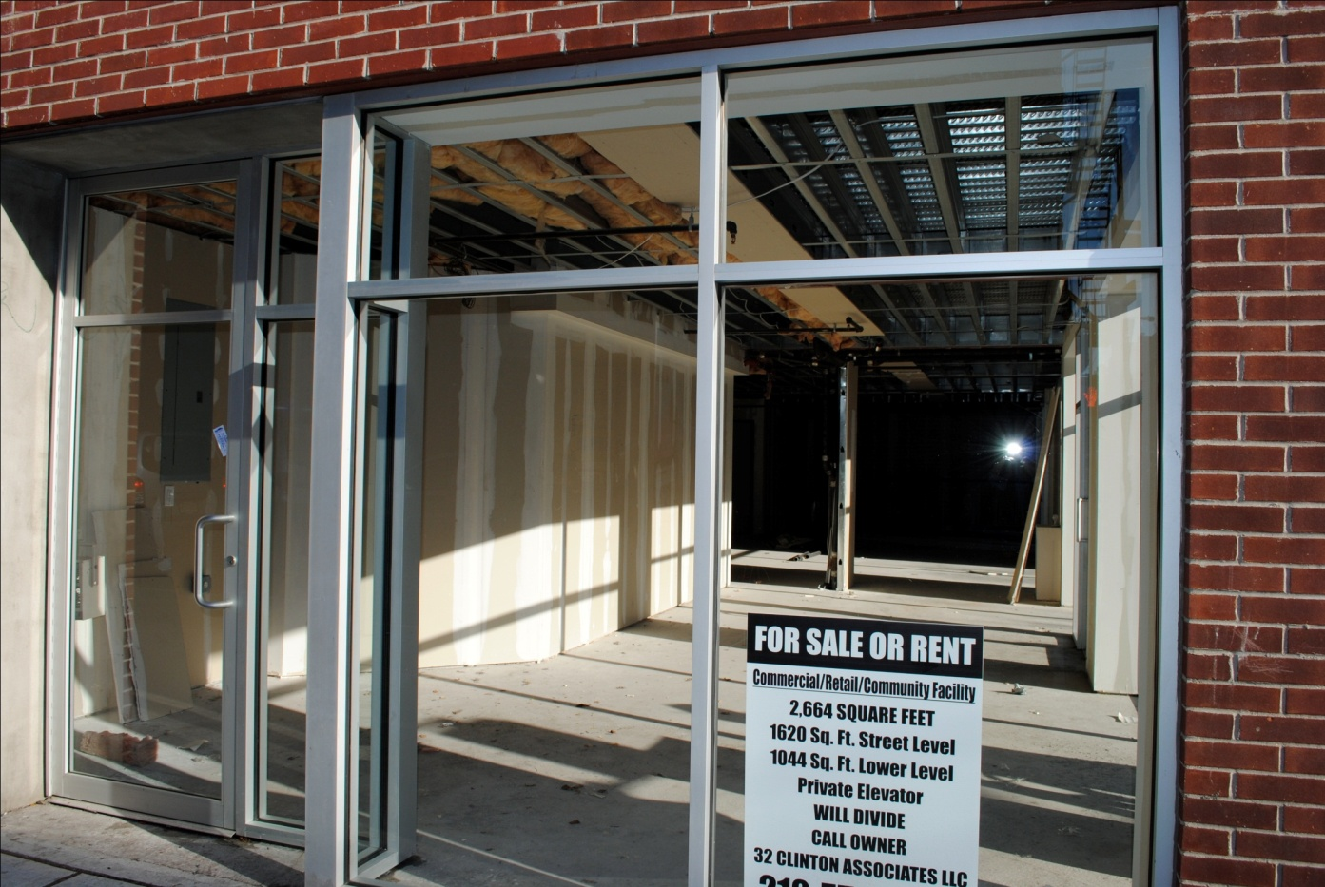
Vacant Stores Vs. Closed in the Daytime
After surveying the west side of Clinton Street between Delancey and Houston, we found that are 11 vacant store fronts and 9 bars/restaurants closed until nighttime.

Slide 11
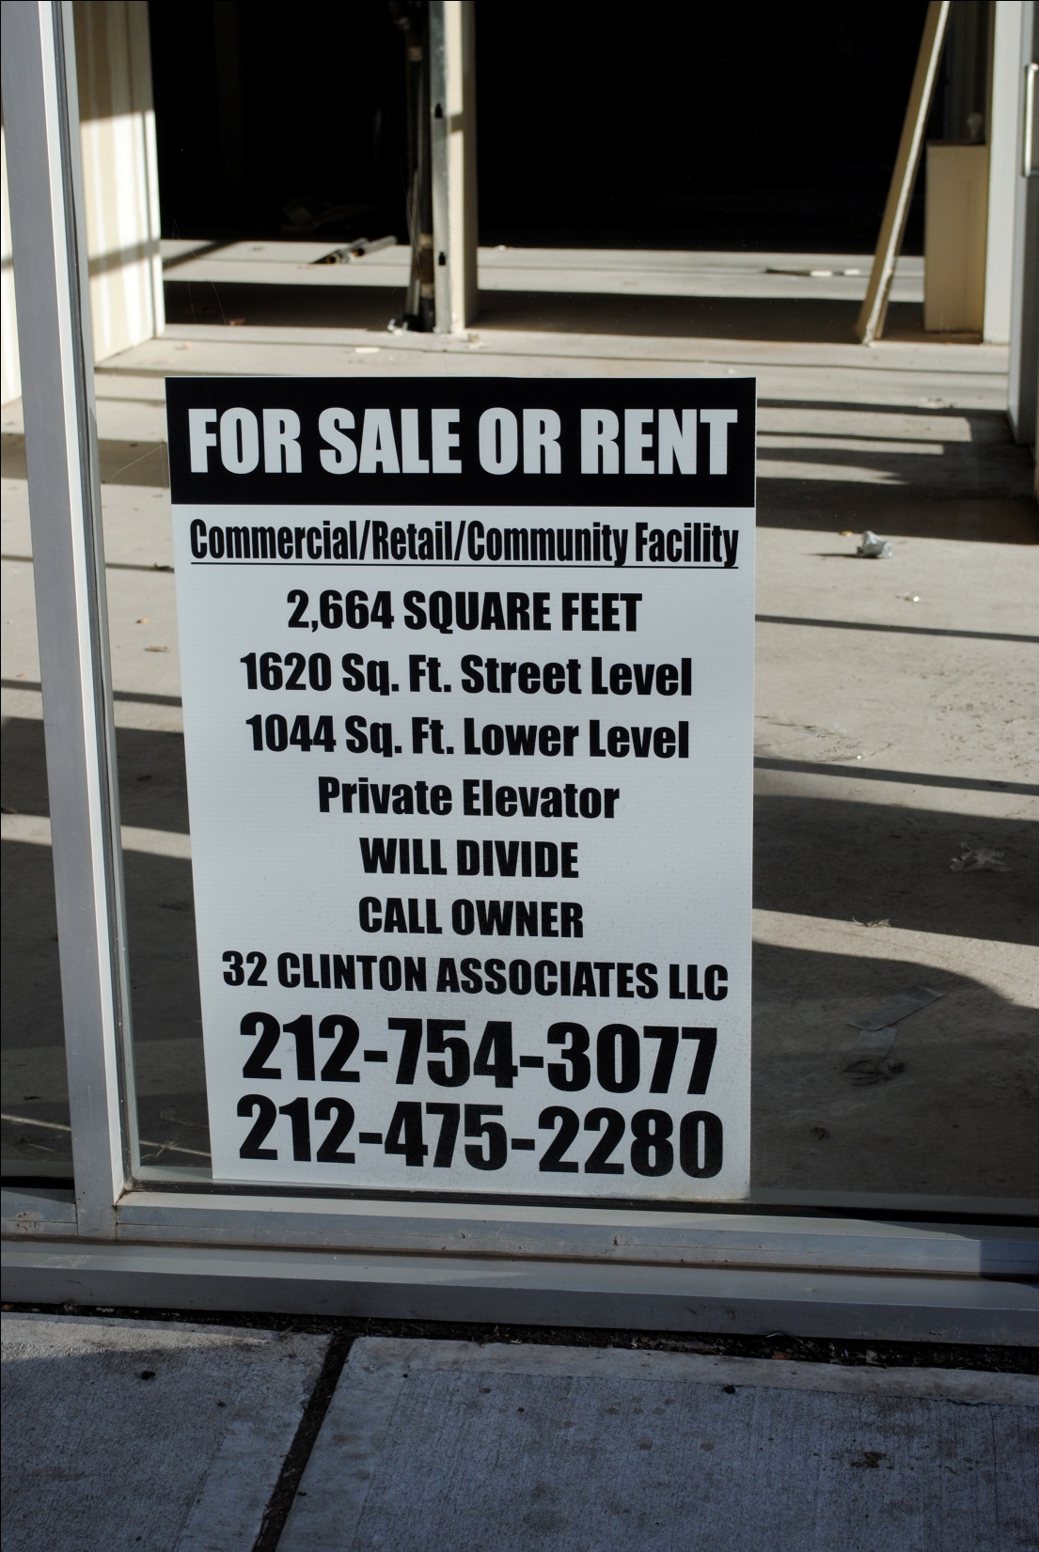
95% of the businesses surveyed said that vacant storefronts posed at least a slight problem (38% said it was a large problem)
Each vacant storefront represents a lack of customers and a lack of business activity
This creates less pedestrian traffic, which many small businesses rely on The vacant storefronts also tend to create an unfriendly atmosphere

Slide 12
Some Rent Statistics
$1,350 for 220 Sq. ft
$4,000 for 700 Sq. ft
$2,200 for 180 Sq. ft
$130 for 1 Sq Ft.
The rents are truly varied, we believe it depends on the location of the store and the type of building it is located in
Whether the space was renovated or not may also play a part

Slide 13
Are Taxes in the Area a problem for Businesses?
Many business owners agreed that taxes have severely increased over time, especially in this area and they found this to be a problem.
Higher Taxes→Higher Rent→Pushing out business owners→Vacant Storefronts →Less retail diversity

Slide 14
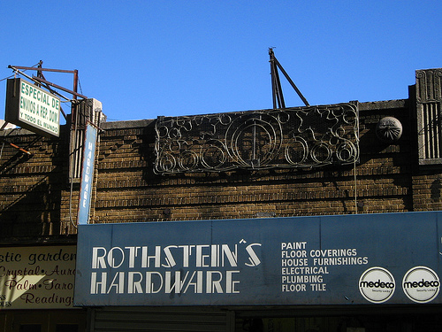
In Business at this location for over 50 years
Rent has increased by approximatley 450%
Going out of business because they are unable to renew their lease at the current price

Slide 15
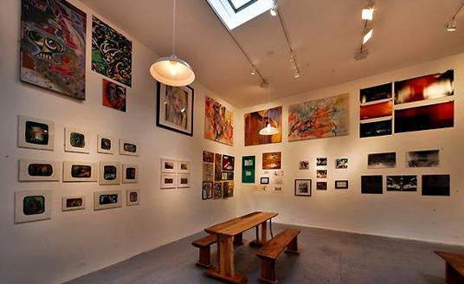
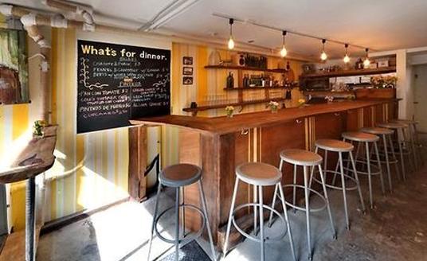
CULTUREfix
Culturefix is a bar, gallery and event space. Offering workshops, gallery openings, parlor games, and live performances, culturefix invites lovers of the arts, food, drink and design to merge. By embracing a broad definition of culture, we offer a variety of “fixes” to meet diverse interests and tastes. Culturefix’s warm environment allows guests to enjoy the arts plus artisanal food and drink without the sterility of a typical gallery or performance space.
By teaming up with other cultural and community organizations, as well as independent curators and artists, we hope to represent the multitude of identities in the Lower East Side–a neighborhood with a long history of creative innovation, immigrant populations, and entrepreneurial spirit.
Culturefix gives its guests an opportunity to define and celebrate their own evolving culture.

Slide 16
Interview with LiaWoertendyke: Exhibition and Events Coordinator
How long has your establishment been open?
The gallery and retail store have been open since June. We got our beer and wine liquor license for the bar in July.
What do you wish to bring to the community through your business?:
Upon opening, we wanted the business be based off the community center model. We wanted a little bit of everything. We aimed to combine community and culture in an accessible and unintimidating environment. A “chill bar” atmosphere with no separation between high culture and low culture.
What time does the retail shop (Dijitalfix) open and what is sold?
It opens at 12:00pm. In general, designer electronics and designer specialty gifts are sold.
What time does the bar/art gallery open?
The bar opens at 5:00pm but is closed on Mondays. The gallery is open in conjunction with the retail shop and can be accessed through the store.
In your opinion, are prices reasonable?
Bar prices are very reasonable and the events held here are, for the most part, free. The retail shop is on the more expensive side.

Slide 17
Interview Continued
Do you feel your business caters solely to the art community?
No. I believe it caters to anyone who likes to eat and drink. Also, the event series is so wide spread that it has the potential to attract everyone.
How do you feel your business fits in with others on Clinton St.?
Many business are mutually supportive of each other. A lot of local business owners, especially from food, beverage and arts establishments, come as customers. Culturefix also buys product from other businesses (Mom and Pop shops) on Clinton St. (i.e. food, hardware, etc.).
What is the general age range of customers?
Regular customers are usually between 25 and 42.
Do you serve many residents of Clinton St. or the surrounding area?
Regulars, for the most part, are residents. About 15 people who live in the area come in at least 3 times a week.
Is rent a problem?
Rent is not that high considering it is shared with Dijitalfix, though rent goes up anually so everything must change accordingly.

Slide 18
Based on these questions and answers, Culturefix, along with many other new independently owned businesses, are the new wave of mom and pop shops. They provide as much as they take from the community. They also hire locally. Although they come in a newer and more modern form, they still are incorporating community ideals and maintaining authenticity of this specific community.

Slide 19
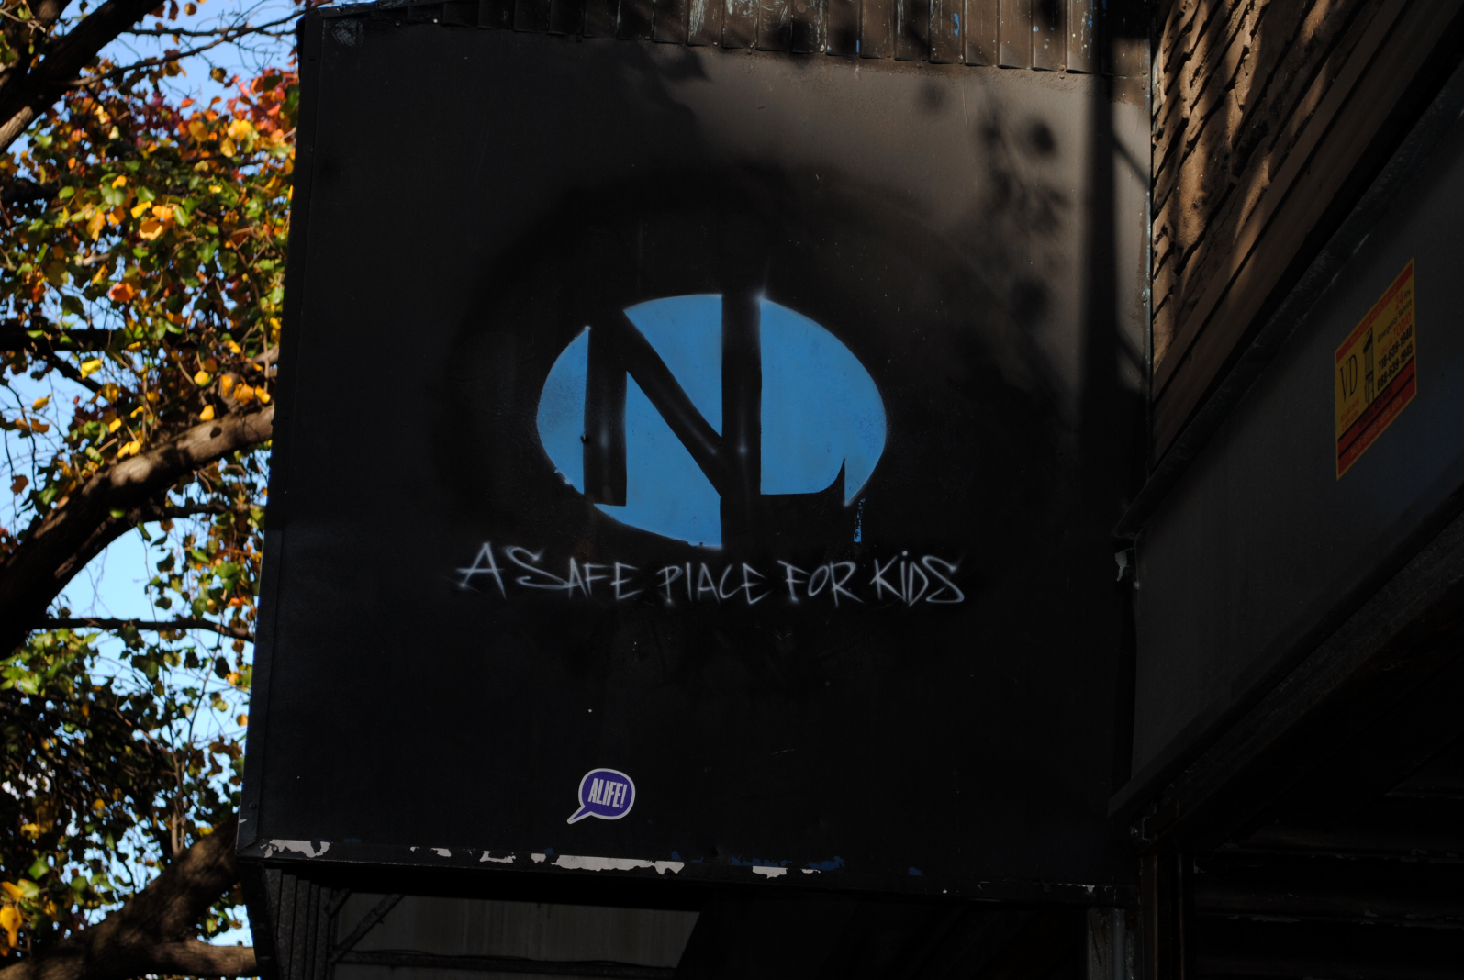
A safe place
A small business located in the area that caters to teenagers, giving them a place to spend time that is not out on the streets

Slide 20
Resident Survey Conclusions
While taxes are high, 75% of the residents surveyed felt the price they paid was worth it
Noise is a noticeable factor but only posed a problem for 50%of those surveyed
Many residents noted the many different stores on Clinton St. and said while most are small shops many larger stores such as Whole Foods are in walking distance
Vacant stores were also considered a problem by residents, most likely because of their look rather than their economic effects
Safety was not a concern, all residents felt adequate police presence

Slide 21
Negative Aspects
The vacant store fronts take away charm from the street
Small businesses (Manly family businesses) are being forced out because they cannot keep up with the escalating rent (Example on next slide)
Although there is currently retail diversity that caters to the residents (Grocery store, laundromat, nail salon, trendy hair salon, barber, cafes, technology/computer repair, boutique store, etc.), there is a fear that even with the resident’s business, some of these stores will not be able to keep up with the rent
The residents that are bothered by the noisiness at night, likely began living there before a nightlife scene existed on Clinton St.
5. The vacant store front take away a lot of the charm that characterizes Clinton Street

Slide 22
Positive Aspects
Right now, many small businesses that cater to the residents’ do exist, but are struggling and in order to be saved changes will have to happen
A huge concern for resident’s everywhere is safety, but on Clinton Street safety is no longer an issue. A middle-aged man we spoke to who had lived in the area all of his life showed us a gap between the cute coffee shop we were in and another building where people would put their arms through with cash and get an injection of heroin, so the street being alive at night really makes a difference in terms of safety

Slide 23
Conclusions
There are a variety of stores but the stores open during the day are mom and pop shops
The vacant storefronts are extremely detrimental to the surrounding businesses because it reduces foot traffic in the area
Many store owners are seeing the effects of increased taxes in the raising of the rent, and do feel that they are effectively being forced to pay the burden of these taxes despite not owning the building
Rent is high in many places, although some rents were strikingly low, we feel that this may be due to rent control or poor locations because of the effect of the vacant store fronts

Slide 24
Recommendations & Implementation for the Survey:
In regards to the surveys, a question regarding rent control should be included
More surveys should be introduced to residents of CB3, while CB3 can come up with conclusions based on business surveys it is also important to take into consideration the actual opinions of a broad variety of residents, not just simply those involved in the community
Perhaps there should be limits to the amount of licenses given out depending on the number of licensed establishments already in the area, the number of residents, the number of complaints, and by ensuring that the establishment desiring the license is beneficial or needed by the community.

