Slide 1
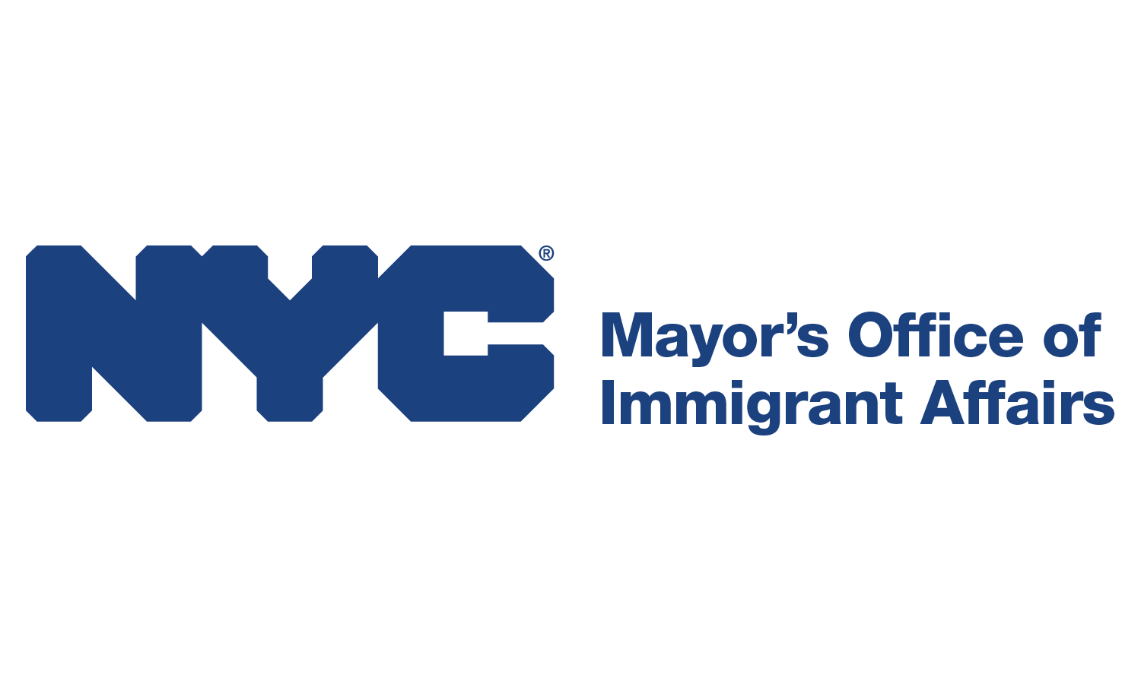
Virtual Presentation of MOIA’s New Report:
A Demographic Snapshot:
NYC’s Asian and Pacific Islander
(API) Population
Learn more about the report: on.nyc.gov/APIReport

Slide 2
Context
Understand demographic diversity within New York City’s API communities—especially within API immigrant communities—and their unique needs
The pandemic saw an increase in discrimination and violence against API individuals in NYC & beyond
Harmful stereotyping that perpetuates the misconception that API communities in the U.S. are “model minorities,” recent immigrants who “do not belong here,” and monolithic.
Goal is to dispel such myths & promote deeper understanding of the API immigrant community
The results will be shared with our agency partners, community partners, electeds, and other stakeholders.

Slide 3
Methodology
Data is based on the latest 5-year data from the U.S. Census Bureau’s American Community Survey.
Note that some groups are a relatively new group in the City and their numbers in the ACS data are relatively small. Because of sampling error around these small estimates, some findings should be interpreted with caution.
MOIA is conscious of the unique needs of the API sub-communities with smaller population presence in NYC. Our outreach team is directly working with them to ensure we hear and address their unique issues and demands.

Slide 4
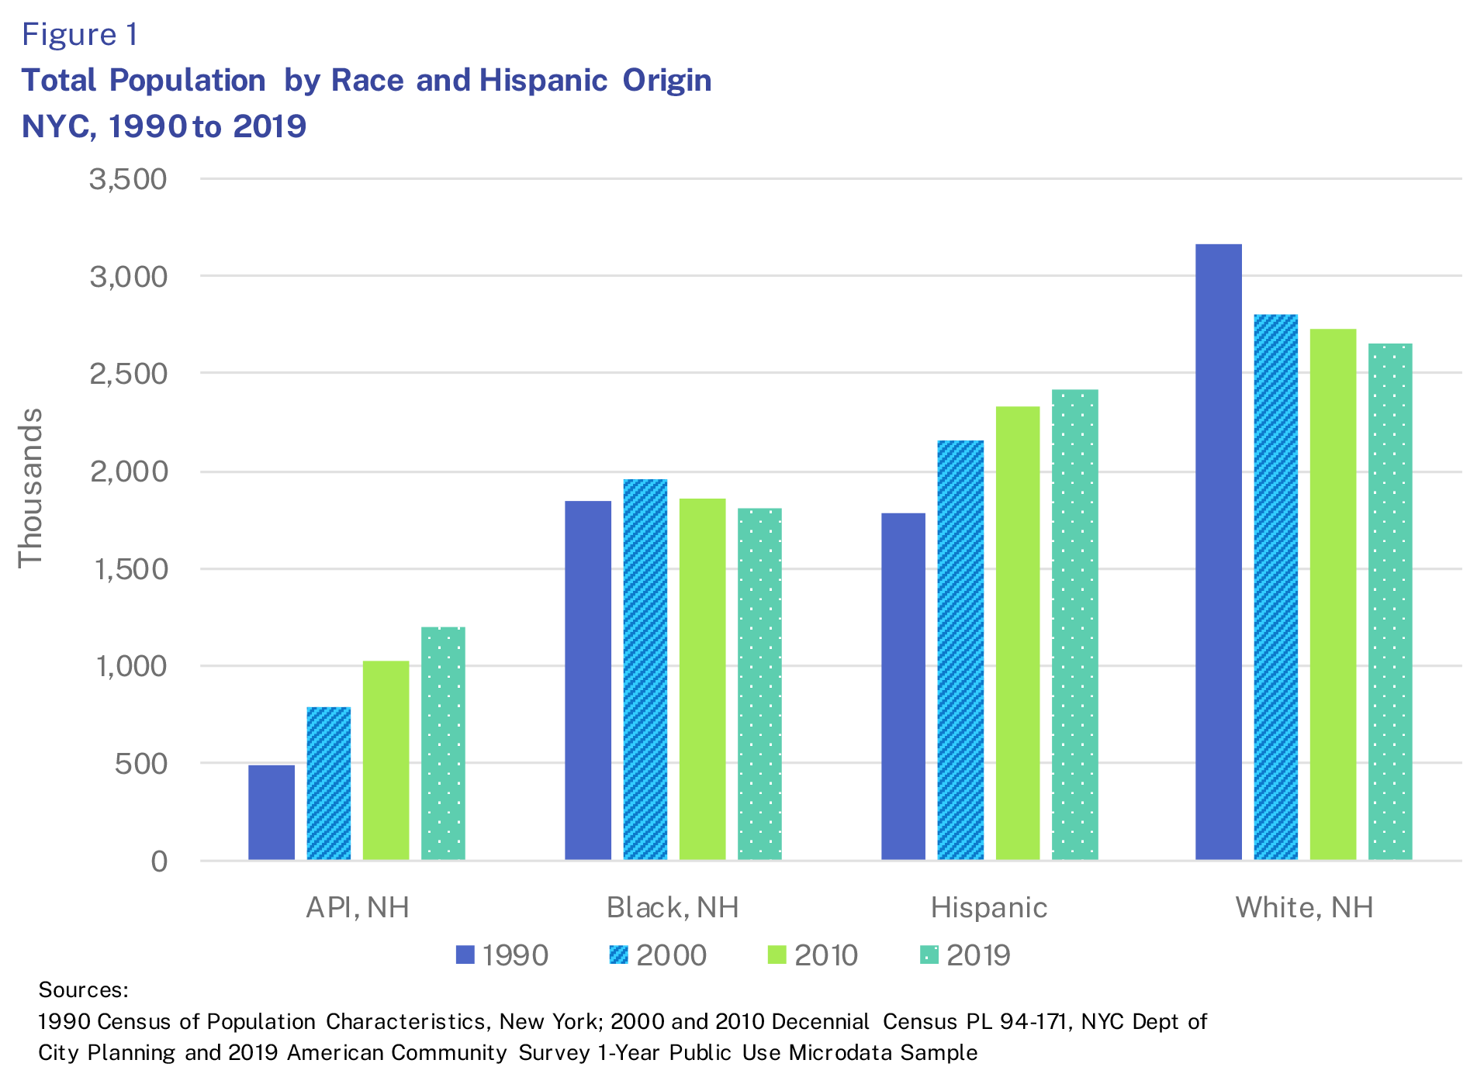
Population Growth:
API is the fastest growing racial group and one of the most diverse racial groups.

Slide 5
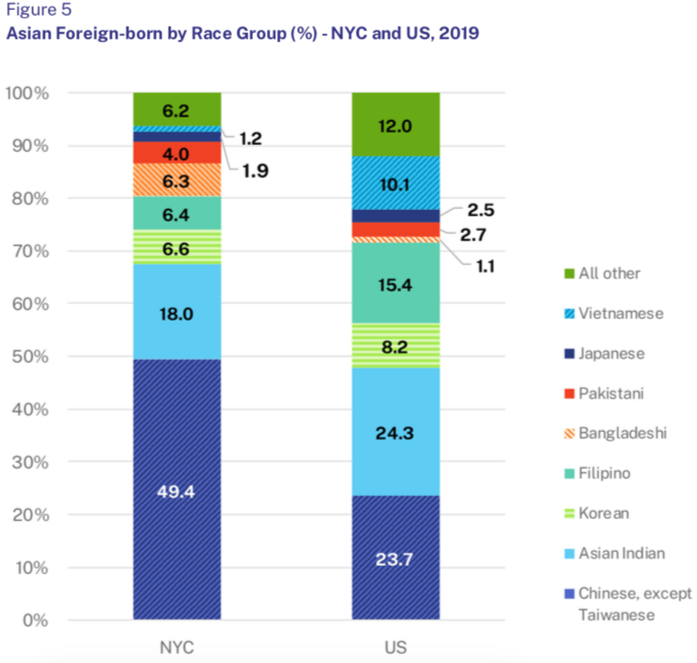
Ethnic Diversity:
API immigrants are one of
the most diverse racial groups
in the City.
They represent more than 30 different ethnic groups.
Source: 2019 American Community Survey 1-Year Public Use Microdata Sample

Slide 6
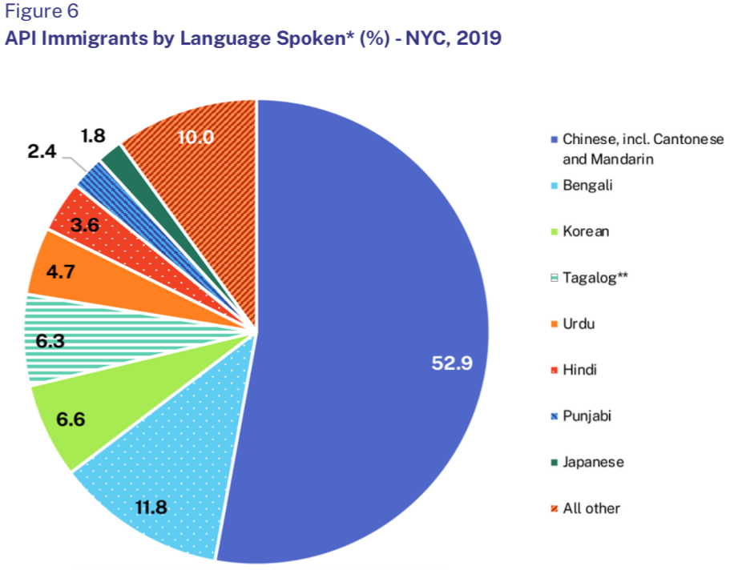
Languages Spoken and LEP:
API immigrants speak more than 50 languages.
*For persons 5 and older who speak a language other than English at home
**Includes Filipino, Cebuano, Ilocano, and other Philiipine languages
Source: 2019 American Community Survey 1-Year Public Use Microdata Sample

Slide 7
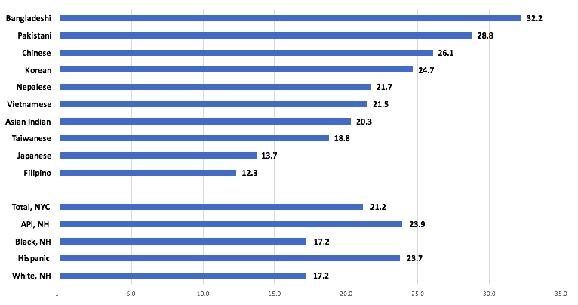
Labor and Economic Characteristics:
Despite the common stereotype, API and Hispanic immigrants have the highest poverty rates of all immigrant groups (24 percent).
Poverty Rate*
Asian Immigrant Groups
Total Foreign-born
*Poverty rate defined using the NYCgov Poverty Measure created by the Mayor’s Office for Economic Opportunity.
Source: 2015-2019 ACS 5-Year PUMS as augmented by NYC Opportunity

Slide 8
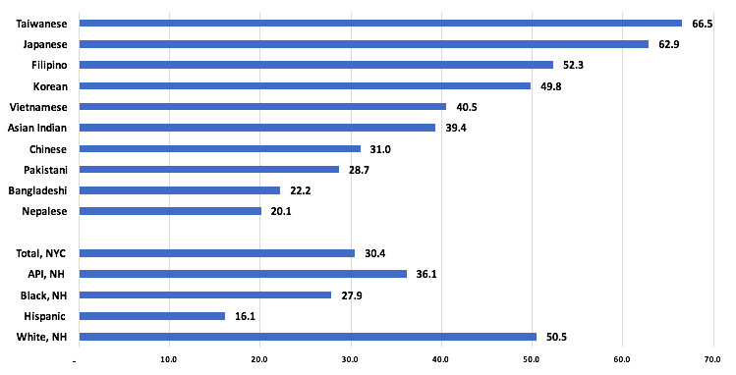
Despite the common stereotype, a much smaller share of API immigrants work in the professional and managerial occupations (36 percent) compared
to White immigrants
(51 percent).
Professional and Managerial Occupations (%)
Asian Immigrant Groups
Total Foreign-born
Source: 2019 American Community Survey 1-Year Public Use Microdata Sample

Slide 9
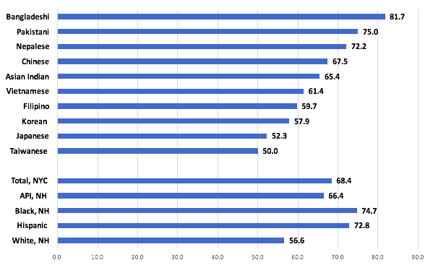
Labor and Economic Characteristics:
Despite the common stereotype, API and Hispanic immigrants have the highest poverty rates of all immigrant groups (24 percent).
Essential Workers* (%)
Asian Immigrant Groups
Total Foreign-born
*Defined by NY State Executive Order 202.6 for all persons 16 and older in the labor force
Source: 2019 ACS 1-Year PUMS as augmented by NYC Opportunity

Slide 10
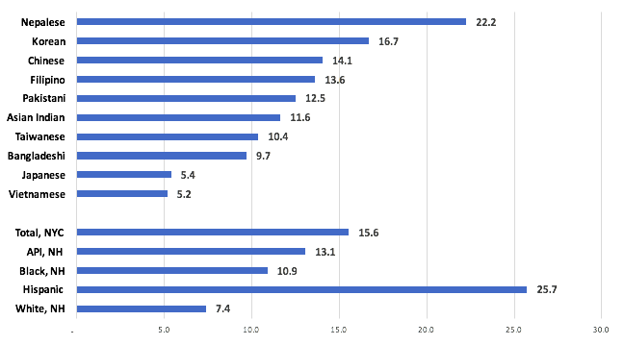
Immigration Status:
13 percent of all API immigrants are undocumented, slightly lower than the share of NYC immigrants overall
(16 percent). However, there
is a wide variation based
on ethnic groups.
Undocumented Immigrants
Asian Immigrant Groups
Total Foreign-born
Source: 2019 American Community Survey 1-Year Public Use Microdata Sample

Slide 11
Virtual Presentation of MOIA’s New Report:
A Demographic Snapshot:
NYC’s Asian and Pacific Islander
(API) Population
Learn more about the report: on.nyc.gov/APIReport

Slide 12
Learn more online at nyc.gov/StopAsianHate

