Slide 1
Steven Banks, Commissioner March 25, 2019
Department of Social Services Preliminary Budget
Testimony

Slide 2
REFORMS
ADDRESS
POVERTY
REDUCE INCOME INEQUALITY
PREVENTION
FIRST
FOCUS
TRANSFORM
APPROACH TO HOMELESS SERVICES
Notes:
Not sure where to put this slide

Slide 3
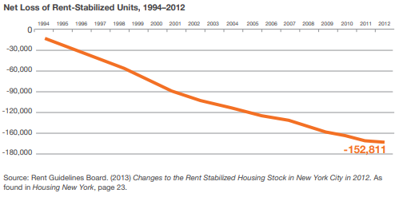
The Rise of Homelessness
Between 2005 and 2015, the median New York City rent increased by nearly 19 percent in real dollars and household income increased by less than 5 percent in real dollars.
Between 1994 and 2012, the city suffered a net loss of about 16 percent of the total rent-regulated housing stock, some 150,000 units.

Slide 4
The Rise of Homelessness
Combined, these and other trends mean that by 2015 the city had only half the housing it needs for about three million low-income New Yorkers.
Renters who are only able to afford an apartment costing $800 or less must search in a market with a vacancy rate 1.1 percent.
Notes:
-Edit to

Slide 5
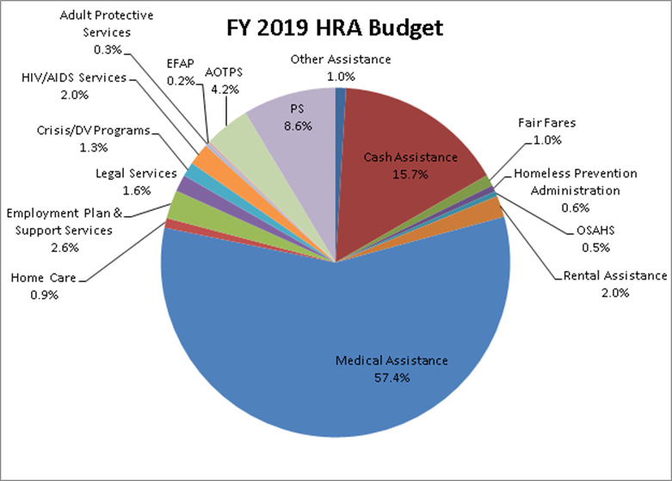
FY 2020 HRA Budget
Notes:
Not sure where to put this slide

Slide 6
FY 2020 DHS Budget
Notes:
Not sure where to put this slide

Slide 7
Reforming Social Services Policies and Access to Benefits
HRA eliminated and replaced the Work Experience Program (WEP).
We successfully advocated for a change in State law to permit clients to obtain college degrees that greatly enhance their ability to earn a living wage.
Clients who were subjected to punitive sanctions for missing WEP assignments received appointments at the Intensive Services Center #71, and if they missed those appointments the entire family would be denied assistance—we closed Center #71.

Slide 8
Reforming Social Services Policies and Access to Benefits
We successfully advocated for a change in State law as applied to New York City to give clients the chance to “cure” a violation and avert a durational sanction – and we also successfully advocated for a reduced State sanction period for SNAP/food stamps.
We put in place new protocols to prevent unnecessary case closings, and State fair hearing challenges decreased by more than 47 percent.
As a result of our reforms, the City is no longer subject to a potential $10 million annual State financial penalty for unnecessary hearings.

Slide 9
Reforming Social Services Policies and Access to Benefits
We now make it easier for clients to continue their assistance if they submit what is needed within 30 days of a case closing.
Homeless clients can now seek assistance at a Job Center in their home borough.
Now seniors can receive services at a Job Center in their home borough.
In 2017, we implemented the Universal Receipt to provide an individual who completes a visit at a Job or SNAP Center with a document that indicates the nature and date of the visit.
A copy of this receipt is available on Access HRA and this receipt process has been codified into local law as a result of legislation sponsored by Speaker Johnson.

Slide 10
Reforming Social Services Policies and Access to Benefits
We improved Access HRA so that SNAP applications, recertifications, and renewals can be done online—now SNAP clients conduct 87% of these transactions online.
Now SNAP eligibility interviews are conducted at the client’s convenience by phone and the percentage of completed telephone eligibility interviews increased from 29 percent in 2013 to 95 percent in 2018.
We reversed New York City’s policy of rejecting the federal Able-Bodied Adults Without Dependents (ABAWD) waiver so that more clients can retain SNAP benefits.
Clients can now submit Cash Assistance recertification questionnaires online, submit documents from a smartphone, and gain access to over 100 case-specific points of information for Cash Assistance and SNAP.

Slide 11
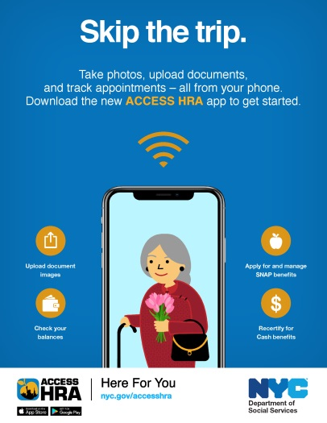
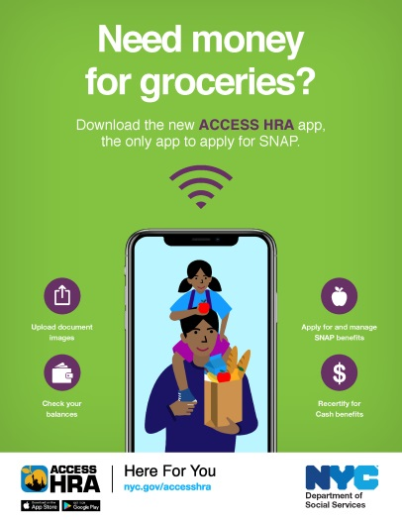
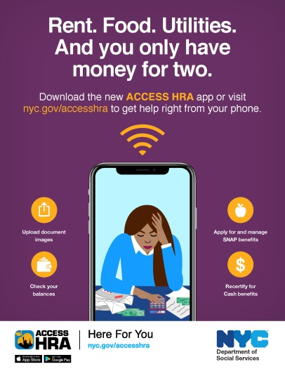
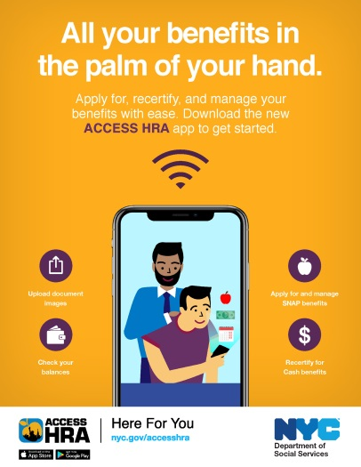
“SKIP THE TRIP”
Transit (subway and bus): English and foreign language
Print and radio: English and foreign language
Social media: English and foreign language

Slide 12
Reforming Social Services Policies and Access to Benefits
We streamlined the rental assistance system by instituting a centralized rent arrears processing unit to ensure payment by the required due date.
We have a streamlined system for making NYCHA payments electronically and are developing a similar payment system for private landlords.
Using Access HRA, clients can confirm rent was paid to their landlords pursuant to a reform now codified by State law.
In 2014, 90 clients per year received reasonable accommodations. As a result of settling the Lovely H. class action lawsuit, now 46,000 clients annually receive reasonable accommodations.
Clients with HIV used to have to wait until they were diagnosed with AIDS to receive HASA assistance – working with Speaker Johnson and Housing Works, we ended that counterproductive policy.

Slide 13
Reforming Homeless Policies and Services
Keeping the shelter census flat over two years for the first time in a decade.
Evictions are down 37% since 2013.
Enabling more than 109,000 children and adults to move out of shelter or avoid shelter altogether.
Bringing people off the streets and out of the subways — more than 2,000 so far who have remained off the streets.
Closing more than 180 substandard shelter sites and siting 42 new borough-based shelters to offer help as close as possible to the anchors of life like jobs, schools, health care, houses of worship and family and support networks.

Slide 14
Addressing Homelessness
PILLARS
of the
PLAN
PREVENTION
REHOUSING
TRANSFORM THE SYSTEM
BRING PEOPLE IN FROM THE STREETS
14

Slide 15
First Pillar: A Prevention First Approach
We have provided emergency rental assistance to over 50,000 households each fiscal year since fiscal year 2015.
We have expanded free legal assistance for New Yorkers in danger of eviction, increasing funding for legal services for tenants exponentially from roughly $6 million to $166 million at full implementation in FY22.
Evictions have dropped by 37% and more than 100,000 New Yorkers were able to stay in their homes between 2014-2018.
15

Slide 16
Second Pillar: Rehousing to Alleviate Homelessness
In 2011, the City and State cancelled the Advantage rental assistance program, resulting in a 38 percent increase in homelessness in just three years, between 2011 and 2014.
We stepped in to fill the gap by creating new rental assistance programs as well as reinstating rehousing programs.
These reforms have helped more than 109,000 move out of shelter or avert shelter since 2014, with the majority exiting shelter into housing.
16

Slide 17
Third Pillar: Transforming the Approach to Providing Shelter
Our plan calls for shrinking the NYC DHS shelter footprint by 45 percent by ending the use of all 360 “cluster” shelter and commercial hotel locations citywide while opening a smaller number of 90 borough-based shelters across the five boroughs.
We’ve already reduced the DHS shelter footprint by nearly 30 percent citywide, getting out of more than 180 shelter sites that did not meet our standards.
For example, on March 13th, we announced the conversion of cluster units to permanent housing in 17 buildings that will enable 1,200 homeless children and adults to be permanently housed with rent-stabilized leases and upgraded apartment conditions.
17

Slide 18
Third Pillar: Transforming the Approach to Providing Shelter
We have sited 42 high-quality borough-based shelters, 23 of which are already open.
The peak number of homeless families residing in shelter at night has declined by nearly 3,000 between 2014 and 2018.
We have achieved this decrease even as we have provided shelter and services to more than 550 evacuees from Puerto Rico.
18

Slide 19
Fourth Pillar: Bringing People In From The Streets
In 2016, we launched HOME-STAT, the most comprehensive street outreach program in the nation, with outreach teams canvassing all five boroughs 24/7/365.
Our HOME-STAT program has helped more than 2,000 individuals come off the streets and subways and remain off in transitional and permanent settings.
19

Slide 20
Fair Fares
The Fare Fares NYC Metrocard allows participants to purchase unlimited weekly and monthly passes at a 50 percent discount at MTA vending machines. The City worked with NYC Transit to phase in a pay-per-ride option, which was launched on March 15, 2019.
Starting on the launch date, DSS/HRA began contacting New Yorkers who are working and receive Cash Assistance, and who do not already receive transportation assistance, to inform them of their eligibility and invite them to visit the nearest Fair Fares NYC location to pick up their Fair Fares Metrocard. In February, DSS/HRA began contacting some working SNAP recipients as well.
Additional mailed notices, reminder phone calls and texts were, and continue to be, made to eligible individuals who have not picked up their discounted card.
Eligible individuals and those with questions can also call 311 and HRA Infoline for assistance in receiving the Fair Fares Metrocard.
In the first week of March, we launched a targeted digital advertising campaign to inform eligible individuals about the program and encourage them to pick up their discounted Fair Fares Metrocard.

Slide 21
Fair Fares
Beginning next month, DSS/HRA will expand eligibility to all working New Yorkers with incomes at or below the Federal Poverty Level who are receiving CA or SNAP benefits and do not already receive transportation assistance. And we are making it even easier for participants to get enrolled and receive their Fair Fares card. Next month, eligible clients will be able to enroll in the Fair Fares program online using ACCESS HRA and receive their card through the mail without any need to come into an office.
Planning is underway to expand the program in the Fall of 2019 to more low-income New Yorkers, such as those served by the City University of New York (CUNY), the New York City Housing Authority (NYCHA), and veterans.
In January 2020, we plan to launch an open enrollment process for all eligible New Yorkers at or below the Federal Poverty level who don’t have discounted transportation assistance from HRA or NYC Transit.
In the preliminary budget, the Fair Fares program was funded with $106 million in FY20 (the second year of implementation).

Slide 22
The State and Federal Landscape
The State Executive Budget proposes to cut reimbursement of Temporary Assistance for Needy Families (TANF) to New York City by 10 percent, which will amount to a $125 million cut in annual public assistance funding.
This proposed cut will imperil our reforms to improve client services.
The Trump administration released a proposed rule in February that would restrict Able Bodied Adults Without Dependents (ABAWD) waivers to areas where the unemployment rate is higher than 7 percent compared to the current unemployment rate threshold of 10 percent.
This Trump Administration attack on low-income single adults will exacerbate food insecurity and result in many New Yorkers losing their SNAP benefits if they do not find 80 hours of work in a month.
22

Slide 23
Thank you!
23

