Slide 1
Steven Banks, Commissioner May 19, 2015
Budget
Testimony
Human Resources
Administration
Department of
Social Services

Slide 2
Overview: Key Accomplishments
Employment
We are issuing concept papers to begin the RFP process for new employment and training programs
Already converted 500 CUNY WEP slots into work study
Developing an RFP to enhance employment services for people with HIV who are eligible through our HASA program or our new Employment Plan
Currently 1,271 clients are enrolled in four-year college
Access to SNAP/Food Stamps
Launched a new version of AccessNYC
Can now apply and recertify for SNAP/food stamps on line
Made it easier to submit documents using scanners in our officers and at community organizations
Beginning later this month it will be possible to submit documents using your smart phone
Partnered with NYCHA in 15 targeted NYCHA developments to identify residents who qualify for but are not using SNAP/food stamps
Initiated a major outreach campaign to increase access to SNAP/food stamps

Slide 3
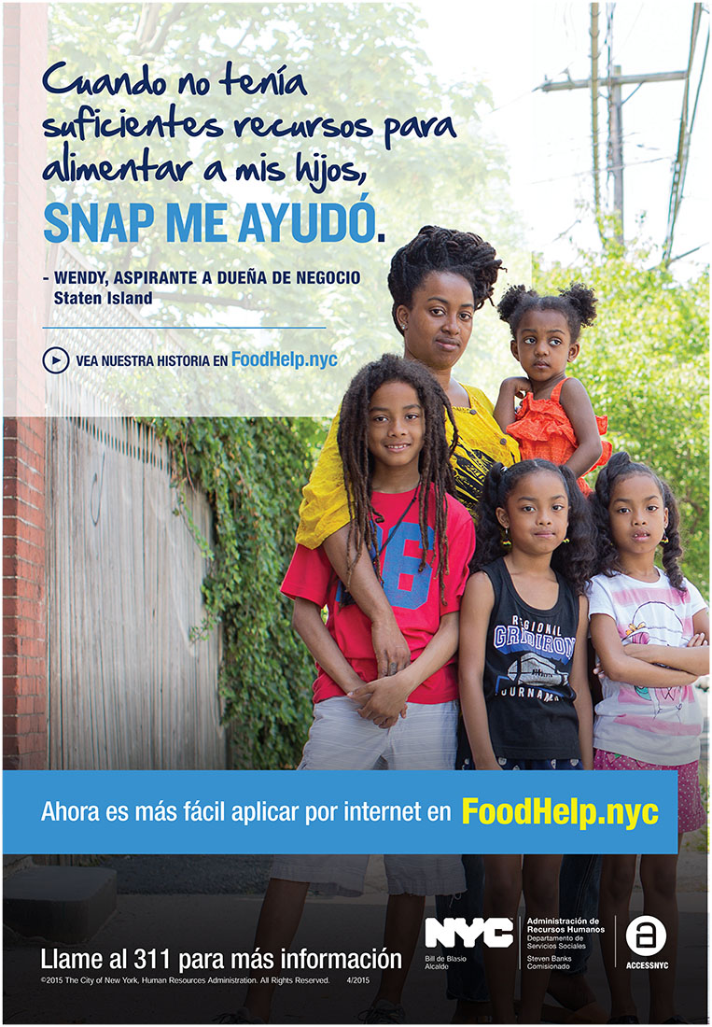
Major Initiatives: SNAP/Food Stamps Access

Slide 4
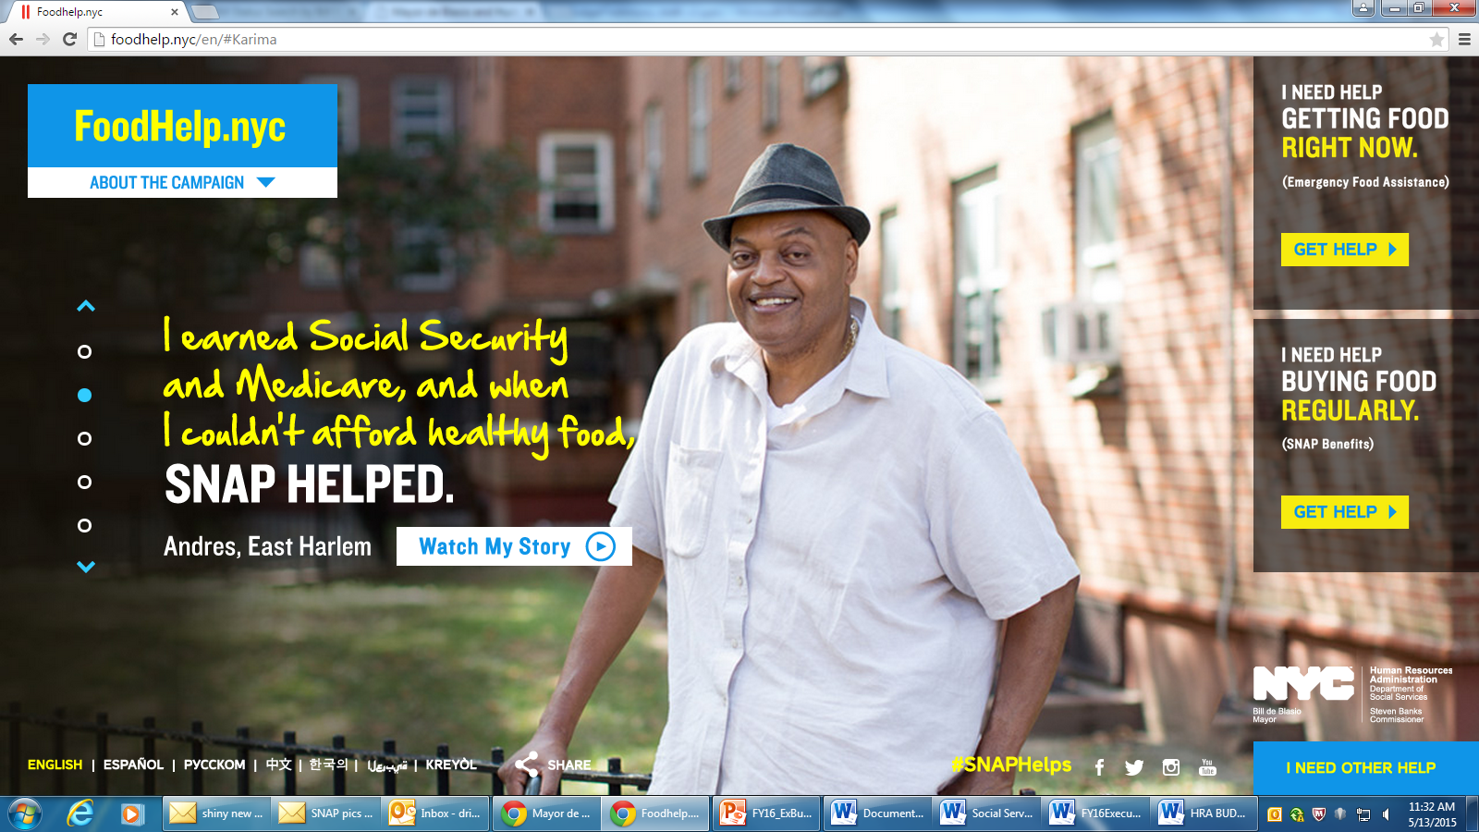
Major Initiatives: SNAP/Food Stamps Access

Slide 5
Overview: Key Accomplishments
Homelessness
Between December 2014 and April 2015, in partnership with DHS, provided rental assistance to 2,000 households, including almost 5000 children and adults, to enable them to move from shelter to housing.
Including Section 8 and NYCHA referrals, a total of more than 4,000 households, with more than 12,000 children and adults, were moved into homes during the first 10 months of FY’15.
Implemented a new program for Judges to immediately refer at risk tenants to legal services providers in the Bronx, Brooklyn, Manhattan and Queens Housing Courts, with the roll out in Staten Island to come shortly.
Program Accountability and Integrity
The Brooklyn D.A. recently arrested participants in a massive fraud scheme that offered free sneakers to Medicaid clients in return for submitting to unnecessary treatment. HRA staff were the main undercover operatives gathering evidence to bring down this operation and also staffed the phone taps and provided translations of conversations that exposed this cruel and unlawful treatment.
The New York Times reported on HRA’s use of sophisticated data mining to root out fraud. Using this approach, HRA was able to focus its efforts on cases that were most likely to be fraudulent instead of cases without merit.

Slide 6
Overview: NYC Human Resources Administration (HRA)
HRA serves approximately 3 million low-income New Yorkers through a broad range of programs to address poverty and income inequality and prevent homelessness.
As of the Executive Budget, HRA has a Fiscal Year 2016 operating budget of $9.9 billion ($7.7 billion in City funds)
78 percent is for Medicaid payments and cash assistance benefits.
The balance supports employment programs, homeless prevention, legal services, rental assistance, and other services for low-income New Yorkers.
HRA continues to be responsible for much of the Medicaid program - which totals $29 billion in NYC, although only 20 percent of these costs are part of the HRA budget; HRA also administers $3 billion in federal SNAP (food stamps) benefits that do not pass through the City budget.
This means that HRA is responsible for a total of $35 billion in programs and services.

Slide 7
HRA is about more than cash assistance;
we help low-income workers stay on the job
Annually HRA provides critical support that helps many low-income New Yorkers remain in the workforce:
Efforts aimed at keeping low-income workers in the workforce are much less expensive and more efficient than providing assistance to New Yorkers after they are out of the workforce, especially after an extended absence.
500,000 receive ongoing cash assistance annually; any given month 360,000 on cash assistance.
2.445 million receiving Medicaid
1.716 million receiving federally-funded food assistance
700,000 receiving home energy assistance
100,000 receiving one-time cash assistance annually to prevent evictions and utility shutoffs and assist with other emergencies
190,000 children assisted through child support income

Slide 8
Table 1: Benefits and Services
Cash Assistance
500,000 receive ongoing assistance over the course of a year and another 100,000 receive one-time emergency grants; 360,000 recipients in any given month, of whom about 8,500 are receiving one-time assistance
Emergency Food Assistance Program
Home Energy Assistance Program
1,120,031 average monthly meals/people served in fiscal year 2014
Child Support
796,145 recipients in heat year 2014*
282,190 cases with orders as of February 2015
Over $742 million in collections in CY 2014
Over 92% of collections distributed directly to families
Supplemental Nutrition Assistance Program (SNAP)/food stamps
1.7 million recipients as of March 2015
HRA Administered Medicaid
2.445 million enrollees as of March 2015 (excludes enrollees in NYS Health Exchange beginning 1/1/14)
*heat year runs from November to October.

Slide 9
Table 2: Support for Vulnerable Populations
Adult Protective Services
3,884 cases being assessed for services as of March 2015
Homecare
123,005 total home care enrollees as of March 2015
HIV/AIDS Services Administration
32,309 cases served as of March 2015
Domestic Violence
Over 1,000 families served per day in emergency and transitional shelters in February 2015
Teen Relationship Abuse Prevention Program
7,428 students received counseling in 2014
3,492 non-residential cases served in February 2015
6,213 undercare cases as of March 2015

Slide 10
Overview: NYC HRA Staff
14,439 budgeted headcount in FY’16, paid for with a combination of City, State, and federal funds
Public servants who chose to work at HRA to help New Yorkers in need; many dedicating their entire careers to public service
Diverse workforce: 70% women, 59% African-American, 18% Hispanic, 15% White, and 8% Asian
Unionized workforce
CWA Local 1180
Teamsters Local 237
The Civil Services Bar Association of Local 237
The Organization of Staff Analysts
The New York State Nurses Association
The United Brotherhood of Carpenters and Joiners
IBEW Local 3
Local 30 of the International Union of Operating Engineers
DC 37 Local 1549
DC 37 SSEU Local 371
DC 37 Local 2627
DC 37 Local 1407
DC 37 Local 924

Slide 11
Chart 1: HRA Executive Budget FY 2015
*includes LINC rental assistance and CityFEPS

Slide 12
Chart 2: HRA Executive Budget FY 2016
*includes LINC rental assistance and CityFEPS

Slide 13
Executive Budget Overview
In the Executive Budget, $28.6 million ($29.7 million tax levy) and 57 positions were added in 2015; in 2016, the increase was $162.8 million ($131 million tax levy) and 328 positions were added.
The HRA budget as of the Executive Plan totals $9.9 billion ($7.66 billion tax levy) in 2015, and is virtually unchanged in 2016, with an increase of .4% ($33 million) in tax levy funds.
The tax levy increase is due to:
rental assistance increases for additional placements in 2016 compared to 2015;
additional legal services including expansion of the anti-harassment initiative;
new staff in 2016 to implement reasonable accommodation requirements;
growth in the IDNYC program to manage additional applications.
Total headcount is 14,535 in 2015 and 14,439 in 2016 (City funded headcount is 10,601 increasing to 10,689).

Slide 14
Executive Budget Overview: Capital
HRA’s ten year capital budget is $191.8 million of which $137.5 million are City funds:
$78.6 million for technology to streamline operations, including key investments to Client Benefits Re-engineering;
$76.1 million for facilities maintenance, equipment and improvements;
$33.9 million for the installation of telecommunications equipment;
And $3.2 million for vehicles.

Slide 15
2016 Executive Budget: Major Initiatives and Reforms
$32 million ($18 million City funds) for LINC rental assistance, increased LINC rent levels, Federally-funded Tenant Based Rental Assistance (TBRA), City FEPS and related programs.
Allows for a combined total of 8,480 move outs in FY’16 through funding for LINC, CityFEPS and Tenant Based Rental Assistance (TBRA)
$20 million (increasing to $36 million in FY’17 as providers ramp up) for anti-harassment legal services and $4.3 million for related outreach – an increase from the prior Administration which funded an anti-eviction initiative at $6.4 million that is also increasing to $13.5 million in FY’16.
$51 million for Cash Assistance and $21.9 million for additional rent arrears ($58.9 million City funds) to support an average of 360,000 receiving ongoing benefits and 8,600 receiving one-time grants, while maintaining the flat annual caseload of 500,000. The total Cash Assistance budget is $1.48 billion ($651 million City Funds).

Slide 16
2016 Executive Budget: Major Initiatives and Reforms
$5.6 million for additional immigration legal assistance and services to address Executive Action.
$14.8 million (declining to $7.5 million in 2017) for additional staff and OTPS for IDNYC; the projected decline is based on projected future demand following the extraordinary ramping up process this year to meet the current demand. However, if the level of demand remains higher than projected, adjustments can be made on an expedited basis as evidenced by the expedited response to the unprecedented demand this year.
$13 million ($9 million City funds) for reasonable accommodations for clients with disabilities, including 74 baseline staff and one-time contractor and consultant costs.
$12.3 million ($4.8 million City funds) for 252 reform positions, including additional call takers, homeless prevention and legal services staff, and HASA case managers.

Slide 17
2016 Executive Budget: Savings and Efficiencies
Savings of $21.3 million ($9.6 million City funds), growing to $28.5 million ($12.7 million City funds) in 2017, from reductions in unnecessary and duplicative administrative functions and positions, which are repurposed to support HRA’s new reform staffing and other important operational changes.
Administrative savings of $380,000 ($249,000 City funds) in HASA as a result of a new contract to manage the emergency housing portfolio for homeless clients with HIV/AIDS.
Improved claiming in 2015 is providing additional one-time revenue from federal fringe benefits, producing City savings of $72 million.

Slide 18
HRA Reforms: Re-engineering Update
HRA’s Re-engineering initiative is about making it easier for clients to access benefits, and reducing the burden of things like data entry on staff so they can focus on helping people in need. To do this, we are using the latest technology to give clients greater access and making our internal processes more efficient.
Clients can apply and recertify for SNAP/food stamps online through ACCESS NYC and will be able to conduct interviews by phone.
Clients can fax documents, or scan them at HRA electronic document submission centers.
Later this year, clients will also be able to view information about their case and update their information remotely.
We are launching a new initiative that will allow clients to submit documents via their smart phones.

Slide 19
Major Initiatives: SNAP Access
1.7 million New Yorkers currently receive federal SNAP/food stamps from HRA but data suggest that more qualify but do not receive benefits, particularly seniors and immigrants.
Make enrollment for federal benefits easier
Funding in FY’16 restores the headcount cut by the prior Administration, thereby improving services
Clients can now use PCs to submit applications and designated staff have been assisting clients with accessing services on-site.
On-demand interviews are being implemented so clients can call at their convenience
Improving AccessNYC so clients can both apply and recertify online
Launching an initiative so clients can use a smart phone to submit documents
Launch major outreach campaign
Targeted ads on subways, buses, and bus shelters, and in neighborhood locations such as check cashing stores, bodegas, hair and nail salons, barber shops and laundromats.
Partnering with dozens of community organizations, food pantries and advocates to generate a strong social media outreach effort and gain support for the campaign by leveraging the digital presence of community partners and with specially designed posters and brochures, #SNAPhelps.
Materials will be available in English and the six Local Law languages (Spanish, Russian, Chinese, Korean, Arabic, and Haitian Creole.)

Slide 20
HRA Reforms: Employment Plan
Recurring annual assistance in a given year is provided to 500,000 clients and 360,000 in any month;
Of the approximately 90,000 who are subject to work requirements, 25,000 have jobs; however, they make so little they still qualify for public assistance.
about half are children, many more are seniors or have permanent or temporary disabilities and for that reason not subject to work requirements.
HRA is changing the way that it provides employment services, moving from a one-size fits all approach to improved and individualized assessments, emphasis on education, training and employment-related services and long-term sustainability and eliminating unnecessary punitive and duplicative actions.
HRA’s past approach was to track job placements for only 6 months, but 25-30% of HRA’s reported placements & assistance ended up with clients returning to seek recurring Cash Assistance again within 12 months.

Slide 21
HRA Reforms: Employment Plan
Reforms to HRA’s employment programs are based on these principles:
Maximize Education, Training, And Employment-Related Services
60% of employable clients lack a high school diploma
Allow recipients up to age 24 to participate in full-time basic education
Increase access to targeted training for jobs in high-growth industries and utilize available Career Pathway programs
Allow participation in four-year college degree programs
Replace “One-Size-Fits-All” Approach With Improved Assessments & Programs That Address Specific Clients’ Needs & Abilities
Concept papers seeking proposals for new vendor contracts to implement the reforms are being released.

Slide 22
Major Initiatives: Homelessness Prevention
Substantial Investment in homelessness prevention services
Homelessness Prevention Administration within HRA oversees new and expanded programs to enhance homelessness prevention and early intervention and streamline services.
Homelessness Diversion Units (HDUs) located at all HRA Job Centers and at DHS’ PATH facility are utilizing diversion tools that include short-term financial support
HRA is deploying on-site staff at DHS Homebase offices around the City and at the NYCHA administrative hearings office in addition to staff at the Housing Courts
The Early Intervention Outreach Team (EIOT) conducts outreach to families and individuals in need of legal assistance or emergency rental assistance based on early warning referrals from the Housing Court
The Landlord Ombudsman Services Unit (LOSU) addresses the needs and concerns of landlords and management companies that provide permanent housing for families and individuals receiving public assistance
The Rental Assistance Program implements the various LINC initiatives and CityFEPS
The Legal Assistance Initiatives Program manages HRA’s consolidated legal services programs
Family Independence Administration’s Central Rent Processing Unit centrally processes, issues and delivers emergency rental assistance payments

Slide 23
Major Initiatives: Legal Services Initiatives
An unprecedented commitment of $49.2 million in FY’16, growing to $65.2 million in 2017.
Anti-Harassment Tenant Protection Program
HRA received $5 million in the February Plan to begin the initiative in FY’15; to ensure services began immediately, funds in the remainder of FY’15 were contracted to two legal service providers, LSNY and Legal Aid, who already have citywide anti-eviction contracts.
$20 million in 2016 and $36 million in the baseline as the providers fully implement the services, with an additional $4.3 million for outreach to inform residents of the upcoming changes and ensure they are aware of their legal rights.
For residents currently living in 6 neighborhoods identified for rezoning and 13 zip codes in and around rezoning areas to:
prevent tenant harassment and displacement,
keep families and individuals in their homes,
maintain affordable housing and
stabilize neighborhoods.
HRA is preparing an RFP and will have new contracts in place by the Fall
of 2015.

Slide 24
Major Initiatives: Legal Services Initiatives
The Executive Budget adds:
$5.6 million for legal assistance and related services for immigrants, focused on Executive Action for New Yorkers seeking to adjust their immigration status.
This anti-harassment and immigration funding is in addition to the $23.6 million in the 2016 baseline:
$13.5 million for anti-eviction services, including programs consolidated at HRA during FY’15 and funds added in the November Plan to increase the prior Administration’s program from $6.4 million to $13.5 million
$5.4 million for immigration related legal services
$2.1 million for civil legal services for seniors
$2.6 million for legal services to secure federal disability benefits
In 2015, HRA also oversees $18.2 million in legal services funding added by the Council during the budget process.

Slide 25
Major Initiatives: Rental Assistance to Prevent and Alleviate Homelessness
LINC Rental Assistance – adds funding for increased rent levels and to fully fund the LINC programs in the out-years
$7.2 million in total and City funds in FY’16 and $13.1 million in total and City funds in FY’17 to fund rental assistance at HUD fair market rents.
$2.1 million City funds beginning in 2016, increasing to $18.5 million ($20.5 million City) in 2017 and $52.9 million ($53.8 million City) in 2018 for continuation of the existing LINC programs and for the new LINC VI. The Executive Budget supports a projected 6,355 new LINC placements in 2016, in addition to the nearly 2,000 move outs in 2015.
LINC Aftercare - $1.6 million in total funds ($1.3 million in City funds) for additional LINC Aftercare services in 2016 and beyond.
LINC Landlord Campaign - $1.0 million in total and City funds in FY’15 and $2.7 million in total and City funds in FY’16 to implement a grass-roots campaign to promote access to affordable housing for homeless families and adults.

Slide 26
Major Initiatives: Rental Assistance to Prevent and Alleviate Homelessness
There now exist six unique LINC programs for homeless New Yorkers.
LINC I: Rental Assistance for working families;
LINC II: Rental Assistance for families with multiple shelter system stays over a period of time and multi-system involvement;
LINC III: Rental Assistance for survivors of domestic violence;
LINC IV: Rental Assistance for seniors and for adults receiving Supplemental Security Income, Social Security Disability, or veterans disability benefits;
LINC V: Rental Assistance for working adults; and
LINC VI: Rental Assistance for families with children currently in shelter who exit to live with relatives or friends.

Slide 27
Major Initiatives: Rental Assistance to Prevent and Alleviate Homelessness
Shelter Relocations (Dec. 2014 – April 2015) | HPD SECTION 8 | NYCHA Priority Referral | LINC TOTAL | TOTAL
Progress To Date (Households) | 242 | 1786 | 2009 | 4,037
Progress To Date (Individuals) | 842 | 6215 | 4973 | 12,030
*As of May 1, 2015, prior to CityFEPS rollout

Slide 28
Major Initiatives: Rental Assistance to Prevent and Alleviate Homelessness
CityFEPS Rental Assistance
HRA and DHS implemented a new rental assistance and homelessness prevention program called CityFEPS.
It is modeled on the state Family Eviction Prevention Supplement (FEPS) program, but the rent levels are increased to the Section 8 range that landlords will accept in the current market.
$578,000 in total funds and $173,000 in FY’15 and $8.475 million in total fund and $2.542 million in FY’16 and $12.0 million in total funds and $3.6 million in City funds in FY’17. CityFEPS funds a single cohort of 1,000 families; assumes 125 families will move into housing in FY’15 and the remaining balance of 875 will move into housing in FY’16.
Federal HOME Tenant Based Rental Assistance
Our new HOME Funded TBRA Program will provide assistance to 1,250 households that are either currently residing in shelter or are chronically street homeless. Eligible households will have at least one child or adult in receipt of federal Supplemental Security Income or Social Security benefits.
This is funded at $10.8 million in total funds, including $590,000 in City funds for inspections in FY’16; and it increases to $18.5 million in 2017.

Slide 29
Major Initiatives: HASA
As of March 2015, HRA serves 32,309 medically eligible individuals through HASA programs and services.
To enhance services for clients, we are implementing a HASA Master Lease Contract to administer housing placements at a cost of $1.7 million in FY’16 and $2.3 in the baseline.
Developing an RFP for a program within our existing budget to enhance employment services for people with HIV who are eligible through our HASA program or our new Employment Plan.

Slide 30
HRA Major Initiatives: IDNYC
Through a collaboration with the Mayor’s Office of Immigrant Affairs and the Mayor’s Office of Operations, HRA is proud to serve as the “back office” for IDNYC.
The infrastructure for this program, including the front-facing enrollment staff as well as the back-end review staff and all equipment, sits within HRA. This is why the whole of the IDNYC budget is in HRA.
HRA support includes: back-end application processing, hiring of personnel, procurement and space renovation.

Slide 31
HRA Major Initiatives: IDNYC
$6.5 million in FY’15 and $14.8 million in FY’16 for total funding of $20 million and $25 million respectively. If the level of demand remains higher than projected, adjustments can be made on an expedited basis as occurred this year for the unprecedented ramp up
Processing 20,000 applications a week
Currently operating in 26 locations, including revolving “pop-up” sites

Slide 32
HRA Reform Initiatives
Providing Reasonable Accommodations and the Lovely H. Settlement
As discussed in HRA’s Preliminary Budget testimony, we will implement significant reforms to provide greater accessibility to clients with disabilities as part of a proposed Settlement that would end the nine years of litigation of the Lovely H. case.
Reasonable Accommodation/Lovely H. – Funding provided for 74 HRA staff, increased vendor services due to volume, one-time costs of infrastructure needs, and SSI federal appeals services in a new RFP.
WeCARE/Lovely H. - related reforms:
Clients can submit documents by mail, fax and email; Receipts provided for submissions;
Clients offered copies of their Biopsychosocial (BPS);
Clients offered assistance in obtaining needed medical documentation for WeCARE or Reasonable Accommodation requests.

Slide 33
HRA Reforms
Examples of Ongoing Reforms Implemented Since the Preliminary Budget Hearing
Reforms to address HRA policies that have harmed clients, have had an adverse impact on staff workload and morale, and subject the City to potential financial penalties:
Developing a plan to include financial literacy in new service model
Developed fillable version of the FIA School Training and Enrollment Letter (W-700D) to eliminate the need for in-person submission and reduce administrative burden on participating training and educational programs (particularly CUNY) in verifying enrollment and hours of participation
Implemented Shelter Exit Transition (SET) Program for single adults in DHS shelter
Implemented independent job search pilot as part of our State-approved Employment Plan
Implemented interim Medicaid Renewal on-demand fax unit pending State Medicaid takeover
Enrolling clients in HSE, ESL, ABE in full-time education activities

Slide 34
HRA Reforms
Made the Child Support Arrears Credit Program application available on the HRA website to provide easier access to debt reduction programs
Designing program to include Harm Reduction Services as a referral option for clients
Implemented WeCARE Second Chance appointments
Automated the Financial Waiver process between the HRA Office of Child Support Enforcement and community-based organizations.
Notifying Non-Custodial Parents that they can enroll in the Arrears Credit Program to reduce child support debt owed
Developed tracking system for complaints relating to services for LGBTQI clients

Slide 35
Thank you!
Human Resources
Administration
Department of
Social Services

