Slide 1
Payments, Billing, and Refunds
e-Services Updates

Slide 2
e-Services Navigation and Updating Information
Jo-Ann Winter

Slide 3
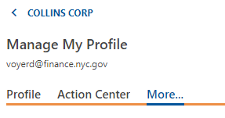
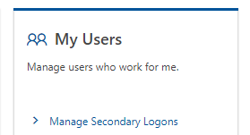
Secondary Logons
Manage My Profile
2. More
3. Manage Secondary Logons
Notes:
You can create and manage logons for your staff that only have access to customers and accounts that you determine. This allows staff to act on your behalf to perform tasks such as filing returns and making payments for your business or clients. Go to Manage My Profile above the orange line, then press More above the orange line again and then under My users click on Manage Secondary Logons.

Slide 4
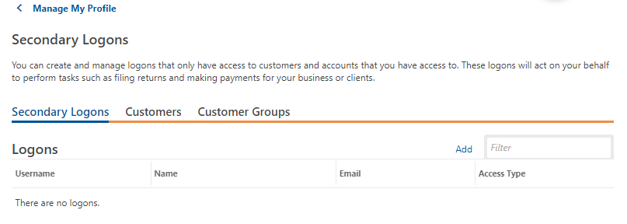
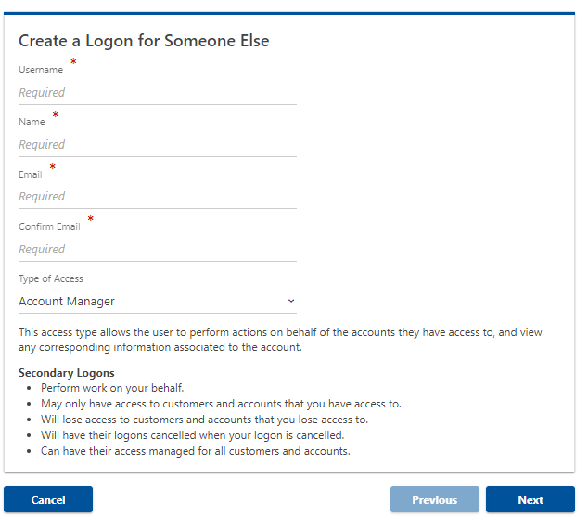
Secondary Logons
4. Add
5.Complete all required fields, click Next
Notes:
Logons. Under Secondary Logons click on Add. Then you will get to the Create a Logon for Someone else page. Then you will get to the Create a Logon for Someone else page, where you’ll type a username, Name, email, confirm email and then click on next. Once this is completed, follow the prompts to successfully create a secondary logon for someone else.

Slide 5
Changing Passwords
1. Manage My Profile
2. Profile tab, Security Panel, Change Password
Notes:
Once you are logged into your e-Services account, you will see the screen on the left. In order to set a password, please direct your cursor to “Manage My Profile” above the orange line and it’ll take you to the screen on the bottom right. Under Security below the orange line, click on “Change Password”.

Slide 6
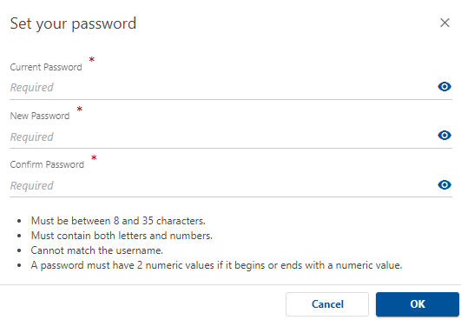
Changing Passwords
3. There are four password requirements:
Must be between 8 and 35 characters
Must contain both letters and numbers
Cannot match username
Must have 2 numeric values if it begins or ends with a numeric value.
4. Fill in the required fields and click ok to set your new password.
Notes:
Once you are logged into your e-Services account, you will see the screen on the left. In order to set a password, please direct your cursor to “Manage My Profile” above the orange line and it’ll take you to the screen on the bottom right. Under Security below the orange line, click on “Change Password”. Once you see this screen, you can set your password. Please keep in mind the following 4 password setting requirements. (Read the list). Once you are successful in creating a password, click ok. If you do not meet those requirements, you will be unable to set a password for e-Services.

Slide 7
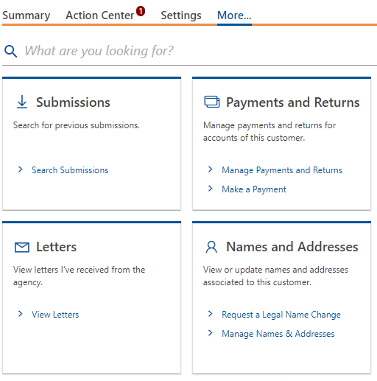
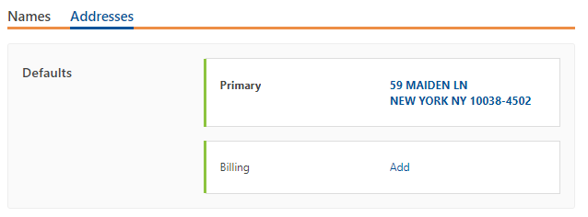
Adding an Address
1. Under “More,” click on Manage Names & Addresses
2. Select Addresses
3. Add
Notes:
To change an address, click on More above the orange line first. Then under Names & Addresses, click on Manage Names & Addresses link, which will take you to the bottom right hand screen. Click on addresses, then hover over to the Add section right next to billing.

Slide 8
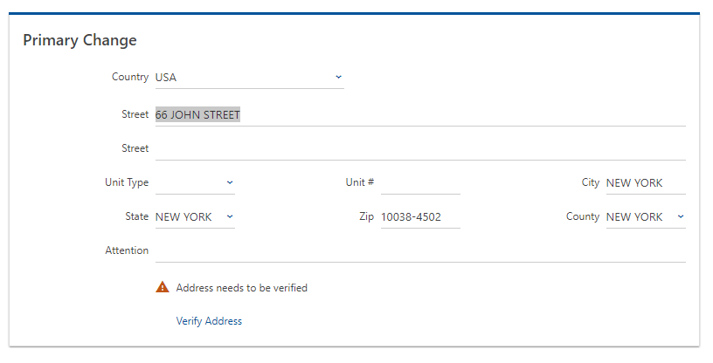
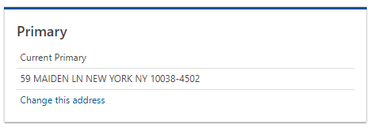
Changing an Address
1. Click on the old address.
3. Enter the new address and click Verify Address
2, Click Change this address
Notes:
That takes you to the bottom left-hand screen , where you will click on Change this address. The old address is 66 John Street on the first floor in New York, New York 10038. Type in the new address by deleting all old information. In this case, it is 59 Maiden Lane, 1st floor in New York, New York, 10038. Click on Verify Address.

Slide 9
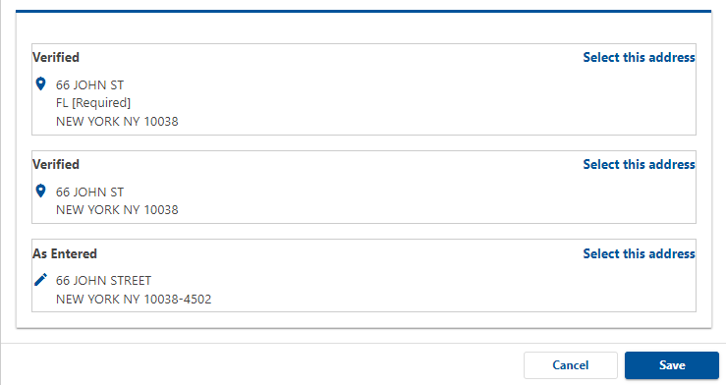
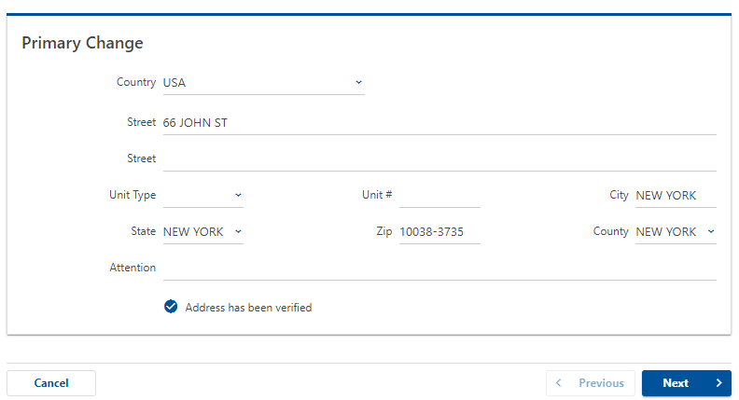
Changing an Address (continued)
4. Select the best match
5. Review the new address and click “Next”
Notes:
Click on the “As Entered” or “Verified” Address and then save it twice. After this is completed, press next.

Slide 10
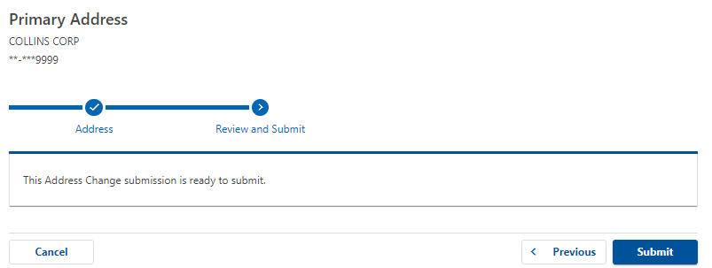
Changing an Address (continued)
6. Select submit to complete the change
Notes:
The review and submit shows that this submission is ready to submit. Click on Submit.

Slide 11
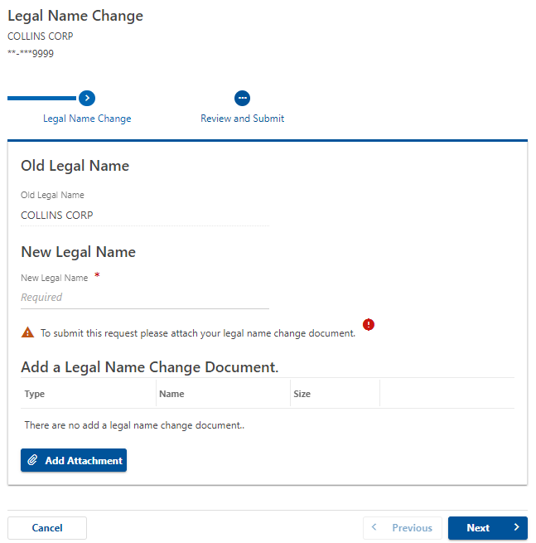
Legal Name Change
1. Click on More, Request a Legal Name Change.
2. Enter new Legal Name, attach your official documentation, Next
Notes:
To request a legal name change, click on More. Then under names and addresses, click on the 2nd list item Request a legal name change. That will take you to the screen on the right, where it shows the old legal name and an option to enter the new legal name. After that’s entered, you have to attach your legal name change document. You do that by clicking on Add and attaching that document to this screen. Then click on next. Click on Review and Submit, then Submit for this Legal Name Change to take effect.

Slide 12
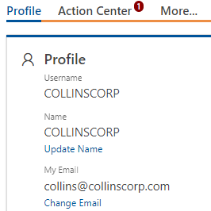
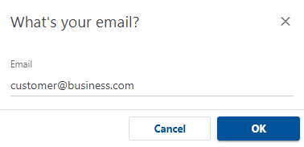
E-mail Address Change
1. Go to Manage My Profile.
2. Select Change Email
3. Enter the new email address and click ok.
Notes:
For e-mail address change, click first on Manage my profile on the top left screen above the orange line. Under profile, click on change e-mail. As shown on the right-hand screen, a new window will pop up asking what’s your email. Input the new email address here and click on the ok button. Please NOTE: all changes will result in an email from e-Services that something was changed.

Slide 13
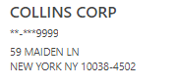
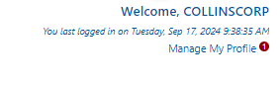
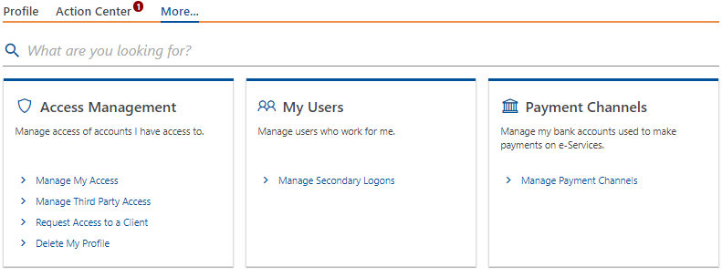
Update Bank Information
1. Click on Manage My Profile.
2. Select More, then Manage Payment Channels.
Notes:
In order to update your bank information, click on Manage my profile link above the orange line once again, click on More, and this time you will click under payment channels on the link that says Manage Payment Channels. Click on the plus icon that says setup new payment channel . To select the payment channel type, click on the blue arrow which will show the two options: Direct Debit foreign bank or direct debit-US Bank. In this payment channel only a direct debit-us bank is allowed. The direct debit foreign bank is not allowed as a payment channel. Click Save.

Slide 14
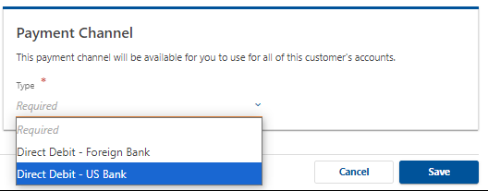
Update Bank Information (continued)
3. Click Setup New Payment Channel.
4. Select Direct Debit- US Bank
Direct Debit can only be drawn on US Bank.
5. Click Save
Notes:
In order to update your bank information, click on Manage my profile link above the orange line once again, click on More, and this time you will click under payment channels on the link that says Manage Payment Channels. Click on the plus icon that says setup new payment channel . To select the payment channel type, click on the blue arrow which will show the two options: Direct Debit foreign bank or direct debit-US Bank. In this payment channel only a direct debit-us bank is allowed. The direct debit foreign bank is not allowed as a payment channel. Click Save.

Slide 15
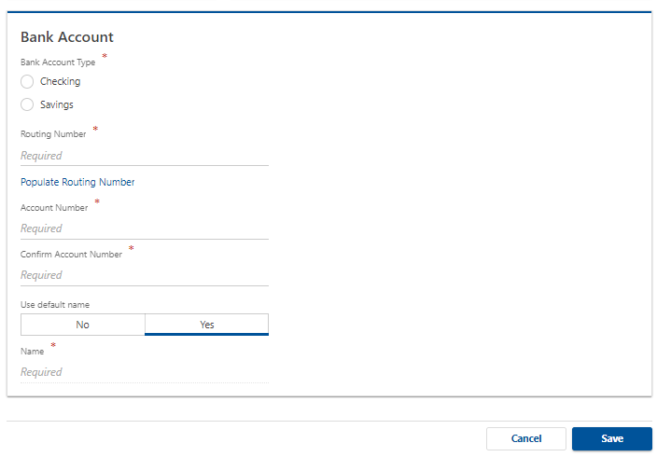
Update Bank Information (continued)
6. Enter all required information and Save
Notes:
Once you click on direct debit us bank option, click on which type of bank account it is (Checking or Savings), enter the routing number and account number. Where it asks to use default name, you can choose yes or no and if it is yes, enter that name in the required field. Click on save and that will complete the Bank information. As I previously mentioned, direct debit – foreign bank is an invalid payment type and isn’t allowed.

Slide 16
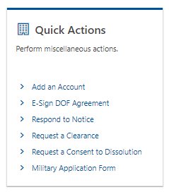
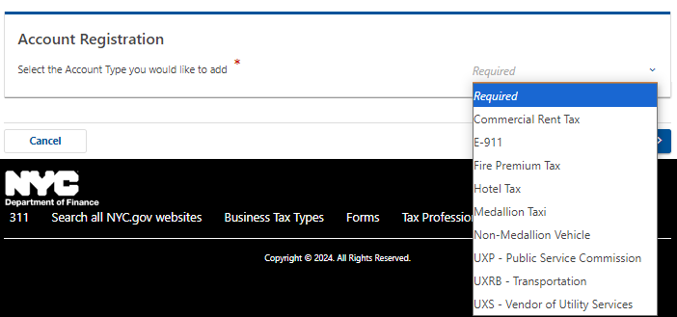
Adding an Account
1. Click on More.
2. Under Quick Actions, click on Add an Account.
3. Under Account Registration, click on Account Type
Notes:
To add an account, click on More, and on the bottom left-hand corner, click on Add an Account under Quick Actions. Once you click on that, it takes you to the right-hand screen, which asks for the account type (Commercial Rent Tax, E-911, Fire Premium Tax, Hotel Tax, Medallion Taxi, Non-Medallion Vehicle, UXP-Public Service Commission, UXRB-Transportation, UXS-Vendor of Utility Services, etc).

Slide 17
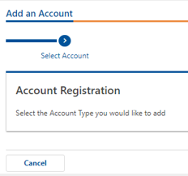
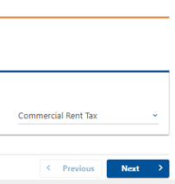
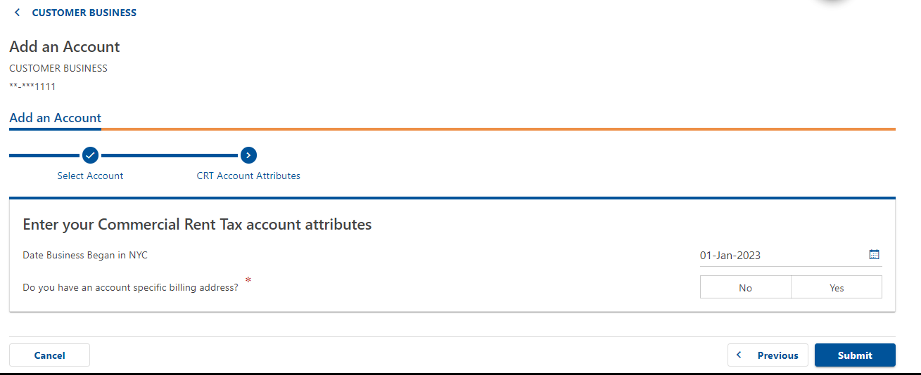
Adding an Account (continued)
Select the appropriate account type
In this example, Commercial Rent Tax, click next.
2. Enter the Account Attributes
Date business began in NYC.
Account specific billing address.
3. Submit
Notes:
The account types are Commercial Rent Tax, E-911, Fire Premium Tax, Hotel Tax, Medallion Taxi, Non-Medallion Vehicle, UXP- Public Service Commission, UXRB-Transportation, or UXS- Vendor of Utility Services. In this case, we chose the first option Commercial Rent Tax and then click next. On the bottom screen, you then have to enter your Commercial Rent Tax account attributes, which is when the business began in NYC. Enter a date or use the calendar to select a date. The system asks if you have an account specific billing address. Enter yes or no to this question and then click Submit.

Slide 18
Payments on e-Services
Fredeline Sylvestre

Slide 19
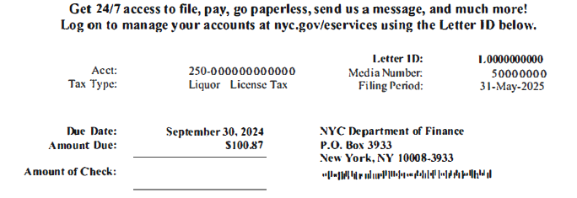
Making Payments with a Letter ID
The Letter ID, which a 10-digit number and begins with the letter “L,” can be found at the top and the bottom of your Notice

Slide 20
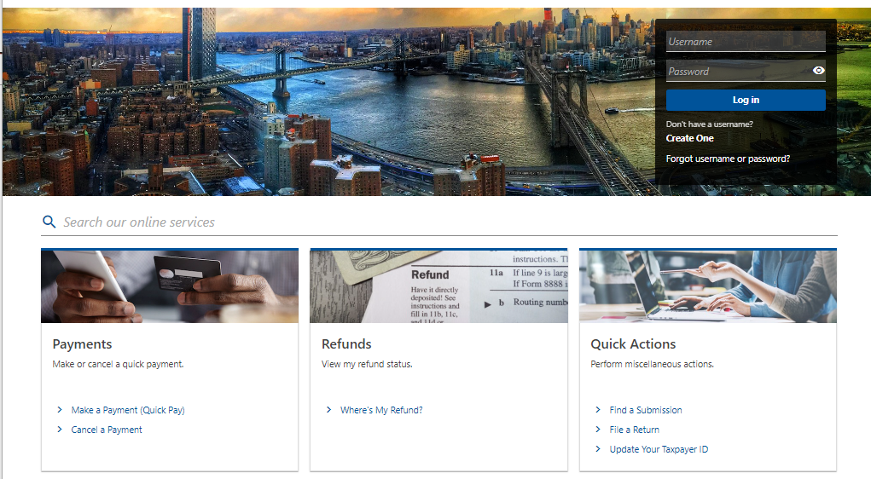
Making Payments with a Letter ID
No need to Log In
Select Make a Payment (Quick Pay)

Slide 21
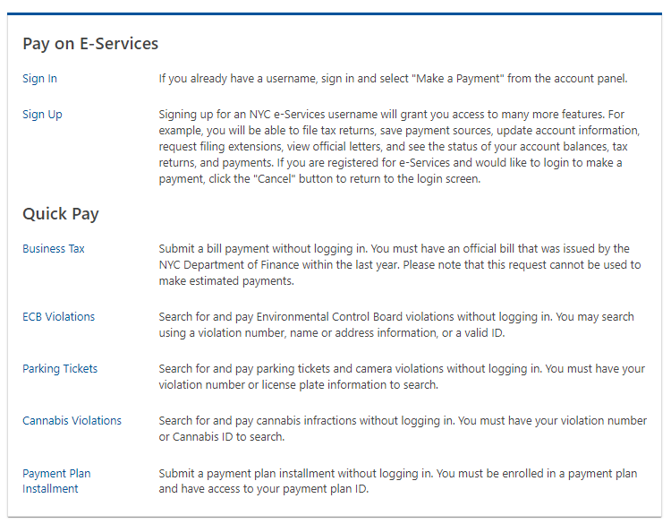
Making Payments with a Letter ID
Select Business Tax for Business or Excise Tax payments
Notes:
Under Quick Pay pick the option Business Tax

Slide 22
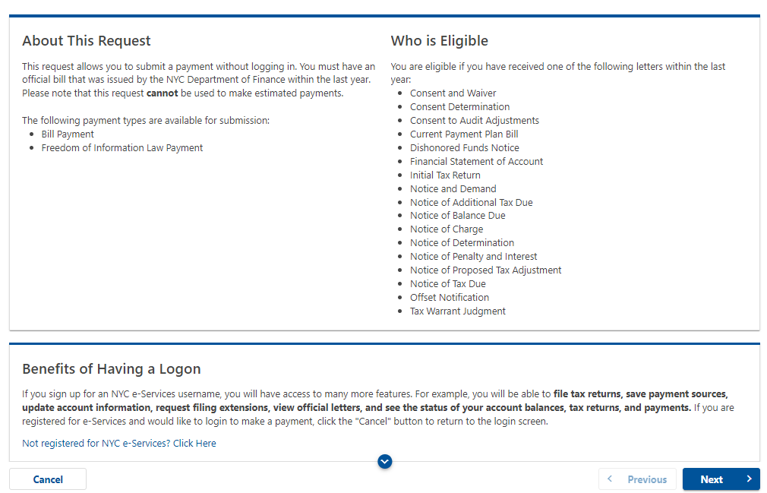
Making Payments with a Letter ID
Select “Next”

Slide 23
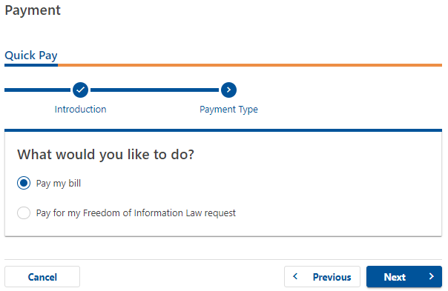
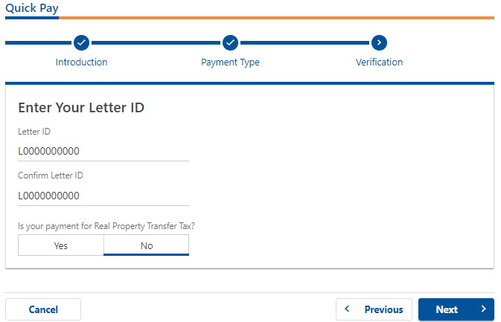
Making Payments with a Letter ID
1. Select Payment Type
2. Click Next
3. Enter and confirm Letter ID
4. Click Next

Slide 24
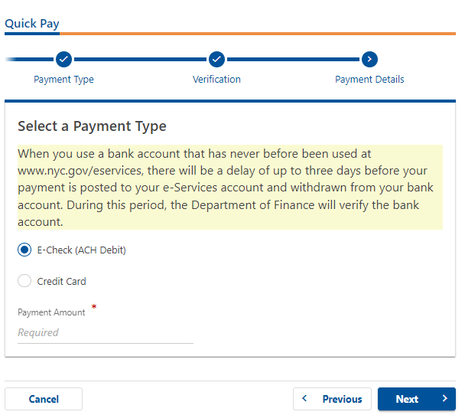
Making Payments with a Letter ID
Select Payment Type
E-Check (no fee)
Credit Card (nominal fee)
2. Enter Amount
3. Click Next

Slide 25
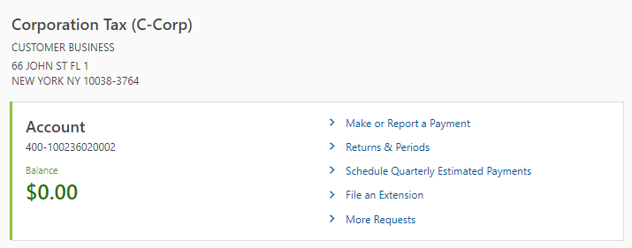
Make or Report a Payment Via e-Services
From your account panel, click on Make or Report a payment
E-Check (ACH Debit) or Credit Card
ACH Credit or Fedwire Payments
Notes:
From your account panel, click on Make or Report a payment

Slide 26
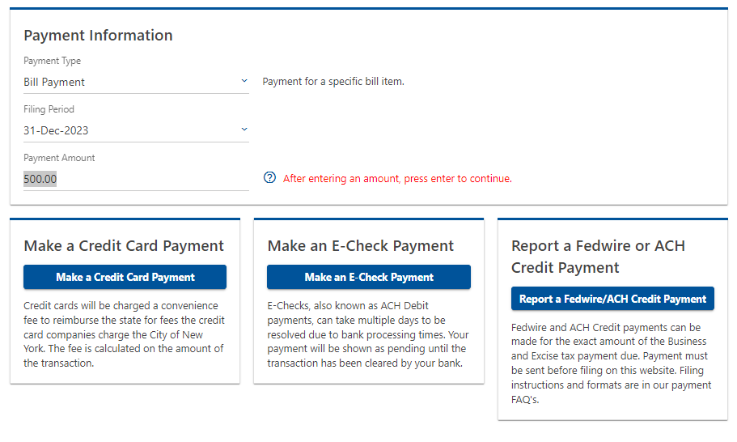
Make or Report a Payment Via e-Services
2. Select Payment Type and Filing
Period from the drop-down lists
3. Add your payment amount
4. Select a Payment Type
Credit Card
E-Check (ACH Debit)
Fedwire/ACH Credit

Slide 27
Reporting an ACH Credit or Fedwire Payment
ACH Credit or Fedwire payments can be made for Business and Excise taxes
Provide to your bank the Department of Finance’s:
ABA routing number (021000322 - Bank of America NA, New York, NY 10017); and
Business and Excise tax bank account number (9355930443 - Bank of America, One Bryant Park, New York, NY 10036)
To report an ACH Credit/Fedwire payment to the Department via e-Services, you must have the Wire Reference number (aka Trace Number), amount, date, and contact name.

Slide 28
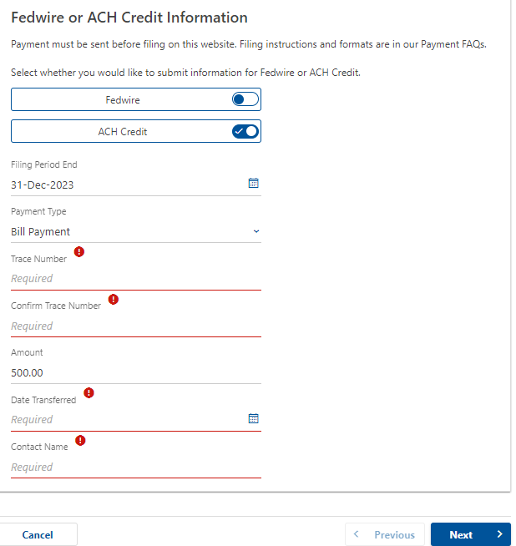
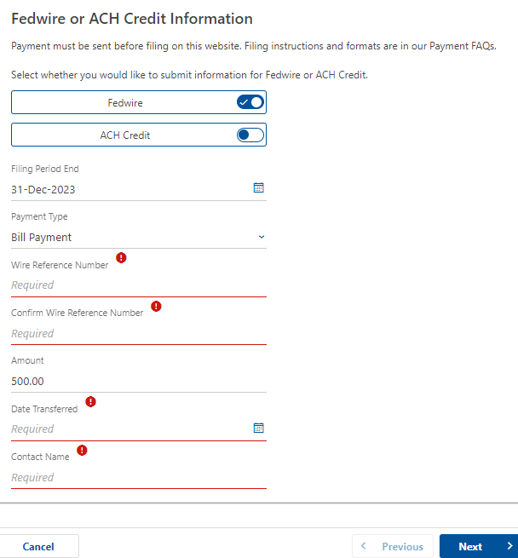
ACH Credit Payment
ACH Credit or Fedwire Payment
Fedwire Payment
1. Fill in the required information:
Trace or Wire Reference Number
Amount
Date
Contact Name
2. Click Next
Notes:
Fill in the required information with the Trace or Wire Reference Number, Amount, Date, and Contact Name.

Slide 29
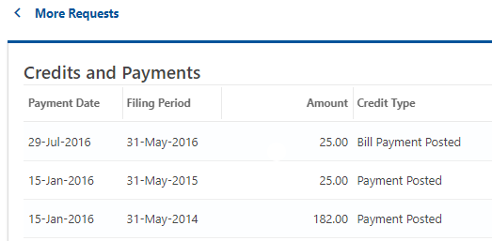
Viewing Credits and Payments
From the Account Panel
1. Click More Requests
3. Credits and Payments View
2. View Credits and Payments
under Payments & Returns
Notes:
From the account panel, click on More Requests

Slide 30
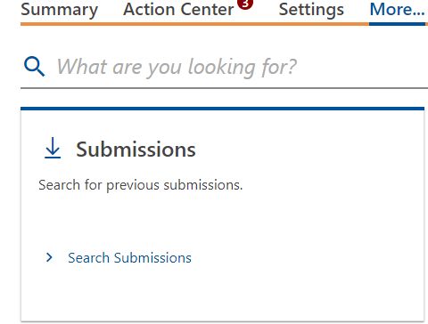
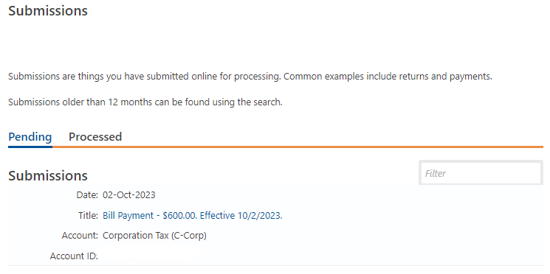
Canceling Payments
On the Summary Screen, click More
then Search Submissions
3. Click on the Payment you’d like to cancel
Please note: Credit Card Payments cannot be canceled via e-Services. Please call 311 for assistance.
Notes:
Click Search Submissions

Slide 31
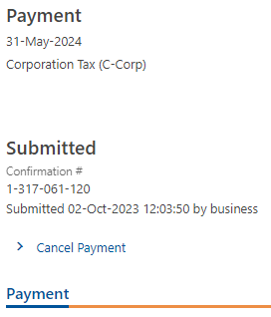
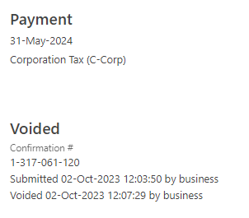
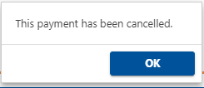
Canceling Payments
4. Click “Cancel Payment”
5. Click Yes and OK to Confirm
Payment has been canceled

Slide 32
Contact Us
Send a Message in e-Services
Respond to a Notice
Virtual Assistant Pilot
Dolores Voyer

Slide 33
Have a Question? Contact Us
1. On the Summary Page, Click More
2. In the Messages Panel​, Send a Message
Notes:
Sending us a question is easy through e-Services. On your Summary page, click on the “more” link, then under the Messages panel, click on Send us a Message

Slide 34
Contact Us
1. Choose the Customer
3. Choose the Period
2.Choose the Account
4. Choose General for all matters
not related to Collections
Notes:
A series of choices will be presented to you: After each selection, you’ll click on Next.
You will see a list of all customers to whom you have access. Choose your customer.
A list of that customer’s accounts will be presented to you. Choose the account.
Then the period.
After you’ve specified the Customer, account, and period, you will be asked whether your question is a general question or a collections question.
Choose “General” for questions about payments, billing, refunds, and e-Services questions. Or choose “Collections” for Statements of Account, Payment Plans, or Warrants. Next

Slide 35
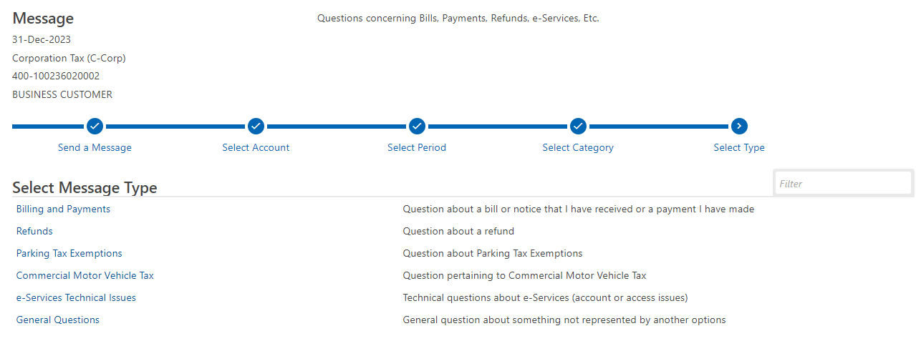
Contact Us
5. Select a message type. More specific information helps us answer your inquiry faster
Notes:
Choose which type of Message you’ll be sending

Slide 36
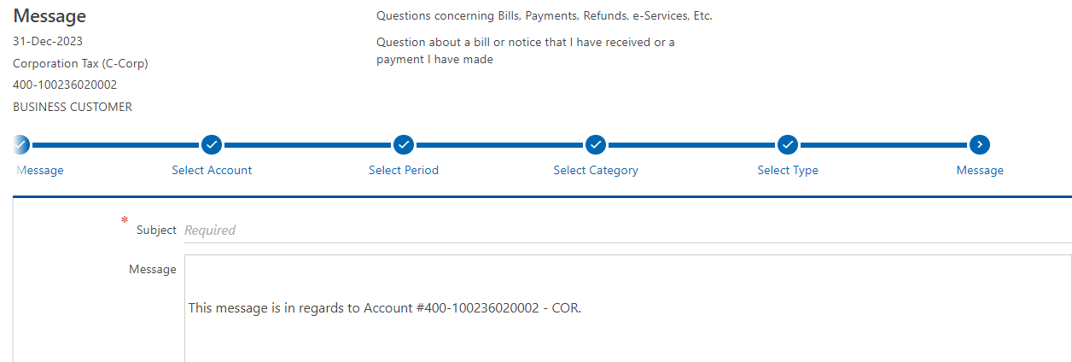
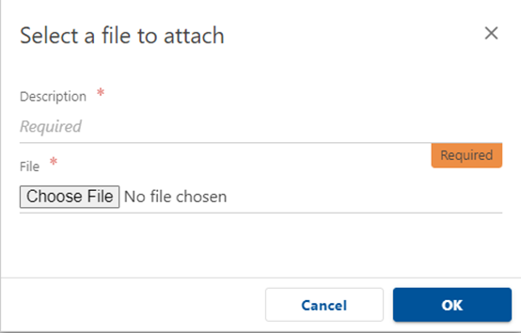
Contact Us
1. Give us the details of your inquiry
3. Lines with red asterisks are required
information. Click OK
2. Add documents as attachments to your message.
4. Click Submit. You will receive a confirmation.
Notes:
Add a subject and your complete message here. Then compose your message as you would any email. You may also add attachments.
Lines with red asterisks are required information.
Click Submit and a confirmation message will appear.

Slide 37
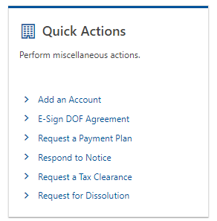
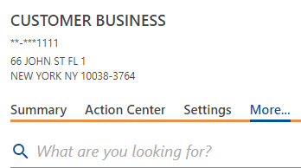
Respond to a Notice Using Quick Actions
1. Have your Notice’s Letter ID ready
3. Under Quick Actions, Click Respond to Notice
2. From the Summary Page, click More
Notes:
To use our “Respond to Notice” function, You’ll need the letter ID from the notice. From your customer homepage, click on the More tab, click on Respond to Notice under Quick Actions

Slide 38
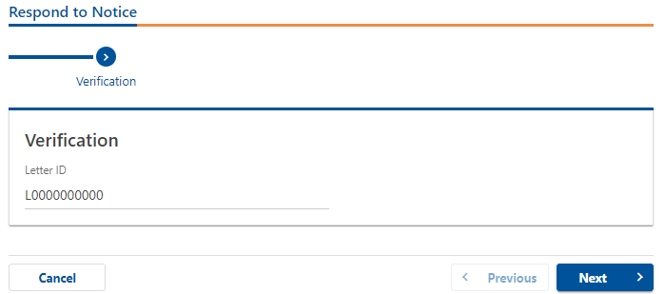
Respond to a Notice Using Quick Actions
4. Add you Letter ID
Notes:
Add the letter ID, which you’ll remember always starts with the letter L and has 10 digits following, from your notice where indicated and click Next

Slide 39
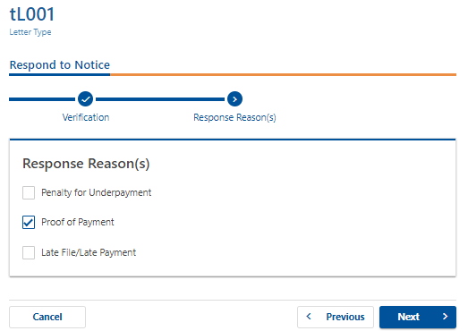
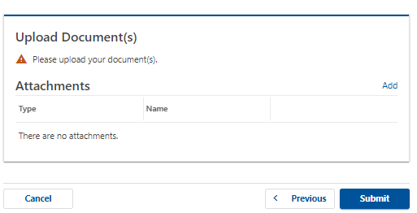
Respond to a Notice Using Quick Actions
6. Add Attachments if needed. Lines with a red asterisk are
required information
5. Choose Your Response Type, Next
Notes:
Choose your response reason, add any attachments, and click OK

Slide 40
Respond to a Notice Using Quick Actions
7. Click Submit
8. Write down or print the confirmation number
for your records
9. Click OK to return to e-Services
Notes:
Click submit. You may print your confirmation or click ok to return to eServices.

Slide 41
Virtual Assistance
Notes:
We’d like to introduce you to Linda, our virtual assistant. Linda can help point you in the right direction for questions and general information. While she is not trained to answer account-specific inquires, she can help you navigate through e-Services and provide information on rules and procedures. Linda will give you replies which include links that take you exactly where you need to go in e-Services, as well as useful information for frequently asked questions quickly, in real time.

Slide 42
Refunds
Kustaa Pantin, Grace Wong

Slide 43
Requesting a Refund on e-Services
1. Log into your e-Services account.
2. Click on “More Requests.”

Slide 44
Requesting a Refund on e-Services
3. Go to Refunds and Click on Request a Refund

Slide 45
Requesting a Refund on e-Services
4. Enter amount you would like refunded and/or credited forward.
Please only enter amounts that you have not already requested.

Slide 46
Where’s My Refund?
You do not need to log in to inquire about the status of your refund.
On the e-Services page, click on the “Where is My Refund” link

Slide 47
Where’s My Refund?
1. You must fill in all required information:
account ID
account type
refund amount
2. Click Search

Slide 48
Submitting a REAP/LMREAP Application Relocation and Employment Assistance Program
1. Log into e-Services.
2. From the Summary Page, Click on More Requests

Slide 49
Submitting a REAP/LMREAP Application
3. Go to Business Credit Applications.
4. Choose the application to be filed.

Slide 50
Submitting a REAP/LMREAP Application
5. Select a filing period from the drop-down menu.
If you are submitting a new application, select the appropriate application.
If you are filing for annual renewal, select “Annual Certification.”

Slide 51
Commercial Motor Vehicle Tax (CMVT)
Andrea Parker

Slide 52
Difference in Account Options Between Medallion and Non-Medallion Accounts
Medallion accounts do not have the option to register plates
through 3rd Party eServices access
1. To register a plate for a Non-Medallion vehicle, click on Register a License Plate
Notes:
There are 2 types of plates/accounts.

Slide 53
Adding Plates on Non-Medallion Accounts
2. Have your DMV-issued registration handy.
All information with a red asterisk is required
Notes:
These are the basic pieces of information that need to be taken from a DMV-issued registration in order to add a plate onto a CMVT account. Anything with a red asterisk is a required field that must be filled in.

Slide 54
Managing License Plates on CMVT Accounts
1. Use the Manage Your License Plates link to mark plates as
inactive, surrendered, or replaced
Notes:
On any CMVT account you can manage your list of license plates by pressing the “Manage Your License Plates” link. This will allow plates to be marked as inactive, surrendered or replaced with a new plate.

Slide 55
Managing License Plates on CMVT Accounts
2. Click the Manage link on the row that the plate is in
Notes:
In order to make changes to a license plate you must click on the “Manage” link in the row that the plate is in.

Slide 56
Managing License Plates on CMVT Accounts Options
Choose which of the 3 options best suits your needs
Notes:
After clicking on the “Manage” link you can choose which of the 3 options best suits your needs.

Slide 57
Managing License Plates on CMVT Accounts – Inactivate or Discontinue
1. To Inactivate, add the cease date and click “OK”
2. To Discontinue, add the date that the plate was surrendered to DMV and click “OK”
Notes:
Inactive plates can be temporarily inactive. Inactivating a plate will provide the opportunity for the plate to be re-activated later on down the line. To inactivate a plate you must click on the “Inactivate” option. The only required information is a cease date (the date when the plate stops being used within the 5 boroughs). This option is almost exclusively used by businesses outside of the 5 boroughs as vehicles can still be active within other New York State (or any other state) jurisdiction without needing to be surrendered if they aren’t active within the 5 boroughs.

Slide 58
Managing License Plates on CMVT Accounts – Replacing a Plate
3. You will be able to choose the old plate number and add new plate
number to replace it
Notes:
Also referred to as transfer a plate. This allows a payment for an old plate # to be used towards a new plate #. To replace a plate you mist click on the “Replace” option. Upon clicking replace you will be able to mark a plate number as the old plate and a new plate number as the new plate, ensuring the return is up to date and any prior payment made for the old plate number will apply to the new one.

Slide 59
Skip the Commute!
All functions are available online via e-Services! www.nyc.gov/eservices
Make Payments
Transfer Plates
Request TLC Clearance Letters
View Outstanding Balances
Address Changes
Bulk Filing-Now open all year
Contact us

Slide 60
Tips and New Developments
Dennis Tairi, Kate Trachtenberg

Slide 61
Amended Returns
1. Make sure the amended return box is checked
2. If the change is due to an IRS or New York State audit adjustment, make sure the appropriate box is checked,
and a Date of Determination is entered
3. Provide an explanation for filing an amended return
Notes:
We are noticing a lot of issues regarding amended returns.
When filing an amended return, make sure the amended box is checked. If this box is not marked, it may result in your return not being posted.
If the change is due to an IRS or New York State audit adjustment, make sure that the appropriate box is checked, and a Date of Determination is entered.
If you’re submitting an amended return, please submit a statement or explanation stating why you’re filing an amended return. Failure to do so may result in your refund requests being delayed and/or rejected.

Slide 62
Valid Extension Requests
Extension of time to file, not pay.
Make sure to fill in all the lines. Blank or incomplete extensions may be deemed invalid.
Valid extension = timely filed AND properly estimated.
Properly estimated means:
a) Not less than 90% of the tax for the year for which an extension is requested
as finally determined OR
b) not less than the tax shown on the return for the preceding taxable year
that consisted of 12 months.
Notes:
What makes a valid extension?
Taxpayers may request an automatic 6-month extension of time to file their returns. This is an extension of time to file a return, not an extension of time to pay the tax for the year.
For an extension to be considered “valid” the tax due must be properly estimated and timely filed. The taxpayer must submit a properly estimated amount of tax for the year, meaning:
a) not less than 90% of the tax for the year for which an extension is requested as finally determined OR
b) not less than the tax shown on the return for the preceding taxable year that consisted of 12 months.
Finance will not grant an extension to a taxpayer that fails to meet all of these requirements.
If the taxpayer has obtained a valid automatic extension, only interest will be charged on any balance due with the return.

Slide 63
Commercial Rent Annual Return Errors
Please submit the entire return
The CR-A is an annual return, not a 4th quarter filing
Taxpayers must report the rent for the whole Commercial Rent Tax year, not just the 4th quarter
Small Business Tax Credit
Rate class
The Base Rent Before Rent Reduction (or, if less than one full year, the Annualized Base Rent Before Rent Reduction) should be used to determine the rate the rent paid for a premises is taxed at.
Multiple locations in the same premises
Multiple floors, suites, and units in the same premises (Borough-Block-Lot) should be included as one premise per RCNY 19 §7-01
Notes:
Taxpayers appear to be making many errors when filing their Commercial Rent Tax annual returns. In order to prevent any discrepancies in the future, we will be going over some of the common errors, and how to remedy them.
Some taxpayers only submit page 1 when filing their CRT annual return. Please submit the entire return, so that we can avoid any discrepancies with the tax and any corresponding credits the taxpayer may be entitled to.
CR-A returns should report the rent paid for the entire CRT year, not for the 4th quarter. Some taxpayers are treating the CR-A as a CR-Q4, and this is incorrect.
The Small Business Tax Credit can be computed on page 3 of the CRT annual return. Taxpayers have not been filling this form out correctly. 1) please enter the total income from the period preceding the CRT period the taxpayer is filing for (example: if the taxpayer is filing a CR-A for 6/1/2023 through 5/31/2024, then enter the income from the 2022 return, or 2021 if it’s a fiscal year, depending on the end date). For premises that were occupied for less than one full year, the Small Business Tax Credit is not computed based on the annualized base rent. If the amount paid is below $250,000, but the annualized base rent is above $250,000, the taxpayer is not entitled to the credit. In addition, if pages 2 and 3 of the CR-A are not submitted, the taxpayer’s Small Business Tax Credit will be disallowed.
Some taxpayers make an error where they take the base rent after the 35% rent reduction on page 2, and use that to determine the tax rate. The base rent BEFORE rent reduction (or, if less than one full year, the annualized base rent BEFORE rent reduction) should be used to determine the rate the rent paid for a premise is taxed at, which are on lines 13 and 14 of page 2 of the return.
Multiple locations (floors, suites, units) in the same premise (block, building, lot) should be included as ONE premise. Taxpayers sometimes separate out each floor, and this is incorrect. This can be found in the CR-A instructions, as well as in the definitions section of RCNY 19 Section 7-01.
As an added note: Taxpayers often request their period balances prior to filing, so they know how much they have, and how much they need to pay. Just a heads up, we are currently working an easier method for the taxpayers to get this information.

Slide 64
Final Return Checkbox
Be sure to check the Final Return checkbox if the business has ceased operations in New York City.
Notes:
The Final Return Checkbox: what it’s for, due date changes for final returns,
how P&I accrues on a final return
If a taxpayer ceases doing business in the city before the end of their usual tax year, there is an accelerated filing and payment deadline.
The City requires taxpayers to file a final return on or before the 15th day after the date that the corporation ceases to be subject to tax.
Taxpayers that are unable to file the return by this date can file for an automatic extension for filing.
The same as with a standard “non-final return” the proper estimated tax must be paid by the date of the extension, or it will not be considered valid.
Penalties and interest would accrue from this 15-day date rather than the typical March/April deadline.

Slide 65
Biotechnology Credit
Credit available for companies subject to NYC business taxes (UBT, GCT, Corp. Tax) that qualify as a Qualified Emerging Technology Company (QETC).
The credit is sum of the following amounts:
18% of the cost or other basis of research and development property, and certain other costs and fees incurred in connection with emerging technology activities
9% of qualified research expenses paid or incurred by the taxpayer
100% of high-technology training expenses paid or incurred by the taxpayer, limited to $4,000 per employee per year
For taxpayers filing as part of a combined group, the credit is computed on a separate company basis and may be applied against the combined tax. The total amount of credit allowable to a taxpayer is capped at $250,000.
Credit is limited to a span of three years 2023-2025, and there is a $3 million cap on total value of credits that can be issued each year.
Additional guidance and examples available on our website. www.nyc.gov/biotechcredit
Notes:
Biotechnology Credit
Credit that is available for businesses that provide free or subsidized infant or toddler care for their employees.
A QETC must meet the following qualifications to be eligible:
The company must be engaged in biotechnology
The total annual product sales must be $10 million or less
The company’s primary products or services must be classified as emerging technologies, OR the company has research and development (“R&D”) activities in New York City, and the ratio of R&D funds to net sales equal to or greater than the average ratio of all companies surveyed by the National Science Foundation
The company has research and development (“R&D”) activities in New York City, and the ratio of R&D funds to net sales equal to or greater than 6%
The company must have 100 full-time employees or less, and at least 75% of those employees must be employed in New York City
The gross revenues for the immediately preceding year cannot be greater than $20 million (this amount includes affiliates and related members)
The credit is calculated based on the sum of the following amounts:
18% of the cost or other basis of research and development property, and certain other costs and fees incurred in connection with emerging technology activities
9% of qualified research expenses paid or incurred by the taxpayer
100% of high-technology training expenses paid or incurred by the taxpayer, limited to $4,000 per employee per year
For taxpayers filing as part of a combined group, the credit is computed on a separate company basis and may be applied against the combined tax. The total amount of credit allowable to a taxpayer is capped at $250,000.
The credit is limited to a span of three years 2023-2025, and there is a $3 million cap on total value of credits that can be issued each year.
Taxpayers will have to apply on or before January 15th of each year – if this date falls on a weekend or holiday, the deadline will be extended to the next business day.
If an application is incomplete as of this date, the taxpayer may lose all or part of their credit.
The Department of Finance will determine the amount of Biotechnology Credit that may be claimed and will mail a certificate of eligibility to the taxpayer indicating the amount that may be claimed on or before February 28th.

Slide 66
NYC Pass-Through Entity Tax (PTET)
Administered by the New York State Department of Taxation and Finance.
Optional tax under Tax Law Article 24-B1 that applies to city partnerships or city resident New York S corporations for tax years beginning on or after January 1, 2022.
Only taxpayers that have elected to participate in the New York State pass-through entity tax (NYS PTET) may annually elect to pay on certain income specified in the law.
The NYC PTET annual election must be made on or after January 1 but no later than March 15.
The election must be made online through the entity’s New York State Business Online Services account using the Pass-Through Entity Tax (PTET) Annual Election web application.
The NYC PTET election will be made at the same time as the NYS PTET election.
Estimated payments of NYC Unincorporated Business tax for city partnerships and NYC General Corporation tax for city resident New Yok S corporations must still be made to NYC when a taxpayer elects to participate in the NYC PTET.

Slide 67
Employee Retention Credit (ERC)
NYC Treatment of the Federal Employee Retention Credit
Wages and salaries disallowed as a federal business expense deduction due to the taxpayer’s receipt of the federal Employee Retention Credit between 2020 and 2022 may be deducted when computing New York City taxable income for the taxable year.
Banking Corporation Tax taxpayers should report this modification on Form NYC-1, Schedule B, Line 20.
Business Corporation Tax taxpayers should report this modification on Form NYC-2 or NYC-2A, Schedule B, Line 18.
General Corporation Tax taxpayers should report this modification on Form NYC-3A or NYC-3L, Schedule B, Line 14.
Unincorporated Business Tax taxpayers should report this modification on Form NYC-202, Schedule B, Line 14 or Form NYC-204, Schedule B, Line 18.

Slide 68
Interest on Underpayments with Valid Extension
For New York City business taxes, interest must be paid on any amount of tax that is not paid by the statutory due date even if an extension of the time for filing has been granted.
Interest runs from the last date for payment under the law until the date paid.

Slide 69
Questions?

