Slide 1
How DOF Is Enhancing Customer Experience

Slide 2
Panel Introduction
Division | Name
Customer Operations – Collections | Pamela Parker-Cortijo Siu Chan Shenneth King Demonstration Table: Caressa Ogletree Jessie Guzman
External Affairs | Thomas DiGiulio
Payment, Billing and Refunds | Alfonso Abreu Jackson Revolus

Slide 3
Overview of DOF Customer Service
Collections

Slide 4
NYC Department of Finance’s Four Pillars
NYC Department of Finance
Fairness
Transparency
Efficient | Effective
Customer Service
NYC Department of Finance (DOF) is responsible for administering the tax revenue laws of the city fairly, efficiently / effectively, and transparently to instill public confidence and encourage compliance while providing exceptional customer service.

Slide 5
OCA
DOB
DOT
Other NYC Agencies
NYS
IRS
Others
Taxpayers
Collections
External Affairs
Payment, Billing and Refund
Taxpayer Advocate (Appendix A)
Legal Affairs
(Appendix B)
Tax Audit (Appendix C)
Sheriff (Appendix C)
Universe of DOF Customer Service

Slide 6
Customer Inquiry Channels
Call Centers
Chat Bot
CRM Portal
Email
Mail
Voice Bot
Web message (e-Services)
Business Centers

Slide 7
Customer Engagement and Self-Service Enhancements
e-Services (online portal) | New Debt Type – ECB and Parking Judgments Self-Service Payment Plan Benefits for Registered Accounts/Customers
Chat Bot and Voice Bot | Chat Bot Status: Pilot/Training Volume and Statistics Top Inquiries Voice Bot Status: In Planning Stage
Property Tax Payment Plan | 3 types of Property Tax Payment Plans No Down Payment Requirement Monthly or quarterly payments for up to 10 years
Improved Notices and Website | Status: Completed | In effect

Slide 8
Interaction among/between DOF Divisions
Panel

Slide 9
DOF Division - Collections
Division Description:
The Collections Division is responsible for managing the life cycle of the Department's delinquent business/excise tax warrants, parking judgment debt, and ECB judgment debt.
Sources of Customer Inquiries:
Taxpayers (web messages via e-Services, calls via call center, visits at business centers)
Other DOF Divisions (External Affairs, Legal Affairs, Taxpayer Advocate, Payment/Billing/Refund)
NYC (City Council, Mayor’s Office, DOB, DOT, Other NYC Agencies)
NYS, IRS and Others
DOF Divisions Interacted With To Resolve Customer Inquiries:
Mainly External Affairs, Taxpayer Advocate, Payment Billing and Refund
Collections also work closely with Legal Affairs, Sheriff, and Tax Audit for cases that require timely attention and special review

Slide 10
DOF Division – External Affairs
Division Description:
The External Affairs Division is responsible for internal and external agency communications. This includes customer and constituent services, public outreach efforts, intergovernmental and legislative affairs, web and social media, marketing, executive communications, and the review of all agency letters, notices, and other public-facing materials.
Sources of Customer Inquiries:
Taxpayers
Elected Officials
Other DOF Divisions (Collections; Legal Affairs; Taxpayer Advocate; Payments, Billing and Refunds)
We collaborate with other DOF Divisions to resolve customer inquiries and issues:
Collections; Legal Affairs; Payments, Billing and Refunds; Office of the Taxpayer Advocate; Property; etc.

Slide 11
DOF Division – Payment, Billing and Refund
Division Description:
The Payments, Billing and Refunds Division is responsible for posting returns and payments, billing, and distributing refunds. The division is the starting point for tax liabilities and balances, after which other units and divisions begin their work, such as Collections and the Audit Division.
Sources of Customer Inquiries:
Taxpayers and their authorized representatives
Other DOF Divisions (Collections, External Affairs, Legal Affairs, Taxpayer Advocate)
DOF Divisions Interacted With To Resolve Customer Inquiries:
Collections, Taxpayer Advocate, Audit, Legal Affairs

Slide 12
Examples of Customer Service Flow (also see Appendices D-F)
Taxpayer Advocate
Collections
Audit
Taxpayer Advocate
Customers
Collections
# 1 Inquiry regarding account balance and payment options (Business/Excise Tax)
# 2 Inquiry regarding DOT permit placed on hold due to judgment debt (ECB)
External Affairs
Collections
DOT
Collections
Customers
City Council
Customers
External Affairs
Collections
External Affairs
City Council
# 3 Inquiry via City Council on behalf of a constituent regarding judgment debt (Parking)

Slide 13
Customer Engagement and Self-Service Enhancements: e-Services
Collections

Slide 14
What is e-Services
NYC e-Services
is a secure online portal that allows taxpayers to manage their tax and collections accounts online.

Slide 15
What is New in e-Services
Debt Types:
Business Tax and Excise Tax
ECB (new)
Parking (new)
Benefits for Customers/Taxpayers:
Streamlined Management of Judgment Debt
Self-Service Payment Plan
User-Friendly Account Updates, Communication (via web message), and Access to Letters, Notices and Statements

Slide 16
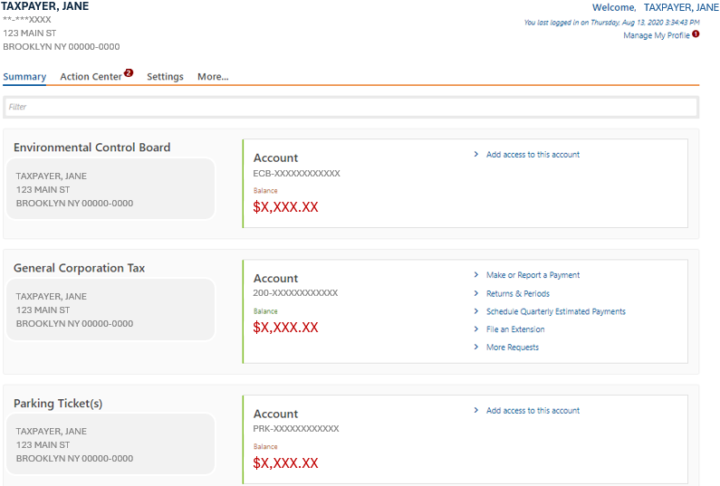
e-Services - New Debt Types - Streamlined Management of Judgment Debt

Slide 17
e-Services - New Debt Types - Streamlined Management of Judgment Debt
Registered customers/users can
see account and judgment debt information, now for Business/Excise Tax, ECB and Parking
create self-service payment plans (40,000+ active payment plans)
manage account and update preference/settings

Slide 18
Customer Engagement and Self-Service Enhancements: Chat Bot and Voice Bot
Collections

Slide 19
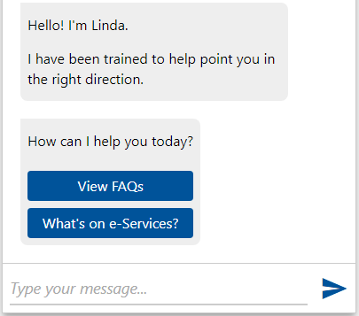
Chat Bot – Meet Linda
On the e-Services home page, Linda the Chat Bot can be found at the top right of the screen.
Once activated/clicked, users can view FAQs, find out a list of services included in e-Services, or type a question for Linda to search and respond.

Slide 20
Chat Bot – What Linda Can Do
Linda can help users find transactions available on e-Services and displays answers to frequently asked questions.
Divisions/Areas of Inquiries Covered:
Collections
Business/Excise Tax
Parking
ECB (in the pipeline)
Payments, Billing and Refunds

Slide 21
Chat Bot – Examples Scenario #1
A customer who wants to find out more information about entering a payment plan and how/where to sign up.
Suggested Path When Engaging Linda:
User is logged off (assuming a non-registered customer)
User enters "I can't afford my taxes" or "I can't afford my parking tickets"
User clicks on “Visit our website“ to go to webpage with eligible details
User who do not have an e-Services profile can click “Register here” to start the registration process.

Slide 22
Chat Bot – Examples Scenario #2
A customer who has issue creating an account in e-Services and wants to find out how to register/set up.
Suggested Path When Engaging Linda:
User is logged off (a non-registered customer)
User enters "How do I register"
User clicks on "Troubleshooting Registration"
User determines if any of the FQAs help.
If not, user can click on "I need technical assistance" to get call in information

Slide 23
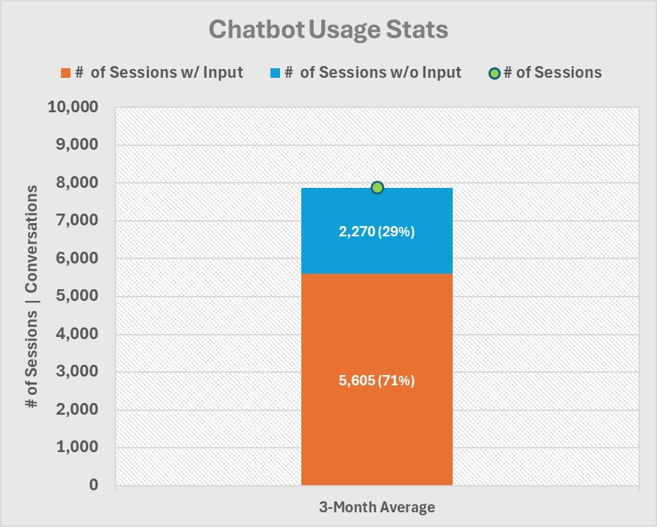
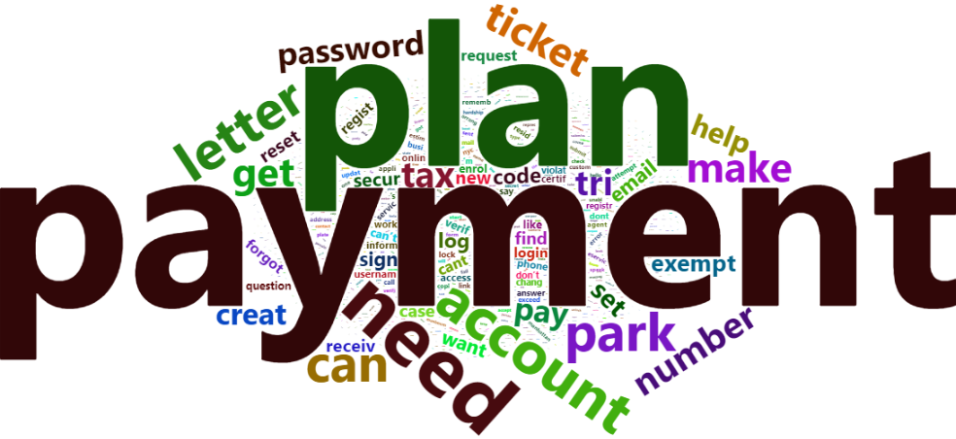
Chat Bot – Volume and Statistics
Volume (per month):
7,800+ chatbot sessions
Statistics:
71% with at least one input
Top 3 Inquiries:
Payment Plan related
Payment related (balance, etc.)
Account Registration / Log In

Slide 24
Voice Bot
DOF is currently planning a voice bot pilot program that will use an AI ‘assistant’ to help customers:
Initial phase:
Answer most parking ticket questions
Lookup and pay parking violations and set up payment plans
Phase 2:
Lookup and pay property taxes (answering property-related question not included)
Benefits:
24/7 customer service via voice bot
Understand questions spoken in natural language in any of 11 languages
Shorter wait times for a representative, if needed
Securely pay parking violations
Securely pay property taxes
Enable call center staff to focus on customer issues that require a human

Slide 25
Customer Engagement and Self-Service Enhancements: Property Tax Payment Plan
Payment, Billing and Refund

Slide 26
Property Tax Payment Plans
The Department of Finance offers 3 types of Property Tax Payment Plans:
Standard Payment Plan
Reduced Interest Rate Payment Plan
Property Tax and Interest Deferral (PT AID) Payment Plan
Highlights:
No Down Payment Requirement
Monthly or quarterly payments for up to 10 years.
Notes:
If you have overdue property taxes, you may be eligible to set up a payment plan, so you can pay what you owe in installments instead of all at once.
The Department of Finance offers 3 types of Property Tax Payment Plans. (refer to slide).
The highlights for all property payment plan types are (refer to slide)

Slide 27
Standard Property Tax Payment Agreement
Highlights:
All property types are eligible.
No income limit
No down payment required.
Monthly or quarterly payments for up to 10 years.
Notes:
The most common payment plan is the Standard Payment Plan. The highlights of this plan are that all property types are eligible and there is no income limit.
Applicants must provide proof of ownership. If the property is owned by a corporation, the individual who signs the payment plan must first provide written proof of Power of Attorney or that they are an officer of the corporation.

Slide 28
Reduced Interest Rate Property Tax Payment Plan
Highlights:
Low Interest Rate
For single-family homes, condominiums, or other tax class one property with an assessed value of $250,000 or less.
Primary residence for at least one year.
The total income of all owners does not exceed $200,000.
No down payment required.
Monthly or quarterly payments for up to 10 years.
Notes:
Certain property owners may qualify for the Reduced Interest Rate Payment plan. The highlights of this plan are: (refer to slide)
You will automatically receive a Reduced Interest Rate if you are enrolled in a standard payment plan, are up to date on your payments, and receive the Senior Citizen or Disabled Homeowner’s Exemption or the Enhanced STAR credit/exemption.

Slide 29
Property Tax and Interest Deferral Program (PT AID)
Highlights:
Low Interest Rates
Income limit of $98,700 (increasing to $107,300 in 2025)
PT Aid has three payment plan types
No down payment required.
Monthly or quarterly payments for up to 10 years.
PT AID Plans:
Low-Income Senior (LIS)
Fixed-Term Income-Based (FTI)
Extenuating Circumstances Income-Based (ECI)
Notes:
PT AID payment plans also allow you to pay overdue property taxes in multiple installments, but because it considers your income, your scheduled payments are likely to be lower and you may be able to defer payments.
There are three PT Aid plans:
Low-Income Senior (LIS): A homeowner must be 65 or older to qualify for this plan.
Fixed-Term Income-Based (FTI): There is no age requirement for this plan and homeowners can enroll in a payment plan which can limit their payments to a maximum of 8% of their adjusted gross income.
Extenuating Circumstances Plan Income-Based: For homeowners who experience the death or serious illness of a property owner or an immediate family member of the owner. If a homeowner experiences a loss of income, they may qualify for this plan or if you are enrolled in the Department of Environmental Protection’s Water Debt Assistance program.

Slide 30
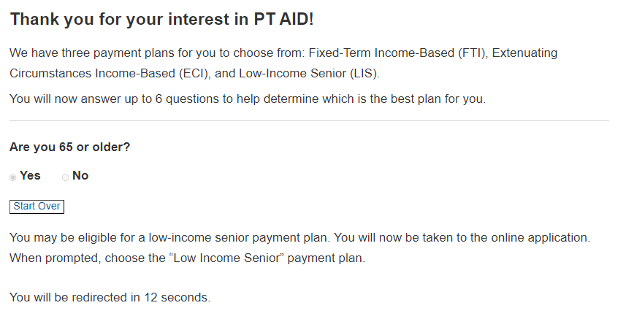
Which payment plan should I apply to?
DOF has an online payment plan screening tool to help taxpayers determine which plan is best.
The online tool is available online at:
www.nyc.gov/checkplaneligibility
Notes:
If you need assistance in deciding which payment plan is best for you, you can use our online payment plan screening tool. The payment plan screening tool is located on the main payment plan page on the DOF site. You will be asked a few questions such as your property type, age, and income. Once complete, you will be directed to the online payment plan application that is best suited for you.

Slide 31
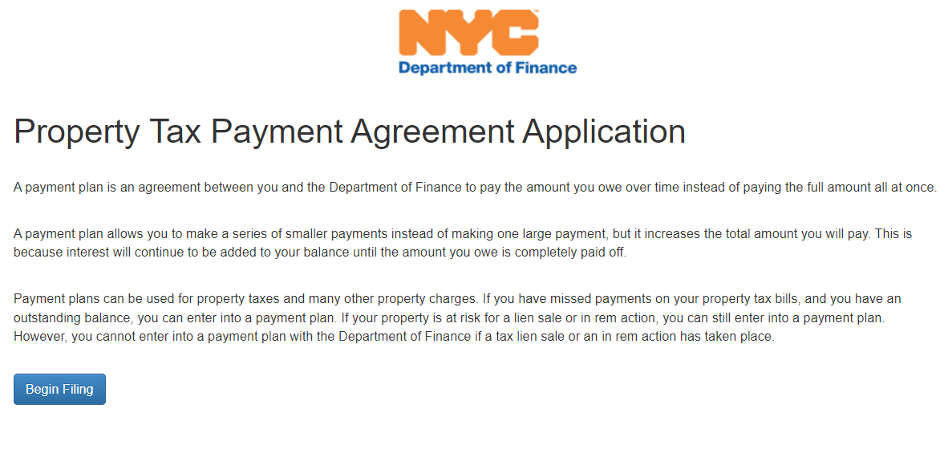
How to Apply?
Taxpayers can easily apply online at the NYC DOF Website:
www.nyc.gov/dofpaymentplans
Notes:
The online Property Payment Plan, also known as Smart File, will ask you to enter your property address which will populate your property information such as the assessed value and the total amount of taxes due.
You may also attach your required documents such as your photo id, income documents, and deed. You will be able to submit your application directly to us in just a matter of minutes.

Slide 32
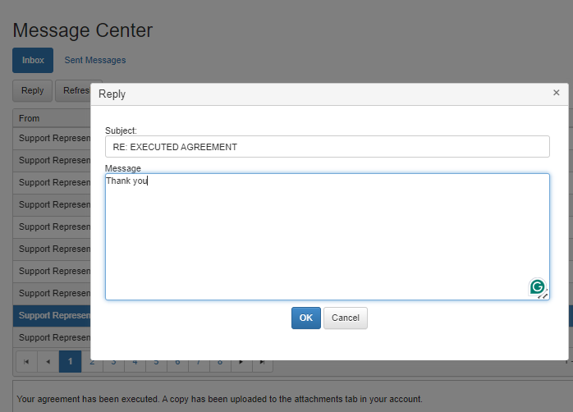
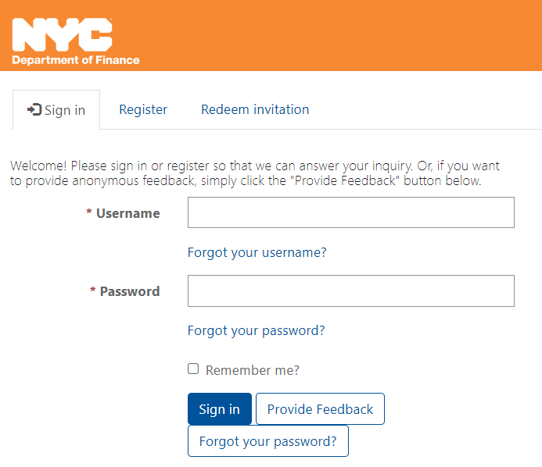
How to contact us?
Via Smart File
www.nyc.gov/PTsmartfile
Via Online at DOF Account
www.nyc.gov/contactptaid
Notes:
To contact us regarding your Property Payment Plan Application, simply message us through Smart File. If you have general questions about property payment plans, contact us by going to www.nyc.gov/dofcustomerservice

Slide 33
Customer Engagement and Self-Service Enhancements: Improved Notices and Website Redesign
External Affairs

Slide 34
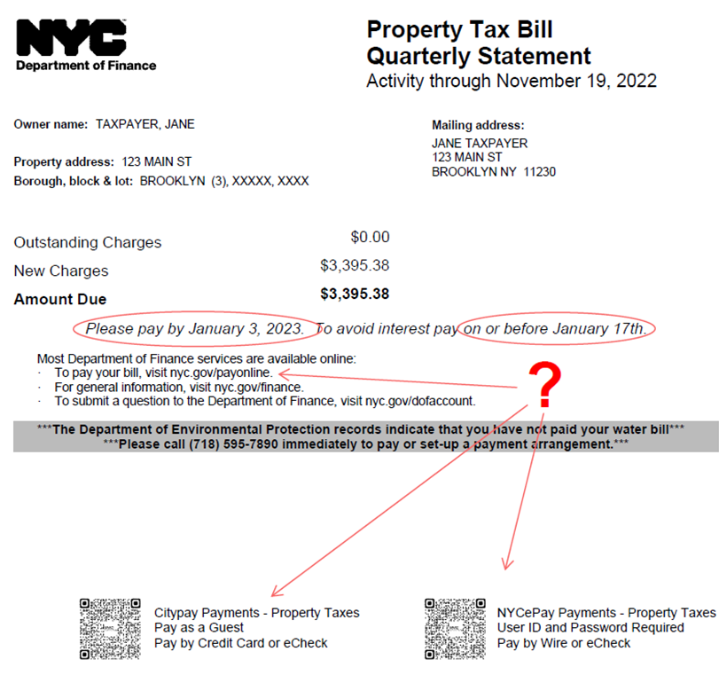
Improved Notices
Previous
Statement of Account (SOA)
Text-heavy
Due date
How to pay online?

Slide 35
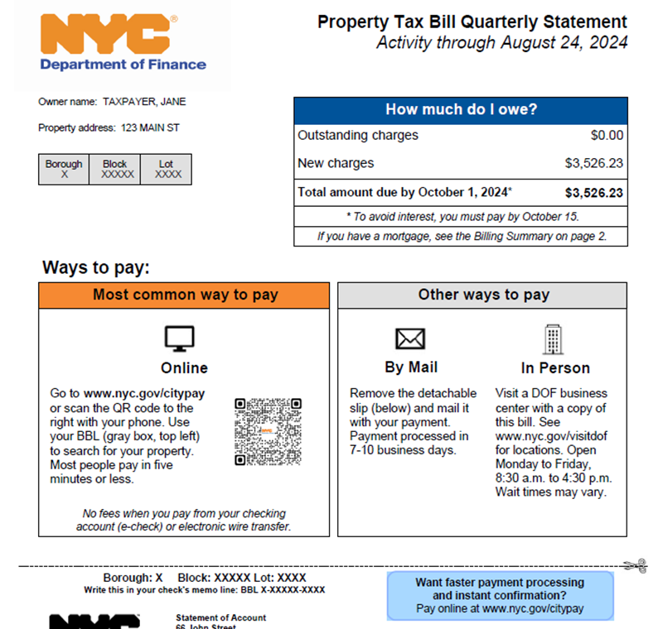
Improved Notices (cont’d)
Redesigned
Statement of Account (SOA)
Eye-catching
Clear payment amount and date
Promote online payment

Slide 36
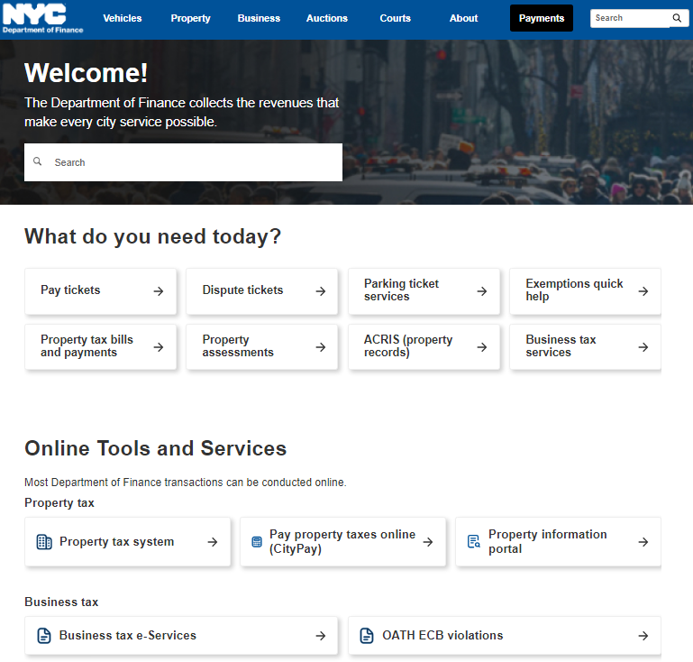
Website Redesign
NYC DOF Website (https://www.nyc.gov/site/finance/index.page)
DOF hired an independent research firm to interview New Yorkers and identify pain points which helped shaped the redesign
Taking direct feedback from New Yorkers combined with website analytics and user experience testing resulted in a new website truly designed by and for the people that use it.

Slide 37
Process Overview - Public Improvement Liens - Bankruptcy
Collections

Slide 38
Public Improvement Lien
Public Improvement Lien Process Overview
When DOF receives a Notice of Lien, DOF works with the NYC Law Department, the NYC Comptroller, and various NYC agencies.
If the Notice of Lien is complete, payment to the contractor will be withheld until the amount withheld equals 150% of the face value of the public improvement lien. See New York Lien Law Section 21(6-a).
The lien is recorded on the Public Improvement Lien Docket.
DOF’s Public Improvement Lien Docket and Public Improvement Lien Form can be located online on DOF’s website by visiting:
https://www.nyc.gov/site/finance/about/public-improvement-lien-mechanics-lien.page
See Appendix G for more details

Slide 39
Bankruptcy
NYC DOF’s Bankruptcy Process Overview
The New York City Department of Finance (DOF) receives electronic bankruptcy notices through the Bankruptcy Noticing Center, in addition DOF receives daily paper bankruptcy notices.
The appropriate divisions at DOF are notified of the new bankruptcy notices and bankruptcy alerts are placed on those taxpayers/ respondents who have filed bankruptcies and DOF stops all collection enforcement action.
DOF is also notified when bankruptcies are dismissed or terminated and will release the holds and continue enforcement action when appropriate.
See Appendix H for more details

Slide 40
Questions
Panel

Slide 41
Appendices

Slide 42
Appendix A - Taxpayer Advocate Division
Division Description:
The Office of Taxpayer Advocate (OTA) takes action on behalf of taxpayers who have been unable to resolve their property and business tax issues through regular agency channels. In addition, the OTA makes systemic recommendations to improve DOF policies and procedures.
Sources of Customer Inquiries:
Taxpayers
Other DOF Divisions (Collections, External Affairs, Legal Affairs, Payment/Billing/Refund)
DOF Divisions Interacted With To Resolve Customer Inquiries:
DOF Divisions (Collections, External Affairs, etc.)

Slide 43
Appendix B - Legal Affairs Division
Division Description:
The Legal Affairs Division serves as the in-house legal department for DOF, providing professional and comprehensive legal advice and services supporting a full range of city tax and other revenue-related matters. Legal Affairs Division attorneys and staff handle various legal issues, including real property taxes and exemptions, business income and excise taxes, collections, parking violations, treasury, land registry, Conciliation Bureau conferences, FOIL, and employment law.
Sources of Customer Inquiries:
Taxpayers
DOF Divisions (Collections, External Affairs, Taxpayer Advocate, etc.)
NYC Agencies (Law Department, Comptroller, etc.)
DOF Divisions Interacted With To Resolve Customer Inquiries:
DOF Divisions (Collections, External Affairs, Taxpayer Advocate, etc.)

Slide 44
Appendix C – Other DOF Divisions
Division Description:
Sheriff Administration
Enforces court mandates and processes, with the majority of duties including Discovery and seizure of property, Cigarette tax and license enforcement, Serving a variety of mandates, etc.
~3,000 cases
Tax Audit
Review supporting documents the taxpayer provided, including
documents previously requested during an audit,
information associated with taxpayers’ claim that they did not receive it since moved to the new property,
documents/information associated with whether the Taxpayer is subject to Unincorporated Business Tax, etc.
Works closely with Collections for approximately 1,700 cases a year
Sources of Customer Inquiries:
Taxpayers
Other DOF Divisions (Collections, External Affairs, Taxpayer Advocate, etc.)
DOF Divisions Interacted With To Resolve Customer Inquiries:
DOF Divisions (Collections, Taxpayer Advocate, etc.)

Slide 45
Appendix D - Customer Services Example (Business/Excise Tax)
Business/Excise Tax
Customer receives a Financial Statement of Account and reaches out to Taxpayer Advocate regarding accuracy of balance and payment options.
Taxpayer Advocate
Collections
Audit
Taxpayer Advocate
Customers
Collections

Slide 46
Appendix E - Customer Services Example (ECB Judgments)
ECB
Customer is a DOT Permittee whose permit has been placed on hold due to outstanding ECB judgment Debt.
External Affairs
Collections
DOT
Collections
Customers

Slide 47
Appendix F - Customer Services Example (Parking Judgments)
Parking
City Council representatives contact DOF on behalf of the constituents regarding their outstanding parking judgment debt.
City Council
Customers
External Affairs
Collections
External Affairs
City Council

Slide 48
Appendix G - Public Improvement Lien
WHAT IS A PUBLIC IMPROVEMENT LIEN?
A public improvement lien is a legal claim against funds for outstanding debt that is used to ensure payment for labor and/or materials supplied by the lien claimant (a sub-contractor) on a public project performed by a general contractor for a government entity.
The public improvement lien creates a lien on funds due to the contractor on a public improvement contract. The lienor may only reach those funds which have been earned but not yet paid to the contractor.
The New York Lien Law provides an alternative remedy when a contractor, including a contractor working with the City of New York, will not, or cannot, honor its subcontracts. The subcontractor may be owed funds by the contractor. The subcontractor cannot put a lien on the City real property that the subcontractor may be working on. Therefore, the law provides that such lien attaches to money earned by, but not yet paid to, the contractor, pursuant to NY Lien Law Section 5.

Slide 49
Appendix G - Public Improvement Lien
New York Lien Law Section 5
A person performing labor for or furnishing materials to a contractor, his or her subcontractor or legal representative, for the construction or demolition of a public improvement pursuant to a contract by such contractor with the state or a public corporation, and any trust fund to which benefits and wage supplements are due or payable for the benefit of such person performing labor, shall have a lien for the principal and interest of the value or agreed price of such labor, including benefits and wage supplements due or payable for the benefit of any person performing labor, or materials upon the moneys of the state or of such corporation applicable to the construction or demolition of such improvement, to the extent of the amount due or to become due on such contract, and under a judgment of the court of claims awarded to the contractor for damages arising from the breach of such contract by the state, or awarded for furnishing labor or materials not contemplated by the provisions of said contract, upon filing a notice of lien as prescribed in this article, except as hereinafter in this article provided. Where no public fund has been established for the financing of a public improvement with estimated cost in excess of two hundred fifty thousand dollars, the chief financial officer of the public owner shall require the private entity for whom the public improvement is being made to post, or cause to be posted, a bond or other form of undertaking guaranteeing prompt payment of moneys due to the contractor, his or her subcontractors and to all persons furnishing labor or materials to the contractor or his or her subcontractors in the prosecution of the work on the public improvement.

Slide 50
Appendix G - Public Improvement Lien
Public Improvement Lien Process Overview
When DOF receives a Notice of Lien, DOF works with the NYC Law Department, the NYC Comptroller, and various NYC agencies.
If the Notice of Lien is complete, payment to the contractor will be withheld until the amount withheld equals 150% of the face value of the public improvement lien. See New York Lien Law Section 21(6-a).
The lien is recorded on the Public Improvement Lien Docket.
DOF’s Public Improvement Lien Docket and Public Improvement Lien Form can be located online on DOF’s website by visiting:
https://www.nyc.gov/site/finance/about/public-improvement-lien-mechanics-lien.page

Slide 51
Appendix G - Public Improvement Lien
New York Lien Law Section 12 requires:
The Notice of Lien must be filed with the contracting agency and DOF.
The Notice of Lien must include:
The name and residence of the lienor;
The name of the contractor or subcontractor for whom the labor was performed or materials furnished;
The amount claimed to be due or to become due;
The date when the payment was due;
A description of the public improvement upon which the labor was performed and materials expended;
The kind of labor performed and materials furnished, and materials actually manufactured for but not delivered to such public improvement; and
A general description of the contract pursuant to which such public improvement was constructed or demolished.

Slide 52
Appendix G - Public Improvement Lien
Contract Number on the Notice of Lien
DOF requests that the Notice of Lien also include a public improvement contract number, if available, to ensure that DOF locates the correct contract.
If the subcontractor is unsure of the public improvement contract number, the contract number may be located at the following webpage: https://www.checkbooknyc.com/smart_search/citywide?search_term=*!*domain=contracts

Slide 53
Appendix G - Public Improvement Lien
Submitting Public Improvement Lien Forms and Related Documents Including Bonds, Satisfactions Of Lien, and Notices Of Lis Pendens
You may mail your completed Public Improvement Lien Form and related documents to:
NYC Department of Finance Collections Division OCA/External Inquiry 59 Maiden Lane, 24th Floor New York, NY 10038
You may submit your completed documents in person.
To schedule a time to submit the documents in person, please email Shaina Carter at CarterS@financ.nyc.gov 24 hours in advance.
The documents may be submitted at the following location:
NYC Department of Finance Collections Division OCA/External Inquiry 59 Maiden Lane, Lobby New York, NY 10038

Slide 54
Appendix G - Public Improvement Lien
A Public Improvement Lien may be discharged in several different ways. New York Lien Law § 21 provides in part as follows:
By filing a certificate of the lienor or his successor in interest, duly acknowledged and approved, stating that the lien is discharged.
By lapse of time as follows:
(a) When one year has elapsed since the filing of the notice of lien or an extension thereof, unless, before the
expiration thereof,
either an extension
or an order continuing said lien has been filed with DOF
or a notice of the pendency of an action to enforce said lien has been filed.
(b) When the period of time for which the lien has been continued by order has expired, unless, before the
expiration thereof,
either an order continuing said lien for a further period of time has been filed with DOF
or a notice of the pendency of an action to enforce said lien has been filed.
By satisfaction of a judgment rendered in an action to enforce the lien.
By order of the court vacating or canceling such lien of record, for neglect of the lienor to prosecute the same, granted pursuant to section twenty-one-a of this article.

Slide 55
Appendix G - Public Improvement Lien
BONDING LIENS
When a lien bond is filed, the bond is reviewed. If the bond is approved, the withheld funds will be released to the contractor.
The filing of the lien bond changes what the lien is attached to. Instead of attaching to the funds withheld by the lien, the lien now attaches to the bond. The bond represents a promise by a surety that, if the contractor fails to pay the subcontractor on the public improvement lien, the surety will make the required payment. See Tri-City Electric Co., Inc. v. People of the State of New York, 96 A.D.2d 146, 468 N.Y.S.2d 283 (4th Dep’t 1983), aff’d 63, N.Y.2d 969, 483 N.Y.S.2d 990 (1984).

Slide 56
Appendix G - Public Improvement Lien
Vouchers
A contractor may request the contracting agency to create a voucher in the in the amount of 150% of the value of the lien, where the contractor has a sum of money due and payable, pursuant to NY Lien Law Section 21 (6-a).
The contracting agency would contact DOF and provide information regarding the voucher to be held.
DOF will place the specific voucher on hold and will release the hold on the rest of the contract funds to the contractor.

Slide 57
Appendix G - Public Improvement Lien
New York Lien Law Section 21 (6-a).
6-a. Where a contractor has to his credit with the state, or with a public corporation, a sum of money by reason of an estimate due and payable to him, and where payment of such estimate is withheld because a notice of lien has been filed against his interest in said money, and where the amount due and payable under said estimate is at least one and one-half times in excess of the amount stated to be due in said notice of lien, the comptroller of the state or the financial officer or person with whom the notice of lien is filed, may pay said estimate, after deducting therefrom a sum which shall be one and one-half times the amount stated to be due in said notice of lien, and said sum so deducted shall be withheld until said lien is otherwise discharged, as provided in this section.

Slide 58
Appendix H - Bankruptcy
BANKRUPTCY NOTICES
The New York City Department of Finance (DOF) receives electronic bankruptcy notices through the Bankruptcy Noticing Center, in addition DOF receives daily paper bankruptcy notices.
The appropriate divisions at DOF are notified of the new bankruptcy notices and bankruptcy alerts are placed on those taxpayers/ respondents who have filed bankruptcies and DOF stops all collection enforcement action.
DOF is also notified when bankruptcies are dismissed or terminated and will release the holds and continue enforcement action when appropriate.

Slide 59
Appendix H - Bankruptcy
When listing DOF as a creditor on a bankruptcy petition or mailing a notice to DOF, please use the following address:
NYC Dept. of Finance
Office of Legal Affairs
375 Pearl Street, 30th Floor
New York, NY 10038

Slide 60
Appendix H - Useful Links
NYC Department of Finance (DOF) Homepage
https://www.nyc.gov/site/finance/index.page
E-Services Homepage and Chat Bot
https://a836-btseservices.nyc.gov/production/eservices
Payment Options, Payment Plan Information and Other information
https://www.nyc.gov/site/finance/pay-now/collections.page
The Office of Taxpayer Advocate Homepage
https://www.nyc.gov/site/finance/about/taxpayer-advocate.page

