Slide 1
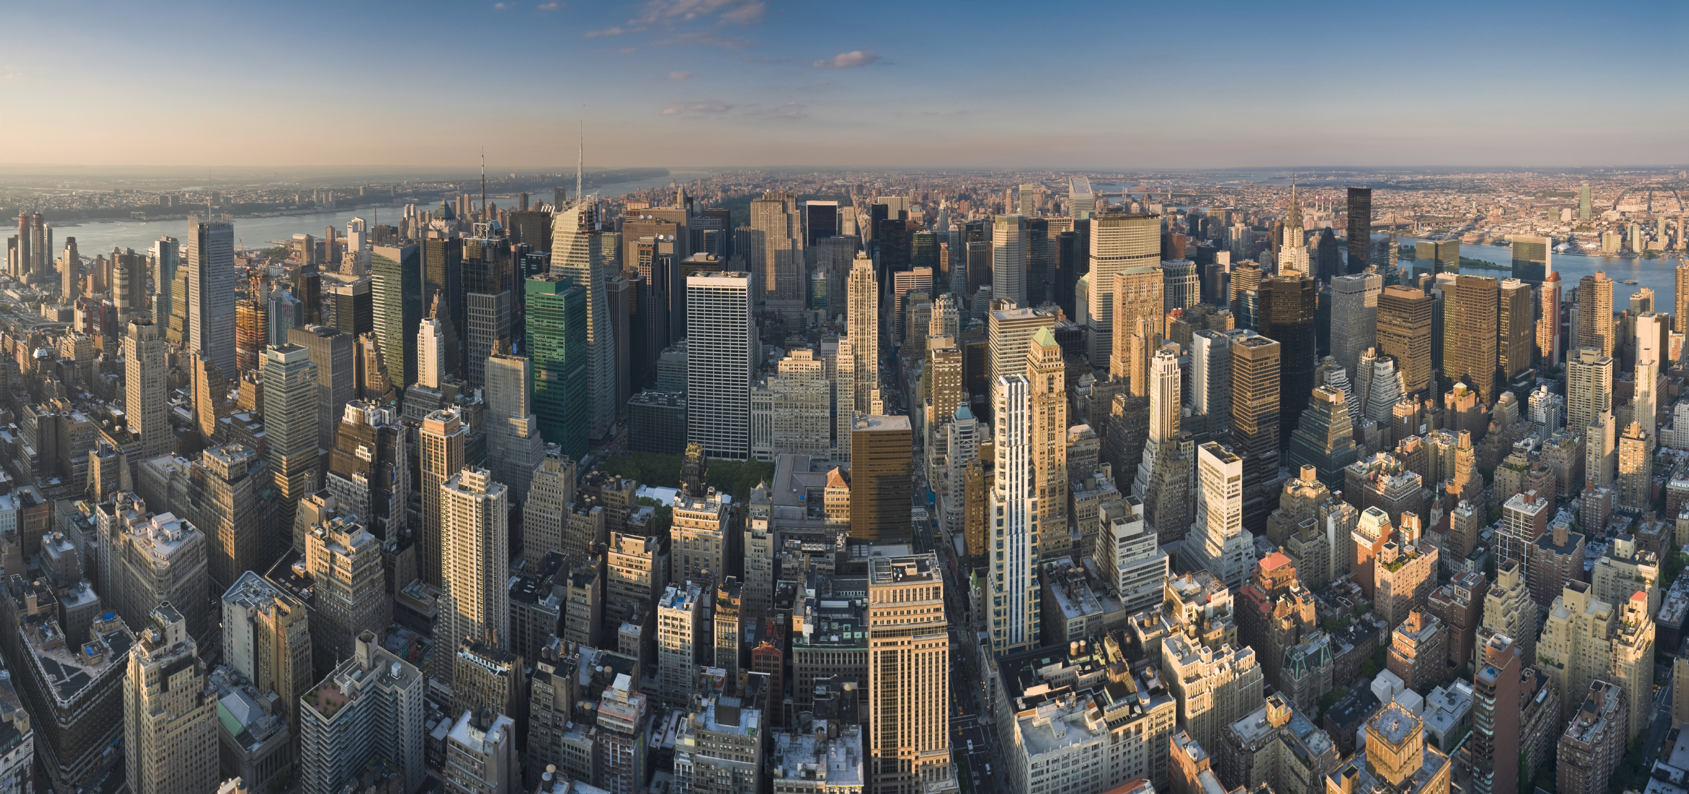
Tabletop exercise
[Date]
[Time]
[Company/Organization]
Disclaimer: These customizable exercise templates were created for the use of private sector organizations by New York City Emergency Management (NYCEM). NYCEM is not responsible for any changes made to exercise materials by participating organizations. The scenarios presented are fictional, and NYCEM cannot guarantee that the City agency actions depicted here will be the City’s response for similar incidents. For more information about the resources NYC Emergency Management have available, please visit us at NYC.gov/emergencymanagement or email us at publicprivate@oem.nyc.gov.

Slide 2
Ground Rules
Don’t fight the scenario! It is a tool to guide the discussion.
This exercise will be held in an open, low-stress, no-fault environment. Varying viewpoints, even disagreements, are expected.
Respond to the scenario using your knowledge of your organization’s current plans and capabilities.
Decisions are not precedent-setting and may not reflect your organization’s final position on a given issue. This exercise is an opportunity to discuss and present multiple options and possible solutions.
Issue identification is not as valuable as suggestions and recommended actions that could improve response efforts. Problem-solving efforts should be the focus.
The Parking Lot: A place to note ideas that can be discussed at a later time.

Slide 3
Background
Tuesday Morning, 9:30 AM
It is a sunny Tuesday morning in New York City and business activities for the week are in full swing. Most employees have already arrived, though there are a few late arrivals who haven’t yet reported in. Several employees are out of the office at meetings in other parts of the city.
One of the employees, Anna, announces that she is going next door on a coffee run and asks if anybody wants anything. Two other employees, Bob and Charles, decide to go with her.

Slide 4
Boom!
Tuesday Morning, 9:42 AM
At 9:42, there is a low rumbling noise, about the volume of a truck passing by. The building shakes slightly, enough for people to look up from what they are doing.
Several seconds later, there is a loud boom, followed by screams from outside on the street. The building shakes noticeably but, with the exception of a painting falling off the wall, there appears to be no immediate impact to your floor. A cloud of dust rises up past the windows facing the street, and a car alarm goes off outside.

Slide 5
Initial Reactions
Tuesday Morning, 9:45 AM
Employee reactions:
    What was that?
    Is it a terrorist attack / bomb / earthquake?
    Are we safe here?
    Should we leave?
Your reactions:
    All of the above, and…
      How do you answer these initial questions/concerns?
      Where are you getting your information from?

Slide 6
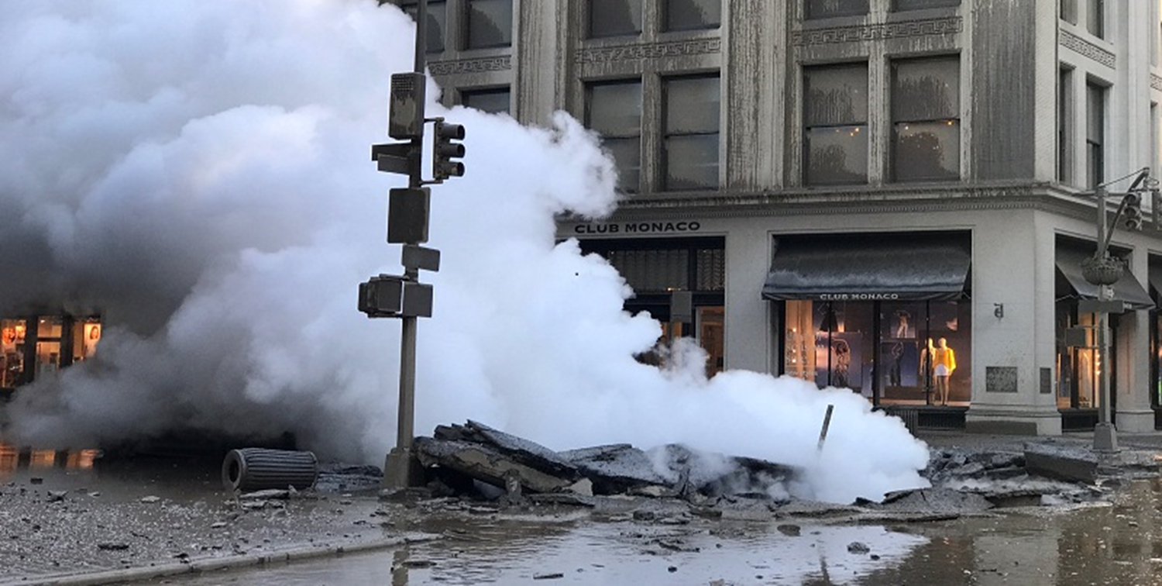
Do You See That?
Tuesday Morning, 9:50 AM

Slide 7
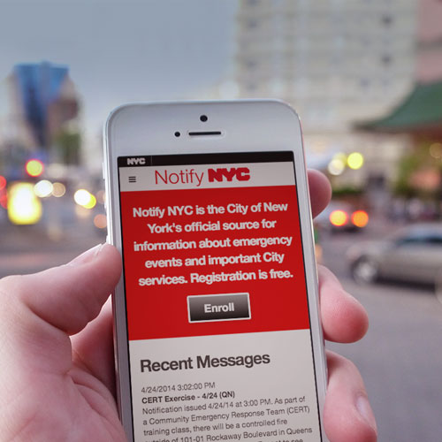
Arriving on Scene
Tuesday Morning, 9:50 AM
You hear the sound of several sirens outside. NYPD, FDNY, and FDNY-EMS are on scene. NYC Emergency Management is en route.
Notify NYC sends out a message informing people to avoid the area due to police activity.

Slide 8
What do we do?
Tuesday Morning, 9:50 AM
Employees on the 5th floor report blown out windows and debris.
Employees on the 7th floor don’t report any physical impact.
What are management’s directions to employees?
  Shelter in place or evacuate?
What about clients that are in the office for a morning meeting?

Slide 9
What’s Next
Tuesday Morning, 9:55 AM
The Fire Safety Manager for the building announces that everyone must evacuate the building through the rear exits and meet at the predesignated meeting place.
Where are people going?
Do employees know the evacuation routes?

Slide 10
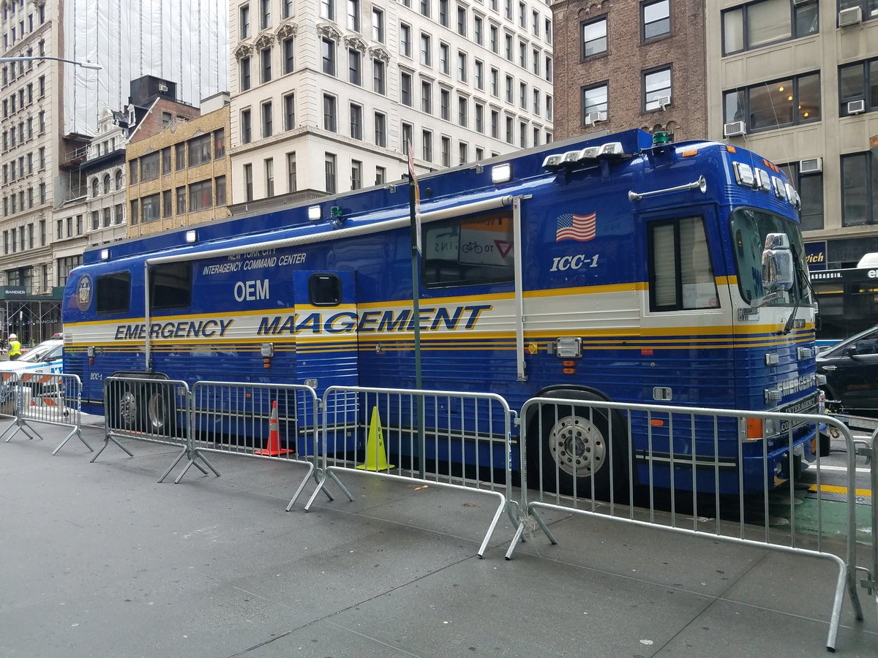
What’s Happening Outside
Tuesday Morning, 10:10 AM
NYPD is on scene establishing a perimeter.
FDNY is evaluating life safety issues and impacts. FDNY-EMS is requesting resources to stabilize and treat individuals.
Department of Buildings (DOB) has been requested to assess structural impacts.
Con Edison is in the process of shutting down power and steam.
NYC Emergency Management is facilitating an initial interagency meeting.

Slide 11
All Present and Accounted For?
Tuesday Morning, 10:15 AM
The police have blocked off access to your block. People are saying that a steam pipe below the street exploded. Employees are clustered at the designated assembly area two blocks away.
A co-worker reminds you, “Elliot and Fran are both out at meetings. Somebody should call them.”
Another co-worker mentions that other employees haven’t yet arrived at work for the day, and then says, “Oh! I got a text message from Bob. He’s in the ambulance with Anna. She seems fine, but she hit her head and they want to make sure she’s okay.”

Slide 12
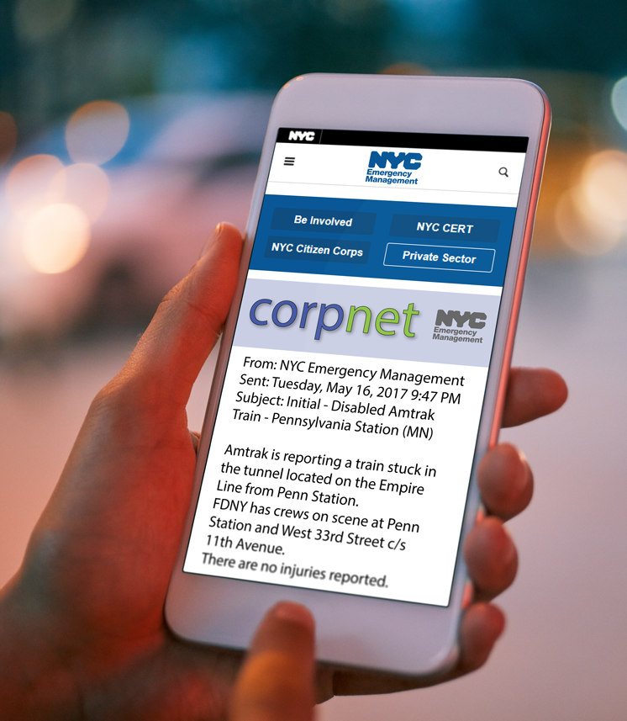
The City’s Response Continues
Tuesday Morning, 10:25 AM
A CorpNet message is sent out with the following information:
Department of Environmental Protection (DEP) is testing for environmental contaminants.
Con Edison has shut down power and steam service and is doing an assessment.
Department of Buildings (DOB) is evaluating the stability of surrounding buildings.
CEAS (Corporate Emergency Access System) has not been activated due to environmental and life safety concerns.
An NYPD officer on the perimeter tells you that access to the block will be shut down for at least several more hours, and potentially for several days.

Slide 13
What Now?
Tuesday Morning, 10:30 AM
The employees—at least those that have stayed—are waiting for instructions about what they should do for the rest of the day and tomorrow.
An employee goes to Human Resources in private and asks if paychecks for last week will still be issued on time and in the usual way.
Another employee left their keys and wallet in the building and needs help getting home.
Several television crews have arrived and they are asking the employees questions.

Slide 14
Press Conference
Tuesday Afternoon, 1:00 PM
You turn on the local news network and learn via the Mayor’s press conference that there was a steam pipe explosion with some impact to surrounding structures. The broadcast camera pans the site and you see what looks to be your building with multiple blown-out windows. The Mayor states that, due to concerns about asbestos, access to the block will be limited for the next few days.
The following weather segment mentions the high chance for rain this evening.
Pressing issues to consider:
Your organization’s equipment and computer servers, not to mention any documents that were left out at the time.
Your organization will have to run without access to its primary facility for the rest of the week.

Slide 15
Moving Forward
For exercise purposes, this marks the end of the immediate response to the steam pipe rupture incident. As response transitions to recovery, your organization may have to consider issues such as client contact, damage assessment, continuity operations, and the insurance adjustment process.
This recovery phase will be the subject of a forthcoming scenario in NYC Emergency Management’s Tabletop Exercise Toolkit.
For more information about the resources that NYC Emergency Management has available for organizations, please visit us at NYC.gov/emergencymanagement or email us at publicprivate@oem.nyc.gov.

Slide 16
Thank you

