Slide 2
NYC Unity Works
Pre-Proposal Conference
February 4, 2020

Slide 3
Agenda
Welcome and Timeline
Stakeholder Engagement
HHS Proposal Submission
Program Overview
Post Award Requirements
Question and Answer Session

Slide 4
Timeline
Proposal Due Date: February 28, 2020 at 2:00 pm
Award Announcement: Spring 2020
Contract Term: July 1, 2020 – June 30, 2024
Questions: RFPquestions@dycd.nyc.gov
(Questions must be received by February 21, 2020)

Slide 5
Stakeholder Engagement We Heard You!- Full list on page 6 of RFP
• Navigators who meet regularly with youth and ensure their access to a broad range of services, especially, to clinical mental health/health and housing services;
• Trauma-informed mental health services and supports, including appropriately trained and supervised mental health counselors who can address youth’s emotional needs and help prevent participants from dropping out of the program;
• Requirement that deliberate efforts be made, through screening and training, to ensure that employers and internship sponsors are sensitive and culturally responsive to the needs of LGBTQI+ youth;
• Flexibility and choice for participants in the attainment of advanced training opportunities;
• Youth with disabilities and youth who are underemployed explicitly included in the target population;
• Workshop topics must include financial literacy.

Slide 6
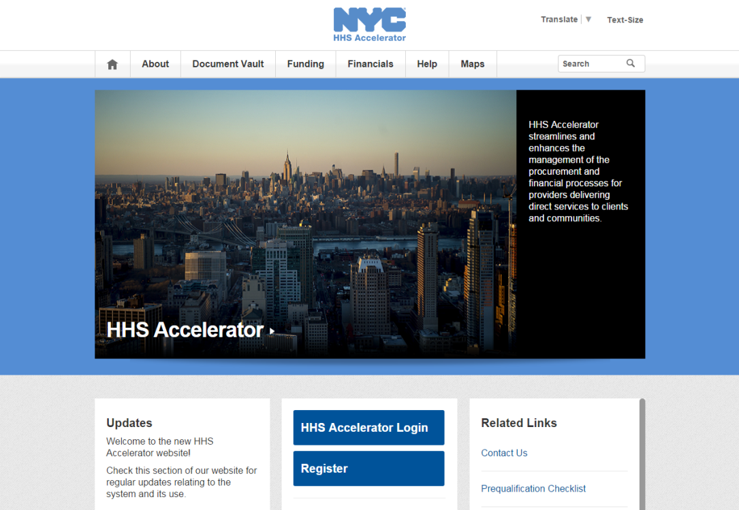
PROPOSING IN HHS ACCELERATOR
The HHS Accelerator System was launched to simplify and improve the competitive contract process for Health and Human Service providers.
Agencies publish all Request for Proposals (RFP) Documents in the HHS Accelerator System.
Prequalified providers approved for relevant Services are “Eligible to Propose” and can submit proposal(s) after RFPs are released.
Providers must submit proposals through the HHS Accelerator System by the proposal due date and time (2 pm).
Need Help?
Contact: help@mocs.nyc.gov

Slide 7
NYC Unity Works Program
NYC Unity Works Overview
Key Program Features
Target Population
Year to Year Timeline
Program Staffing
Expected Outcomes
Partnerships

Slide 8
NYC Unity Works Overview
A comprehensive, long-term employment and education program
Designed to provide employment and education services tailored specifically to the needs of vulnerable LGBTQI+ young people
Builds on the foundation of other successful models:
Workforce Innovation and Opportunity Act Train & Earn (OSY) programs
Performance Partnership Pilot (P3) program
LGBTQI+ Runaway and Homeless Youth programs

Slide 9
Key Program Features
2+1 – two years of direct services, one year of follow-up services
Comprehensive case management/Navigator
Academic and work readiness skill building, including high school equivalency test prep
Subsidized internships
Advanced occupational training opportunities
Partnerships will be key to providing comprehensive services
90 Youth Served (2 groups of 45 each)

Slide 10
Target Population
Runaway and homeless youth, and youth at risk for homelessness
16-24 years of age
LGBTQI+
Not working or underemployed, not in school, or in need of additional employment or literacy skills
90 youth served in total

Slide 11
Year by Year Service Timeline
Year 1 (7/1/20 - 6/30/21) | Year 2 (7/1/21 - 6/30/22) | Year 3 (7/1/22 - 6/30/23) | Year 4 (7/1/23 - 6/30/24)
Group 1 Enrollment and Direct Services (45 youth) | Group 1 Direct Services (45 youth) | Group 1 Follow Up Services (45 youth)
 | Group 2 Enrollment and Direct Services (45 youth) | Group 2 Direct Services (45 youth) | Group 2 Follow Up Services (45 youth)
45 total youth served | 90 total youth served | 90 total youth served | 45 total youth served

Slide 12
Program Staffing
Program Director
Job Developer
Navigators (1:25 staff to participant ratio)
Mental Health Counselor
Workforce Facilitator
Education Specialist
Administrative Support Staff

Slide 13
NYC Unity Works Expected Outcomes
Placement in employment, postsecondary education or advanced occupational training in second quarter after exit
Placement in employment postsecondary education or advance occupational training in the fourth quarter after exit
Attainment of a high school equivalency attainment OR occupational credential
Academic skill gains
For those who enroll with a high school credential, placement in a postsecondary or advanced occupational training program

Slide 14
Partnerships to Enhance Services
DYCD RHY drop-in centers
DYCD RHY crisis programs
DYCD Transitional Independent Living (TIL) programs
Literacy instruction/HSE preparation providers
Advanced occupational training providers
Employers
Post-secondary education institutions
Intensive clinical mental health services
Housing services for the target population

Slide 15
Post Award
Insurance
Responsibility Determination
Subcontractor Compliance
Public Assistance Rider

Slide 16
NYC Liability Insurance Requirement
Commercial General Liability
$1 million per occurrence and $2 million aggregate;
Motor Vehicle Liability (if applicable)
$1 million per accident combined single limit;
Workers’ compensation
Employer’s liability Insurance
Disability benefits Insurance
An original certificate of insurance naming the City of New York, including its officials and employees, as an additional insured.
DYCD will not be able to proceed with processing an awarded contract until it has obtained proof of the necessary insurance coverage.

Slide 17
Responsibility Determination
Please be advised that it is a requirement for all prospective contractors to be determined responsible in the Post Award phase. Therefore, please make sure your Charities’ filings are current and ensure that any outstanding liens or adverse information has been resolved. Unresolved issues often cause significant delays in the post award process.

Slide 18
Notice for Proposer Subcontractor Compliance
Please be advised there is a requirement to utilize the Payee Information Portal (PIP) to identify all subcontractors and to enter all subcontractor payment information, and other related information during the contract term.

Slide 19
Public Assistance Rider
The Purpose of the hiring requirement is to provide work opportunities to individuals who are presently receiving Public Assistance (PA) and are motivated to obtain a job and become self-sufficient.
FAQ Handout

Slide 20
Wrap-up
Q&A
Transcript, presentation and attendance rosters will be posted to DYCD website for viewing
www.nyc.gov/DYCD

