Slide 1
Residential Services for Homeless Young Adults (HYA)
Request for Proposals
EPIN #26019I0001
Pre-Proposal Conference
September 7, 2018, 2:00 p.m.

Slide 2
DYCD’s Mission and Vision
Mission
The New York City Department of Youth and Community Development (DYCD) invests in a network of community-based organizations and programs to alleviate the effects of poverty and provide opportunities for New Yorkers and communities to flourish
Vision
DYCD strives to improve the quality of life of New Yorkers by collaborating with local organizations and investing in the talents and assets of communities to help them, develop, grow and thrive
Note: two sections in the RFP, in particular, reflect expectations that are closely informed by DYCD’s mission and vision:
Program Approach
Community Partnerships

Slide 3
Agenda
Welcome and Timeline
Pre-Qualifying and Proposal Submission
Program Expectations
Post Award Requirements
Question and Answer Session

Slide 4
Timeline
Proposal Due Date: September 21, 2018 at 2:00 pm
Award Announcement: Winter 2018
Contract Term: January 1, 2019 – June 30, 2023
(with an Option for DYCD to Renew for up to an additional two years)
Questions: RFPquestions@dycd.nyc.gov – (Must be received by September 14, 2018)

Slide 5
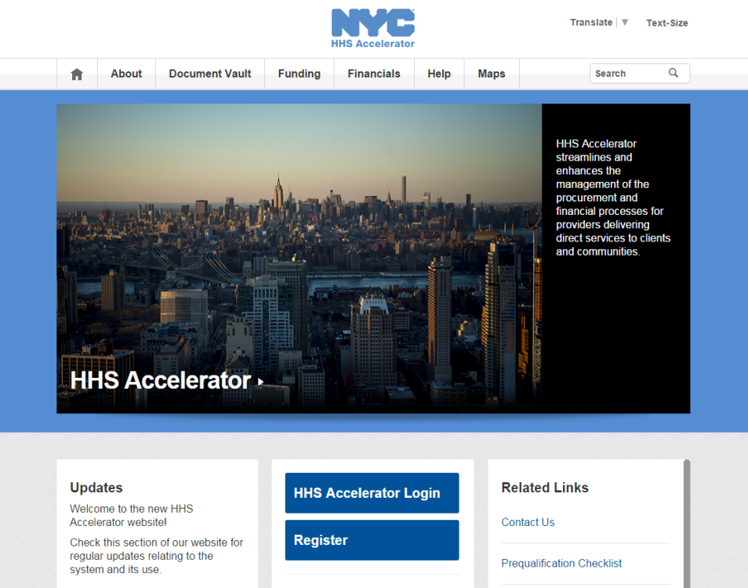
PROPOSING IN HHS ACCELERATOR
The HHS Accelerator System was launched to simplify and improve the competitive contract process for Health and Human Service providers.
Agencies publish all Request for Proposals (RFP) Documents in the HHS Accelerator System.
Prequalified providers approved for relevant Services are “Eligible to Propose” and can submit proposal(s) after RFPs are released.
Providers must submit proposals through the HHS Accelerator System by the proposal due date and time (2 pm).
Need Help?
Contact: help@mocs.nyc.gov

Slide 6
RFP Basics
Contracts will be awarded for Crisis Services and TIL programs serving Homeless Young Adults (HYA) 21-24 years of age
Single competition covers both types of residential services (A separate proposal must be submitted for each site and bed type)
Anticipated Contract Term: January 1, 2019 to June 30, 2023
(with an option for DYCD to renew for up to two additional years)
Price per bed for FY19 (1/1/19 to 6/30/19): $49,595
Price per bed FY20-FY23: $50,410 to reflect cost of living adjustments and increases in indirect costs
Minimum of three (3) awards for a combined total of 60 beds (20 Crisis Services beds and 40 TIL beds) is anticipated

Slide 7
Program Goals
Provide safe and welcoming environment for all HYA
Adopt DYCD’s “Promote the Positive” approach (see link to the Promote the Positive Flipbook in Section 3 of the RFP under “Resources”)
Address health and mental health needs directly and through referrals
Facilitate participant access to additional resources through robust community partnerships
Enable HYA to progress towards stability, economic self-sufficiency and successful independent living
Strive to strengthen family connectedness, defining family broadly to include wider kinship groups and significant non-related caring adults

Slide 8
Program Approach
Adopt strengths-based and trauma-informed approaches that focus on relationship-building, responsible decision-making, and development of abilities to set and achieve goals
Ensure that staff make all HYA feel safe and welcome, through training, protocols and effective supervision
Help participants rebuild family connections (unless inappropriate due to histories of abuse/violence) using DYCD’s online toolkit “Circles of Support”

Slide 9
Organizational Experience
Key expectations
Minimum of 3 years of experience within last 5 providing services to at-risk, vulnerable youth or young adults, including development of individualized service plans (ISPs)
Experience providing services to LGBTQ youth or young adults and other vulnerable groups
History of successful collaboration with other community-based organizations and agencies and meeting funders’ performance targets

Slide 10
Target Population, Service Levels, Hours of Operation
Target Population
Homeless Young Adults (HYA) ages 21-24 years
Even if program targets a particular HYA subgroup (e.g., LGBTQ, sexually exploited) it must serve all HYA who seek services or ensure services are received through appropriate referrals
Programs must make reasonable accommodation for young adults with disabilities (as defined by the Americans with Disabilities Act)
Service Levels
Maximum number of residents is 20, unless OCFS grants a variance
Expected bed utilization rate: 90%
Hours of Operation
Programs must operate and provide onsite staff supervision 24/7
Participants must have access to the program site at all times

Slide 11
Program Services Brief Overview
Intake
Appropriate staff person available to receive referrals between 10am and 8pm
Programs that receive emergency referrals from Drop-In Centers must address all urgent needs of the youth
Staff must provide information about program services and agency policies and processes, including grievance/complaint procedures
Comprehensive Services
In-depth assessment of needs and development of Individualized Service Plan (ISP) within specified time-frames:
Crisis Shelters must complete these tasks within 48 hours and review ISP weekly and revise as necessary
TILs would complete comprehensive assessment and develop ISP within 30 days and review ISP at least every 60 days and revise as necessary

Slide 12
Program Services Brief Overview (Contd.)
Case Management/Counseling
Would include individual and group counseling, and, if necessary to address participant needs, family counseling
Case Management components as described in RFP
Advice on housing options helping the resident identify appropriate housing placements prior to discharge
Life Skills Training
Through coaching, workshops and other approaches help residents acquire basic life skills, as described in RFP

Slide 13
Program Services Brief Overview (Contd.)
Discharge and Follow-Up Services
Exit interviews must be conducted for each young adult prior to discharge
Follow-up case management + other appropriate services
For 30 days following discharge from Crisis Services program
For 90 days following discharge from a TIL program
Involuntary Discharge: all young adults must be informed in writing in advance and given opportunity to challenge the decision

Slide 14
Staffing
Minimum requirements for both Crisis Services and TIL Programs
One full-time onsite supervisor with primary responsibility for the program
One full-time counselor/case manager and other staff necessary for effective program operations
Onsite supervisor and case manager/counselor would have a Bachelor’s degree or higher
If neither the onsite supervisor nor case manager/counselor has a Master’s degree: the contractor would ensure the counselor/case manager is supported by another staff member in the organization with a Master’s degree in social work or a related field
Cultural sensitivity
All staff would be appropriately trained and have the necessary experience to effectively serve youth from any background – especially LGBTQ and sexually exploited youth
DYCD’s Core Competencies for Youth Work Professionals would inform staff training

Slide 15
Community Partnerships
At least five (5) community partnerships with external organizations or agencies are required
At least one partnership with mental health service provider is required
Partnerships are expected to enhance program services and expand options for HYA
Partners may include other DYCD-funded programs provided they are operated by a different organizations
HYA programs that do not specifically target LGBTQ or sexually exploited youth, or other vulnerable groups must have partnerships with specialist providers to ensure cultural sensitivity
Signed Community Partnerships Agreements, summarizing how services for participants will be enhanced, are submitted with the proposal

Slide 16
Program Facility
Key features:
Located within NYC and be accessible by public transportation
Appropriate in size/design to accommodate staff, participants and services in accordance with OCFS Regulations
Complies with Americans with Disabilities Act (ADA)
OCFS-certified at time of contract award OR proposer has submitted application to OCFS and is able to meet applicable state requirements

Slide 17
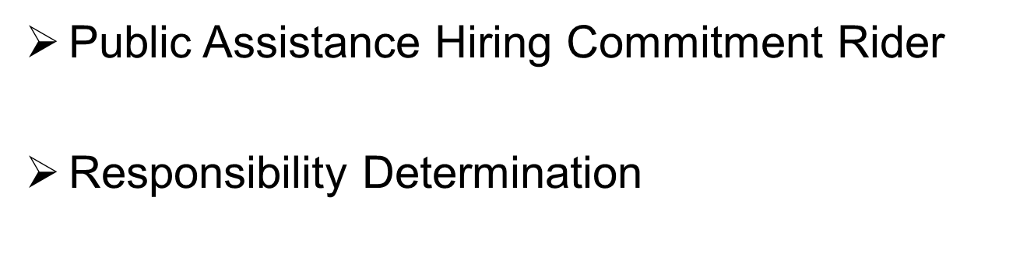
POST AWARD REQUIREMENTS

Slide 18
NYC Liability Insurance Requirement
IMPORTANT INFORMATION
Questions?
Commercial General Liability
$1 million per occurrence and $2 million aggregate;
Motor Vehicle Liability (if applicable)
$1 million per accident combined single limit;
Workers’ compensation
An original certificate of insurance naming the City of New York, including its officials and employees, as an additional insured.
DYCD will not be able to proceed with processing an awarded contract until it has obtained proof of the necessary insurance coverage.

Slide 19
IMPORTANT INFORMATION
Questions?
DYCD encourages MWBE participation and recommends the utilization of certified MWBEs
Transcript, presentation and attendance rosters will be posted to DYCD website for viewing

Slide 20
Questions?
RFPquestions@dycd.nyc.gov

