Slide 2
My Brother’s & Sister’s Keeper Youth Council
Pre-Proposal Conference
October 6, 2021

Slide 3
Agenda
Timeline
PASSPort Proposal Submission
Program Overview
Post Award Requirements
Question and Answer Session

Slide 4
Timeline
Proposal Due Date: October 26, 2021 at 2:00 pm
Award Announcement: Fall 2021
Contract Term: January 1, 2022 – June 30, 2024
Questions: RFPquestions@dycd.nyc.gov
(Questions must be received by October 19, 2021)

Slide 5
PASSPort: Finding and Responding to the MBSKYC RFP in PASSPort

Slide 6
MOCS and NYC Procurement
Compliance,
Advisory &
Partnerships
41
City Agencies
CONSTRUCTION
STANDARDIZED SERVICES
ARCHITECTURE/ENGINEERING
Technology
Solutions
114,000+
Procurement
Actions in FY 20
GOODS
PROFESSIONAL SERVICES
Transparency
& Reporting
26,000+
Vendors in PASSPort
FY19
HUMAN SERVICES
Learning
Management &
Support
6,000+
NYC Procurement Staff

Slide 7
PASSPort: Procurement and Sourcing Solutions Portal
PASSPort Streamlines Citywide Procurement
View Citywide Contracting Opportunities
Respond to
Citywide
Contracting Opportunities
Real-Time Tracking
of Submissions,
Awards &
Contracts
Digital
Signatures

Slide 8
Requirements for Response

Slide 9
Steps to Respond
Create
an account in PASSPort
New! Complete
HHS Prequalification Application in PASSPort
RFP Released in PASSPort
through Public Portal & Browse All RFx
Complete & submit your responses in PASSPort

Slide 10
Create a PASSPort Account

Slide 11
Steps to Create a PASSPort Account
1.
Establish a NYC.ID
Note: If you use HHS Accelerator, you already have a NYC.ID
2.
Submit an Account Request with Your NYC.ID
Note: It can take 1-2 business days for approval
3.
Activate Your Account Once Your Request is Approved
Note: Providers will need to complete and file vendor disclosures in PASSPort if the awards received during a 12-month period exceed $250,000

Slide 12
HHS Prequalification in PASSPort

Slide 13
HHS Prequalification in PASSPort
GOALS
Verify Basic
Business Readiness
Accessibility
Streamline
Further Centralize
Procurement Processes

Slide 14
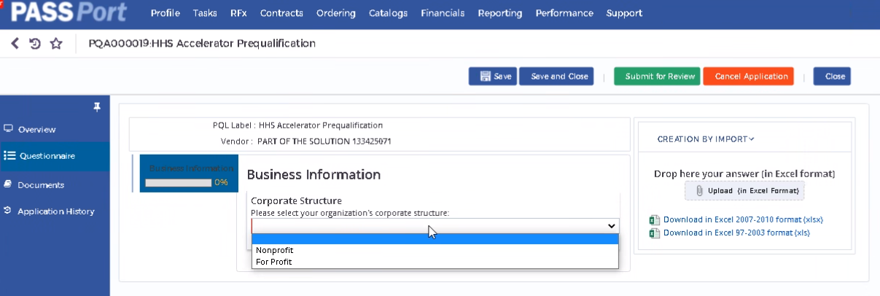
HHS PQL Application in PASSPort
Questionnaire with 10 Business Questions
No Service Application
HHS RFPs released to full HHS PQL
User Roles
-Corporate Structure (Nonprofit/For Profit)
-Certificate of Incorporation or Equivalent
-By-Laws
-Board of Directors
-Tax Filings
-IRS Determination Letter
-Charities Filings/Exemption Letter/Financial Statement
-Conflict of Interest Policy
-Whistleblower Policy
-Articles of Organization
-Financial Controls Part 1 &2 (# of individuals required to sign checks, amounts,
staff financial authorizations)
Vendor Procurement Level 1
Vendor Procurement Level 2*

Slide 15
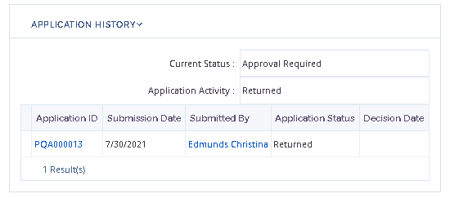
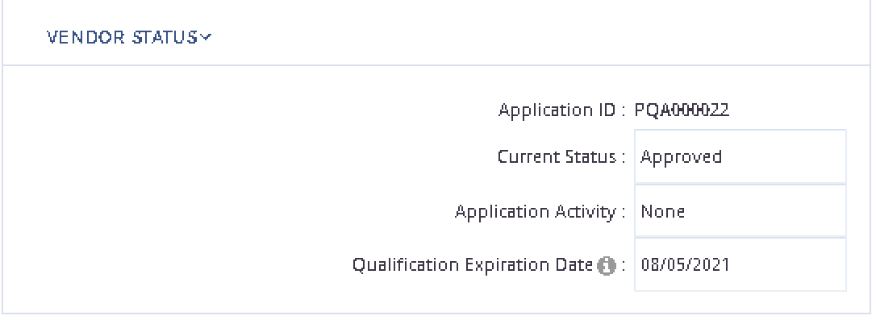
Application Approval and Returned for Revision
2
1
3
Once Approved:
4
1
Providers receive a notification email notifying them of their Approved status and will see their application status has changed to Approved in the Application History section.
When Reviewing, MOCS Approvers can Return the application to the Vendor for Revision
2
Providers receive a notification email notifying them of Returned status and cited reason for revision.
4
Providers can return to the application, make updates, and resubmit for review.
Once application is approved, Application status is changed to Approved.
5
5
3
Providers will see their application status has changed to Returned in the Application History section.

Slide 16
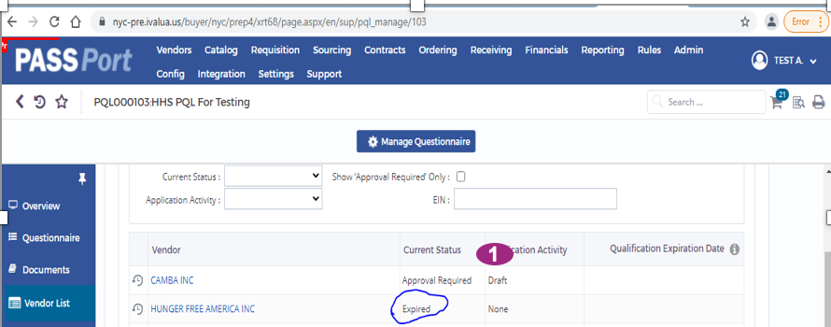
Prequalification Renewals/Expirations
1
2
3
1
PQL Applications are valid for 3 years or until Documentation expires, whichever occurs first.
If Documentation expires, PQL status changes from Approved to Expired.
2
As providers submit proposals to RFx in PASSPort they will be asked to validate and confirm that PQL information is current.
This restarts the clock on Approved status, moving Expiration Date to 3 years after proposal submission date.
3
Users can find current PQL status in the Additional History section of their application under the Application History tab.

Slide 17
Updating Your Application
1
When Documentation Expires or Information needs Updating or Replacing
To make any updates to an Approved application providers should click the Update Application button located at the top of the screen of the application
3
1
2
2
Upon clicking, a new application is created with a new, unique Application ID.
4
3
To upload new documentation, providers can go to the Documents Tab and click on the Upload New Version button.
Once clicked, the Version # changes from 1 to 2 to reflect an update. Providers then click the Save and then Save and Close buttons to finish uploading the new document.
4
5
Once providers have finished updating the application, select the Submit for Review button
5

Slide 18
HHS Accelerator Impact
Remaining Accelerator Functionality
HHS Accelerator Financials
Document Vault
Procurements Module for close out activities and read-only historical data
Applications Module available for read-only historical data
HHSA Account Impacts - Prequalification
Approved HHSA Accounts​
Automatic migration to Approved Account in PASSPort, provided organization has a PASSPort Account​
​
Once migrated to PASSPort, account will expire when Charities documentation expires or when application validity expires, whichever occurs first. ​
​
HHSA will send notifications as applications and Charities documentation expire advising to renew/update in PASSPort.​
​
PASSPort auto generated notifications as application status changes advising to renew/update in PASSPort. ​
​
Other Statuses for HHSA Accounts​
Submit prequalification application in PASSPort.
HHS Solicitation Impacts
Open-Ended RFPs migrate to PASSPort
Addenda for open solicitations updating on HHS PQL in PASSPort

Slide 19
How to Find and Respond to the RFP in PASSPort

Slide 20
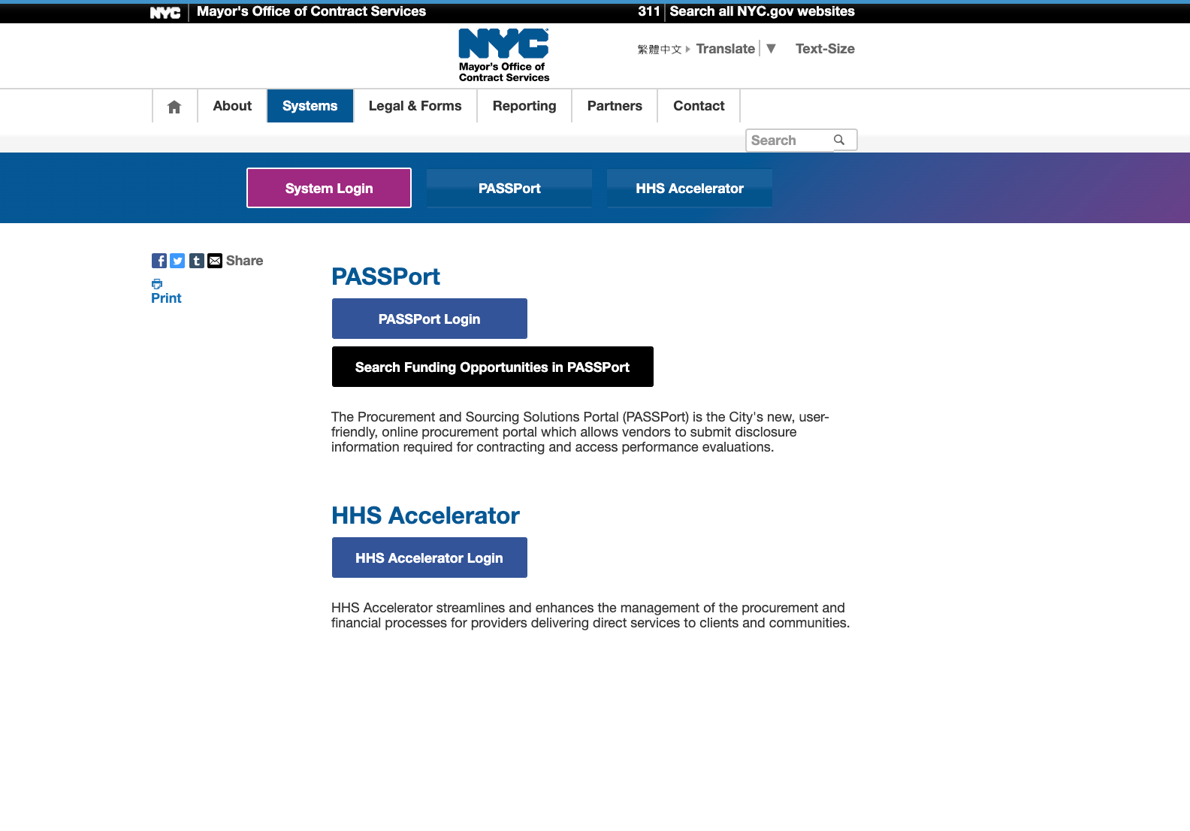
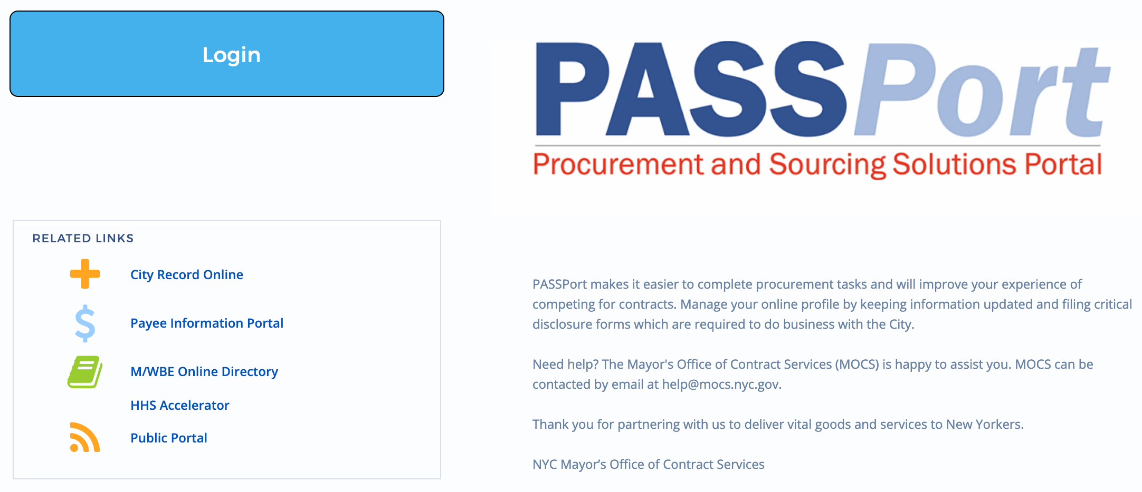
Search for Funding Opportunities
nyc.gov/passport

Slide 21
Find the RFP on the Public Portal
The PASSPort Public Portal provides the general public with a complete list of all RFx opportunities available in PASSPort.

Slide 22
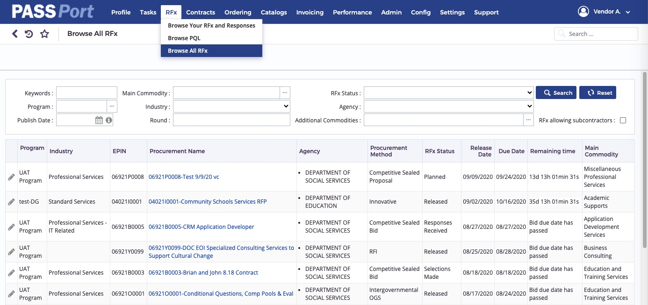
Find the RFP through “Browse All RFx” and “Browse Your RFx and Responses”
The Browse All RFx screen contains a similar structure to the Public Portal, but now that you are logged into your PASSPort account, you will be able to respond to the RFP by clicking the Pencil icon.
The Browse Your RFx and Responses is where you will be able to manage your responses and quickly locate solicitations you have begun work on and solicitations you have submitted responses to.
Notes:
Lizzie

Slide 23
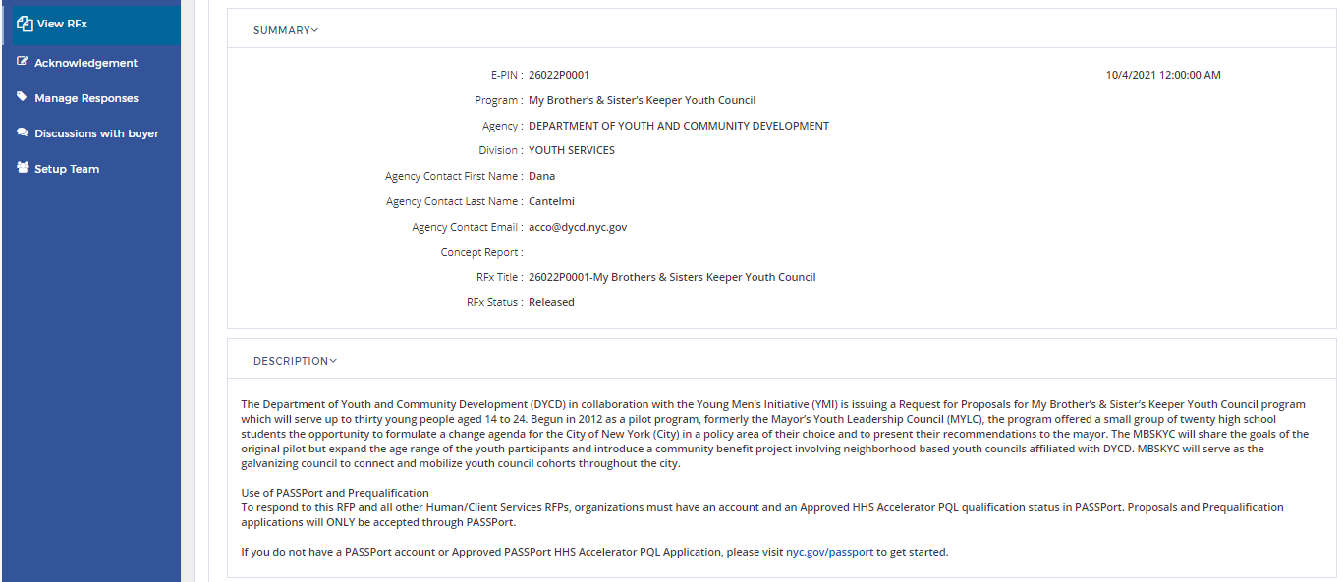
Respond in PASSPort
The View RFx screen displays an overview of the RFP, including a Summary, Description, Key Dates, associated Documents and Pre-Proposal Information.

Slide 24
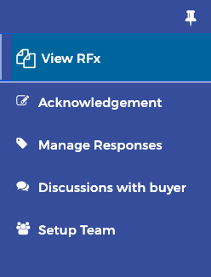
RFx Tabs Overview
The Acknowledgement tab is where providers acknowledge receipt and intent to respond.
The Manage Responses tab is where providers complete the RFP questionnaire, and upload required documentation.
The Discussion with buyer tab is a forum to communicate directly in PASSPort with the contracting agency after you have decided to respond to the RFP.
The Setup Team tab provides the ability to add team members to assist in the response process.
Notes:
Lizzie

Slide 25
Setup Team Tab – User Roles
User Roles
Vendor Admin
Receive direct invite to participate in RFx
Manage and add contacts in Vendor Profile
Create responses
Set up team for responses
Vendor Admin
Vendor Procurement Level 1, Level 2
Vendor Procurement Level 1 & Level 2
Receive direct invite to participate in RFx
Manage and add contacts in Vendor Profile
Create responses
Create applications to PQLs (*only L2 can submit)
Contributor, Vendor Financials Level 1, Level 2
Contributor, Vendor Financials Level 1 & Level 2
Create/edit responses when added to the RFx team in
the Setup Team Tab

Slide 26
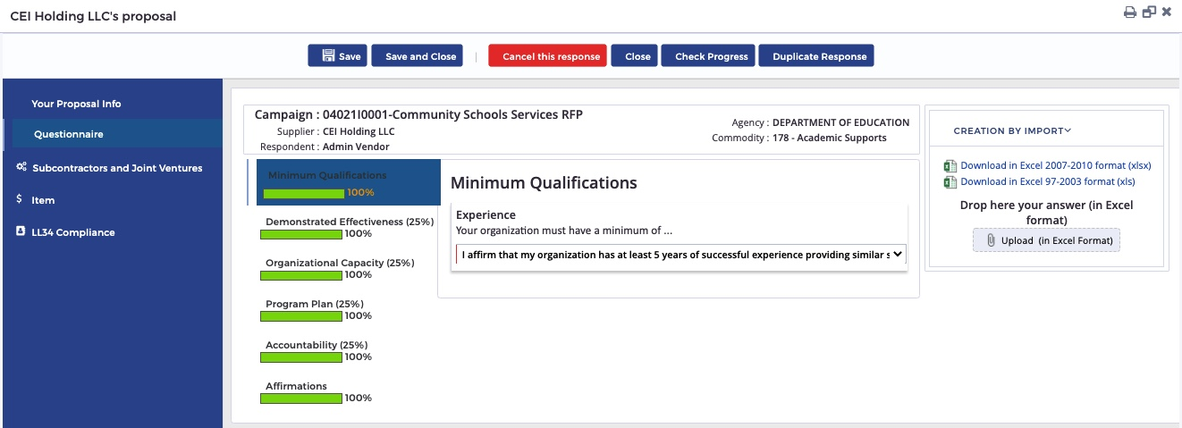
Questionnaire
A progress bar will display the percentage of questions completed for your reference.
Percentages displayed next to section titles will indicate that they will be evaluated and scored.

Slide 27
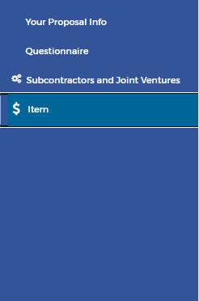
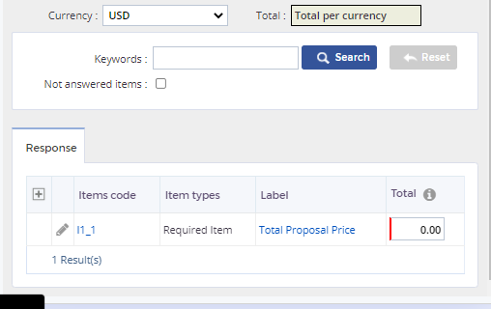
Items / Price Proposal
The system will automatically populate the total price for your proposal in the total per currency box

Slide 28
Resources

Slide 29
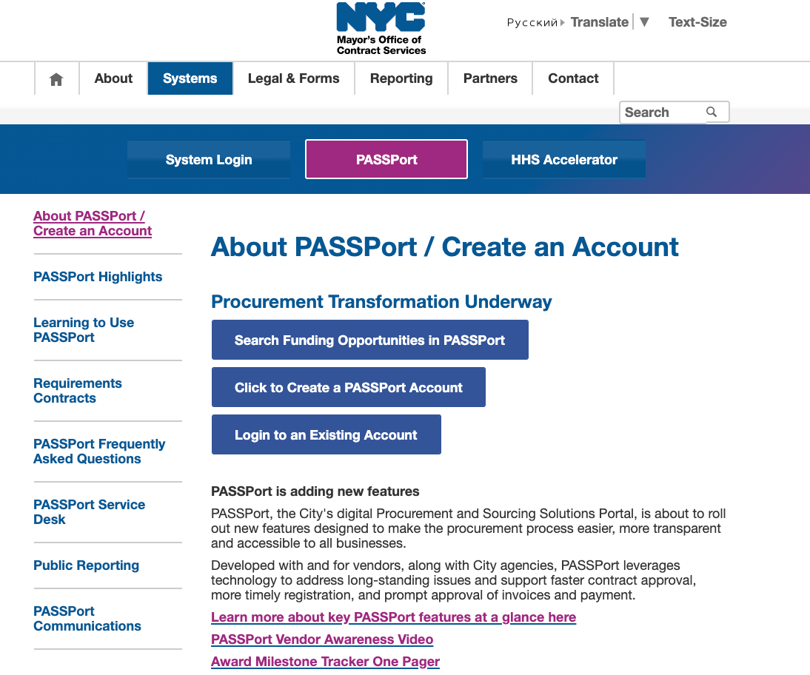
PASSPort Resources
nyc.gov/passport
Create a PASSPort account to become prequalified and to view and respond to opportunities in the system. Search Funding Opportunities through the Public Portal.
Access resources, user manuals, recorded webinars, one pagers, videos and more on how to become prequalified and find and respond toHHS contracting opportunities in PASSPort.
You can also find answers to common questions and submit messages directly to our support team through the PASSPort Service Desk tab.

Slide 31
MY BROTHER’S & SISTER’S KEEPER YOUTH COUNCIL (MBSKYC)

Slide 32
PROGRAM MISSION
The MBSKYC will engage youth aged 14-24
Offer them an opportunity to inform city policies and practices
DYCD programs and initiatives that impact communities throughout the City.

Slide 33
TARGET POPULATION
Youth aged 14-24.
Up to 30 youth would comprise the MBSKYC.
At least 100 youth would comprise ten youth council cohorts (hubs) at DYCD youth programs.

Slide 34
DELIVERABLES/OUTCOMES
MBSKYC participants will successfully connect to and support youth councils at hub sites.
MBSKYC participants will successfully complete at least one community benefit project per year.
MBSKYC participants will successfully develop and complete a civic workplan inclusive of civic engagement and community service opportunities for youth.

Slide 35
DELIVERABLES/OUTCOMES
MBSKYC participants successfully complete a presentation to city officials
MBSKYC participants will successfully co-develop a Youth Policy Summit.
MBSKYC participants will gain leadership skills.
MBSKY participants gain knowledge of civic systems.

Slide 36
CONTRACT TERM & FUNDING
January 1, 2022 - June 30, 2024, with option to renew for three additional years
FUNDING
$130,000 annually for the contract term
Anticipated number of contracts: 1

Slide 37
Post Award Requirements

Slide 38
Post Award
Insurance
Responsibility Determination
Subcontractor Compliance

Slide 39
NYC Liability Insurance Requirement
Commercial General Liability
$1 million per occurrence and $2 million aggregate;
Workers’ compensation
Employer’s liability Insurance
Disability benefits Insurance
An original certificate of insurance naming the City of New York, including its officials and employees, as an additional insured.
DYCD will not be able to proceed with processing an awarded contract until it has obtained proof of the necessary insurance coverage.

Slide 40
Responsibility Determination
Please be advised that it is a requirement for all contractors to be determined responsible in the Post Award phase. Therefore, please make sure your PASSPort Disclosures are up-to-date. Ensure that your Charities filings are current, and that any outstanding liens or adverse information has been resolved. Unresolved issues often cause significant delays in the post award process.

Slide 41
Subcontractor Compliance
Please be advised there is a requirement to utilize the Payee Information Portal (PIP) to identify all subcontractors and to enter all subcontractor payment information, and other related information during the contract term.

Slide 42
Wrap-up
Q&A
Presentation and attendance rosters will be posted to DYCD website for viewing
www.nyc.gov/DYCD

