Slide 1
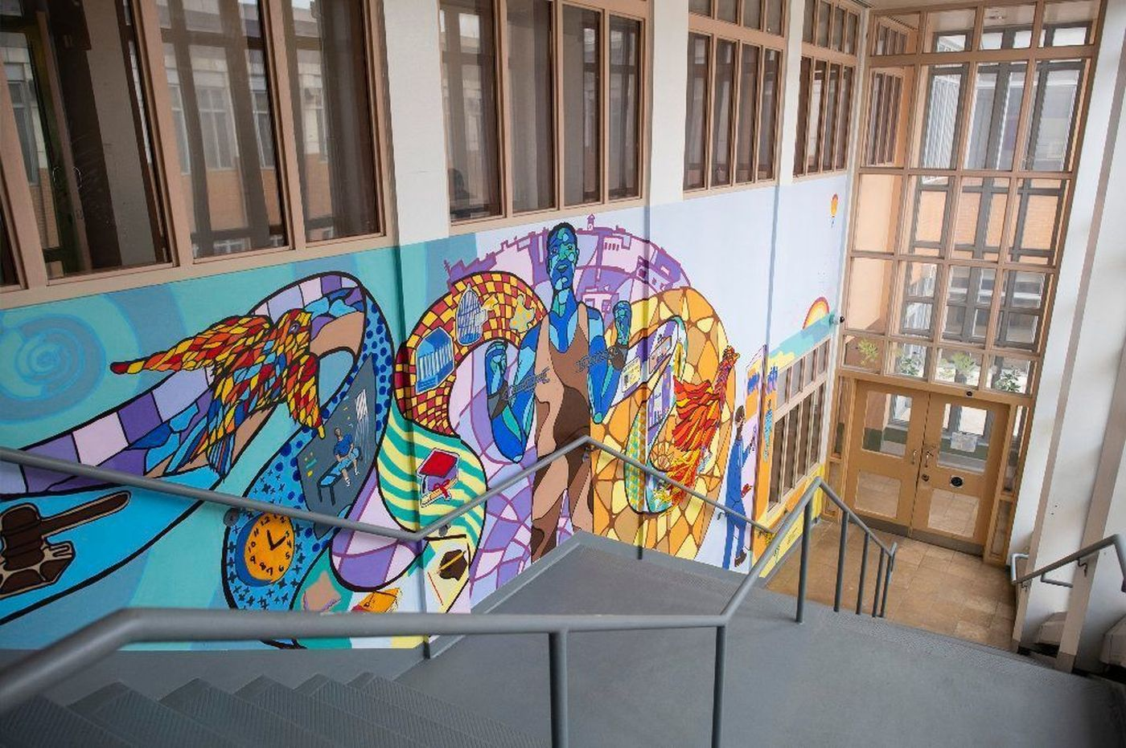
Horizon Program RFP
Mural completed by youth residing in the Horizon Juvenile Center
Pre-Proposal Conference
January 3, 2019

Slide 2
Agenda
Welcome and Timeline
Pre-Qualifying and Proposal Submission
Program Expectations
Post Award Requirements
Question and Answer Session

Slide 3
Timeline
Proposal Due Date: January 17, 2019 at 2:00 pm
Award Announcement: Spring 2019
Contract Term: May 1, 2019 – June 30, 2022
(with an Option for DYCD to Renew for up to three additional years)
Questions: RFPquestions@dycd.nyc.gov
(Questions must be received by January 10, 2019)

Slide 4
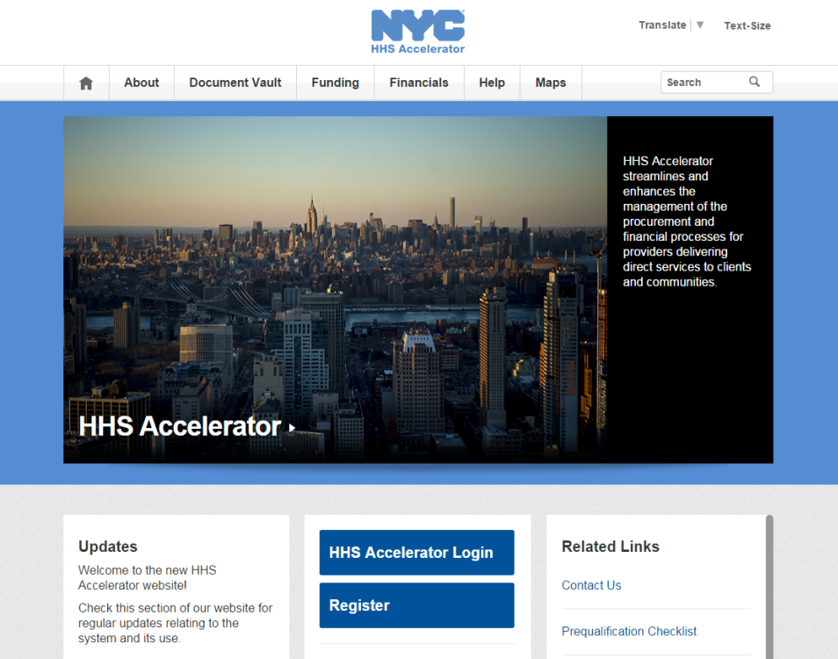
PROPOSING IN HHS ACCELERATOR
The HHS Accelerator System was launched to simplify and improve the competitive contract process for Health and Human Service providers.
Agencies publish all Request for Proposals (RFP) Documents in the HHS Accelerator System.
Prequalified providers approved for relevant Services are “Eligible to Propose” and can submit proposal(s) after RFPs are released.
Providers must submit proposals through the HHS Accelerator System by the proposal due date and time (2 pm).
Need Help?
Contact: help@mocs.nyc.gov

Slide 5
Feedback to Horizon Concept Paper
Horizon Program Concept Paper was released on 10/5/18
Cultural competence : we elaborated on the language on cultural competence in response to comments received, and, to emphasize these points, moved the expectation regarding “expert” staff to a separate paragraph
Restorative Justice : this was added to the list of required program content areas as a result of comments from several different organizations
Program Director qualifications : We changed the proposed requirement from a Master’s degree to a Bachelor’s degree

Slide 6
Programming at Horizon
This RFP comprises one single competition, for one contract award to be located at the Horizon Juvenile Center on 560 Brook Avenue, Bronx NY.
Program Start Up Period: May 1, 2019-June 30, 2019
Full Implementation Direct Services Start Date: July 1, 2019
Anticipated Funding
May 1, 2019-June 30, 2019: $99,167
July 1, 2019 to June 30, 2022: $595,000 annually

Slide 7
Horizon Program
A high quality program offering a diverse array of activities for all available youth residing in the facility. Activities must cultivate supportive relationships, foster social/emotional well-being and offer opportunities to build life skills and explore career options. Programmatic offerings should be reflective of youth interests, build on their strengths and offer opportunities for family engagement wherever possible. The program must effectively collaborate with all on-site partners to ensure efficient implementation of services and administrative operations.
Main Program Features
Required Activity Categories
Restorative Justice
Career Pathways
Enrichment
Life Skills/Leadership Development
Culturally Responsive Staff including Credible Messengers
Transitional Services
Collaboration with all on and off site partners
Subcontractors/Consultants
(35%-50% of budget)
Enroll and Serve
all available youth
Year-Round Programming
Safety

Slide 8
Target Population
It is anticipated that on average, 85 youth will be available for programming on a daily basis.
It is anticipated that the majority of youth served by the program will be 16-21 years old.
It is anticipated that approximately 712 youth in total will be served annually.
The contractor would serve all available youth on the days the program operates.
“Available Youth” refers to the number of youth in the facility who are available for programming (youth who are not occupied in other mandated responsibilities such as court appearances, visits, etc.)
Note: Youth may “age up” within the facility, resulting in youth up to 21 years old.

Slide 9
Hours of Operation
ANNUAL HOURS: 645 hours over a minimum of 43 weeks, including weekdays, weekends and the summer
School Year
At least 3 afternoons (Monday-Friday) at a minimum of 9 hours/week (Monday-Friday)
Weekends
At least 3 hours on Saturday and 3 hours on Sunday, year-round
Summer
At least 105 hours of activities over 7 weeks
Hours are “clock hours”
IE – If a program has 10 activities scheduled between 3pm-6pm, only 3 hours are accumulated towards the 645 total.

Slide 10
Required Staffing
Program Director
Full Time Required
5 years of experience working with justice involved youth
Bachelor’s Degree at minimum
Assistant Program Director
Part Time or Full Time
3 years of experience working with justice involved youth
Bachelor’s Degree at minimum
Masters Degree in Social Work (MSW) Requirement
Either the Program Director or Assistant Program Director is required to have an MSW. This individual will use their expertise to inform programming and collaborate with other clinical/health professionals on site.

Slide 11
Frontline Staff & Credible Messengers
Culturally competent and culturally responsive staff. All program staff, including consultants and subcontractors, would create a welcoming and safe environment for all Horizon youth, irrespective of their backgrounds, beliefs, and traditions. Staff would have strong communication skills and be knowledgeable about and responsive to the cultures of the participants so they are quickly able to engage them and develop supportive relationships with them. As mentors and role models, staff would encourage and inspire youth to build on their strengths, identify their goals and plan for their futures.
Staff would include credible messengers who, due to their backgrounds and life experience, can serve as powerful role models and offer youth transformative personal relationships.
Trauma-Informed Approaches. Psychological factors impact youth in detention who, in addition to being separated from family and friends, may have experienced prior traumas. To take account of these issues and foster resiliency, program staff would adopt trauma-informed approaches in their interactions with youth. Since many detainees may only remain at Horizon for short periods, there is a limited window in which staff can build trust and meaningful, supportive relationships. Program success is likely to depend critically on the presence of staff members who can help youth address emotions such as anxiety, anger and depression and offer them hope for the future through compelling program activities.
High-quality, expert staff. To ensure quality programming, program staff would comprise experienced, well-qualified administrative staff and teaching artists and activity specialists with the appropriate knowledge and expertise in the relevant content area to effectively fulfill their assigned roles. DYCD requires a minimum of 35% of the program budget to be used to hire expert Subcontractors and Consultants to ensure high quality program activities.

Slide 12
Scheduling and Logistics
Activities must be offered simultaneously and in multiple locations (hall based and multi purpose spaces) to serve all available youth.
It is estimated that up to 10 separate groups will need to be served in one program day, in up to 10 separate locations.
This could be accomplished in multiple ways, including providing programming to five groups during the first half of the afternoon and then programming to the remaining five groups during the second half.
Activity design must account for high turnover of participants, some of whom may be there for days while others for months.

Slide 13
Content Areas Explained
Program design must ensure that each participant is exposed to activities in the following content areas:
Restorative Justice: Activities that creatively expose youth to the theme, application and/or theory of “justice.” Restorative Justice activities engage youth in critical thinking projects, discussions and reflective work that fosters respectful dialogue and opportunities for youth to take responsibility and make amends for harm.
Examples: Peace Circles, Peer Mediation, Violence Prevention Workshops, Group Projects that allow youth to examine and/or imagine systems of justice.
Career Pathways: Activities that engage youth in tangible skill building opportunities that help prepare them for post departure career options. Career Pathways activities help provide a bridge between participants and potential employment opportunities.
Examples: Internships, Job Readiness, Entrepreneurship, Barbering, Cosmetology, Guest Speakers.
Enrichment: Activities that engage youth in Creative Arts, STEM and/or Literacy either separately or in conjunction.
Examples: Music, Theater, Dance, Poetry, Yoga, Animation, Videography, Agriculture, Robotics.
Life Skills/Leadership Development: Activities that help develop youth leadership competency - which support successful reintegration upon departure from Horizon. Leadership Development activities help youth understand the meaning of social responsibility and cultivate interest in community.
Examples: Service Learning Projects, Civic Engagement, Youth Councils, Mentoring.

Slide 14
Collaboration
The contractor is expected to collaborate with all operational, administrative, security and youth development staff at Horizon. At a minimum, this means communicating on a regular basis with ACS, DYCD and other staff directly involved with operations at Horizon as well as coordinating and/or attending scheduled meetings.

Slide 15
POST AWARD REQUIREMENTS

Slide 16
IMPORTANT INFORMATION
NYC Liability Insurance Requirement
Commercial General Liability
$1 million per occurrence and $2 million aggregate;
Motor Vehicle Liability (if applicable)
$1 million per accident combined single limit;
Workers’ compensation
Employer’s liability Insurance
Disability benefits Insurance
An original certificate of insurance naming the City of New York, including its officials and employees, as an additional insured.
DYCD will not be able to proceed with processing an awarded contract until it has obtained proof of the necessary insurance coverage.

Slide 17
IMPORTANT INFORMATION
DYCD encourages MWBE participation and recommends the utilization of certified MWBEs
Transcript, presentation and attendance rosters will be posted to DYCD website for viewing

Slide 18
Questions?
RFPquestions@dycd.nyc.gov

