Slide 1
CAPACITY BUILDING: Strengthening Cultural Competency in Beacon Pre-proposal Conference
August 21th, 2017
2:00PM

Slide 2
Welcome & Agenda
Welcome! - Keith
RFP Timeline, Requirements and Proposal Submission – Keith
Overview of Beacon – Wanda
About Capacity Building and RFP Content Area- Meryl
Post Award Requirements- Keith
Question and Answer - Everyone

Slide 3
About DYCD
Mission: The New York City Department of Youth and Community Development (DYCD) invests in a network of community-based organizations and programs to alleviate the effects of poverty and to provide opportunities for New Yorkers and communities to flourish.
Vision: DYCD strives to improve the quality of life of New Yorkers by collaborating with local organizations and investing in the talents and assets of our communities to help them develop, grow and thrive.
Empowering individuals, Strengthening Families. Investing in Communities

Slide 4
RFP Timeline
Proposal Due Date: September 15, 2017 at 2:00PM
Award Announcement: Fall of 2017
Anticipated start date: January 1, 2018
Questions: Must be received by September 8, 2017
RFPquestions@dycd.nyc.gov

Slide 5
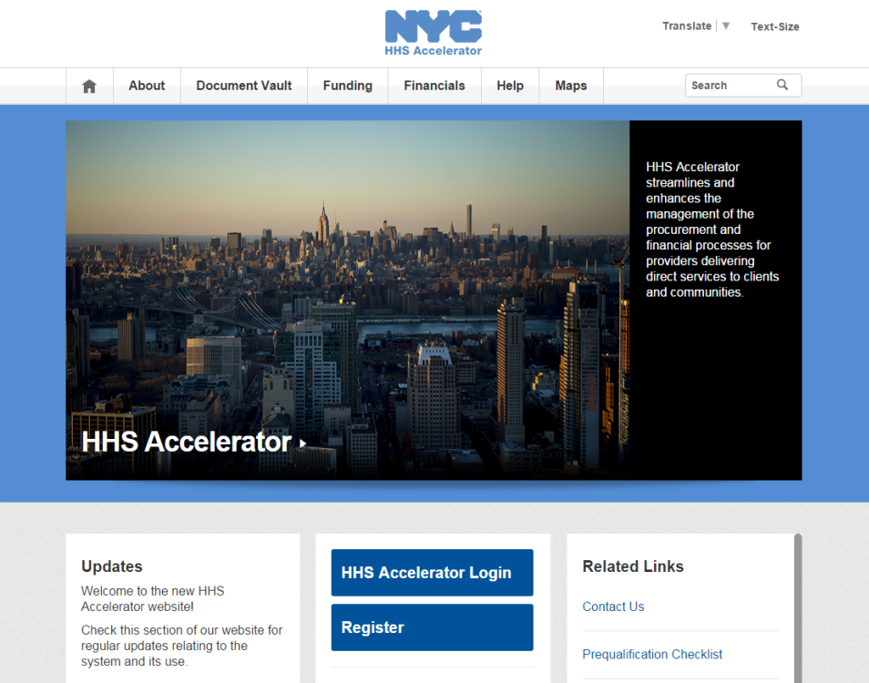
PROPOSING IN HHS ACCELERATOR
The HHS Accelerator System was launched to simplify and improve the competitive contract process for Health and Human Service providers.
Agencies publish all Request for Proposals (RFP) Documents in the HHS Accelerator System.
Prequalified providers approved for relevant Services are “Eligible to Propose” and can submit proposal(s) after RFPs are released.
Providers must submit proposals through the HHS Accelerator System by the proposal due date and time (2 pm).
Need Help?
Contact: help@mocs.nyc.gov

Slide 6
Beacon Programs Wanda Ascherl, Senior Program Director Youth Services

Slide 7
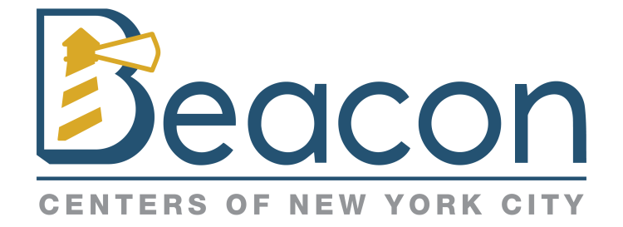
Beacon Community Center
Beacons represent a unique convergence of youth and community development, aiming, in particular, to keep youth out of harm’s way while simultaneously strengthening local communities through an integrated range of services, provided in an educational environment, and tailored to community needs.
Program Goals
Promote positive development by providing safe environments, supportive relationships, high expectations, family engagement and intergenerational activities.
Trusted, neighborhood hub that helps community members access services, strengthens community bonds, and fosters a sense of belonging.
Provide opportunities for all participants to develop skills, increase personal and family well being.
Strengthen community life by expanding partnerships, tapping into City’s resources, encouraging residents to participate in neighborhood activities and connecting community resources to the Beacon.
Support student engagement in school, including among students with chronic absenteeism.
Ensure participants and community members are viewed as potential contributors to the Beacon and the community, are enlisted to help identify local needs, and engaged in the ongoing development of Beacon programs.
Notes:
Administration has committed to a significant increase in funding for the Beacon initiative, with goals that are closely aligned with Mayoral priorities of equity and opportunity in the areas of education, health and well-being, empowered residents and neighborhoods, and personal and community safety

Slide 8
Program Expectations: Approach
Strength-based Frameworks:
Positive Youth Development (PYD)
Social and Emotional Learning (SEL)
Youth Leadership
Safe, Welcoming and Inclusive Environment
The contractor would have protocols for staff behavior and effective training and supervision to ensure the environment is friendly and supportive and everyone is treated with dignity and respect, starting from the very first encounter with program staff.
Family Engagement
Family engagement comprises three critical elements: Communication (i.e., strong and positive family interactions); Participation (i.e., families access the services they need); and Mutually-beneficial partnerships (i.e., family members assume leadership roles and take shared responsibility for outcomes).
Notes:
DYCD expects all the programs it supports to recognize and value the strengths and capacities of individuals and communities.
PYD is an assets-based approach that fosters healthy development and resilience by offering a safe environment, a sense of belonging, and authentic opportunities for participants to be heard and effect change in their lives.
SEL involves intentional development of key skills including self-awareness, self-management, social awareness, relationships and responsible decision-making. Youth Leadership builds on SEL competencies by adding a focus on action (using skills learned to effect change), and reflection (reinforcing lessons learned, building confidence, responding to new challenges).

Slide 9
Annual Target Population/Service Levels
Age Category | Activity Type | Number | Enrollment Criterion
Youth, under 22 years | Drop-In and planned activities | 600 | 3 Visits
Adults 22 years and older | Drop-In and planned activities | 100 | 1 Visit
Adults and Youth, any age | Community Events | 500 | 1 Event
Total |  | *1,200
Of the 600 youth under 22 years, DYCD expects Beacons to enroll at least 100
elementary, 100 middle school students and 100 high school-age youth.
Adult Services: Services would reflect their specific needs and interests.
Please note: The 1,200 are annual enrollment requirements and inclusive of Summer and School Year services.
Notes:
The Beacon would provide activities and services for school-age youth, families, and adults ages 22 years and older, including seniors.
Points:
These are annual figures and are inclusive of summer services.
The school year concentrated population for youth services is 200.

Slide 10
Target Population/Service Levels: School Year Dosage Requirements
School Year – Intensive Participation Levels - 200
Grade/Age | Measure | Target | 200 Total
Elementary (K-5) | Average Daily Attendance | 80% | #
Middle (6-8) | Hours of Beacon activity | 150 hours per participant per school year | #
High School Age (9 -12) and out of school youth through age 21 | Hours of Beacon activity | 100 hours per participant per school year | #
School Year (36 Weeks)
Minimum Hours per Week | Operating Schedule | Total School Year Operating Hours
42 hours over 6 days (Mon-Fri and Sat or Sun) | Weekdays Start: End of the school day End: No later than 10pm Weekends To be negotiated with host school | 1,512
Notes:
Depending on school grade level and community need, CBOs will identify population to serve.
At least 15 school closing days during the school year program is expected to operate for 10 hours a day, from 8am – 6pm, for a total of 150 hours. Provider selects days according to community needs.
Another item that needs to be flagged during contract negotiations.

Slide 11
New Beacon Sites
School | Address | Community District | Contractor
The Dr. Emmett W. Bassett School | 1075 Pugsley Avenue Bronx, NY 10472 | Bronx 9 | Team First, Inc.
The Metropolitan Soundview High School | 1300 Boynton Avenue Bronx, NY 10472 | Bronx 9 | Children’s Arts & Science Workshops, Inc.
PS 264 Bay Ridge Elementary School for the Arts | 371 89th Street Brooklyn, NY 11209 | Brooklyn 10 | Sports and Arts in School Foundation, Inc.
PS 247 | 7000 21st Avenue Brooklyn, NY 11204 | Brooklyn 11 | NIA Community Services Network, Inc.
PS 164 Caesar Rodney | 4211 14th Avenue Brooklyn, NY 11219 | Brooklyn 12 | Church Avenue Merchants Block Association, Inc. (CAMBA)
PS 179 Kensington | 202 Avenue C Brooklyn, NY 11218 | Brooklyn 12 | NIA Community Services Network, Inc.
PS 6 Norma Adams Clemons Academy | 43 Snyder Avenue Brooklyn, NY 11226 | Brooklyn 14 | Research Foundation of the City University of New York
The Woodside Community School | 39-07 57th Street Queens, NY 11377 | Queens 2 | Woodside on the Move, Inc.
The Children’s Lab School | 45-45 42nd Street Sunnyside, NY 11104 | Queens 2 | Sunnyside Community Services, Inc.
PS 14 The Fairview School | 107-01 Otis Avenue Corona, NY 11368 | Queens 4 | Sports and Arts in School Foundation, Inc.
PS 054 Hillside | 86-02 127th Street Queens, NY 11418 | Queens 9 | Young Men’s Christian Association of Greater New York

Slide 12
Capacity building/ RFP Content Area
Meryl M. Jones, Assistant Commissioner, Capacity Building and Professional Development

Slide 13
How does DYCD define capacity building?
Capacity building is as any activity, such as strategic planning, board development, or improvements in program practices or technology, that increases an organization’s program outcomes or sustainability.

Slide 14
Capacity Building Mission
The mission of the Capacity Building unit is to strengthen the capacity of DYCD-funded community-based organizations to ensure that youth and families receive high quality, effective services
The population eligible to receive services are all DYCD- funded organizations
The population targeted to receive intensive services are DYCD-funded organizations ready, willing and able to benefit from capacity-building services

Slide 15
Capacity Building Goals
Increase nonprofit ability to achieve positive outcomes for youth, adults, families, and communities.
To support organizational development and continuous quality improvement through the adoption of exemplary management practices and data-informed decision-making.

Slide 16
About DYCD Capacity Building
Types of Capacity Building supported:
Coaching
Consulting
Training
Conferences
Publications
Also facilitates:
Family Development Training & Credentialing (FDC) Training
Cultivating Curiosity initiatives
College-based Partnerships
Training to various DYCD units

Slide 17
DYCD Capacity Building Strategies
Incorporating Adult Learning Principles
Increased focus on multiple-level staff support
Peer-learning experiences
Strategic Partnerships
Integration of adult learning principles
Sector and sub-sector support
Neighborhood based support

Slide 18
RFP Content Area and TA Competition

Slide 19
TA Competition
Cultural Competence
The National Council for Cultural Competence (NCCC) states that culturally competent organizations:
(1) Have a defined set of values and principles and demonstrate behaviors, attitudes, policies, and structures that enable them to work effectively cross-culturally.
(2) Have the capacity to (a) value diversity, (b) conduct self-assessment, (c) manage the dynamics of difference, (d) acquire and institutionalize cultural knowledge, and (e) adapt to diversity and the cultural contexts of communities they serve.
(3) Incorporate the above in all aspects of policy-making, administration, practice, and service delivery and systematically involve consumers, families, and communities.
(https://nccc.georgetown.edu/foundations/frameworks.html)

Slide 20
Cultural Competence
Capacity building funded through this RFP would be designed to strengthen selected Beacon programs in the area of cultural competence. The fundamental purpose would be to increase the capacity of community-based organizations to deliver services in a manner that welcomes, recognizes, embraces, and appropriately responds to the cultural characteristics of a diverse population. Interventions would be directed toward managerial, supervisory, and frontline program staff.
The selected contractor would:
provide capacity building support and professional development in the area of cultural competence to the eleven newly funded Beacon programs.
engage in stages of capacity building work over the course of the contract, including an assessment of the overall needs of the eleven Beacons, implementation of strategies to address those needs, and an evaluation of the success of the interventions.
develop a strategic two and a half year plan to guide the capacity building work.
The overall intent of the capacity building efforts would be to shift the climate of each organization toward a more sensitive, competent, and holistic approach to providing services to participants who embody many diverse characteristics.

Slide 21
TA Competition Amount
Cultural Competence | Amount per Year
January 1, 2018 – June 30, 2018 | $50,000
July 1, 2018 – June 30, 2019 | $100,000
July 1, 2019 – June 30, 2020 | $100,000
Total for three years: | $250,000

Slide 22
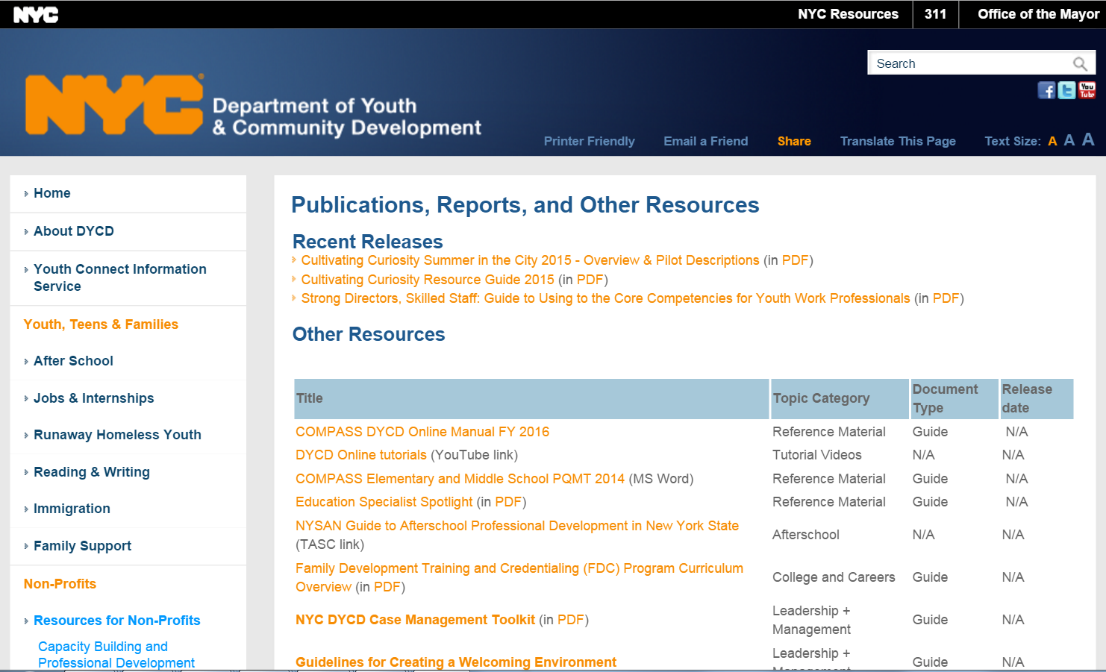
Website link to additional resources
DYCD website/Resources for Nonprofits/Publications
http://www.nyc.gov/html/dycd/html/resources/publications.shtml
Social Media Policy link: https://www1.nyc.gov/assets/dycd/downloads/pdf/DYCD_Provider_Social_Media_Policy.pdf

Slide 23
Post Award Requirements

Slide 24
Post Award Requirements
General Information and Regulatory Requirements
Responsibility Determination
NYC Liability Insurance Requirement
Commercial General Liability
$1 million per occurrence and $2 million aggregate;
Motor Vehicle Liability (if applicable)
$5 million per occurrence;
Workers’ compensation
An original certificate of insurance naming the City of New York, together with its officials and employees, as an additional insured.
DYCD will not be able to proceed with processing an awarded contract until it has obtained proof of the necessary insurance coverage.

Slide 25
Wrap-up
Q&A
Transcript, presentation and attendance rosters will be posted to DYCD website for viewing
www.nyc.gov/DYCD

