Slide 1
Capacity Building Services: Strengthening Organizations Pre-proposal Conference
February 15, 2017

Slide 2
Welcome & Agenda
Welcome and Panel Introduction - Keith
RFP Timeline/Requirements – Keith
HHS Accelerator - Natasha
About Capacity Building - Meryl
RFP Content Areas - Miguel
Post Award Requirements- Keith
Question and Answer - everyone

Slide 3
About DYCD
Mission: The New York City Department of Youth and Community Development (DYCD) invests in a network of community-based organizations and programs to alleviate the effects of poverty and to provide opportunities for New Yorkers and communities to flourish.
Vision: DYCD strives to improve the quality of life of New Yorkers by collaborating with local organizations and investing in the talents and assets of our communities to help them develop, grow and thrive.
Empowering individuals, Strengthening Families. Investing in Communities

Slide 4
RFP Timeline
Proposal Due Date: March 15, 2017 at 2:00PM
Award Announcement: Late Spring
Contracts would be begin July 1, 2017
Questions: Must be received by March 6, 2017
RFPquestions@dycd.nyc.gov

Slide 5
MWBE Utilization Plan
New York City Certified M-WBE
Participation counts towards RFP goal
(Schedule B: Part II: M/WBE Participation Plan)
For-profit (Non M/WBE)
Meet the Participation Goal
(Schedule B: Part II: M/WBE Participation Plan)
-or-
Request a Partial Waiver
(Schedule B: Part II: M/WBE Participation Plan and Part III- Request for Waiver of M/WBE Participation Requirement)
-or-
Full Waiver
(Schedule B: Part III- Request for Waiver of M/WBE Participation Requirement)
Non-profit
Schedule B not applicable
Must upload 501c3 at time of proposal submission

Slide 6
Partial and Full Waiver Requests
Partial Waivers
Approval must be obtained prior to proposal submission
Submit Part III of Schedule B to DYCD for approval no later than March 8, 2017 to Referguson@dycd.nyc.gov
Part II along with your approved waiver form (Part III) must be submitted with your proposal in the HHS Accelerator system
Full waivers
Approval must be obtained prior to proposal submission
Submit Part III of Schedule B to DYCD for approval no later than March 8, 2017 to Referguson@dycd.nyc.gov
Approved waiver form (Part III) must be submitted with your proposal in the HHS Accelerator system

Slide 8
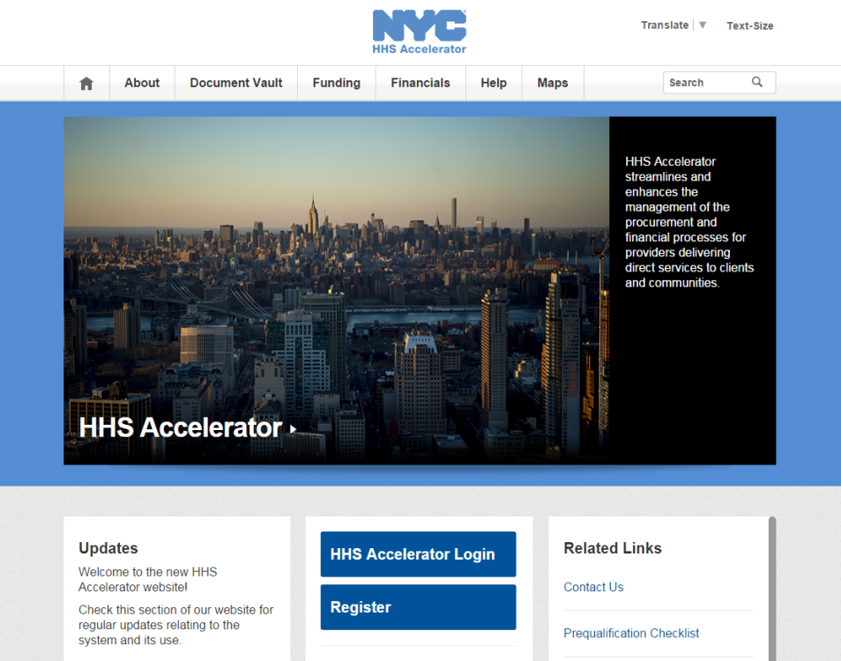
PROPOSING IN HHS ACCELERATOR
The HHS Accelerator System was launched to simplify and improve the competitive contract process for Health and Human Service providers.
Agencies publish all Request for Proposals (RFP) Documents in the HHS Accelerator System.
Prequalified providers approved for relevant Services are “Eligible to Propose” and can submit proposal(s) after RFPs are released.
Providers must submit proposals through the HHS Accelerator System by the proposal due date and time (2 pm).
Need Help?
Contact info@hhsaccelerator.nyc.gov

Slide 9
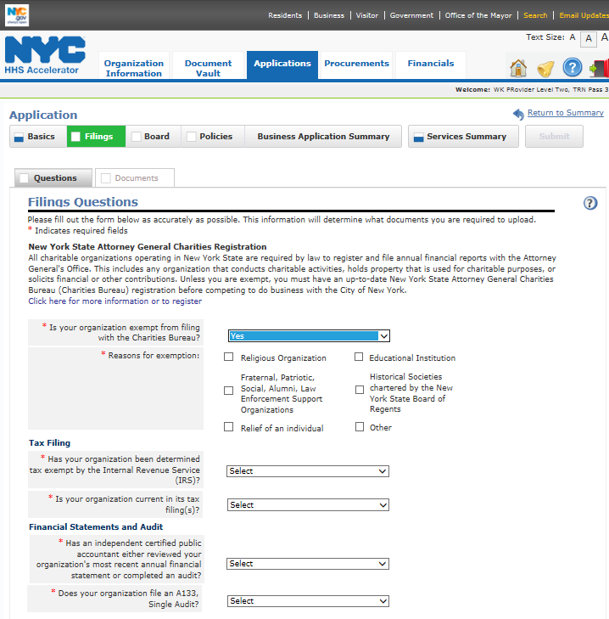
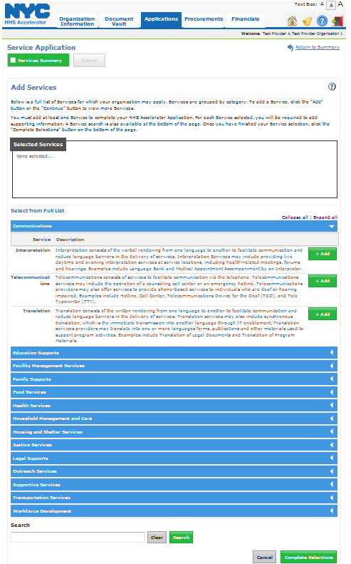
PREQUALIFICATION APPLICATION
Eligibility is determined through a two-part prequalification Application.
Business Application
Service Application
Establish corporate identity
Confirm annual regulatory filings
Board structure and policies.
Browse and search the Client and Community Services Catalog to select services
Establish track record of service delivery.
1
Box turns blue to indicate completion.
3
Options to demonstrate service record:
Contract/ Grant
Key Staff Resume
Statement.
2
*Indicates required field.

Slide 10
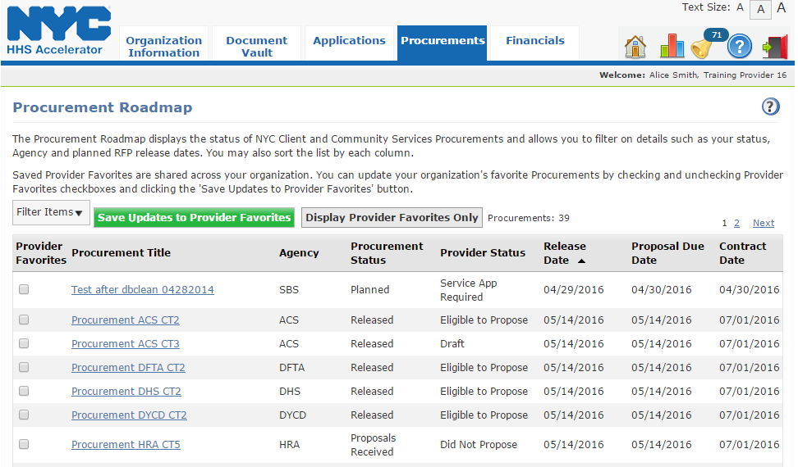
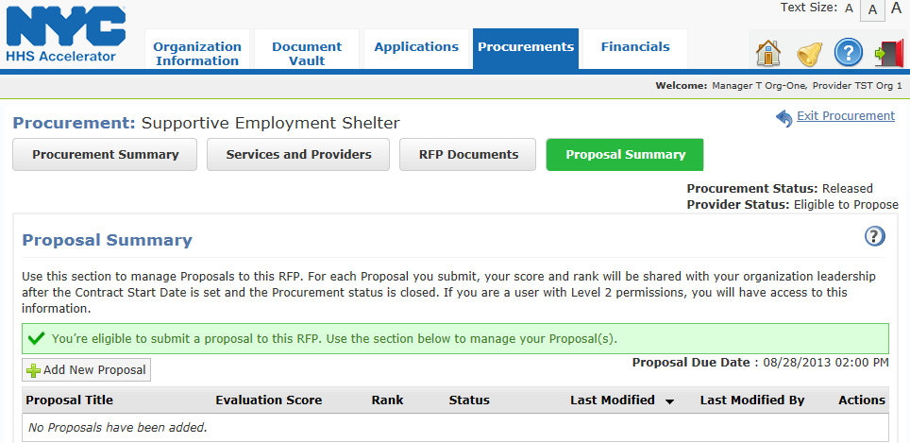
COMPETING FOR FUNDING
Click the “Procurement Title” link to access the Proposal Summary tab.
3
Click “Add New Proposal” to begin your response to the RFP.

Slide 11
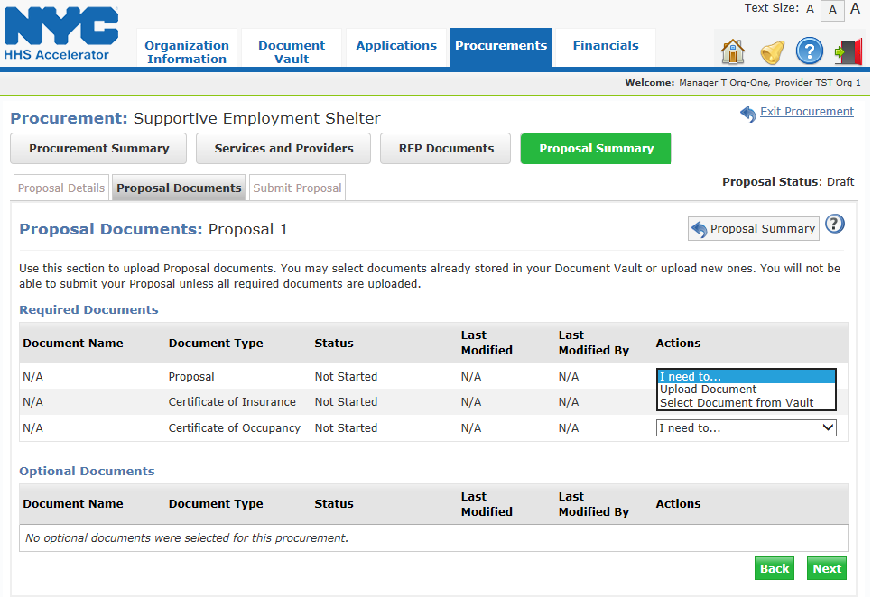
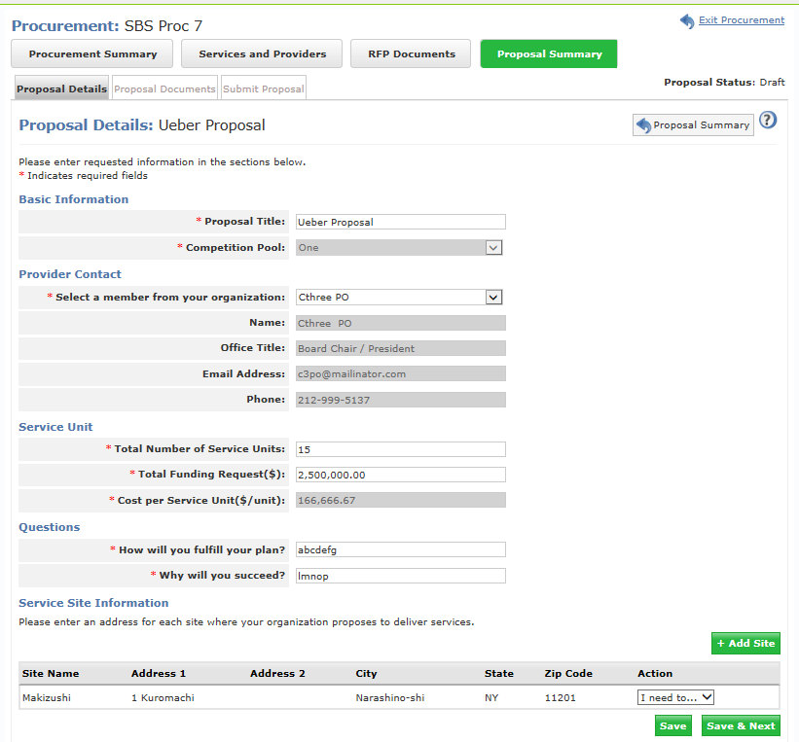
PROPOSAL DETAILS & DOCUMENTS
Review the Proposal Submission Instructions in the RFP for guidance.
Proposal Details
Proposal Documents
Enter a “Provider Contact” who is responsive.
Select the correct Competition Pool, where applicable.
Enter the location where the program will be implemented..
Upload all the “Required Documents” by using the Actions drop-down list.
2

Slide 12
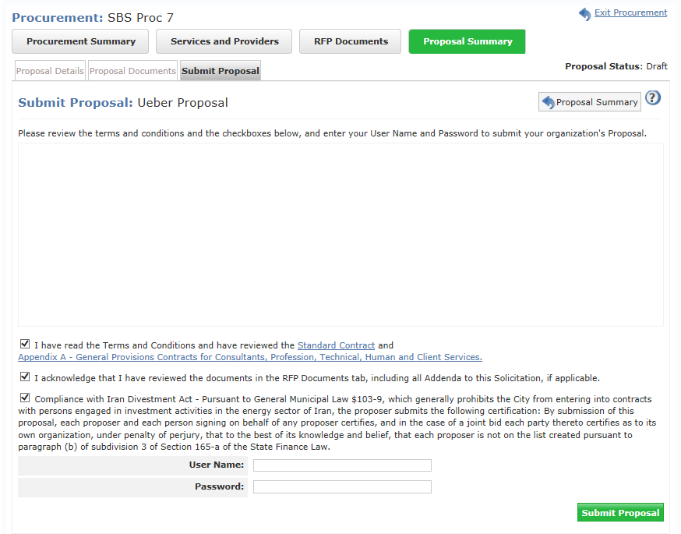
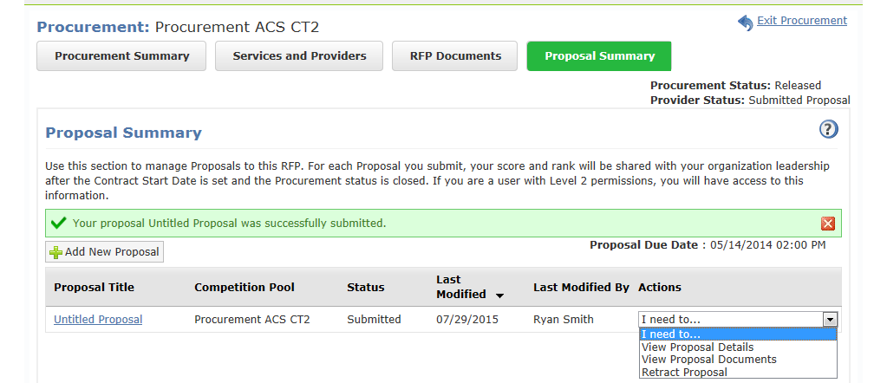
SUBMITTING A PROPOSAL
Proposals must be submitted by 2 pm on the due date in the system.
Submit Proposal
Proposal Status
Check off the attestation boxes, enter your “User Name” and “Password” and click the “Submit Proposal” button.
Once your proposal has been submitted, your organization’s status will change from Draft to Submitted.
2

Slide 13
About Capacity building
Meryl Jones, Assistant Commissioner, Capacity Building

Slide 14
How does DYCD define capacity building?
Capacity building is as any activity, such as strategic planning, board development, or improvements in program practices or technology, that increases an organization’s program outcomes or sustainability.

Slide 15
Capacity Building Mission
The mission of the Capacity Building unit is to strengthen the capacity of DYCD-funded community-based organizations to ensure that youth and families receive high quality, effective services
The population eligible to receive services are all DYCD- funded organizations
The population targeted to receive intensive services are DYCD-funded organizations ready, willing and able to benefit from capacity-building services

Slide 16
Capacity Building Goals
Increase nonprofit ability to achieve positive outcomes for youth, adults, families, and communities.
To support organizational development and continuous quality improvement through the adoption of exemplary management practices and data-informed decision-making.

Slide 17
About DYCD Capacity Building
Types of Capacity Building supported:
Coaching
Consulting
Training
Also facilitates:
Family Development Training & Credentialing (FDC) Training
Cultivating Curiosity initiatives
College-based Partnerships
Training to various DYCD units
Conferences
Publications

Slide 18
DYCD Capacity Building Strategies
Incorporating Adult Learning Principles
Increased focus on multiple-level staff support
Peer-learning experiences
Strategic Partnerships
Integration of adult learning principles
Sector and sub-sector support
Neighborhood based support

Slide 19
RFP Content Areas
Miguel Bonilla, Director, Organization Development

Slide 20
TA Competitions
Board Governance
Fiscal Management
Fund Development Planning
Organization Development

Slide 21
TA Competitions
Board Governance
Critical to organization’s ability to pursue mission and services
Engaged boards are more likely to evaluate organizational performance, oversee finances and raise money
The contractor would help board leadership understand board fiduciary responsibility, role expectations, and executive director performance

Slide 22
TA Competitions
Fiscal Management
Needed in order to hire appropriately, manage organizational growth, and deliver high quality services
Contractor would help nonprofit leaders create program-based budgeting, monitor and understand finance functions, develop and maintain appropriate fiscal controls, and help boards understand fiscal position.

Slide 23
TA Competitions
Fund Development Planning
Important to have plan to create cash reserves, diversified funding streams, and skilled development staff
Contractor would help nonprofit leaders plan for a diverse funding base, identify and recruit appropriate development staff or engage board in fundraising

Slide 24
TA Competitions
Organization Development
Are the skills and practices that bring together stakeholders to plan and execute their work, promote healthy human resource practices, and manage conflict well
Contractor would help nonprofit leaders with strategic planning, establishing internal monitoring systems, effective management and supervision practices

Slide 25
TA Competition Amounts
Competition | Amount per year | Total for 3 years
Board Governance | $100,000 | $300,000
Fiscal Management | $325,000 | $975,000
Fund Development | $100,000 | $300,000
Organization Development | $298,359 | $895,077

Slide 26
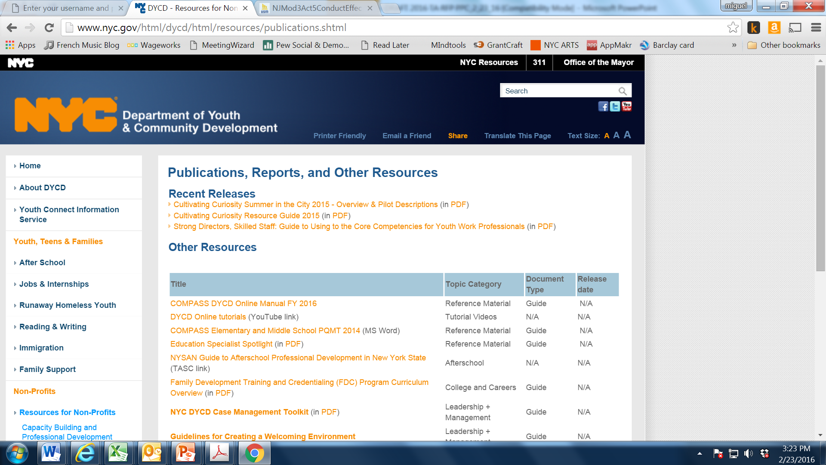
Website link to additional resources
DYCD website/Resources for Nonprofits/Publications
http://www.nyc.gov/html/dycd/html/resources/publications.shtml
Social Media Policy link: https://www1.nyc.gov/assets/dycd/downloads/pdf/DYCD_Provider_Social_Media_Policy.pdf

Slide 27
Post Award Requirements
General Information and Regulatory Requirements
Responsibility Determination
Notice for Proposer Subcontractor Compliance
HireNYC rider

Slide 28
IMPORTANT INFORMATION
NYC Liability Insurance Requirement
Commercial General Liability
$1 million per occurrence and $2 million aggregate;
Motor Vehicle Liability (if applicable)
$5 million per occurrence;
Workers’ compensation
An original certificate of insurance naming the City of New York, together with its officials and employees, as an additional insured.
DYCD will not be able to proceed with processing an awarded contract until it has obtained proof of the necessary insurance coverage.

Slide 29
Wrap-up
Q&A
Thank you!
Transcript, presentation and attendance rosters will be posted on DYCD’s website for viewing.

