Slide 1
Screening and Isolation for Communicable Diseases of Public Health Concern
Essential Staff Training
Updated August 2026

Slide 2
Background
Preparing frontline health workers is critical to protecting communities against threats of all types.
This training is designed to provide you with an overview of recommendations for protection of healthcare facility staff and patients from transmission of communicable diseases of public health concern such as Ebola, Measles, and Middle East Respiratory Syndrome (MERS).
Training is supplemented by no-notice drills to identify strengths and opportunities for improvement.
Notes:
The New York City Department of Health and Mental Hygiene has developed this training to best prepare and protect healthcare workers and the New York City residents from communicable diseases. Such preparedness and protection is critical to defense from all types of threats. This training is designed to provide you with an overview of recommendations for protection from transmission of severe communicable disease such as Ebola, measles, and Middle East Respiratory Syndrome (MERS). In addition to this training, the NYC Health Department together with facility emergency preparedness coordinators are conducting no-notice drills of hospital emergency department staff to enhance preparedness and evaluate response.

Slide 3
Background Continued
Who should complete this training?
  Staff in emergency departments, urgent care centers or other clinics where patients may present with an acute communicable disease including:
    Security staff
    Registration staff
    Triage staff
    Physician and nursing administration responsible for these patient care areas
    Anyone who has public and patient contact
Notes:
Frontline healthcare staff and their administrators in emergency departments, urgent care centers and other clinics, are encouraged to complete this course including:
Emergency department, security, registration, triage and physician and nursing administrators responsible for these patient care areas.
Essentially anyone who has public and patient contact in hospital emergency departments will benefit from completion of this course.

Slide 4
Training Objectives
To understand general process for rapid recognition of a patient who may have a communicable disease of public health concern upon arrival at an Emergency Department (ED) or clinic
To review infection control measures that can minimize potential transmission: identify, isolate, and inform
Intended to supplement, not replace, facility-specific policies, plans, and training
Notes:
This is course is designed to enhance the understanding of frontline workers in the emergency department or clinic of the general process of identification, isolation and management of a patient with potential communicable disease.
The course is intended to supplement, not replace your facility specific plans and training. To facilitate greater understanding of your facility specific practices “Find Out” and “Be Aware” call out boxes are contained throughout the course to provide opportunity to review and better understand your facility processes and protocols.

Slide 5
Introduction
High-consequence infectious diseases (HCID) pose a potential threat to the healthcare system
In an increasingly connected world, new infections can easily be introduced by international travel
Recent examples: Avian Influenza, mpox; Middle East Respiratory Syndrome (MERS-CoV); Ebola virus disease, Lassa Fever,
COVID-19, and measles
Notes:
Recent events have demonstrated increased threats of emerging infectious disease in New York City and nationally.
International travel facilitates introduction of such infectious diseases in our increasingly connected world.
Recent examples include Ebola in West Africa and MERS-CoV in the Middle East.

Slide 6
Definition:
Acute human infectious diseases with:
High illness (morbidity) and case-fatality rates
Few or no available effective treatment or prevention options
Has the ability to spread in the community and within healthcare settings
Examples:
Viral hemorrhagic fevers, Nipah virus, Andes Hantavirus, novel coronaviruses (e.g., MERS)
High-Consequence Infectious Diseases (HCIDs)*
*As defined by the National Emerging Special Pathogen Training and Education Center (NETEC)

Slide 7
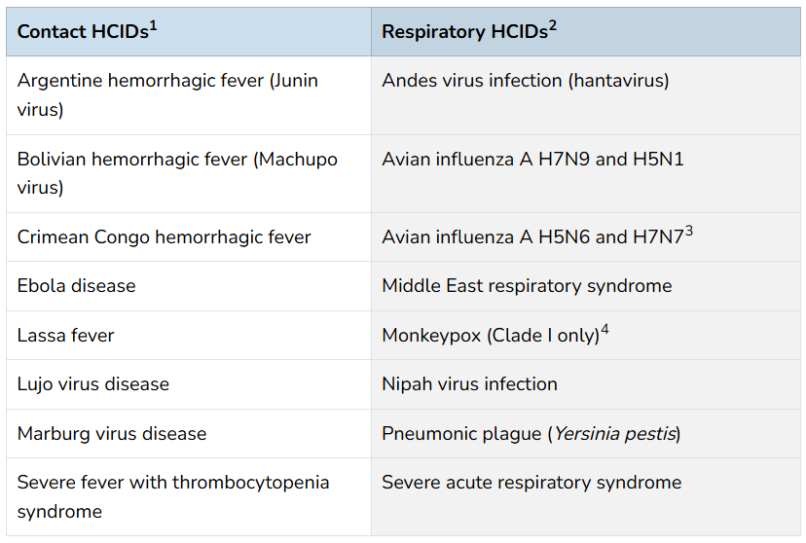
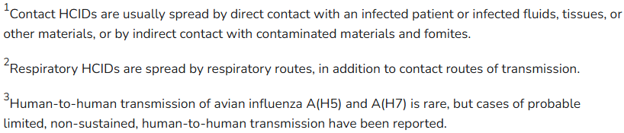
High-Consequence Infectious Diseases
Source: CDC

Slide 8
Additional
Definition:
Infectious diseases that can:
Spread from person to person or from animals to humans
Cause large outbreaks, strain healthcare systems and public health resources, and/or lead to severe disability and death
Require immediate notification to public health department
Examples: in addition to the HCIDs
Measles, tuberculosis, varicella (chickenpox and zoster)
Communicable Diseases of Public Health Concern

Slide 9
Introduction Continued
Emergency Departments (ED) and Urgent Care Centers (UCC) are important and vulnerable points of entry
Stopping the spread of HCIDs and other communicable diseases of public health concern starts with three simple steps
Isolate
Inform
Identify
Notes:
Emergency departments and urgent care centers are vulnerable points of entry into the healthcare system for severe communicable diseases. The ability for all Emergency Department frontline staff to rapidly identify, isolate and manage patients with severe communicable diseases can limit the spread of illness among other patients, staff and visitors and has a significant impact on protecting the health of your community.
This training will review three simple steps you can take to help stop the spread infection including:
How to identify potentially infectious patients
What steps you should take to prevent disease transmission through appropriate isolation and
Knowing who to notify when a potentially infectious patient is identified

Slide 10
Key Concept: 3 I’s
Identify
Isolate
Maintain awareness of current outbreaks
Visible signage: travel
Triage questions: key signs and symptoms and travel
  Fever + rash
    OR
  Fever + travel to outbreak area
    OR
  Fever + respiratory symptoms with either healthcare related exposures or as part of a cluster of two or more persons with similar symptoms
Inform
Patients who screen positive for potential communicable disease should be immediately masked, separated from others and placed in an isolation room
Apply appropriate transmission-based precautions
Appropriate staff Personal Protective Equipment (PPE) should be worn
Following clinical evaluation, suspected communicable diseases of public health concern should be reported to your local health department
Maintain a log of all staff contact
Provide appropriate laboratory testing and patient care based on facility protocols and Health Department recommendations.
Notes:
There are three key concepts associated with the management of communicable diseases in emergency departments. For the purpose of this course we refer to them as the three I’s: identify; isolate and inform. Each aspect will be reviewed during this course.

Slide 11
Identify

Slide 12
Identify:
Initial patient identification
Review Signs and Symptoms
    Fever? → if yes
      Do they have a rash?
        Do they have respiratory symptoms (e.g. cough)?
Travel History
    Personal travel outside country or contact with individual having traveled outside country within the last 3 weeks
FIND OUT: What is your organization’s process for updating staff on current outbreaks, travel advisories or emerging infections?
Notes:
The first step in identification of the patient is screening for fever, rash, respiratory symptoms, and travel history. Each component will be explained in detail.

Slide 13
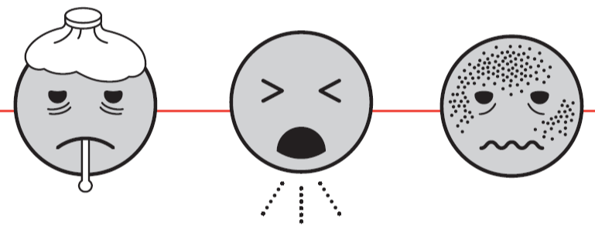
Identify:
Signs and Symptoms
Triage and screening staff should always screen for symptoms of a potential communicable disease of public health concern:
    Recent fever (on presentation or self report) and
    New cough, other respiratory symptoms (e.g. shortness of breath, trouble breathing) and/or
    Rash or skin lesions
FIND OUT: Who screens patients for communicable disease symptoms at your facility?
Notes:
The triage or screening process should include determination of fever, rash, or respiratory symptoms including cough, shortness of breath, and/or trouble breathing. Some electronic health records may have triggers to flag these symptoms as requiring rapid evaluation.

Slide 14

Identify:
Travel History
Facilities should post visible signage in multiple languages instructing patients with fever/respiratory symptoms/rash to report to registration/triage and report symptoms
Signage should use simple messages to direct patients with these symptoms who have traveled out of the United States in the past 3 weeks to report to registration/triage
FIND OUT: Where are signs posted at your facility?
Notes:
Signage should be placed in hospital, emergency department, triage, and registration spaces to instruct patients with relevant signs and symptoms and travel history outside of the United States in vulnerable areas to report symptoms immediately to triage. These signs should be clearly visible and easy to read.

Slide 15
Identify:
Travel History
Continued
The following question should be asked of all patients with fever at initial screening:
    “In the past three weeks have you traveled outside the United States or had close contact with someone who traveled outside the United States”
FIND OUT: Who is responsible for asking this question at your facility?
Notes:
All patients with fever should be asked about travel history outside the United States or contact with someone who has such history.

Slide 16
Identify:
Risk Factors
Other risk factors to consider
  Healthcare exposures
  In an area with a current outbreak (international or domestic)
  Exposure to other people with similar symptoms
  Close contact with wild or domesticated animals, or livestock such as cattle or poultry, including any with signs of illness
BE AWARE: Maintain awareness of current significant outbreaks through New York State (NYS) Department of Health and the Centers for Disease Control and Prevention*
*see resources at the end of presentation
Notes:
Other risk factors to screen for include: exposure to communicable diseases in healthcare settings with a current outbreak and clusters of similar symptoms among a group of individuals.

Slide 17
Identify:
Summary
Positive screening criteria include:
  Fever + rash
    OR
  Fever + travel to an outbreak area
    OR
  Fever + respiratory symptoms (no rash) plus
      International travel to an outbreak area or
      Close contact with a person with febrile respiratory illness + travel or
      Healthcare related exposures or
      Part of a cluster of two or more persons with similar symptoms
Notes:
In summary, positive screening for possible communicable disease includes
Fever and a rash
OR
Fever and travel to an area with an outbreak
OR
Fever and respiratory symptoms with either healthcare related exposure or part of a cluster of two or more people with similar symptoms

Slide 18
Isolate

Slide 19
Isolate
Patients who are identified as at risk based on signs, symptoms and/or travel history or other exposure risks should:
      Be given a surgical mask for source control
      Perform hand hygiene
      Be separated and placed in an Airborne Infection Isolation Room (negative pressure) or private room with door closed
Triage staff should also perform hand hygiene
BE AWARE: Know locations of isolation rooms and personal protective equipment
Notes:
The next step in the process is to isolate the patient as quickly as possible.
The patient should be shown how to wear the mask and instructed to wear this mask at all times. The patient should keep the mask on at all times while in the isolation room, unless it is an Airborne Infection Isolation Room, in order to minimize contamination of the room.
The patient should be instructed on how to perform hand hygiene after coughing or other contact with respiratory secretions, bodily fluids, or their rash.
If an Airborne Infection Isolation Room, private room or pre-identified examination area is not available, the patient should be asked to stay in an area of the waiting room that allows at least three feet of separation between the patient and others in the waiting area. The patients should be instructed to keep the surgical mask on at all times while in the waiting area and discouraged from walking around the Emergency Department or clinic.
Triage and screening staff should perform hand hygiene immediately upon placement of the patient in the isolation room.

Slide 20
Isolate:
Personal Protection
The number of staff entering the patient’s room should be limited to essential staff
Standard, droplet, airborne, and contact precautions should be followed as appropriate
Hospital policy and procedures for use and disposal of
personal protective equipment (PPE) should be followed
FIND OUT: More about your Hospital PPE policies and procedures
Notes:
Personal protection of the patient, healthcare workers and other emergency department patients is critical.
The number of people in contact with a suspected patient should be limited.
Relevant precautions including standard, droplet, airborne and contact precautions should be followed. More information on each of these will be provided in this training. Associated personal protective equipment, PPE, should be used.

Slide 21
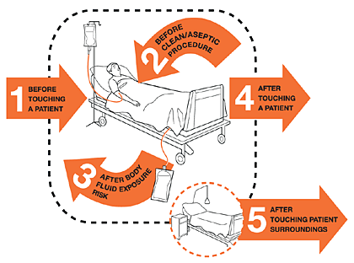
Standard Precautions:
Hand Hygiene
Perform hand hygiene before and after contact with a patient or when entering and exiting a patient room
Five moments for hand hygiene (WHO)
Notes:
Proper hand hygiene is first line of defense against transmission of infectious diseases. Perform hand hygiene by means of handwash with soap and water or handrub with alcohol-based product. You should perform hand hygiene before and after entering a patient’s room or contact with a patient.

Slide 22
Standard Precautions:
Personal Protective Equipment (PPE)
Assess the risk of exposure to body fluids or contaminated surfaces BEFORE any health-care activity
Select PPE based on the assessment of risk:
  Clean non-sterile gloves
    → protect hands
  Clean, non-sterile fluid-resistant gown
    → protect skin/clothing
  Mask and eye protection or a face shield
    → protect face, mouth, nose eyes
Notes:
Proper selection and use of personal protective equipment is based on the assessment of potential risk of exposure. You should follow your facilities instructions for putting on and removing PPE.
All of the PPE listed here prevent contact with the infectious agent, or body fluid that may contain the infectious agent, by creating a barrier between the worker and the infectious material. Gloves, protect the hands, gowns or aprons protect the skin and/or clothing, masks and respirators protect the mouth and nose, goggles protect the eyes, and face shields protect the entire face. PPE should never be re-used and must be changed between patients.

Slide 23
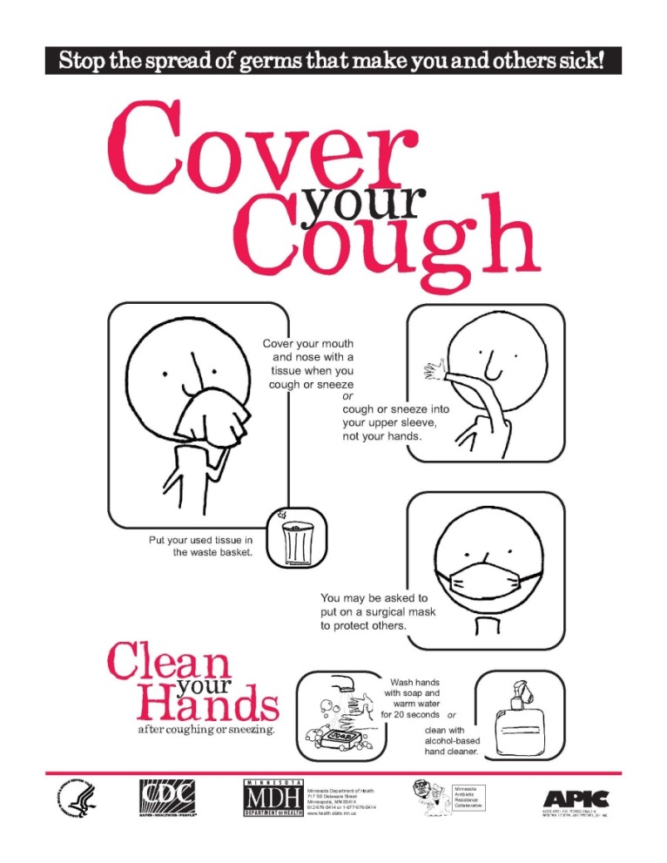
Standard Precautions:
Respiratory Hygiene
Cover mouth and nose when coughing or sneezing
Hand hygiene after contact with respiratory secretions
Spatial separation of persons with acute febrile respiratory symptoms
Notes:
Standard precautions include respiratory etiquette. Patients and caregivers should be sure to cover mouth and nose with the elbow or tissue when coughing or sneezing. Provide instructions on respiratory etiquette and tissues to all patients with respiratory symptoms. Hand hygiene should be performed after contact with respiratory secretions. Any patient with a fever and cough should be separated from patients and caregivers by at least 3 feet.

Slide 24
Isolate:
Contact Precautions
Prevent transmission through contact
    Direct contact → infection spread through physical contact with an infected person/lesion
    Indirect contact → infection spread through contact with a contaminated object or person
Examples: C. dificile, multidrug resistant organisms (e.g. MRSA,
C. auris), lice, scabies
Also apply where the presence of excessive wound drainage, inability to control stool, or other discharges from the body suggest an increased potential for environmental contamination and risk of transmission
Notes:
Contact precautions are used with any patient who has wound drainage, fecal incontinence, vomiting, or other discharges that suggest increased exposure potential.

Slide 25
Isolate:
Contact Precautions Continued
A single-patient room is preferred for patients who require
Contact Precautions
Healthcare personnel caring for patients on Contact Precautions wear a gown and gloves for all interactions that may involve contact with the patient or potentially contaminated areas in the patient's environment
Donning PPE upon room entry and discarding before exiting the patient room is done to contain pathogens
Notes:
Patients on contact precautions should be placed in a single room with bathroom or commode. All healthcare workers coming in direct contact with the patient should wear appropriate PPE including gown, gloves, and facial shield as needed. PPE should be donned upon entry to the room and properly removed and discarded before exiting the patient room.

Slide 26
Isolate:
Droplet Precautions
Prevents transmission of pathogens spread when infected droplets come into contact with mucous membranes of the eyes, nose or mouth
Examples: Influenza, Pertussis, meningococcal meningitis
Give patient a mask and place in a single room if possible
Personnel should wear a face mask for close contact* with infectious patients; don mask upon entering a patient room
Patients should wear a mask when being transported (if tolerated) and follow respiratory hygiene/cough etiquette
*Close contact is generally defined as in a closed space or within 3 feet of the patient
Notes:
Use Droplet Precautions for patients known or suspected to be infected with pathogens transmitted by respiratory droplets that are generated by a patient who is coughing, sneezing, or talking. Those patients should be given a mask and placed in a single patient room. Healthcare personnel should wear a simple face mask for close contact with the patient. The patient should also wear a mask when being transported to and from the room and they should be instructed to follow appropriate respiratory and cough etiquette.

Slide 27

Isolate:
Airborne Precautions
Prevents transmission of pathogens that remain infectious over long distances when suspended in the air
Examples: rubeola virus [measles], varicella-zoster virus [chickenpox], M. tuberculosis
Patients should be placed in an airborne infection isolation room (AIIR, i.e. negative pressure room)
    An AIIR is a single-patient room equipped with special air handling and ventilation capacity
Healthcare personnel should wear a fit tested N95 respirator, donned prior to room entry
Notes:
Airborne precautions prevent transmission of diseases that remain infectious over long distances when suspended in the air such as tuberculosis and severe acute respiratory system.
Patients on airborne precautions should be placed in a designated airborne infection isolation room with special air handling and ventilation capacity.
Caregivers should wear a mask or respirator as deemed appropriate to the specific pathogen and recommended by infection control.

Slide 28
Isolate:
Special Respiratory Pathogens
Some severe respiratory infections require enhanced precautions
Middle East respiratory syndrome coronavirus (MERS-CoV), Severe Acute Respiratory Syndrome (SARS), novel Influenzas (e.g. bird flu) are examples of diseases that require
        Standard precautions
        Contact precautions
        Airborne precautions
        Face shield/eye protection
Notes:
Middle East respiratory syndrome coronavirus, known as MERS-CoV, Severe Acute Respiratory Syndrome, known as SARS, Ebola and novel influenzas like bird flu are examples of highly communicable diseases requiring enhanced infection control precautions.

Slide 29
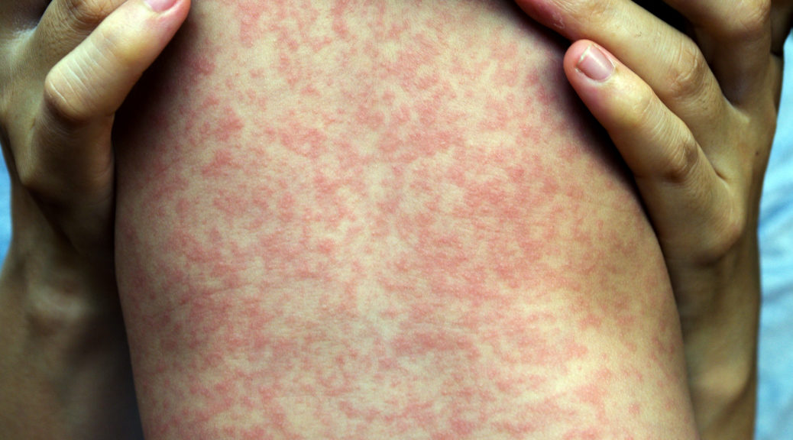
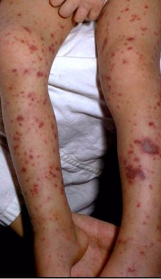
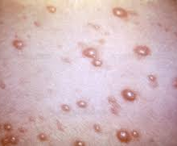
Isolate:
Special Rash Pathogens
Measles
Meningitis
Measles
    Airborne isolation
    If no airborne room available→ isolate, keep door closed and room must remain empty 2 hours after vacated
Chicken pox (Varicella-Zoster)
    Airborne isolation + Contact precautions
Meningitis
    Droplet + contact precautions
Varicella-Zoster
Notes:
The presence of a rash is indicative of a potential infectious disease including measles, chickenpox, or meningitis. Each of these conditions require isolation and associated infection control protocol implementation.

Slide 30
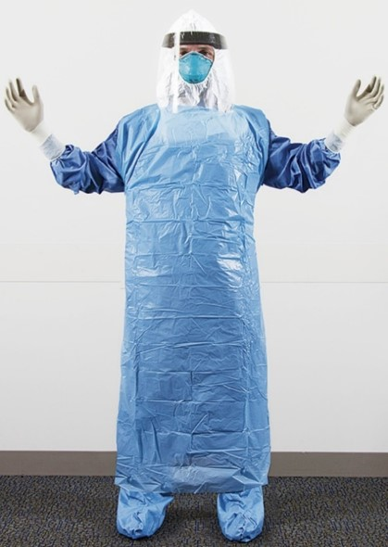
Isolate:
Viral Hemorrhagic Fevers
Severe infections that can be spread through direct and indirect contact and require full barrier precautions
Examples: Ebola, Marburg, Lassa Fever
Keys to staying safe
  Be familiar with your facility's Ebola protocols
  Know your role and responsibilities
  Only staff who have received comprehensive training and demonstrated competency in Ebola-related infection control practices should care for patients with suspected VHFs
Go to the CDC’s page on Viral Hemorrhagic Fevers: Guidance for PPE for more information
Notes:
Viral hemorrhagic fevers (or VHFs) are some of the most severe infectious diseases that can be spread through direct and indirect contact and require full barrier precautions that cover the entire body. Some examples of VHFs include Ebola, Marburg and Lassa Fever.
Every facility should have their own protocols for Ebola and VHF PPE.
The keys to keeping yourself and those around you safe are to make sure you are familiar with your facility's Ebola protocols, and make sure you know what someone in your role would be expected to do if there was a patient identified with a potential VHF. Most importantly, only staff who have received comprehensive training and demonstrated competency in Ebola-related infection control practices should care for patients with suspected VHFs.

Slide 31
Inform

Slide 32
Inform
Once triage/screening staff has identified a patient with a positive communicable disease of public health concern screening → Inform
    Triage staff should promptly notify ED leadership (e.g., Charge Nurse)
    ED leadership should ensure patient is isolated appropriately and identify a clinician to conduct initial clinical assessment using appropriate PPE
Notes:
Once triage or screening staff have identified and isolated a patient with a positive screening for a communicable disease they should notify emergency department leadership, such as charge nurse or attending, immediately. Emergency department leadership should identify a clinician to provide prompt clinical assessment of the patient using appropriate PPE.

Slide 33
Inform:
External Notifications
Once determined a patient has suspected communicable disease of public health concern it is essential the Infection Control Practitioner and/or his/her designee notify your local health department [insert contact information]
Maintain a log of the names and contact information of all staff in contact with patient
Provide appropriate laboratory testing and treatment based on the clinical evaluation and health department recommendations
Notes:
In addition to internal notifications the New York City Health Department should be contacted as well via the provider access line:
1-866-NYC-DOH1
1-866 (692-3641)
A log of all staff in contact with the patient should be initiated and maintained and appropriate laboratory testing and treatment should be provided based on the clinical evaluation and New York Health Department recommendations.

Slide 34
Inform:
Internal Notifications
After consultation with your local health department, the following positions within the hospital may need to be notified of a patient with suspected communicable disease of public health concern
    ED Administration Supervisor
    Infectious Disease/Hospital Epidemiologist
    Infection Control
    Hospital Administrator on Duty (AOD)
    Nursing Head
    Housekeeping
    Security
FIND OUT: Who should be notified at your facility?
Notes:
If a patient is deemed suspected to have a communicable disease after clinical evaluation the following internal notifications may need to take place as indicated by your facility’s plan:
Emergency Department Administration Supervisor
Infectious Disease / Infection Control
Hospital Administrator on Duty
Nursing Head
Housekeeping
Security

Slide 35
Remember
We are only as strong as our weakest link
    Know what to look for
    Know the protocols
    Know your role
    Communication is key
    Don’t be afraid to ask
    *When in doubt…don’t wait, isolate
Notes:
In summary it is important to remember that we are only as strong as our weakest link. In order to protect yourself and your community, it is important to be aware of what signs and symptoms to look for, what questions to ask, to understand your facility plans and protocols for communicable diseases and to communicate promptly to the appropriate entities. Above all if there is any doubt or question you should ask. Better to be safe than sorry.

Slide 36
Resources
New York State DOH Global Health Update Reports
  https://globalhealthreports.health.ny.gov/
CDC Health Alert Network
  https://www.cdc.gov/han/php/about/index.html
CDC Outbreaks and Incidents
  http://emergency.cdc.gov/recentincidents/index.asp
CDC Post-Travel Evaluation of the Ill Traveler
  https://www.cdc.gov/yellow-book/hcp/post-travel-evaluation/post-travel-evaluation-of-the-ill-traveler.html
Notes:
More information on any of these concepts can be found at the following websites. Additionally questions and concerns should be addressed to your emergency preparedness and infection control leaders.

Slide 37
Resources
Biothreats Emergence, Analysis, and Communications Network (BEACON)
Georgia Department of Public Health Travel Clinical Assistant (TCA)
Minnesota Department of Health HCID Toolbox
Please download the course resources for tools and job action sheets
Notes:
More information on any of these concepts can be found at the following websites. Additionally questions and concerns should be addressed to your emergency preparedness and infection control leaders.

