Slide 1
Cause of Death Webinar on
Death Certification
New York City Department of Health and Mental Hygiene
Bureau of Vital Statistics
This session should not be recorded.

Slide 2
Why is cause of death important?
Public health programs and policies
Clinical and population research
Surveillance of outbreaks, pandemics and emergencies

Slide 3
What deaths do clinicians certify?
The manner of death includes:
Natural or
External (accident, homicide, suicide or undetermined)
Clinicians certify natural deaths, which are caused exclusively (100%) by disease.
If an injury of any sort causes or contributes to death no matter how minor the contribution, the manner of death cannot be natural. You should consult with the Office of the Chief Medical Examiner (OCME) on these cases.
For more resources, visit nyc.gov/ocme, search for and scroll to the bottom section titled
nyc.gov/ocme,
“report a case”
"Training Resources to Improve Cause of Death Reporting."

Slide 4
Deaths that the OCME Certifies
OCME has jurisdiction over deaths occurring under the following circumstances:
Criminal violence or from an unlawful act or criminal neglect
Accidents (such as motor vehicle, industrial, home or public place)
Suicides
Drug or chemical overdose or poisoning
Sudden death of a person in apparent good health
Deaths during diagnostic or therapeutic procedures or from complications of such procedures
Deaths resulting from employment either due to disease, injury or toxic agents
Deaths which occur in any suspicious or unusual manner
For more information on New York City reportable deaths, visit nyc.gov/ocme and search for
nyc.gov/ocme
report a case.

Slide 5
Death Registration Process*
Medical Certifier:
Pronounces and certifies the cause of death within 24 hours of death
Bureau of Vital Statistics:
Approves registration
Funeral Director or Facility:
Signs within 72 hours of death
Office of the Chief Medical Examiner:
Reviews and approves any cases going for cremation
*As mandated by the New York City Health Code §205.03 “Reporting deaths.” Available at
www1.nyc.gov/assets/doh/downloads/pdf/about/healthcode/health-code-article205.pdf.

Slide 6
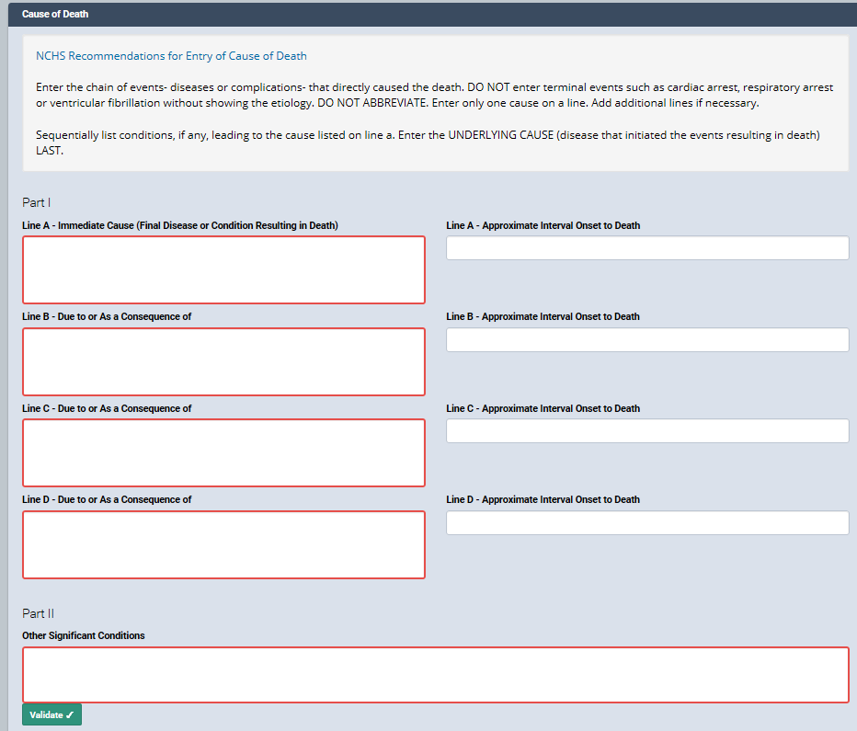
How to report cause of death?
Include the chain of events that directly caused the death in Part I.
Put the best estimate of the time interval between the onset of each condition and death.
Include other significant conditions contributing to death in Part II.

Slide 7
How to report cause of death?
Immediate Cause
Hours
When completing Part I, ask “What was the final disease or condition that happened right before the patient’s death?” or “What was the last condition I was intervening upon to prevent my patient from dying?”
Enter the answer to these questions, which is the immediate cause, on Line A.

Slide 8
How to report cause of death?
Immediate Cause
Hours
Intermediate Cause
Days
Once you have identified the immediate cause, ask “What disease or condition caused the condition in Line A?”
This is an intermediate cause. Enter this on Line B.

Slide 9
How to report cause of death?
Immediate Cause
Hours
Intermediate Cause
Days
Intermediate Cause
Months
Similarly, for Line C, ask “What disease or condition caused the condition in Line B?”

Slide 10
How to report cause of death?
Immediate Cause
Hours
Intermediate Cause
Days
Intermediate Cause
Note: This might not be the admitting diagnosis but the condition that caused life-threatening complications that required hospitalization.
Months
Underlying Cause
Ask questions until you determine the condition that is NOT the result of another condition. This is known as the underlying cause.

Slide 11
How to report cause of death?
Immediate Cause (Most recent condition)
Hours
Intermediate Cause (An older condition)
Days
Part II contains one or more conditions or events that were not directly in the chain of events in Part I but those that the medical provider feels contributed to the individual’s death.
Intermediate Cause (An even older condition)
Months
Underlying Cause (The oldest start of the chain of events)
Years
Other significant conditions
Source: Hanzlick R. Cause of Death and the Death Certificate. 2006.

Slide 12
How can eVital assist you?
You must save the page in eVital. This will check for some NYC-specific reminders.
Click “Validate” to run the information you entered through the CDC server to check for errors.

Slide 13
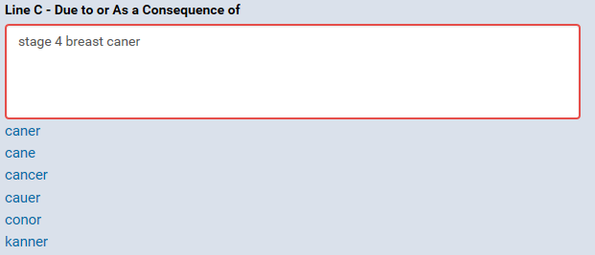
Possible Validation Errors:
Acronyms and Misspellings
Click the correct spelling from the drop-down list for the condition you intended.

Slide 14
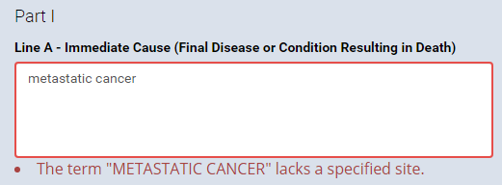
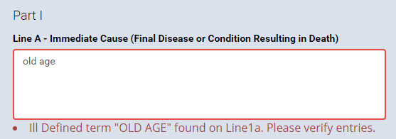
Possible Validation Errors:
Ill-defined or Ill-specified Conditions
Enter a specific primary organ site.
Death due to old age is rare; re-review the chart.
Review the record and provide a more specific cause.
For cancer deaths, specify the primary organ site whenever possible.
For deaths of the elderly, do not specify “old age.” Try to determine a cause or pre-existing condition for the patient.

Slide 15

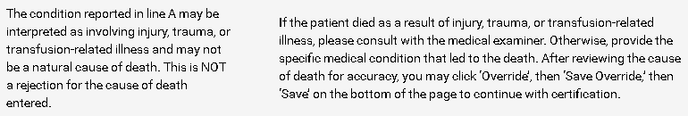
Possible eVital Reminders:
Possible Trauma
Consult OCME if suspicious of external causes.
OR:
Specify the natural etiology and override the edit check.

Slide 16

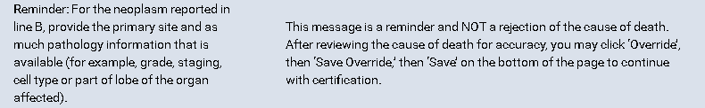
Possible eVital reminders:
Cancer
Provide as much information as is known for the diagnosis and override the edit check.

Slide 17

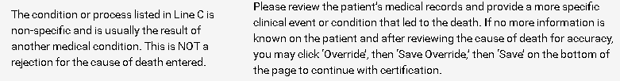
Possible eVital Reminders:
Nonspecific Underlying Cause
Provide a cause of the condition whenever possible. If this is all that is known, override the edit check.

Slide 18
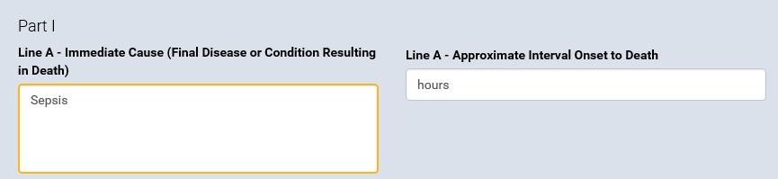
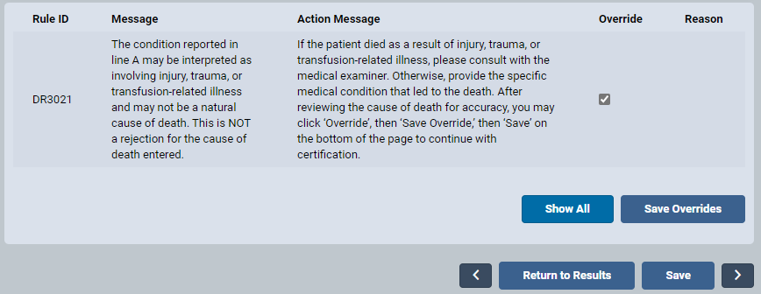
How to override edit checks?

Slide 19
Examples of Nonspecific Underlying Causes
If the conditions below are on the death certificate, include additional information to explain how this condition arose.
Cardiac arrhythmia
Cerebral vascular accident (cerebral infarct)
Cirrhosis
Congestive heart failure
Deep vein thrombosis
Dementia
End stage organ diseases
Gastrointestinal hemorrhage
Multi-organ failure
Myocardial infarct
Paraplegia or quadriplegia
Pulmonary fibrosis
Pneumonia
Pulmonary embolism
Spontaneous hemorrhage
Sepsis
Note: Causes of death highlighted in blue can be a consequence of natural or nonnatural causes.

Slide 20
Recommendations for Completing COD
Provide a "story" of why the patient died at this time and in this way.
Conditions recorded on the death certificate represent Medical Certifiers’ best medical opinion.
List the most recent condition on the top line and list the oldest (underlying cause) on the last line of Part I.
Time frames are required when completing the DC. It is acceptable to put ”unknown” if impossible to estimate.
Do not cite terminal events (asystole, cardiac arrest or respiratory arrest) in the COD statement.
Enter one condition on each line.
List other conditions not directly related but contributed to death in Part II.
Do not abbreviate.

Slide 21
Keys to Proper Cause of Death Documentation
Identify appropriate clinical items to include on certificates.
Enter these items in medically probable sequence.

Slide 22
Patient A:
67-year-old woman was found unresponsive by her family. EMS brought patient to the ER where she was admitted to the ICU.
Upon admission, chest X-ray identified pneumonia.
Patient had worsening renal function and was septic. Family requested comfort care, and terminal extubation was performed.
Patient was recently hospitalized for pneumonia.
Patient had a history of COPD, coronary artery disease, CHF and chronic renal failure but was not on dialysis. Patient has a history of breast cancer (no details of this diagnosis found in this record).
Blood cultures were positive for Enterococcus.

Slide 23
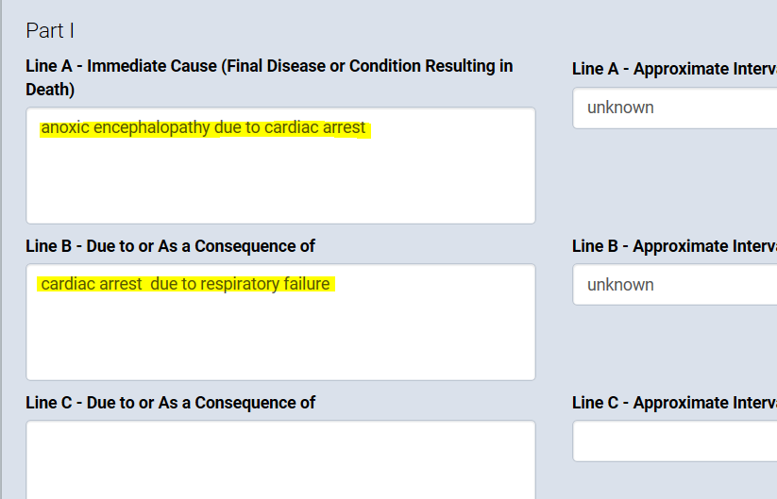
Patient A: Actual Death Certificate

Slide 24
Patient A: Death Certificate
Sepsis is allowed on a death certificate if it is not the only condition reported or due to trauma or injury.
Sepsis due to Enterococcus
Days
Bilateral pneumonia
Days
Severe Chronic Obstructive Pulmonary Disease
Years
Breast cancer history is not entered since not enough information indicated it contributed to death.
Coronary artery disease. Congestive heart failure. Chronic renal failure not on dialysis.

Slide 25
OR: Patient A’s Death Certificate
We recommend against entering terminal mechanisms, but it is acceptable to start here if it is not the only condition reported.
Acute cardiorespiratory failure
Gram-positive sepsis
Bilateral pneumonia
Severe Chronic Obstructive Pulmonary Disease
Coronary artery disease. Congestive heart failure. Chronic renal failure not on dialysis.

Slide 26
Patient B:
A 90-year-old female nursing home resident with past medical history of HTN, Gout, CAD, Advanced Dementia resulted in a bedridden state.
Parkinson’s disease was thought to be the probable cause for dementia.
Patient was admitted for hypotension and failure to thrive.
Patient was diagnosed with multilobar pneumonia.
Family requested comfort care.
Patient’s condition deteriorated, and she died.

Slide 27
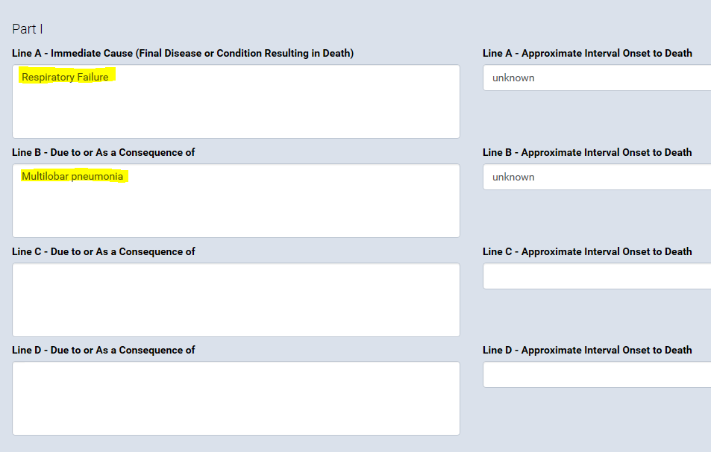
Patient B: Actual Death Certificate

Slide 28
Patient B: Death Certificate
Multilobar pneumonia
2 days
Provide the cause for dementia whenever possible.
Advanced dementia
5 years
Probable Parkinson's disease
Years
You can qualify unconfirmed diagnoses with terms such as “possible,” “probable” or “presumed.”
Failure to thrive, hypertension and Coronary Artery Disease.

Slide 29
OR: Patient B’s Death Certificate
Failure to thrive
Weeks
Advanced dementia
5 years
Probable Parkinson's disease
Years
Pneumonia, hypertension and Coronary Artery Disease.

Slide 30
OR: Patient B’s Death Certificate
Multilobar pneumonia
2 days
Bedridden state due to advanced dementia
5 years
Probable Parkinson's disease
Years
Failure to thrive, hypertension and Coronary Artery Disease.

Slide 31
OR: Patient B’s Death Certificate
Multilobar pneumonia
2 days
Probable Parkinson’s disease with dementia
Years
Failure to thrive, hypertension and Coronary Artery Disease.

Slide 32
Example 1
Acute Respiratory Distress Syndrome
Days
Presumed COVID-19 Infection
Weeks
If the diagnosis is not confirmed but you have clinical suspicion of COVID-19, you can qualify the diagnosis with terms such as “possible,” “probably” or “presumed.”
Add any comorbidity that may have put the patient at higher risk for death from COVID-19.
Diabetes and hypertension.

Slide 33
Example 2
Story:
A 23-year-old was in a motor vehicle accident six months ago, which left her paralyzed, ventilator-dependent and a nursing home patient.

Slide 34
Example 2
Enterobactor Sepsis
If the physician had stopped at pneumonia, the medical examiner’s case would have been missed.
Always determine the most specific underlying cause of death.
Bilateral Lower Lobe Pneumonia
Chronic respiratory failure requiring ventilations
6 months
C4 spinal cord injury due to motor vehicle accident
6 months
Because the underlying cause is an accident, it must be referred to the OCME.
Quadriplegia

Slide 35
Example 3
Say you are in the ED, and a patient comes in, and all you really know is that they had a severe upper GI bleed.
Upper gastrointestinal bleed
hours
What are some conditions that could have led to a GI bleed?
For example:
  Peptic ulcer disease (NSAID use)
  Esophageal varices (cirrhotic liver)
  Mallory Weiss tear
  Cancer
You would likely suspect one of these more than another based on even very minimal history and start treatment and a workup based on your clinical suspicion.
Notes:
You would likely suspect one of these more than another based on even very minimal history and start treatment and a work up based on your clinical suspicion.
The degree of certainty you have when writing your assessment and plan for your intake H&P is the same level of certainty we expect when completing a death certificate.

Slide 36
Example 3 (Continued)
Hours
Upper gastrointestinal bleed
Years
Probable peptic ulcer
The degree of certainty you have when writing your assessment and plan for your intake history and physical examination is the same level of certainty we expect when completing a death certificate.
Notes:
Now assuming that the diagnosis of a bleeding peptic ulcer was not confirmed, but suspected as the cause -- maybe because the patient was known to have peptic ulcer disease in the past, maybe what medications they came in with -- you might use the terms “probable”, “suspected”, or “possible” to indicate the unconfirmed diagnosis.
What then becomes the UCOD in this case?
Peptic ulcer
Suspected non-natural cause call ocme, but if minimal clinical suspicion of natural cause enter it. As long as you rule out external cause.

Slide 37
Example 4
Your 80-year-old patient with a past medical history of hypertension, CAD and dementia is found dead at home. The Medical Examiner determines the death is due to “natural causes.”
How do I determine the Cause of Death for this expired patient?
Do not enter the term “natural causes.”
Review the patient’s medical records to determine which conditions in their history could have been related to their death.
  Enter the most likely suspected underlying cause on line A.
  Enter all the patient’s other medical history in part II.
  These cases will often have limited immediate and intermediate causes.
When you are contacted by the Medicolegal Investigator from the OCME to discuss the case, you will be able to ask them questions about the patient.
You can also reach out to the Quality Improvement unit if you need any additional assistance.

Slide 38
How to address common issues?
Issue | Solution
Medical history unknown at place of death | Use primary care provider, family members or nursing home as resources.
Diagnosis is not confirmed. | Use terms such as “probable,” “possible” or “suspected.”
Unknown organism | Use terms such as “probable” or “unknown organism.”
OCME’s consult is triggered – possible unnatural cause. | If natural, use terms such as “nontraumatic” or “spontaneous.”
OCME’s consult is triggered – possible nonspecific cause. | Trace back further to identify the more specific and natural underlying cause of death.

Slide 39
New York City COD Resources
NYC Department of Health and Mental Hygiene Bureau of Vital Statistics. “Filling out Death Certificates Pocket Card.” dc-pocket-reference-card.pdf
NYC Department of Health and Mental Hygiene. “Improving Cause of Death Reporting” eLearning webinar. http://www1.nyc.gov/assets/doh/media/icdr/index.html
NYC Office of Chief Medical Examiner. “Mortality Data Quality Improvement Newsletter.” nyc.gov/assets/doh/downloads/pdf/vs/newsletter.pdf

Slide 40
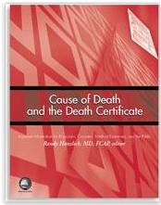
Other Resources
Oregon Department of Human Services. “Reporting Causes of Death for the Elderly.” August 2019. http://www.oregon.gov/oha/PH/BIRTHDEATHCERTIFICATES/REGISTERVITALRECORDS/Documents/Death/cdelderly.pdf
Centers for Disease Control and Prevention. Physicians’ Handbook on Medical Certification of Death. April 2003. https://www.cdc.gov/nchs/data/misc/hb_cod.pdf -
NYC Office of Chief Medical Examiner. Reporting a Case. https://www.nyc.gov/site/ocme/services/reporting-a-case.page
Hanzlick R. Cause of Death and the Death Certificate. 2006.

Slide 41
Contact
nyc.gov/health/evital.
For more information on death registration, visit
For more information on Cause of Death, visit the "Training and Resources" webpage at
Quality Improvement Unit: Assists clinicians with natural causes of death.
Hours: 9 a.m. to 5 p.m. from Monday to Friday
Phone: 646-632-6300
Email:
Constituent Services Unit: Assists eVital users with technical issues.
Hours: 9 a.m. to 5 p.m. from Monday to Friday
Phone: 646-632-6705
Email:
https://www1.nyc.gov/site/doh/data/data-sets/training-and-resources.page.
VitalQI@health.nyc.gov
evital@health.nyc.gov

Slide 42
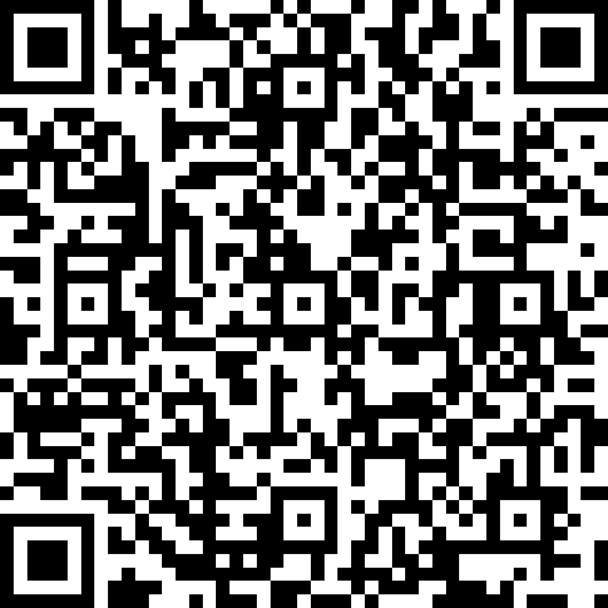
Visit the link below or scan the QR code to evaluate the training.
https://forms.office.com/g/nyf0vkndmc

