Slide 1


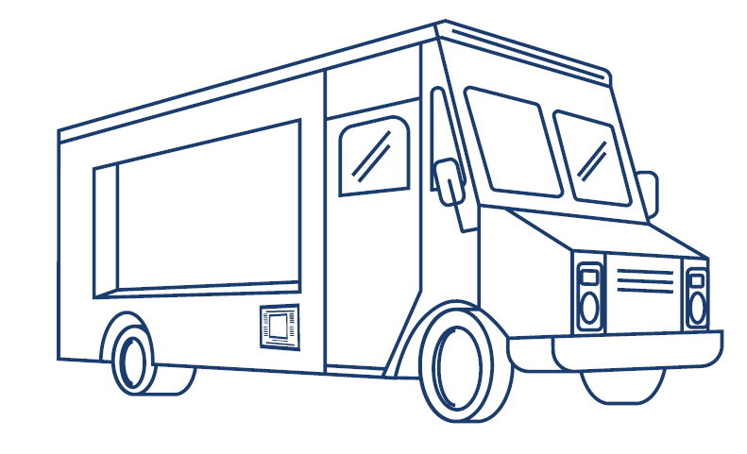
Supervisory Licenses
What Mobile Food Vendors Need to Know

Slide 2
Overview
Reviewing the new process of getting a full-term permit.
What is a supervisory license and how is it different from a mobile food vending license?
What is a supervisory license permit and how is it different from a full-term permit?
What if you have a permit and receive a supervisory license offer?

Slide 3
11,000 Additional Permits During 2026 to 2031
A 2021 local law changed how vendors can get a year-round permit by creating a new type of license called a supervisory license, which is limited in number.
  A supervisory license allows a vendor to apply for one year-round (full-term) permit. The Health Department has waiting lists to get a supervisory license.
  Supervisory license-permitted units must have a supervisory license holder while operating.
  These changes do not apply to green cart, temporary (seasonal), or restricted area permits.
Local Laws 54 and 59 of 2026 increase the number of permits. 2,200 supervisory license applications will be issued each year from July 2026 to June 2031.
New process to get a year-round mobile food vending permit
Supervisory license waiting list
Supervisory license
Full-term permit

Slide 4

What Is a Supervisory License (SL)?
Two types:
  A citywide license.
  A license for all New York City (NYC) boroughs except Manhattan (non-Manhattan).
A supervisory license allows you to:
  Vend on the same units as an MFV license holder.
  Work as the designated SL vendor on an SL-permitted unit in the area you have a license for.
  Apply for one full-term permit for the area indicated on your license.
There are three waiting lists: one for citywide, one for non-Manhattan, and one for people with disabilities and U.S. veterans.

Slide 5
Where Can You Work as a Supervisory License Holder?
If you have a citywide supervisory license, you can work as the supervisory license holder on any supervisory license-permitted unit.
If you have a non-Manhattan supervisory license, you can work as the supervisory license holder on any supervisory license-permitted unit outside of Manhattan.
If you work as the designated supervisory license holder outside of the geographical restrictions of your license, you can receive a violation that carries a penalty of $1,000.

Slide 6
Supervisory License: How Is It Different?
MFV License
Supervisory License
No limit. Anyone can apply for this license.
Limited number. You must be on a waiting list.
Required for restricted area, green cart, temporary, and full-term permits issued before July 2022.
Required for new full-term permits issued on and after July 2022.
You can work on any permitted unit.
You can work on any permitted unit as a vendor.
You can renew your license if it expires.
Cannot renew if it expires. You can return to an MFV license if it expires.
The license term is two years.
Initial expiration is the same as your current license. After renewal, license term is two years.
The initial and renewal fees are $50.
The initial fee is $0, and the renewal fee is $438.

Slide 7
Supervisory License Permit: How Is It Different?
Full-term permits before July 2022
Permit types: citywide, borough-specific
Applicant must have an MFV license; there is a limited time to apply.
Supervisory license permits
Permit types: citywide, non-Manhattan
Applicant must have a supervisory license; there is no time limit to apply.
Requires that all workers must have an MFV license.
Requires a supervisory license holder to operate; other workers must have an MFV license or supervisory license.

Slide 8
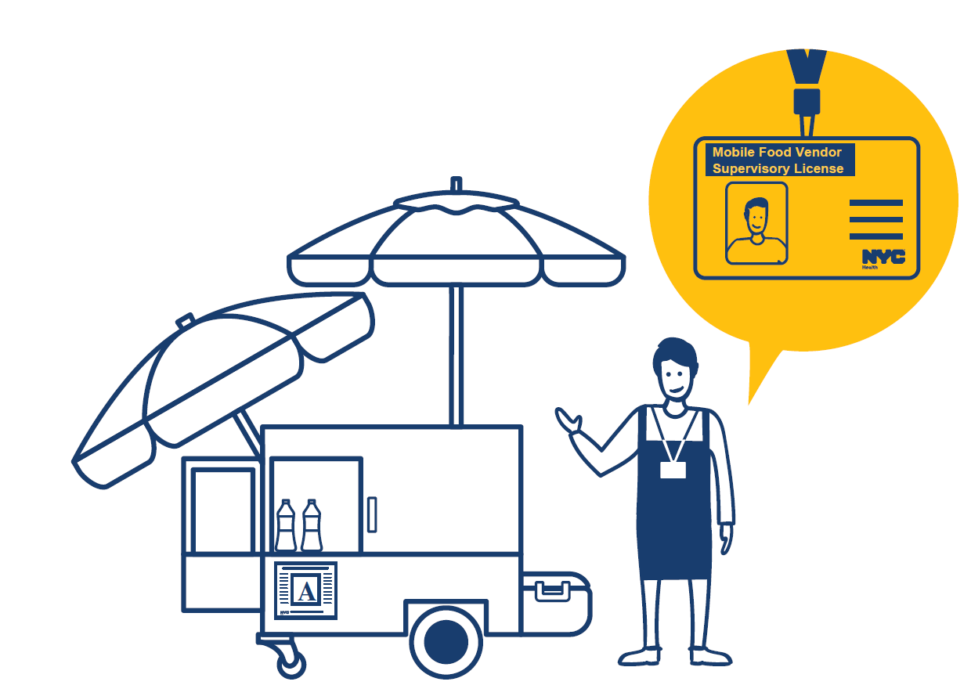
Requirement for Supervisory License Permits: A Supervisory License Holder Must Be Working While Operating
Operating in Manhattan — only a citywide supervisory license holder can meet this requirement.
Operating outside of Manhattan — any supervisory license holder can meet this requirement.
The mobile vending food unit will be closed, and the permit holder will receive a violation that carries a penalty of $1,000 for operating without a supervisory license holder.

Slide 9

How Do You Get a Supervisory License?
The NYC Health Department will mail you an application when your position number on a waiting list is reached.
You must have a current mobile food vending license.
  If your MFV license is within 3 months of the expiration date, renew it first, then submit your application to avoid any additional fees.
You must submit a complete application, including any required proof, by the application deadline.

Slide 10
Full-Term Supervisory License Permit
Once you receive your supervisory license, you will be able to apply for a full-term permit.
You will be mailed a supervisory license permit application. There is no deadline to submit the application.
Your unit requires at least one supervisory license holder, and all vendors working must have either an MFV license or a supervisory license.

Slide 11
You Have a Permit and Received a Supervisory License Offer. Can You Have Both?
No. Each vendor can only get one permit, except restricted area permits.
If you apply for a supervisory license, you have 270 days after your supervisory license is issued or until your current permit expires, whichever is sooner, to turn in your current permit.
You must decide if you will apply for the supervisory license or keep your current permit.
  Business factors to consider:
    Where do you plan to vend?
    What type of food will you sell?
    What times of year do you plan to operate?
    Do you plan to be the primary person working on the unit?

Slide 12
What If You Do Not Get a Supervisory License?
You keep your MFV license and can work on any permitted MFV unit (including a supervisory license-permitted unit, if a supervisory license holder is present).
Your offer letter includes a date by which you must apply.
If you miss the deadline, you will be removed from the supervisory license waiting list.
You keep your current permit, if you have one.
You remain on other permit waiting lists, if applicable.

Slide 13
All Full-Term Permits Will Require a Supervisory License in 2031
For citywide or borough-specific permits issued before July 1, 2022, the permit holder’s MFV license will convert to a supervisory license on July 1, 2031. These units will require a supervisory license holder be present while vending.
Local Laws 54 and 59 of 2026 moved this date forward by one year from Local Law 18 of 2021.
The Health Department will issue rules on this requirement at a later date.

Slide 14
Keep Your Contact
Information Up to Date
All supervisory license and permit information will be sent to the mailing address on record.
You can update your mailing address by:
  Sending an email that includes your license or permit number to DOHMHdocs@dcwp.nyc.gov, or
  Making an appointment to visit the Citywide Licensing Center in Manhattan
    To make an appointment:
      Call 212-435-0441, or
      Email licensingappointments@dcwp.nyc.gov

Slide 15
For More Information
Visit nyc.gov/health/mobilefood for information about supervisory licenses and permit information, including forms and fact sheets. You can also call 311 for support and ask for mobile food.

Slide 16
Questions?

