Slide 1
Institutional Referral Process for Single Adults from Inpatient Departments of Healthcare Facilities to DHS Facilities
Presented by: Fabienne Laraque, MD, MPH, Medical Director

Slide 2
Overview
Goals
Overview of Shelter System
The Referral Procedure
2018 New Form Guidelines
Discharge Guidelines to Single Adult Shelters
The Referral Process
The HCF-DHS Referral Form
Resources for Healthcare Facilities
Identifying and Supporting Homeless Patients
Communication Between HCF and DHS Staff
Data Collection

Slide 3
Goals of the Institutional Referral Procedure
For clients new to DHS only, screen for referrals where insufficient placement efforts were made:
HCF will attempt more placements or document their efforts in more details
Screen for referrals of persons from health care facilities (HCF) who may be medically inappropriate for shelter and cannot obtain the level of care needed in shelter:
Avoid shelter entry
Place in appropriate level of care
Coordinate discharge and care for persons discharged to shelter who are medically appropriate for shelter but have significant medical needs
Communication
Coordination
Improve health outcomes
Reduce high utilization

Slide 4
Overview of Shelter System
There are no respite and no medical shelters in the DHS shelter system
DHS programs within the scope of the Referral Form:
Single Adult Shelters
DHS Street Solutions sites
Home care cannot be provided on an ongoing basis
All single adult clients have to be able to perform their ADLs
Pregnant women should be referred to family intake

Slide 5
Single Adult Shelter System
Congregate settings with shared bathrooms
3 intake facilities:
Men: 30th St.
Women: Franklin St. and Help Women’s Center (HWC)
6 single adult assessment shelters
4 for men
2 for women
Has various shelters including:
Employment
General
Mental health (MH)
Substance use (SUD)
And a small number of semi-specialized (veterans, young adult, LBGTQI, older adults)
MH and SUD shelters are served by MH and SUD providers
Shelters do not provide nursing services or 24 hrs medical services
Home care is not possible except a limited number of services offered by Visiting Nurse Services on a case-by-case basis

Slide 6
DHS Street Solutions
Drop-in Centers
Showers, food, services
6 operational in all five boroughs
Outreach
24/7 proactive canvassing, outreach, and engagement across the five boroughs, including streets and subways
Safe Havens
16 Safe Haven shelters
Solely take referrals from experienced street outreach teams
Low-barrier programs and flexible requirements, no curfew and private or semi-private rooms with shared bathrooms
Safe Haven staff are trained to manage the variety of behaviors and situations of chronically street homeless clients and most have on-site medical care
Most have on–site care at varying levels but they are not skilled nursing facilities, no DHS facilities provide skilled nursing or overnight medical services
Please note that patients should never be discharged to the street

Slide 7
The Referral Procedure
Provides:
A clear understanding of how to refer a patient from a healthcare facility (HCF) to the DHS shelter system
Overview of the shelter system
Criteria for medical appropriateness and inappropriateness
Information on alternatives to shelter for patients who are homeless or unstably housed
Roles and responsibilities for DHS sites, the DHS Office of the Medial Director (OMD), and HCF
Found at: https://www1.nyc.gov/site/dhs/shelter/singleadults/single-adults-hospital.page

Slide 8
2018 New Form Guidelines
Single form sent at a single point in time
Must be emailed to the appropriate DHS facility/office
Please note that typing the form is best practice however if this is not possible handwritten forms will be accepted
After July 1, faxes will not longer be accepted and all forms must be emailed to the appropriate site
Determinations will be made with in 1 business day for inpatient stays less than 30 days, and within 2 business days for inpatient stays 30 days or more
Specific criteria for medical appropriateness must be met
Form, procedure, and training presentation found at: https://www1.nyc.gov/site/dhs/shelter/singleadults/single-adults-hospital.page
Rigorous data collection methods
Notes:
*With the exception of men who are new to the DHS system- these referrals should be sent to OMD

Slide 9
Discharge Guidelines for Single Adult Shelters
HCF will receive a response from DHS within:
1 business day for stays less than 30 days
2 business days for stays 30 days or more
Once a positive determination is received, HCF can discharge the client, but only between the hours of 9:00am and 3:00pm Mon-Fri
Only patients who are able to live entirely independently (perform ADLs) are appropriate
Patients may have limitations or special needs, including:
Medical assistance up to twice per day by a visiting nurse
Wounds that are not overly weeping and draining
Needed access to a temporary bed for rest
Use of ambulatory aids, enhanced equipment, or a first floor placement
Medically necessary diet
Use of an oxygen concentrator
Notes:
Examples are:
Need assistance with wound care up to twice per day by a visiting nurse
Wound not overly weeping and draining
Need access to a temporary bed for rest
Use ambulatory aids (wheelchair, walker, cane), enhanced equipment (a higher bed for easier transfer from wheelchair, refrigeration unit for medications) or a first floor placement
Up to twice daily visiting nurse medication administration for up to two weeks post discharge (for self-limited illnesses, such as an infection and when the treatment will end at or before two weeks)
Monthly assistance with medication arrangement in pill boxes via a nurse
Need medically necessary diet
Use an oxygen concentrator (a Health Care Provider Medical Verification Statement must be sent with the Referral Form)

Slide 10
Discharge Guidelines for Single Adult Shelters
HCF should start the discharge process early in the hospital stay. For information on asking patients about their housing stability see slide 35
HCF should never discharge a patient without first submitting a Referral Form and receiving a positive determination
For referral of clients new to DHS (or not at DHS >1 year), HCF are expected to assist clients in staying in current housing or finding alternatives to DHS shelter prior to submitting a referral form
All follow-up information must be included in the referral form or be submitted to the receiving shelter on day of discharge at the latest
HCF should submit clinical support documentation for reasonable accommodations with the Referral form for all appropriate cases
Notes:
Please note that HCF are only expected to help clients find housing who are new to DHS or did not come to the healthcare facility from a DHS facility

Slide 11
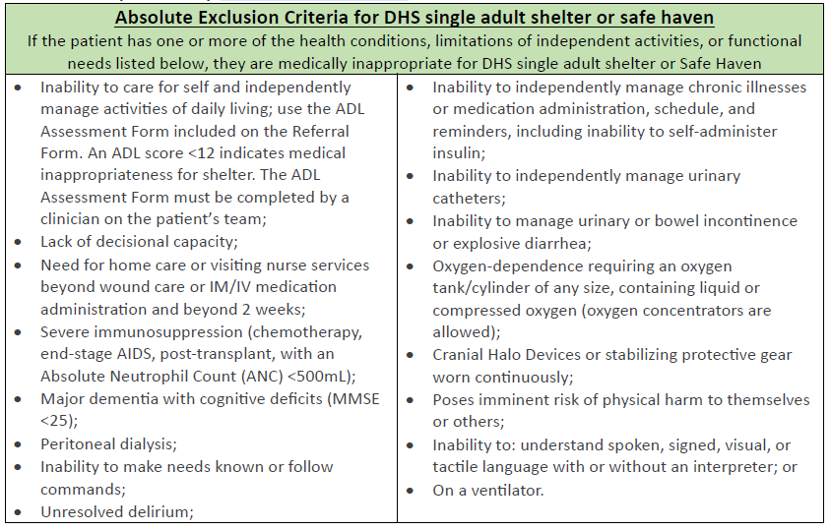
Absolute Exclusion Criteria

Slide 12
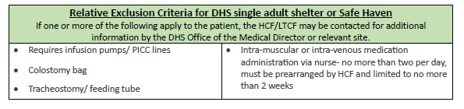
Relative Exclusion Criteria
*New!
If a patient meets these criteria, the DHS facility or DHS Medical Office will speak with the healthcare facility to confirm that the patient can manage all ADLs including the condition listed in this section, and is stable and independent.

Slide 13
Reasonable Accommodation Form
https://www1.nyc.gov/assets/dhs/downloads/pdf/client-accom-request-form.pdf
Asks for the patient information and reasonable accommodation need (can be filled out at the hospital)
Include supporting documentation
The form and supporting documentation should be printed and given to the patient to give to the shelter director upon arrival.

Slide 14
The Referral Process
After determining that a patient is homeless, the HCF should call the DHS Referral Line at 212-361-5590 to determine if a patient is a current DHS client. The HCF will receive:
For returning clients, the name, phone number, and email of the shelter director of the patient’s assigned shelter
For new clients, the email of OMD or women’s intake*:
DHS-HCFreferral@dhs.nyc.gov for men,
HCF-Referral@helpusa.org for women.
The HCF will complete**:
All sections for patients who are new to the DHS single adult shelter system or have been out of shelter for 12 months or more
All sections except Section 2 for patients returning to shelter/ safe haven
*The HCF is responsible for obtaining consent to share clinical information with DHS prior to submitting the referral form
**The form must be filled out as a fillable PDF, handwritten forms will not be accepted

Slide 15
The Referral Process
HCF will email the completed form to the appropriate contact (shelter, safe haven, outreach team, women’s intake, or medical office)
For all potentially eligible clients, it is best practice that an HRA 2010e supportive housing application be completed
HCF should not submit referrals for clients who meet the absolute exclusion criteria
Upon receipt of the referral, the form will be reviewed to determine if additional information is needed or the client is medically appropriate
The reviewer will respond via email with a determination regarding medical appropriateness within 1 business day for stays of less than 30 days, and 2 business days for stays of 30 days or more
Please note that if the DHS reviewer requests additional information the 1-2 day ‘clock’ pauses until requested information is received from the HCF
Upon receipt of a positive determination, the HCF may discharge the patient anytime between 9:00am and 3:00pm, Mon-Fri, after coordinating with the receiving shelter for persons who still have serious medical needs

Slide 16
The Referral Process - Discharge Coordination
The HCF will be asked to:
Make clear on the referral form if the client has complex medical needs
Provide clinical support documentation for a reasonable accommodation if necessary
For patients with persistent medical needs and those who require a bed the same day, the HCF will contact the destination DHS facility prior to discharge to discuss the need for a bed at time of discharge
The shelter/safe haven and HCF are jointly responsible for coordinating the discharge of the client
The HCF must:
Arrange all appropriate follow-up care including transportation (or establish that the client can independently travel to all appointments)
Provide a minimum of 2 week medication supply to the patient upon discharge unless otherwise directed
Provide oxygen concentrator if medically appropriate for patients requiring oxygen therapy
Communicate all follow-up information with the destination shelter staff

Slide 17
The Referral Process - Inappropriate Referrals
If a patient arrives and the referral is inappropriate or incomplete due to:
Inappropriateness due to medical reasons,
No referral form was sent, or
Lack of discharge planning;
The DHS site will submit a notification to their medical provider if they have one, or otherwise DHS OMD, via their Program Administrators
The medical provider or OMD will follow up or file a complaint with the HCF, relevant HCF association, and the appropriate state agency
Quarterly reports on inappropriate referrals will be produced

Slide 18
The Referral Process- Roles and Responsibilities
OMD
Oversee and provide support and training for the referral procedure
Review referrals for men new to the DHS single adult shelter system
Collect and analyze referral data
DHS site staff
Review incoming referrals from women new to the DHS single adult shelter system and all returnees
Communicate with the HCF regarding the determination and discharge coordination
Alert Program Administrator and their medical provider and as needed OMD, about inappropriate referrals
Collect and report data
HCF staff
Assist patient in avoiding homelessness prior to sending referral form
Complete and send referral form prior to patient discharge
Follow this guidance and discharge on Mo-Fri 9am-3pm
Coordinate all necessary follow-up care for patient, provide 2 weeks of medications and communicate arrangements to shelter staff

Slide 19
QUESTIONS???

Slide 20
The Referral Form
Introduction and directions
Section 1: Patient Demographic and Hospital Information
Section 2: Past and Current Housing History
Section 3: Clinical Information
Section 4: Functional Status: Activities of Daily Living
Section 5: Discharge Plan
Section 6: Treating Team Signature
Shaded sections (in yellow) are required to be filled out by the HCF

Slide 21
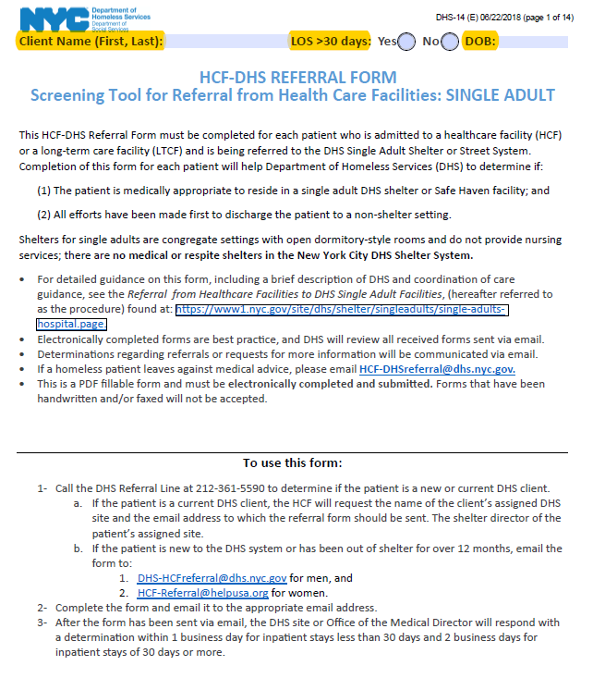
The Referral Form
Introduction and directions
Includes directions on completing the form, where to send, and timeline
Has information on medical appropriateness criteria, relative exclusion criteria
Information for DHS use only in determining appropriateness of referral and other data collection variables
All required sections will be shaded in YELLOW

Slide 22
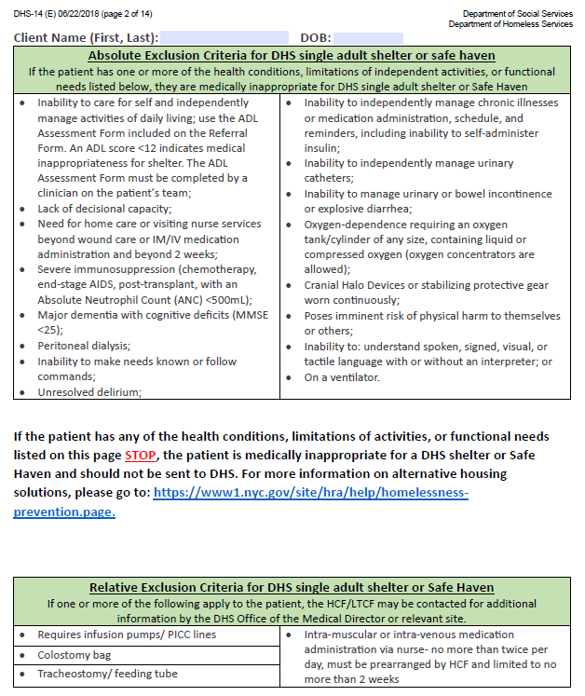
The Referral Form
Absolute and relative exclusion criteria
Includes information on medical appropriateness criteria and relative exclusion criteria
If a patient meets any of the conditions listed in the absolute exclusion criteria then a referral should not be sent
If a patient meets any of the conditions listed in the relative exclusion criteria a referral may be sent but follow-up information may be requested

Slide 23
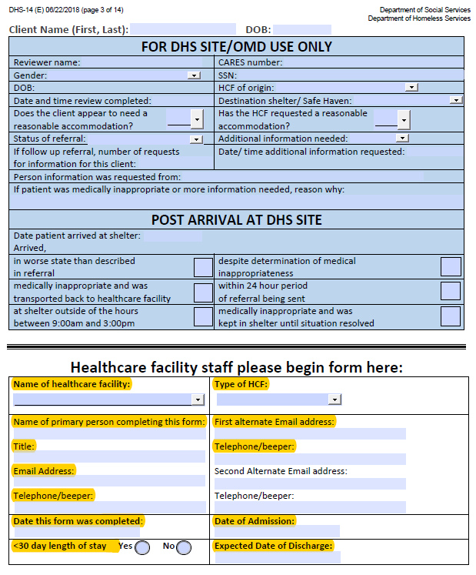
The Referral Form
DHS determination and HCF contact information
DHS determination section
Should only be completed by DHS site staff or OMD staff
Must be filled out upon receipt of the referral and receipt of the client
HCF section (bottom half of the form) should be filled out by HCF
Required for all referral submissions

Slide 24
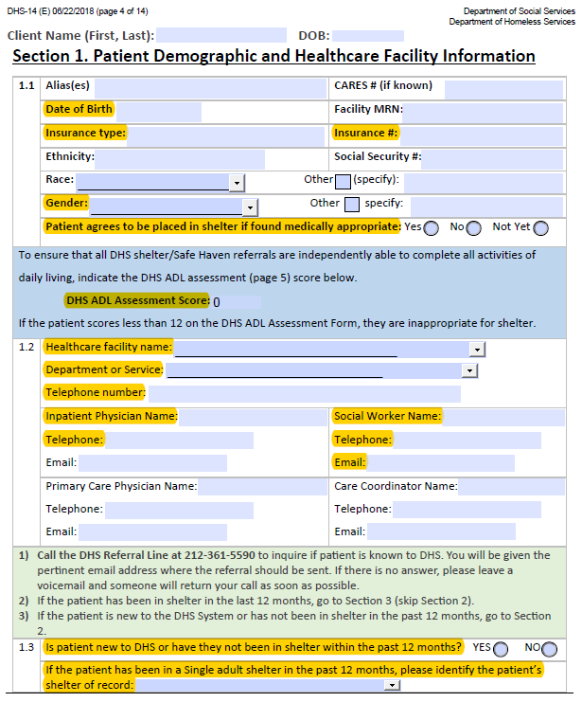
The Referral Form
Section 1: Patient Demographic and Hospital Information
Basic patient demographic information
Contact information for the HCF treatment team staff
Instructions on referring the patient to the correct DHS facility or OMD
Required for all referral submissions

Slide 25
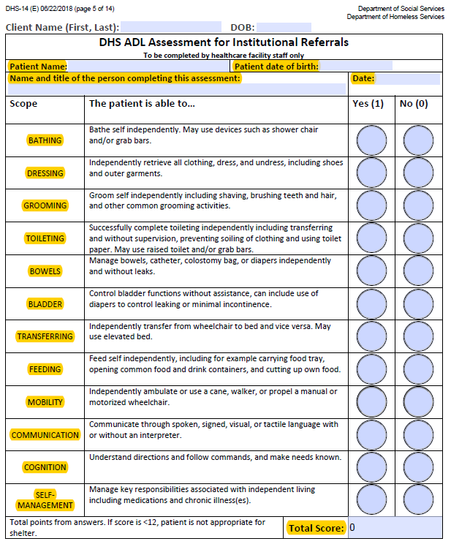
The Referral Form
The DHS ADL Assessment form
Patients must score a 12 to be considered appropriate for shelter
If a patient scores less than a 12 they are not appropriate for shelter and the HCF staff should not continue to fill out the referral form.
Required for all referral submissions

Slide 26
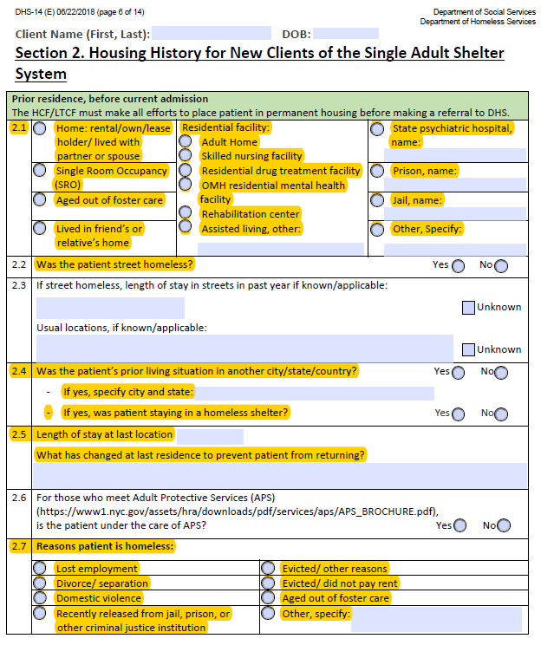
The Referral Form
Section 2: Past and Current Housing History
Prior housing history
Only one radio button should be selected
Reasons for current homelessness
Only one radio button should be selected
Efforts to place patient in alternative housing
Please list all attempts
Required only for NEW clients

Slide 27
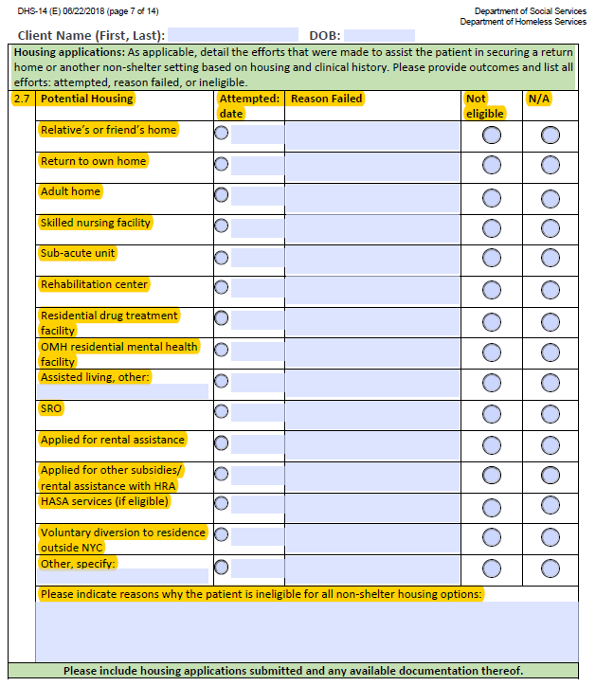
The Referral Form
Section 2: Past and Current Housing History
Prior housing history
Only one radio button should be selected
Reasons for current homelessness
Only one radio button should be selected
Efforts to place patient in alternative housing
Please list all attempts
Required only for NEW clients

Slide 28
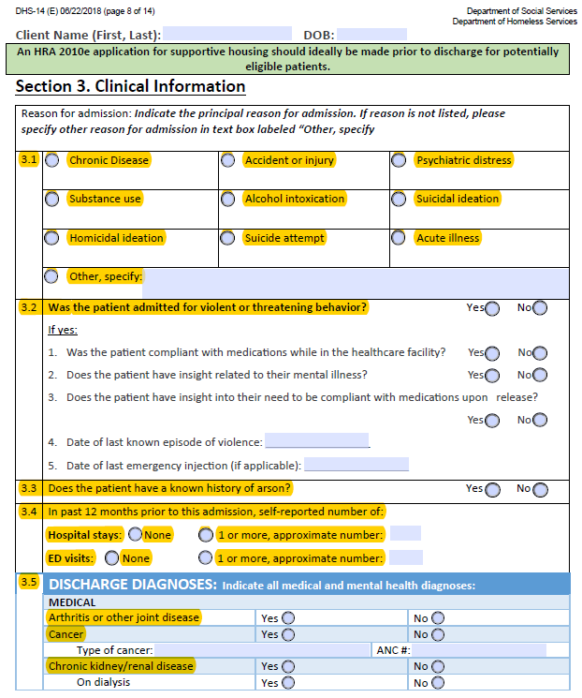
The Referral Form
Section 3: Clinical Information
Reason for current admission
Only one radio button should be selected
Information on client if admitted due to violent or threatening behaviors
If patient was admitted due to violent or threatening behaviors, follow up questions 1-5 are required
Arson and hospitalization history
Diagnoses upon discharge information
Required for all referral submissions

Slide 29
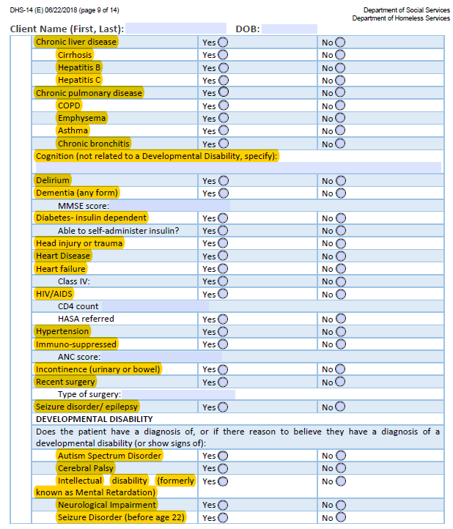
The Referral Form
Section 3: Clinical Information
Reason for current admission
Only one radio button should be selected
Information on client if admitted due to violent or threatening behaviors
If patient was admitted due to violent or threatening behaviors, follow up questions 1-5 are required
Arson and hospitalization history
Diagnoses upon discharge information
Required for all referral submissions

Slide 30
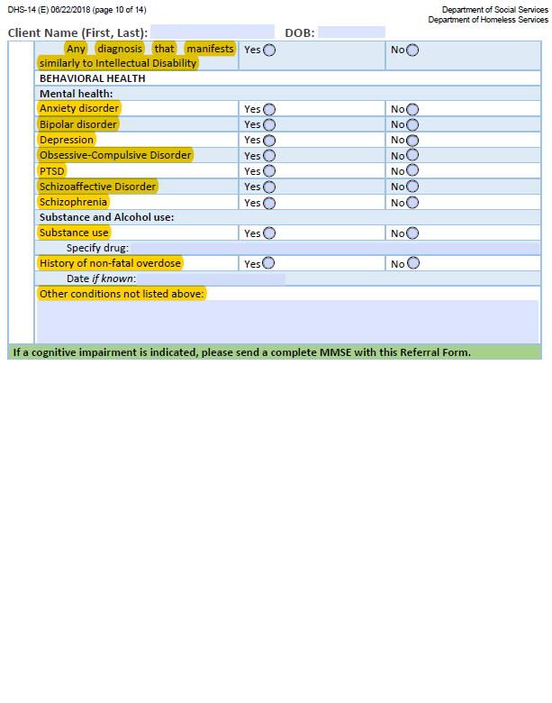
The Referral Form
Section 3: Clinical Information
Reason for current admission
Only one radio button should be selected
Information on client if admitted due to violent or threatening behaviors
If patient was admitted due to violent or threatening behaviors, follow up questions 1-5 are required
Arson and hospitalization history
Diagnoses upon discharge information
Required for all referral submissions

Slide 31
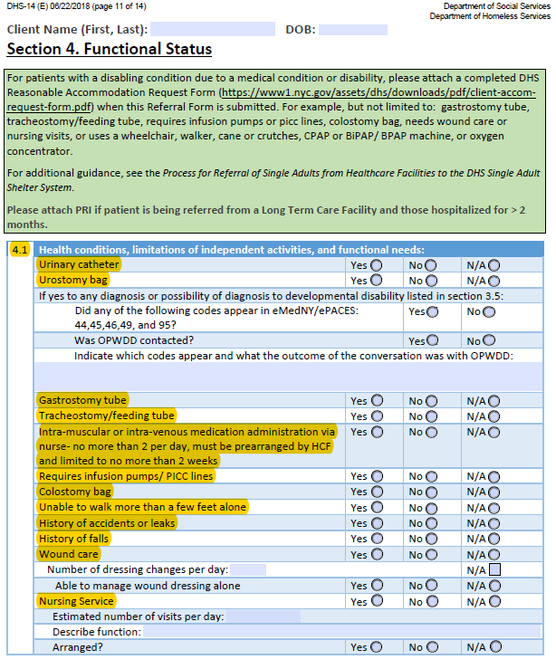
The Referral Form
Section 4: Functional Status: Activities of Daily Living
Information on relative exclusion criteria
Any reasonable accommodation needs
Link to the Reasonable Accommodation form online
Durable medical equipment needs
Medication list- can be attached or copy/pasted into the textbox provided
Required for all referral submissions

Slide 32
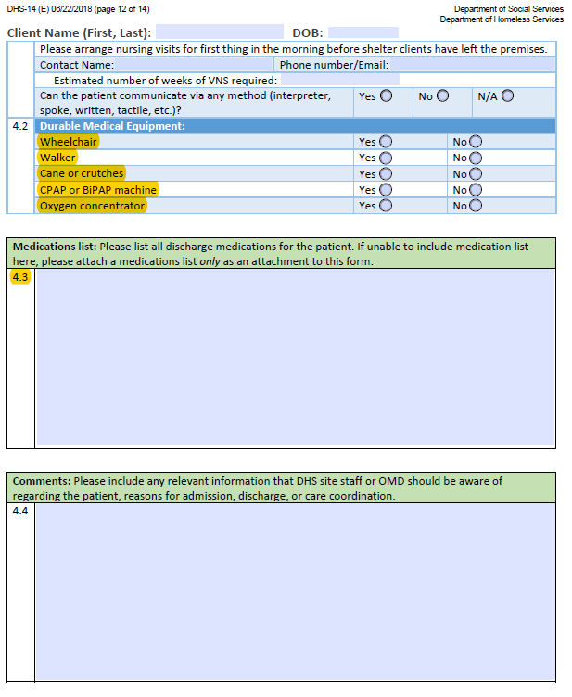
The Referral Form
Section 4: Functional Status: Activities of Daily Living
Information on relative exclusion criteria
Any reasonable accommodation needs
Link to the Reasonable Accommodation form online
Durable medical equipment needs
Medication list- can be attached or copy/pasted into the textbox provided
Required for all referral submissions

Slide 33
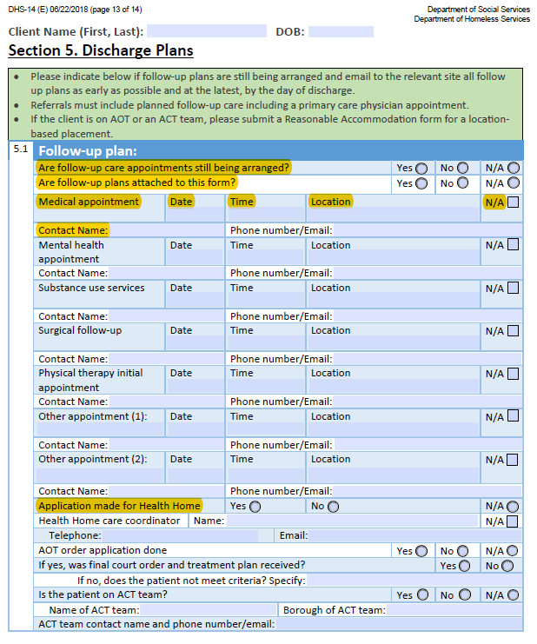
The Referral Form
Section 5: Discharge Plan
All follow-up appointments that have been made at time of referral submission
If the HCF is still making follow-up plans, submit plans by day of discharge
All discharged patients must have at least a follow-up appointment with a PCP
Please note that referrals to a walk in clinic are not acceptable follow-up plans
Required for all referral submissions

Slide 34
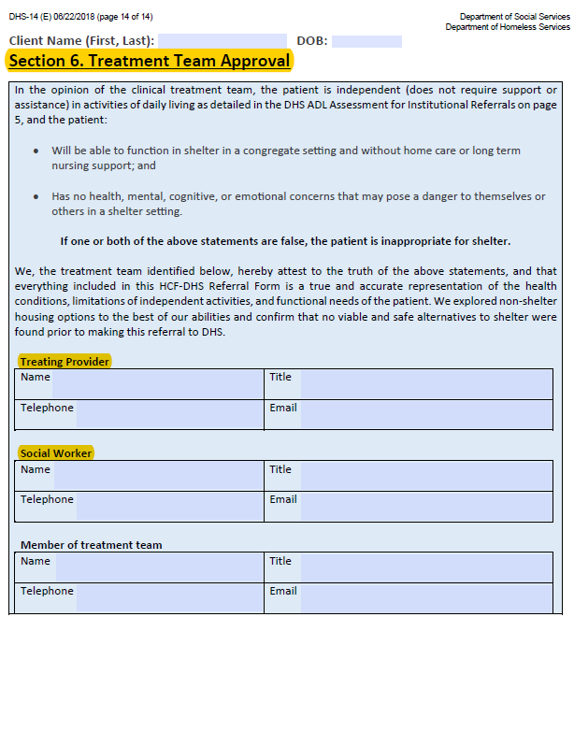
The Referral Form
Section 6: Treatment Team Approval
Must be approved by at least one member of the treatment team
Required for all referral submissions

Slide 35
QUESTIONS???

Slide 36
Identifying and Assisting Homeless Patients
To facilitate a faster referral and ensure that DHS has time to review all incoming referrals, it is necessary to identify if a patient is homeless early in the hospital stay.
The following questions may be asked to ascertain if a patient is or may become homeless during their inpatient stay:
1- Where did you stay last night?
2- Can you return to this place upon discharge?
3- If not, is there other housing where you can stay upon discharge?
State that they will not be treated differently at the hospital if they are homeless or unstably housed.
Identifying social determinants of health is critical to improving health outcomes and reducing inappropriately high utilization of medical services
See Billioux A, Standardized Screening for Health-Related Social Needs in Clinical Settings. National Academy of Medicine, 2017.

Slide 37
Identifying and Assisting Homeless Patients
If the patient cannot return to housing, the HCF should assist them in any referrals to HRA or other housing support resources
If the patient is being discharged after a long inpatient stay the HCF should provide evidence of applications to permanent housing or support programs
If a patient needs assistance with ADLs or skilled nursing care, they need to be referred elsewhere
If the patient stayed on the street or in a shelter, please call the DHS Referral Line at 212-361-5590
If the patient stayed at a friend’s house, at a relative’s house, etc., and state they cannot return there upon discharge, please call HRA at: 718-557-1399
If a patient has development disabilities, contact OPWDD at: 646-766-3276

Slide 38
Assisting Patients At-Risk of Homelessness
If the patient has a place to return but this housing is at risk:
To refer to Homebase for eviction prevention, mediation with landlord or primary tenants, or temporary assistance, call 311 for the nearest Homebase office or go to
https://www1.nyc.gov/site/hra/help/homebase.page. Please call to make an appointment.
If the patient has rent arrears, HRA provides grants at local Job Centers in order to cover arrears and prevent eviction https://www1.nyc.gov/site/hra/help/cash-assistance.page
For ongoing rental assistance, SEPS is the ongoing rental assistance program available in the community for single adults who meet the eligibility criteria (see next slide).

Slide 39
Assisting Patients At-Risk of Homelessness
SEPS is available for single adults living in the community who meet the following criteria:
Income below 200% of the federal poverty line
A veteran at-risk of shelter entry OR
In eviction proceedings or evicted within the past year and one of the following criteria:
Active APS case
Shelter history
Rent controlled apartment
Apply for SEPS at Riseboro for housing in Brooklyn, Queens and Staten Island and at Bronxworks in the Bronx and Manhattan
Riseboro - Brownsville
145 East 98th Street Brooklyn, NY 11212
Call 917-819-3200 for an appointment
Riseboro - Bushwick
1475 Myrtle Avenue Brooklyn, NY 11237
Call 347-295-3738 for an appointment
Bronxworks
630 Jackson Avenue, Bronx, NY 11455
Call 929-252-7110 for an appointment

Slide 40
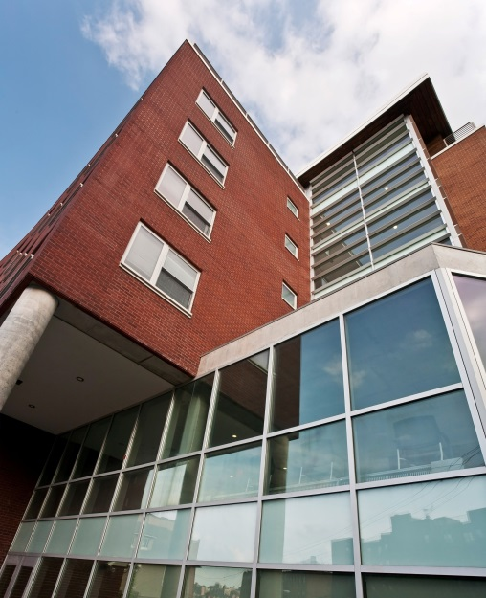
What is Supportive Housing?
Permanent affordable housing with voluntary support services.
Congregate: One building, often combined with affordable housing for the community
Scattered-site: Private market apartments rented in the community in which clients are visited by case managers
Clients have their own units and pay 30% of their income toward rent
Access to on-site social services to promote community integration and support to achieve maximum independence
Jericho Project’s Kingsbridge Veterans Residence CD 14

Slide 41
Who is Served in Supportive Housing?
Homeless individuals living with mental illness and/or struggling with substance use disorders
Individuals with HIV/AIDS
Youth aging out of foster care
High-risk homeless families in which the head of household living with mental illness, substance use disorders, and/or HIV/AIDS
Homeless veterans with a disabling condition
High-cost Medicaid recipients who are homeless and living with a disabling condition

Slide 42
Services Provided in Supportive Housing
Person-centered planning to develop effective goals related to housing stability, financial security, and progress toward recovery.
Evidence based approaches such as Motivational Interviewing, Health and Wellness Self-Management, and Trauma Informed case management.
Utilization of peer services and tenant participation activities for inclusive and comprehensive program operations.
On site services and community service linkage to support residents to achieve their recovery goals and foster independence.

Slide 43
Mayoral Commitment: Creating 15,000 Supportive Housing Units in Next 15 Years
Population | Housing Type | Estimated Projections | Total by Population
Single Adults With SMI/SUD |  |  | 10,673
 | Congregate | 5,155
 | Scattered-Site | 5,518
Adult Families Head of Household with SMI/SUD |  |  | 1,004
 | Congregate | 341
 | Scattered-Site | 663
Families with Children |  |  | 2,087
Head of Household with SMI/SUD | Congregate | 654
 | Scattered-Site | 982
Young Adults, Ages 18-25 w/ Children or Pregnant Women | Congregate | 361
 | Scattered-Site | 90
Young Adult Singles, Ages 18-25 |  |  | 1,236
 | Congregate | 989
 | Scattered-Site | 247
TOTAL |  |  | 15,000

Slide 44
Applying for Supportive Housing
HRA’s Placement Assessment and Client Tracking (PACT) unit reviews housing applications submitted by acute and long-term psychiatric hospitals, shelters, outreach teams, correctional facilities, and community-based agencies.
This initiates the approval and placement process for a continuum of supportive housing options.
Annually, the PACT unit reviews about 25,000 applications and 63% are approved for NY/NY and/or SMI housing.
Generally, an application for supportive housing requires the following:
Psychiatric evaluation, by an appropriately licensed professional
Psychosocial Assessment
Housing documentation (unsheltered stay)
The psychiatric and psychosocial assessment must be completed no more than 6 months prior to submission of the application.
Application criteria can be found in the “What’s New” section of PACTWeb.

Slide 45
The Supportive Housing Coordinated Assessment Survey
Prior to initiating a supportive housing application, it is recommended that a coordinated assessment survey is completed.
The Coordinated assessment survey:
Is accessible to all PACT users
Generates a list of supportive housing and rental subsidies the household is potentially eligible for
If the Survey returns a ‘match’ on a client: income and identifying documents (i.e. SS card, birth certificate) and prior supportive housing applications for the last five years are available

Slide 46
Supportive Housing Referral/Placement
Placement Agencies assist in referral and placement process:
For NY/NY III approved individuals or families, PACT system electronically notifies the referral source and the appropriate Placement Agency – HRA/DSS, HASA, ACS, SOMH
HRA/DSS makes electronic referrals of eligible clients for six (6) of the NY/NY III categories of permanent supportive housing
NYC 15/15 approvals- Referrals/Placement Agency HRA/DSS
For SMI and NY/NY I/II, the approved individuals are referred/placed by the referral source or through SPOA (managed by CUCS)
CUCS publishes a NYC Vacancy Update every two weeks with housing provider intake contacts
CUCS provides housing consultation and referral assistance by phone

Slide 47
Supportive Housing Resources
Contact the HRA technical user support for training and access to the Supportive Housing Application at 929-221-4515.
Contact CUCS housing referral assistance at 212-801-3333.
Visit CUCS website for SPOA process, vacancy update and other resources: cucs.org
For placement information, or to find out the status of an application, contact Fuad Rasulov, Program Manager at (212) 607-2409 or rasulovf@hra.nyc.gov.

Slide 48
Communicating with DHS Site Staff
Communication between DHS sites and HCF is crucial for the wellbeing of our patients/clients
HCF and DHS staff who are located within a short distance of each other are encouraged to set up visits and have the staff tour each facility to better understand the workflows and pathways of the other facility
HCF will be provided with name, phone number, and email of the DHS site reviewer (on-site director or intake coordinator) when calling the DHS Referral Line to facilitate communication
HCF will be provided a list of shelter/sites directors name, telephone number and email address
Phone numbers and emails of referring HCF staff and treating physician should be noted on the referral to facilitate care coordination and communication

Slide 49
Sending and Receiving Emails
HCF are required due to HIPAA regulations to send encrypted emails.
These emails may be sent ‘as normal’ or via a third party encryption site such as Kiteworks depending on the email server that is used by the referring healthcare facility
DHS recipients of emails may need, depending on the type of encryption to register and log into an encryption site such as Kiteworks.
OMD suggests that DHS site staff set up the same username and password for all encryption sites that are used to access emails.
This username and password should be shared with all individuals who will be receiving encrypted emails.
If DHS staff have any questions or concerns about accessing encrypted emails through a third party, please contact the Office of the Medical Director at DHS-HCFReferral@dhs.nyc.gov

Slide 50
The Referral Process- Workflow
A healthcare facility (HCF) determines they have a homeless patient with no alternative options
The HCF calls HCF referral line at 212-361-5590 to determine if the client has a current shelter of record
Patient has not been in a DHS shelter ever or within in the past year but is willing to go
Patient was in shelter within past year and is willing to return
Patient was in a Safe Haven within the past year and is willing to return
The patient is street homeless and is unwilling to go to shelter
HCF fills out Referral Form at https://www1.nyc.gov/site/dhs/shelter/singleadults/single-adults-hospital.page, and emails the form to the receiving shelter, Safe Haven, Outreach Team, Medical Director’s Office, or women’s intake as appropriate
HCF will receive a determination regarding the medical appropriateness of the patient within 2 business days
If the patient can be accommodated, appropriate discharge plan is made and patient is discharged to the Safe Haven
HCF contacts borough outreach team and works with the team to create an appropriate discharge plan
If the patient is not appropriate for discharge to a DHS shelter, the HCF may be offered resources if available to create a safe discharge plan for the patient to a more appropriate setting
If the patient is appropriate for shelter the HCF can plan to discharge the patient between the hours of 9:00am and 3:00pm Monday-Friday
If the patient cannot be accommodated, the HCF and Safe Haven will communicate

Slide 51
Thank you!
If you have any questions or comments on the new form, please reach out to Terre Pring at pringt@dhs.nyc.gov
For discussion about clients being referred, contact Felicia Martin at fmartin@dhs.nyc.gov or Fabienne Laraque at flaraque@dhs.nyc.gov
The referral form and procedure will be rolled out on July 1, 2018.

