Slide 1

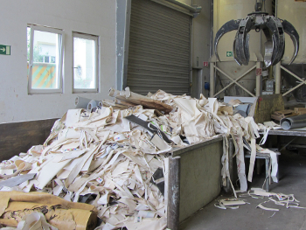
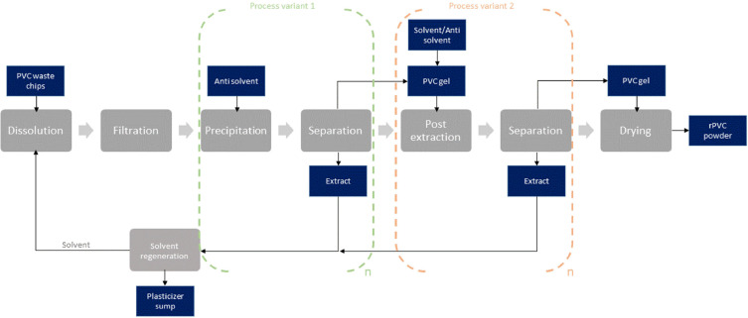
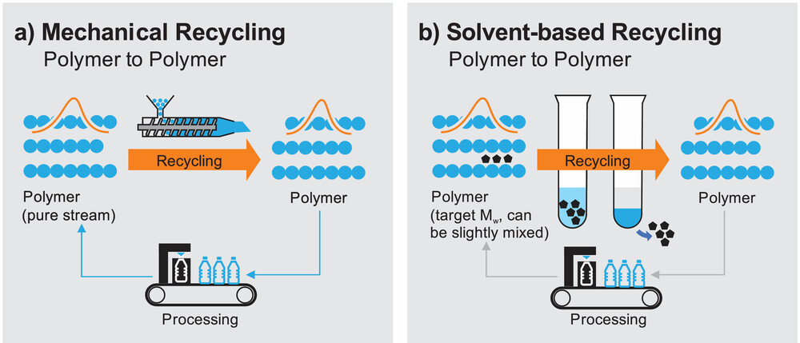
Vinyl Flooring: Post-Consumer Reusability
By: Amy Beloume, Matthew Fung, Kezia Smith
ESC-210-C: Materials Science
Professor Huang
Background
Vinyl flooring, (alternatively named polyvinyl chloride (PVC) and luxury vinyl tile (LVT) flooring), was first formulated in 1930 from sodium chloride, and contains 43% raw petrochemical materials by mass.¹ PVC is used mainly due to its durability, water resistance and aesthetic versatility. Yet, due to the concern of “unavoidable waste” in PVC flooring, focus has shifted to reducing, reusing and recycling material waste, converting PVC into usable, post-consumer product.²
Figure 1. Scraps of PVC Flooring Before the Recycling Process³
Recyclability Proposals for PVC Flooring
The following are a few proposed recycling methods in literature:
Pyrolysis and combustion – a method of slowly heating PVC to isolate simpler compounds for energy recovery. ⁴
Window profiles – PVC in the outer frame and sash of a window may reduce heating costs by 20% in the average apartment. ⁴
Light concrete – with suitable insulation, use in floors and walls can decrease carbon emissions by 16 kg (~35 lb). ⁵
Figure 2. Flow Chart of PVC Recycling into Reusable Post-Consumer Product⁶
PVC recycling can be bifurcated into two processes:
  Feedstock – energy recovery and thermal decomposition, HCl recovered
  Mechanical – reusage or formation into post-consumer products
The mechanical method is deemed more efficient; waste can be processed in the same factory of manufacture. PVC material can then be used in admixtures. For PVC powder blends to achieve similar properties to raw materials, additives and mineral fillers are necessary. This process can conserve up to 90% more energy compared to the processing of purely raw materials.¹
  Figure 3. Mechanical and Solvent-Based Recycling for the PVC Polymer⁷
Material Properties of PVC
Physical ⁸
Oil resistant
Durable
Fire retardant
Processable
Malleable
Mechanical ⁹ ¹⁰
Density: 0.0419 – 0.0596 lb/in³
Specific Gravity: 1.3-1.7
Compressive Strength: 7,250-8,120 psi
Tensile Strength: 7,300 psi
Flexural Strength: 4,060-14,100 psi
Elongation at Break/Yield: 24-145%
Young’s Modulus: 3.5-10 psi
Flexural Modulus: 3-8 psi
Chemical ¹¹ ¹²
Acid and alkali-resistant
Soluble in aromatic hydrocarbons, ketones, cyclic ethers
Insoluble in organic solvents
Resistant to change in molecular structure
Chemically bonded on a hydrogen polymer
Chlorinated and halogenated
NYC-Specific Context
Under Executive Order 4, the New York State Office of General Services (NYSOGS) issued the following specifications regarding floor coverings in 2022:¹²
Carpet and other floor coverings (including PVC flooring) emit volatile and semi-volatile organic compounds (VOCs and SVOCs)
Phthalates, once used as plasticizers in PVC flooring, have been discontinued due to VOCs, and replaced by dioctyl terephthalate (DOTP).
“Resilient” flooring includes PVC flooring, defined as non-textile flooring produced in the form of tiles and sheets.
All entities involved in procuring flooring must limit to the best extent possible all PVC and recycled PVC.
Chlorinated materials, including PVC, should not be intentionally added.
Should the NYSOGS issue a new contract regarding flooring, there will be an additional clause for carpet/carpet tiles devoid of PVC or perfluorinated chemicals (PFCs).
Based on information from NYCHA and other government agencies, vinyl flooring is used in a high number of older buildings. According to the NYCHA Design Guidelines, the use of vinyl finishes (which include PVCs and any other petrochemical vinyl) is prohibited.¹³
The NYC Department of Sanitation recommends that vinyl and laminate flooring and tiles should be disposed as trash. ¹⁴
Discussion
As of right now, most PVC flooring is simply disposed of, rather than being recycled or reused. Even though PVC has been criticized for its environmental and health impacts, it is also a useful material when managed properly. Approaches like pyrolysis, combustion, and mechanical recycling show that PVC can be used in ways that reduce harm and conserve energy.
In New York City, the recyclability proposals should be implemented. PVC flooring is common in older residential and public buildings, and during renovation projects the flooring is sent to landfills. Implementing these proposals would reduce waste.
References
Lewandowski, K., Skorczewska, K. (2022). A brief review of poly(vinyl chloride) (PVC) recycling. Polymers (Basel), 14(15), 3035. doi: 10.3390/polym14153035
Contract Flooring Association (CFA). (2021). Zero avoidable waste in flooring - Towards a circular economy. Axion.
Hickman, D. (2022, April 22). Using PVC in a sustainable way. ChemistryViews. https://www.chemistryviews.org/details/ezine/9638841/Using_PVC_in_a_Sustainable_Way/
Kajda-Szcześniak, M., & Czop, M. (2022). Comparison of pyrolysis and combustion processes of vinyl floor panels using thermogravimetric analysis (TG-FTIR) in terms of the circular economy. Energies, 15(4), 1516. https://doi.org/10.3390/en15041516
Piana, M. (2005). The PVC industry’s contribution to sustainability in the building and construction sector. In Sustainable Development and Planning II, Vol 1. https://www.witpress.com/elibrary/wit-transactions-on-ecology-and-the-environment/84/15562
Wagner, S., Schlummer, M. (2024). Application of solvent-based dissolution for the recycling of polyvinyl chloride flooring waste containing restricted phthalate plasticizers. Resources, Conservation and Recycling, 211, 107889
Mangold, H., Vacano, B. (2022). The frontier of plastics recycling: Rethinking waste as a resource for high-value applications. Macromolecular Chemistry and Physics, 223(13), 2100488. https://doi.org/10.1002/macp.202100488
PVC’s physical properties. ECVM. (2019, December 12). https://pvc.org/about-pvc-old/pvcs-physical-properties/
Overview of materials for PVC, rigid grade. (n.d.). https://www.matweb.com/search/datasheet_print.aspx?matguid=69642362cb864d25b8f6eb9d02092ecf
Sarker, M., Rashid, M. M. (2012). Polyvinyl chloride (PVC) waste plastic treatment using zinc oxide (ZnO) with activated carbon and produced hydrocarbon fuel for petroleum refinery. International Journal of Engineering and Science, 1(8), 29-41. www.researchinventy.com
PVC’s physical properties. PVC. (n.d.). http://www.seepvcforum.com/en/content/6-pvc-s-physical-properties
Office of General Services. (2022). Approved EO 4 specifications: Floor coverings. GreenNY, 1-7
New York City Housing Authority (NYCHA). (2025, May 8). NYCHA Design Guidelines, Apartment Renovation. https://designguidelines.nycha.info/apartment-renovation/
New York City Department of Sanitation (DSNY). (n.d.). Construction Debris. https://www.nyc.gov/site/dsny/collection/get-rid-of/construction-debris.page

