Slide 1
Town+Gown:NYC Master Academic Consortium Contract
and
Master Applied Construction Innovation Research Services Contract
Procurement Leaders Meeting
October 17, 2024
Terri Matthews, Director, Town+Gown
@matthewte@ddc.nyc.gov
Program Webpage
@https://www1.nyc.gov/site/ddc/about/town-gown.page

Slide 2
TOWN+GOWN/NYC
unique and innovative New York City-based university-community partnership bringing academics and practitioners together on Built Environment research
action research program, with academics and practitioners as equals in knowledge creation
practitioner is an active participant in research, not a research subject, so that, from the start, applied research will be of value and use to the practitioner
increases applied built environment research, using New York City as a laboratory, and transfers and translates research results to inform and support changes in practices and policies
two mechanisms:
faculty directed research component ( = funded research)
experiential learning component (= “free” research)

Slide 3
FACULTY-DIRECTED RESEARCH COMPONENT—Two Master Contract Options
Master Academic Consortium Contract for general academic research with 14 schools in vendor pool
Brooklyn Law School
City University of New York
Columbia University
Cornell University
Drexel University
Fordham University
Manhattan College
New York Institute of Technology
New York University
Pace University
Pratt Institute
State University of New York
The Cooper Union
The New School
Master Applied Construction Innovation Research Services Contract for targeted applied practice-based innovation research in construction, engineering design, and management with the Institute of Design and Construction Innovation Hub at New York University, Tandon School of Engineering (“Institute”).

Slide 4
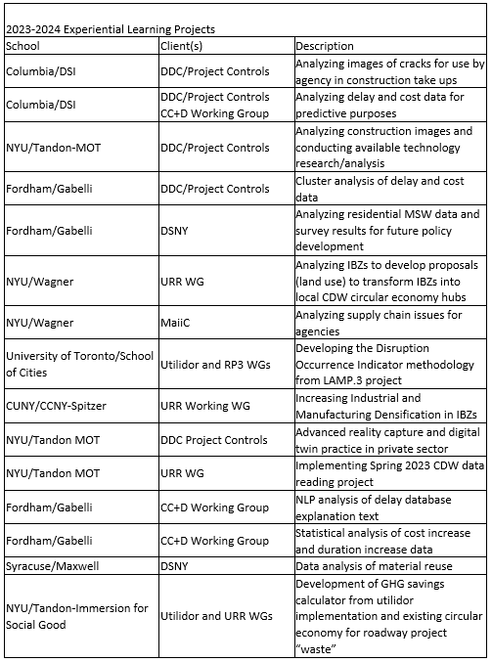
EXPERIENTIAL LEARNING COMPONENT

Slide 5
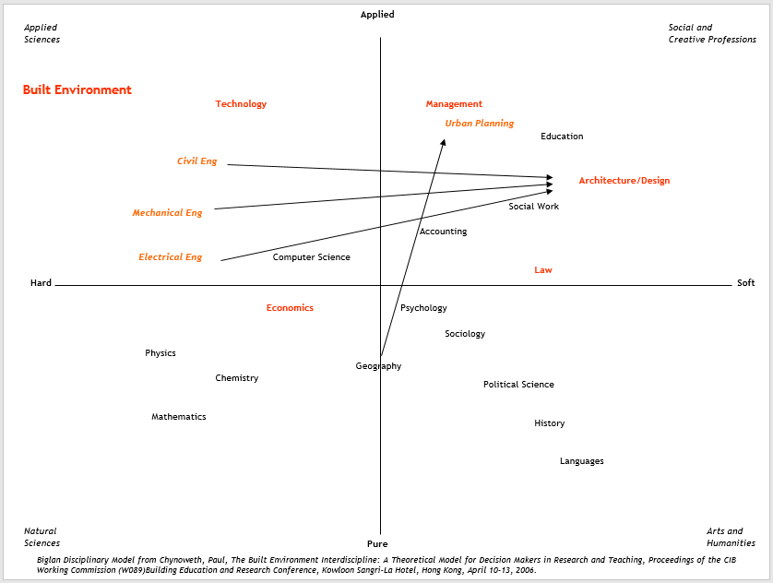
BUILT ENVIRONMENT ACADEMIC DISCPLININARY FRAMEWORK
Permits Most Types of Research Agencies Need

Slide 6
PROCUREMENT BACKGROUND
Master Academic Consortium Contract
Town+Gown’s 2008-2009 incubation period involved a small group of public and private stakeholders to seek a model to increase built environment research
Experiential Learning Component launched in 2009-2010.
Faculty-Directed Learning Component commenced in 2009-2010 with innovative procurement method to create the Master Contract:
master contract form operating via task orders
open-ended procurement (ended 1 year after date of first contract registration)
negotiated acquisition feature permitted schools to participate in drafting of contract
Option to extend term for five years in process
Master Applied Construction Innovation Research Services Contract
The Institute is a membership-based and industry-supported academic research center that conducts applied and practice-based research on innovation in construction, engineering design, and management aimed at improving efficiency and cost control, while emphasizing sustainability, fiscal responsibility, and safety, within a collaborative platform of faculty and industry members who are experienced and independent experts.
First master contract with a membership-based research center used the negotiated acquisition method and is distinct from the other master contract.

Slide 7
FEATURES OF BOTH MASTER CONTRACTS
easy and quick way for agencies, with their own funds, to tap faculty-level academic knowledge and expertise
significantly reduces overall procurement time compared to stand-alone RFPs, since users submit short-form RFPs, quickly transforming awarded proposals into short-form task orders—all template documents are on the Town+Gown website
contains intellectual property, confidentiality, cost-accounting, collaboration, and subcontracting provisions that are suitable for academic research as distinct from professional consultant services
permits third-party funds to fund projects or to supplement city funds for projects
academic institutions can collaborate with each other (Master Academic Consortium Contract), merging their research strengths to address interdisciplinary nature of built environment issues; academic institution can collaborate with private sector experts (Master Applied Innovation Research Services Contract) to bring innovative practices to bear.

Slide 8
WHEN AN AGENCY IS THINKING OF USING EITHER MASTER CONTRACT . . .
Notify T+G of Intent to Use a Master Contract. Please call or email Terri Matthews (212 313 3546 or matthewte@ddc.nyc.gov) or send the form on the Town+Gown: NYC webpage per above to notify T+G when you know that your agency’s program staff is serious about using the Master Contract for a Research Project.
Local Law 63 Compliance—new trigger = $1 Million as of 10/01/24
Alerts Town+Gown to the amount budgeted/allocated for research project, so Town+Gown can assure that all Master Contracts have sufficient capacity amounts associated with them in FMS to handle all RFPs in the pipeline
Master Contracts have been registered so that DEP, DOT, DDC, Parks, DCAS, DHMH, DOB and DOC can access the Master Contracts without a separate registration action; if your agency is not listed above, Town+Gown will amend the Master Contract so that your agency can access it.
Review Master Contract Provisions. The Master Contracts have payment features and Appendix A features suitable for faculty-directed research that are different than City standard consultant contract provisions; Master Contract Sections 3.2 and 3.3 cover academic budgeting principles and PPB Rule application; innovative procurement for Master Contract defers compliance with the City’s insurance requirements until Task Order award, but agency elects non-statutory insurance in RFP; App. A Section 6.01 A and B are options for academic publication—if agency elects B, it must include the terms of the license to publish in RFP.

Slide 9
ASPIRATIONAL 120-DAY PROCESS--Master Contract structure is faster than a stand-alone procurement
The first 45-day period
Researchers have 45 calendar days to respond to an agency RFP after Town+Gown sends RFP to academic institutions Note—The process “clock” does not include the time it takes between agency indication of interest and finalization of the RFP
The second 45-day period (could be shorter)
Agency evaluates Proposals in Response and turns awarded Proposal into the Task Order for registration with Comptroller’s Office
Responsibility determinations are not required for Task Orders, but it is advisable to make sure the awardee institution is up to date in the PASSPort system.
The last 30-day period
Comptroller’s Office registration within 30 days--experience with the Comptroller’s Office on all Task Orders has been good

Slide 10
PROCESS DETAILS
Template RFP, Proposal in Response and Task Order work together to make the process as easy as possible:
Town+Gown will work with the agency on the RFP, T+G will review and finalize it before T+G releases it to the vendor pool to assure compliance with Master Contract provisions; agency has option to use PASSPort for an additional release of the RFP to the vendor contacts via the master contract catalog
Agencies receive Proposals in Response directly from researchers and evaluate them (evaluation template available on the T+G webpage)
Once the agency determines the apparent winner and conducts any necessary negotiation, the agency and T+G will work together to turn the awarded Proposal into the Task Order, which the agency registers with the Comptroller; agency has the option to use PASSPort for the Task Order execution and registration

Slide 11
FIRST AMENDMENT TO MASTER ACADEMIC CONSORTIUM CONTRACT (provisions already in other master contract)
Incorporates the new 2018 Appendix A insurance provisions wholesale, replacing the prior insurance provisions; contains an easy-to-understand chart of required insurance, which is now in the template RFP—agencies are able to omit insurance that is not statutorily mandated, and most, if not all, faculty-directed research does not require professional liability insurance.
Permits Academic Practitioners to reimburse Consultants for long-distance travel to New York City, consistent with City policy, all other City contracts, and the provisions of Directive No. 6.
Revises App. A, Section 5.08 to outline the route to publication using Confidential Materials and to work better with Sections 6.01 A and 6.01B publication provisions.
Revises App. A, Section 6.01B to require an agency to indicate in the Mini RFP the nature of the license it will grant to the Academic Partner to use the Copyrightable Materials for publication purposes when an agency chooses or is required (e.g., FEMA funds) to elect the provisions of Section 6.01B, as approved by DDC.
Eliminates reference to Appendix B, which is the Innovative Procurement approval document, and changes all references to Appendix C, which are the template documents, to become Appendix B.

Slide 12
REMINDER RE: OPTIONAL PROVISION FOR AGENCY CONSIDERATION
Section 3.2 (e) of the Master Contract permits an agency’s RFP to allow the Consultant to use a percentage equivalent of academic contract effort when making requisitions for payment in place of using the hourly rate calculation required by Section 4.2(b)(3) so that payments can look more like professional services payment requisitions, and permits an agency to make multiple awards under an RFP.

Slide 13
PROTOCOLS
Soliciting GAC Advice on Academic Research before Procurement Activities Get Underway. Agencies have expressed ideas for a research project under the Master Contract but wanted first to know whether their ideas are actually suitable for academic research, instead of work by consultants. This protocol would involve an email from Town+Gown requesting information from the schools and receiving written responses that Town+Gown would forward to the agency.
RFP Pipeline Advance Notice. For more complex scopes of research when the 45-day return period may still be challenging the GAC schools, this protocol permits T+G to give them advance notice of RFPs in the pipeline so they to identify the right researchers early and have them ready to field Proposals in Response as soon as the RFP is officially released. The time for Town+Gown: NYC to send advance notice would be when the agency alerts Town+Gown: NYC that is fairly certain that it will proceed with an RFP. Note: we may also extend the standard return period in consultation with the agencies.
Agency+Academics Research Exchange (R/EX) Events. The first R/EX event on 9/24/24 with DEP and DOT was a streamlined version of the old 2017-2018 Agency+GAC research meetings. Academic and agency researchers present what they are working on, using the 2 minute/slide “Pitchfest” model, to exchange knowledge and research ideas, to identify commonalities for them to consider collaborative approaches outside the procurement process. There were 60 presentations with researchers from 10 academic institutions, and close to 100 participants. T+G plans to conduct similar R/EX Events with other city agencies—please let us know if your agency would be interested in learning about this opportunity.

Slide 14
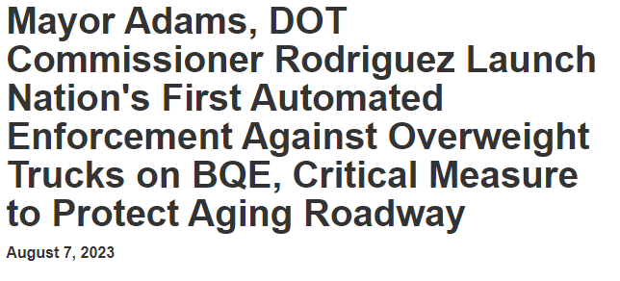
RESULTS.1 MASTER CONTRACT PROJECTS SUPPORT NYC POLICY CHANGE

Slide 15
RESULTS.2 MASTER CONTRACT UTILIZATION
21 RFPs leading to Task Orders with 19 awards to 9 out of the 14 schools*—one DEP RFP is at award stage and one DEP RFP just released
Funding levels range from $50,000 to $2.5 M, with the average funding level at approximately $349,000 and the mean at $100,000.
7 agencies have used the Master Contract to date, with DEP as the highest user (@ 8), followed by DOT and DDC (@ 4 each).
Nifty charts to follow!
* Tufts cancelled its master contract due to PASSPort, so 10 out of 15 schools since the beginning

