Slide 1

Mud, Glorious Mud: A Dive into Dredged Material (URR.12)
Navigational Dredge Material and NYS DEC Regulations
Terri Matthews, Director, Town+Gown:NYC
with help from Kathleen Prather, NYS DEC

Slide 2
Federal and State Law Context
The federal Resource Conservation and Recovery Act (RCRA), enacted in 1976, is the nation’s comprehensive federal framework for the management of solid and hazardous waste.
Under RCRA §1004 (27), solid waste is understood to be:
“any garbage, refuse, sludge... and other discarded material, including solid, liquid, semisolid, or contained gaseous material resulting from industrial, commercial, mining, and agricultural operations, and from community activities”
RCRA, Subtitle D, addresses non-hazardous municipal and industrial waste. Pursuant to RCRA § 4001, instead of relying on direct federal permitting or enforcement, the core function encourages state and local governments to develop comprehensive plans themselves.
In 1988, the NYS Solid Waste Management Act (Act) included the State’s Solid Waste Management Plan. The Act prioritized a four-part hierarchy of solid waste management to decrease and redirect the amount of recyclable and reusable solid waste away from the landfills, which includes: (2) reuse material for the purpose for which it was originally intended or to recycle material that cannot be reused.

Slide 3
Historical Context
In 1991, the federal government established Part 258 regulations, which established minimum national criteria under RCRA and the Clean Water Act for all Municipal Solid Waste Landfills (MSWLFs).
In 1993, NYSDEC updated the Part 360 regulations, issued pursuant to the Act, which govern solid waste, to comply with the federal government’s 1991 Part 258 regulations. Beneficial Use Determination (BUD) regulations were greatly expanded.
In 2017, NYSDEC completely overhauled the Part 360 regulations, including for BUDs (Section 360.12)
The Part 360 regulations state that the BUD petition must include a “justification that the waste functions as an effective substitute for the commercial product or raw material.”
Once the NYSDEC grants a BUD, the waste material ceases to be considered a solid waste (for the purposes of Parts 360-365) when used as described in the BUD.
NYSDEC 2023 revisions to Part 360 regulations did not greatly change NDM BUD or processing facility requirements.

Slide 4
Part 360 Definition
360.2(b)(181) – “Navigational dredged material (NDM)” – material, other than material dredged primarily to remove contamination, which is dredged or excavated from the waters of the state, including sediment, soil, mud, sand, shells, gravel or other aggregate, for the direct or indirect purpose of establishing, maintaining, or increasing water depth, or increasing the surface or cross-sectional area of the water body.
This definition distinguishes NDM as Navigational versus Remedial
not primarily to remove contamination but rather to alter dimensions of a water body
not from dredging to remove PCBs and other chemicals from rivers under state or federal Superfund projects or other cleanups
NDM is removed without respect to composition of the sediment, and ranges from very clean to being a hazardous waste

Slide 5
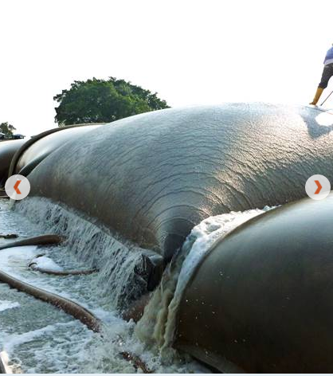
Navigational Dredged Material (NDM) is a solid waste pursuant to NYS solid waste regulation except where excluded or when granted a beneficial use determination (BUD)
BUDs can be pre-determined (no DEC review needed) or case-specific
Reasons for NDM BUDs for NDM:
Possible adverse effects from contamination—physical or chemical
NDM can be an effective substitute for soil or aggregate after dewatering,
amending or processing.
If NDM requires amendment or dewatering that is not taking place on the site of dredging, or any other kind of processing, this activity needs solid waste facility authorization under Subpart 361-9 in addition to a BUD for the final NDM product.
Picture Source: TenCate Geosynthetics Website: www.tencategeo.us/en-us/solutions/dewatering

Slide 6
360.12(c) Beneficial Use: Pre-Determined
360.12(c)(1)(iii): NDM used outside ecologically sensitive areas, as commercial aggregate in place of sand or gravel if the NDM contains at least 90 percent sand and gravel, as determined by a standard grain size analysis method approved by the department and performed by an independent laboratory, and if the NDM contains less than 0.5 percent total organic carbon;
360.12(c)(3)(xii): clay, till, or rock excavated as part of navigational dredging, which is separated from overlying navigational dredged material and used as fill or aggregate

Slide 7
360.12(e) Beneficial Use: Case-Specific
NDM BUD Petitions
Contents of a petition
Minimum sampling requirements (sampling for a DEC or USACE dredging permit can be substituted!)
Parameter list in 360.12(e)(4)(i) is general – dredgers should always consult with DEC to develop a site-specific list!
Use as fill or cover must meet 360.12(d) requirements for land placement of lower of Part 375 Residential and Groundwater Soil Cleanup Objectives (SCOs) or case-specific criteria based on placement location.
Annual reporting
Five-year expiration
Beneficial Use Determinations (BUDs) - NYS Dept. of Environmental Conservation

Slide 8
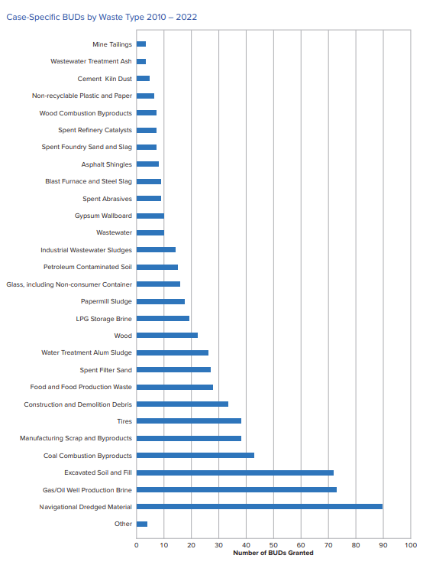
Case-specific BUDs granted for NDM was the largest waste type from 2010-2022:
New York State Solid Waste Management Plan, p. 18.

Slide 9
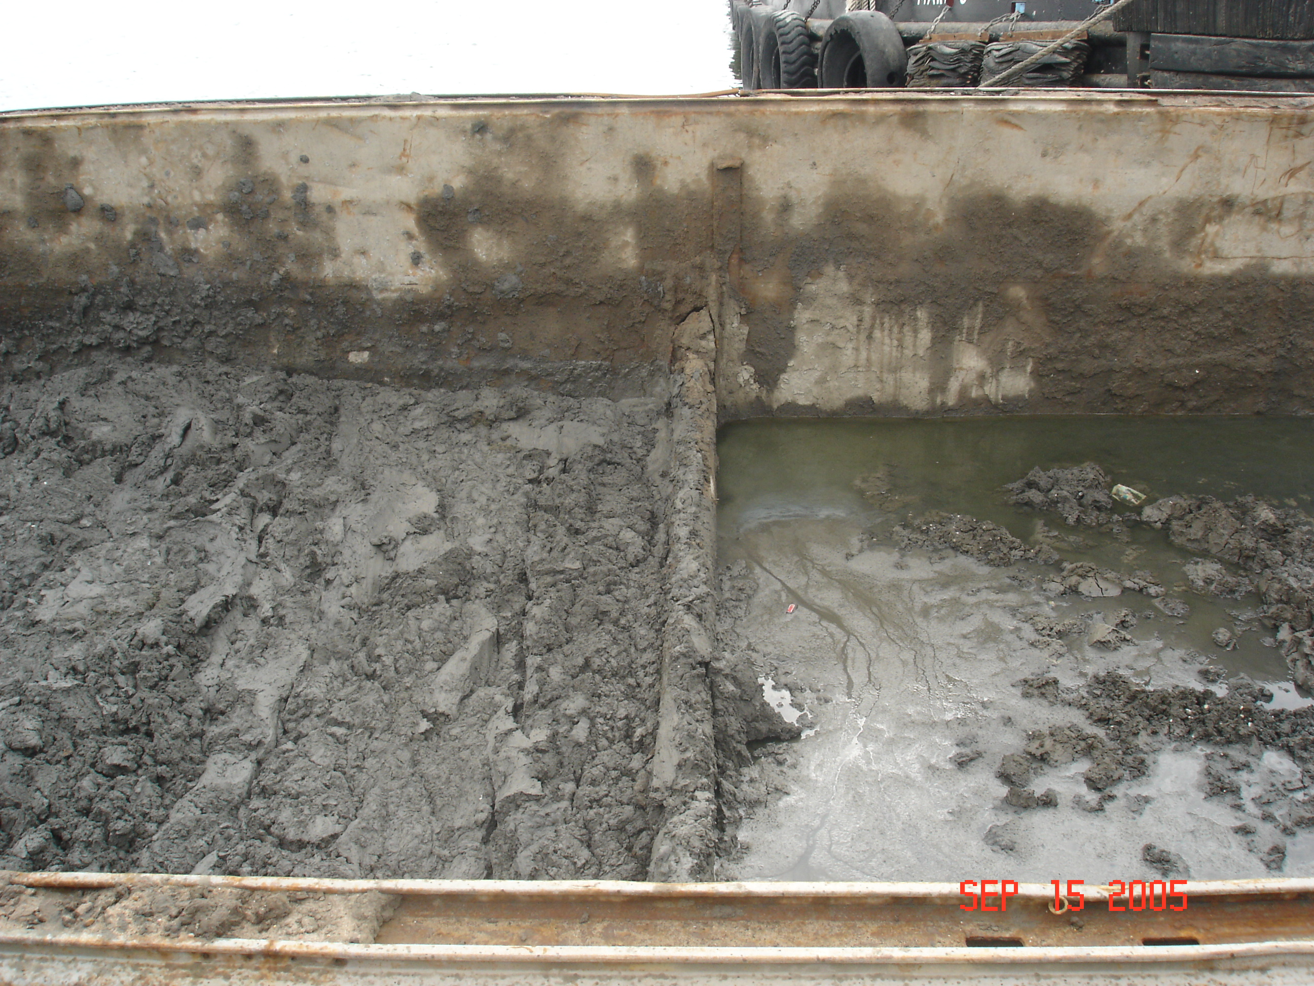
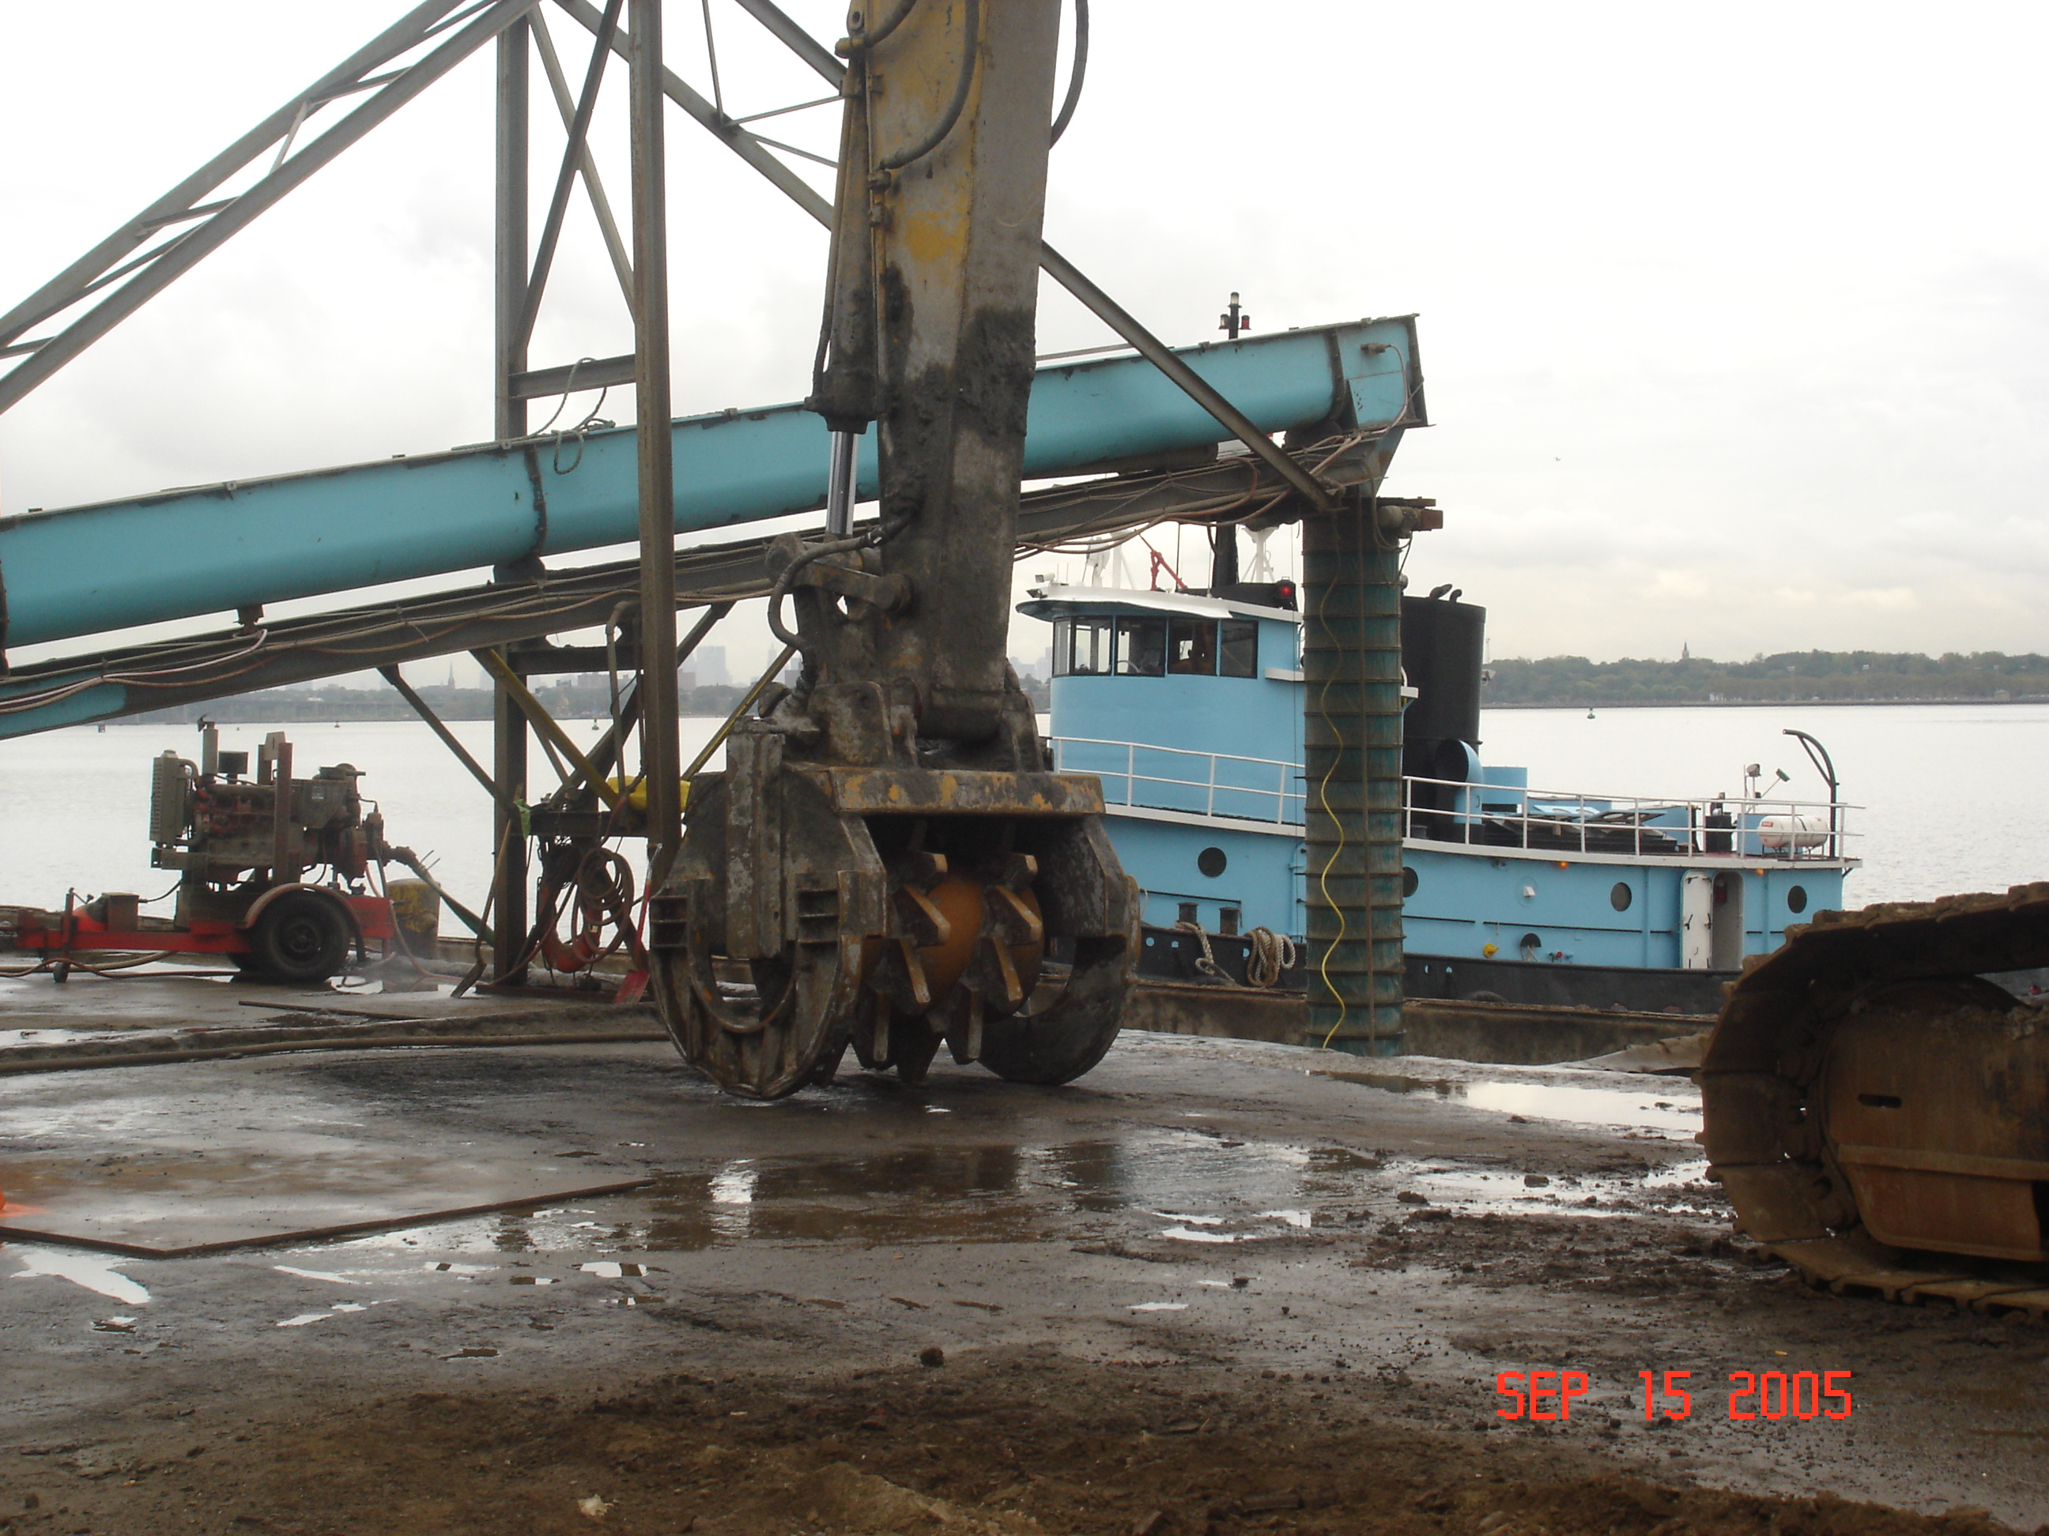
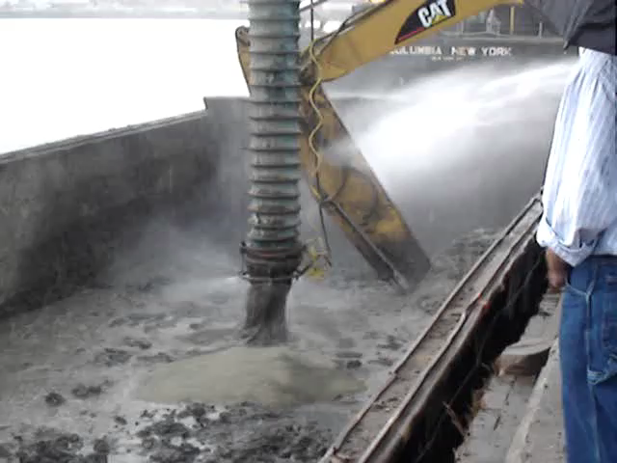
Amending NDM

Slide 10
Part 361 Material Recovery Facilities
If NDM requires amendment or even passive dewatering or any other kind of processing that is not on the site of dredging, it is not covered by a BUD and this activity needs solid waste facility authorization
Subpart 361-9 Navigational Dredged Material Handling and Recovery Facilities
Exemption for NDM processing on site of generation or same ownership or control (360.14(b)(1))-- most NDM handling and recovery facilities will be EXEMPT due to same ownership or control
Registration for sites where NDM is amended with portland cement or dewatered on pads or in geotextile tubes
Permit for other sites/facilities
Outputs - NDM from these facilities:
Case Specific BUD – 360.12(e) for use as Fill, Cover or aggregate.
Alternative Operational Cover at landfills - 363-6.21(c)
Since 361-9 came into existence in November 2017, no entity has registered or received a permit to process NDM under this regulation.

Slide 11
FURTHER QUESTIONS?
Kathleen A. Prather, P.E.
Supervisor, Solid Waste Recovery and Medical Waste Section
Division of Materials Management
New York State Department of Environmental Conservation
625 Broadway, Albany, NY 12233-7260
P: (518) 402-8678 | F: (518) 402-9024 | kathleen.prather@dec.ny.gov

