Slide 1

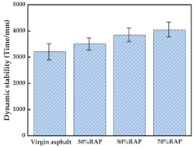
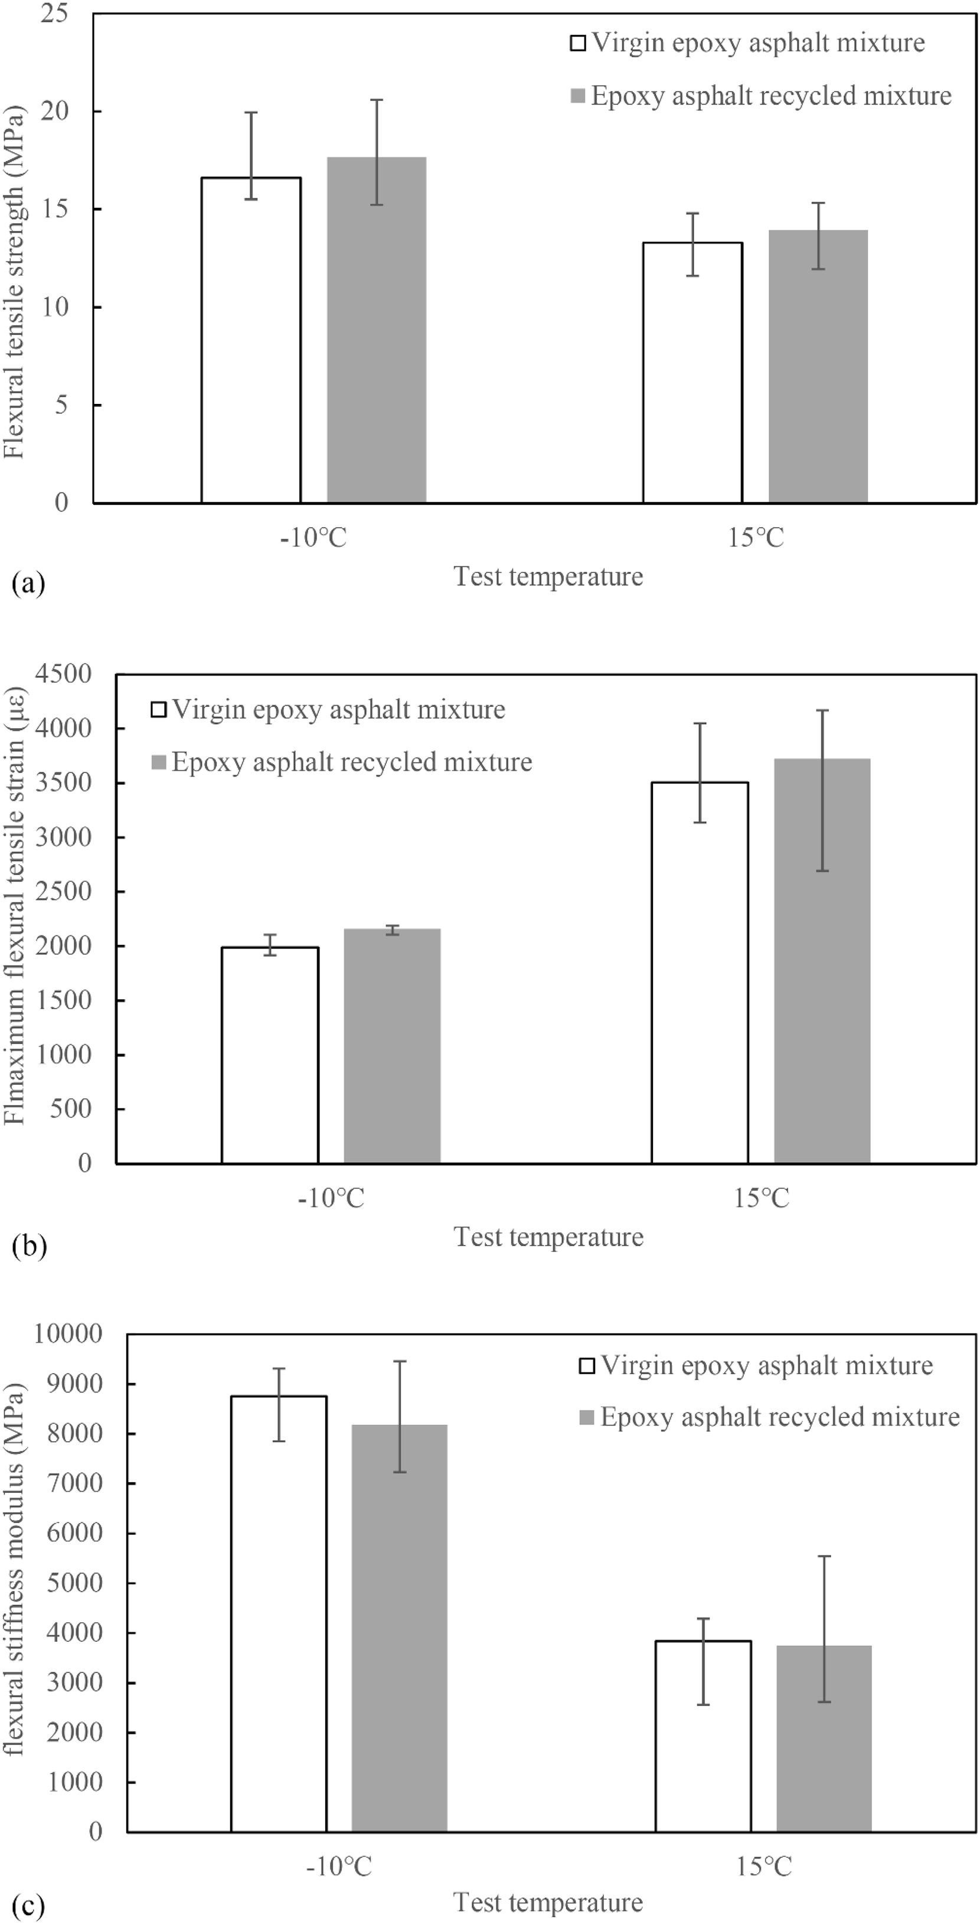
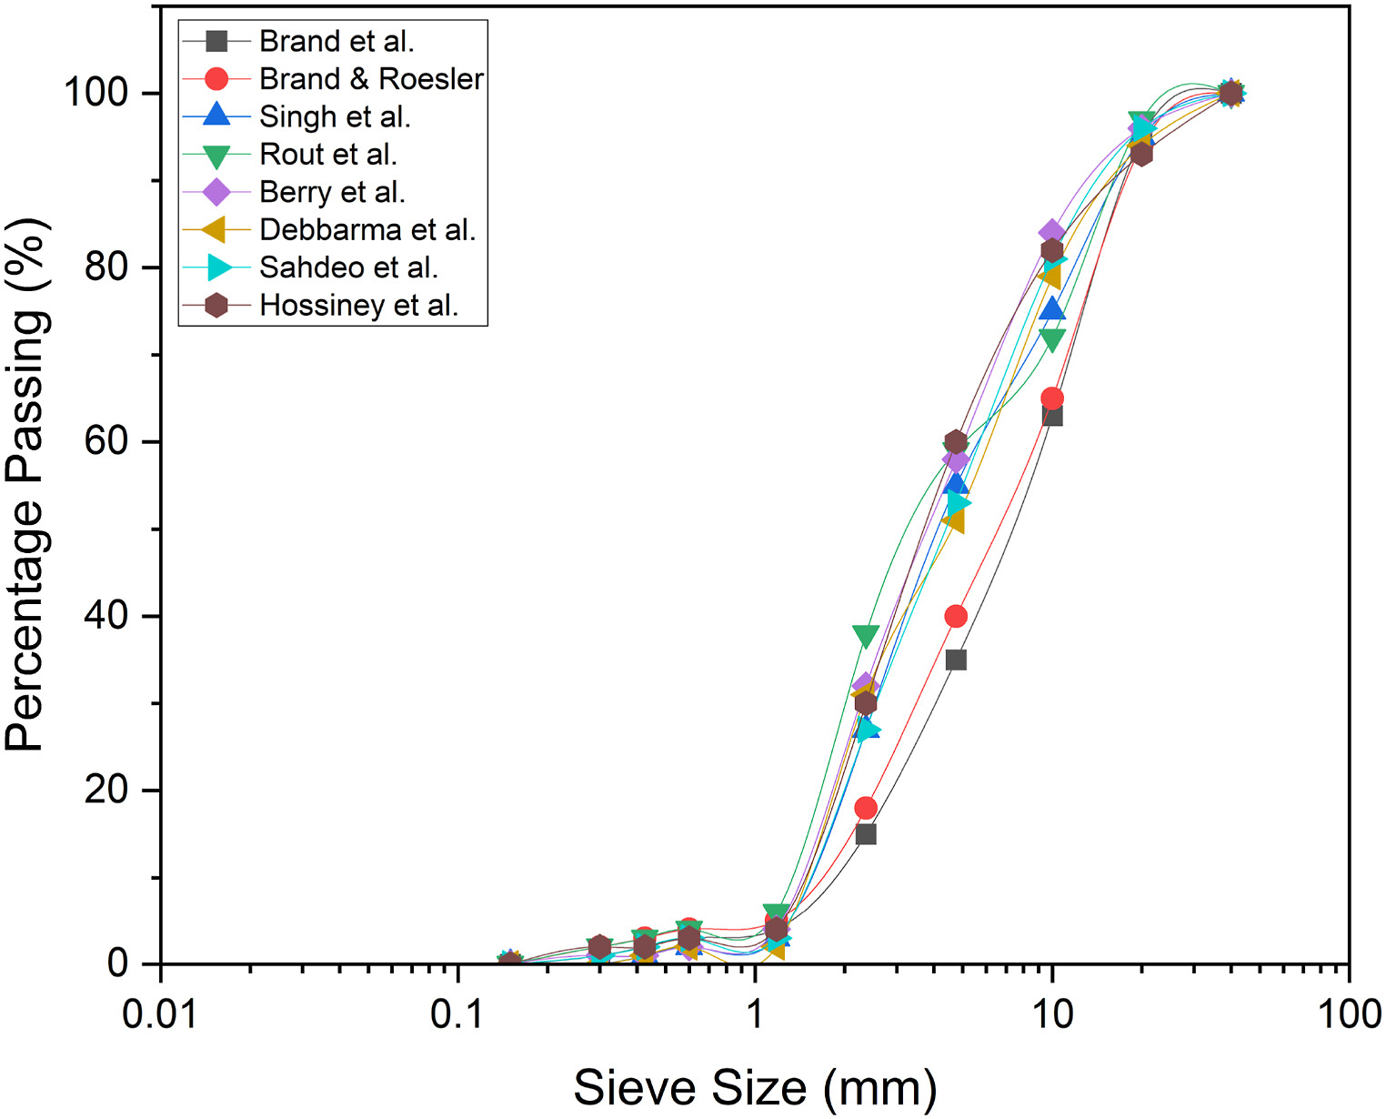
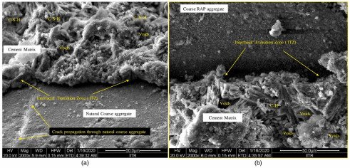
Beneficial Use of Reclaimed Asphalt in New York City​
Rachel Koo, Irene Lee, Katharine Moncrieffe​
Introduction​
Introduction​
Introduction​
Embankment Fill
Hot Mix Asphalt Pavement
Recycled asphalt pavement is a material mainly used in horizontal infrastructure, like highways, roads, and base layers. Over 250 thousand tons of RAP were produced in-house in FY24, and at least 200 tons can be diverted from landfills daily with 50% RAP usage.
Increased usage provides economic and environmental benefits, and we suggest increasing RAP usage guidelines and exploring alternate usage options in NYC, particularly for base layers. However, launching long-term field trials in high-traffic areas to understand performance in NYC's climate must be done prior.
Granular fill material for road embankments, berms, and general earthwork
Must comply with AASHTO gradation standards
Benefits:
Lower compacted unit weight leads to higher yield and similar shear strength compared to similarly graded natural aggregate
Limitations:
Should not be within top 5 or 8 ft of embankment (rigid and flexible pavement)
Should not be immediately above underground structures or bedrock
Improper placement can cause excessive settlement
Recycles RAP as new asphalt for roads, highways, streets
Asphalt content determination: crushes and screens to desired gradation, QC testing, ignition oven method
Benefits:
Cost-effective - expanded use reduces quarry excavation and long-distance hauling
Efficient rutting resistance and moisture resistance in high-RAP mixes
Equally as effective fatigue performance to virgin mixes
Limitations:
RAP stockpiles must be soil-free and debris-free
Mixes must meet conventional mix design requirements
High-RAP mixes need rejuvenator or binder mix adjustment
Introductin​
Cement Stabilized Base Course
NYC Specifications
RAP blended with Portland cement or other agents to chemically enhance strength
Crushing or screening, and blending with cement (3-7% by weight) or other stabilizers
Moisture-density relationship testing to determine optimum moisture content
Benefits:
Higher strength and stiffness than unbound RAP
Almost 70-100% RAP is viable with proper cement content
Limitations:
Must meet strength requirements in lab testing before field application
Granular Base Layer
Local Law 71: Requires minimum 30% RAP in new asphalt mixes and establishes regulatory framework for RAP use citywide.
DOT permitted 100% RAP mixes for use on city streets with mandatory QC testing and RAP Control Plan.
Material availability: NYC's extensive road network and frequent utility work generate substantial RAP quantities locally.
Green Asphalt facility currently working towards 100% RAP mixes with performance specifications for NYC climate.
RAP blended with aggregate to create structural foundation layers under pavement
Requires crushing and screening, aggregate-blending, and testing
Benefits:
Cost-effective alternative to virgin aggregate that's readily available from local sources
Comparable strength to conventional aggregates in blends
Limitations:
Need consistent testing and stockpile management
RAP has lower bearing capacity than aggregate
Blending must meet AASHTO physical requirements and bearing strength specifications
Cold Mix Asphalt Pavement
Material Properties
RAP with emulsified/foamed asphalt and recycling agents to produce cold base mixtures
Primarily for base courses on low-to-medium traffic volume roadways
Typically covered with HMA overlay/double seal
Cold plant mix – RAP is combined with emulsified/foamed asphalt and/or virgin aggregate in batch drum-mix plant
CIPR – process to mill/scarify, screen/size, and mix with liquid rejuvenators and emulsion
Benefits:
No heat application required
Lower energy consumption than hot mix asphalt
Used on low-volume roads – cold mix is cost-effective
Limitations:
Not recommended for wearing surface due to overlay/seal and 2 weeks curing
  Structural and durability considerations
Improper emulsion application will cause flushing or rutting
Chemical Properties: similar to mineral aggregate composition – 93-97% makeup
Physical Properties: depends on constituent materials and type of mix (ex. wearing surface)
Unit Weight: 1940-2300 kg/m³ (120-140pcf)
Moisture Content: normally up to 5%, maximum of 7-8%
Asphalt: normally 4.5-6%, maximum of 3-7%. asphalt penetration of 10-80mm at 77°F
Absolute Viscosity: normally 4000-25000 poises at 140°F
California Bearing Ratio (CBR): 20-25% (100% RAP), >150% (40% RAP & 60% agg.)
Figure 4. Comparison of dynamic stability of different types of asphalt mixtures.
Figure 2. Comparison of flexural tensile strength of virgin and recycled asphalt at –10 and 15 °C.
Citations:
Antunes, Vítor, et al. "Performance Assessment of Reclaimed Asphalt Pavement (RAP) in Road Surface Mixtures." Recycling, vol. 6, no. 2, 13 May 2021, p. 32, https://doi.org/10.3390/recycling6020032.
Fan, Yulou, et al. "Cracking Resistance Evaluation of Epoxy Asphalt Mixtures with 100% Reclaimed Asphalt Pavement (RAP)." Construction and Building Materials, vol. 395, 30 June 2023, p. 132320, www.sciencedirect.com/science/article/abs/pii/S0950061823020366, https://doi.org/10.1016/j.conbuildmat.2023.132320.
"Asphalt Pavement Recycling with Reclaimed Asphalt Pavement (RAP) - Recycling - Sustainability - Pavements - Federal Highway Administration." Www.fhwa.dot.gov, 30 Oct. 2020, www.fhwa.dot.gov/pavement/recycling/rap/.
"Reclaimed Asphalt Pavement - Material Description - User Guidelines for Waste and Byproduct Materials in Pavement Construction - FHWA-RD-97-148." Www.fhwa.dot.gov, www.fhwa.dot.gov/publications/research/infrastructure/pavements/97148/046.cfm.
"Reclaimed Asphalt Pavement - User Guideline - Embankment or Fill - User Guidelines for Waste and Byproduct Materials in Pavement Construction - FHWA-RD-97-148." Www.fhwa.dot.gov, www.fhwa.dot.gov/publications/research/infrastructure/structures/97148/rap135.cfm.
"Chapter 2 - Reclaimed Asphalt Pavement in Asphalt Mixtures: State of The Practice, April 2011 - FHWA-HRT-11-021." Www.fhwa.dot.gov, www.fhwa.dot.gov/publications/research/infrastructure/pavements/11021/002.cfm.
Tsakoumaki, Maria, and Christina Plati. "A Critical Overview of Using Reclaimed Asphalt Pavement (RAP) in Road Pavement Construction." Infrastructures, vol. 9, no. 8, 5 Aug. 2024, p. 128, https://doi.org/10.3390/infrastructures9080128.
Wen, Haifang, et al. "Utility and Limitations of Using Recycled Asphalt Pavement (RAP) as Roadway Embankment Material." Washington State Transportation Center, depts.washington.edu/trac/research-news/geotechnical-engineering/utility-and-limitations-of-using-recycled-asphalt-pavement-rap-as-roadway-embankment-material/.
University of Wyoming LTAP Center. "Performance of Reclaimed Asphalt Pavement on Unpaved Roads." Oct. 2011, rosap.ntl.bts.gov/view/dot/23962.
"DDC Features: Green Asphalt." Nyc.gov, 2025, www.nyc.gov/site/ddc/resources/features/july-2016-green-asphalt.page.
"Climate Week: NYC DOT Will Test New Asphalt Mixes Containing 50 Percent Recycled Road Pavement, Helping Reduce City's Carbon Footprint." Nyc.gov, 25 Sept. 2024, www.nyc.gov/html/dot/html/pr2024/climate-week-new-asphalt-mixes.shtml.
Figure 1. SEM micrographs of natural and RAP aggregates.
Figure 3. Comparison of RAP aggregate sieve analysis.

