Slide 1
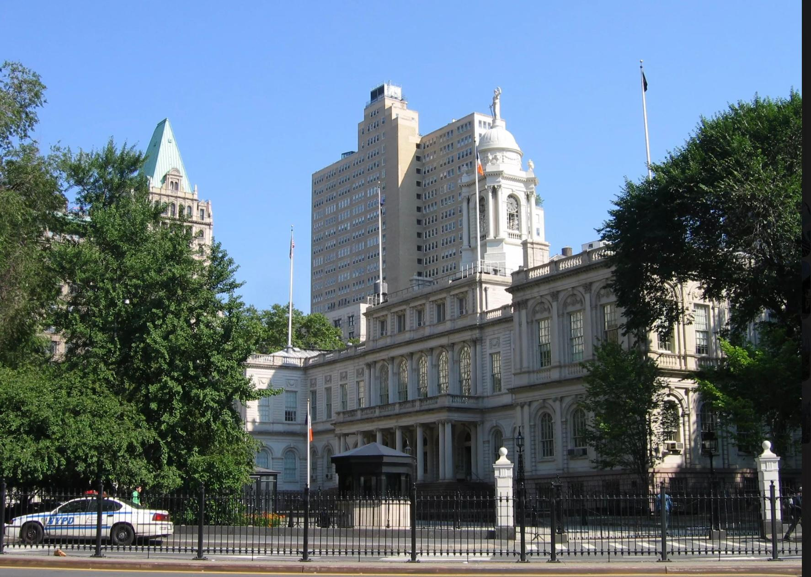


Fordham University / Gabelli School of Business x Town+Gown:NYC @ NYC DDC + NYC Mayor’s Office of Operations
Collaborative
Public Construction
Data Analytics
NYC Capital Program
PUBLIC BUILDINGS
By Thuy Duong Nguyen, My Le, Kamrul Islam, Faris Al-Dhahi, Tamir Bujinlkham

Slide 2
Agenda
Agenda
01
1
Public Building Data Overview
5
Schedule Variables Analysis
2
Descriptive Analysis
6
02
Predictive Modeling
3
Typology Deep Dive
7
Conclusion
03
4
Budget Variables Analysis
04

Slide 3
Public Building Data Overview

Slide 4
Dataset Overview
Dataset:
  Contains 921 Public Building Projects across the five NYC boroughs
  Includes 29 sponsor agencies and 14 project typologies
Project Scope:
  Each project has unique identifiers which are: PID, FMSID, and Reporting Period
  The lifecycle of each project includes:
Pre-Design → Design → Procurement → Construction → Close-out
  Financial data includes: total budget, budget variance, spend-to-date %, and cost changes across reporting periods
  Schedule data includes: phase start/end dates, forecast completion, actual durations, and documented delay causes

Slide 5
Descriptive Analysis

Slide 6
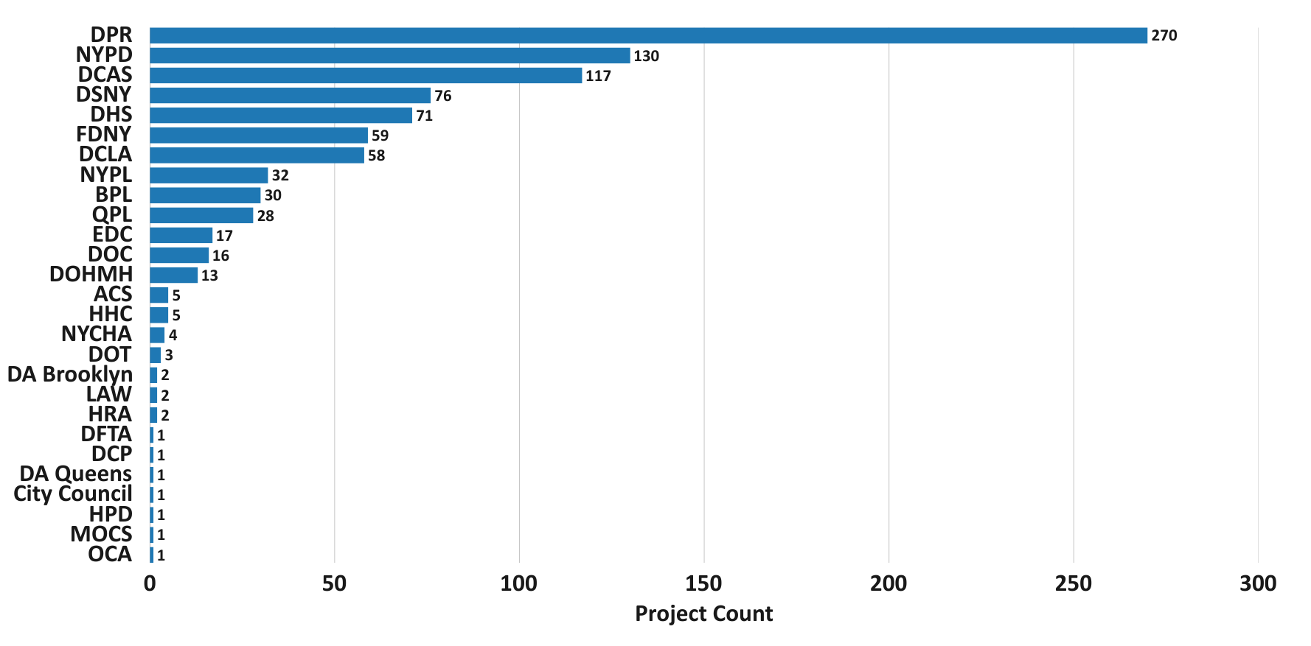
Projects by Sponsor Agency

Slide 7
Geographic Distribution of Projects by Borough
(as a proxy for density)
  Manhattan has the highest number of projects, followed by Brooklyn and Queens.
  Project counts act as a proxy for borough-level population density.
Manhattan
298
Bronx
130
Brooklyn
236
Staten Island
61
Queens
206

Slide 8
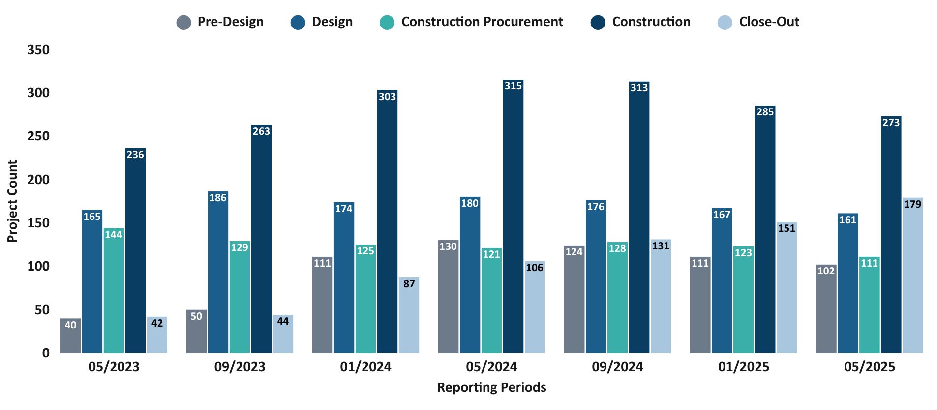
Reporting Periods Across Status
(7 Reporting Periods)

Slide 9
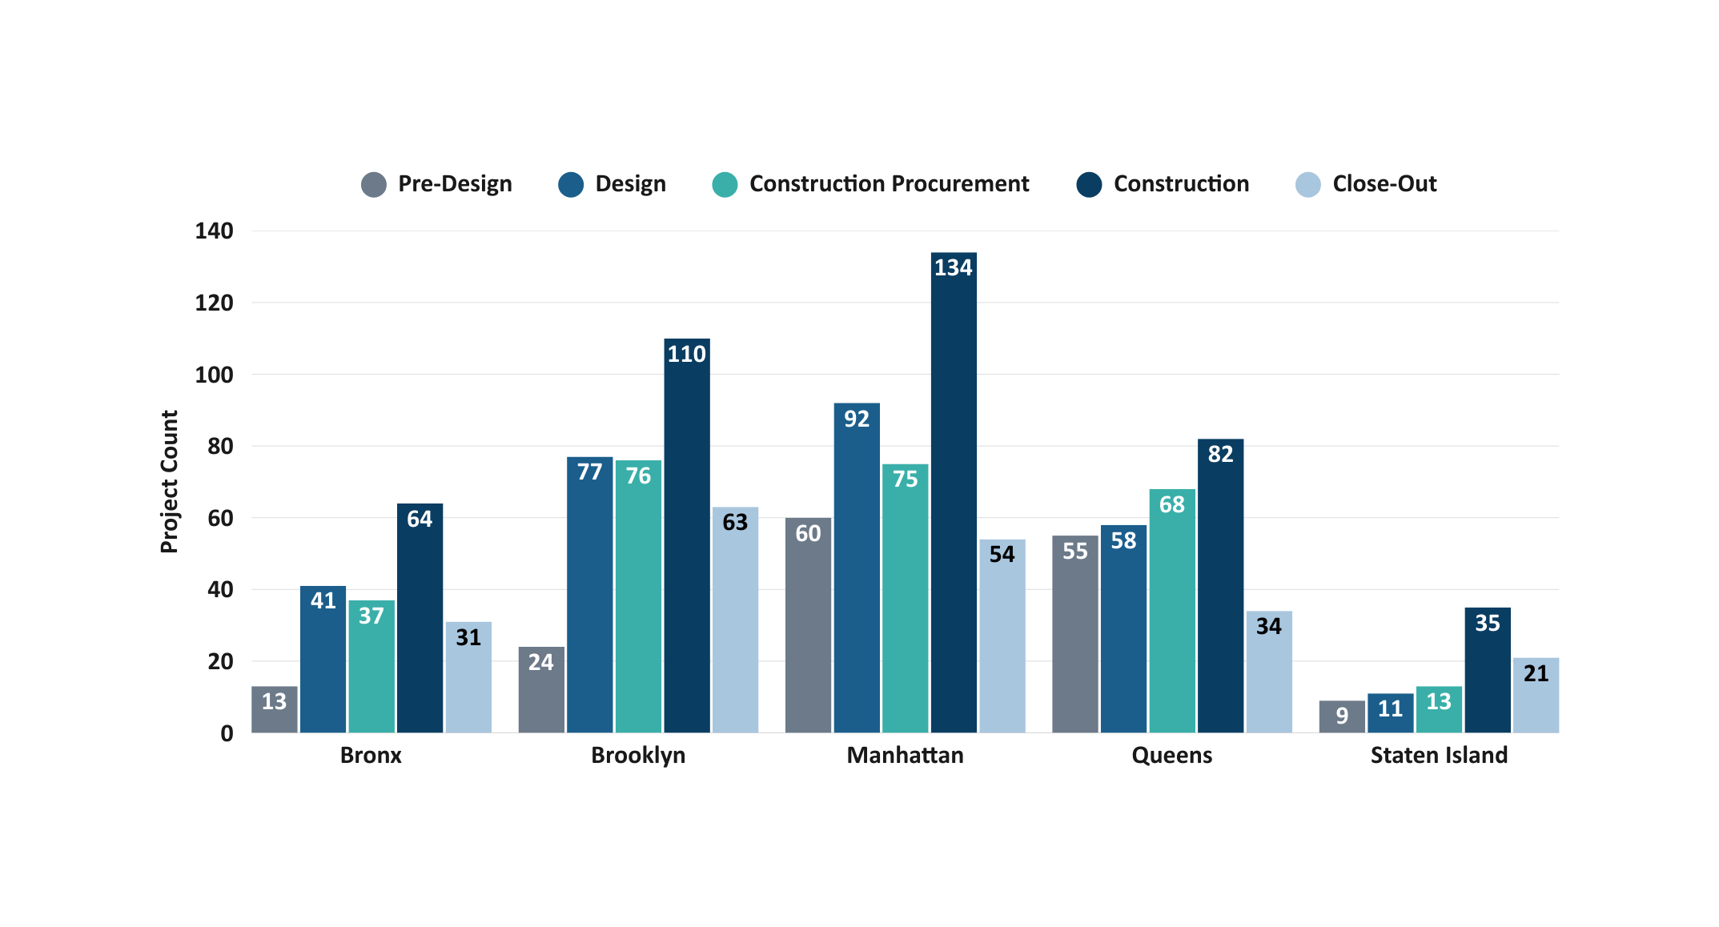
Project Phase Distribution by Borough
(as a proxy for population density)
Construction is the dominant phase across all boroughs, with Manhattan and Brooklyn showing the highest overall project counts
Staten Island consistently has the lowest number of projects across every phase.

Slide 10
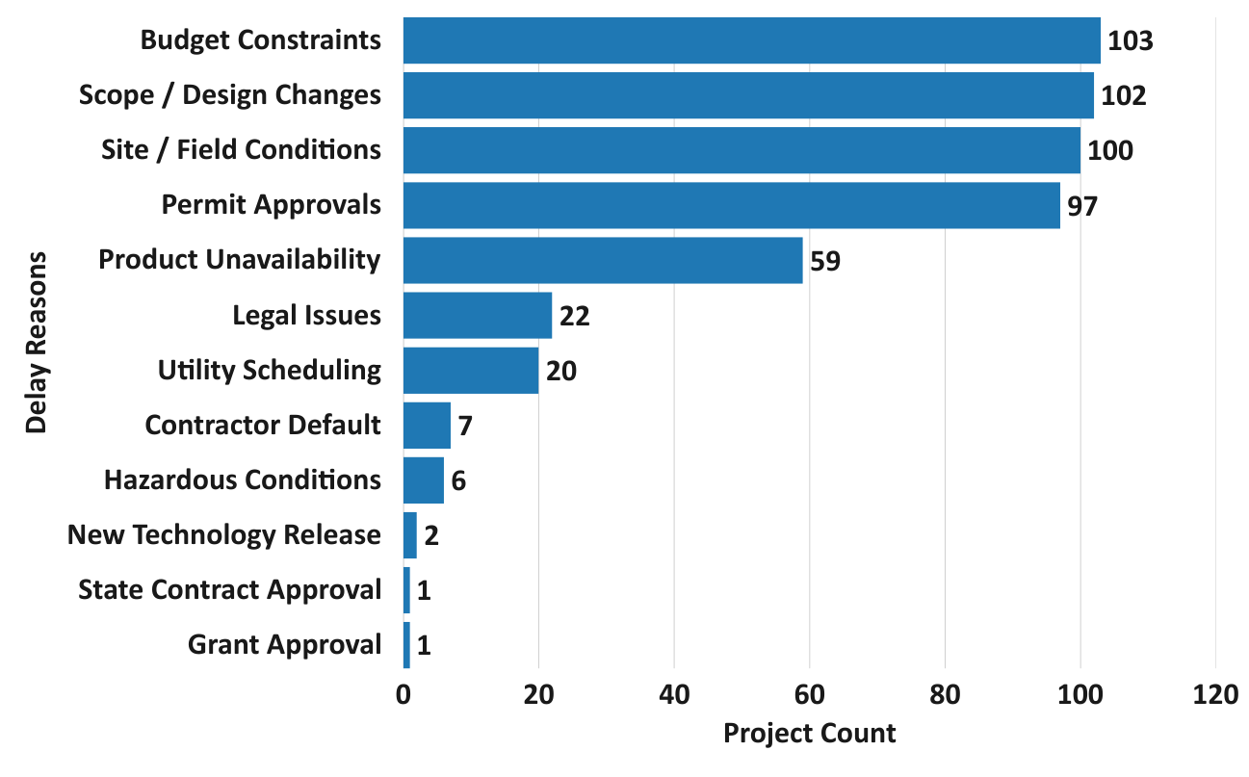
Most Common Reasons of Project Delays
• Budget constraints, scope/design changes, site/field conditions, and permit approvals are the leading drivers of project delays.
• Lower-frequency causes - such as legal issues, utility work, and contractor default - occur less often but still impact select projects.

Slide 11
Typology Deep Dive

Slide 12
Typology Overview
  Typology represents how Public Building projects can be categorized based on their function for analysis.
  Typology classification will help future analyses of performance across project types and understand how typologies relate to schedule and budget variables and reason for delays.

Slide 13
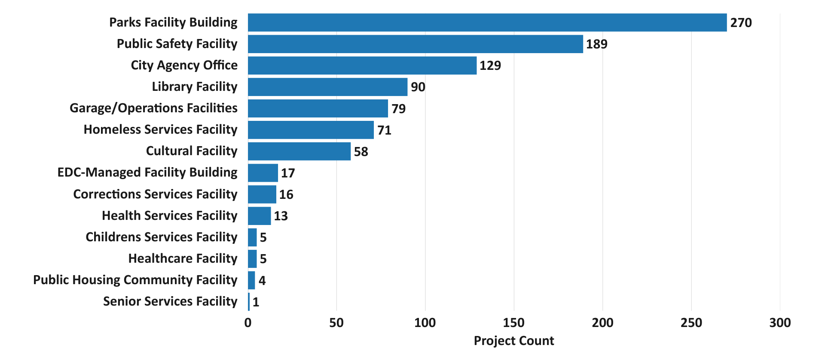
Number of projects per Typology

Slide 14
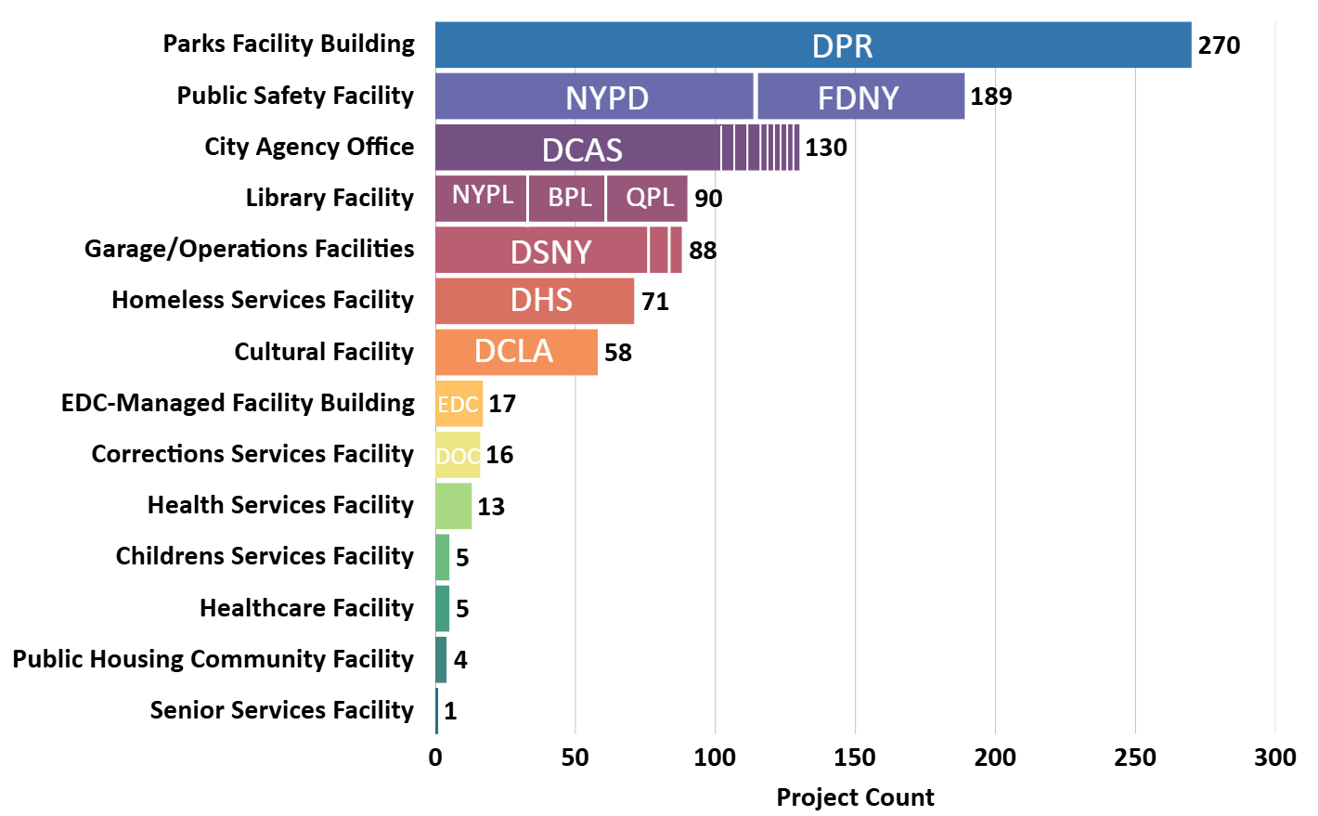
Typology × Sponsor Agency
DPR
  Project volume is concentrated among a few key agencies (DPR, NYPD, FDNY, DCAS, DSNY, DHS), which drive the highest-volume typologies.
  Most typologies map to a single primary sponsor, while City Agency Offices and Library Facilities show more diversified sponsorship.
NYPD
FDNY
DCAS
NYPL
BPL
QPL
DSNY
DHS
DCLA
EDC
DOC

Slide 15
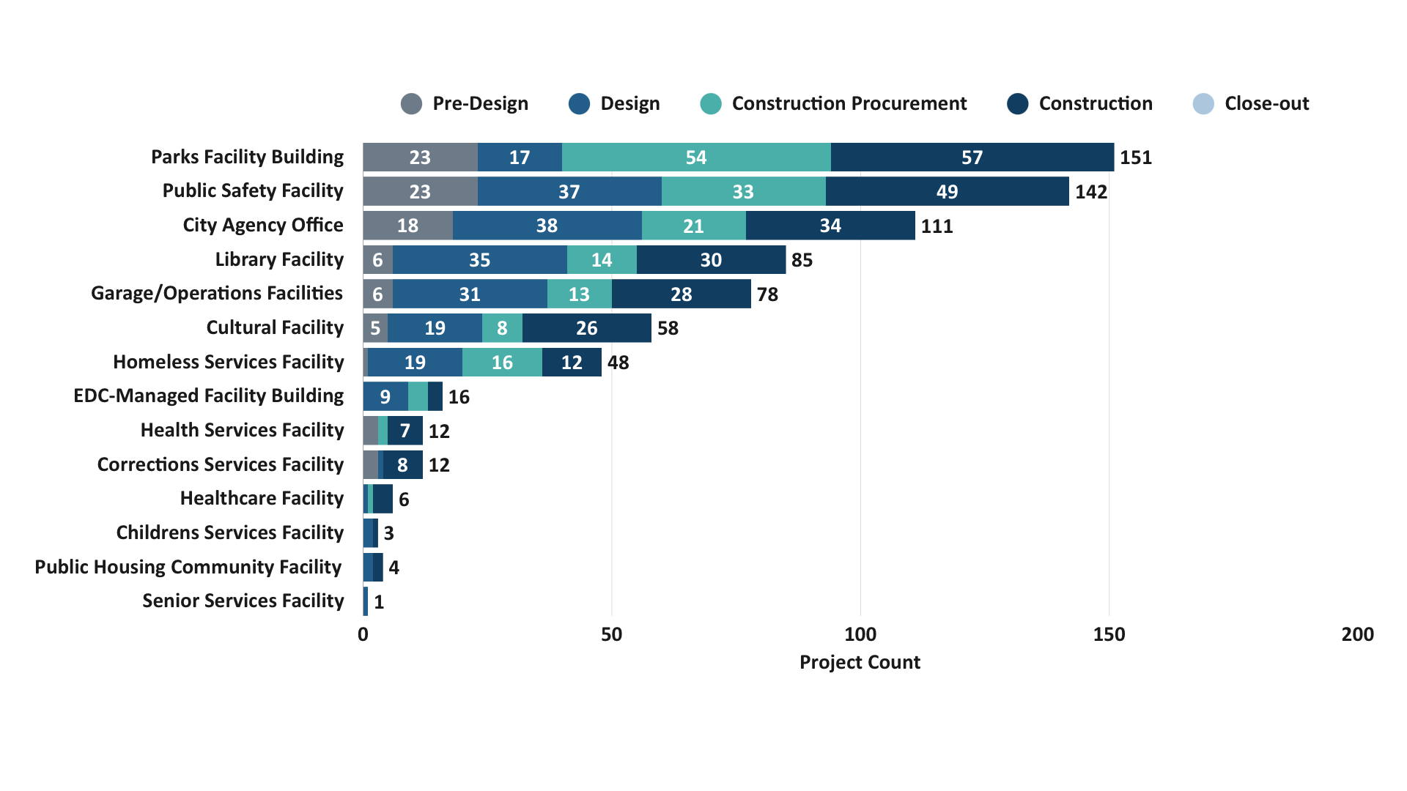
Typology × Project Status

Slide 16
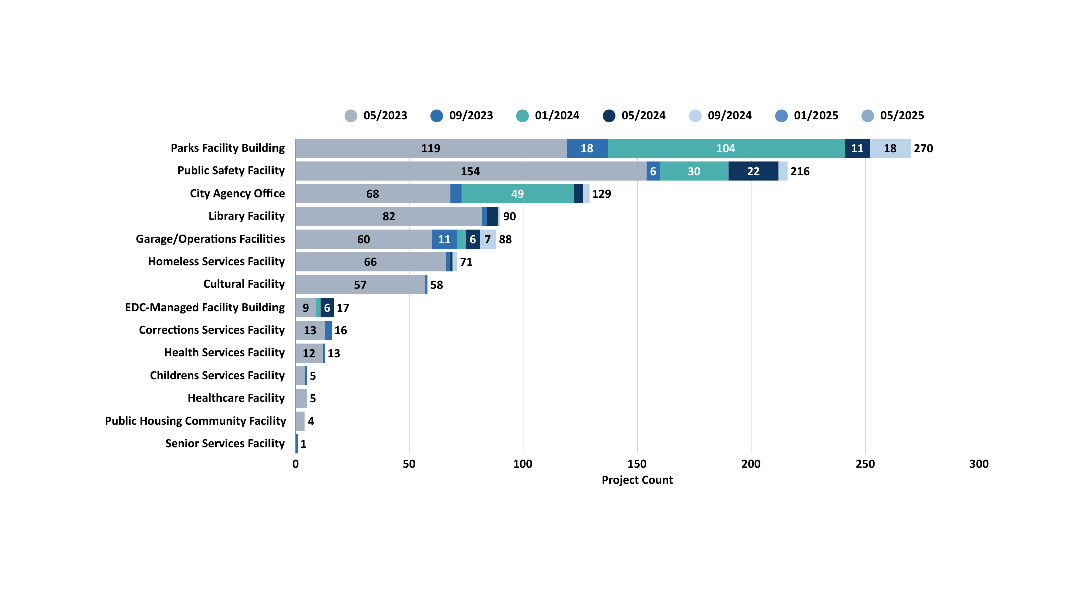
Project Count by Typology
(7 Reporting Periods)
Project counts vary widely by typology, with categories such as Parks Facilities, Public Safety, and City Agency Offices consistently showing the highest volumes across reporting periods.
Lower-volume typologies, including Healthcare, Public Housing, and Senior Services, remain small in count across all periods.

Slide 17
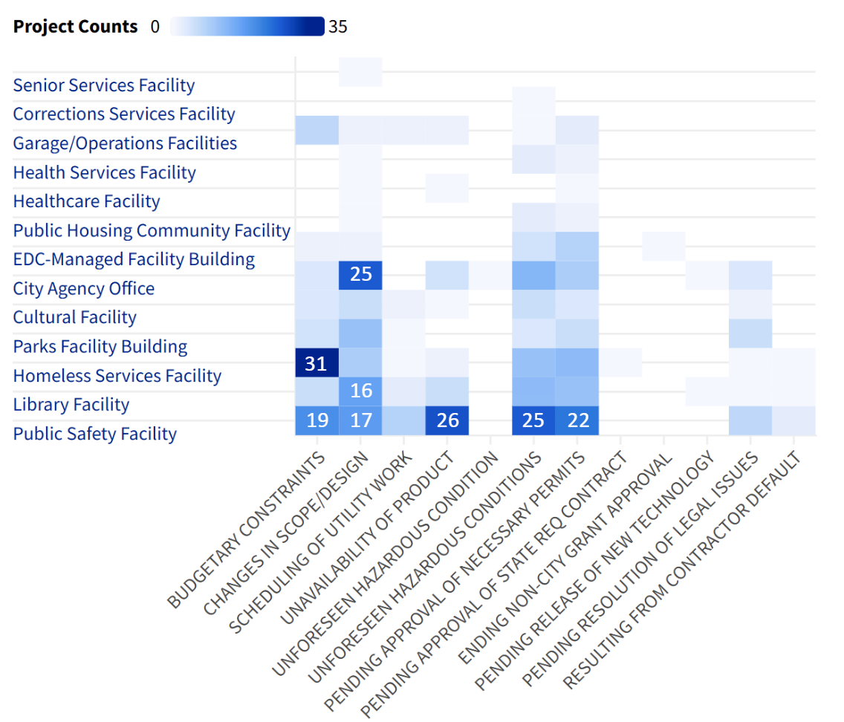
Typology × Delay Categories
This is a heatmap of facility typology by delay reason, where where darker cells indicate more projects in that typology reporting that specific delay reason
Only 13 appear here because one typology (Children Service Facility) has no recorded delay reasons, so it’s excluded when filtering to delayed projects.
Delay activity is concentrated in a few typologies (Homeless Services, City Agency Offices, Parks, and Libraries)
25
31
16
19
17
26
25
22

Slide 18
Budget Variables Analysis

Slide 19
Variables used in this analysis
Budget & Spend Variables
Total Budget
Spend to Date
Spend % (spend_pct)
Budget Variance
Average Spend % (by Sponsor Agency / Typology)
Project & Schedule Variables
Project Typology
Sponsor Agency
Total Project Duration (days)
Average Duration (days)
Project Count

Slide 20
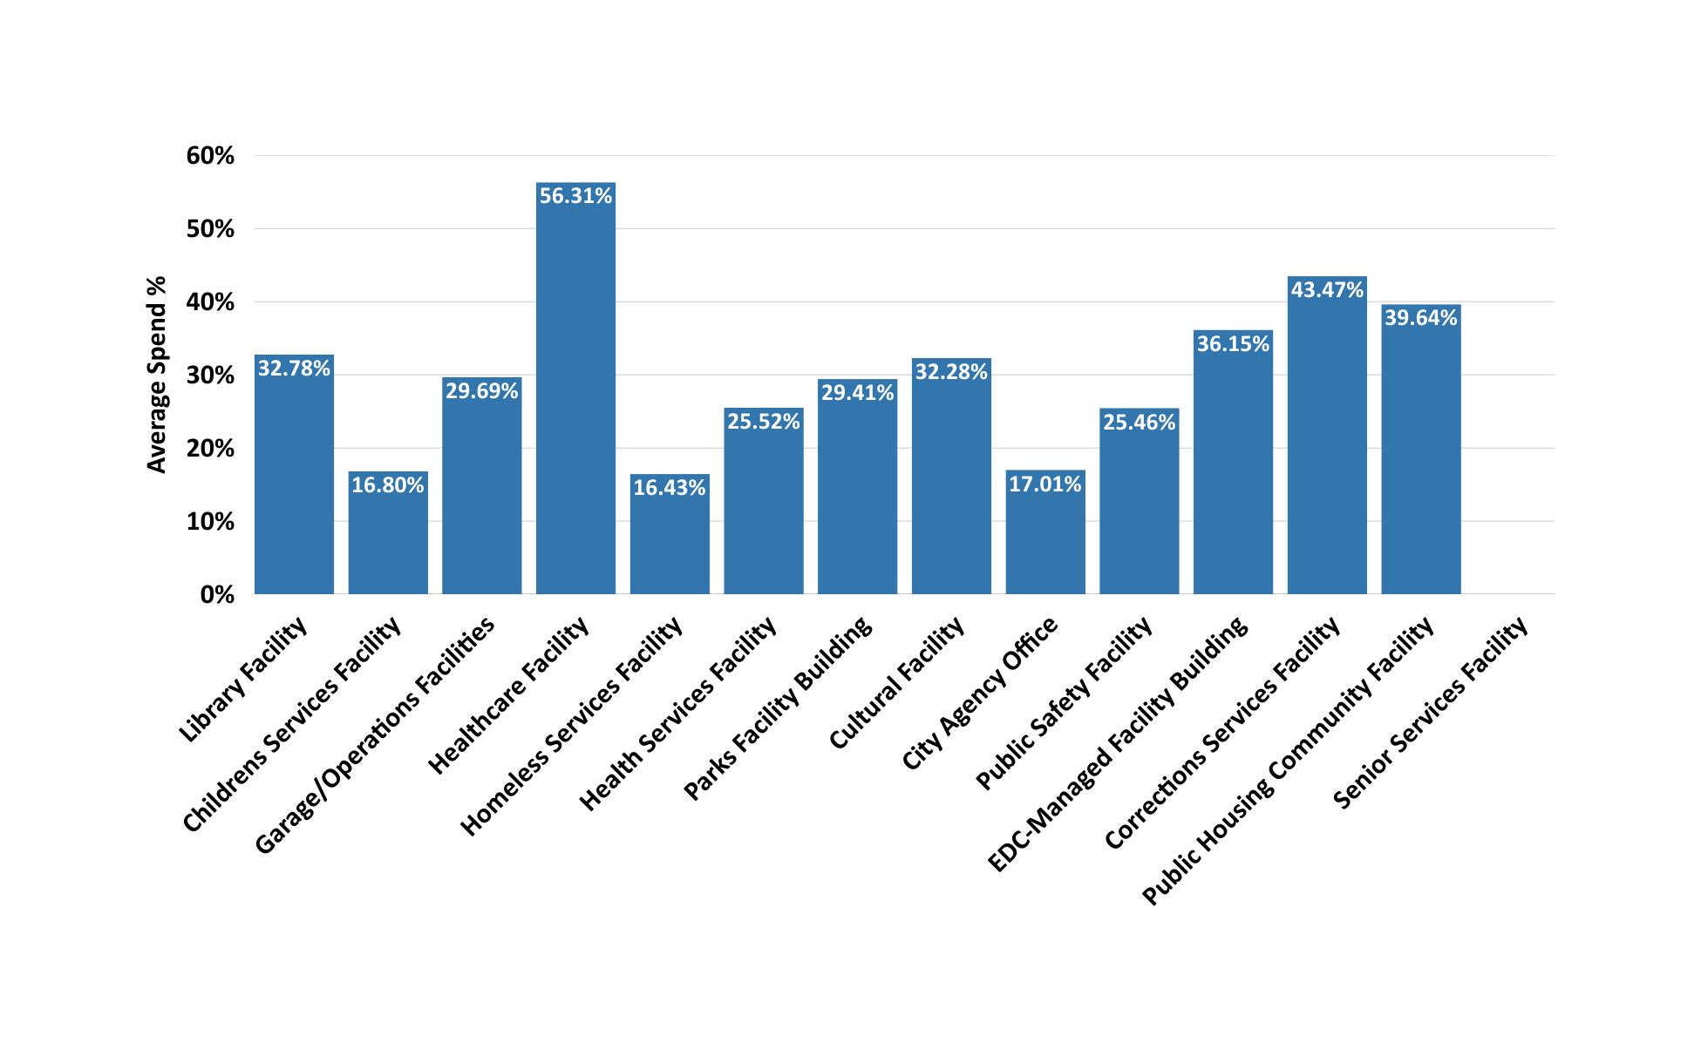
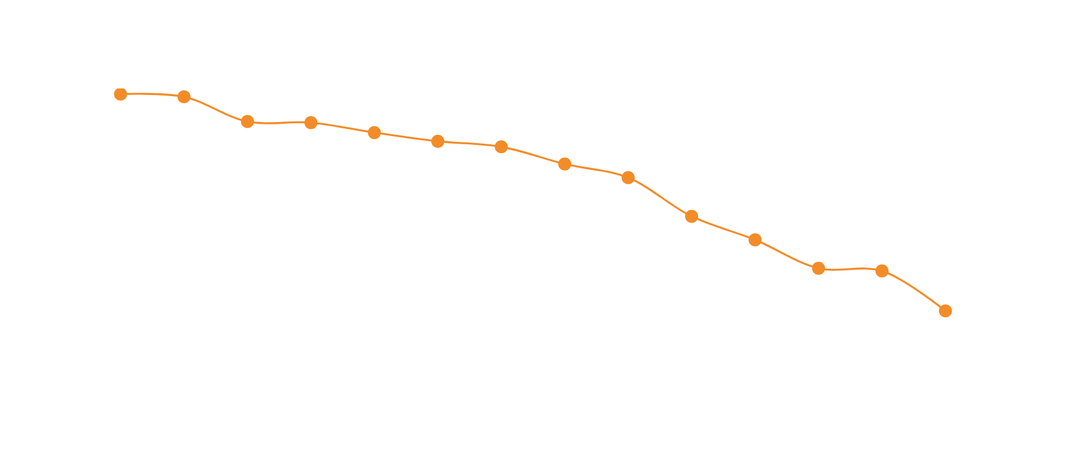
Spend vs Duration By Typology
Average Spend %
Average Duration (Days)
3000
Facilities differ in both spending pace and project length, with some typologies showing higher spend % while others show longer durations.
2500
2000
1500
Average Duration (Days)
1000
500
0

Slide 21
Spend vs Duration By Typology
Average Spend %
Average Duration (Days)
3000
Facilities differ in both spending pace and project length, with some typologies showing higher spend % while others show longer durations.
2500
2000
1500
Average Duration (Days)
1000
500
0

Slide 22
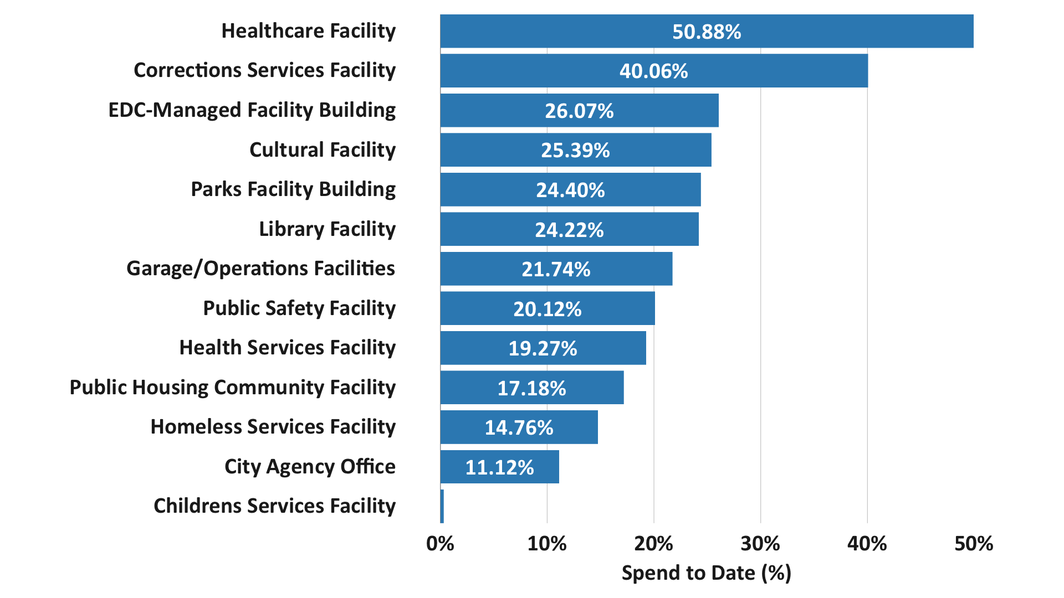
Average % Budget Spent By Typology
The bar chart shows how spending progress differs across facility types.
Highlights typologies with faster budget drawdown (Healthcare, Correction Services, EDC-Managed Facility) versus those with slower spend pace.

Slide 23
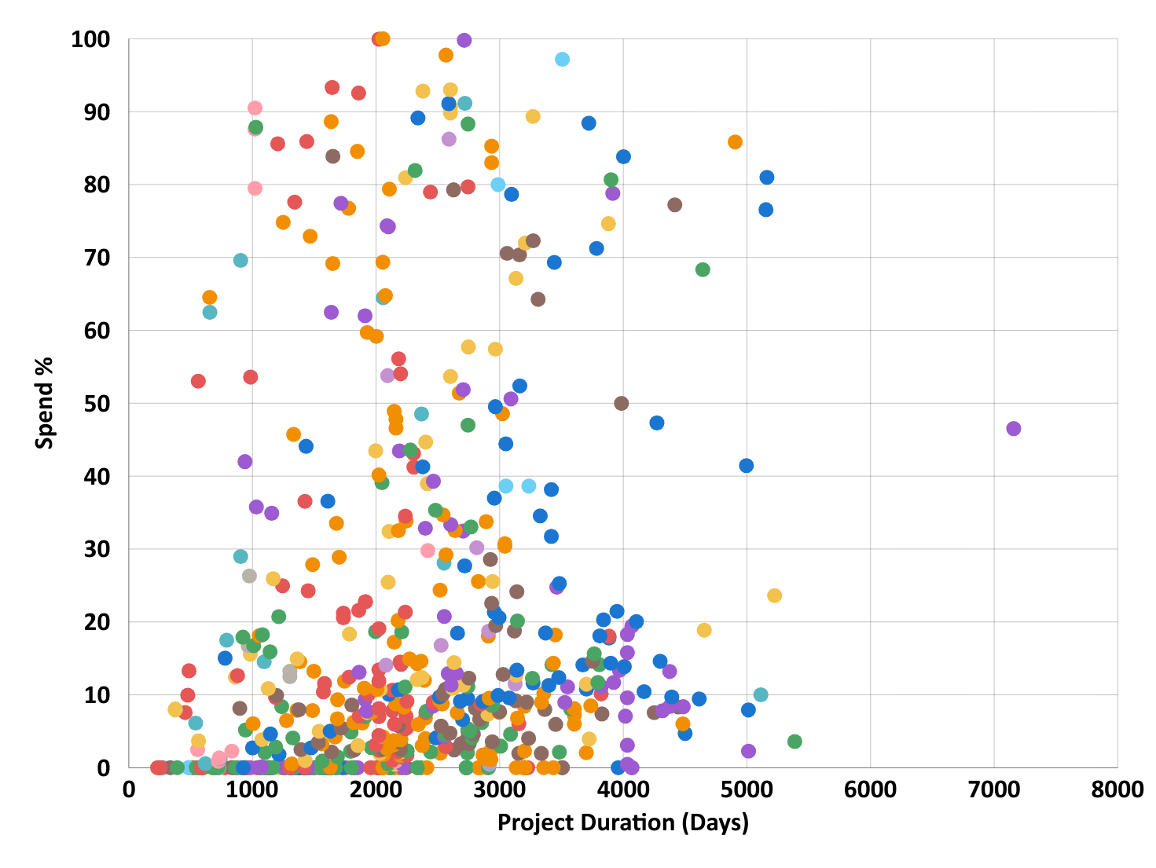
Spend vs Duration Breakdown by Typology
Typology
Library Facility
Homeless Services Facility
Parks Facility Building
Healthcare Facility
Garage/Operations Facilities
Senior Services Facility
Public Safety Facility
Health Services Facility
City Agency Office
Children's Services Facility
Cultural Facility
Corrections Services Facility
EDC-Managed Facility Building
Public Housing Facility
Spend % shows no correlation with project duration
Projects with both short and long timelines appear across all spend levels.
Duration ranges vary by typology: some facilities show wide variability while others form tighter, more consistent clusters.

Slide 24
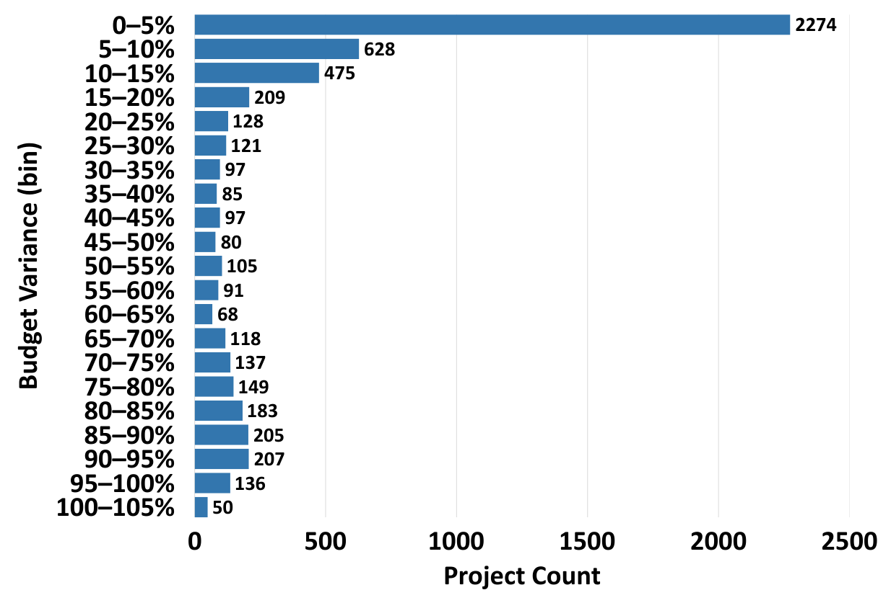
Budget Variance Distribution
  Most PB projects fall within the 0–10% budget-variance range.
  Project counts decrease steadily as variance increases.
  Only a small subset of projects appears in the higher-variance bins (50–100%).

Slide 25
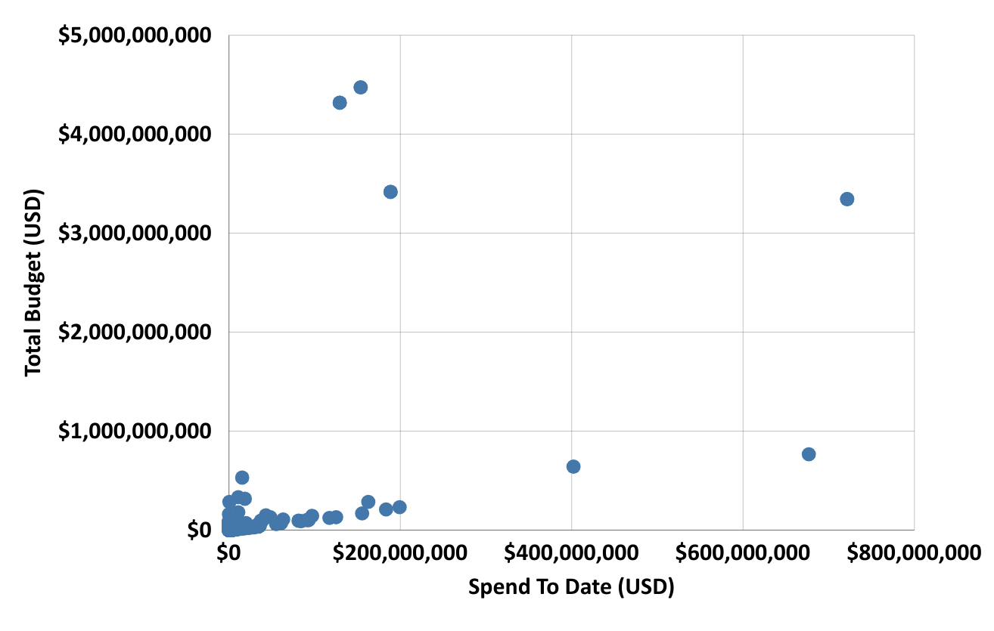
Total Budget and Spend to Date
  Scatterplot of Spend to Date vs. Total Budget with a trend line indicating the overall relationship between spending and budget size.
  Larger-budget projects show wide variation in spend-to-date, meaning budget size alone does not explain spending progress

Slide 26
Schedule Variables Analysis

Slide 27
Variables used in this analysis
Total Project Duration (Forecast Completion – Actual Design Start)
Design Phase Duration (days)
Procurement Phase Duration (days)
Construction Phase Duration (days)
Schedule Change (%)
Delay Duration (days)
Completion Rate (%)
On-Time vs Delayed Flag

Slide 28
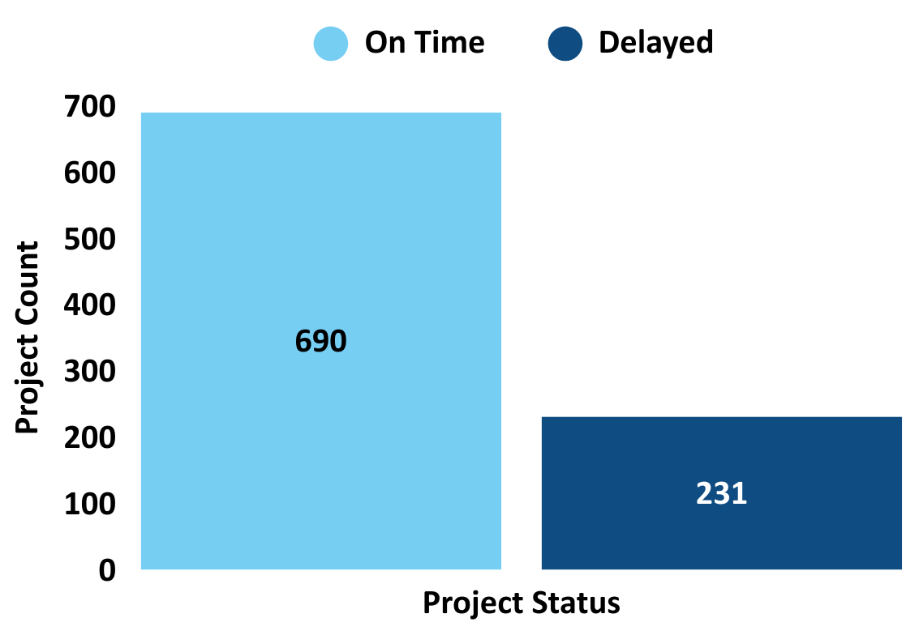
On Time vs Project Delayed Performance
  Projects are classified as “Delayed” if they fall into the longest-duration quartile.
  In the PB dataset, more projects are on time than delayed under this classification.

Slide 29
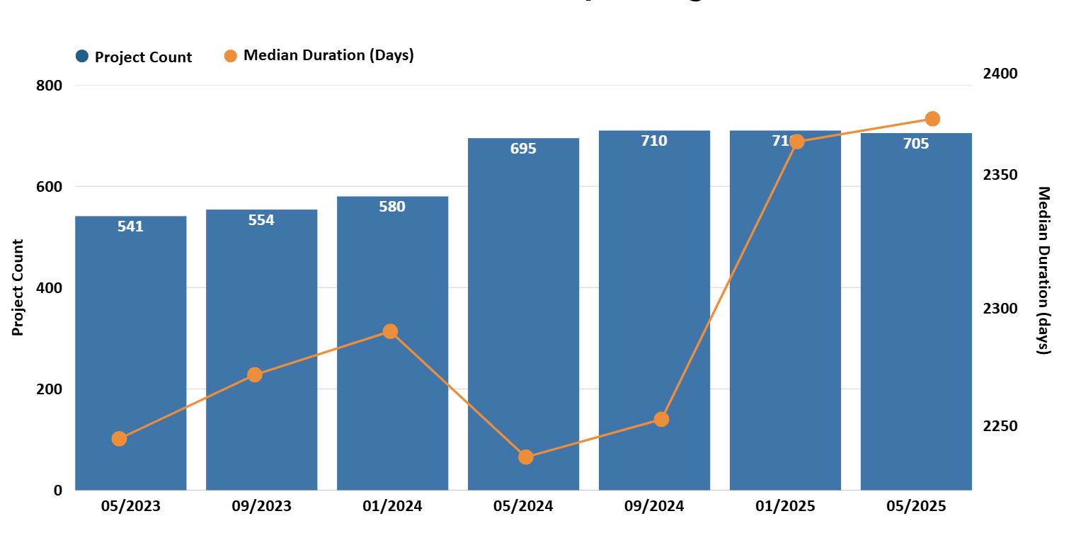
Project Count and Median Duration
(7 Reporting Periods)
  Project counts increase across 7 reporting periods, showing a growing number of active projects captured in later reporting cycles.
  Median durations remain consistently high across all periods, showing that long timelines persist with only small changes between reporting periods.

Slide 30
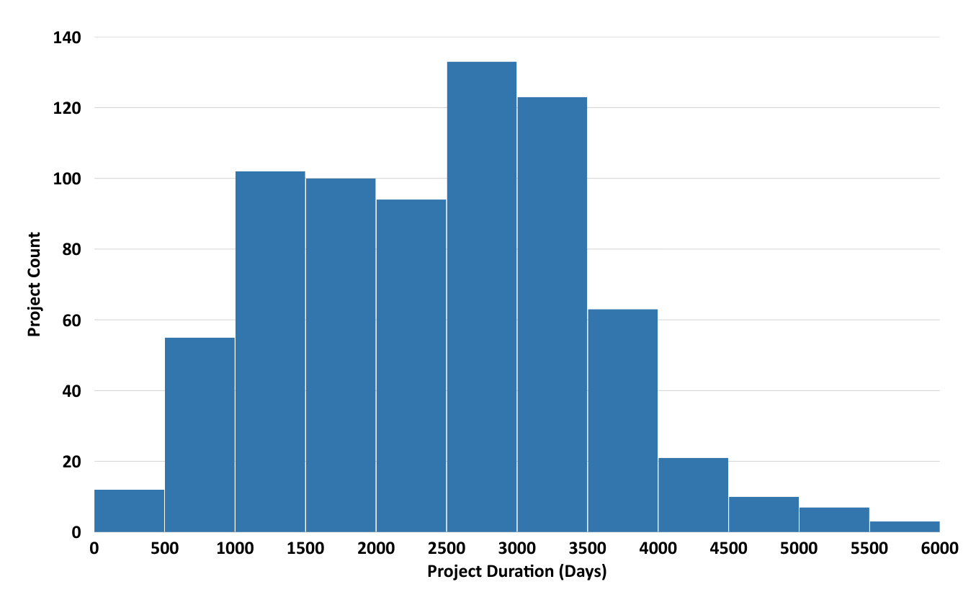
Distribution of Total Project Duration
  The distribution shows most project durations fall between 1,000–3,500 days, indicating multi-year timelines are common across PB projects.
  A smaller number of projects extend beyond 4,000 days, reflecting the upper range of durations observed in the dataset.

Slide 31
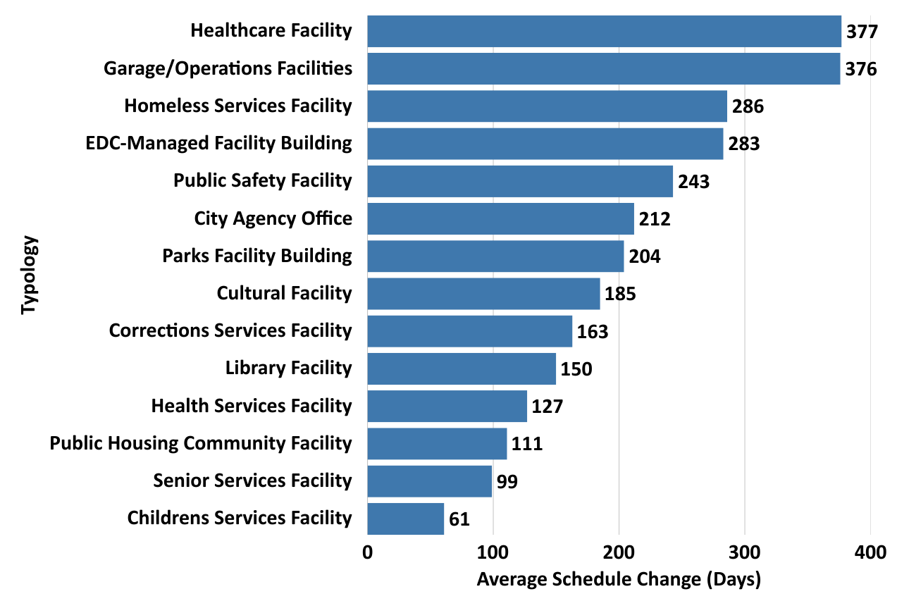
Average Schedule Change (Days) by Typology
  Average schedule change differs across typologies, with Healthcare and Garage/Operations showing the largest average change
  Several other typologies fall in mid-range values, while Children’s Services and Senior Services show the smallest changes.

Slide 32
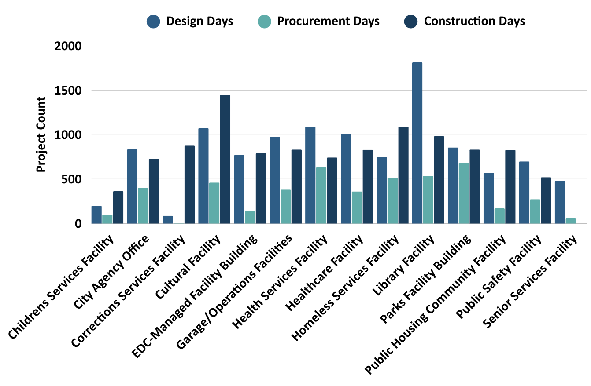
Average Phase Duration by Typology
  Construction is the longest phase across nearly all typologies, with Library, Cultural, and Homeless Services Facilities showing the highest durations.
  Design and procurement durations vary widely by typology, producing distinct phase profiles across facility types.

Slide 33
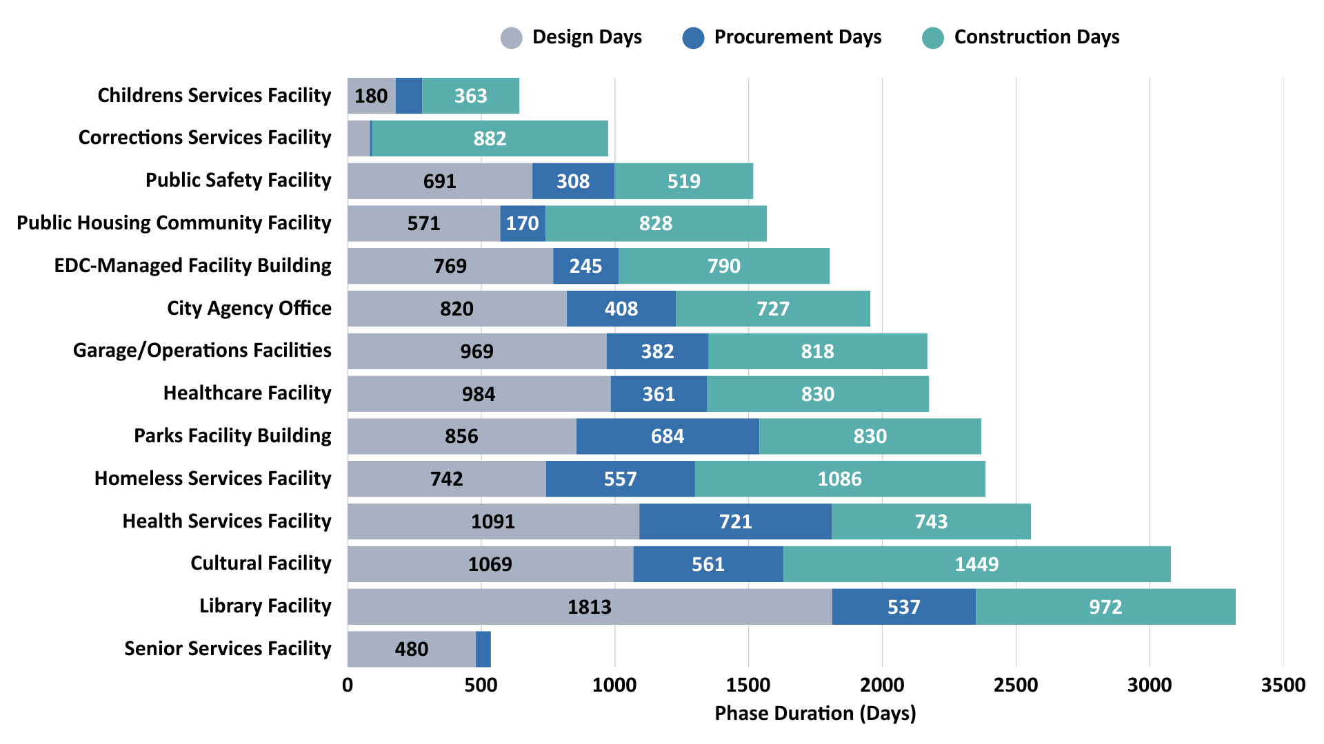
Phase Lengths by Typology
Project duration varies by typology, with Library, Cultural, and Health Services Facilities taking far longer than other facility types.
Construction is the dominant driver of total time across typologies, with some (like Library and Cultural) also slowed by long design phases.

Slide 34
Predictive Modeling

Slide 35
Predictive Modeling: Forecasting Delay Risk
Purpose of the Model
This predictive model is developed to estimate the likelihood a Public Buildings project will experience a schedule delay.
By learning from thousands of historical project records, the model helps us identify higher-risk projects earlier in the process.
How the Model Works:
The model ues the whole PB dataset and analyzes patterns from past PB projects ( size, spending behavior, agency characteristics, and typology)
Then, it assigns each new project a delay risk score, indicating how similar it is to projects that fell behind schedule in the past
Higher scores suggest projects that may require greater attention or early intervention.

Slide 36
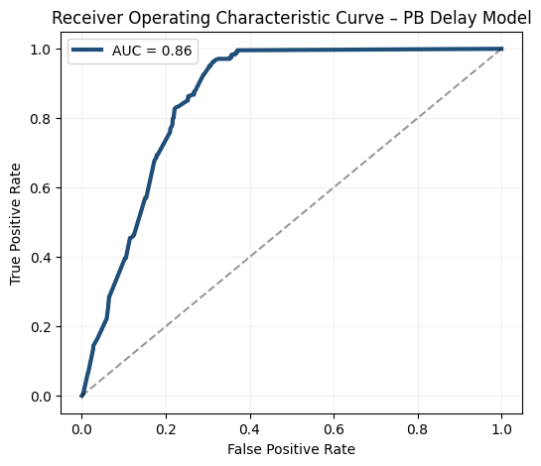
Predictive Modeling: Forecasting Delay Risk
The curve demonstrates how well the model separates projects likely to be delayed from projects likely to remain on time. A more curved line indicates stronger performance.
The Area Under the Receiver Operating Characteristic Curve (AUC) is a measurement between 0 and 1 that summarizes how well the model performs.
0.5 means the model is no better than random guessing
1.0 means the model perfectly separates delayed and on-time projects
→ Our AUC is approx 0.85, which indicates strong and reliable performance.
→ The model is effective at ranking projects by their risk of delay, which makes it a possible valuable decision-support tool.

Slide 37
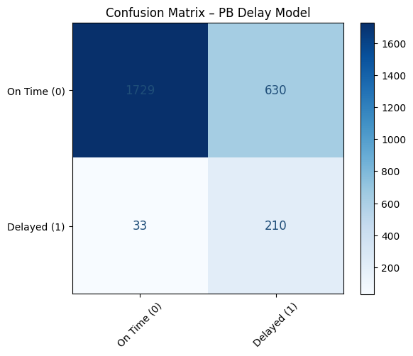
Confusion Matrix – PB Delay Model
This is a confusion matrix shows how well the model predicts project delays by comparing: what actually happened vs.what the model predicted.
→ It helps us understand where the model performs well and where it makes mistakes, giving a clear picture of reliability.
Correctly identified on-time projects: 1,729
Correctly identified delayed projects: 210
Projects predicted as delayed but actually on time: 630
Projects predicted as on time but actually delayed: 33
→ The model is very strong at identifying on-time PB projects, which is useful for filtering out low-risk cases.
→ As expected for early-stage predictors, some delays are missed because late-stage issues (e.g., field conditions, utilities, change orders) cannot be observed in early data.

Slide 38
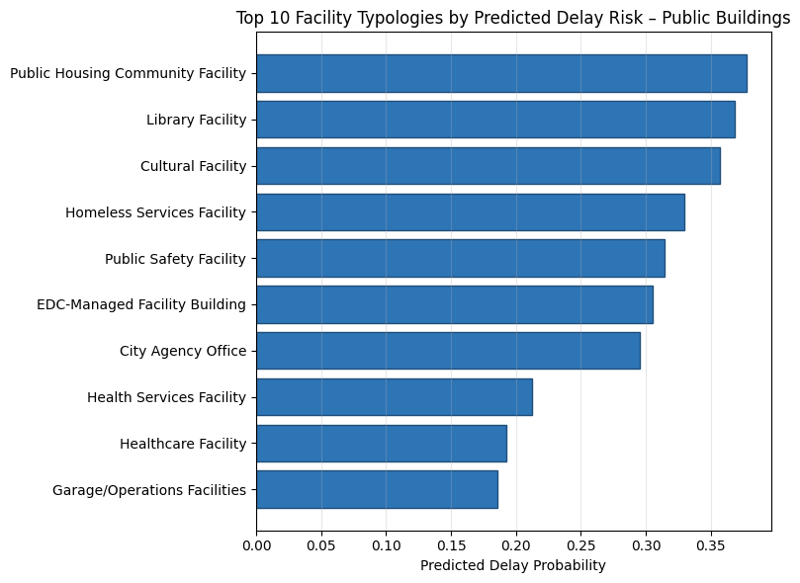
Top 10 Typology by Delay Risks
High-risk PB typologies include:
Public Housing Community Facilities
Library Facilities
Cultural Facilities
Homeless Services Facilities
Public Safety Facilities

Slide 39
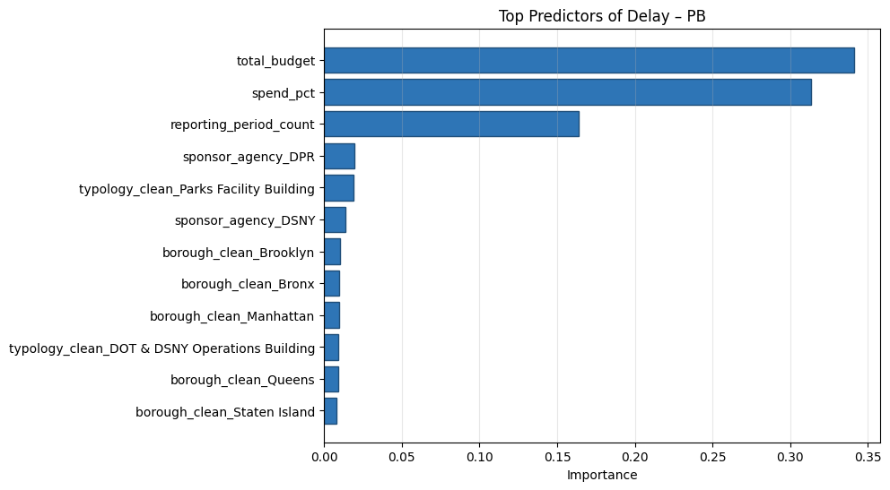
Top Predictors of Delay
Project Size (total budget) – Larger PB facilities are much more likely to experience delays.
Early Spend % – Slow early spending signals potential execution issues and future delays.
Reporting Period Count – Older projects with more reporting cycles tend to accumulate risks.
Sponsor Agency – Agencies with larger or more complex building portfolios show higher risk.
Typology – Certain public-building categories ( Parks Buildings, DOT/DSNY Ops buildings) exhibit structural schedule challenges.
Borough – Geography still matters, but it is a smaller predictor compared to budget and spend behavior.
→ Delay risk in Public Buildings is driven most by project scale and early spending pace, followed by agency characteristics and facility typology, with borough effects being modest.

Slide 40
Conclusion

Slide 41
Conclusion
Conclusion
The dashboard was designed for public transparency, not analytics, requiring extensive cleaning, joining, and manual labeling.
With only seven reporting periods and limited variables, we cannot make strong conclusions yet, only demonstrate the dataset’s emerging analytical potential.
Early analyses show clear promise for identifying budget and schedule risks as reporting periods mature.
Future enhancements - agency PB/Infra label, agency typology automation, and external dataset integration via FMSID, will significantly expand analytical value.
Point 2
Description

Slide 42


Fordham University / Gabelli School of Business x Town+Gown:NYC @ NYC DDC + NYC Mayor’s Office of Operations
THANK YOU SO MUCH!

