Slide 1

Che391 Pilot-Plant Design for Biomass Pyrolysis
Pilot-Plant Design for
Biomass Pyrolysis
Sungone Philip Seo

Slide 2






Project Purpose
Biochar Price
Vendors
Operators
Customers
PYREG
ETIA Ecotechnologies
Bioforcetech
Pyrocal
Airburners
Quonset Soil Solutions
Standard Biochar
Ephrata Borough Authority
Downer

Slide 3
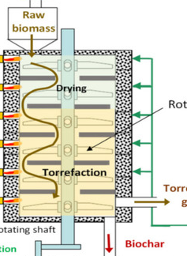
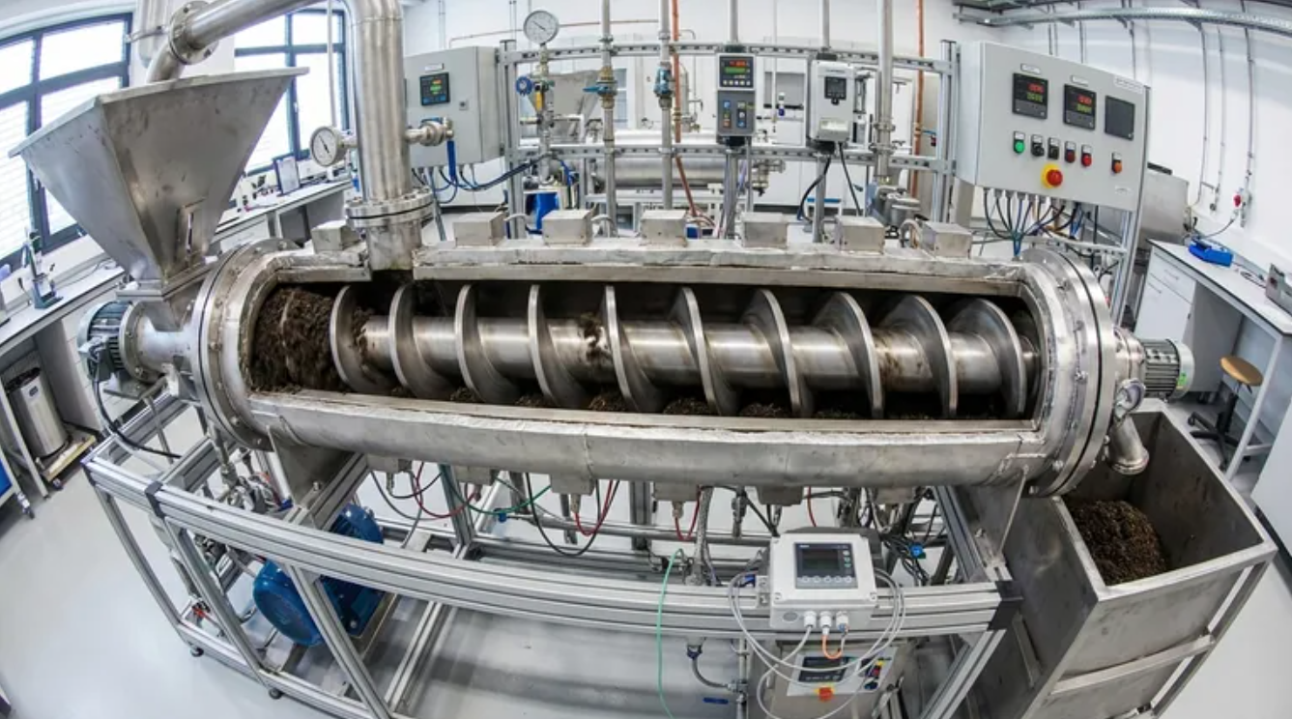
Auger vs. Hearth
Auger Reactor
Hearth Reactor
Biomass is moved by a rotating screw
Tightly sealed
Biomass is moved by gravity
Mechanically simpler but larger

Slide 4

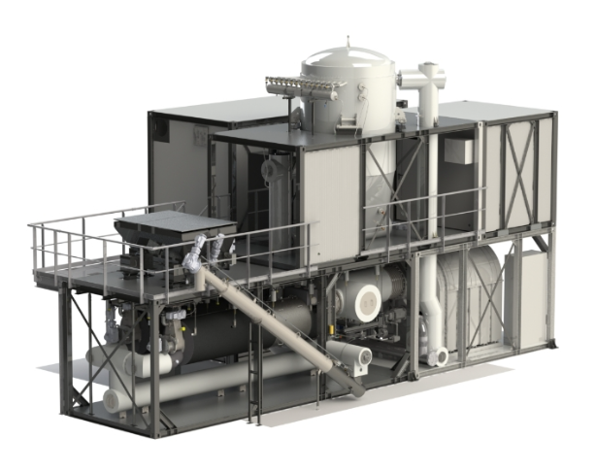
Vendor 1: PYREG
https://pyreg.com/
Company based in Germany making biomass and biosolids pyrolizers
Country
Germany
Founded
2009
Portfolio
Installed over 50 plants and EBC type-certified (European Biochar Certificate)
HQ
Rhineland-Palatinate, Germany
Product
PX500, PX1500, PX6000
Reactor
Auger

Slide 5
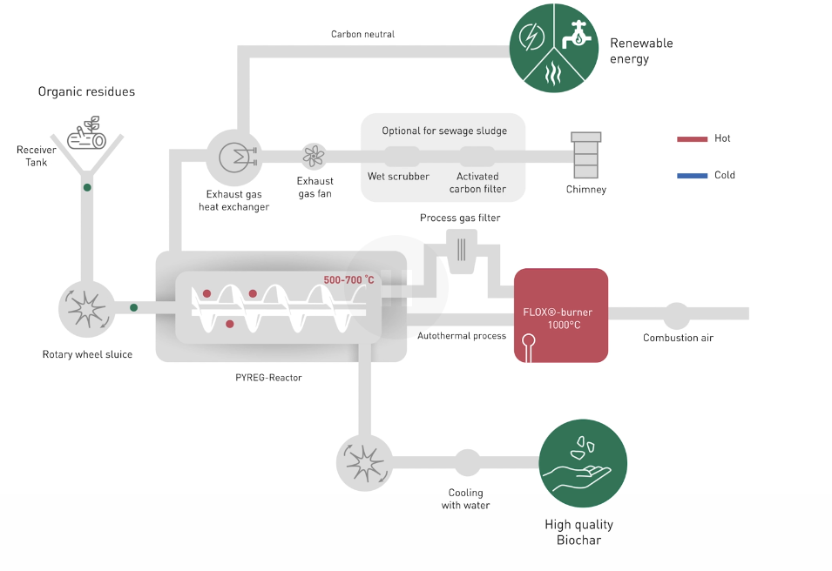
Products PX500/1500/6000
3 products
Specifications | PX500 | PX1500 | PX6000
Footprint | 12m*6m*5m | 13m*7m*7.8m | 21m*14m*7.5m
Temperature | 500~700 °C
Feedstock | Hay, wood chips, nut shells, cardboard, etc
Capacity | 0.15t/h | 0.4125t/h | 1.65t/h
Power Consumption (Max) | 12kW (E) | 38kW (E) | 120kW (E)
Heat Output | 200kW (Q) | 600kW (Q) | 2,500kW (Q)
Remark | Has testing center for personal analysis
Product Specifications

Slide 6
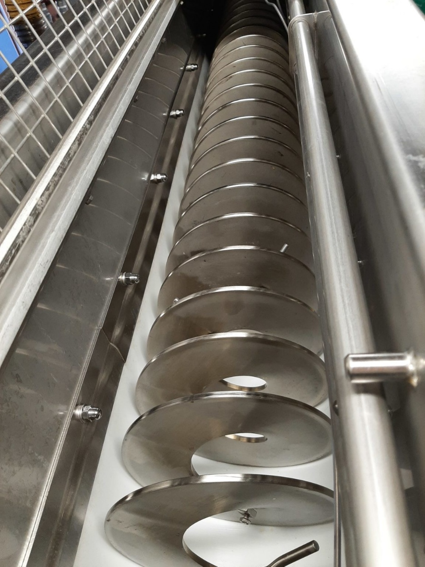

Vendor 2: ETIA
https://etia-group.com/
French engineering group that provides tailor-made electrically heated reactors
Country
France (became part of Norwegian group in 2019)
Founded
1989 (First biochar plant in 2016)
Portfolio
150 delivered machines in 35 countries (Including U.S)
HQ
Paris
Product
Biogreen (electrically heated screw conveyor)
Reactor
Auger-based

Slide 7
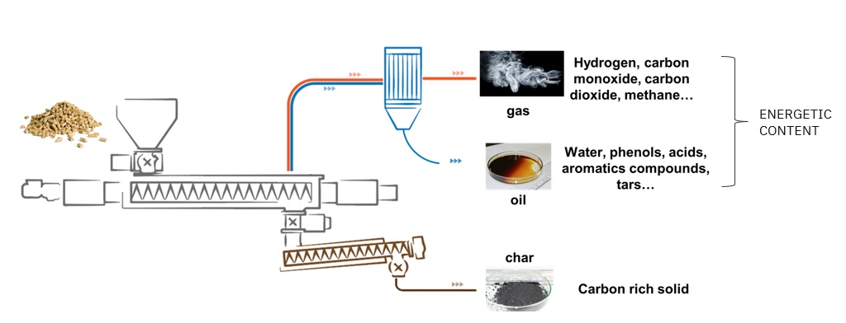

Product Biogreen
Electrically heated screw conveyor
Specifications
Footprint | Tailor-made solutions
Temperature | ~850 °C
Feedstock | Any kind of non-ferrous dry material (Mostly biomass, plastics, waste)
Capacity | ~1t/h
Remark | Heated by low voltage current
 | Residence time can be controlled by screw rotation speed
 | Easy and reliable control of temperature/residence time
Spirajoule Specifications

Slide 8
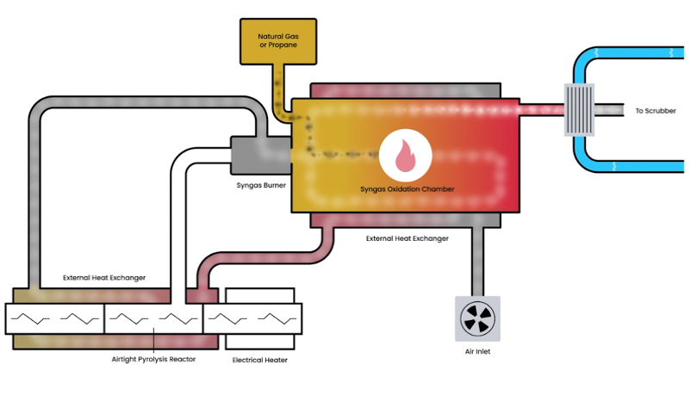
Vendor 3: BIOFORCETECH
https://bioforcetech.com/
Based in San Francisco. All completed projects are based on biosolid pyrolysis
Country
U.S
Founded
2012
Portfolio
Installed 14 plants in US and Italy
HQ
San Francisco
Product
Sigma
Reactor
Auger

Slide 9
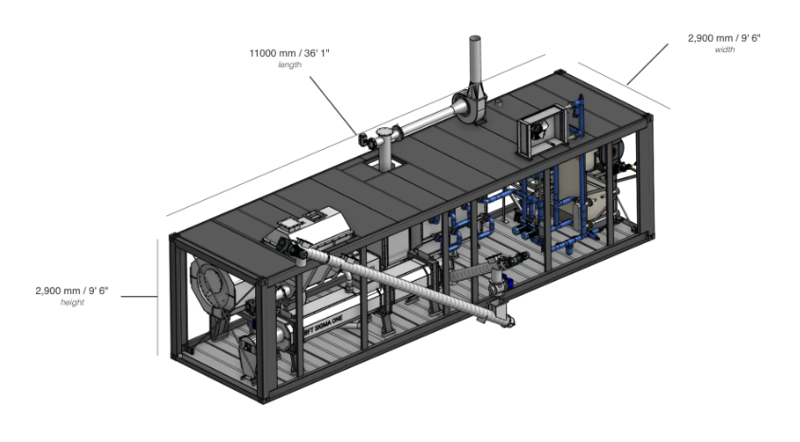
Product Sigma
Specifications | Sigma
Footprint | 11m*2.9m*2.9m
Temperature | 500~700 °C
Residence Time | 10-30 minutes
Empty Weight | 13,500Kg
Feedstock | Biosolids, sewage sludge, wood chips, nut shells, manure (Particle size: ~30mm; Moisture: 5-35%)
Capacity | ~0.11t/h
Remark | Destroys PFAS
Sigma Specifications

Slide 10

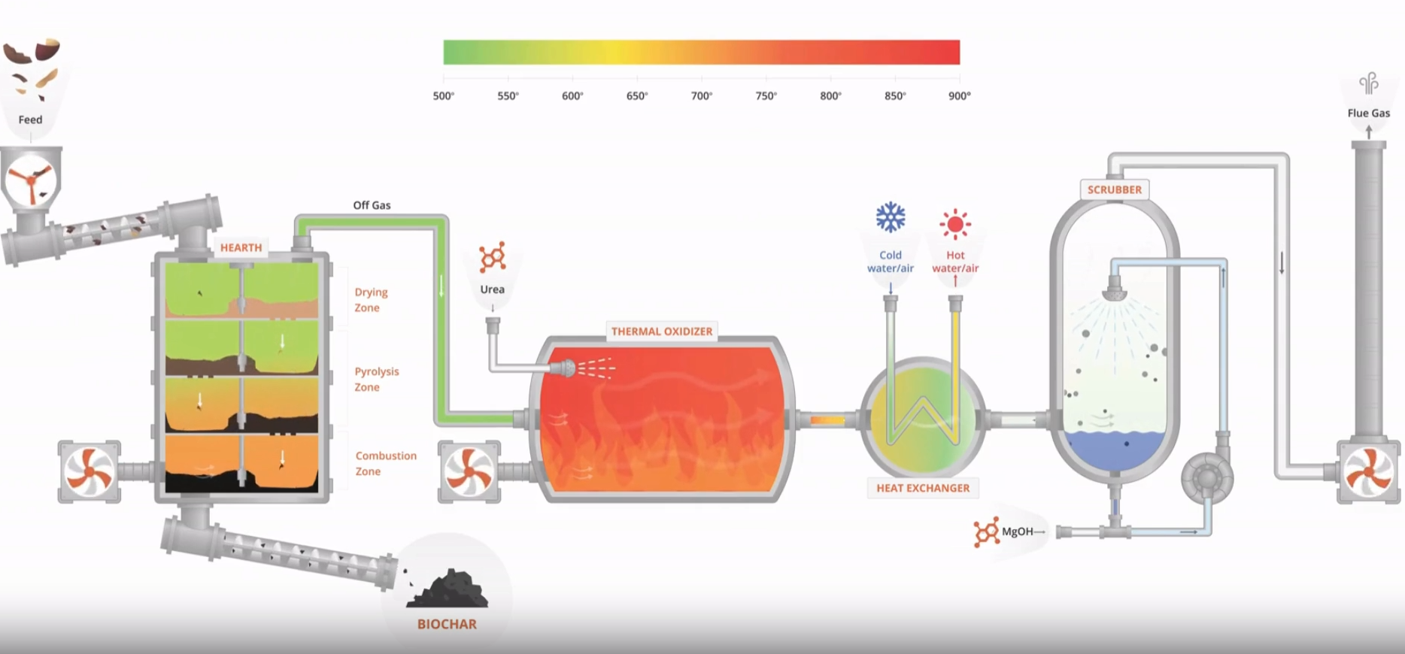
Vendor 4: PYROCAL
https://www.pyrocal.com.au/
Based in Australia, hearth-based reactors
Country
Australia
Founded
2014
Portfolio
Around 20 units in 8 countries
HQ
Toowoomba, Australia
Product
CCT12, CCT20
Remark
Hearth-based reactor

Slide 11
Product CCT12/CCT20
Specifications | CCT12 | CCT20
Footprint | 15m*4m*5m | 32m*14m*9m
Temperature | -
Feedstock | Biomass, biosolids (Moisture: ~12%; Particle Size: 10mm*10mm)
Capacity | 0.2t/h | 0.6t/h
Power Consumption | 15~30kW (E) | 40~60kW (E)
Heat Output (Max) | 480kW (Q) | 1440kW (Q)
Remark | Has testing center for personal analysis
Specifications

Slide 12

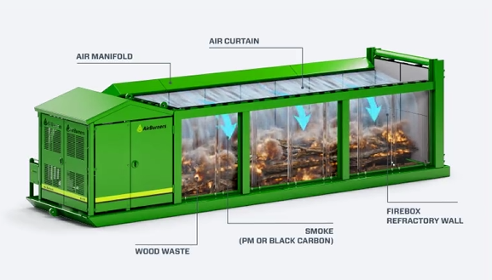
Vendor 5: Air Burners
Portable “closed circle recycling” technology for on-site biomass disposal
Country
United States
Founded
1997
Portfolio
30+ international markets
HQ
Palm City, Florida
Product
FireBox Series
Reactor
Air Curtain Burner

Slide 13
Vendors & Products
Average Electricity Consumption:
88kW (for 1t/h capacity)
Average Heat Output:
1820kW (for 1t/h capacity)
Vendors | Product | Volume | Temperature | Feedstock | Capacity | Electricity Consumption | Heat Output
ETIA (France) | Biogreen | - | ~ 850 °C | Biomass, Biosolids | 1t/h | - | -
PYREG (Germany) | PX500 | 360 m³ | 500~700 °C |  | 0.15t/h | 12kW | 200kW
 | PX1500 | 710 m³ |  |  | 0.4125t/h | 38kW | 600kW
 | PX6000 | 2205 m³ |  |  | 1.65t/h | 120kW | 2,500kW
BIOFORCETECH (San Francisco) | Sigma | 92.5 m³ | 500~700 °C |  | 0.11t/h | - | -
PYROCAL (Austrailia) | CCT12 | 300 m³ | 500~700 °C |  | 0.2t/h | 15~30kW | 480kW
 | CCT20 | 4032 m³ |  |  | 0.6t/h | 40~60kW | 1,440kW
Air Burners (Florida) | FireBox S100 | 44 m³ | ~ 1000 °C | Biomass | 3-5t/h | - | -
 | FireBox S200 | 69 m³ |  |  | 7-9t/h
 | FireBox S300 | 128 m³ |  |  | 11-13t/h
Specifications
Airburners’ main focus is on making portable reactors for disposing biomass through controlled burning
Average Volume:
2420 m³ (for 1t/h capacity)
Average Temperature:
620 °C

Slide 14

Operator 1: Standard Biocarbon
4 PYREG units operating in Maine using residual wood from Lumber Production (Pleasant River Lumber)
4.3 million tons of low-grade wood demand disappeared since 2014
Vendor
PYREG
Founded
2020
Project Cost
$5.6 Million
HQ
Portland, Maine
Feedstock
Residual wood product from lumber production
Units
4 units of PX1500
Startup
2022

Slide 15

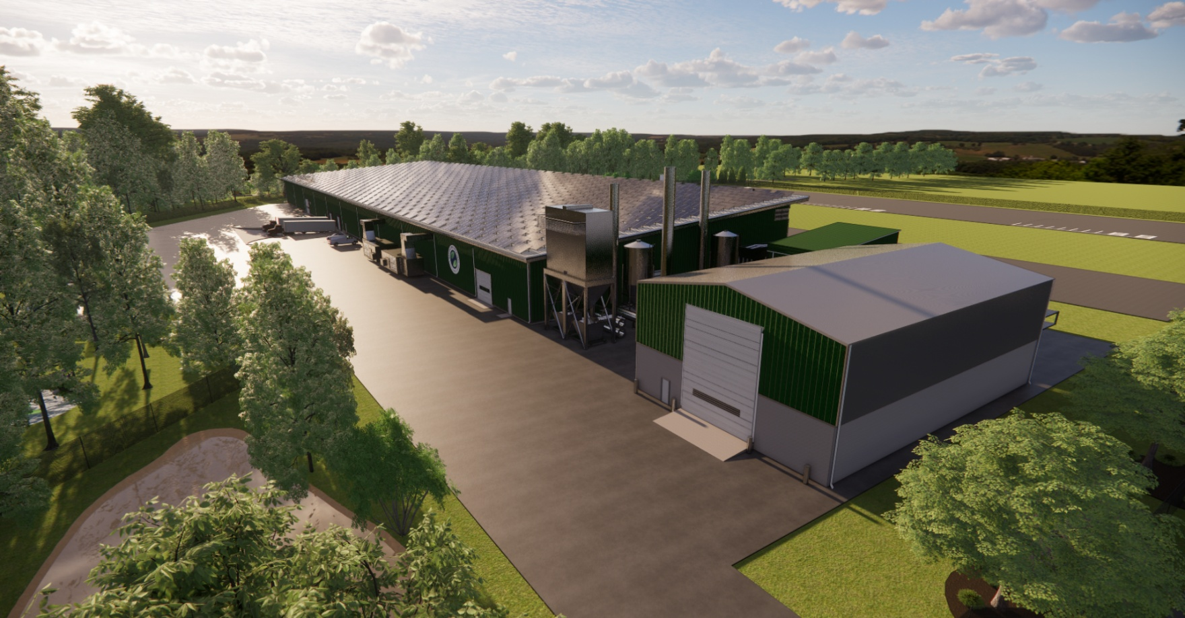
Operator 2: Quonset Soil Solutions
https://qssbiochar.com/our-products/
4 operating units from ETIA in Rhode Island using forest by-products to produce 6,000 ton/year biochar
Vendor
ETIA
Founded
2023
Project Cost
$27 Million
HQ
Cranston, Rhode Island
Feedstock
Forest by-products
Units
4 Biogreen Reactors
Startup
2025

Slide 16


Operator: Public Agencies
Vendor
Bioforcetech (Dryers), PYREG (Pyrolizers)
Vendor
BluSkyCarbon Inc.
Location
Ephrata, Pennsylvania
Location
Minneapolis
Project Cost
Not Public
Project Cost
Not Public
Feedstock
Dewatered biosolids (wastewater treatment)
Feedstock
Urban wood waste
Startup
2025
Startup
2025

Slide 17
Pyrolizers in Use
Vendors | Product | Operator | Project
 |  |  | Project Cost | Business Type | Feedstock | Feedstock Consumption | Startup
ETIA (France) | Spirajoule | Quonset Soil Solutions (Rhode Island) | $27 Million | Private | Biomass | 35,000 ton/year (Estimated) | 2025
PYREG (Germany) | PX500 | Standard Biochar (Maine) | $5.6 Million | Private | Biomass | 12,000 ton/year | 2022
 | PX1500
 | PX6000
BIOFORCETECH (San Francisco) | Sigma | Ephrata Borough Authority (Pennsylvania) | - | Public | Biosolids | 4,000 ton/year | 2025
BluSkyCarbon (Canada) | Vulcan II | Minneapolis City | - | Public | Biomass | 3,600 ton/year | 2025
Specifications
Project Cost per 1,000 ton/year:
$620,000

Slide 18
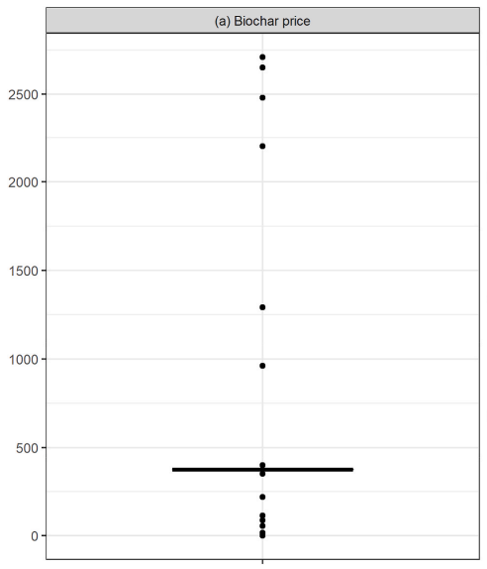
Biochar Price
Campion, N.; Sproul, E.; Oates, L.; Krapf, M.; Yamaji, K.; Yeo, J.-Y.; McElroy, E. E.; Ingraffia, M.; Davidson, M. R.; Kohler, H.-P. E.; et al. Techno-Economic, Environmental and Social Assessments of Biochar Systems: A Systematic Review. J. Clean. Prod. 2023, 405, 136296.
Systematic review on biochar price (published 2023)
Range
$17.15
$2,710 (per ton)
~
Median
$400
median

Slide 19
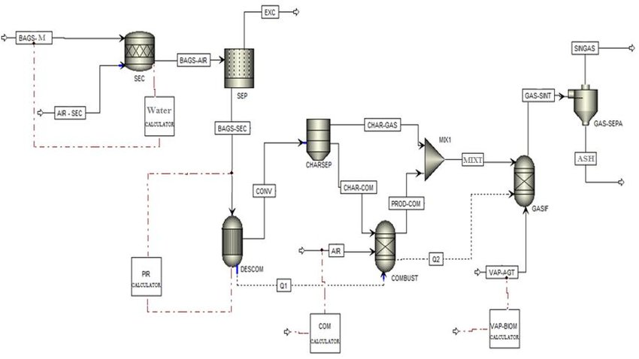
Future Work
Process Simulation
Better Economic Analysis
Optimization

Slide 20
Thank you

