Slide 1
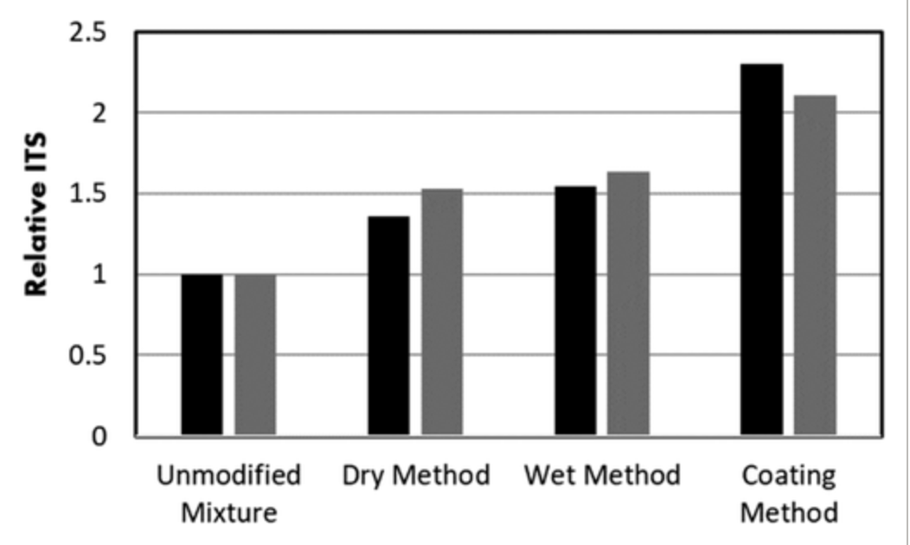
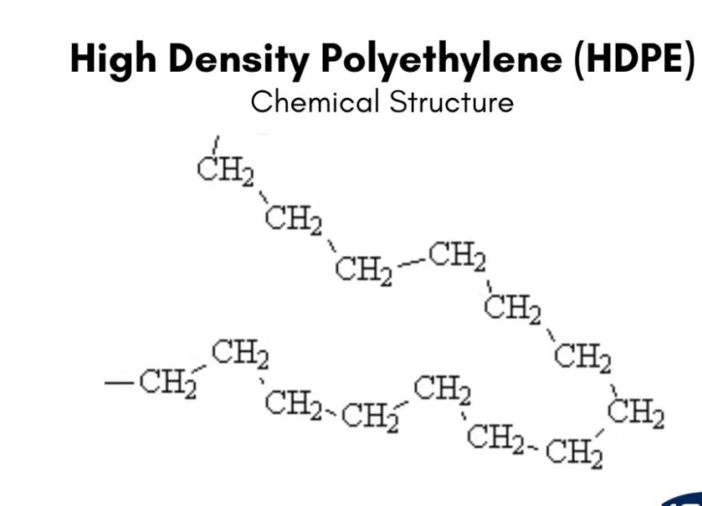
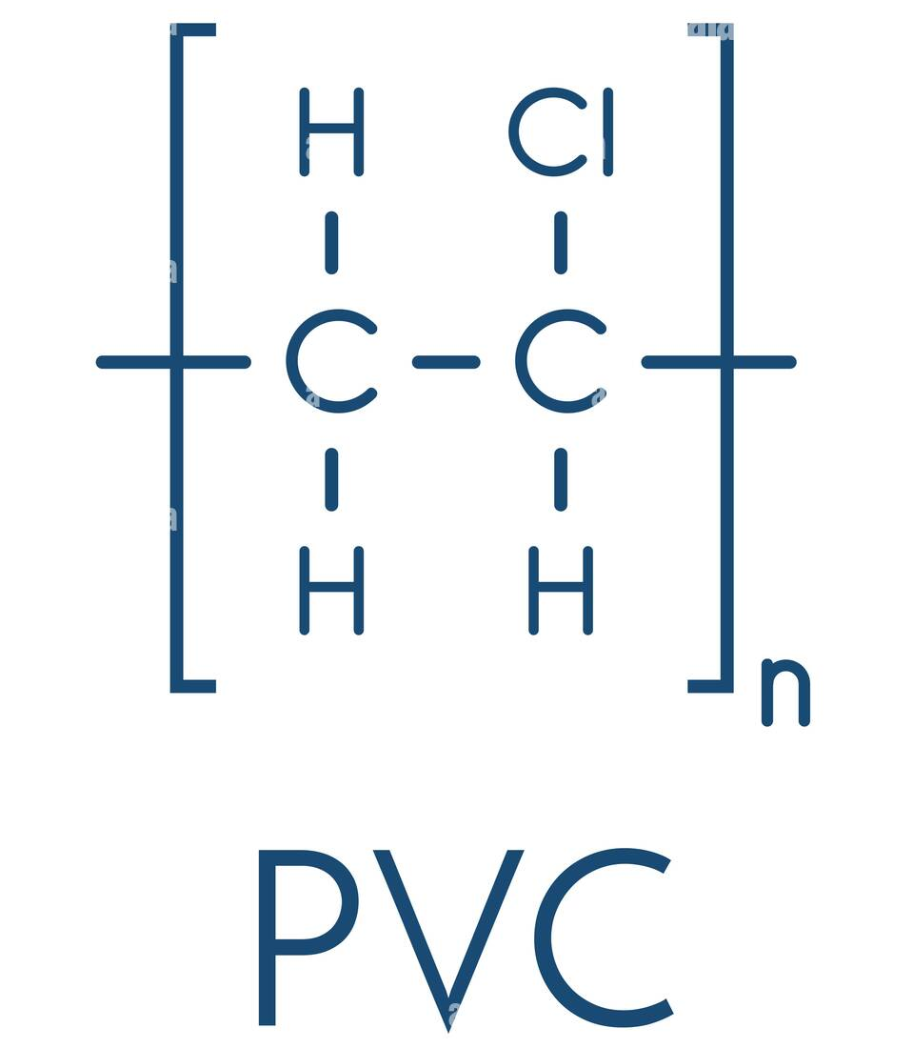
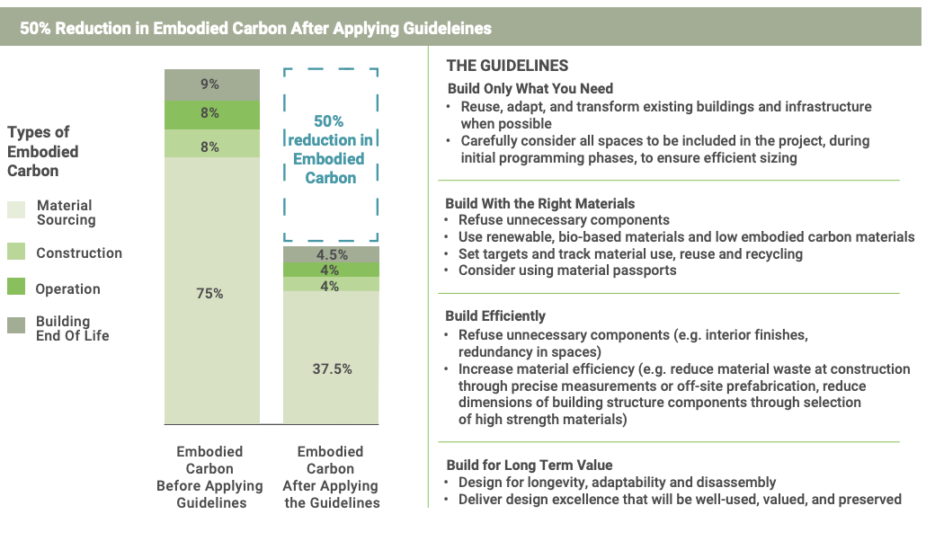
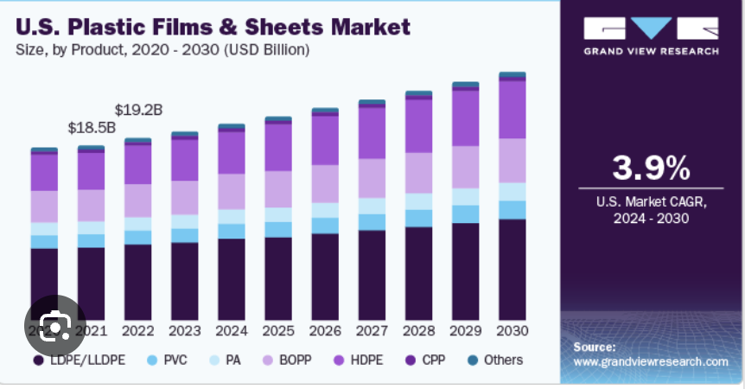
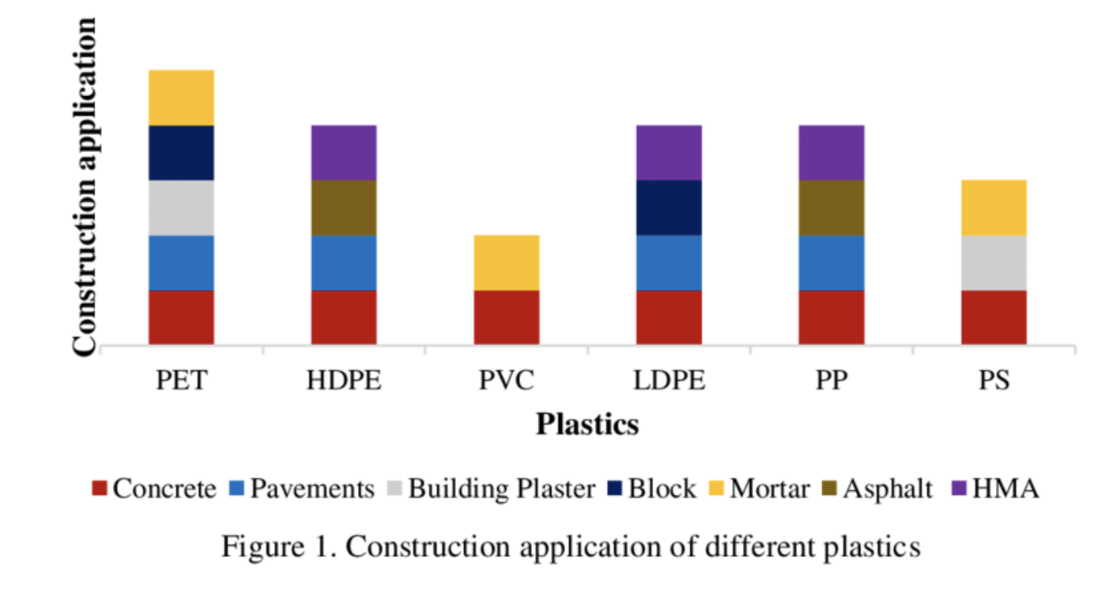
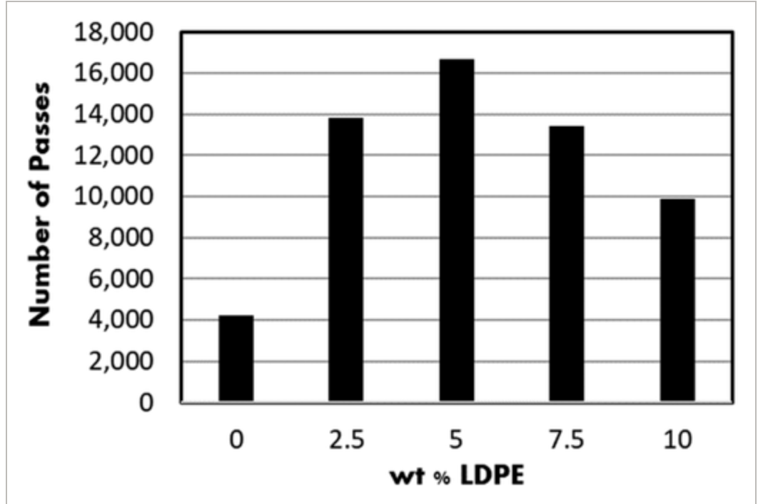
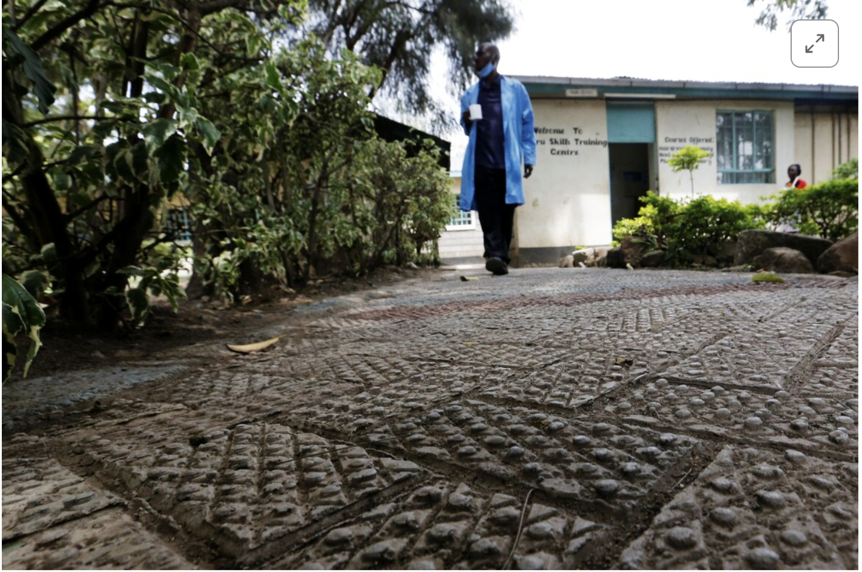
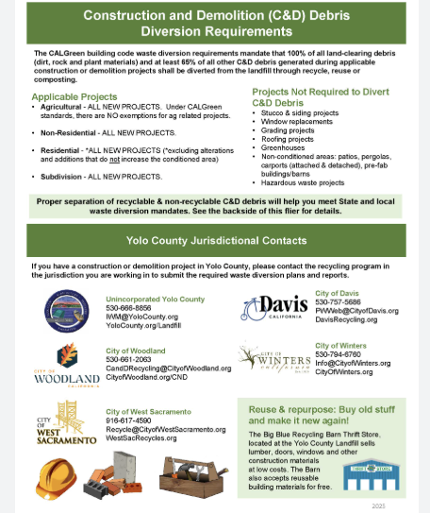

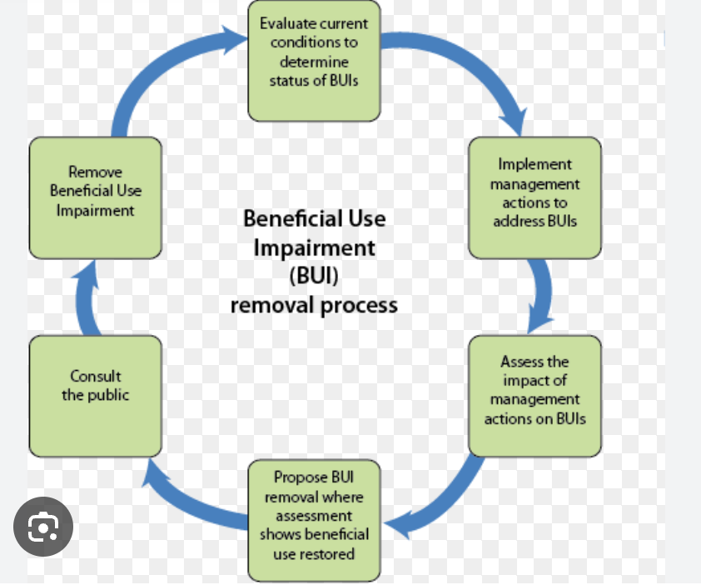
Beneficial Use Potential Of Construction Plastic (PVC, HDPE) In NYC
Saad Sattar, Etka Pakel, Zeedan Mir
Background/Material Properties
Construction plastics such as PVC (Polyvinyl Chloride) and HDPE (High-Density Polyethylene) are widely used in construction for for pipes,membranes, sheathing etc. causing them to be major contributors to the construction and demolition waste stream.
These plastic possess properties of being durable, long lasting and resistant to weather. These properties make them to be persistent in landfills however also causes them to be useful in construction.
These plastics appear in vertical building systems such as plumbing, insulation and siding as well as horizontal infrastructure such as water mains, gas pipes and drainage systems.
NYC generates hundreds of thousands of tons of construction and demolition plastic with PVC and HDPE being large contributors.
Beneficial options part 1
Recycle into new construction products
Use as Aggregate in plastic (Concrete and Asphalt)
Manufacturing Lightweight Plastic Bricks or Blocks
Energy Recovery
Reuse in landscaping and infrastructure
Recycle into new construction products
They could convert the plastic into new constructions products by cleaning and shredding it and this will reduce the amount of landfill
The benefit of using the plastic again is the idea of creating durable products for construction, and lowering the cost of the material
Use as Aggregates in plastic (Concrete and Asphalt)
The plastic was shredded to replace the sand and gravel in the concrete
The benefit options of this is the idea of reducing concrete cracking, improves the performance of the asphalt concrete and lowers the weight of the material
Manufacturing Lightweight Plastic Bricks or Blocks
The material is melted and compressed into interlocular bricks that can be used for retaining walls, walkways, small structures, and low-house costing
Reduces the amount of the carbon produced, good for low-cost housing, and finally creates water resistant bricks and blocks
Beneficial options part 2
Energy Recovery
The plastic that can’t be recycled is used as fuel source in facilities that makes the solid waste into a produce energy in the form of electricity and heat
This supports new york zero waste goal, reduces fossil consumption, and creates electricity and heat from materials that can’t be recycled
Reuse in landscaping and infrastructure
They need to be cleaned, shredded, and extruded into boars or posts
The purpose of this is to use it in outdoors as a substitute element for making the outdoor objects
It makes the object more durable, weather resistant from water as water can’t rot the plastic unlike wood, reduces the maintenance needed, and it's great for new york city weather where the material can’t be damaged from salts used for snow or the water freezing in the fence.
NY specific content
For a material to be considered as a solid waste BUD(Beneficial Use Determination) needs to be granted for the particular waste of that material
Without the BUD, the material is more tightly regulated/limited if it is reused from demolished plastic
For a facility to handle demolition/construction debris it needs to be registered as a CDFHRF(Construction & Demolition Debris Handling/Recovery Facilities)
The only construction debris that could enter to these factories are the uncontaminated ones
Uncontaminated material is a material that isn’t exposed to poisonous and polluting material
If a city has a population of more than 1 million they could only recycle or reuse 50% of them by its weight under the Senate bill, A1802A
Conclusion
HDPE appears to have more circular reuse potential as it can be melted down and formed repeatedly without losing strength, making it ideal for recycled lumber, decking and piping.
- PVC on the other hand, is preferable in longer lasting applications as it's more durable and chemically resistant but because it's made of chlorine and processing additives it's less viable for mechanical recycling and potentially hazardous when recycled.
- Research shows plastics can be used in construction (i.e polymer concrete, plastic aggregate, pavement bases) however, this reduces compressive strength and changes permeability which suggests recycled plastics are better used in smaller applications not structural or not load bearing.
-The construction industry in NYC makes plastic recycling efforts complicated due to co-mingled C&D streams, limited sorting capacity, lack of consistent collection pipelines, and higher processing costs compared to landfill disposal.
References (Scan Me)

