Slide 1
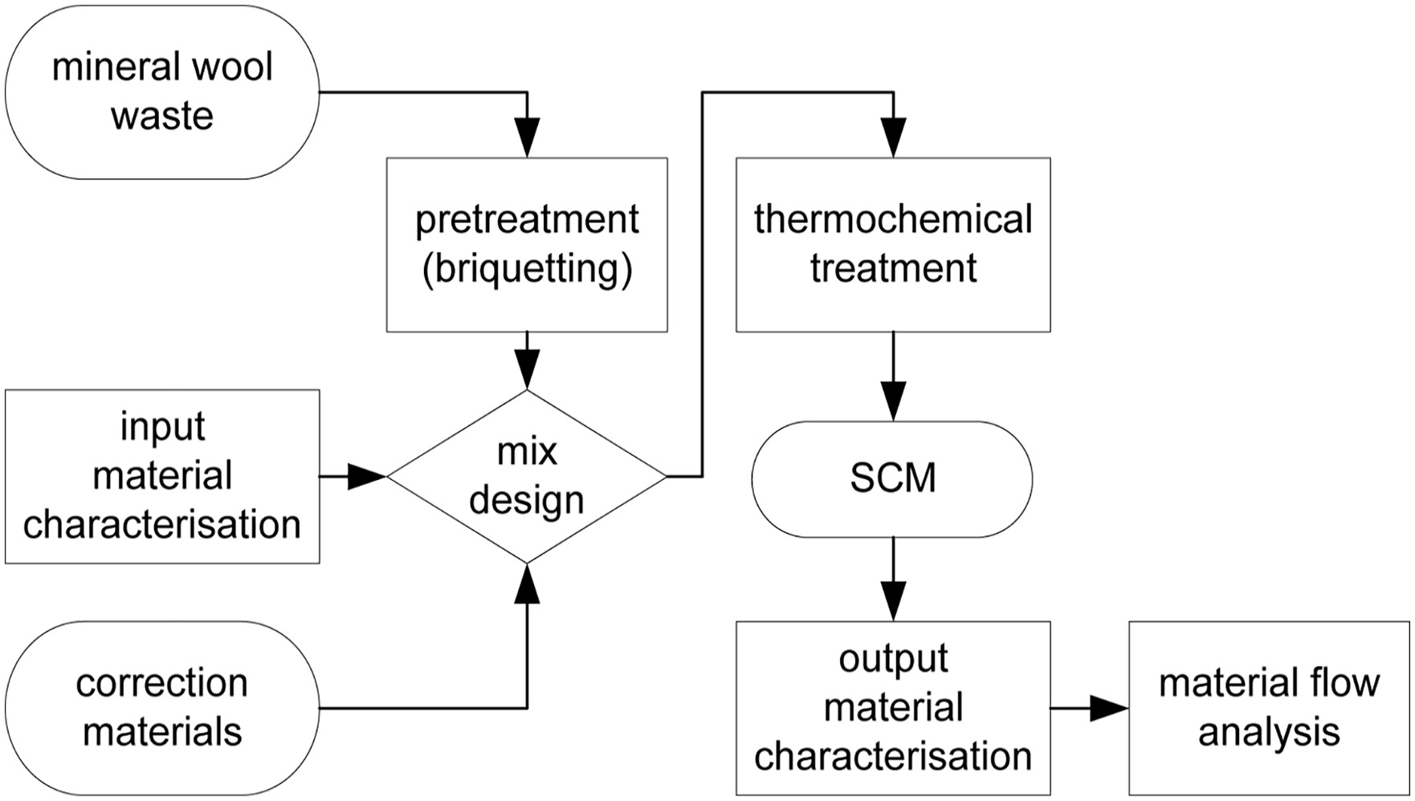
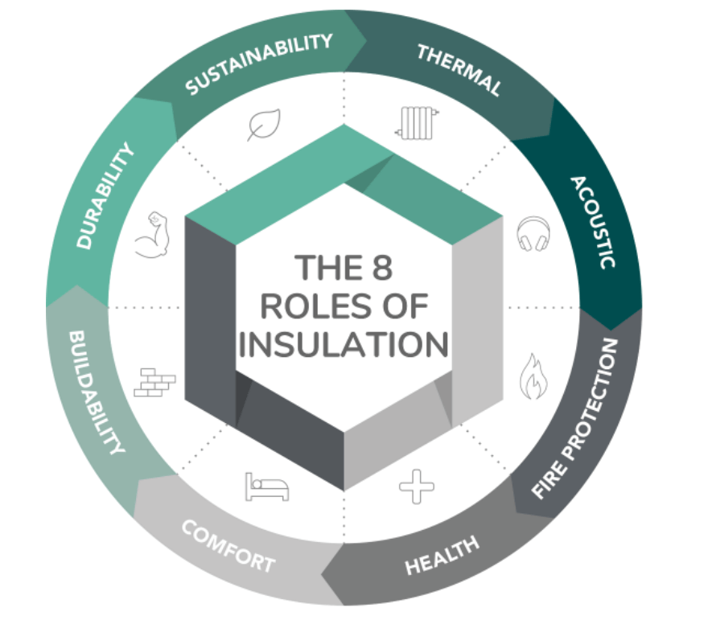
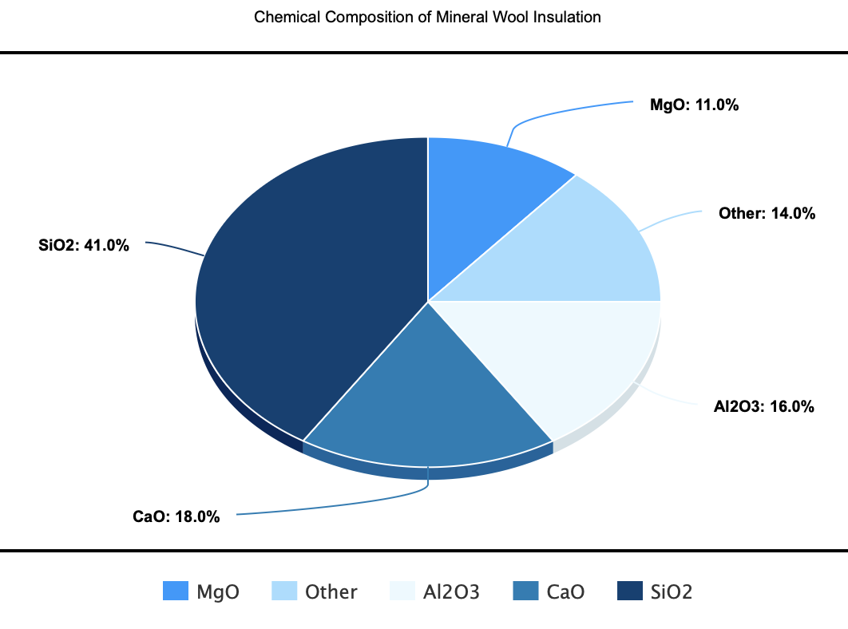
Beneficial Reuse of Mineral Wool Insulation Waste
The Cooper Union for the Advancements of Science and Art
Lixiang Chen, Jason Oh, Ethan So
Mineral Wool Waste Recycling Process into SCM
Background
Properties
Mineral Wool
  Used as insulation in buildings and houses
  Approximately 8-10 million tons are produced yearly
  Approximately 2.54 million tons are dumped into landfills yearly
Objective
  Research and present on existing circular C&D waste method for mineral wool insulation
Intrinsically
Extremely fire resistant
Thermal stability
Soundproof
Chemical Composition
39%-43% SiO₂
14%-23% CaO
14%-18% Al₂O₃
8%-14% MgO
Chemical Composition of Mineral Wool Insulation (Stone Wool)
Regulations
Methods of Reuse/Disposal
Benefits/Drawbacks
DSNY – Only DIY projects can be disposed
Guidelines require private hauling of C&D debris under the responsibility of the Contractor
Must pass ASTM standards relevant to material, such as fire safety and specific placement to act as vapor barriers
Methods of Reuse
  Crush and mix into cement as SCM
  Raw material for silica aerogel
  Fiber additive to lime mortar
  Circular Economy
Methods of Disposal
  Regular landfill
  Hazardous landfill
Benefits
  Recycled mineral wool has similar properties to fresh mineral wool
  Improves flexural strength and durability in mortar
  Is a cheap SCM
  Is a low embodied carbon material
Drawbacks
  Highly variable composition leading to variable properties when used as a SCM
  Slightly reduces compressive strength in concrete
Citations
Yap, Z. S., Khalid, N. H. A., Haron, Z., Mohamed, A., Tahir, M. M., Hasyim, S., & Saggaff, A. (2021). Waste mineral wool and its opportunities—a review. Materials, 14(19), 5777
NYC Department of Sanitation (DSNY). (2023). 2023 NYC Waste Characterization Study. https://www.nyc.gov/assets/dsny/downloads/resources/reports/waste-characterization-studies/2023/wcs-2023.pdf
Yliniemi, J., Ramaswamy, R., Luukkonen, T., Laitinen, O., de Sousa, Á. N., Huuhtanen, M., & Illikainen, M. (2021). Characterization of mineral wool waste chemical composition, organic resin content and fiber dimensions: Aspects for valorization. Waste Management, 131, 323–330. https://doi.org/10.1016/j.wasman.2021.06.022
Borzova, M., Gauvin, F., & Schollbach, K. (2025). Upcycling waste mineral wool into ambient pressure-dried silica aerogels. ACS Sustainable Chemistry & Engineering, 13(7), 2955–2965. https://doi.org/10.1021/acssuschemeng.4c09976
Doschek-Held, K., Krammer, A. C., Steindl, F. R., Sattler, T., & Ju+B2:W3hart, J. (2024). Recycling of mineral wool waste as supplementary cementitious material through thermochemical treatment. Waste Management & Research: The Journal for a Sustainable Circular Economy, 42(9), 806–813. https://doi.org/10.1177/0734242x241237199
Pozorski, E. M. A., Michał Malendowski, Wojciech Szymkuc and Zbigniew. (n.d.). Determination of thermal properties of mineral wool required for the safety analysis of sandwich panels subjected to fire loads. https://doi.org/10.3390/

