Slide 1

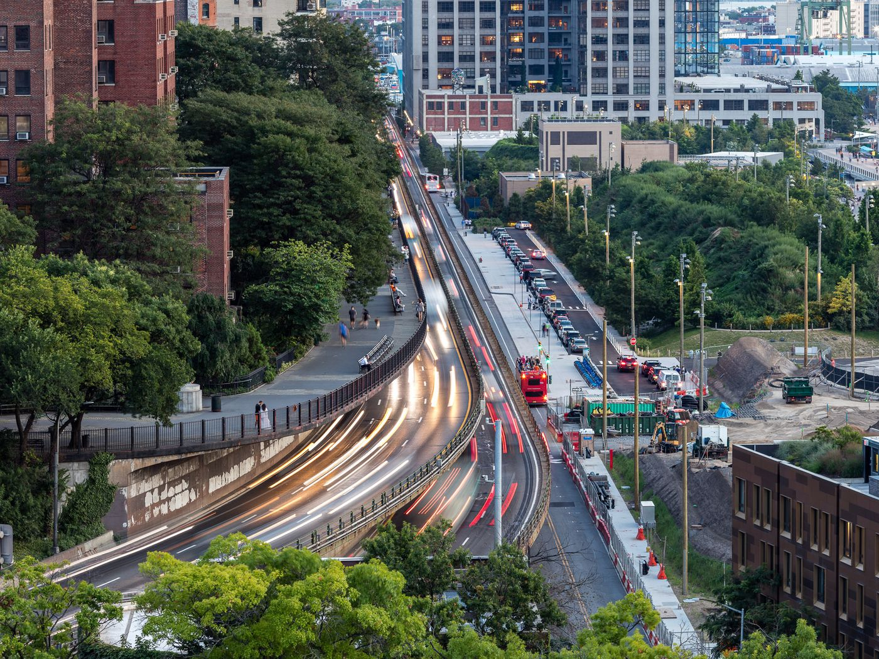

FORDHAM UNIVERSITY/GABELLI × (TOWN+GOWN:NYC @ NYC DDC + NYC MAYOR’S OFFICE OF OPERATIONS)
Collaborative
Public Construction
Data Analytics
NYC Capital Program
INFRASTRUCTURE
By: Amogha Manchinahalli Srikanta, Nicholas Adegoyega, Sanjita Shanmuga Sundaram, Hesham Hassanin and Irenosen Ekore

Slide 2
Agenda
01
05
02
06
03
07
04
Schedule Variable Analysis
Infrastructure Data Overview
Descriptive Analysis
Predictive Modelling
Typology Deep Dive
Conclusion
Budget Variable Analysis

Slide 3
Infrastructure Data Overview

Slide 4
The Dataset
Dataset:
Contains 1,850 Infrastructure Projects spanning all 5 NYC boroughs
Includes 12 sponsor agencies and 14 typologies
Project Scope:
Each project includes unique identifiers which are: PID, FMSID, and Reporting Period
The lifecycle of each project include:
Pre-Design→ Design → Procurement → Construction → Close-out
Financial data includes: total budget, budget variance, spend-to-date %, and cost changes across reporting periods
Schedule data includes: phase start/end dates, forecast completion, actual durations, and documented delay causes.

Slide 5
Descriptive Analysis

Slide 6
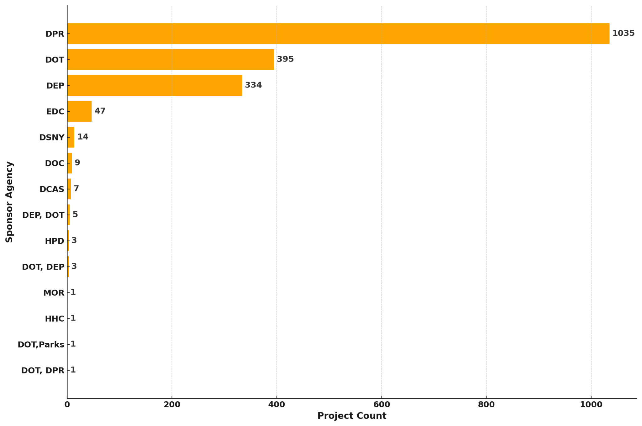
Projects by Sponsor Agency

Slide 7
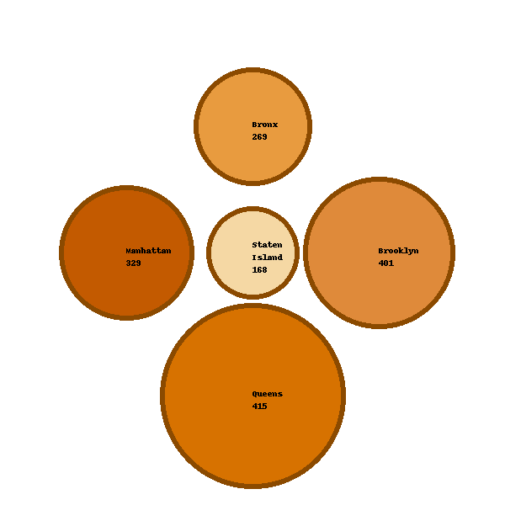
Geographic Distribution of Projects by Borough
(as a proxy for density)
Queens has the highest number of projects, followed by Brooklyn and Manhattan.
Project counts act as a proxy for borough-level population density.

Slide 8
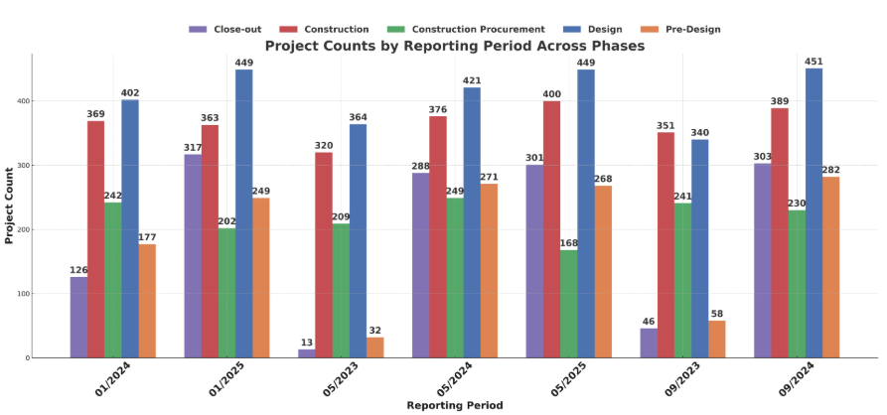
Reporting Periods across Status
(7 Reporting Periods)

Slide 9
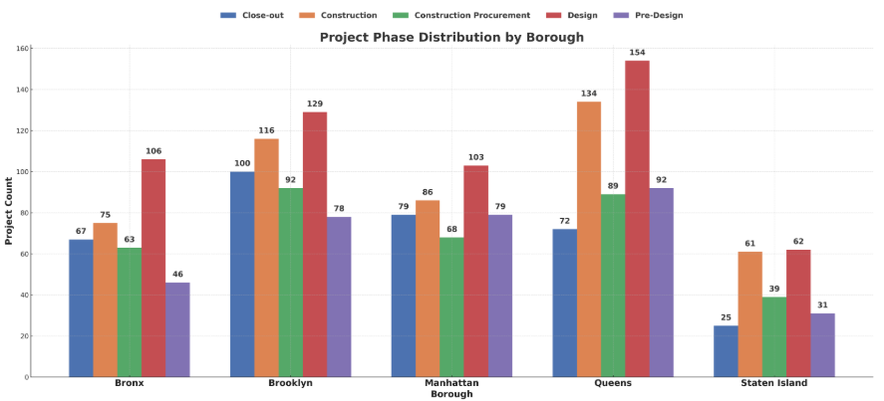
Project Phase Distribution by Borough
(as a proxy for population density)
Queens and Manhattan have the highest counts across most phases.
Staten Island consistently has the lowest number of projects across every phase.

Slide 10
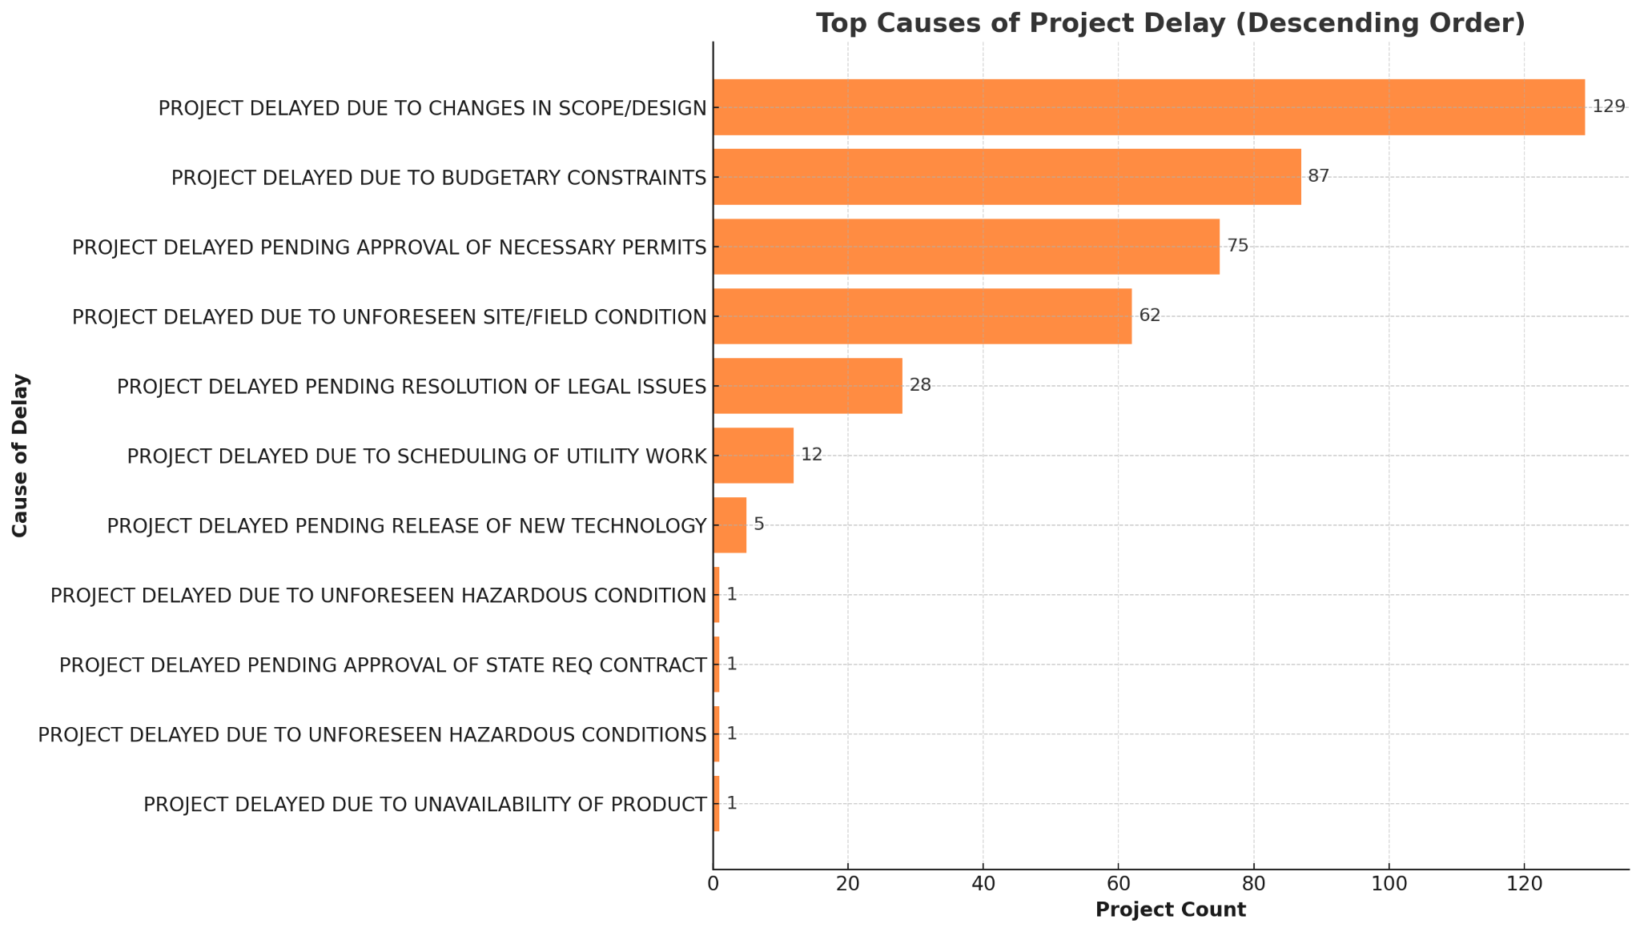
Most Common Reasons for Project Delays
Shows the most frequent delay drivers, with scope/design changes, budgetary constraints, pending approvals and site/field conditions ranking as the top causes.
Lower-frequency delays such as unavailability of product, hazardous condition occur less often but still impact select projects.

Slide 11
Typology Deep Dive

Slide 12
Infrastructure Typology Overview
Typology represents how Infrastructure projects are categorized based on their function.
This classification helps us compare performance across project types and understand how typologies related to schedule and budget variable and reason for delays

Slide 13
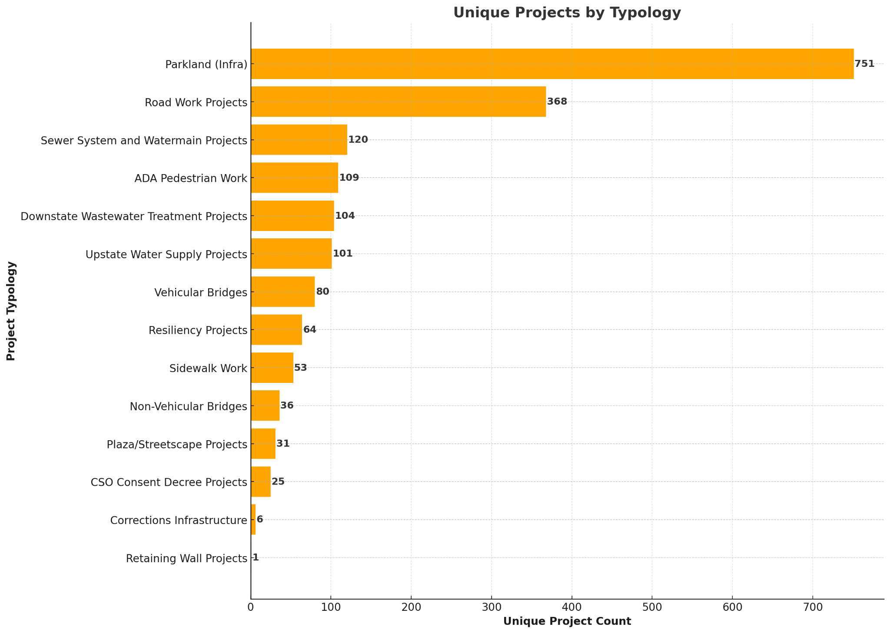
Number of projects per Typology

Slide 14
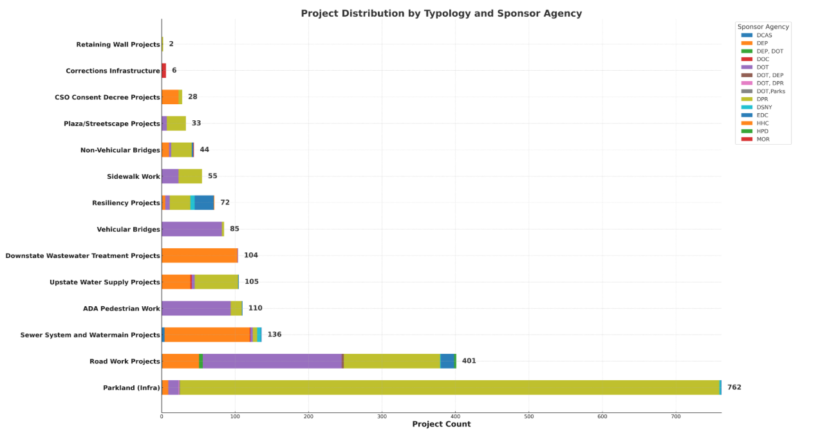
Typology × Sponsor Agency

Slide 15
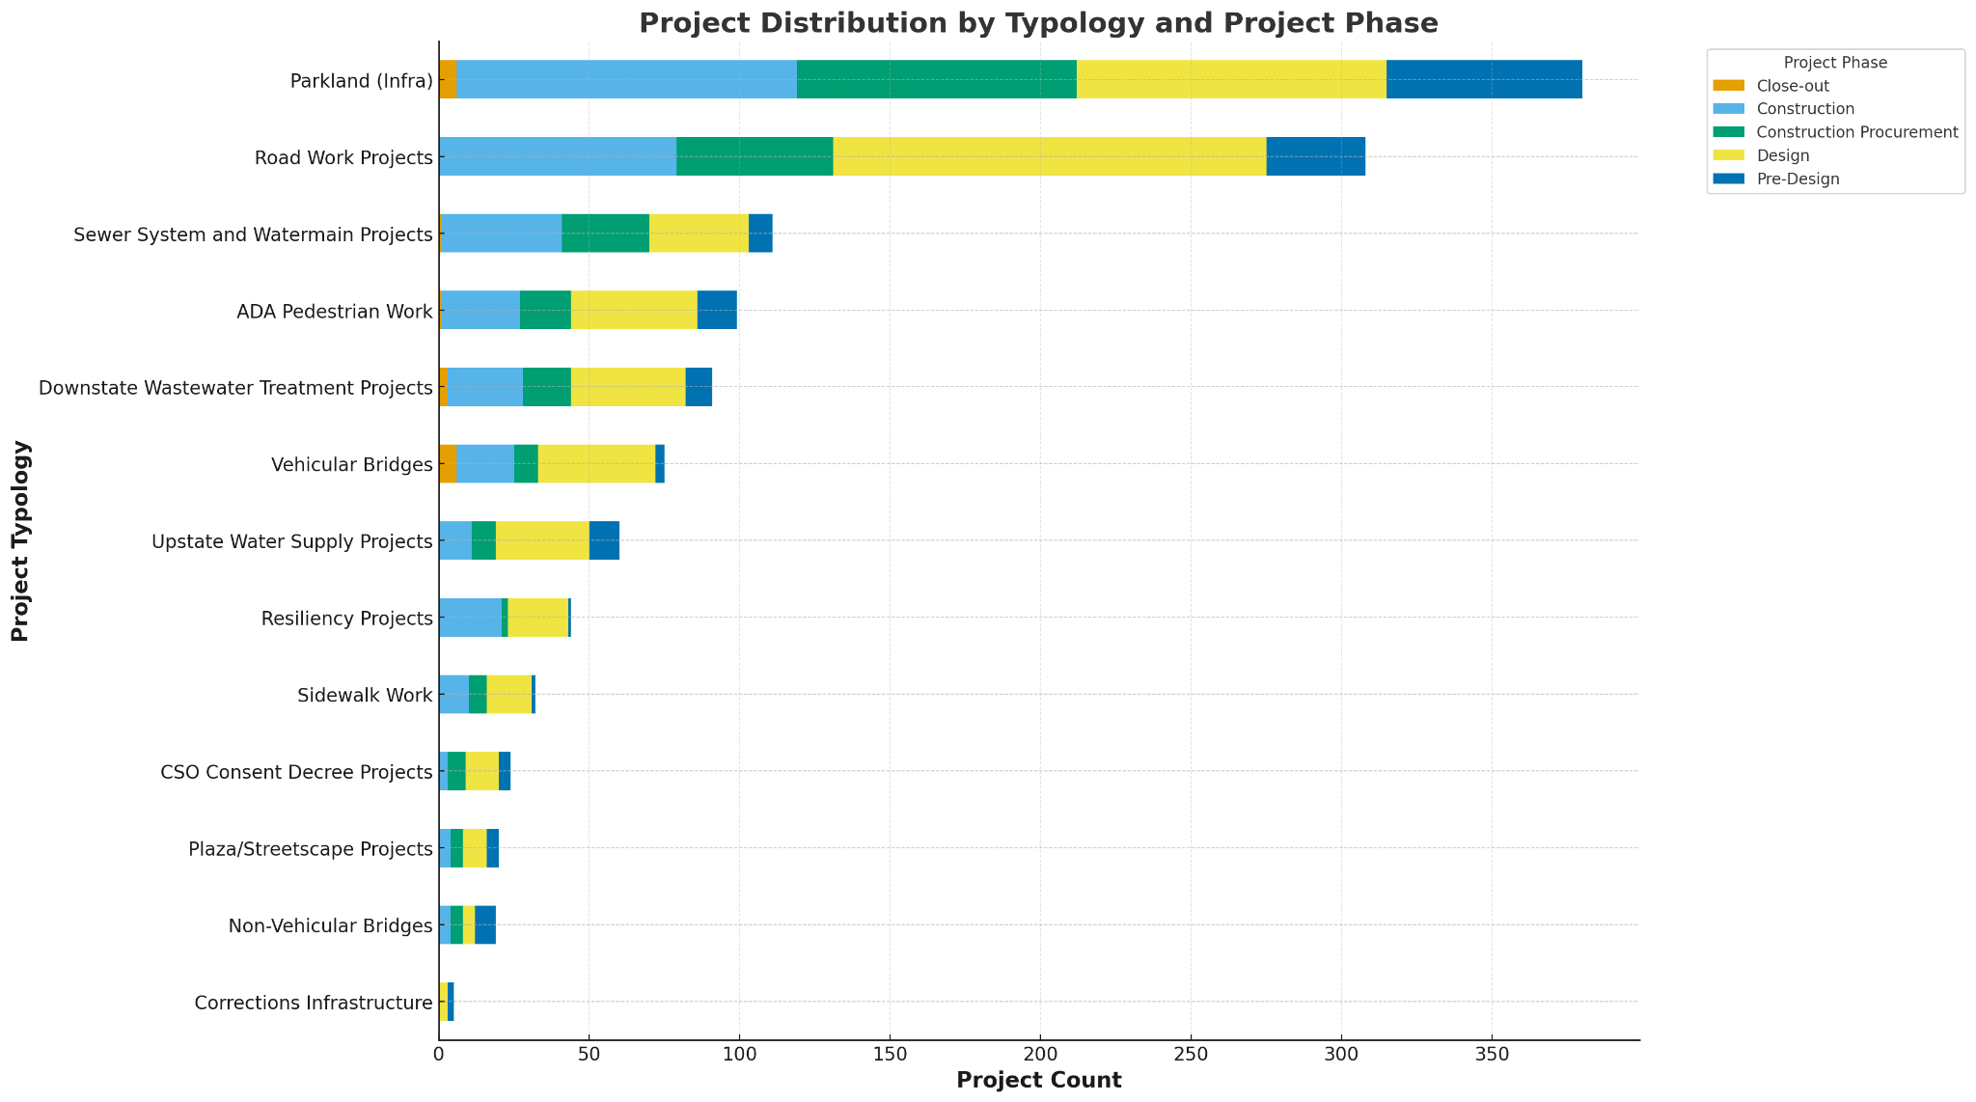
Typology × Project Status

Slide 16
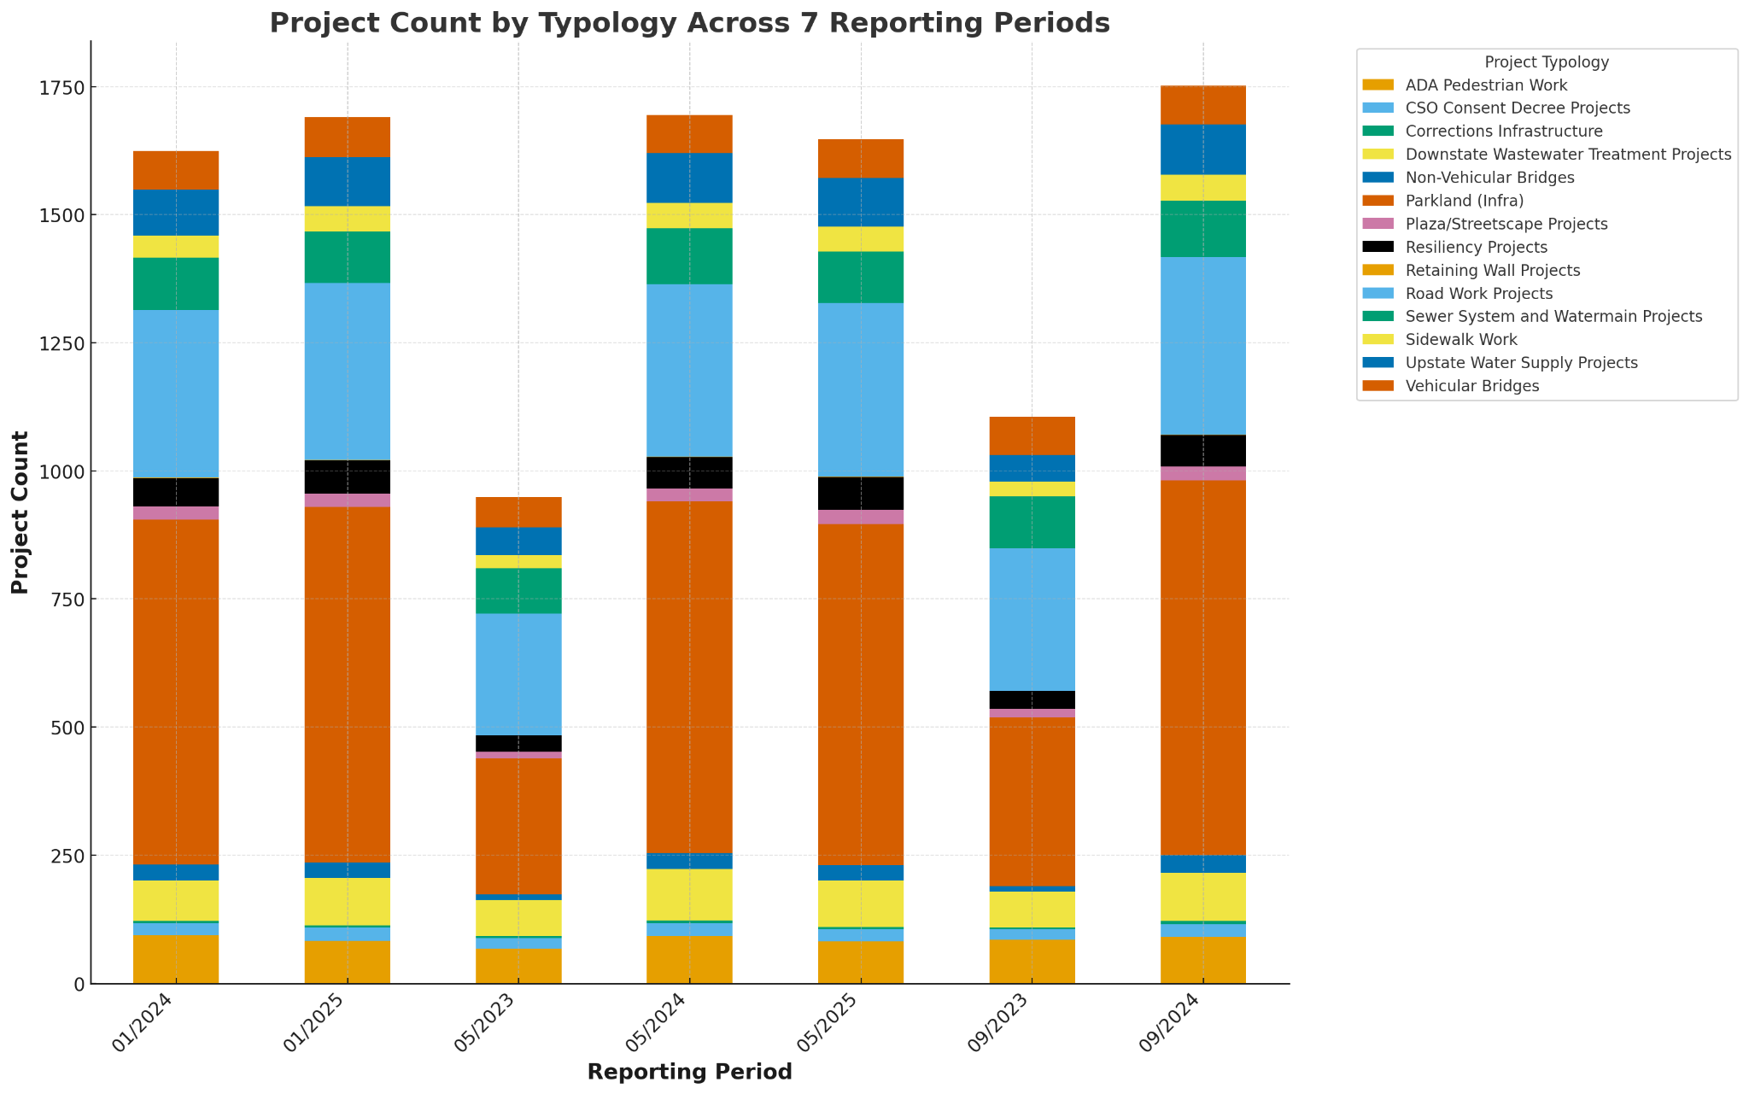
Project Count by Typology
(7 Reporting Periods)

Slide 17
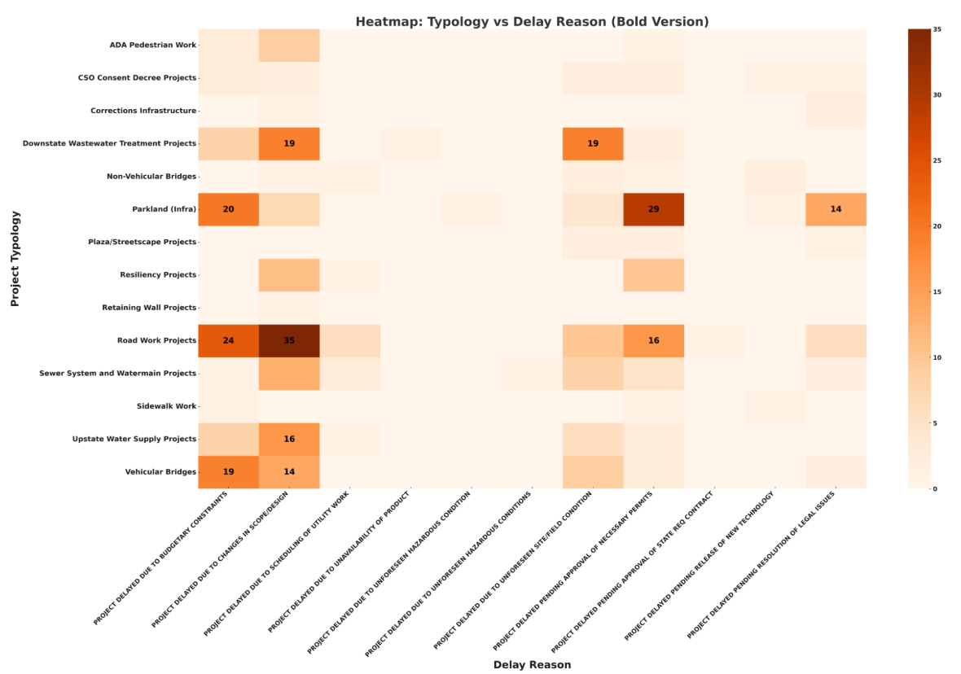
Typology × Delay Categories - Heatmap
This is a heatmap of facility typology by delay reason, where where darker cells indicate more projects in that typology reporting that specific delay reason
Budget Constraints, Scope/Design Changes, and Permit/Approval Delays are the dominant delay drivers.
Delay patterns are not uniform — they are strongly shaped by the nature of the typology.
Roadway & Parkland projects → impacted by funding, approvals, and design changes.
Water & Wastewater projects → impacted by regulatory oversight and permitting.
Very few delays → appear lightly colored.

Slide 18
Budget Variable Analysis

Slide 19
Variables used in this analysis
Budget & Spend Variables
Total Budget
Spend to Date
Spend % (spend_pct)
Budget Variance
Average Spend % (by Sponsor Agency / Typology)
Project & Schedule Variables
Project Typology
Sponsor Agency
Total Project Duration (days)
Average Duration (days)
Project Count

Slide 20
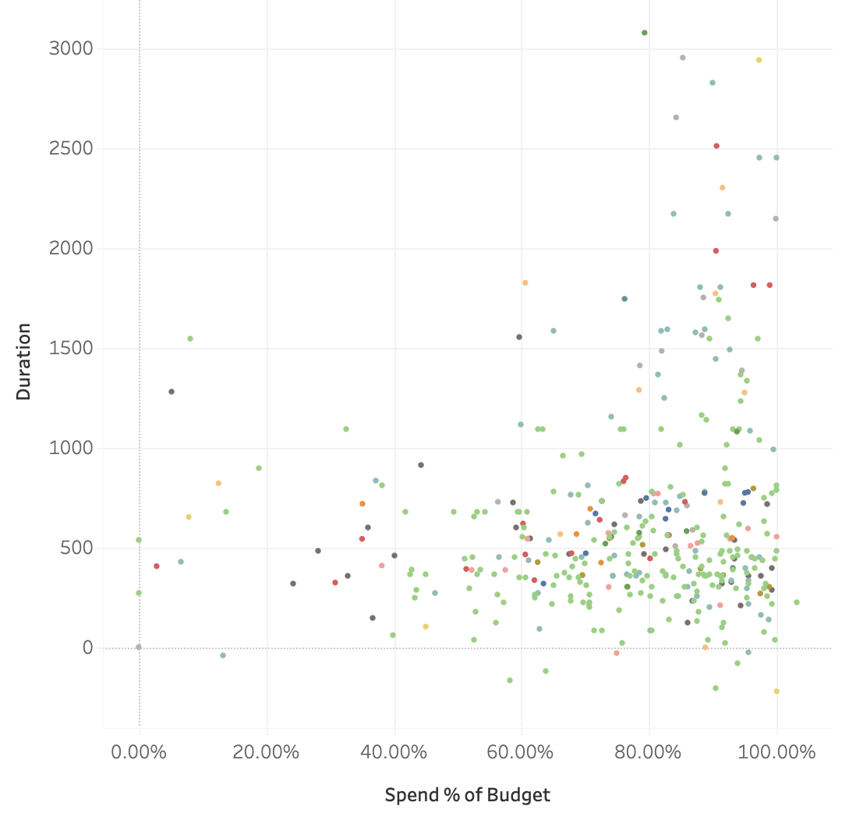
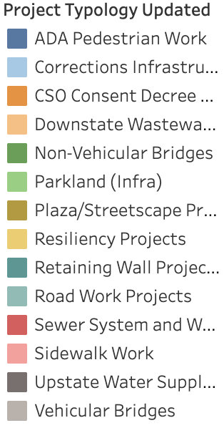

Correlation Analysis: Spend % vs Duration by Typology
There is no strong relationship between spend % of budget and construction duration.
Projects across typologies cluster at low-to-mid spend levels, regardless of how long they have been active.
A few outliers show high spend % with longer durations, but these do not indicate a consistent trend.
This suggests that project typology and agency-driven factors influence spending progress more than duration does
Notes:
“Here we’re comparing how much of the budget has been spent against how long each project has been in construction.Across typologies, we don’t see a meaningful correlation — projects can be long or short in duration and still show similar spend % levels.Most projects cluster below 60–70% spend, even at higher durations.A few typologies have outliers with higher spend %, but these are exceptions.Overall, duration alone doesn’t explain spending progress — internal agency processes, project complexity, and typology-specific factors are more influential.”

Slide 21
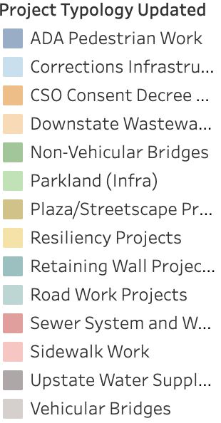
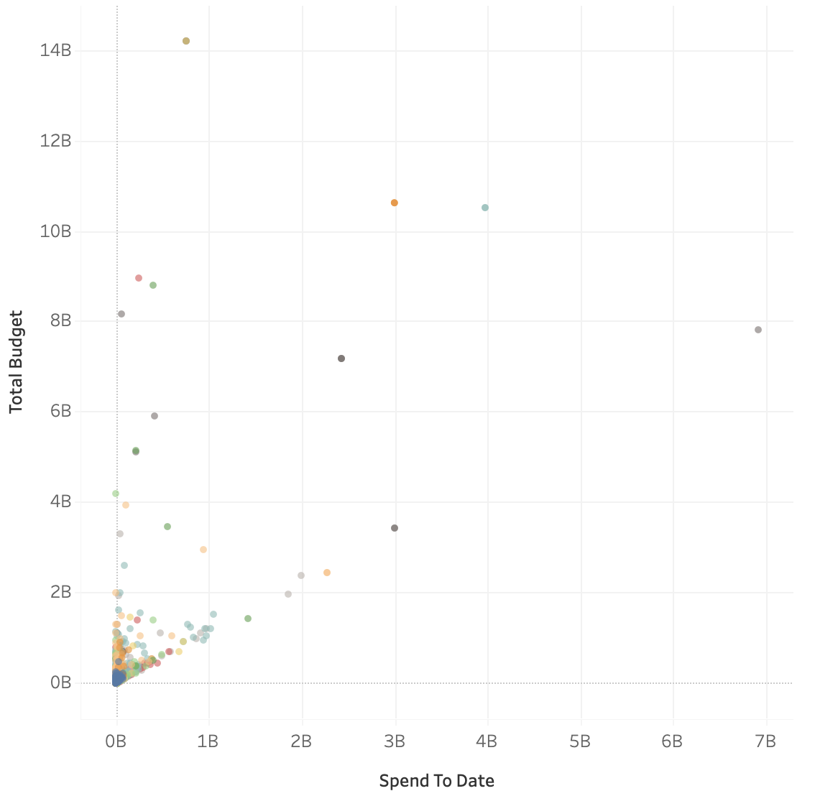
Correlation Analysis: Spend vs Total Budget By Typology
This scatter plot shows the relationship between spend-to-date and total project budget across Typologies.There is a clear positive correlation — projects with larger total budgets generally have higher spend amounts.Most typologies cluster in the lower budget / lower spend range, while only a few large-scale typologies extend into the high-budget, high-spend area.
Notes:
“This chart looks at whether higher-budget projects tend to spend more in absolute dollars.
We do see a positive relationship — projects with larger total budgets generally show higher spend-to-date amounts.
However, the clusters show that typology matters: most typologies stay in the lower-budget, lower-spend range, while only a small group of large-scale infrastructure projects reach the upper-right portion of the chart.
Overall, spend-to-date increases with total budget, but project type drives where each project sits on this curve.”

Slide 22
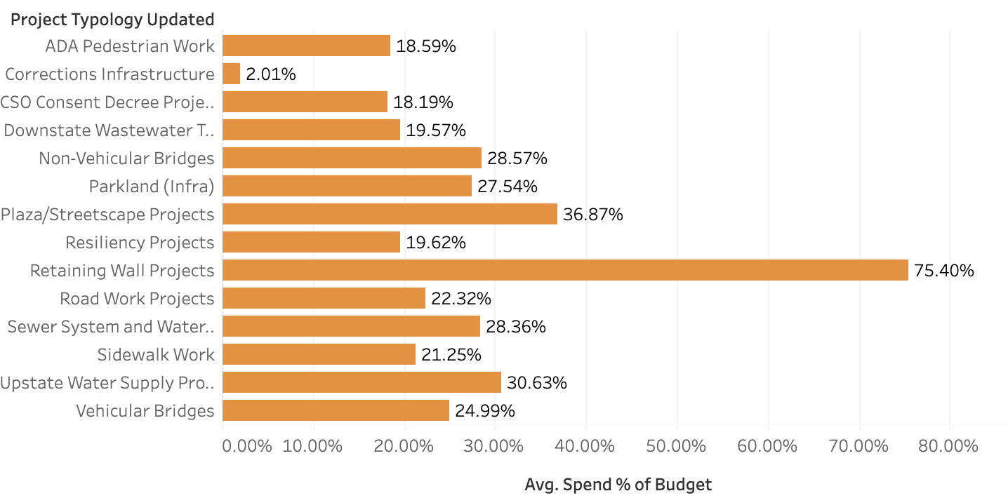
Average % of Budget Spent By Typology
Spending varies widely across typologies. Retaining Wall Projects show the highest spend % by far, indicating accelerated or concentrated spending.
Most other typologies cluster around 18–30%, with Plaza/Streetscape Projects and Upstate Water Supply Projects slightly higher.
Corrections Infrastructure shows the lowest spend %, indicating very early-stage or under-progress projects.
Notes:
“Spending varies significantly across project typologies. Retaining Wall Projects stand out with over 75% spend, indicating very fast or concentrated activity. Most other typologies fall in the 18–30% range. Plaza/Streetscape and Upstate Water Supply Projects show slightly higher progress. Corrections Infrastructure is the lowest at 2%, which may indicate early-stage or under-active projects.”

Slide 23
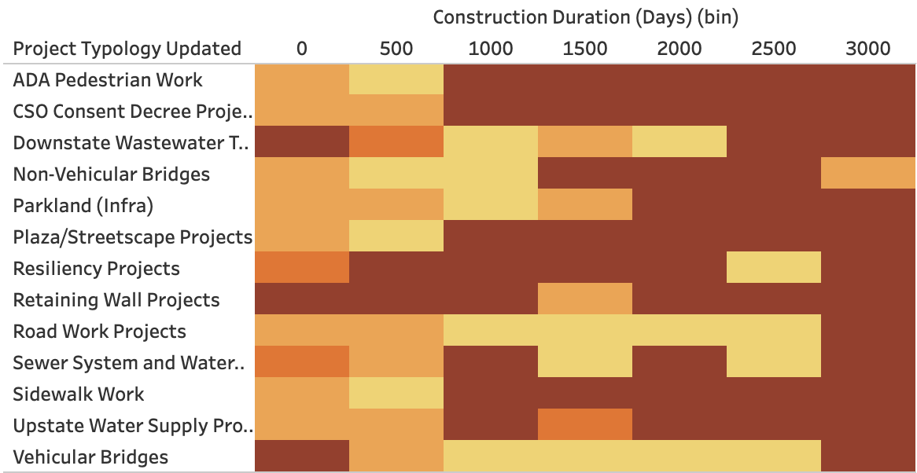
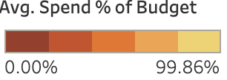
Spend vs Duration By Typology in Heap Map
DSNY-type projects (Solid Waste / Sanitation–related typologies) show higher spend %, especially in shorter durations.
DOT-related typologies generally appear in longer duration bins with moderate spending levels.
DPR-related projects show steady mid-range spend % across most durations.
DEP-related water + wastewater typologies tend to have lower spend %, often spread across longer project durations.
Notes:
“This heatmap shows how different project typologies distribute their spending across duration ranges.A few patterns stand out:
DSNY-related typologies show higher spend percentages, especially in the shorter duration bins.
DOT-related typologies tend to fall into longer durations with moderate spending.
DPR typologies show consistent, mid-range spend levels across most durations. DEP water and wastewater typologies tend to have lower spend percentages, even across longer project timelines. The key point is that spending behavior varies more by typology than by duration. Duration alone doesn’t predict spend % — project type and agency-specific factors play a bigger role.”

Slide 24
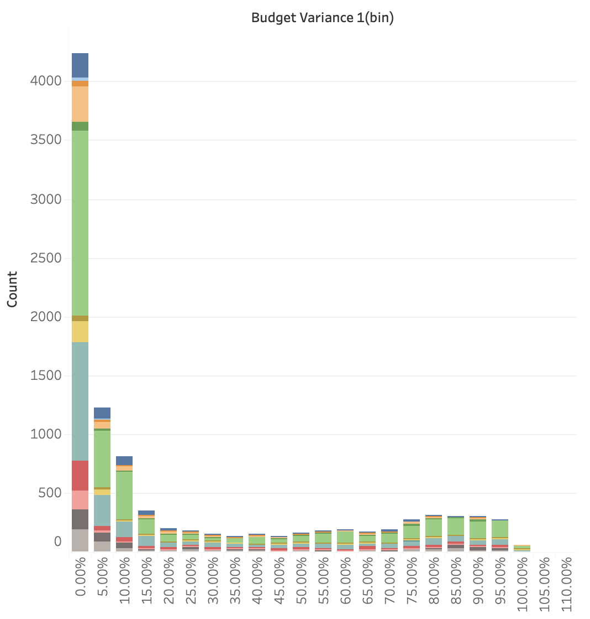
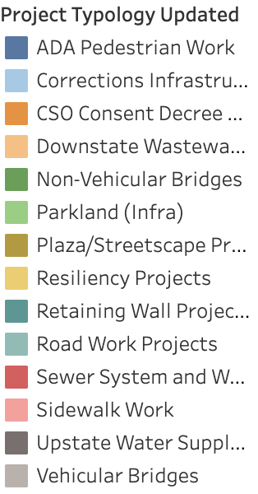
Budget Variance Distribution in Histogram
Most projects fall in the 0–10% budget variance range, meaning they’ve used only a small portion of their total budgets so far. Project counts drop sharply after 10%, showing that the majority of projects are still in early spending phases. Only a small number of projects reach higher variance levels (50–100%), and this pattern is consistent across typologies.
I
Notes:
“This chart shows how far along projects are in using their total budgets. The x-axis groups projects into Budget Variance bins, and the y-axis shows how many projects fall into each group. Most projects cluster in the 0–10% range, meaning they’ve only spent a small portion of their total budget so far. After 10%, the number of projects drops sharply — confirming that the majority are still in early spending phases. We also see a long tail toward higher variance levels, but these represent far fewer projects, indicating that only a small subset is approaching full budget utilization.”

Slide 25
Schedule Variable Analysis

Slide 26
Variables used in this analysis
Total Project Duration (Forecast Completion – Actual Design Start)
Design Phase Duration (days)
Procurement Phase Duration (days)
Construction Phase Duration (days)
Schedule Change (%)
Delay Duration (days)
Completion Rate (%)
On-Time vs Delayed Flag

Slide 27
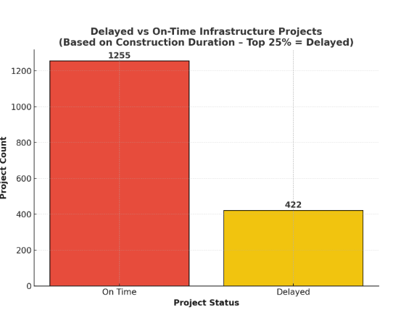
On-Time vs Delayed Project Performance
Projects are classified as Delayed if they fall into the longest-duration quartile.
In the Infrastructure dataset, more projects are on time than delayed under this classification.

Slide 28
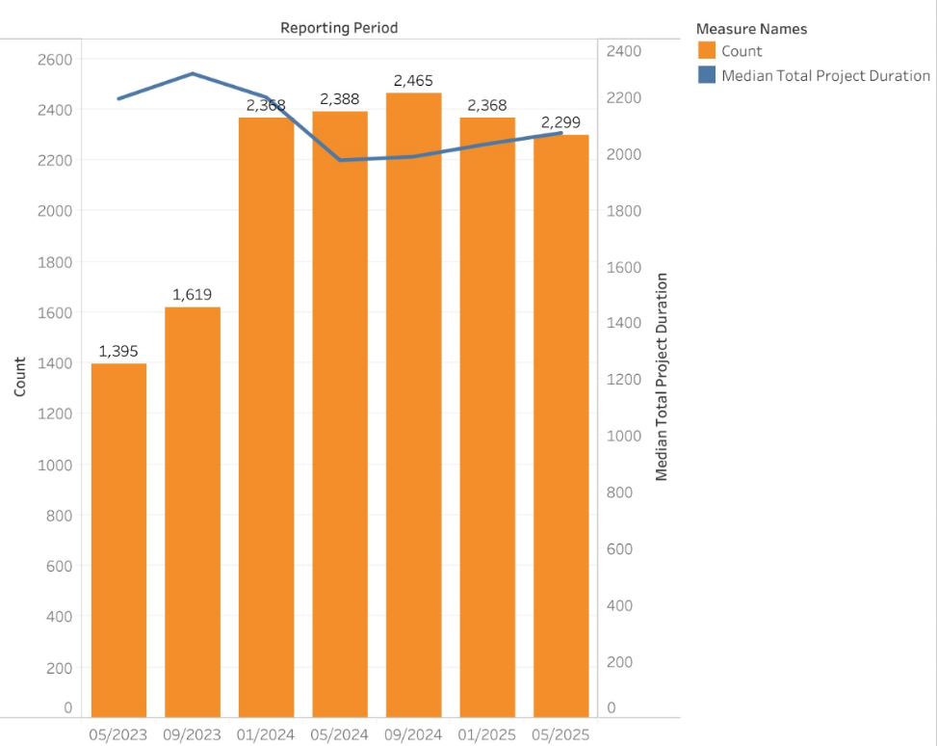
Project Count and Median Duration
(7 Reporting Periods)
Project counts increase across 7 reporting periods, showing a growing number of active projects captured in later reporting cycles.
Median durations remain consistently high across all periods, showing that long timelines persist with only small changes between reporting periods.

Slide 29
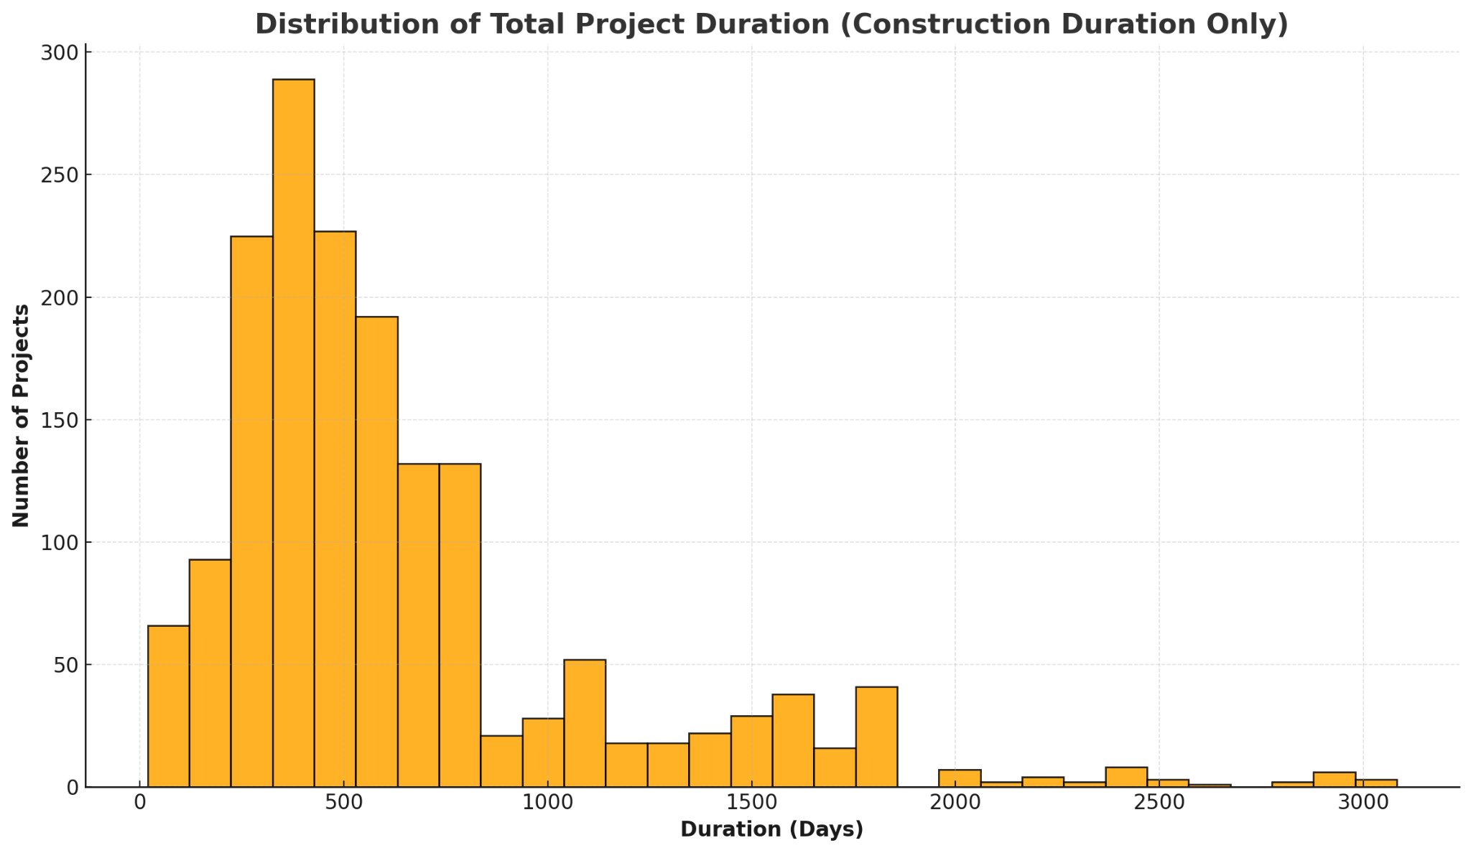
Distribution of Total Project Duration
Most Infrastructure projects fall between 0–900 days.
A smaller set exceeds 1000 days, suggesting higher complexity or repeated delays.
Highlights structural schedule challenges and the need to flag long-running projects early for targeted oversight.

Slide 30
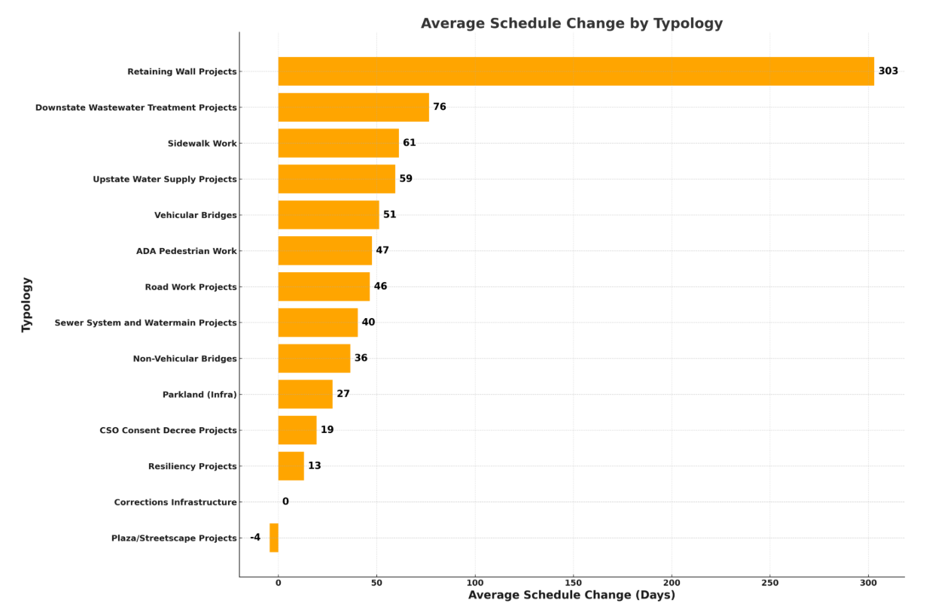
Average Schedule Change (Days) by Typology
Average schedule change differs across typologies, with Retaining Wall Projects showing the largest average change
Several other typologies fall in low-range values, while Corrections Infrastructure shows no change.

Slide 31
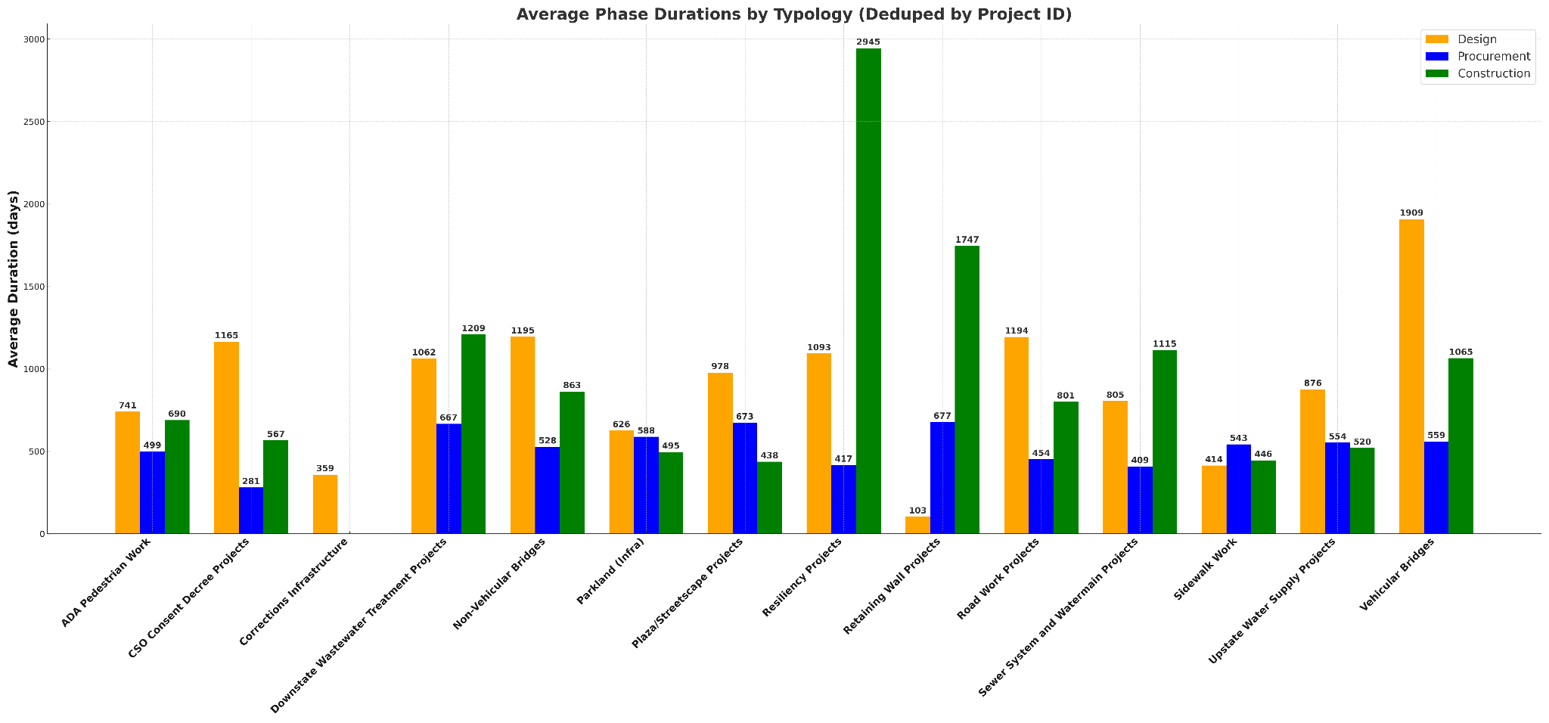
AVERAGE PHASE DURATION BY TYPOLOGY
Vehicular bridges, resiliency projects, and major water/wastewater infrastructure show the longest design and construction durations, reflecting their engineering complexity.
Sidewalk work, ADA upgrades, and smaller site projects tend to have shorter durations consistent with simpler scopes.
Streetscape, parkland, and mid-scale infrastructure projects fall in the moderate range with balanced timelines.
Some typologies may show unusually short durations due to incomplete dates or small sample sizes in the dataset.

Slide 32
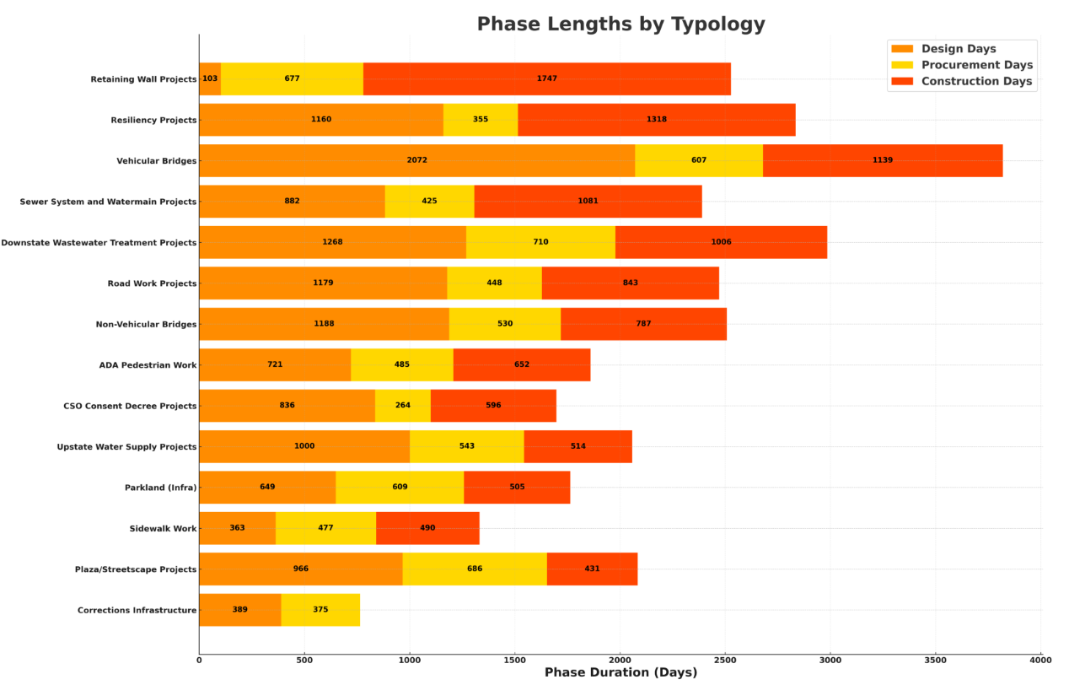
Phase Lengths by Typology
Phase durations vary across typologies, showing distinct distributions of time spent in each phase.
Construction and Design generally represent the longest portion of project timelines, while procurement length differ more widely across facility types.

Slide 33
Predictive Analysis

Slide 34
Predictive Modeling: Forecasting Delay Risk
Purpose of the Model
This predictive model is developed to estimate the likelihood if an Infrastructure project will experience a schedule delay.
By learning from thousands of historical or previous project records, the model helps us identify higher-risk projects earlier in the process.
How the Model Works:
The model uses the whole Infrastructure dataset and analyzes patterns from past projects ( size, spending behavior, agency characteristics, typology, etc)
Then, it assigns each new project a delay risk score, indicating how similar it is to projects that fell behind schedule in the past
Higher scores suggest projects that may require greater attention or early intervention.

Slide 35
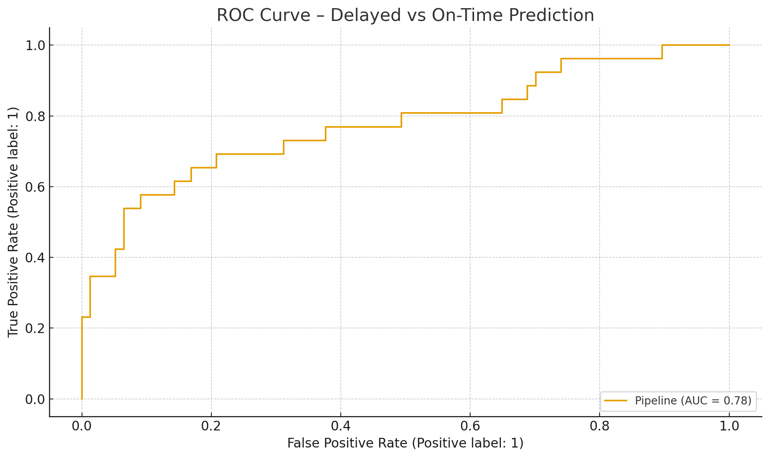
Receiver Operating Characteristic Curve: Forecasting Delay Risk
The model can separate high-risk from low-risk projects with good reliability, making it suitable for early warning dashboards.
The Area Under the Receiver Operating Characteristic Curve (AUC) is a measurement between 0 and 1 that summarizes how well the model performs.
0.5 means the model is no better than random guessing
1.0 means the model perfectly separates delayed and on-time projects
→ Our AUC is approx 0.78, which indicates a good and reliable performance.
→ The model is effective at ranking projects by their risk of delay, which makes it a possible valuable decision-support tool.

Slide 36
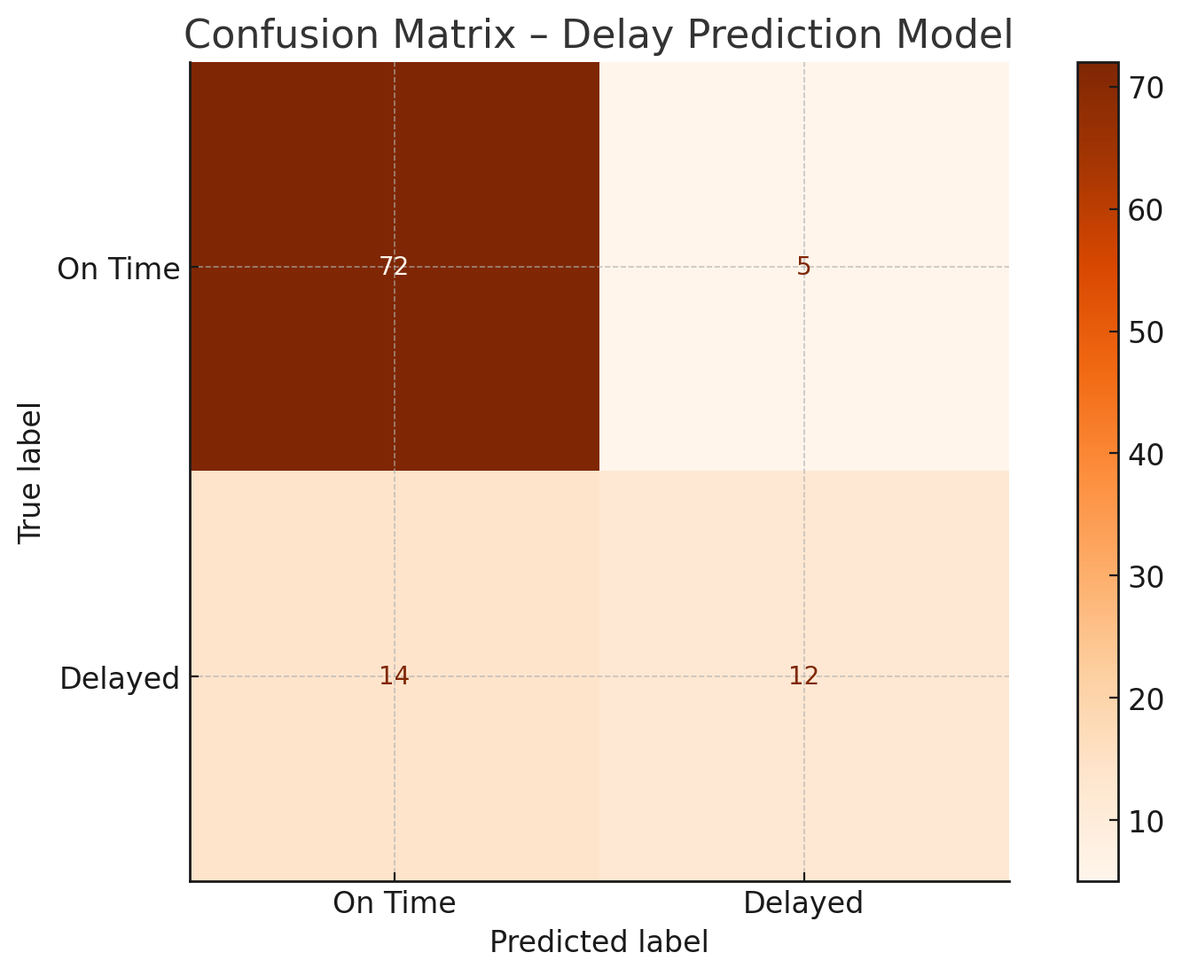
Confusion Matrix: Forecasting Delay Risk
This is a confusion matrix shows how well the model predicts project delays by comparing: what actually happened vs.what the model predicted. → It helps us understand where the model performs well and where it makes mistakes, giving a clear picture of reliability.
True On-Time correctly predicted: 72
True Delayed correctly predicted: 12
False Alarms (On-Time predicted as delayed): 5
Missed Delays (Delayed predicted as on-time): 14
The model is very strong at identifying on-time projects, but like most early-stage predictors, it misses some delays because late-stage conditions (field issues, utilities, change orders) aren’t visible early in the dataset.

Slide 37
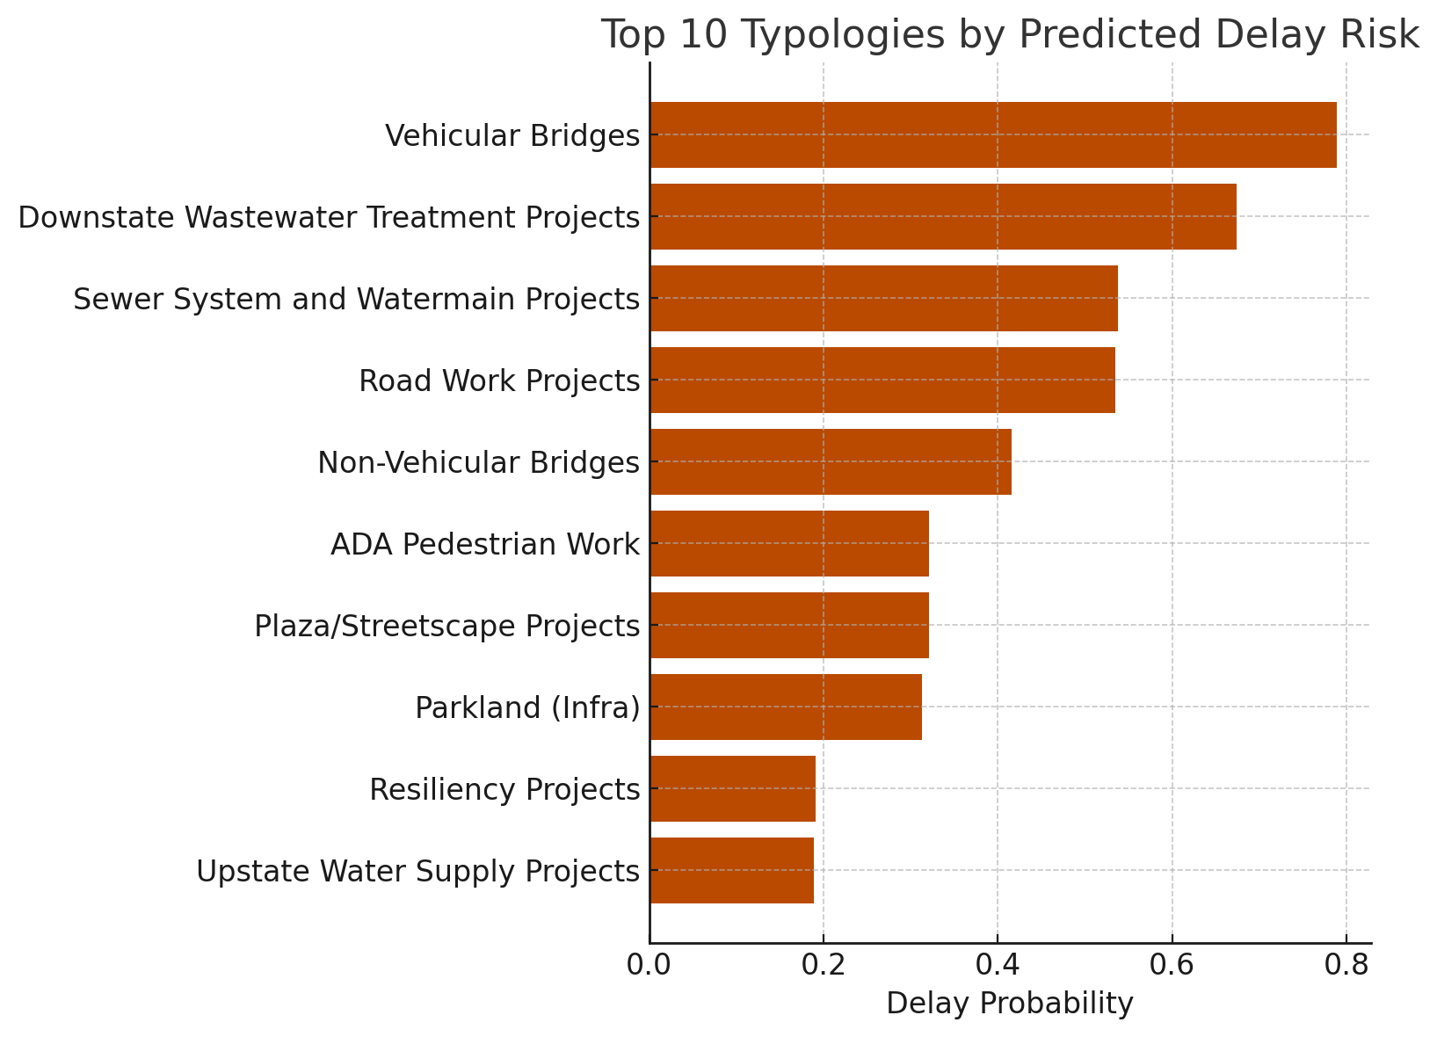
Top 10 Typologies by Predicted Delay Risk
Feature Extraction
High-risk typologies include:
Vehicular Bridges
Road Work Projects
Water/Sewer Infrastructure
Non-Vehicular Bridges
Lower-risk typologies (not in top 10) include:
Sidewalk Work
Plaza/Streetscape
Parkland Infra
Use: Helps planners predict which project types require more schedule contingency.

Slide 38
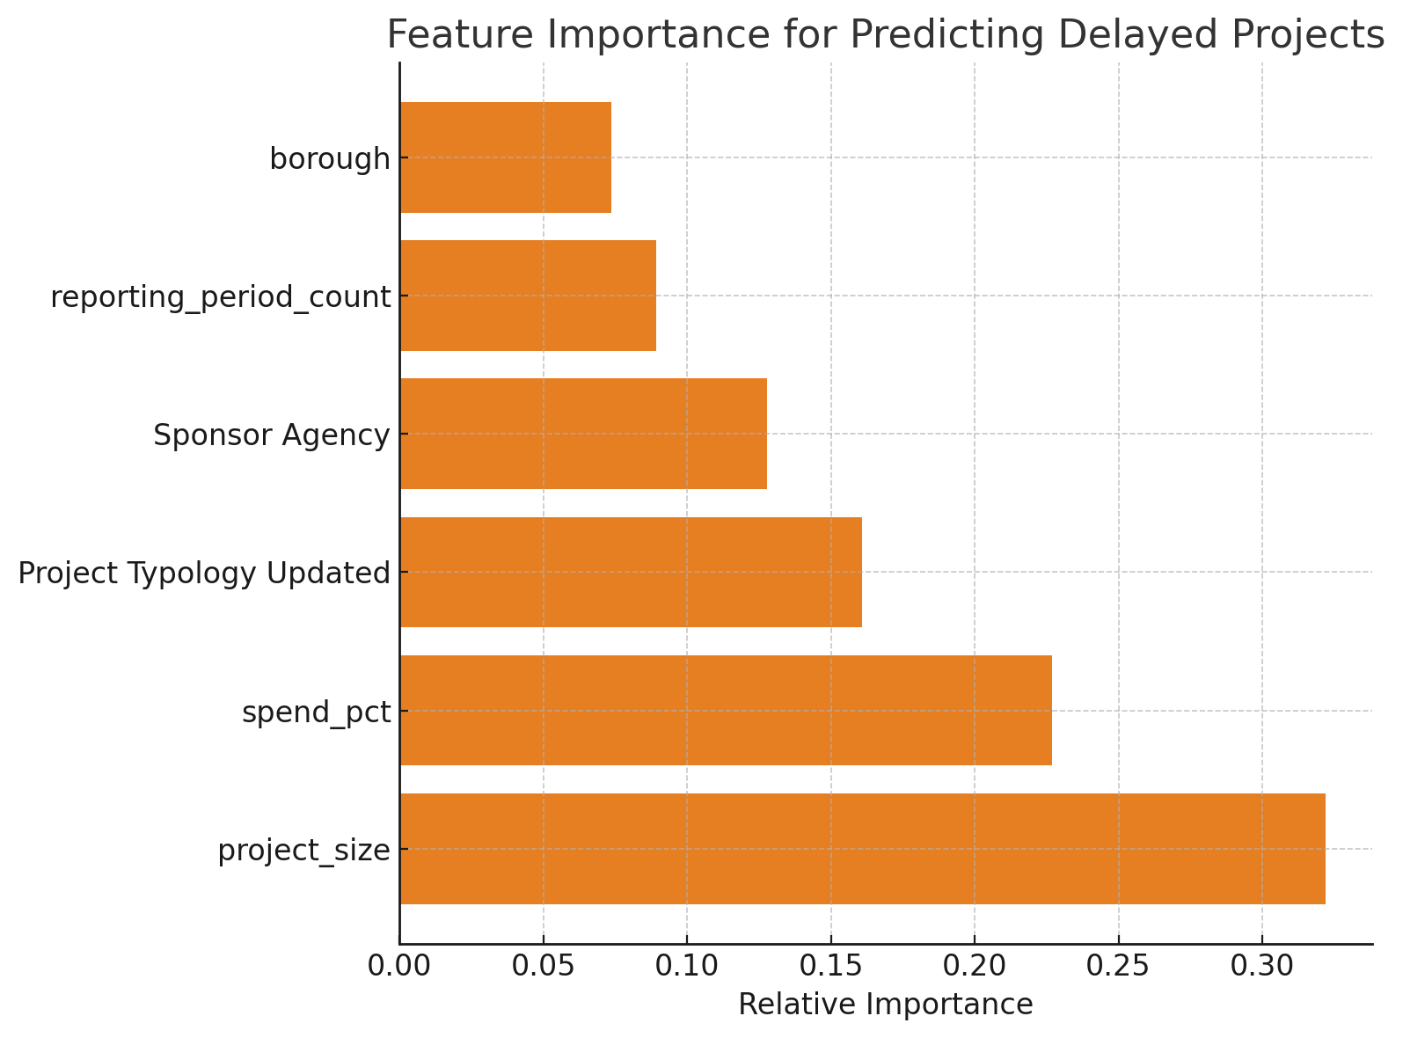
Predictive Modeling: Forecasting Delay Risk
Project Size (total budget) – Larger projects → much higher chance of delay
Early Spend % – Slow early spending → future risk
Typology – Bridges, sewer/water, resiliency have higher inherent risk
Managing Agency – Agencies with more complex capital portfolios show higher risk
Reporting Period Count – Projects with more reporting cycles tend to be older/more exposed
Borough – Location matters, but least among all predictors
Takeaway:
Delays are driven most by project scale and early spending pace, followed by technical typology and agency, with geography playing a smaller role.

Slide 39
Conclusion

Slide 40
Conclusion
Conclusion
The dashboard was designed for public transparency, not analytics, requiring extensive cleaning, joining, and manual labeling.
With only seven reporting periods and limited variables, we cannot make strong conclusions yet, only demonstrate the dataset’s emerging analytical potential.
Missing key fields (CB#, contractor, change orders) and imbalanced distributions restrict deeper citywide analysis.
Early analyses show clear promise for identifying budget and schedule risks as reporting periods mature.
Future enhancements - agency PB/Infra labeling, refined typologies, and external dataset integration via FMSID, will significantly expand analytical value.
Point 2
Description

Slide 41


FORDHAM UNIVERSITY/GABELLI × (TOWN+GOWN:NYC @ NYC DDC + NYC MAYOR’S OFFICE OF OPERATIONS)
THANK YOU SO MUCH

