Slide 1
Establishing the Analytical Foundation for Intersecting Public Policy and Design Approaches to Improving Infant and Maternal Health Outcomes
Rishabh Basu, Emma Ferguson, Jordyn Grady, and Lizmarie Montemayor Robles

Slide 2
Table of contents
01.
02.
03.
04.
05.
06.
General Birth Trends in NYC
Providers of Natal Services
Medicaid Funding for Natal Services
Index of Needs
Case Studies
Steps For the Future
Slide 1 of 24

Slide 3
Table of contents
01.
02.
03.
04.
05.
06.
How many babies are born in NYC? What healthcare facilities are currently chosen by mothers?
Providers of Natal Services
Medicaid Funding for Natal Services
Index of Needs
Case Studies
Steps For the Future
Slide 1 of 24

Slide 4
Table of contents
01.
02.
03.
04.
05.
06.
How many babies are born in NYC? What healthcare facilities are currently chosen by mothers?
Where are OB GYNs, Midwives, and Doulas found in NYC? Is it well-distributed, or are there neighborhoods with higher concentrations?
Medicaid Funding for Natal Services
Index of Needs
Case Studies
Steps For the Future
Slide 1 of 24

Slide 5
Table of contents
01.
02.
03.
04.
05.
06.
How many babies are born in NYC? What healthcare facilities are currently chosen by mothers?
Where are OB GYNs, Midwives, and Doulas found in NYC? Is it well-distributed, or are there neighborhoods with higher concentrations?
What does Medicaid cover? How much are facilities reimbursed for all natal services? What about reimbursement for standard delivery care? Is this enough to cover costs?
Index of Needs
Case Studies
Steps For the Future
Slide 1 of 24

Slide 6
Table of contents
01.
02.
03.
04.
05.
06.
How many babies are born in NYC? What healthcare facilities are currently chosen by mothers?
Where are OB GYNs, Midwives, and Doulas found in NYC? Is it well-distributed, or are there neighborhoods with higher concentrations?
What does Medicaid cover? How much are facilities reimbursed for all natal services? What about reimbursement for standard delivery care? Is this enough to cover costs?
Which neighborhoods demonstrate the highest need for patient-focused alternative natal care? How is this measured?
Case Studies
Steps For the Future
Slide 1 of 24

Slide 7
Table of contents
01.
02.
03.
04.
05.
06.
How many babies are born in NYC? What healthcare facilities are currently chosen by mothers?
Where are OB GYNs, Midwives, and Doulas found in NYC? Is it well-distributed, or are there neighborhoods with higher concentrations?
What does Medicaid cover? How much are facilities reimbursed for all natal services? What about reimbursement for standard delivery care? Is this enough to cover costs?
Which neighborhoods demonstrate the highest need for patient-focused alternative natal care? How is this measured?
Why do certain neighborhoods have a higher need for patient-focused, alternative natal care?
Are there any alternative natal care providers in NYC?
Steps For the Future
Slide 1 of 24

Slide 8
Table of contents
01.
02.
03.
04.
05.
06.
How many babies are born in NYC? What healthcare facilities are currently chosen by mothers?
Where are OB GYNs, Midwives, and Doulas found in NYC? Is it well-distributed, or are there neighborhoods with higher concentrations?
What does Medicaid cover? How much are facilities reimbursed for all natal services? What about reimbursement for standard delivery care? Is this enough to cover costs?
Which neighborhoods demonstrate the highest need for patient-focused alternative natal care? How is this measured?
Why do certain neighborhoods have a higher need for patient-focused, alternative natal care?
Are there any alternative natal care providers in NYC?
What should we explore further to better understand approaches to improving infant and maternal health outcomes?
Slide 1 of 24

Slide 9
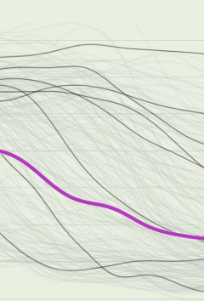
01.
General Birth Trends in NYC

Slide 10
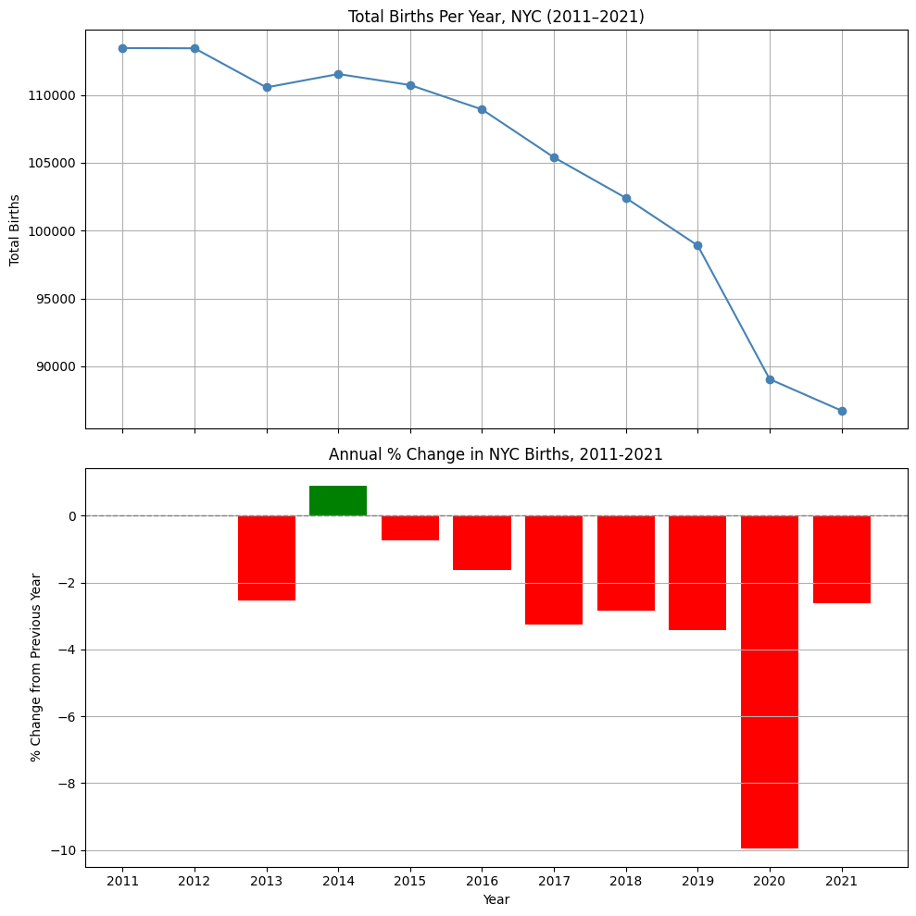
In 2011, just over 113,000 babies were born. In 2021, this number dropped to about 87,000 babies.
Across NYC, no.of births rate have been declining by, on average, by 2.61% each year.
This data quantifies the number of births occurring at voluntary hospitals, municipal hospitals, at home, birth centers, and alternative birthing locations.
Slide 2 of 24

Slide 11
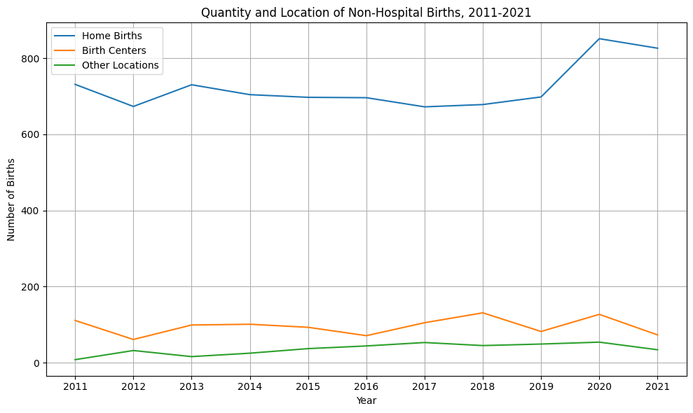
Despite the decline in hospital births, the quantity of births occurring at home, birth centers, or other alternative birthing locations remains relatively constant.
Slide 3 of 24

Slide 12
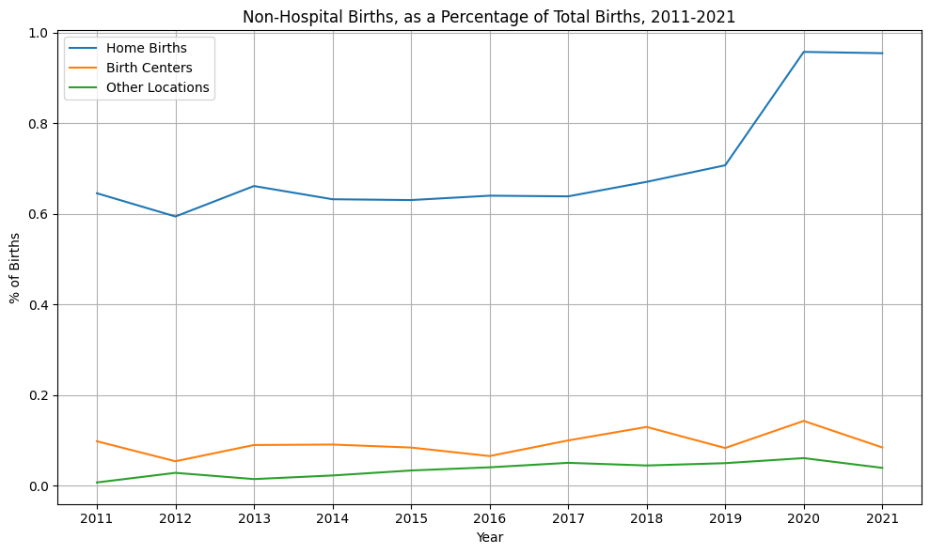
In fact, the percentage of all births that are home births has slightly increased.
However, home births still account for a minimal proportion of all births at less
than 1%.
Slide 4 of 24

Slide 13

02.
Providers of Natal Services

Slide 14
Medicaid Enrolled Providers
No. of Providers in NYC by Borough (2025)
Borough | No. OBGYNs | No. Midwives | No.Doulas | Total
Bronx | 345 | 149 | 14 | 508
Brooklyn | 266 | 152 | 44 | 462
Manhattan | 537 | 101 | 17 | 655
Queens | 275 | 75 | 28 | 378
Staten Island | 64 | 9 | 7 | 80
Total | 1487 | 486 | 110 | 2083
Slide 5 of 24

Slide 15
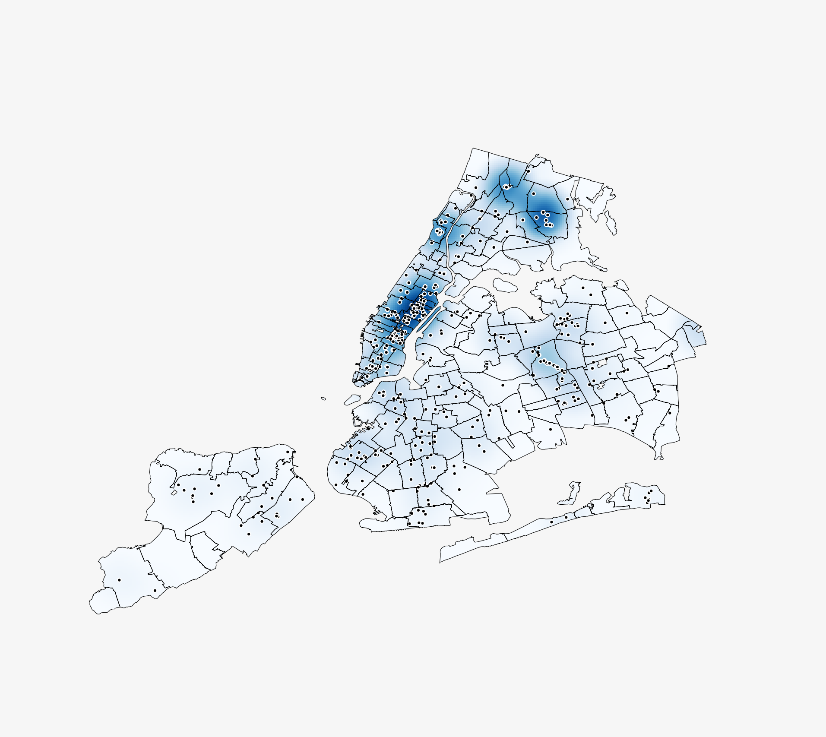
OB GYNs
Density Heatmap of OB GYN Providers
The areas with the highest concentration of OB GYNs are Manhattan (Inwood & Washington Heights and Upper East Side) and the Bronx (Southeast Bronx and Bronx Park & Fordham), containing the only neighborhoods with over 100 OB GYNs
Slide 6 of 24

Slide 16
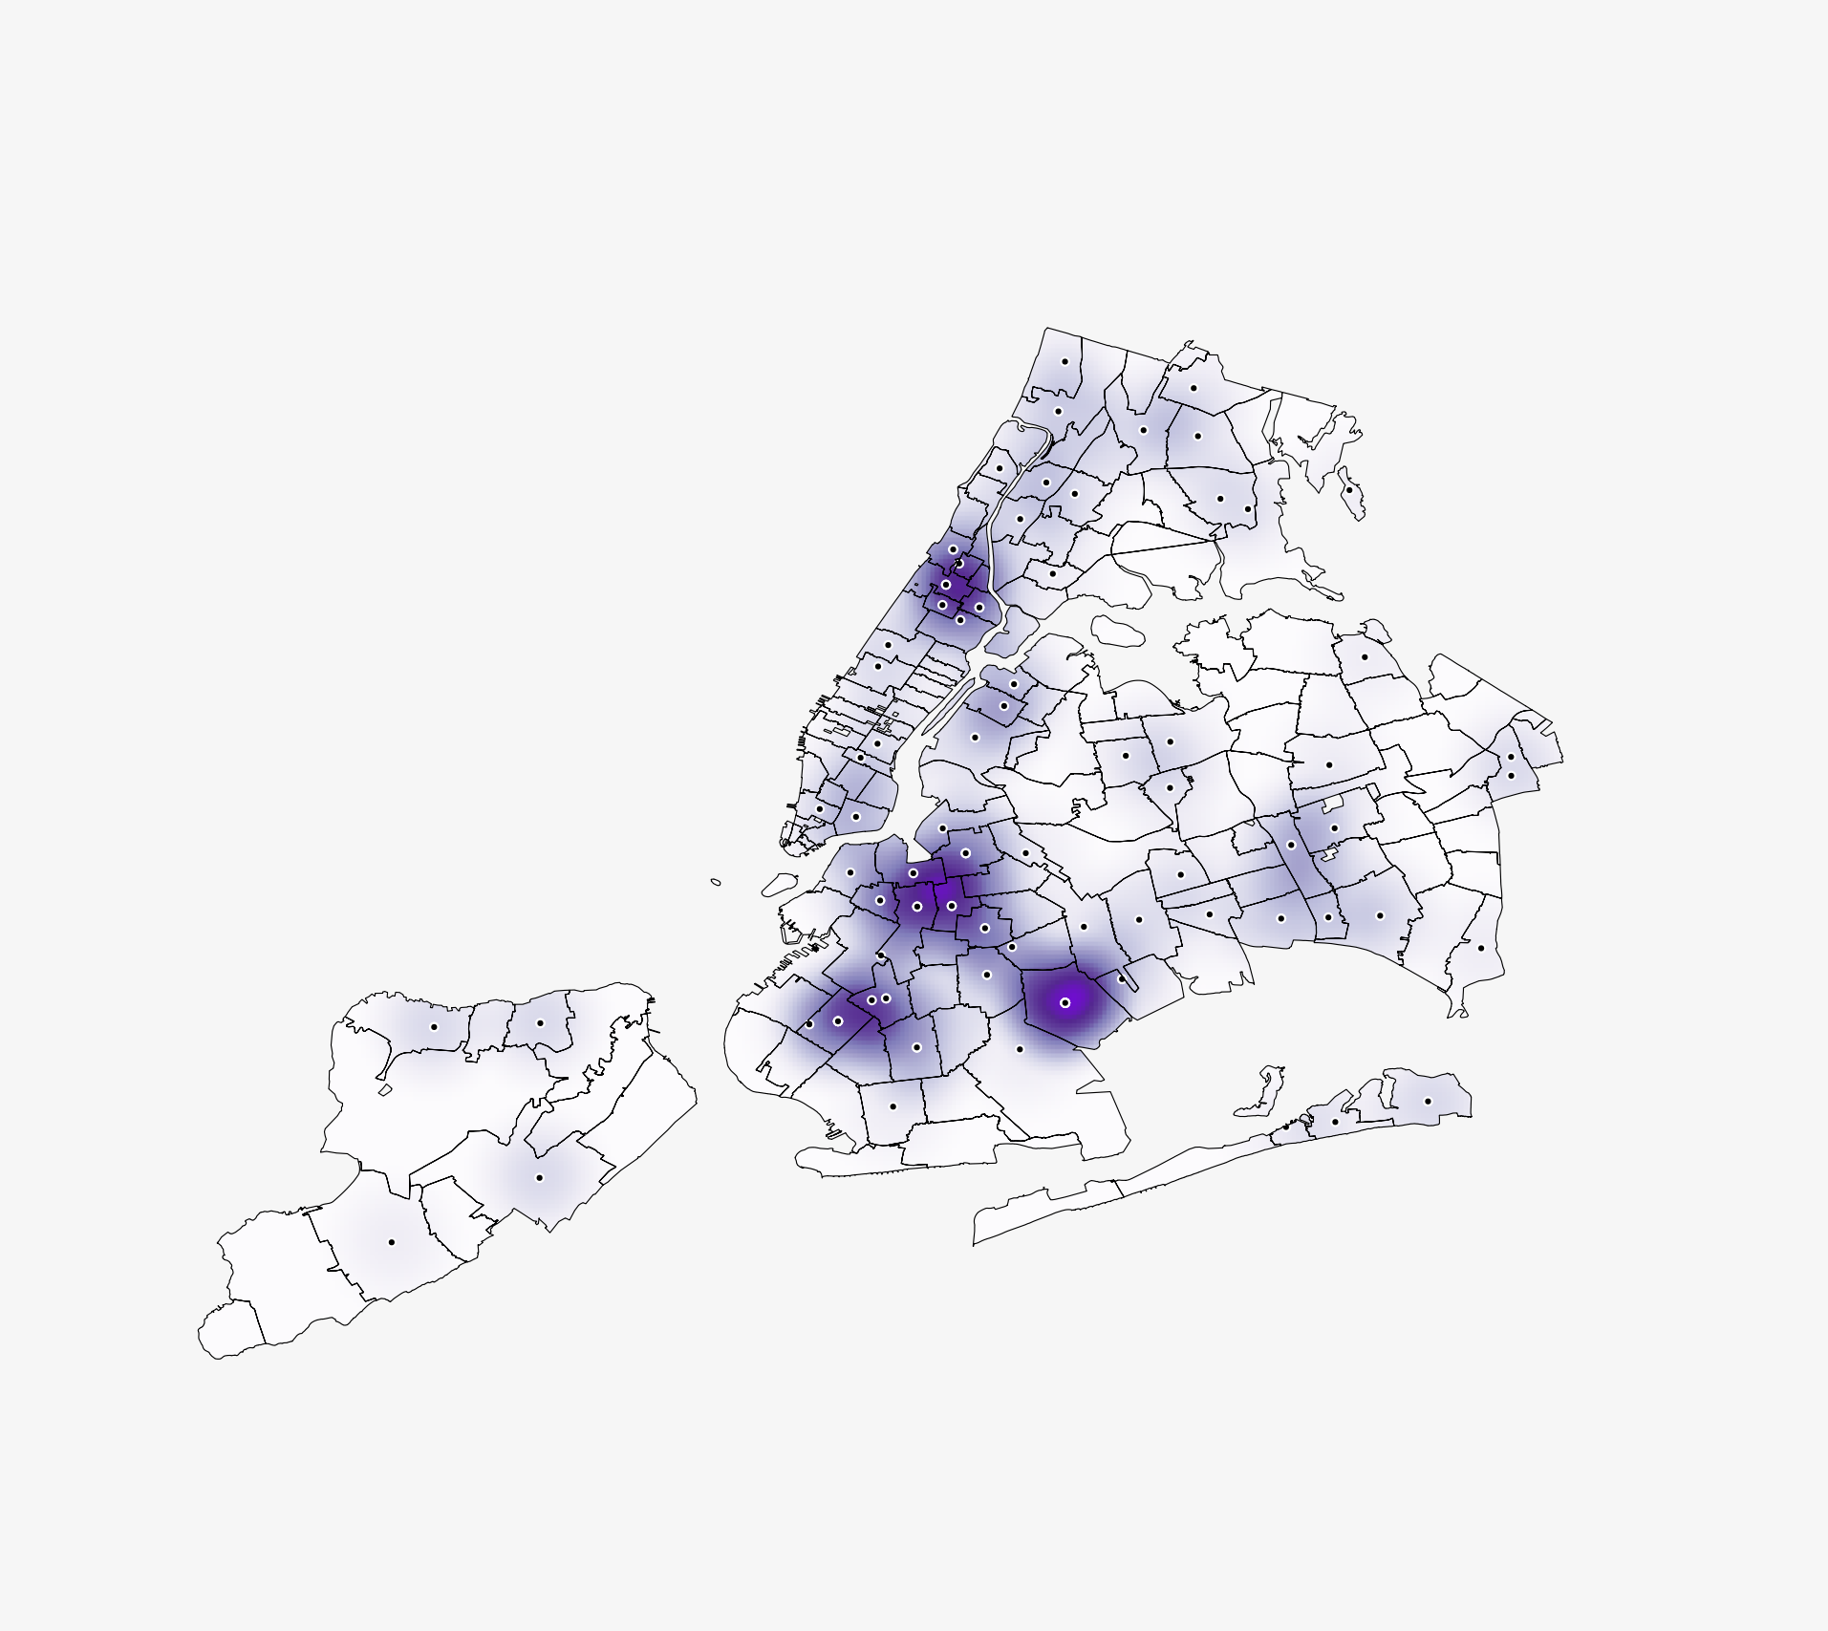
Doulas
Density Heatmap of Licensed Doulas
There are 8 neighborhoods with no medicaid enrolled, licensed doulas.
The neighborhoods with the most doulas are Borough Park and Canarsie & Flatlands
Slide 7 of 24

Slide 17
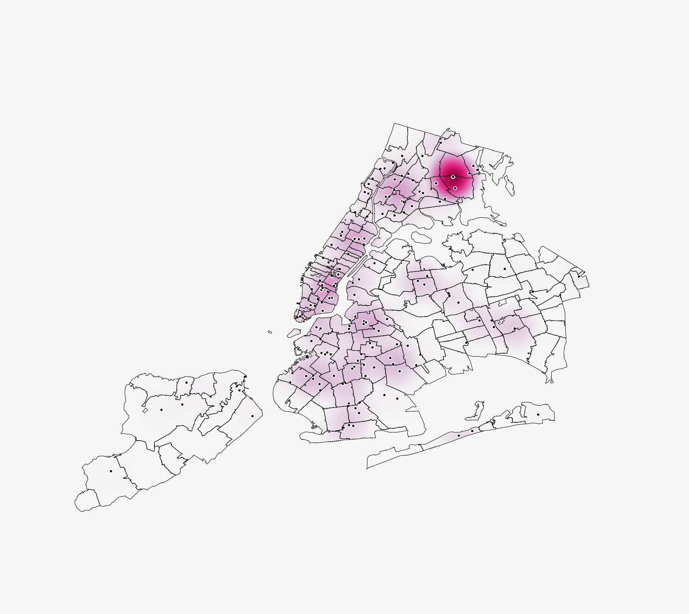
Midwives
Density Heatmap of Licensed Midwives
There are 2 neighborhoods with no licensed midwives.
The Southeast Bronx has the highest concentration of Midwives at 85 which is over 10% higher than any other neighborhood in NYC
Slide 8 of 24

Slide 18
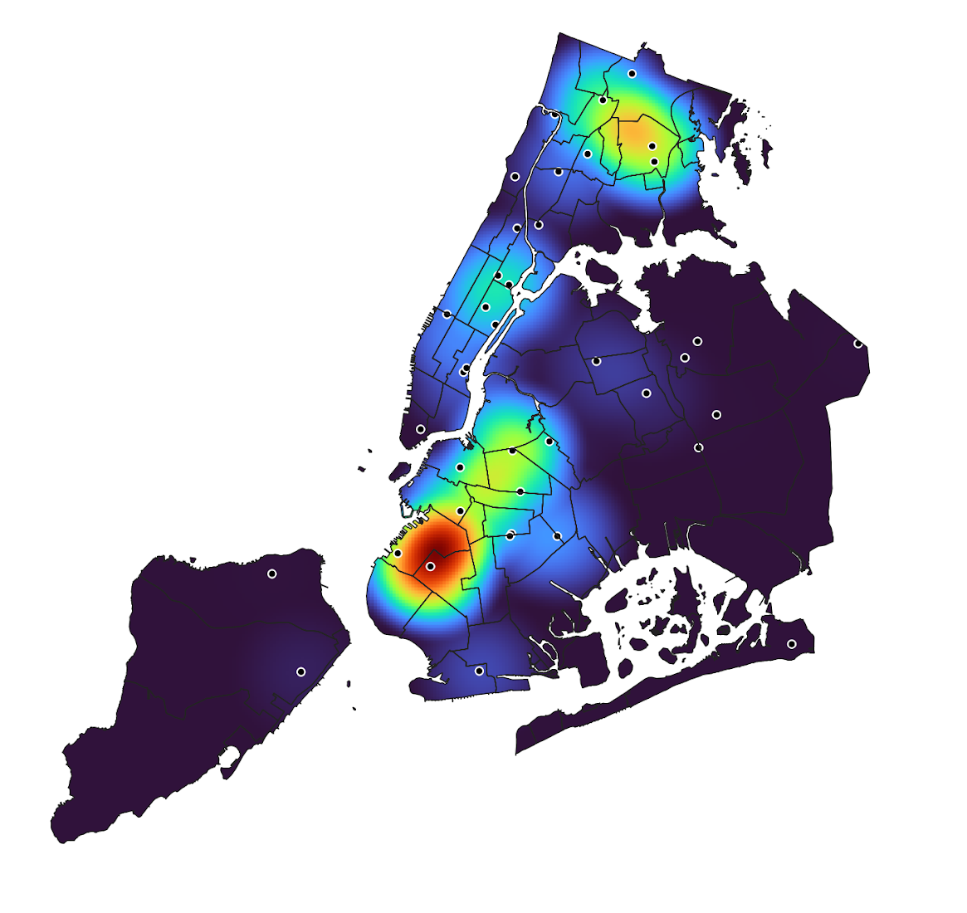
Births Attended by Midwives
Heatmap of Births Attended to By a Licensed Midwife, by NYC Healthcare Facility (2021)
The facilities with the highest attendance of births by midwives are The Jacobi Medical Center in Southeast Bronx at 58% of total births and Maimonides Medical Center in Borough Park at 1,472 ( 22% of total births)
Slide 9 of 24

Slide 19

03.
Medicaid Funding

Slide 20
MEDICAID ANALYSIS
Total Estimated Reimbursement =
(Service Reimbursement + Educational Component + Capital Reimbursement) × No. of discharges
DME Add-On
APR-DRG Weight × Case Payment Rate
We estimated Medicaid reimbursement for each hospital discharge on Medicaid from years 2015 - 2021
Unfortunately, we had to exclude 2018 due to uncertainty as to what APR-DRG weights to use for that year
Slide 10 of 24

Slide 21
Profit Estimate = Total Estimated Reimbursement - Total Costs
Profit Estimate : A measure of how comfortably hospitals have been able to cover their costs through Medicaid reimbursements
Accounting Gap Estimate = Total Estimated Reimbursement - Total Charges
Accounting Gap Estimate : A measure of the perceived deficit at which hospitals are running, based on the difference between what they charge and what they get reimbursed through Medicaid
Slide 11 of 24

Slide 22
MEDICAID REIMBURSEMENT
Total Medicaid reimbursement has stayed relatively the same over time
Total estimated profit has gone down
Accounting deficit estimate has gone up
Signifies rising costs and charges
Year | Total Capital Reimbursement (in millions of dollars) | Total Reimbursement (in millions of dollars) | Total Estimated Profit (in millions of dollars) | Accounting Gap Estimate (in millions of dollars)
2015 | 193.7 | 1,499.9 | 270.7 | -2,124.1
2016 | 238.7 | 1,558.9 | 293.9 | -2,172.4
2017 | 195.5 | 1,408.7 | 128.2 | -2,474.6
2019 | 186.9 | 1,484.1 | 111.6 | -3,081.9
2020 | 163.3 | 1,289.5 | -48.5 | -3,225.4
2021 | 189.3 | 1,355.8 | -218.7 | -3,695.4
Slide 12 of 24

Slide 23
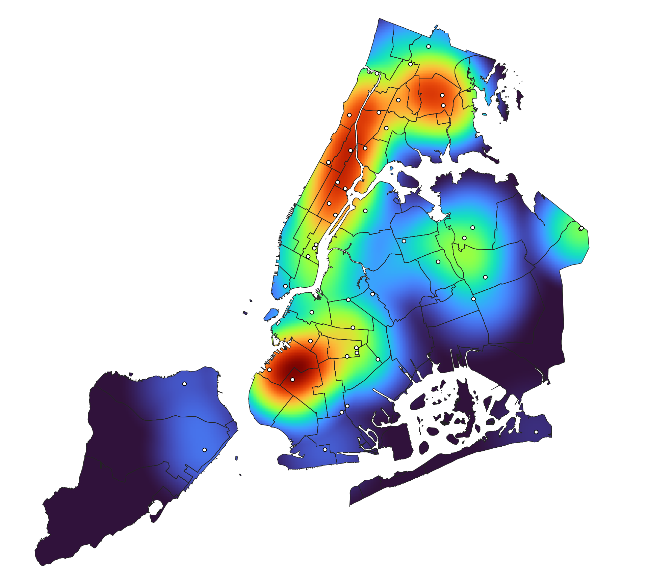
Total Medicaid Reimbursement for All Natal Services, with Maternal Healthcare Facilities, Aggregated 2015-2021
Key Findings:
Manhattan, Brooklyn, and Bronx healthcare facilities are reimbursed the most for all natal services, including high-risk deliveries and its associated needs.
Slide 13 of 24

Slide 24
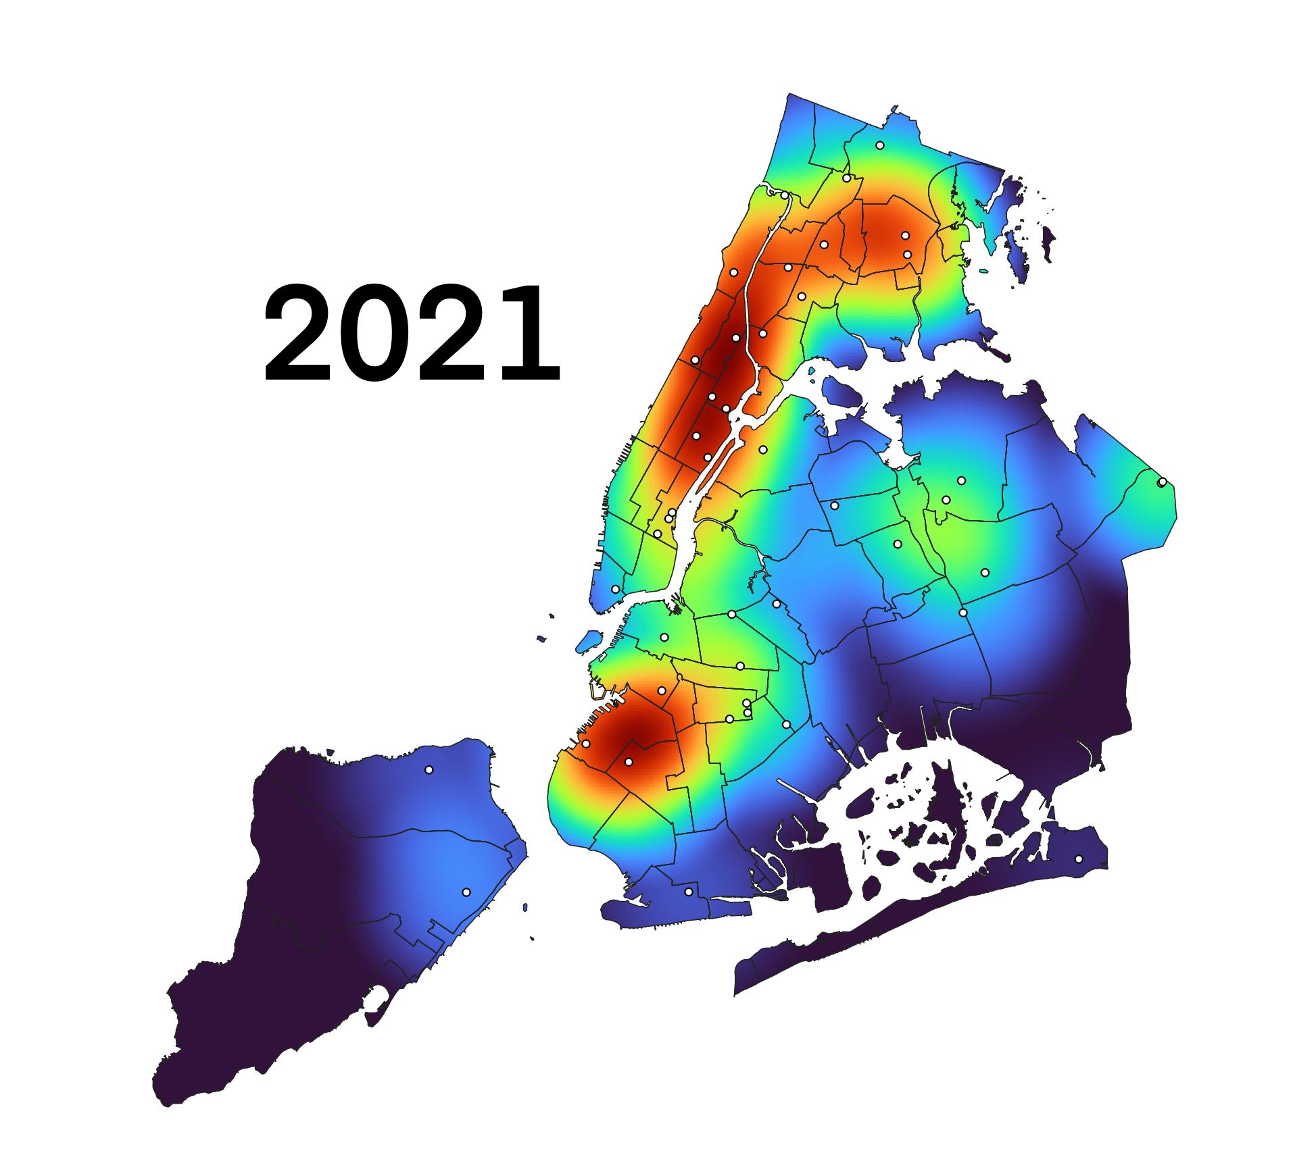
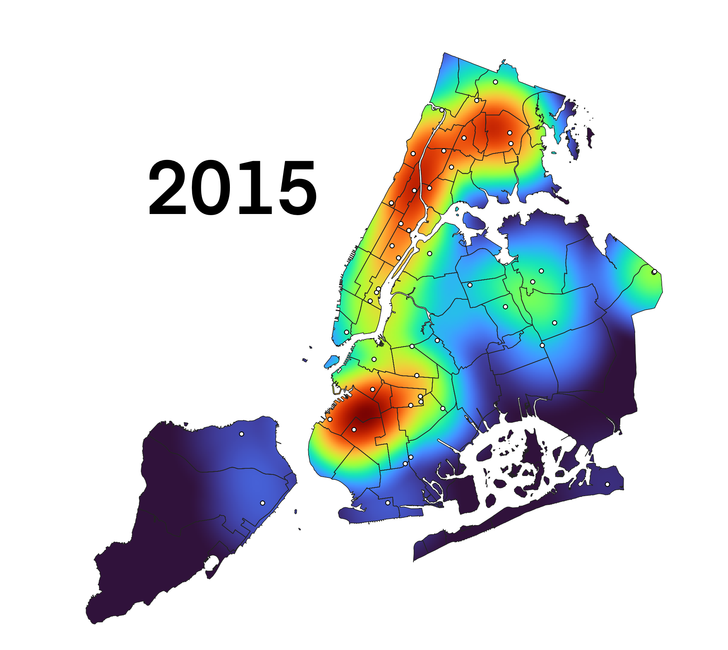
Total Medicaid Reimbursement for All Natal Services, with Maternal Healthcare Facilities, Annually 2015-2017, 2019-2021
Key Findings:
Manhattan, Brooklyn and Bronx healthcare facilities are reimbursed the most for all natal services, including high-risk deliveries and its associated needs.
Slide 14 of 24

Slide 25
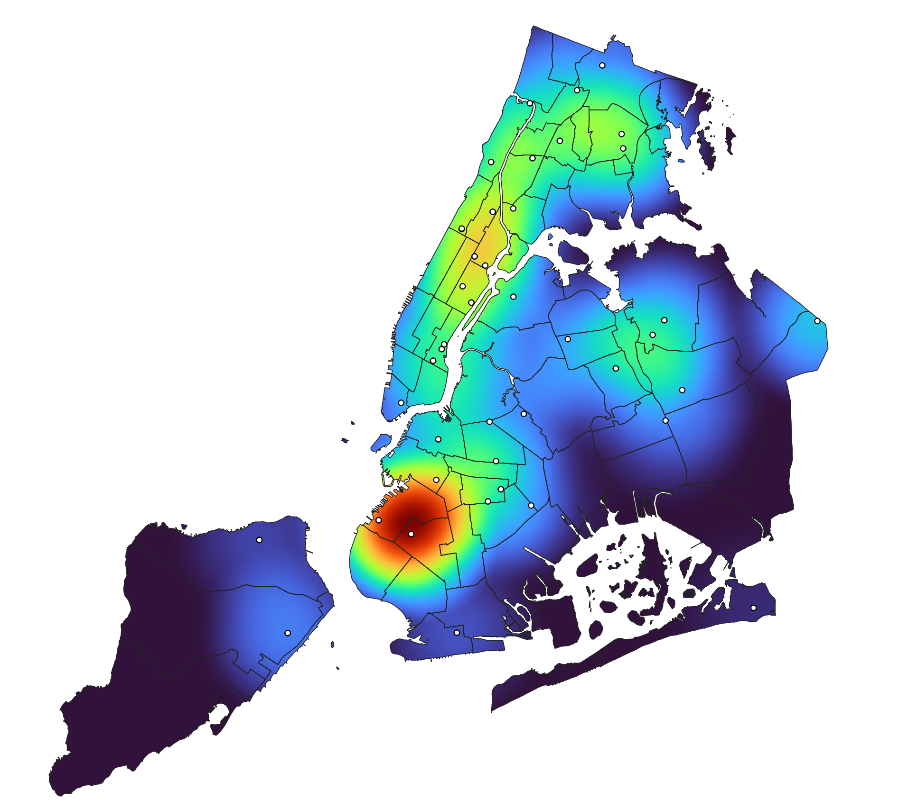
Medicaid Reimbursement for Standard Vaginal Delivery and Afterbirth Care, with Maternal Healthcare Facilities
Aggregate 2015-2021
Key Findings:
Brooklyn healthcare facilities account for the highest amount of Medicaid funding for standard, low-risk vaginal deliveries and standard afterbirth care services.
This suggests healthcare facilities in Manhattan and the Bronx handle more high-risk deliveries.
Slide 15 of 24

Slide 26
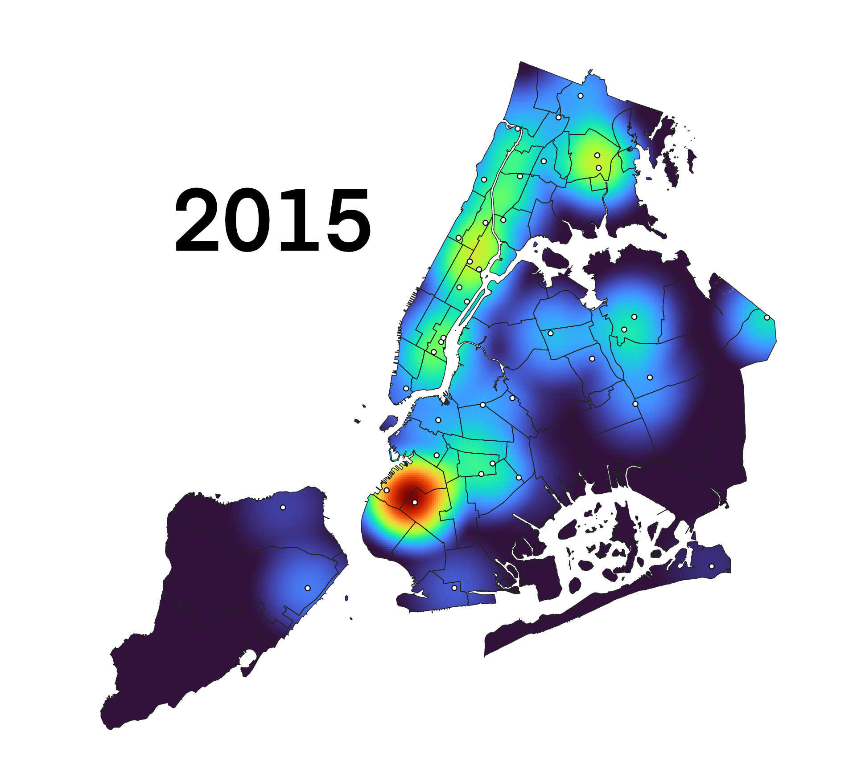
Medicaid Reimbursement for Standard Vaginal Delivery and Afterbirth Care, with Maternal Healthcare Facilities
Annually 2015-2017, 2019-2021
Key Findings:
Brooklyn healthcare facilities account for the highest amount of Medicaid funding for standard, low-risk vaginal deliveries and standard afterbirth care services.
This suggests healthcare facilities in Manhattan and the Bronx handle more high-risk deliveries.
Slide 16 of 24

Slide 27

04.
Index of
Needs

Slide 28
Index Of Needs
What is it?
Why does it matter?
Weighted sub-indices for maternal race, education, family income, prenatal care, and the no. of net births and net births on Medicaid.
Unit of Observation: District Community
Highlights areas where systemic inequities related to race, socioeconomic status, education, prenatal care access, and healthcare coverage intersect to impact maternal and infant health outcomes.
Replicable.
Slide 17 of 24

Slide 29
Index of Needs – Qualitative Study
RACE | Black, Hispanic, and multiracial women experience higher rates of mistreatment, medical mistrust, and bias from their healthcare providers during childbirth.
EDUCATION | Lower levels of education correlates with lower health literacy, communication challenges, and a reduced trust in providers.
INCOME | Income impacts a person’s ability to obtain timely prenatal care, afford necessary medications, secure transportation to medical appointments, and access peer resources and supports.
MEDICAID | The quantity of medicaid- funded births both identifies lower-income need, but also neighborhoods that can finance new birthing centers.
BIRTHS | A high density and quantity of births in a neighborhood requires healthcare facilities to be well equipped to provide diverse and adequate care for more patients.
PRENATAL CARE | Higher rates of inadequate prenatal care indicate barriers to accessing care. This index captures auxiliarily factors that contribute to poor natal care.
MULTI-INDEX | Need is multidimensional. Numerous variables intersect to shape patient needs and birth outcomes.
Slide 18 of 24
Notes:
Studies show that doula support leads to: lower cesarean rates, fewer complications during labor, improved birth satisfaction and confidence, and better pos

Slide 30
Indices Formulas
RACE INDEX | (45.71 × Births with black mothers + 40 × Births with hispanic mothers + 14.29 × Births with Asian mothers)/(10 × Total number of births)
EDUCATION INDEX | (40 × Births with mothers with less than a high school education + 30 × Births with mothers with a high school diploma/GED + 20 × Births with mothers with an associate’s degree + 10 × Births with mothers with a bachelor’s degree)/(10 × Total number of births)
INCOME INDEX | 10 × (0.75 × (1 - Percentile median family income with children across NYC) + 0.25 × (1 - Percentile median family income without children))
MEDICAID INDEX | 10 × Proportion of births paid by Medicaid
BIRTHS INDEX | Percent total number of births across NYC (in %)
PRENATAL CARE INDEX | (50 × Births with mothers who received no prenatal care + 33.5 × Births with mothers who received pre-natal beginning the third trimester + 16.5 × Births with mothers who received pre-natal beginning the second trimester)/(10 × Total number of births)
MULTI-INDEX | 2 × Birth index × ((32.73 × Race index + 21.82 × Medicaid index + 20 × Prenatal care index + 16.36 × Income index + 9.09 × Education index)/500)
Slide 19 of 24

Slide 31
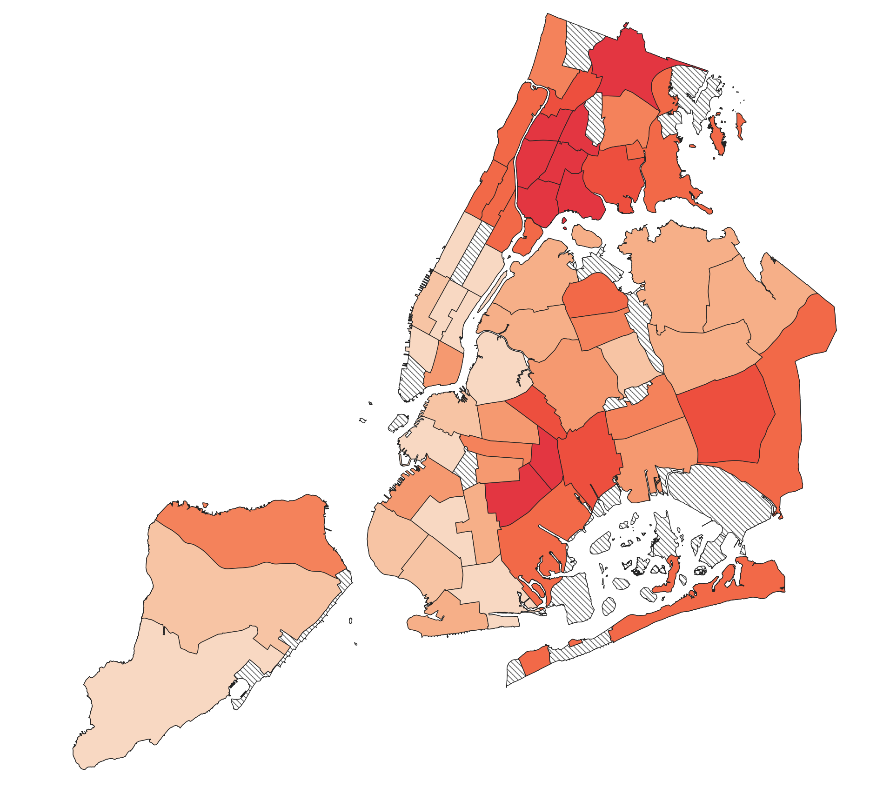
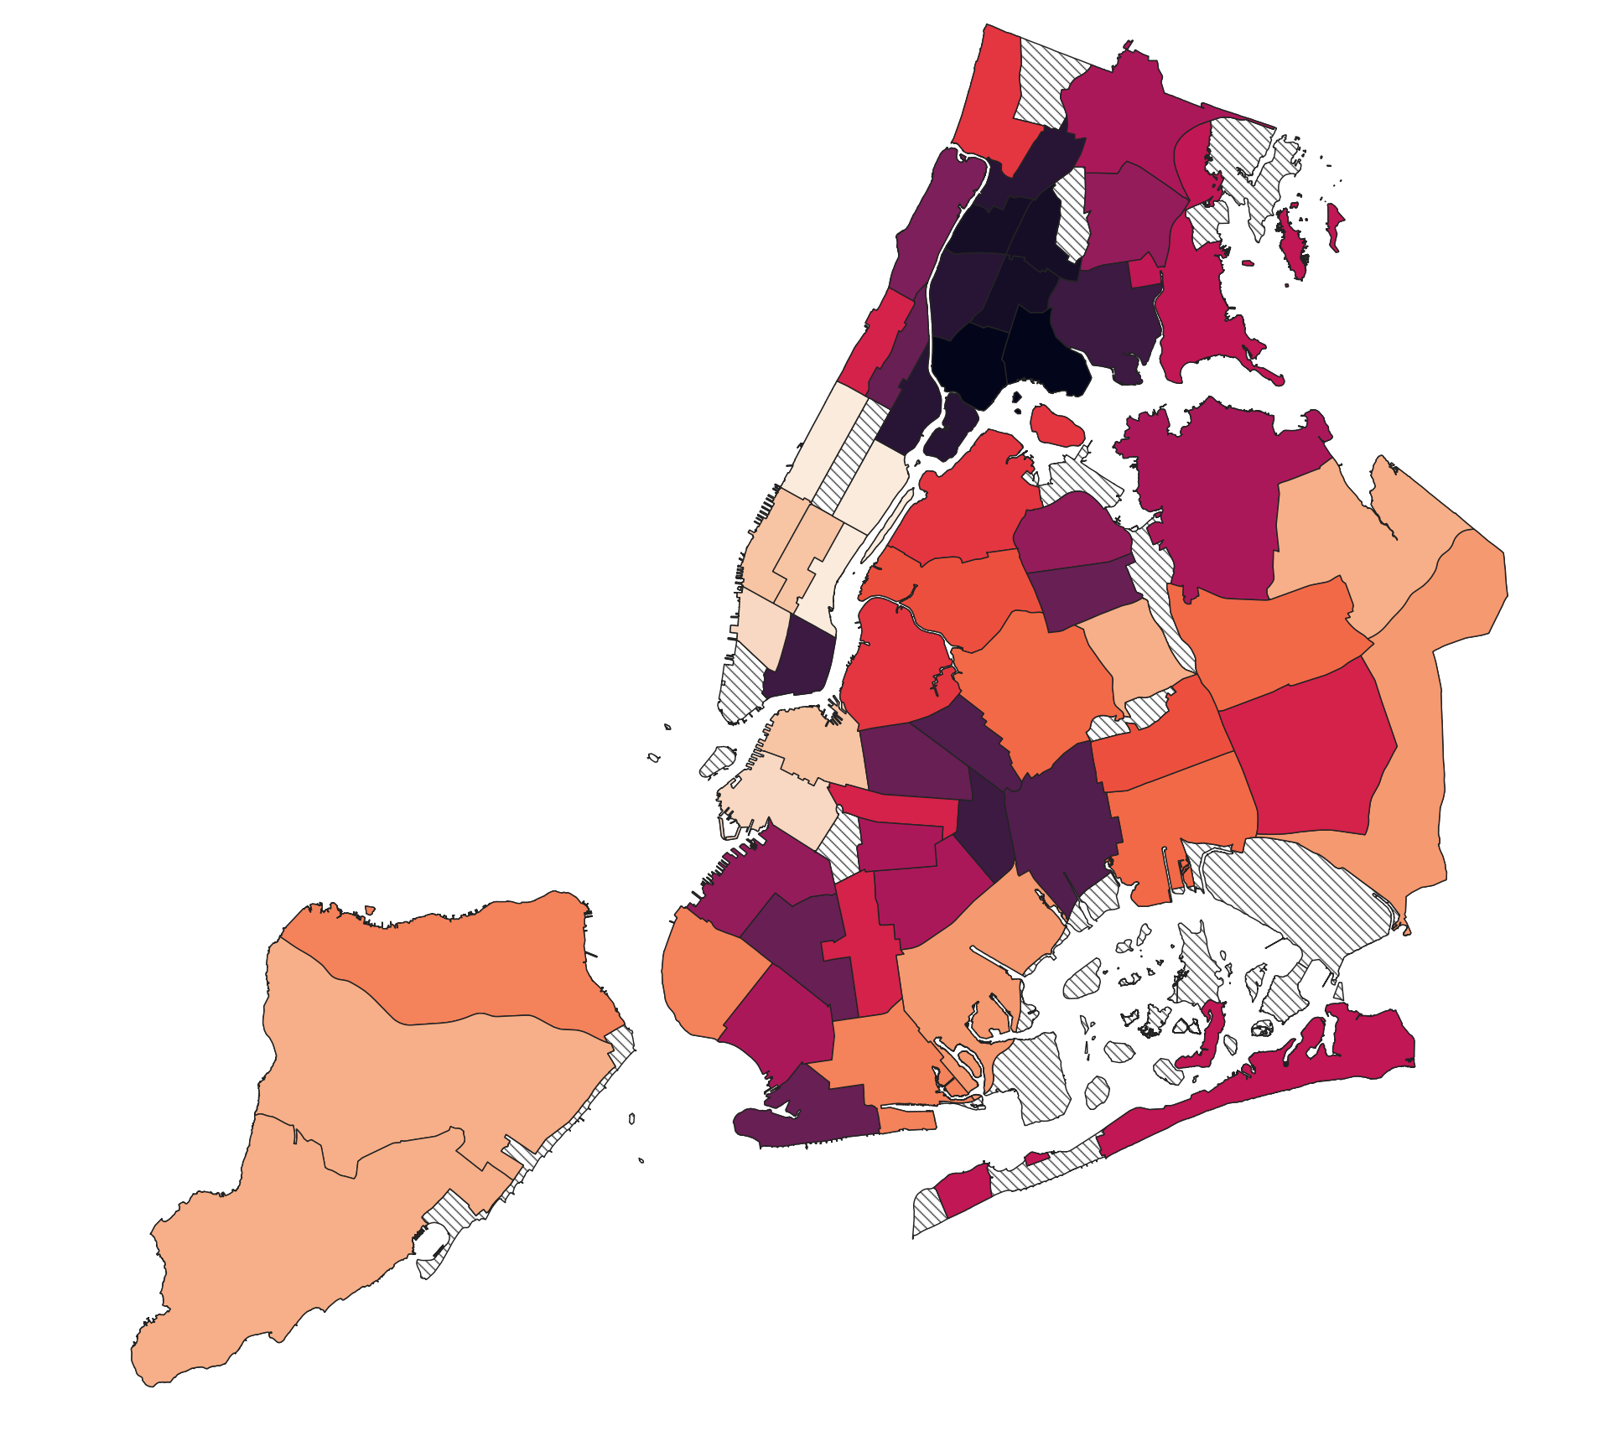
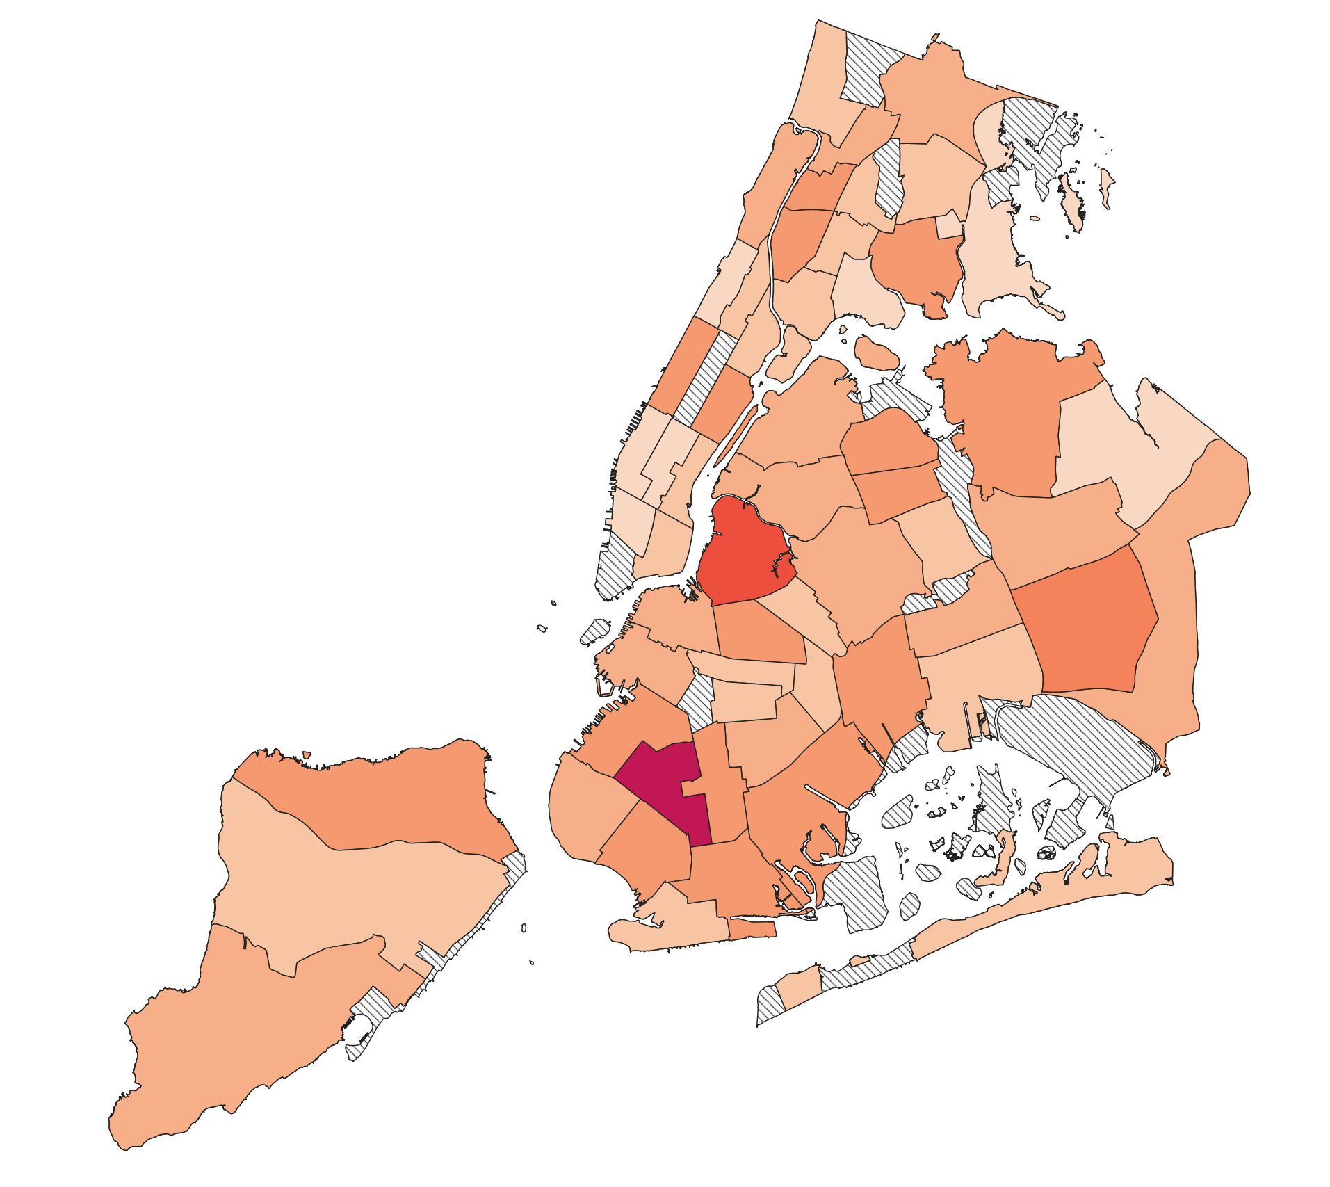
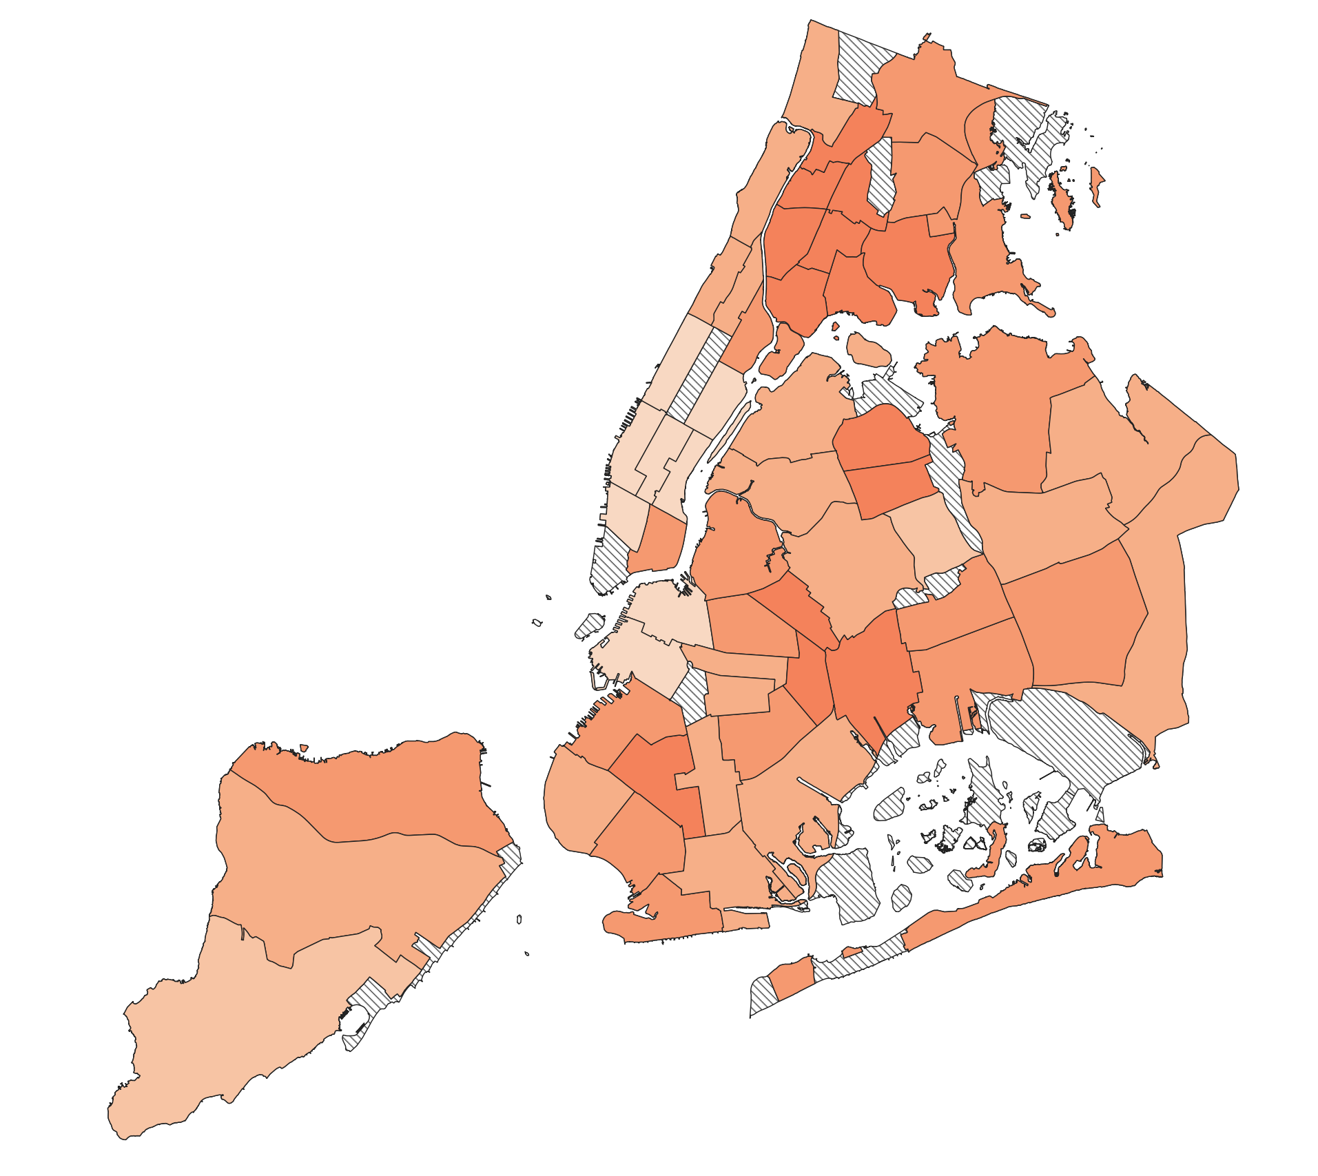
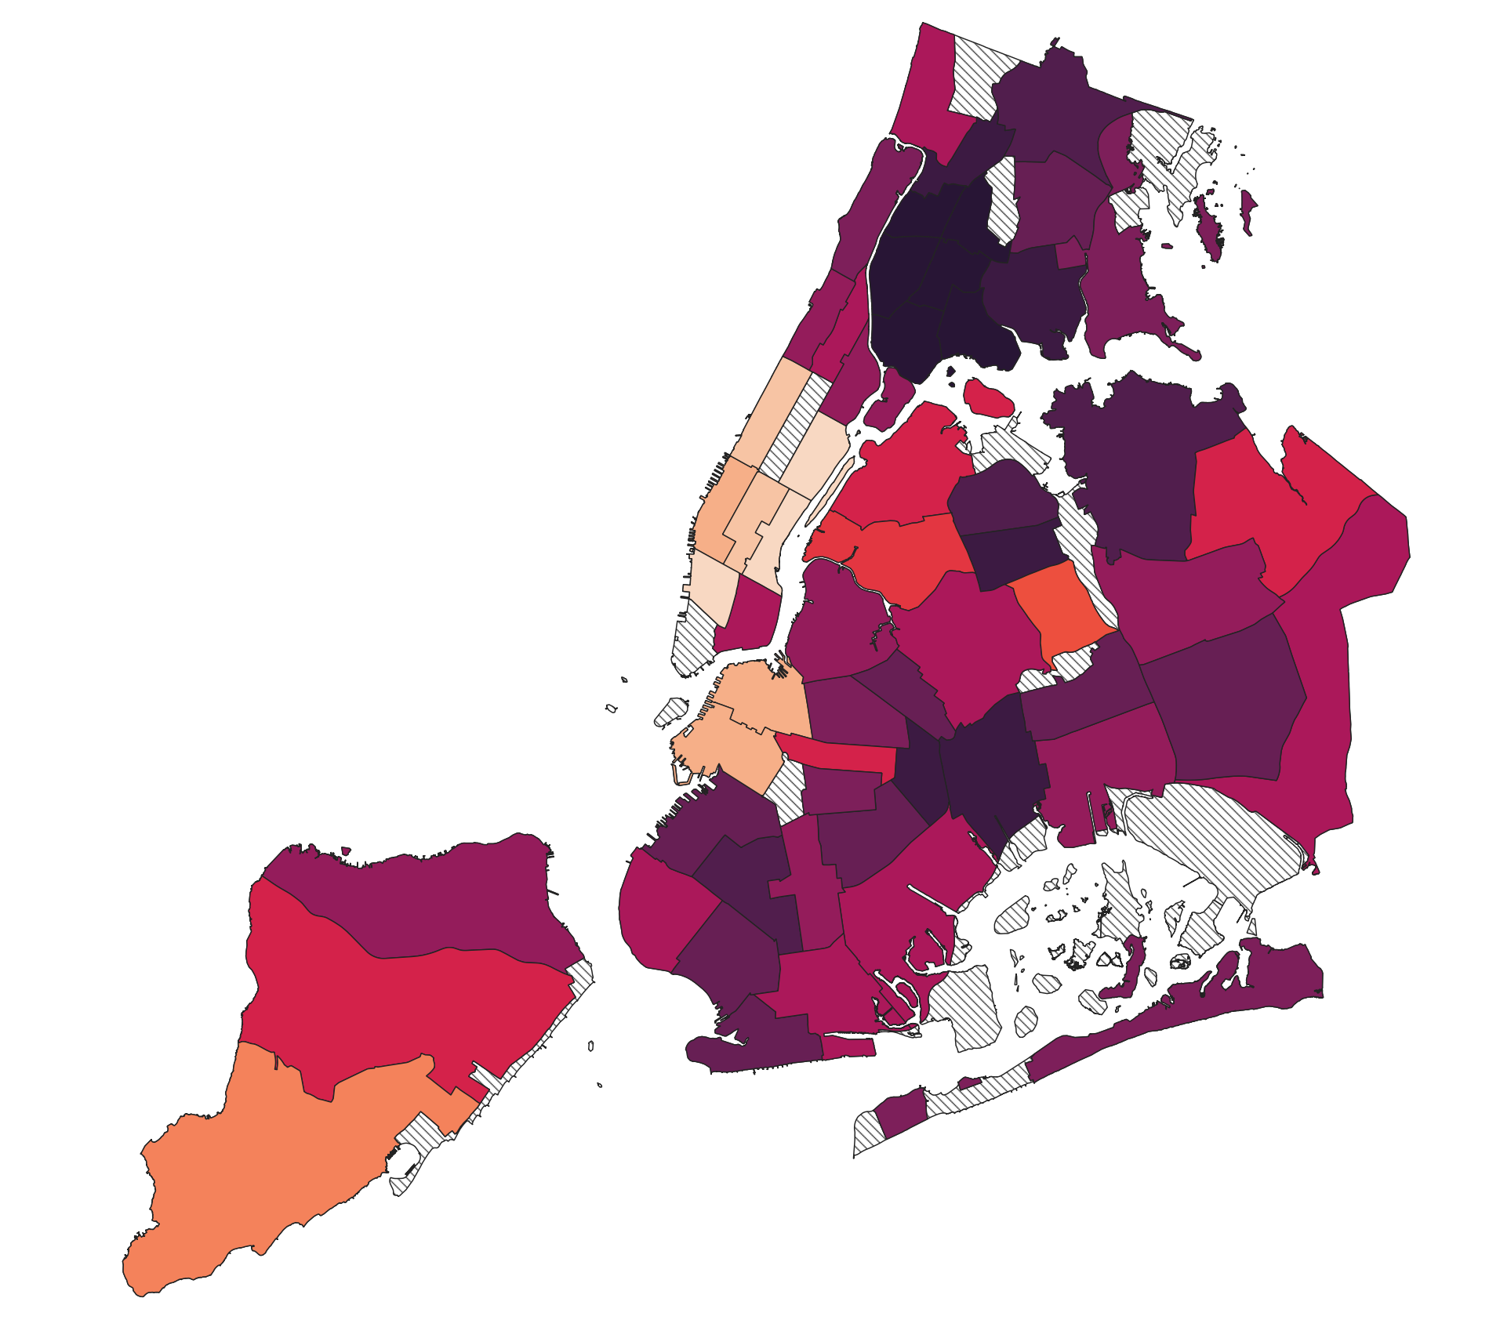
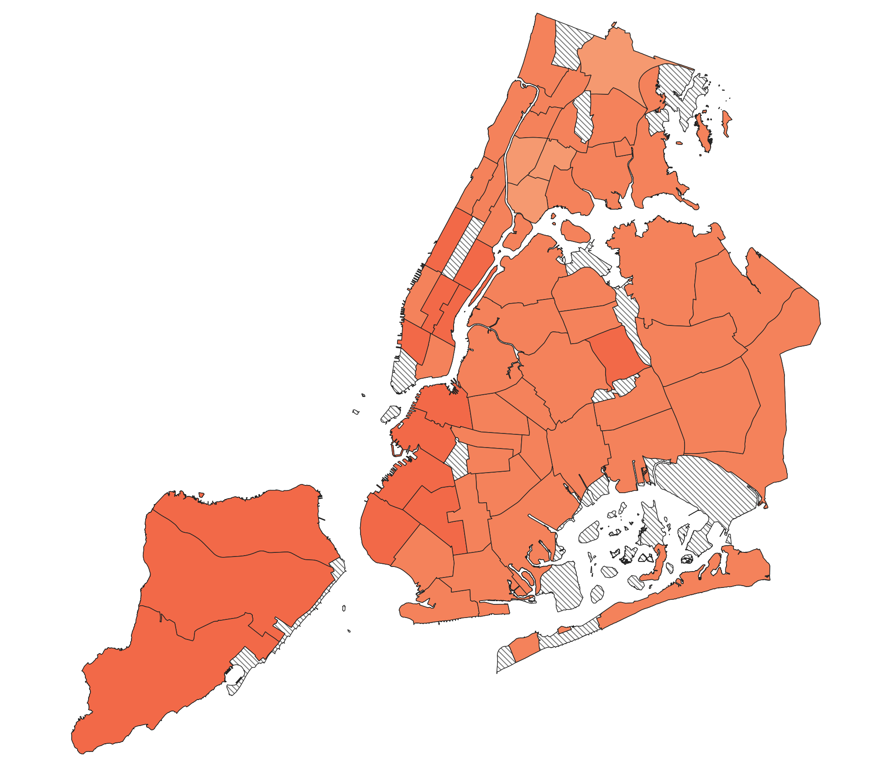
Aggregate Sub-Indexes, 2015-2021
RACE
INCOME
BIRTHS
EDUCATION
MEDICAID
PRENATAL CARE
Slide 20 of 24

Slide 32
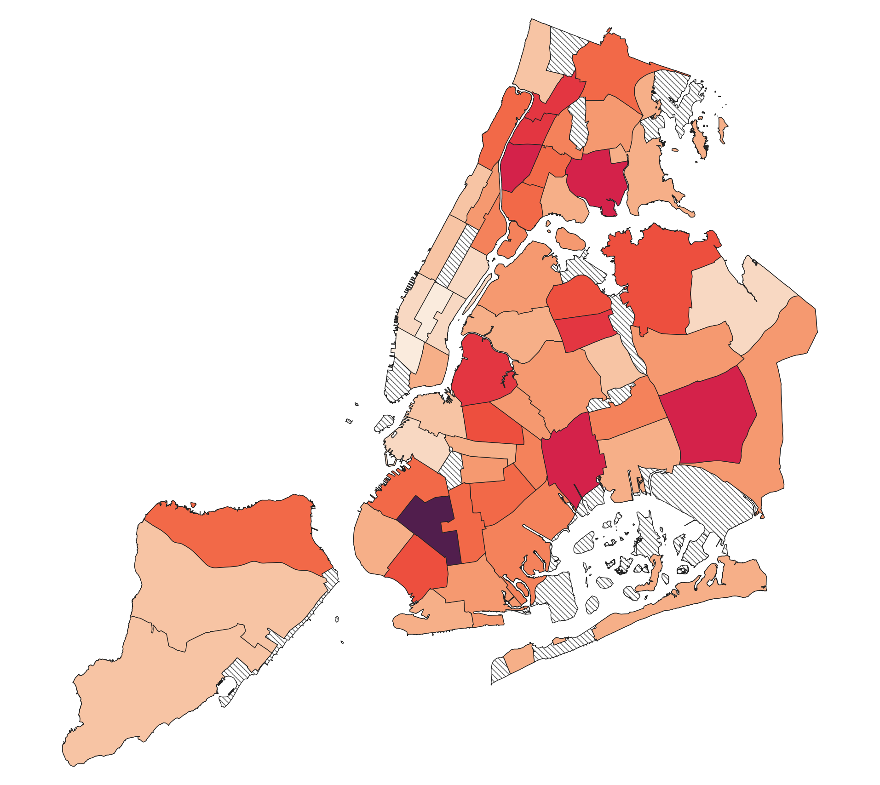
Aggregated Multidimensional Needs Index by NYC Community District, 2015-2021
Key Findings:
Borough Park, Brooklyn has the highest needs index of 7.85. Greenwich Village/SOHO has the lowest needs index at 0.31.
Average Score, By Borough
Bronx: 3.06 (Highest)
Brooklyn: 3.00
Queens: 2.51
Staten Island: 1.84
Manhattan: 1.33 (Lowest)
GREENWICH VILLAGE / SOHO
BOROUGH PARK
Slide 21 of 24

Slide 33

05.
Case Studies

Slide 34
Borough Park
Community Context
Gender Roles & Family Dynamics
Birth Practices & Institutional Trust
Highest birthrate in the city & highest needs index
Based on demographic trends of large households, early marriages, and low-income families
Shaped by religious tradition and clearly defined gendered spaces
Influences expectations around childbearing
Religious norms & rabbinical guidance carry significant influence
Maimonides Medical Center is the most widely used hospital, but institutional trust is conditional
The Role of Midwives & Doulas
Barriers & Community Support
Implications for System Design
Tied for highest doulas in the city & midwives attended 1,472 births at Maimonides Medical Center
Limited access to culturally competent providers, modesty requirements, and expectations of large families
Communal support systems are well established
Disregarding religious norms can be dangerous
Community, faith, & culture can be positively impacted by doulas and midwives
Slide 22 of 24

Slide 35
The Birthing Place & Womb Bus
Community Context
Bronx Maternal Mortality
Vision & Launch
The Bronx has the highest severe maternal morbidity rate in NYC: 377 per 10,000 vs 283 per 10,000 citywide
Black women in the Bronx are 9x more likely to die from pregnancy-related complications
Key causes: medical mistrust, transportation barriers & structural racism
The Birthing Place is a freestanding, BIPOC-led initiative for culturally competent reproductive services in the Bronx
Prenatal education, lactation counseling & mental health support
The Role of Midwives & Doulas
Barriers & Community Support
Support & Funding
Maryam Clinic provides holistic prenatal and postpartum care with a team of midwives, OB/GYN & doulas
Medicaid billing approved & community-led care model
Womb Bus - mobile wellness hub
Travels into the Bronx providing services
Since its launch, it has reached more than 800 families in high need areas
Support and funding come from various sources: political endorsement, seed funding (10,000 grant in 2023), and ongoing capital campaigns
Slide 23 of 24
Notes:
Scalable phased approach:
Freestanding birth center: capacity building classes and programs for community members
Womb bus builds trust and addresses immediate community needs
Maryam clinic offers integrated care in collaboration with doulas, midwives, and OB/GYNs
*Not just an alternative, but a core part of the public health system in NYC

Slide 36

06.
Steps For the Future

Slide 37
Further Recommendations
Research involving non-hospital facilities (like clinics) non-explicitly providing maternal services, i.e. in tandem with other services
Research involving providers whose enrolment with Medicaid is pending in NYS
Research involving Medicaid reimbursement for non-hospitals
Furthering present research beyond 2021
Slide 24 of 24

Slide 38
Questions?

