Slide 1
Introduction to US Army Corp of Engineers Dredge Program
Arsheen Ehtesham- Dredged Material Management-SME
Operations Division
U.S. Army Corps of Engineers, New York District
17 November 2025

Slide 2
Agenda
Why should we talk about mud?
Basics!
      Why do we dredge?
      What is dredged material?
      Where do we dredge?
      Dredging equipment.
Environmental Coordination
How can dredged material be useful and Beneficial!
NYSDEC- Beneficial Use Determinations
Working with USACE.
Questions?

Slide 3
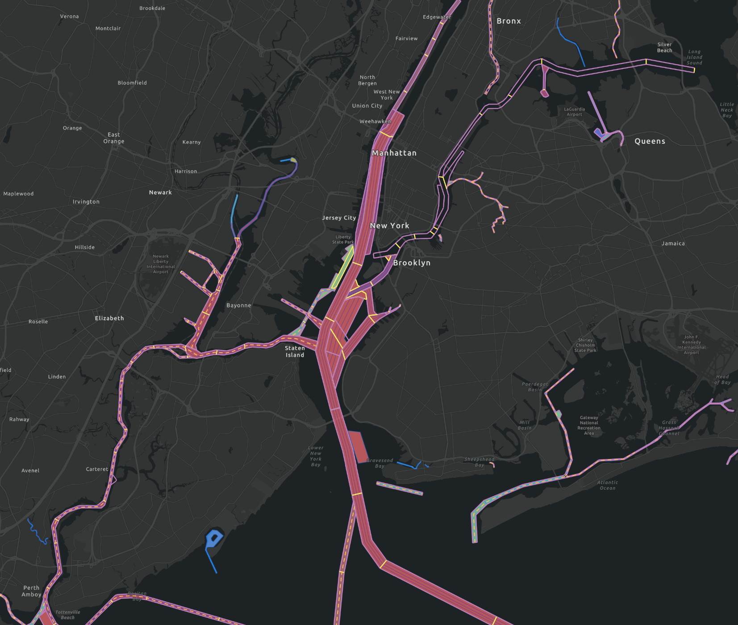
Why are we here discussing MUD?
Routine Maintenance Dredging
USACE New York District maintains approximately 45 Federal Navigation Channels.
On average New York District generates 1 million cubic yards of maintenance dredged material per year with a single project averaging 150,000-250,000 cubic yards.
Material types can include sands, silts and silty-clays.

Slide 4
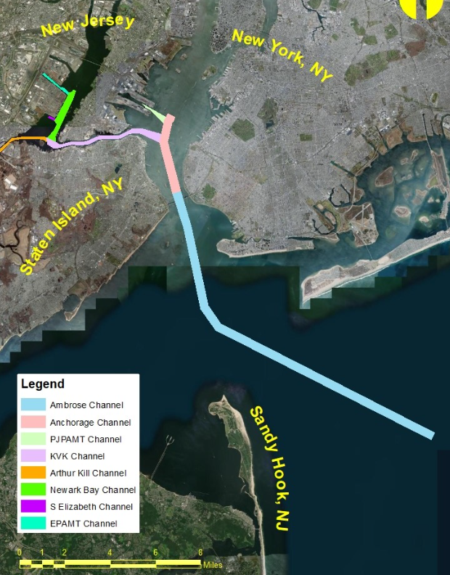
Why are we here discussing MUD?
Harbor Deepening and Channel Improvements
The Recommended Plan would deepen the pathways from sea to Elizabeth – Port Authority Marine Terminal and Port – Jersey Port Authority Marine Terminal to a maintained depth of -55 feet MLLW.
The effort would result in 30 million cubic yards of dredged material including sand, silts, and rock. The project is currently in the design and engineering phase.
Project Website:
https://www.nan.usace.army.mil/New-York-New-Jersey-Harbor-Deepening-Channel-Improvements-Preconstruction-Engineering-Design/

Slide 5
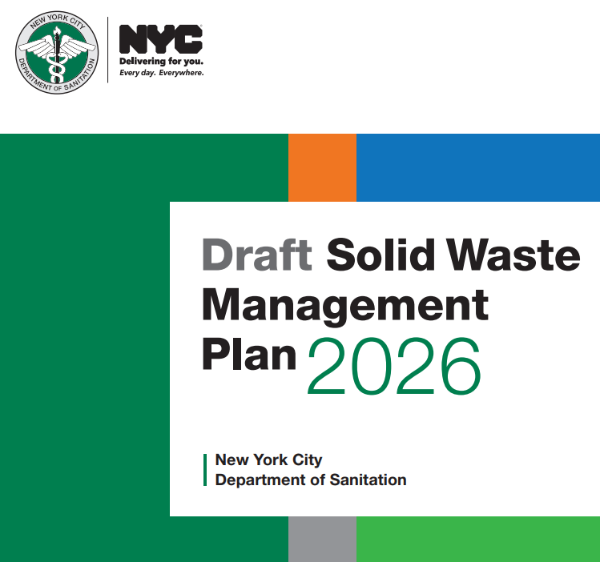
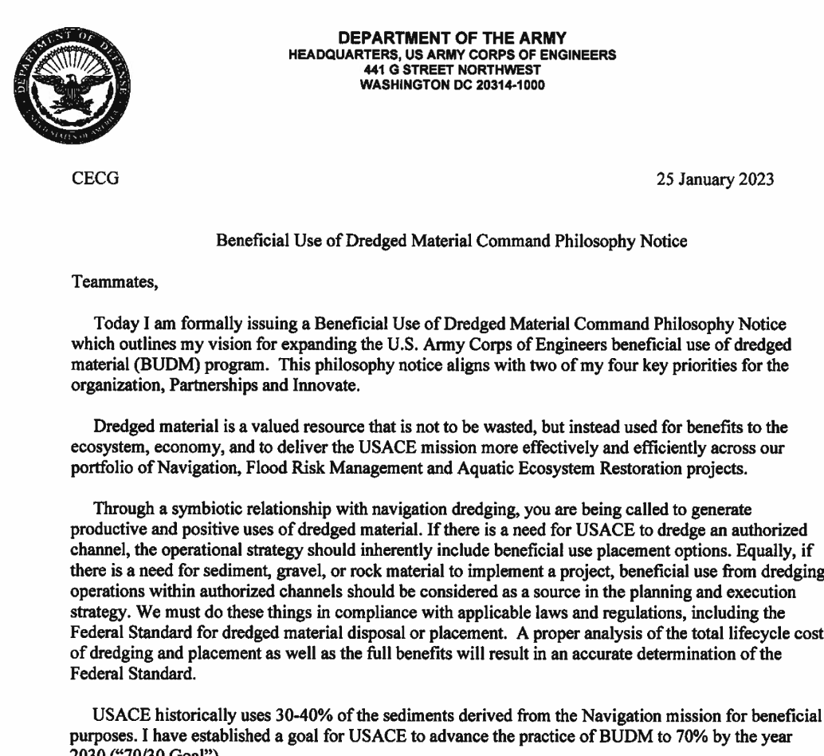
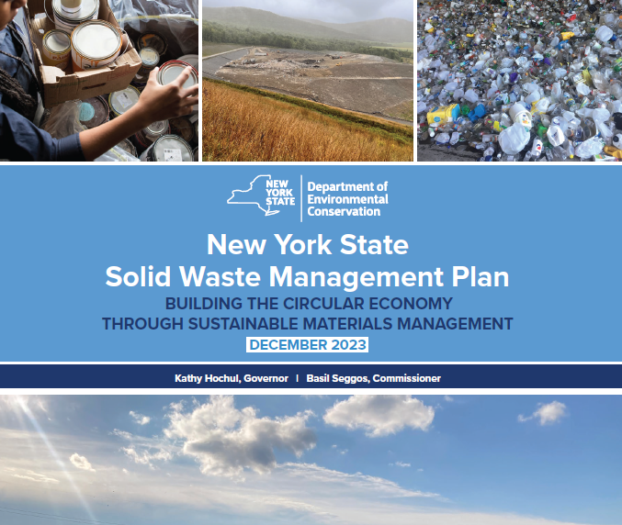
Why are we here discussing MUD?
USACE Goal For Beneficial Use of Dredged Material
In January 2023, USACE Lt. General Spellmon issued a philosophy notice establishing a goal of 70% beneficial use of dredged material by 2030.
This initiative aligns with the circular economy principles championed by New York State and New York City, which prioritize the reuse of materials.

Slide 6
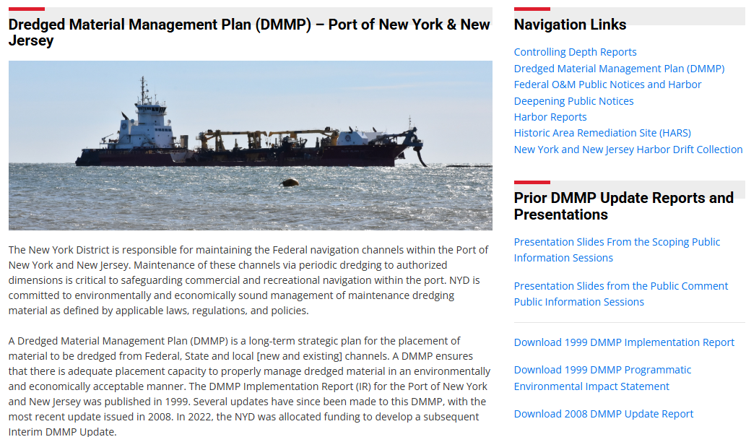
Why are we here discussing MUD!
2025 Dredged Material Management Plan Update
In July 2025, USACE New York District issued an update to the Dredged Material Management Plan to the Port of New York & New Jersey. This update evaluated the anticipated dredged material placement demand and placement site capacity from 2025 thru 2029.
USACE anticipates approximately 20 million cubic yards of dredged material will be generated over the next 5 years from regional projects, USACE O&M and USACE deepening projects.
Project Website:
https://www.nan.usace.army.mil/Missions/Navigation/Dredged-Material-Management-Plan/

Slide 7
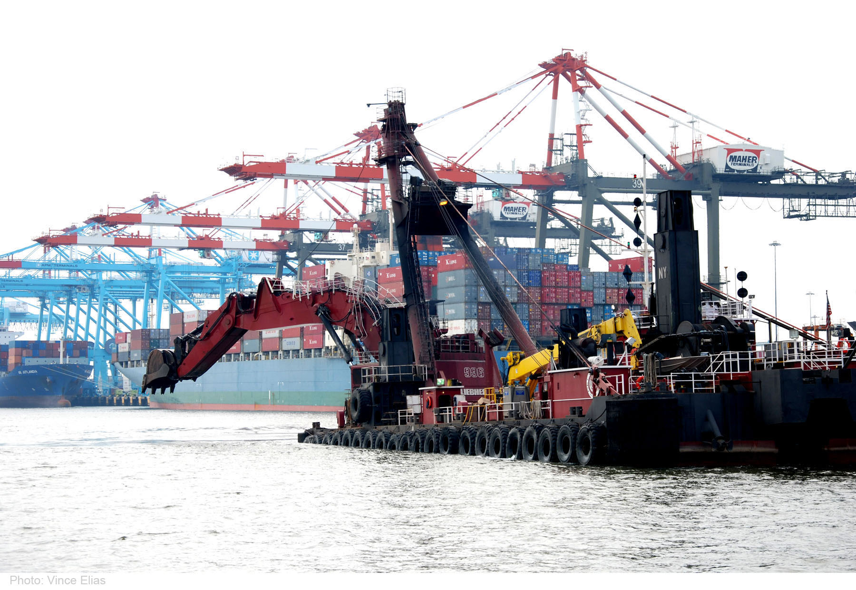
Background- Dredged material
Q: What is Dredged Material?
A: Naturally accumulated sediment (or existing rock) that is excavated from the bottom of channels, berthing area and other navigation facilities to create or maintain sufficient depth for safe and efficient vessel operation
Q: Why do we dredge?
A: Dredging is a central part of the U.S Army Corps of Engineers’ (USACE) largest mission – to maintain clear, safe and navigable federally authorized channels.
Photo: USACE dredging operations in the Port Jersey Channel, New Jersey.
Source: New York, New Jersey Harbor deepening project provides environmental, economic benefits > U.S. Army Corps of Engineers Headquarters > Story Article View

Slide 8

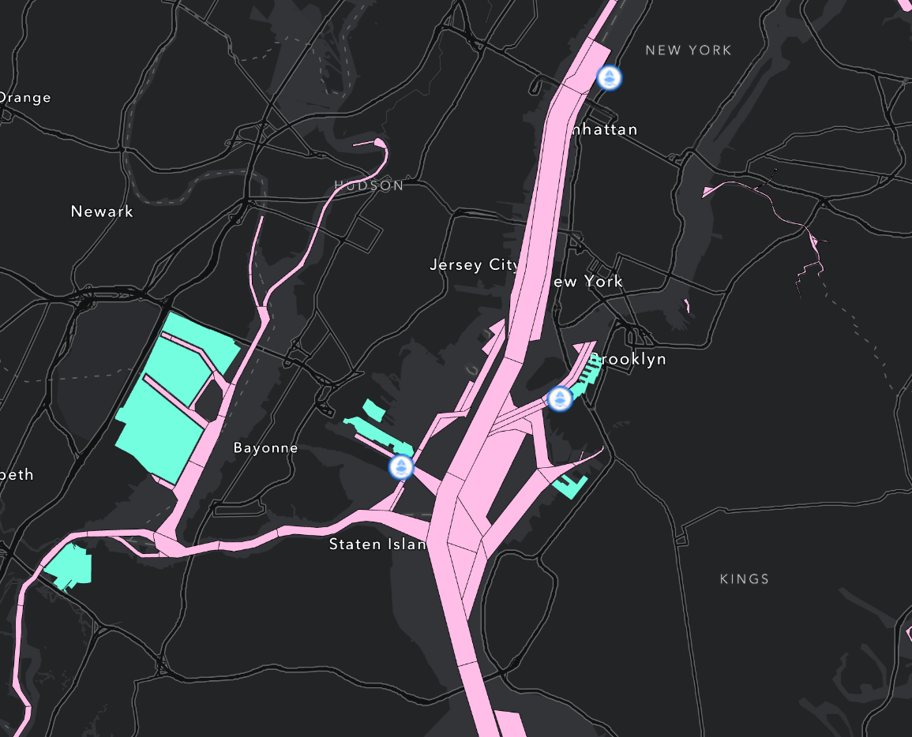
Where Do we dredge
PORT FACILITIES
FERRY TERMINALS
The District's area of responsibility encompasses 8 major river basins and Lake Champlain, Port of New York/New Jersey, 400 miles of coastline, planning & construction of environmental remediation projects, responding to military contingencies & civil emergencies, regulating impacts to wetlands & navigable waterways as well as providing real estate services support to nearly 400 U.S. Armed Forces recruiting stations & numerous military installations.
FEDERAL NAVIGATION CHANNELS MAINTAINED BY USACE-NYD

Slide 9
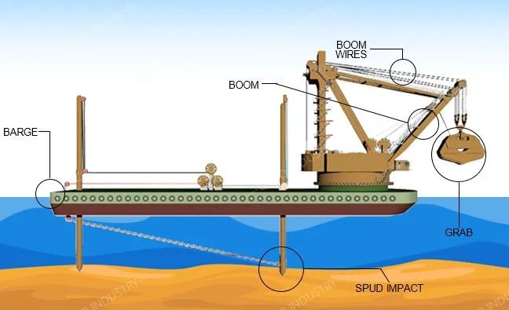
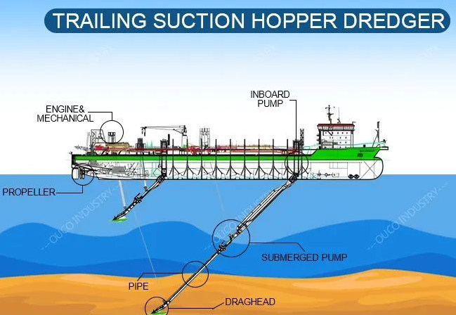
Background- dredged equipment
MECHANICAL DREDGE WITH SUPPORT BARGE
Commonly used for projects requiring precise excavation, debris removal, or dredging in confined areas, like maintenance of marinas, harbors, and waterfront infrastructure. These dredges can remove a wide range of materials, from consolidated clays and gravel to large debris and obstructions. The dredged material is then loaded onto barges for transport to a placement site.
Commonly used for beach nourishment and nearshore placement of dredged material. A pipeline is laid from the dredge to the placement site, and the dredged material is pumped through it. This method is particularly effective and efficient when working with sandy material.

Slide 10
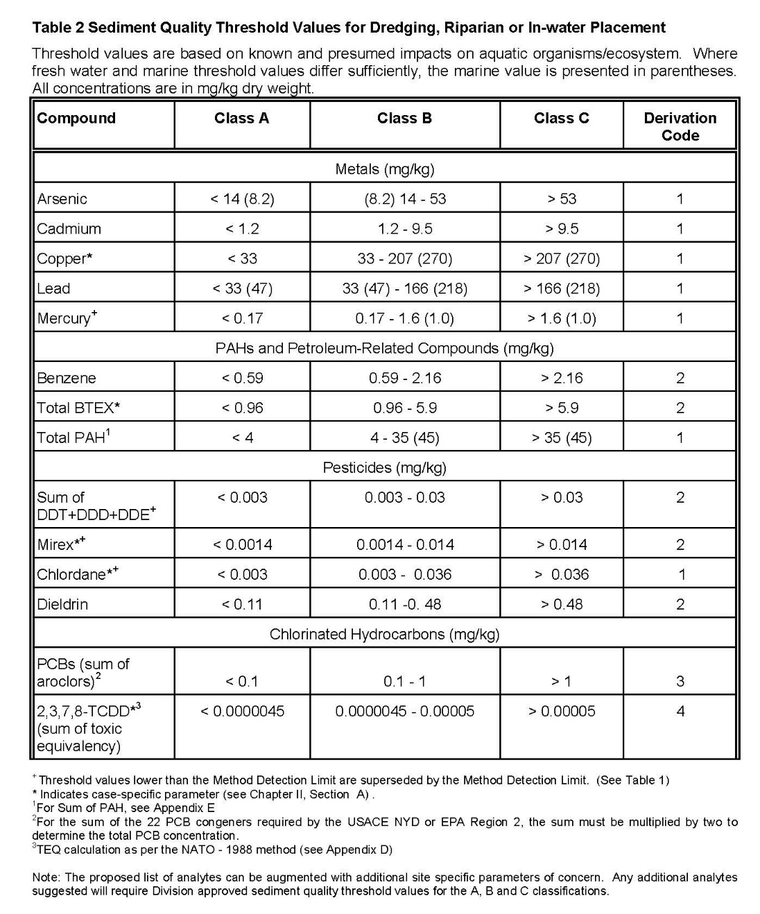
Sampling and testing- NYSDEC and NJDEP
USACE requests a Sediment Sampling and Analysis Plan – jointly approved by NYSDEC and NJDEP.
The SSAP provides detailed guidance on sample compositing and analysis requirements.
Sample analysis conducted on on raw and amended dredged material. Amended here means quick amendment with Portland cement. Final placement sites may require specific criteria.
Analyzed for TOGS 5.1.9 and NJDEP Site Remediation Standards.
TOGS 5.1.9 In-Water and Riparian Management of Sediment and Dredged Material

Slide 11
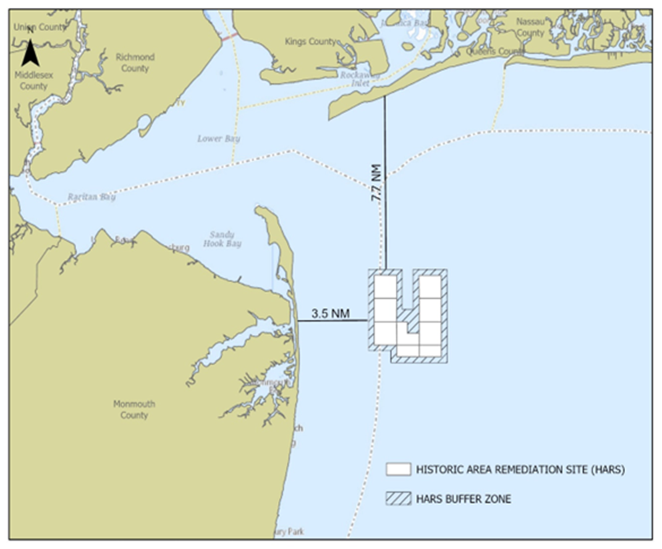
Sampling and Testing - HARS
Historic Area Remediation Site (HARS)
Designated a remediation site under the Marine Protection, Research, and Sanctuaries Act (MPRSA) in 1997.
~15.7 square nautical mile benthic area, includes the Mud Dump Site and surrounding area.
Remediation deemed complete when over 95% of a Priority Remediation Area (PRA) is capped with a minimum 1-meter-thick cap layer of dredged material that meets Category I standards.
As of October 2025 – 159 federal & private projects have been dredged, and ~88 MCY of remediation material has been placed at the HARS since 1997
Location of HARS: 3.5 nautical miles (NM) east of Highland, NJ and 7.7 NM south of Rockaway, NY.

Slide 12
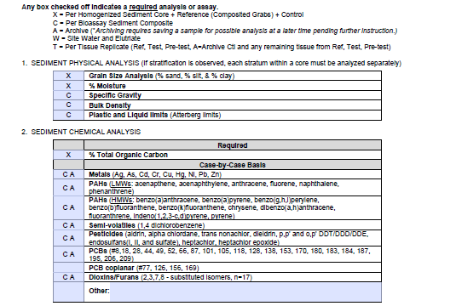
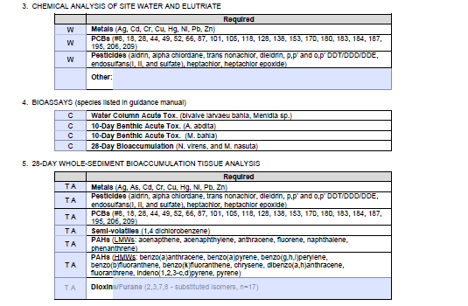
Sampling and Testing- HARS
Follows regional testing manual (April 2016)
Sampling plan is prepared in concurrence with EPA Region 2.
Sampling includes, physical characteristics of sediment, chemical analysis of sediment, site water and elutriate, bioassays and sediment bioaccumulation tissue analysis.
Bioaccumulation performed on worm and clam species.
Conducted with robust QA/QC requirements.

Slide 13
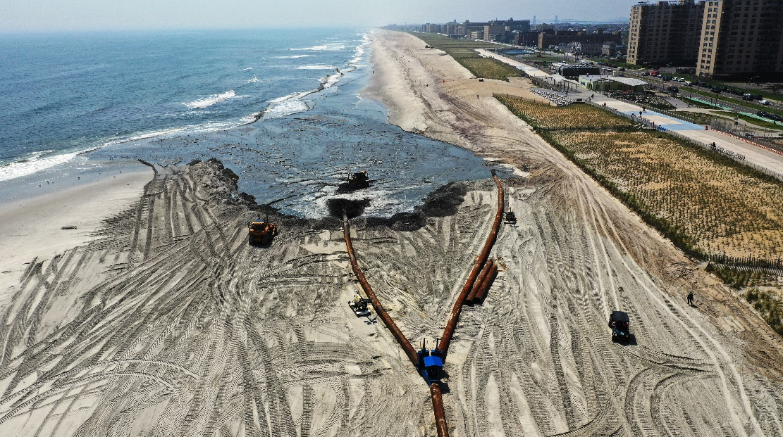
How Dredged material is used
Beneficial uses of dredged material are defined as “productive and positive uses of dredged material, which cover broad use categories ranging from fish and wildlife habitat development, to human recreation, to industrial/commercial uses”
(USACE Beneficial Uses of Dredged Material, Engineer Manual 1110-2-5026).”
Location
Photo: Beach nourishment in Rockaway, NY. April 2019.

Slide 14
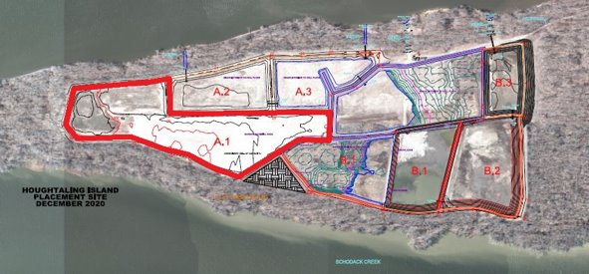
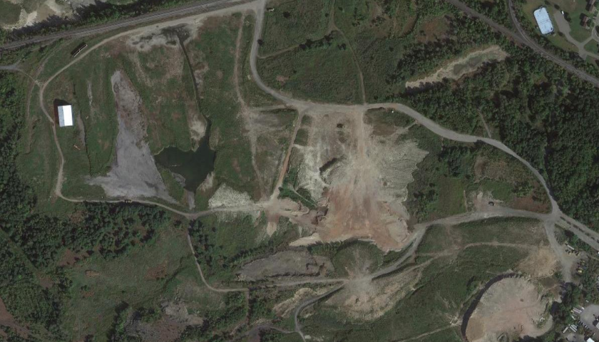
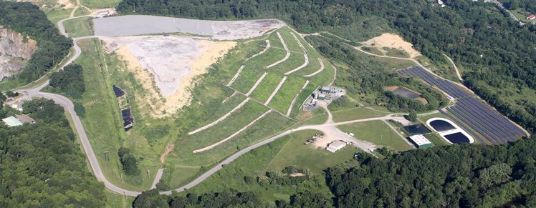
Types of beneficial use
Construction and Industrial/Commercial Uses
Strip Mine Reclamation, Solid Waste Landfill and Alternative uses.
Multipurpose Uses and Other Land Use.
Top left. Houghtaling Island placement site, as of December 2020.
Top right. Satellite view of the Hazleton Creek Associates placement site in Hazleton, PA (source: Google Maps)
Bottom left. PCFA Warren County District Landfill in Oxford, NJ.
HARS
Notes:
A few more examples of beneficial use include
Construction and Industrial or Commercial Uses: where dredged material can be used to improve or construct harbor and port facilities, roads, and island and historic preservation areas.
Multipurpose Uses and Other Land Use: which could be a combination of aquatic and/or land based uses
And dredged Material used for the reclamation of abandoned strip mines, capping or protecting solid waste landfills, or the manufacturing of bricks and hardened materials, such as road surfaces.

Slide 15
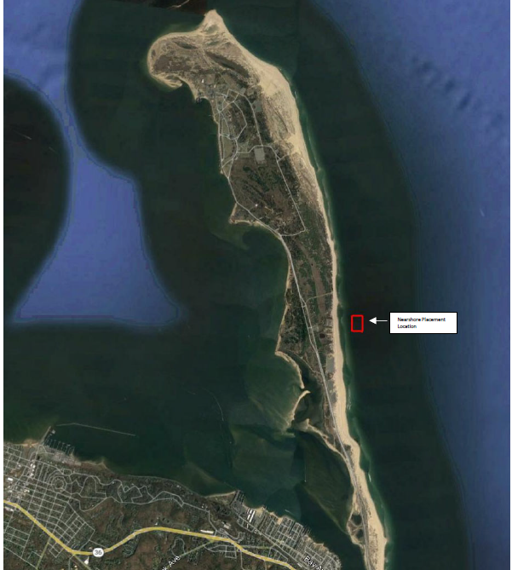
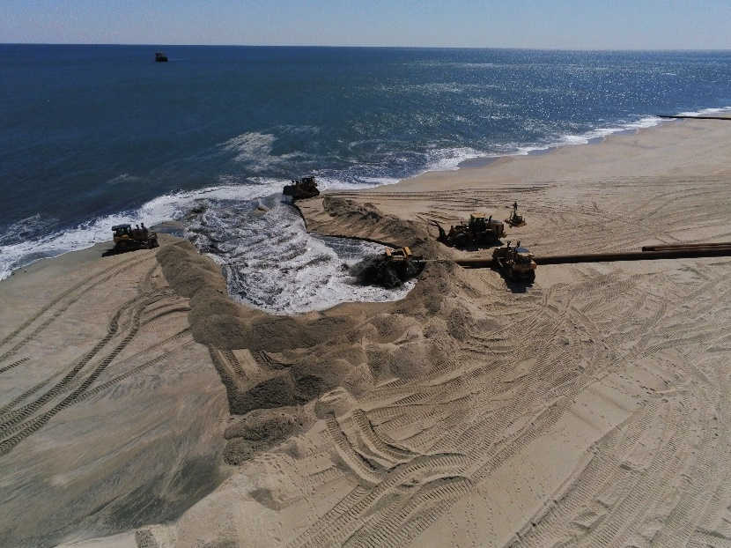
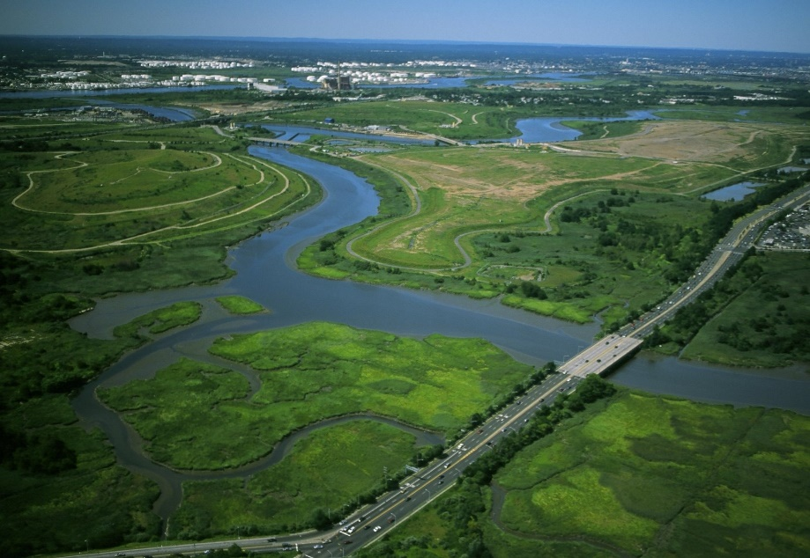
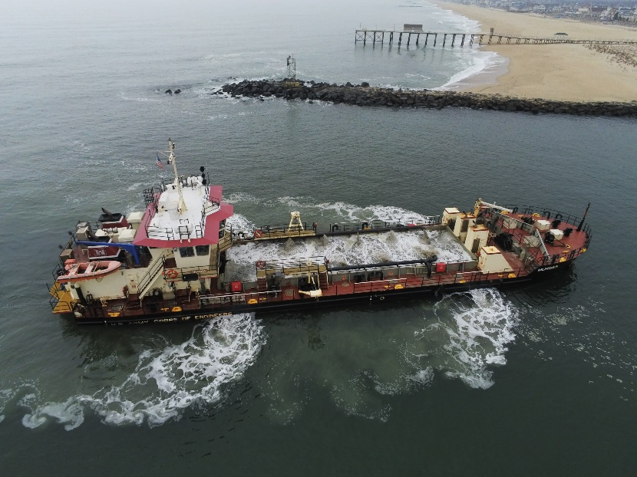
Types of beneficial use
Aquatic Habitats
Beach/Shoreline Nourishments
Wetland Habitats
Parks and Recreation
Top left. Nearshore placement site for FY23 Shrewsbury River, located on the east side of Sandy Hook, NJ.
Top right. Shoreline placement during the FY23 Sea Bright to Manasquan, NJ project.
Bottom left. Aerial photo of Government Dredge, Murden, placing sand north of the north jetty during FY23 Shark River Maintenance Dredging.
Bottom right. Aerial photo if Freshkills Park Staten Island, NY
HARS
Notes:
Some examples of beneficial use include
Placement of dredged material to develop or support Aquatic Habitats/
Beach or Shoreline placement
Placement activities supporting the development of parks and recreational areas
And dredged Material placed to construct or nourish wetland habitats, this can include freshwater and saltwater marshes
The image in the lower left depicts another example of the beach placement. This time for the sea bright to Manasquan, new jersey coastal storm risk management and erosion control project. The lower right image shows one of the army corps dredging vessels’, the Murden operating near the Shark River inlet in New Jersey.

Slide 16
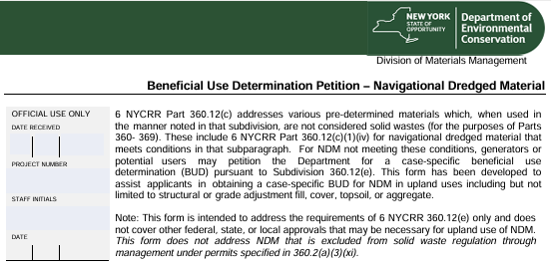
NYSDEC- Beneficial Use Determinations
Pre-determined BUDs applicable to dredged material:
Material | Beneficial Use | Regulatory Citation
No Longer Considered Solid Waste When Used - 360.12(c)(1)
Dredged sand and gravel | Aggregate | 360.12(c)(1)(iii)
No Longer Considered Solid Waste When Meeting Requirements for Use - 360.12 (c)(3)
Clay, till, or rock excavated as part of navigational dredging | Aggregate or fill | 360.12(c)(3)(xii)
For USACE projects, the contractor is responsible for applying for the BUD.
Most recent dredged material placement under a BUD was in Staten Island for fill and surface cover purposes.
A majority of dredged material anticipated for upland placement is routed to NJ and PA.

Slide 17
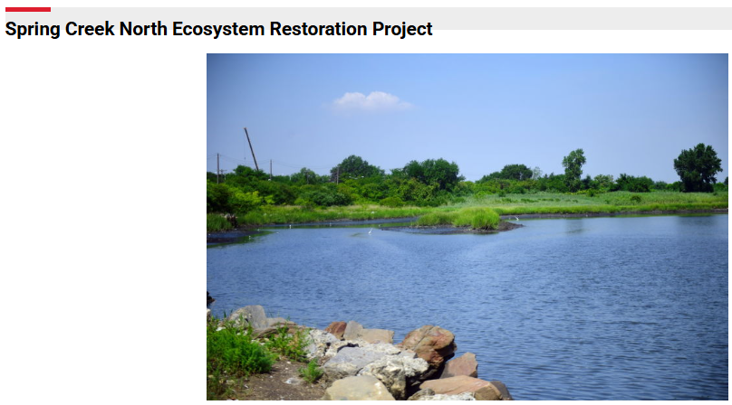
Working with USACE
Who can be a Non-federal Sponsor?
A non-federal sponsor of a U.S. Army Corps of Engineers (Corps) project may be a state, a political sub-part of a state or group of states, a Native American (Indian) nation, quasi-public organizations chartered under state laws (e.g., a port authority, flood control district or conservation district), an interstate agency or non-profit organizations. Project sponsorship is formalized by legal agreements between the sponsor and the U.S. Government that outline legal responsibilities.
What are the Cost-share Requirements?
The Corps provides the first $100,000 of feasibility study costs.
A non-federal sponsor must contribute 50 percent of feasibility study costs that exceed $100,000; plus 25-35 percent of preconstruction, engineering and design costs; and 100 percent of operation and maintenance costs.
STUDY COST
Total Feasibility Study Cost: $1,045,796
Federal: $572,898 and Non-Federal: $472,898
DESIGN
Total Design Cost: Approximately $2,897,000
Federal (75%): $1,815,000 and Non-Federal (25%): $605,000
Non-Federal (100%- additional NYC Parks Enhancement Activities): $477,000
IMPLEMENTATION COSTS: Construction Contract: $17,745,000

Slide 18
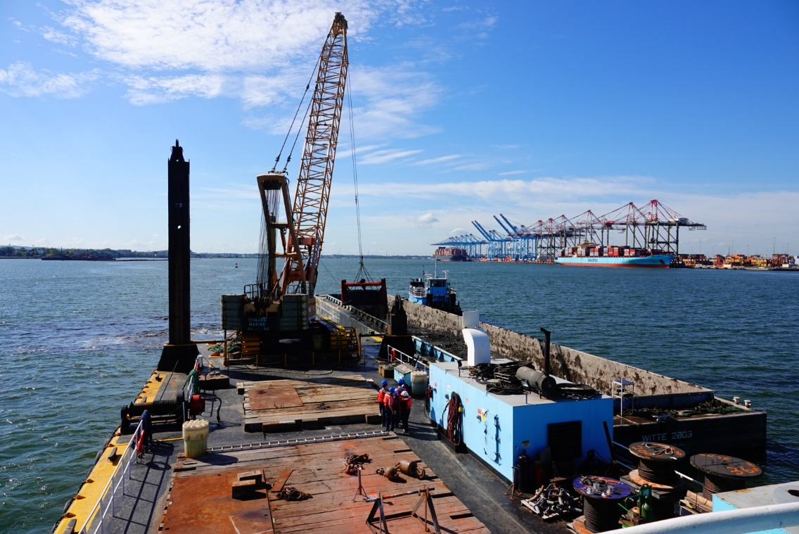
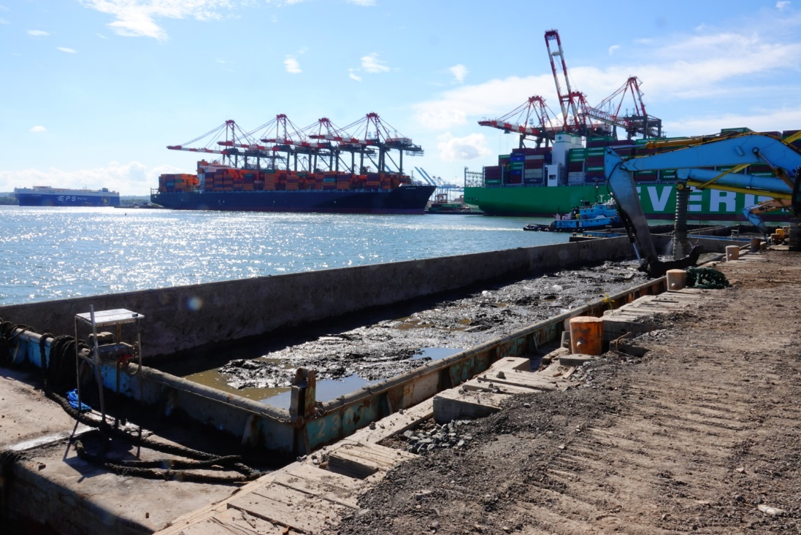
Working with USACE
USACE O&M Projects and Contractors
USACE will coordinate placement sites for beach nourishment, ecological restoration, ocean disposal etc.
For upland placement, site selection is conducted by the project dredge Contractor.
USACE provide sampling and testing data collected during the project coordination phases.
Some placement sites may require additional testing which is conducted by the Contractor.
If required, the Contractor is also responsible processing the dredged material in the form of amendment with cement.
Above. USACE contractor utilizing a mechanical dredge at Newark Bay. Dredged materials from this project were taken for beneficial use for mine reclamation in New Jersey.
Left. USACE contractor using a backhoe to mix cement as an amendment into dredged material from Newark Bay per placement site specifications.

Slide 19
QUESTIONs?
Contact Information:
Arsheen.Ehtesham@usace.army.mil
917-790-8084

Slide 20
USACE Web resources
Dredge Information System:
https://ndc.ops.usace.army.mil/dis/
National Channel Framework: https://experience.arcgis.com/experience/b413139f18c046009ebcf62abea941dd/page/Map/
RSM Sediment Placement Data Viewer: https://experience.arcgis.com/experience/448e41753a1f408e9dd2c98896e818c0/page/2022-Present/
Controlling Depth Reports and Surveys:
https://www.nan.usace.army.mil/Missions/Navigation/Controlling-Depth-Reports/

