Slide 1

Utilidor project – Report
Alec Tristani, Chloé Arson
Based on the work of 13 motivated undergraduate and graduate students:
Royce Andrews, Junwon Hur, Yiksan Yu, Qinghe Xu, Tanvi Saxena, Ivy Quan, Matthew Zhang, Karen Chen, Andy Chen, Annelise Gross, Caroline Schell, Fatima Bah and Ian Grenda
Wednesday, January 14th 2026

Slide 2
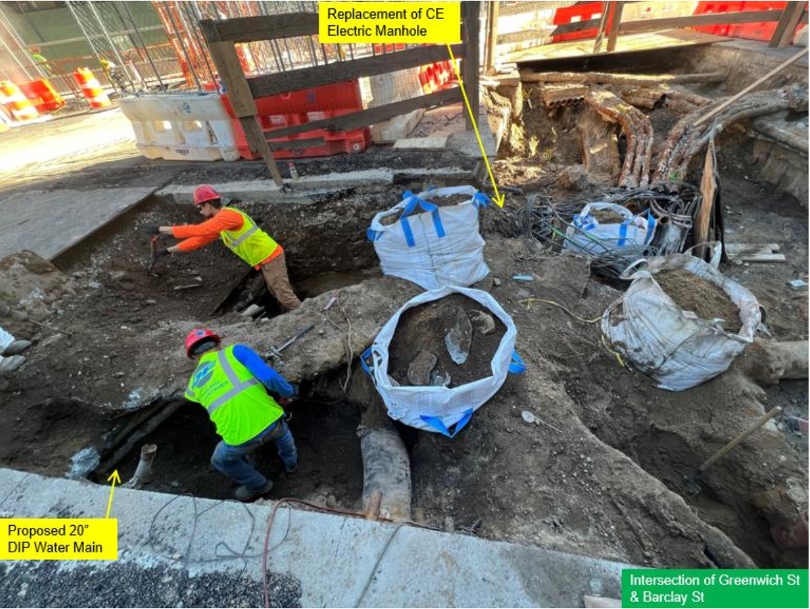
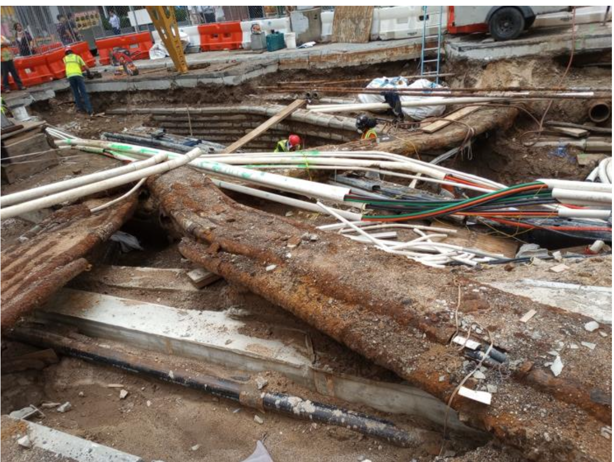
Why utilidors?
Benefits of utilidors:
Eﬀective use of ground level surface;
Long-term management, accessibility and productivity;
Less prone to wear and tear;
Long-term outlook outweighs the short-term costs.
Hand Excavation to expose the Interfering Telecom and Electrical Utilities Overlying the New Water Main Alignment
Exposed Telecom and Electrical Utilities with the start of Casing Removal

Slide 3
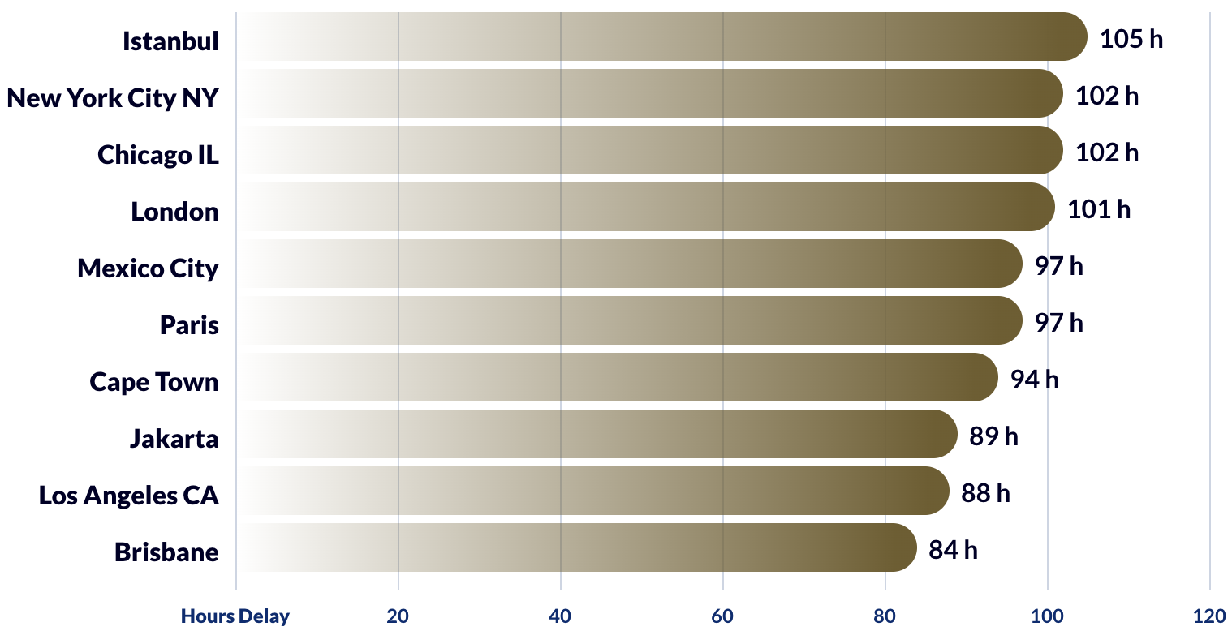
New York City traffic statistics
Highest traffic delay times by city – Worldwide (2024)

Slide 4
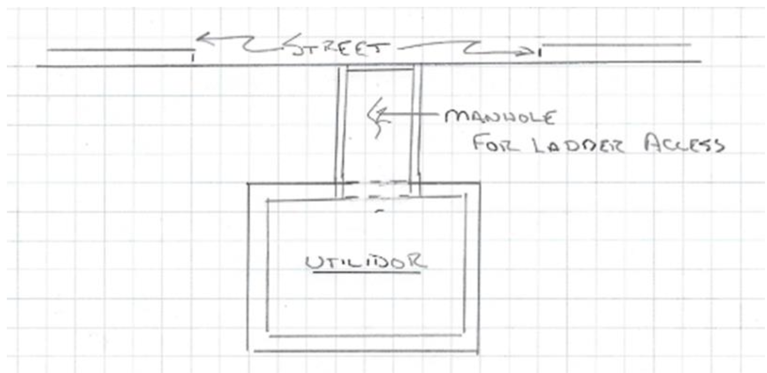
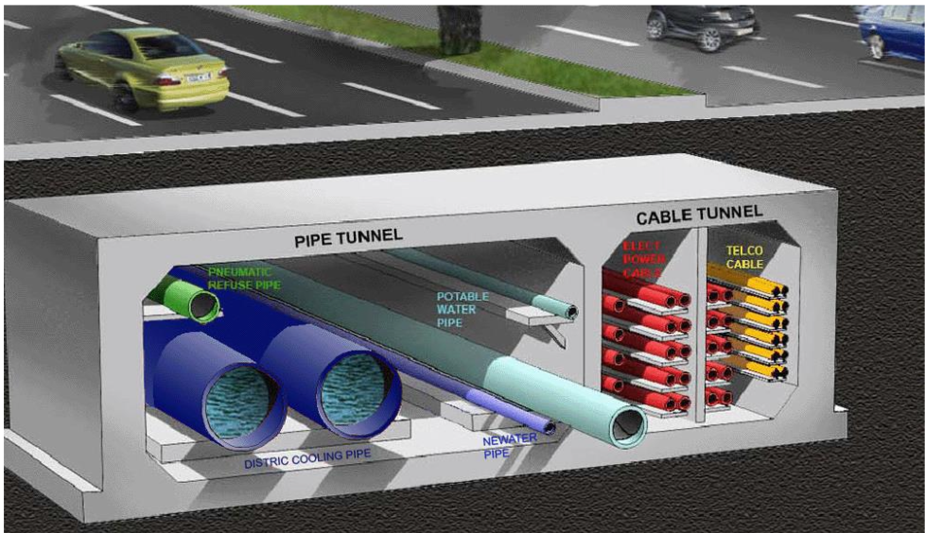
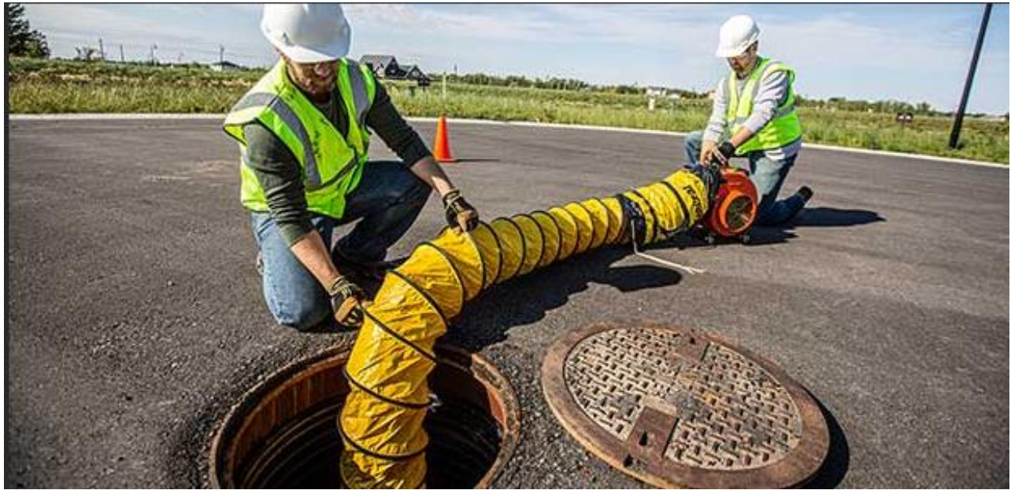
Short-term project: optimize utilidor designs
Objective: Design utilidors
Conduct a scientific literature review on utilidors worldwide and on the geology of New York City.
Perform 2D numerical simulations to evaluate structural stability under different geotechnical configurations
Analyze tunnel cross-section shapes: assess geometry, lining thickness & dimensional requirements
Provide design recommendations for the construction of utilidors across the city
Confined Space Access into a Utilidor
Utilidor compartmentalization for access and security – Cross Section of Marina Bay Utility Tunnel

Slide 5
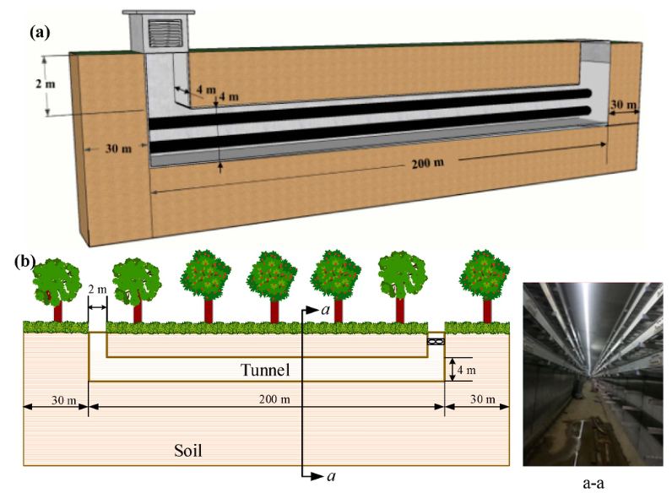
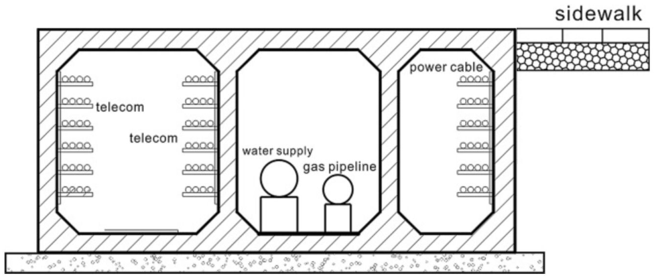
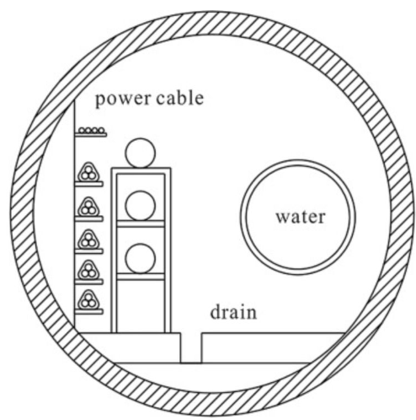
Utilidors in the world
Objective: Conduct a literature review to examine current worldwide practices in utilidor design.
Helsinki, Finland:
200 km of technical/maintenance, of which 60km dedicated to heating, cooling and electricity.
Located 20 m to 120 m below ground level
Beijing, Shanghai, China (Multi-Utility-Tunnels):
Shallow depth (3 m), large dimensions (> 6 m)
Rectangular and Circular cross sections
Currently existing utilidors in China with square and circular cross-sectional shapes.

Slide 6
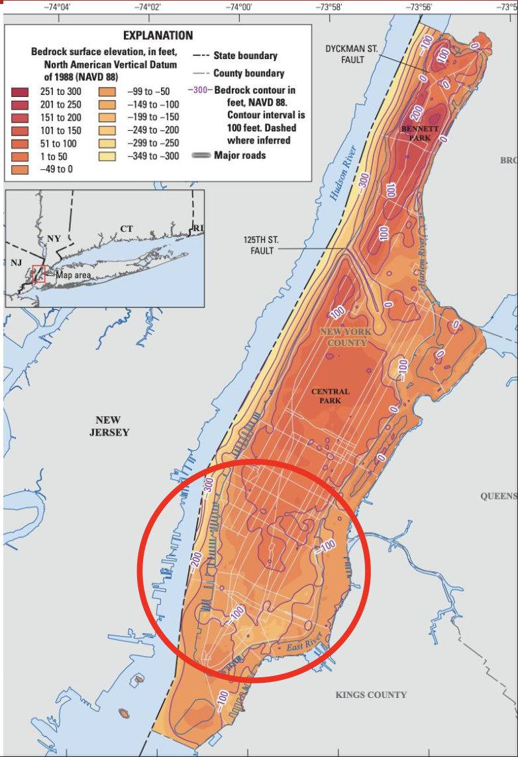
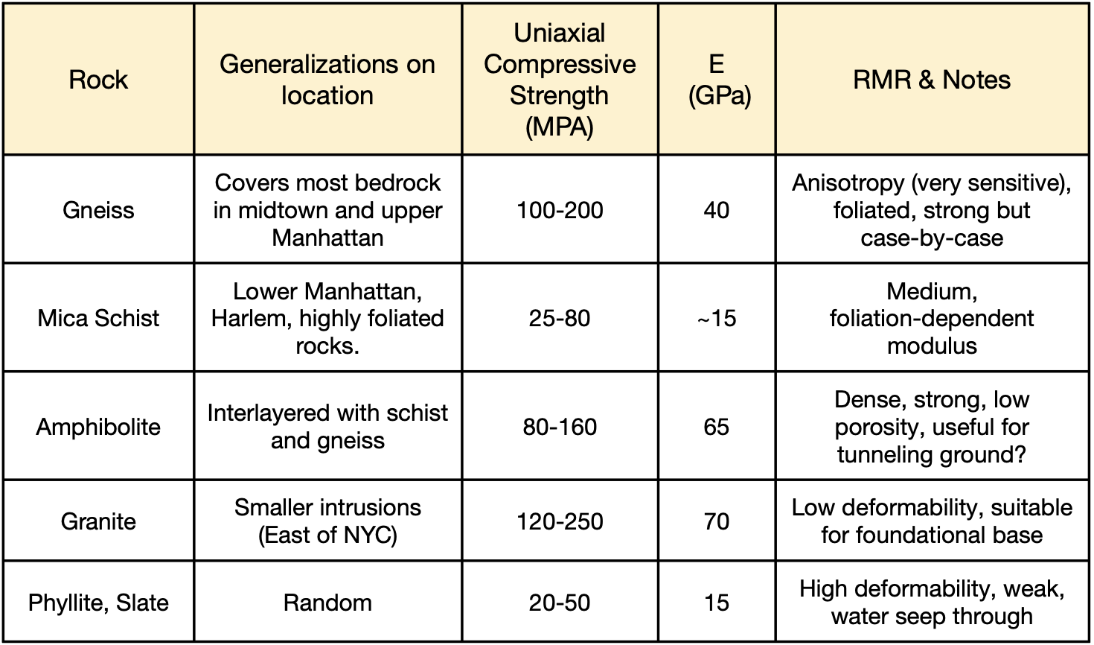
NYC Geology
Objective: Characterize the ground properties to enable accurate numerical simulations.
Rock Properties in New-York City

Slide 7








Numerical Modeling – Problem Setup
Objective: Perform 2D numerical simulations to evaluate structural stability under different geotechnical configurations.
$$y$$
$$σ_{s}$$
$$x$$
$$h$$
$$R$$
$$σ_{R}$$
$$σ_{h}$$
$$σ_{h}$$

Slide 8
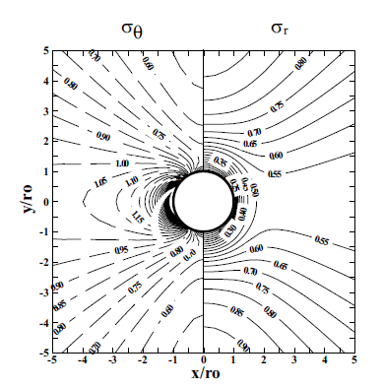
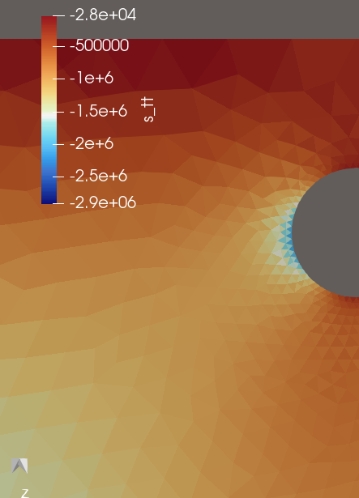
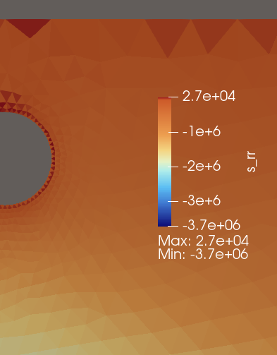
Parametric studies – Comparison with analytical solutions
Bobet and Einstein, “Tunnel Design Methods” Fig 4.6

Slide 9
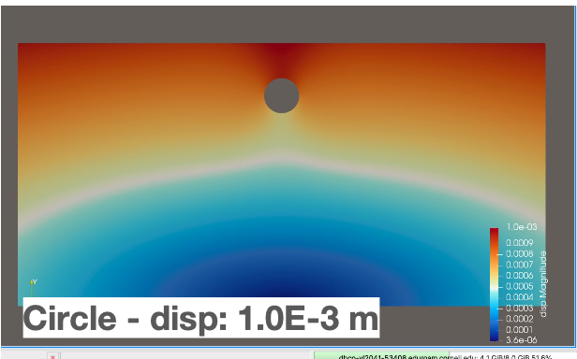
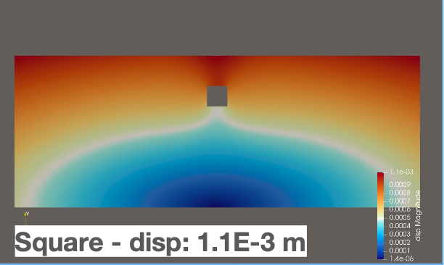
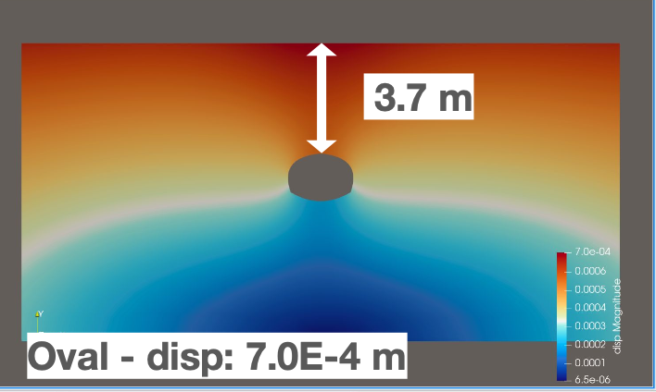
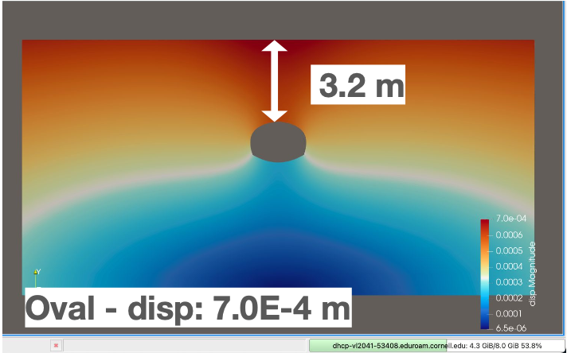
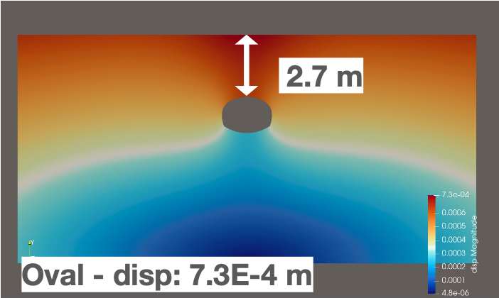
Parametric studies – Section shape and depth
Manhattan Schist parameters
Young’s modulus - E = 1.5 x 1010 Pa
Poisson’s ratio = 0.3
(coeﬀ. of earth pressure) K = 1
Unit weight - γ = 1.8 x 104 N/m3

Slide 10
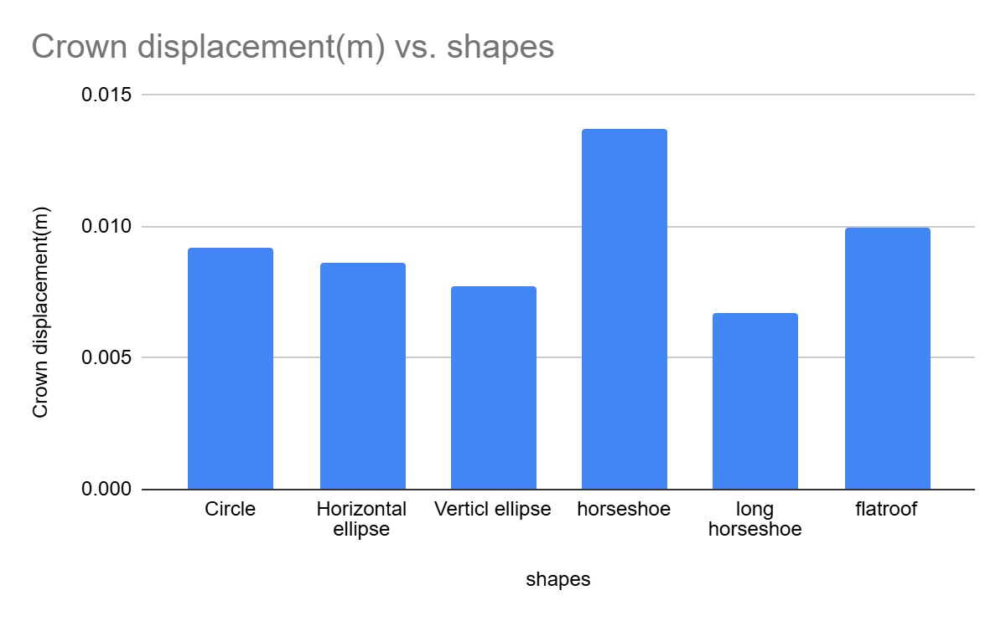
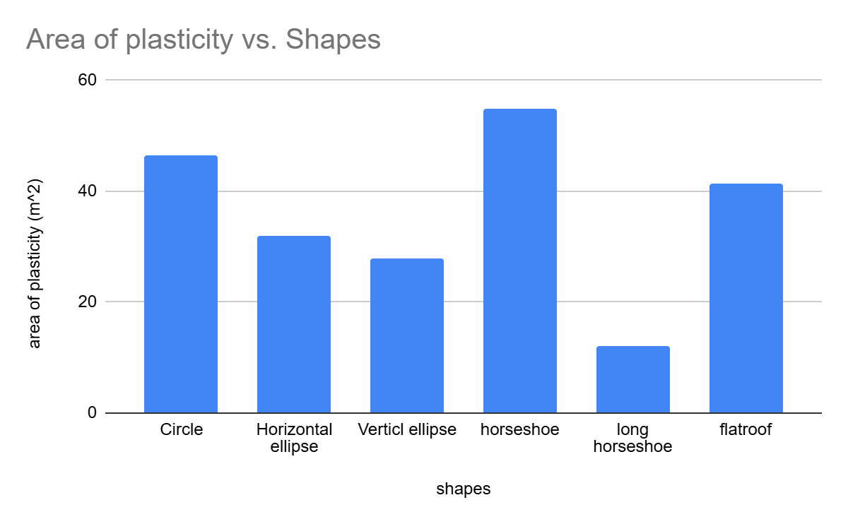
Parametric studies – Effects of depth, section shape and elastic parameters

Slide 11
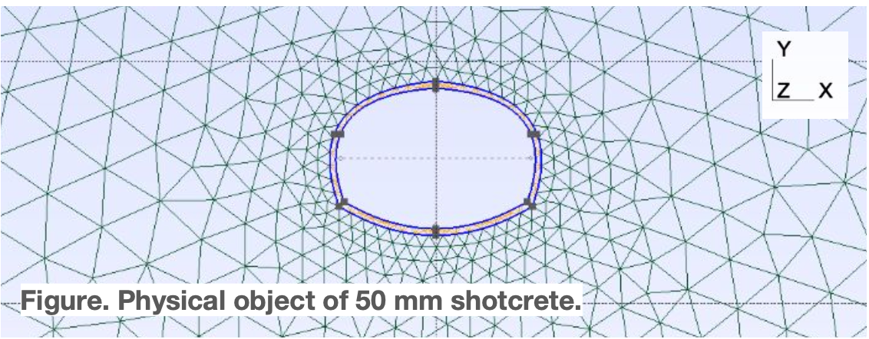
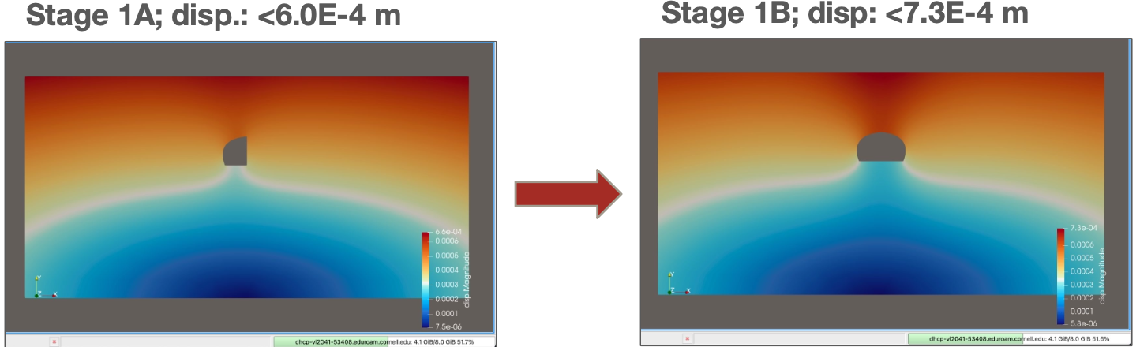
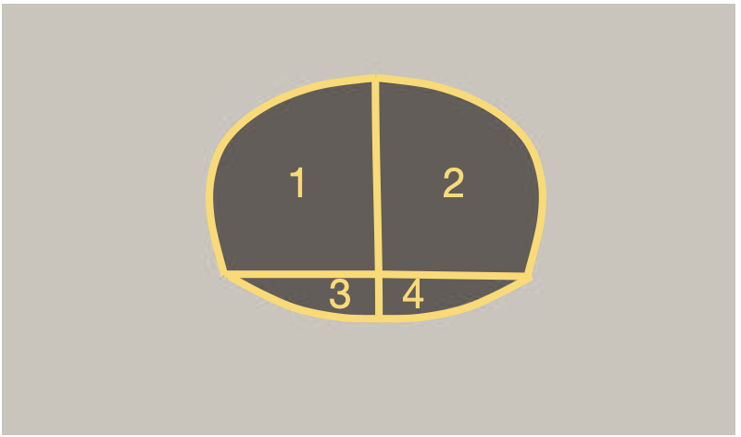
Parametric studies – Effect of the support and sequential excavation
Portland cement
E = 20 GPa
Poisson’s ratio = 0.2
Density = 2,400 kg/m3 (American Shotcrete Assoc.)

Slide 12
Conclusions and future work
Pedagogic conclusions:
Students were able to learn new concepts related to geotechnical engineering and tunnel design
Research skills: scientific literature review, self-learning, independence
Multidisciplinary work: geomechanics theory, infrastructure design, numerical modeling, scientific visualization
Technical conclusions:
Square cross section shapes at shallow depth and circular section for deeper tunnels
Recommend NYC include depth of tunnel/overburden pressure as important parameter
Future work:
Consider groundwater behavior, heterogeneities and account for plasticity
Complexify the geometry and account for side corridors
Extend the study to other areas besides Manhattan
Develop a tool readily applicable by practitioners based on machine learning

Slide 13
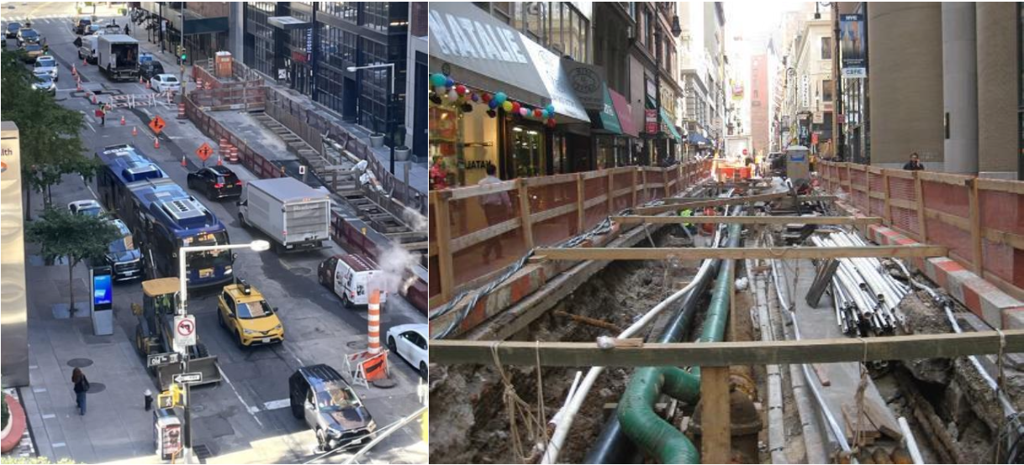
Long-term project: develop predictive maintenance tools
Objective: improve current maintenance operation systems
→ Identify data sources that will be collected in practice
Generate synthetic data when necessary using analytical or numerical methods
Construct a virtual model, whether based on analytical or numerical approaches
Integrate data into the virtual model to complete a Digital Twin
Explore the use of machine learning techniques to enhance Digital Twin implementation
Typical congested condition at site of utility construction (Right) and close-up view exposed underground utilities (left)

Slide 14
Utilidor project – Report
Urban Engineering – Shallow tunnels – Rock Mechanics – Numerical modeling – Data Analysis – Predictive maintenance
Thank you for your attention!
Contact:
Chloé Arson: cfa36@cornell.edu
Alec Tristani: ayt34@cornell.edu

