Slide 1
SCIENTIFIC COLLABORATIONS

Slide 2
Water and Climate research priorities: WWT Smart Grid
NYSERDA WWTP Submetering – Wet Stream
Secondary treatment – conventional activated sludge compressors and blowers, mechanical aerators, high purity oxygen activated sludge cryogenic oxygen generation air compressors and mixers, return activated sludge pumps, trickling filter pumps, and rotating biological contactor drive motors and blowers
Notes:
2ndary T: Biological and chemical treatment processes designed to remove organic matter
Typical standard for secondary effluent is BOD / TSS ≤20 mg/L every 30-day (avg).
Secondary treatment, inclu activated sludge, trickling filter, rotating biological contactors;
Advanced treatment; Disinfection
Primary treatment and digestion were not submetered as these processes did not have large motors.

Slide 3
Water and Climate research priorities: WWT Smart Grid
WW Energy-Water Intensity
Solids Disposal Requirements
3 – 4% of electricity annually consumed in US is for water and wastewater conveyance and treatment (56B kW)
Water/wastewater utilities typically the largest consumers of energy in municipalities, often 30 – 40% percent of total energy consumed
Energy costs are second only to Labor in Utilities’ operating budgets, also one of the most controllable.
Upwards of 30% of a WWTP operational costs are from Energy use¹
10% reduction in energy use by Water & WW could save more than 10B kWh annually, representing a cost savings of ~$750 million²
Advanced Nutrient Removal Plants (TKN, P, Micropollutants)
Reliance on External Energy Sources
1.) Metcalf, L., Eddy, H.P., Tchobanoglous, G., 2003. Wastewater engineering: treatment, disposal, and reuse, 4th ed. McGraw-Hill New York.
2.) Evaluation of energy conservation measures for wastewater treatment facilities, 2010. EPA.
Notes:
Where does the electrical energy used by WWTPs typically go? (Aeration followed by Pumping)

Slide 4
Water and Climate research priorities: WWT Smart Grid
Energy Costs Rise Due To
Implementation of more stringent effluent requirements: Nutrients Removal (TKN, P) and emerging contaminants (micropollutants, pharmaceuticals).
Enhanced treatment of biosolids drying/pelletizing, landfills no longer accepting sludge.
Aging wastewater collection systems that result in additional inflow and infiltration, leading to higher pumping and treatment costs.
Increase in electricity rates especially in context of climate change policies
Water reuse requiring water that is potable or fit-for-use in agriculture or aquifer recharge.
New sources of water require huge amounts of energy to supply – Old water sources (aquifers and surface runoff) nearly free to $50/acre-ft; New sources well over $500.
Community Sustainability targets set by local authorities which municipal agencies must meet.
NYC Local Law 97 2019 requires City-owned buildings to reduce GHG emissions 40% by 2025

Slide 5
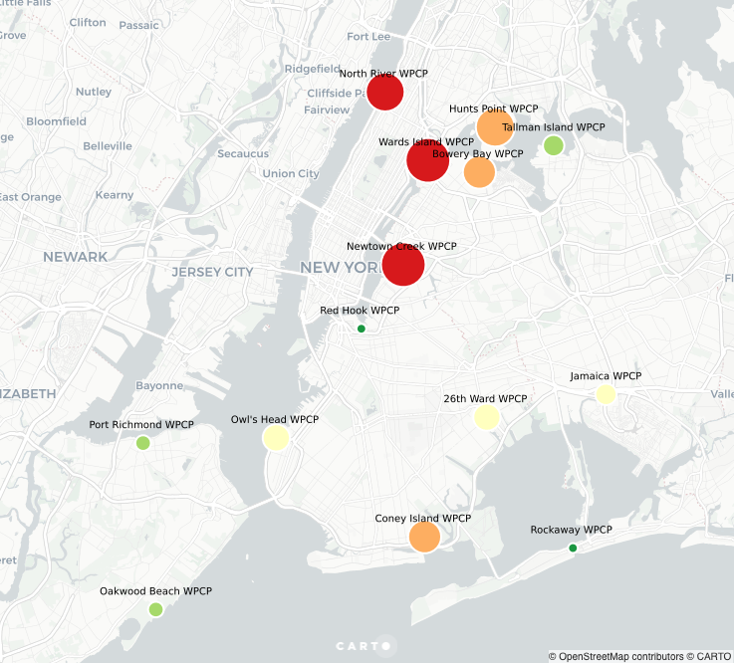
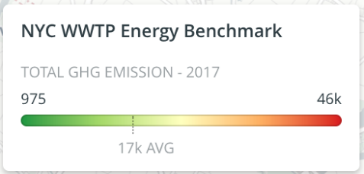
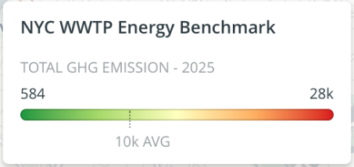
Water and Climate research priorities: WWT Smart Grid
NYC Local Law 97 Required Reductions

Slide 6
Water and Climate research priorities: WWT Smart Grid
WWTP Demand Response & Renewables
WWTP Energy Demand Profile
CAISO Net Load P(load) - P(rne): 2020 Trend
Notes:
Blue – Up Regulation Peaks (customers should consume more energy)
Red – Down Regulation Peaks (customers should consume less energy)
Left – WWTP energy demand profile one day, summer time
Right – CAISO net load: is defined as the total load on the power grid (i.e. power demand from consumers) minus input from variable generation resources (i.e. wind and solar). Therefore Power generated by conventional plants will become more variable. For instance, solar power comes in daylight hours, conventional generation doesn't need to produce around midday. Conventional PP require long periods of time to start or stop producing power, some cannot (i.e. nuclear, geothermal, hydro)
CAISO itself is not responsible for generating power for the grid, it oversees the energy production market and is charged with securing enough power to satisfy California's electricity demand at any given time.

Slide 7
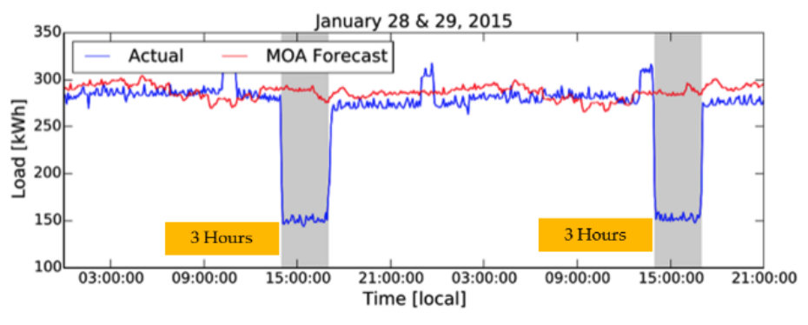
Water and Climate research priorities: WWT Smart Grid
Auto DR Case Study – Donald M. Somers WPCP
Tertiary treatment plant discharging to San Francisco Bay.
Case study on fast, automatic, continuous control of loads: Fast-DR helps the grid to manage contingencies with Day-Ahead Warning (top) & 10-Min Warning (bottom)
Key Equipment: pond aerators, pond circulation pumps, digester pumps, and fixed growth reactor fans.
Baseline load 275kW - 150kW load shed (55% reduction).
Pros:
Equipment could be shut down for 4 hours w/o negative consequences;
440-acre pond provides oxygenation to the secondary effluent to Reduce turbidity in Shut-Offs
DR offered New Revenue streams, improved analysis/monitoring for environmental compliance, higher returns of investment by reducing energy costs.
Ibid

Slide 8
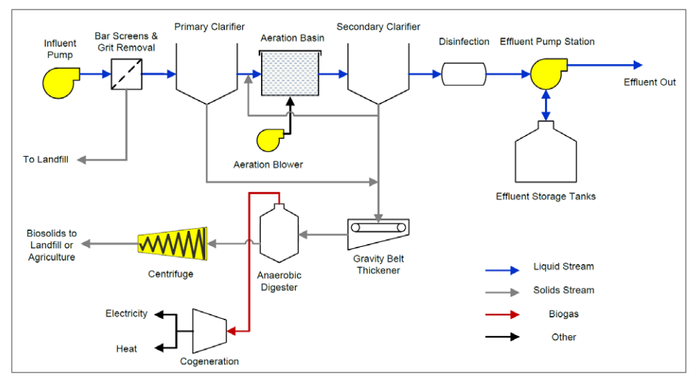
Water and Climate research priorities: WWT Smart Grid
W-SMART Research & Collaboration Projects
Energy Neutral & Demand Control
Determine effect on quality parameters of Effluent and Sludge by Variable Demand Loads
Treatment Aeration
Wastewater Pumping
Sludge Pumping Transport
Support Auto-DR with AI assisted Intelligent Process Control and Optimization:
Pre-Processed Historical Plant Data
Statistical Mono and Multi-Parameter Analysis of COD, TSS and TKN
AI anomaly detection analysis in Auto-DR Scenario Simulations
Develop a WWTP Demand Response Optimization Tool for Energy-Water Systems Co-Optimization
Supports decision making for WWTP owners and operators
Energy System Operators gauge impact from water sector DR participation
Assists in cost/benefit analysis of plant upgrades to Energy System
Schematic of a WWTP
Highlighted equipment is suitable for DR
Notes:
Gravité = hauteur eau atteinte
(difficultés associer à un débit)
Débordements + remontées nappe
1658 : 8,96m

Slide 9
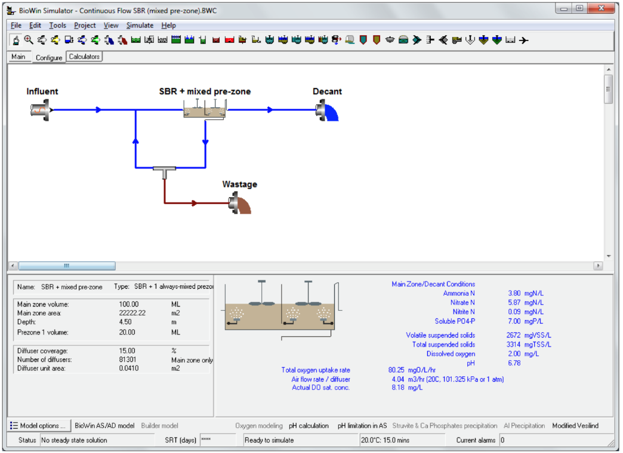
Water and Climate research priorities: WWT Smart Grid
How to Study Effects? Digital-Twin WWTP Models
We propose to use the IWA Active Sludge Model in order to study the Effect of Aeration Demand Response on Effluent Quality
Utilizing an existing model of a WWTP, Offline Scenario Simulations of Aeration DR will be packaged into a database for studying the Effects on Effluent Quality Parameters using Artificial Intelligence Pattern Recognition
IWA Active Sludge Model:
BIOWIN (pictured)
GPS-X
STOUT
Modelica
WEST
This database and AI algorithms will be made in conjunction with:
SIAAP MOCOPE’E Research Programme &
Water Treatment Co. of Hof HaCarmel
BIOWIN GUI – SBR with Waste Recycling and Mixed Anoxic/Aerobic Tank

Slide 10
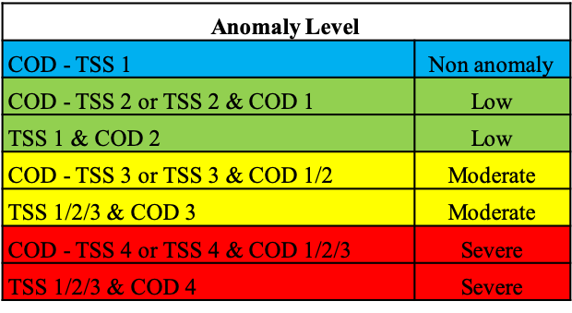
Database Processing
Functional Architecture
Numerical Simulation
Database
Effluent & Treatment Parameters
AI Model Building
Long Short-Term Memory DNN
ASM/BIOWIN/GPS X
Statistical Analysis
Anomaly Detection System
Confidence level of anomaly likelihood
Severity of the anomaly
Risk of the anomaly
Sensor Deficiency
ASM
Models
Self-Corrective Action

Slide 11
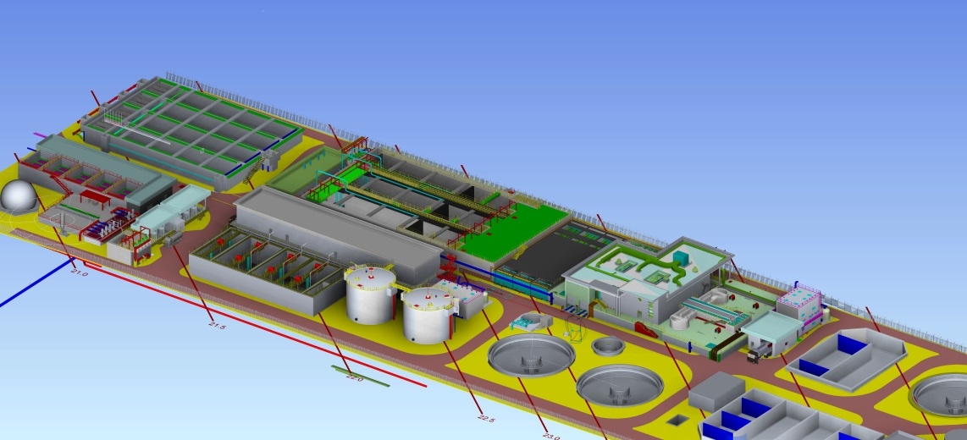
Data Availability – Nir Etzion WWTP
The Nir Etizon WWTP is in the 400 Level of design & currently in the construction phase.
In order to ensure cost-minimization & 100% water reuse, the plant was designed w/ a digital-twin BIOWIN model integrated to an in-situ network of process sensors
Average daily design flow: 32,000 m3/day (7.0 mgd)
Peak day design flow: 51,100 m3/day (11.2 mgd)
Influent
COD: 1,100 mg/l
BOD: 440 mg/l
TSS: 450 mg/l
TN: 80 mg/l
TP: 12 mg/l
Effluent
COD: 70 mg/l
BOD: 10 mg/l
TSS: 10 mg/l
TN: 10 mg/l
TP: 1.0 mg/l
E coli: 10 mg/l
Turbidity: 2.0 NTU
SAR: 5.0
Liquid line
Pretreatment – course and fine screen
Primary clarifier with possible fermentation
EQ tank
Biological treatment – A2O, MLE, UCT & RAS fermentation
Secondary clarifier
Deep bed sand filtration
UV and chlorine dioxide disinfection
Sludge line
Centrifuge thickeners
Anaerobic digesters for primary sludge
Aerobic digesters for WAS
Dewatering centrifuges

