Slide 1
Bi- and Tri-lateral Funding
Prof. Debra F. Laefer
Dept. of Civil & Urban Eng. & Center for Urban Science + Progress

Slide 2
Bi- and Tri-lateral Funding Opportunities
US Based Funding Options
Charities and Not-for-Profits
Federal Grants
Federal Contracts
State Grants
Municipal Grants
*
2

Slide 3
Bi- and Tri-lateral Funding Opportunities
US Based Funding Options
Charities and Not-for-Profits
Federal Grants
Federal Contracts
State Grants
Municipal Grants
*
3

Slide 4
Bi- and Tri-lateral Funding Opportunities
US Based Funding Options
Charities and Not-for-Profits
Federal Grants
Federal Contracts
State Grants
Municipal Grants
*
4

Slide 5
Bi- and Tri-lateral Funding Opportunities
US Based Funding Options
Charities and Not-for-Profits
Federal Grants
Federal Contracts
State Grants
Municipal Grants
*
5

Slide 6
Bi- and Tri-lateral Funding Opportunities
US Based Funding Options
Charities and Not-for-Profits
Federal Grants
Federal Contracts
State Grants
Municipal Grants
*
6

Slide 7
Bi- and Tri-lateral Funding Opportunities
Finding Types with International Component
Focused overseas programs
Supplements
Bi-lateral and tri-lateral
*
7

Slide 8
Bi- and Tri-lateral Funding Opportunities
Opportunities
Where to find?
Who can participate?
How much money?
How does do these work?
Where to start?
*
8

Slide 9
Bi- and Tri-lateral Funding Opportunities
How to Find
*
9

Slide 10
Bi- and Tri-lateral Funding Opportunities
How to Find
*
10

Slide 11
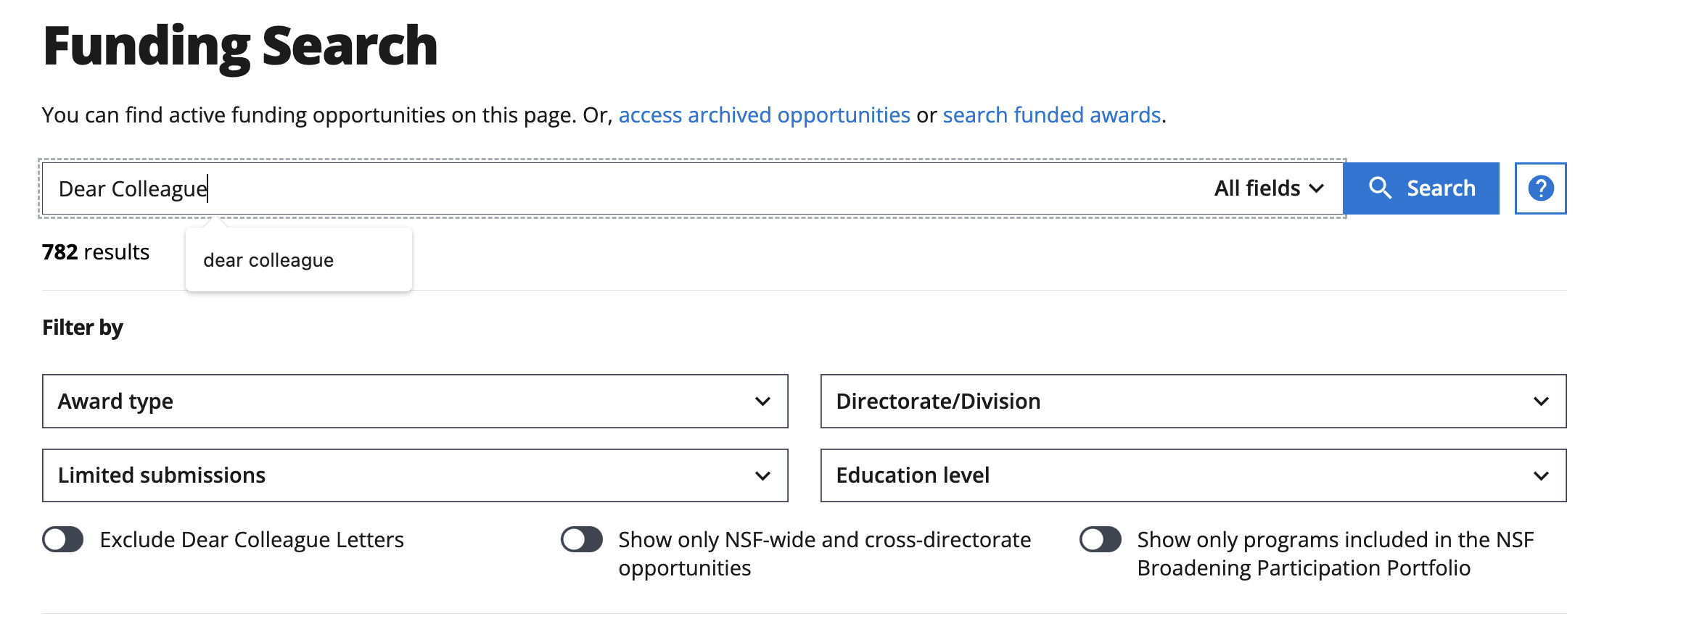
Bi- and Tri-lateral Funding Opportunities
How to find
https://new.nsf.gov/funding/opportunities
*
11

Slide 12
Bi- and Tri-lateral Funding Opportunities
Who can participate
US-based programs can fund short outbound visits for all team members
Limited funding for inbound visits to US
Direct reimbursement and must use US-based carrier
Destination programs usually limited to US citizens and permanent resident
*
12

Slide 13
Bi- and Tri-lateral Funding Opportunities
How much money?
Each program has a cap
Equal and non-equal contributions
No co-mingling of funds
*
13

Slide 14
Bi- and Tri-lateral Funding Opportunities
How does this work?
Model Types
Unspecified (unsolicited and solicited)
Restricted
Hybrid
Review Types
NSF only
Partner only
Either NSF or Partner
Both NSF and Partner
*
14

Slide 15
Bi- and Tri-lateral Funding Opportunities
How does this work?
Find a partner
Check the requirements
Eligibility
Timelines (90 days)
Planning grants
Israel
NSF 20-094
UK-Germany
Crops
NSF 23-096
India
Biotech & Bioeng
NSF 24-054
*
15

Slide 16
Bi- and Tri-lateral Funding Opportunities
US, Republic of Ireland, Northern Ireland
NSF no pre-requirements
Northern Ireland – Value proposition 4 pages
Republic of Ireland
– Letter of Intent
– Brief value proposition 10 weeks ahead
– Full draft 6 weeks ahead
*
16

Slide 17
Bi- and Tri-lateral Funding Opportunities
How does this work?
Find a program of division (check NIH & USDA)
Find a partner
Check funder and institutional requirements
Create a timeline
*
17

Slide 18
Bi- and Tri-lateral Funding Opportunities
How does this work?
Find a program of division (check NIH & USDA)
Find a partner
Check funder and institutional requirements
Create a timeline
When to start? Today!
*
18

Slide 19
Bi- and Tri-lateral Funding Opportunities
Thank You
Debra.laefer@nyu.edu
*
19

