Slide 1
Modelling Tools to Support Integrated Water Planning (WSIMOD)
Barnaby Dobson, Ziyan Zhang, Leyang Liu, Ana Mijic
Water Systems Integration research group
Department of Civil and Environmental Engineering
Imperial College London

Slide 2
Does integration in the water cycle impact me?
I model drainage networks, so I guess no?
I focus on water supply only so..

Slide 3
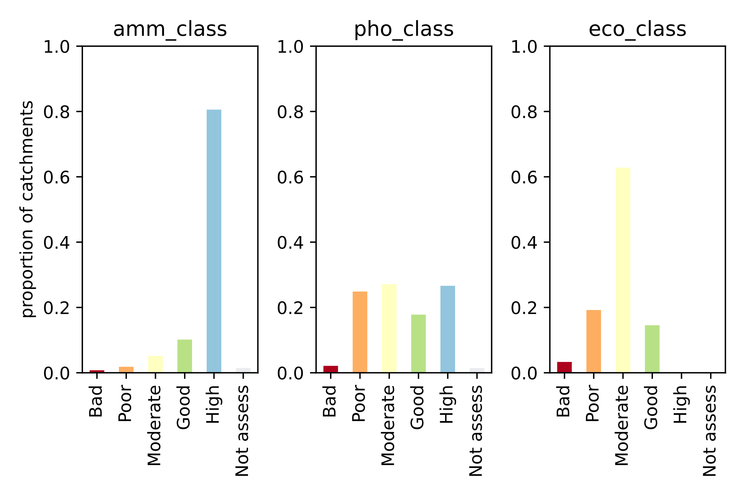
Functioning infrastructure
Does not guarantee
Good water quality

Slide 4
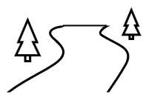
The UK may spend billions to alleviate sewer spills and we don’t know what impact this will have on rivers (unless we project impacts into the river!)
We care about the river, not about infrastructure… so we need to consider in-river conditions
This is because in-river impacts depend on dilution
100kg of spill into 2000m3 of water
10kg of spill into 100m3 of water

Slide 5
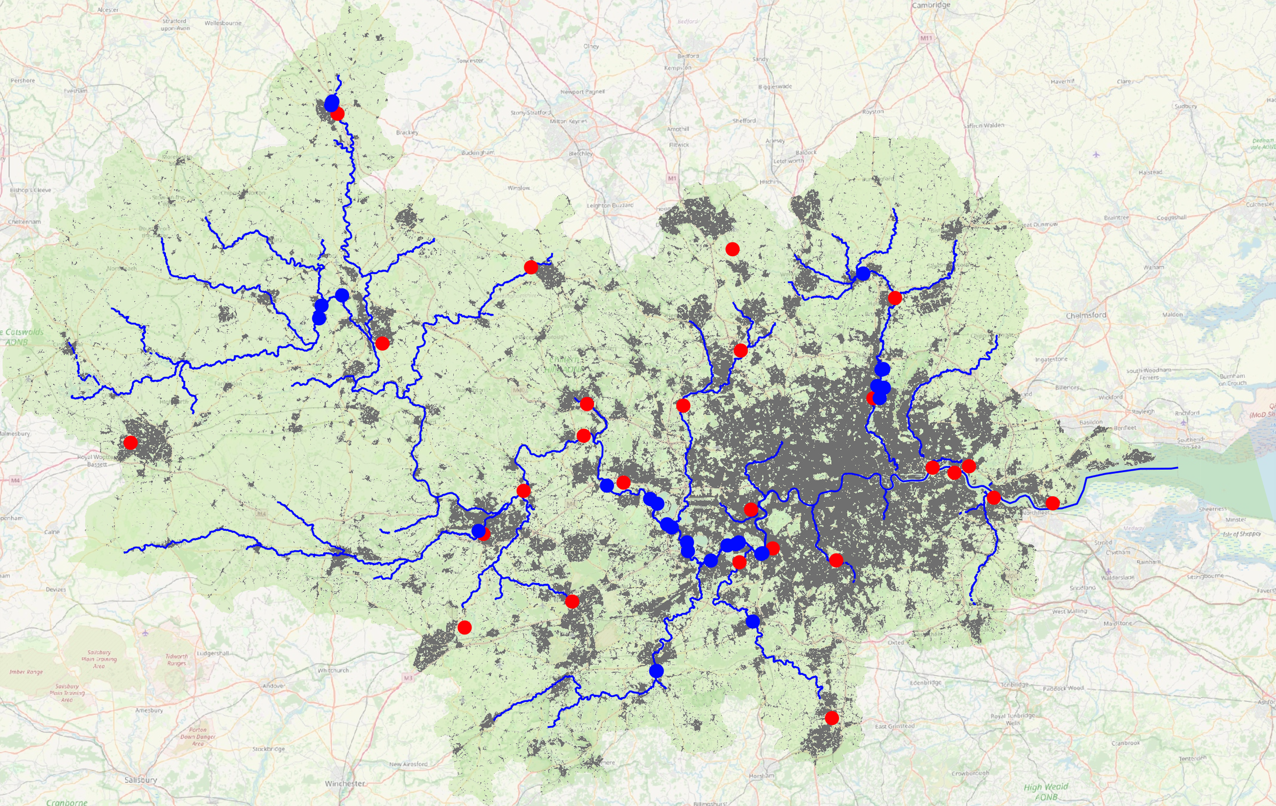
Even if you don’t care about sewer spills, dilution impacts the whole water cycle
Wastewater Plant (>10Ml/d)
Surface Water Abstraction (>10Ml/d)
Rivers
Thames Catchments
Built-up land use

Slide 6
Whatever you do with supply will interact with pollution (especially at low flows!)
Reservoir
Rain
Upstream river
Downstream river
Abstraction
Effluent discharge
50% polluted water
Reservoir
Rain
Upstream river
Downstream river
Abstraction
Effluent discharge
75% polluted water

Slide 7
We understand (more or less) how things are connected
Distribution
Consumption
Sewerage
CSO
Freshwater Treatment
Wastewater Treatment
Land runoff
Supply System
River
Groundwater

Slide 8
But we model them separately
Distribution
Consumption
Sewerage
CSO
Freshwater Treatment
Wastewater Treatment
Land runoff
Supply System
River
Groundwater

Slide 9
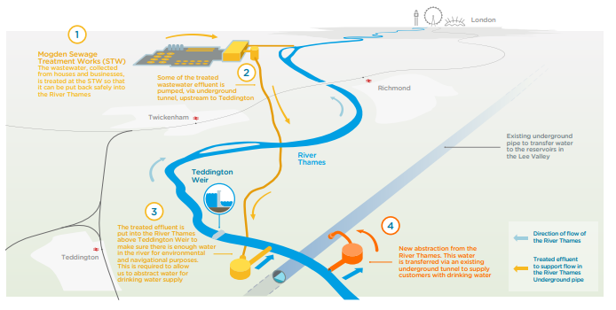
We are considering inherently ‘joined-up’ infrastructure projects – e.g. wastewater reuse
Thames Water WRMP 2019

Slide 10
Does wastewater reuse have external impacts on river quality?
Normal day – no wastewater reuse
Normal day – wastewater reuse
Wastewater treatment
To supply
Wastewater treatment
Upstream river
Upstream river
Effluent discharge
Effluent discharge
Worse than
Yes, positive impacts!!! :D

Slide 11
Does wastewater reuse have external impacts on river quality?
Sever overflow day – no wastewater reuse
Sever overflow day – wastewater reuse
Wastewater treatment
Full sewers!
To supply
Wastewater treatment
Full sewers!
Upstream river
Upstream river
Effluent discharge
Effluent discharge
Better than
But also sometimes negative..

Slide 12
Integrated modelling
AMAZING!
Of the water cycle
So futuristic..

Slide 14
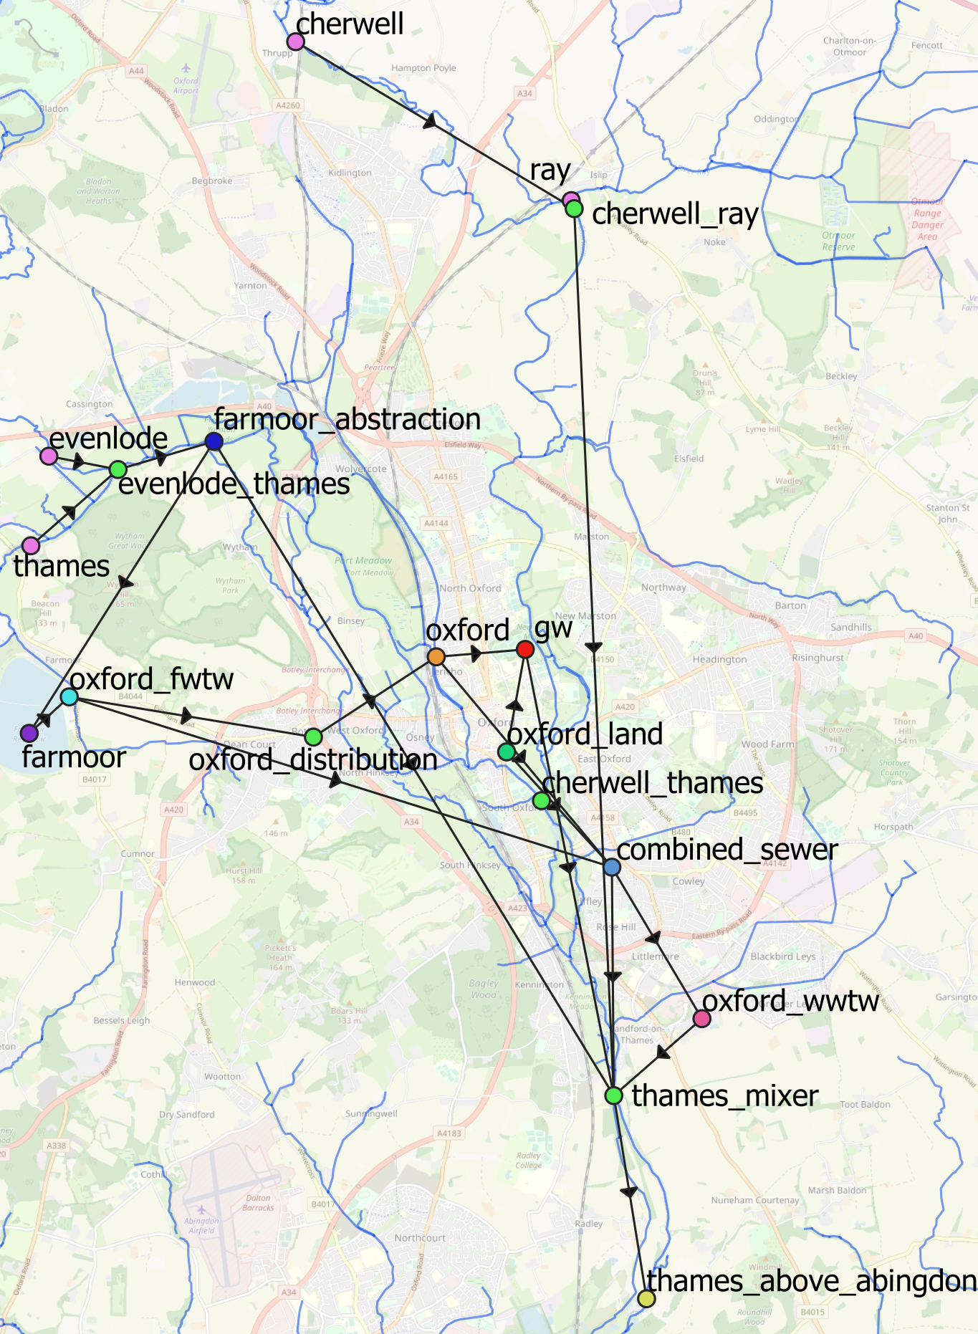
It is a node and arc model, where nodes represent distinct models and arcs convey water quality and quantity

Slide 15
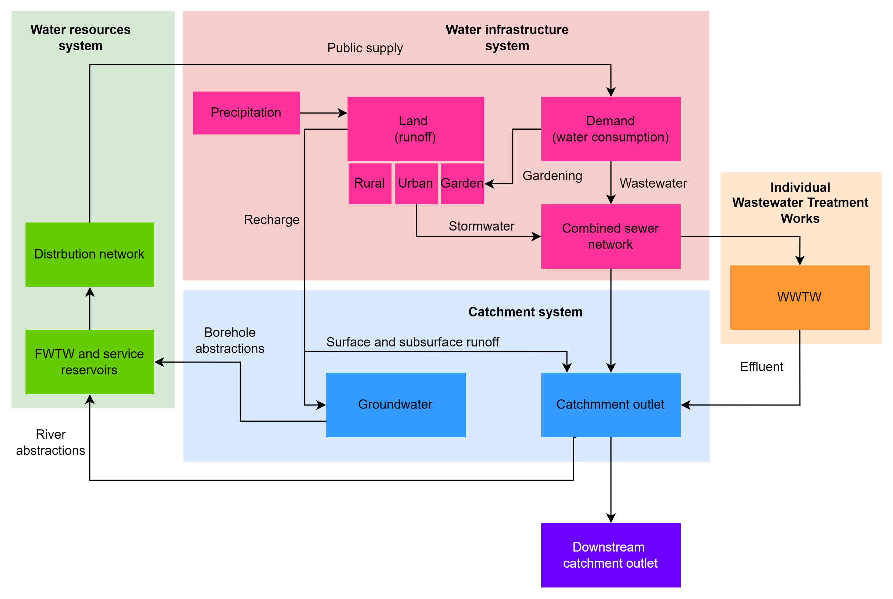
.. Or with connectivity
Note: this arrangement is easily customised

Slide 16
WSIMOD development timeline
CityWat
model
CityWat-SD
semi-distributed
model
CityWat-Plan
framework
CityWat-Storm
model
CityWat +
drainage
emulation
2020
2021
2022
WSIMOD
software
CatchWat
model [6]
CatchWat-SD
model
Regional Water Planning using WSIMOD
Rural
water
systems
Water Systems Integration
Urban water
systems
CatchWat-NBS +
optimisation
WSIMOD for future options analysis
*list of references will be included at the end of the presentation

Slide 17
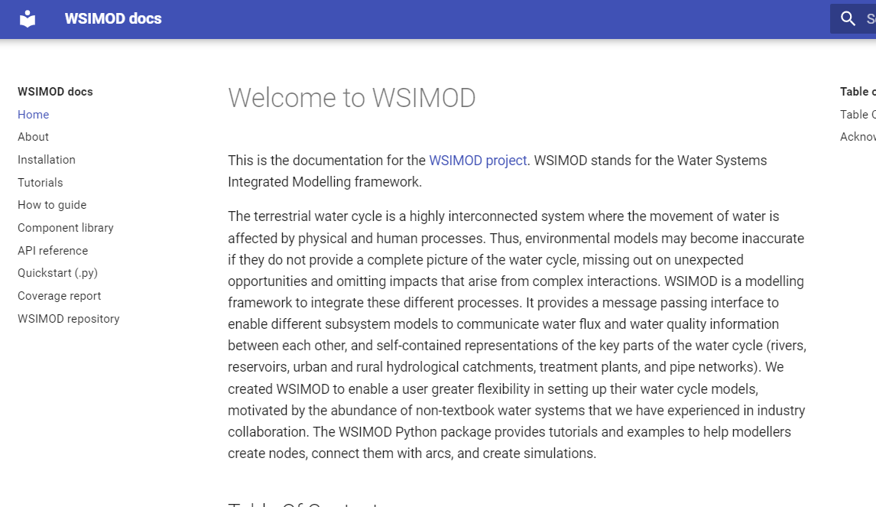
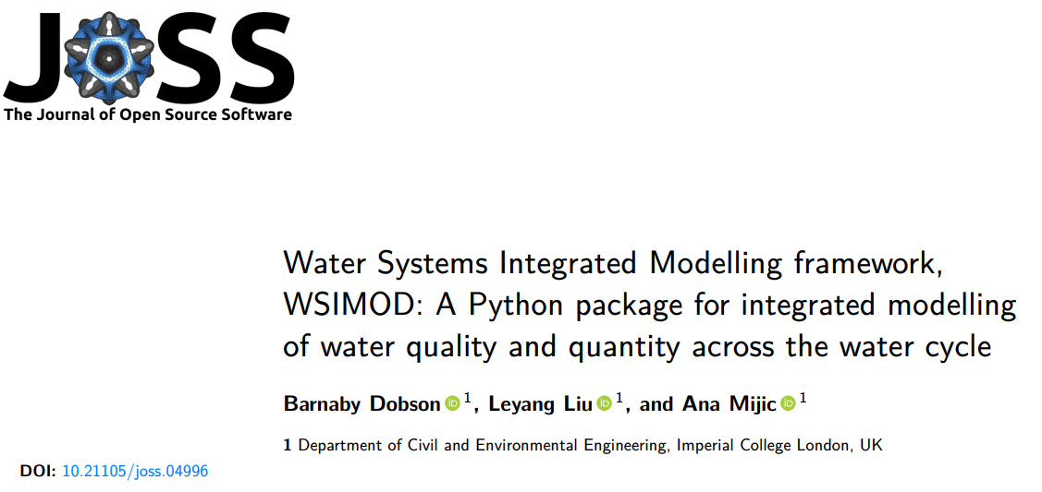
Integrate all parts of the water cycle in a highly flexible way
Automated* setup for anywhere in England (and soon Wales)
Well documented and open-source software package
Package peer reviewed by research software engineers
Applications published in seven peer reviewed articles (+ two under review)
Used in two practical applications subcontracting for Mott MacDonalds (clients Environment Agency and Greater London Authority) and two underway

Slide 18
Upper Lea case study
Integrated water management study for the Greater London Authority

Slide 19
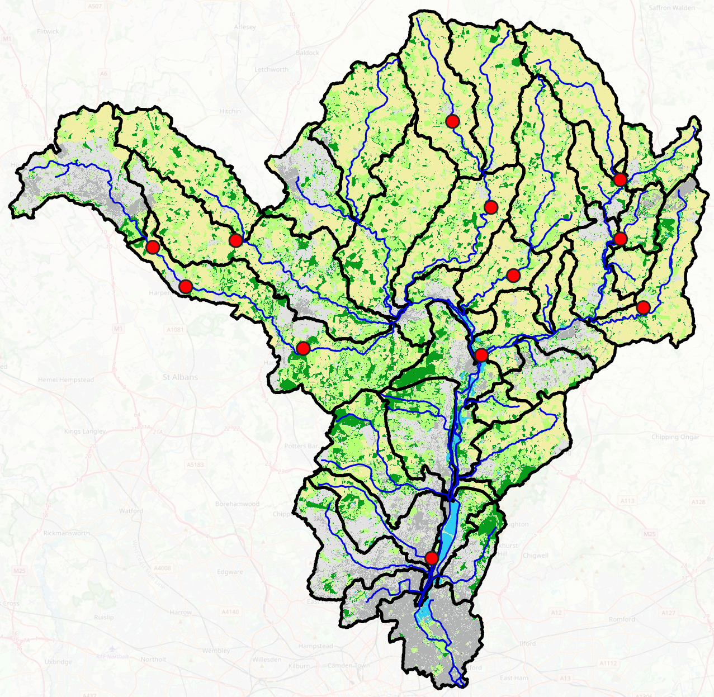
Example study area – Lea catchments for GLA
Arable
Improved grassland
Woodland
Suburban
Urban
Freshwater
River (WFD cycle 2)
WWTW (serving >1500p, UWWTD)
Abstraction (informal TW contact)
Sub-catchments (WFD cycle 2)
Copper mills FWTW
Lea reservoir group (informal TW contact)
Data also used, but not visualised:
-Climate data (precipitation, temperature, evapotranspiration) 2000-2020; HadUK
-Garden areas and population; ONS
-Crop types, fertiliser/manure application, atmospheric pollution deposition; CEH
-Wastewater catchments

Slide 20
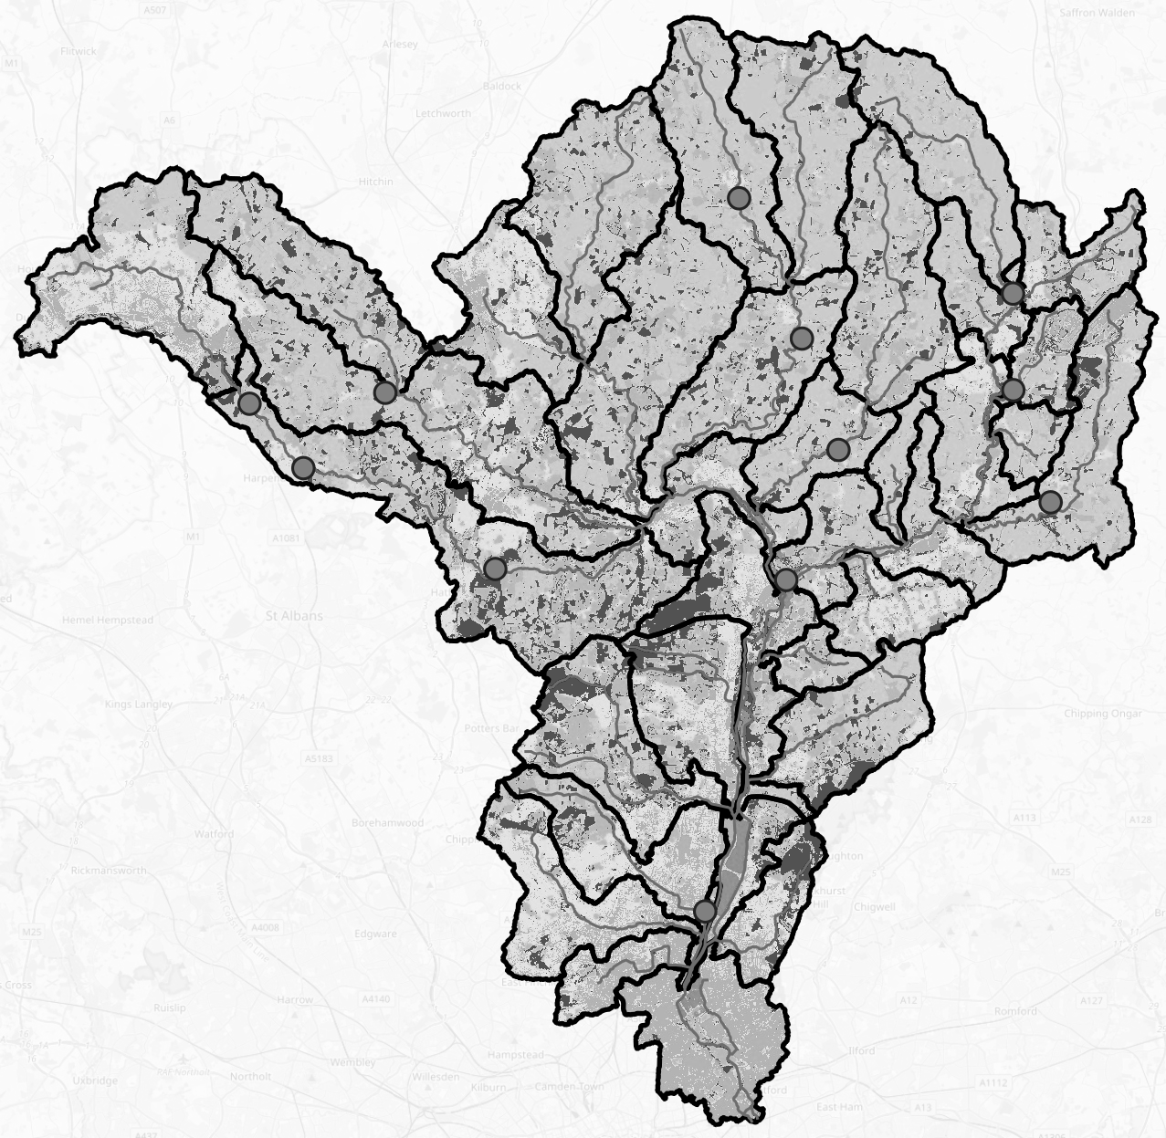
Modelling Assumptions (Water Resources)
New River intake: 100Ml/d capacity, 50Ml/d minimum downstream required flow
KGV intake: 2600Ml/d capacity, 550Ml/d annual average, 275Ml/d minimum downstream
Thames Lea tunnel: 225Ml/d entering model
NLARS: 180Ml/d entering model when reservoir storage is within the level 1 curve of LTOA
Coppermills FWTW: 415Ml/d leaving model
Please note! Some of these numbers are educated guesses, simulations are very sensitive to them
New River intake
King George V intake (aggregated Walthamstow intakes)
NLARS
Aggregated Lea reservoirs
Thames-Lea tunnel
Coppermills FWTW

Slide 21
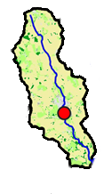
Modelling Assumptions (Hydrology & Wastewater)
Schematic of a typical catchment

Slide 22
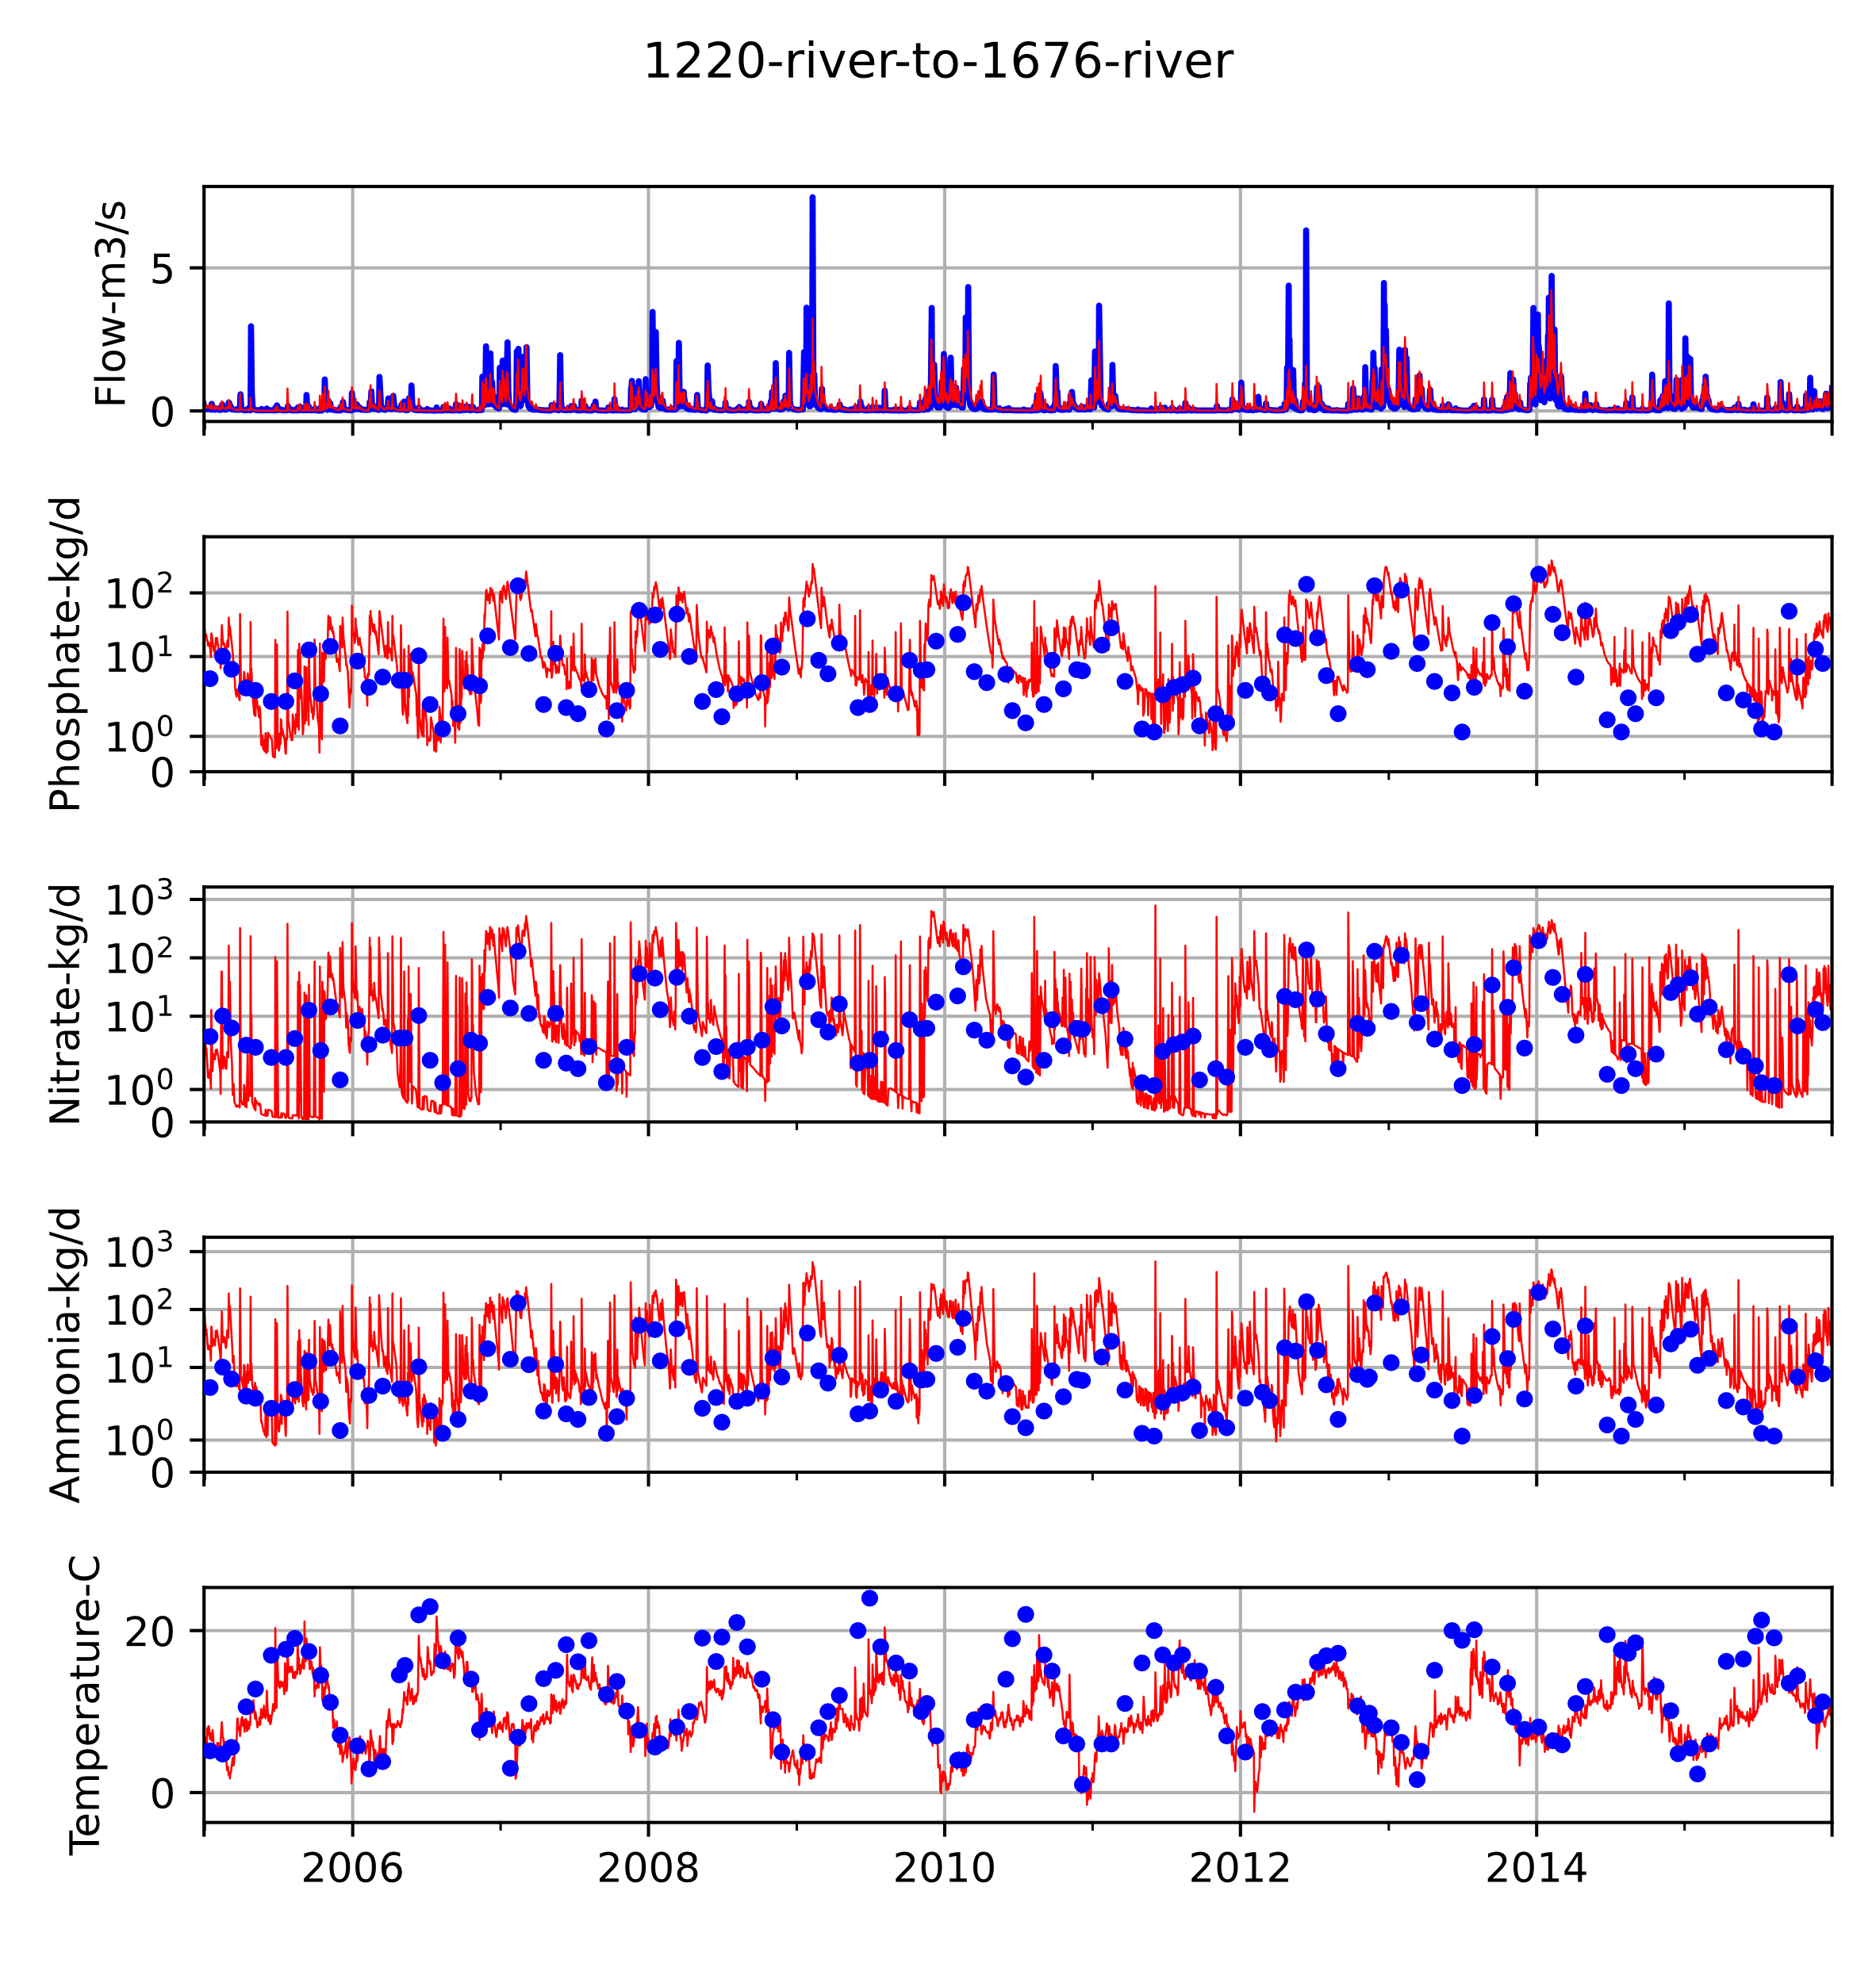
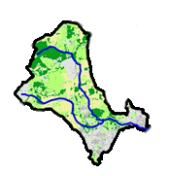
Baseline Simulations (Rivers) – example Enfield catchment Turkey Brook
Flows in range 0.5-0.8NSE at 7 NRFA gauges across the catchment, with some calibration.
Currently water quality has not yet been calibrated.
Observed
Simulated
Water quality spikes are highly sensitive to: infiltration, mis-connection, and urban pollutant deposition. All of which I have minimal data on.

Slide 23
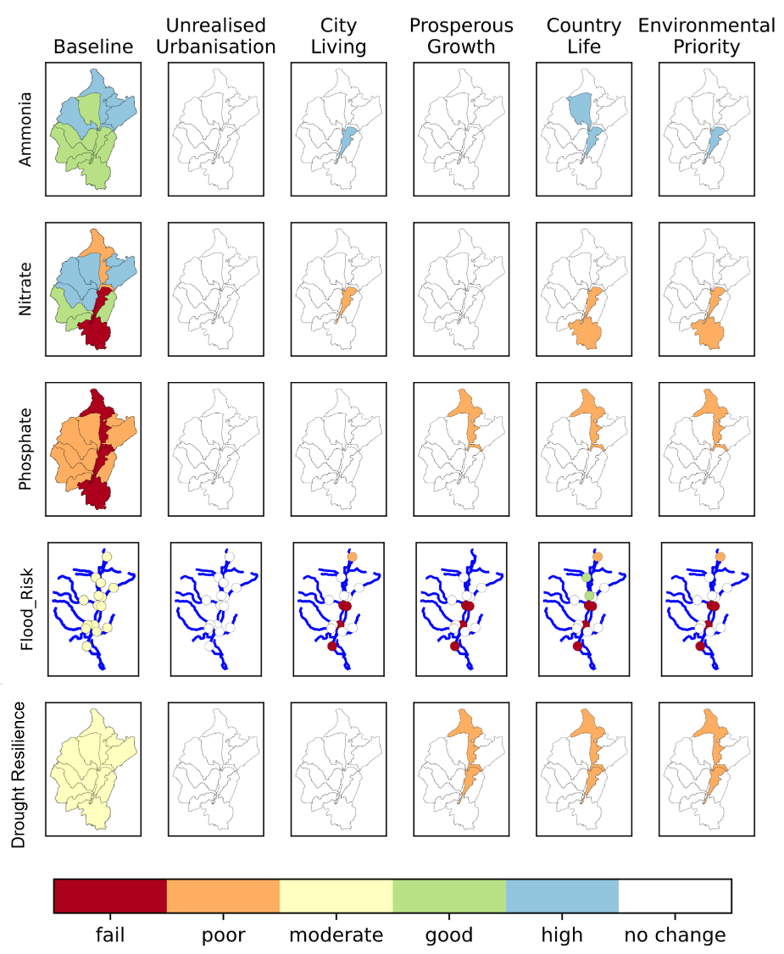
WSIMOD lets you project how different scenarios or interventions may impact WFD classification
This scenario implements WWTW improvements…
Which improves the existing phosphate classification from a fail…
… to a poor classification

Slide 24
What next?
Surely not??
It’s too many things!
Can we integrate more…?

Slide 25
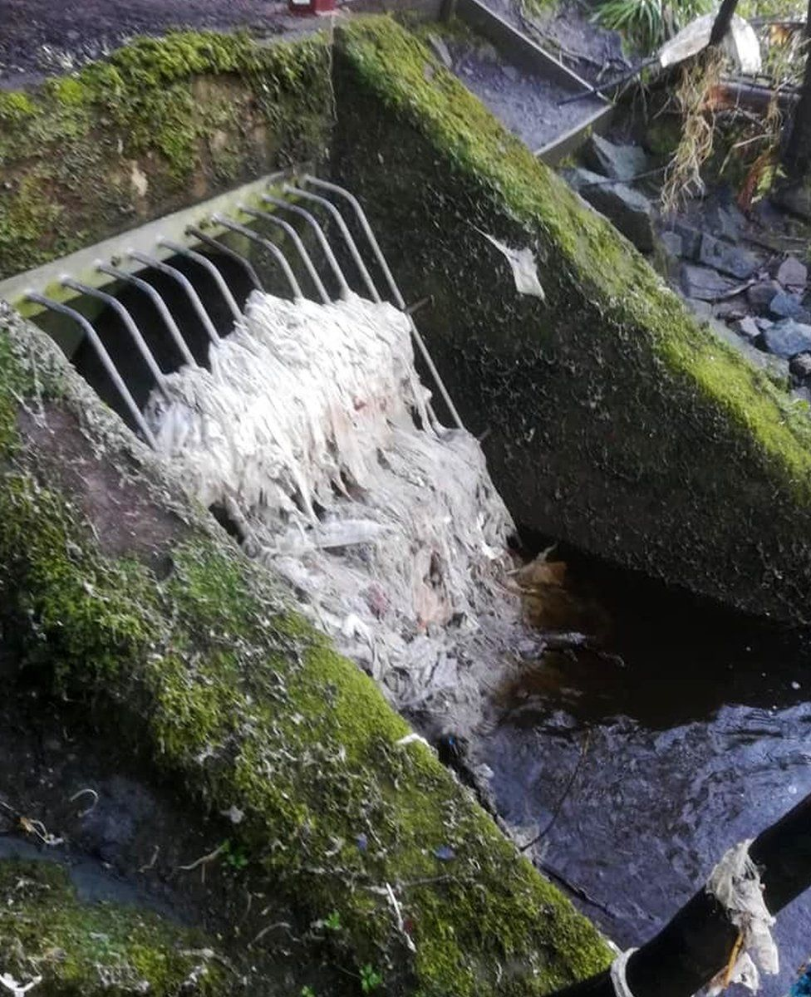
Functioning infrastructure
Is not the same as
Good water quality
Is not the same as
Functioning ecosystem

Slide 26
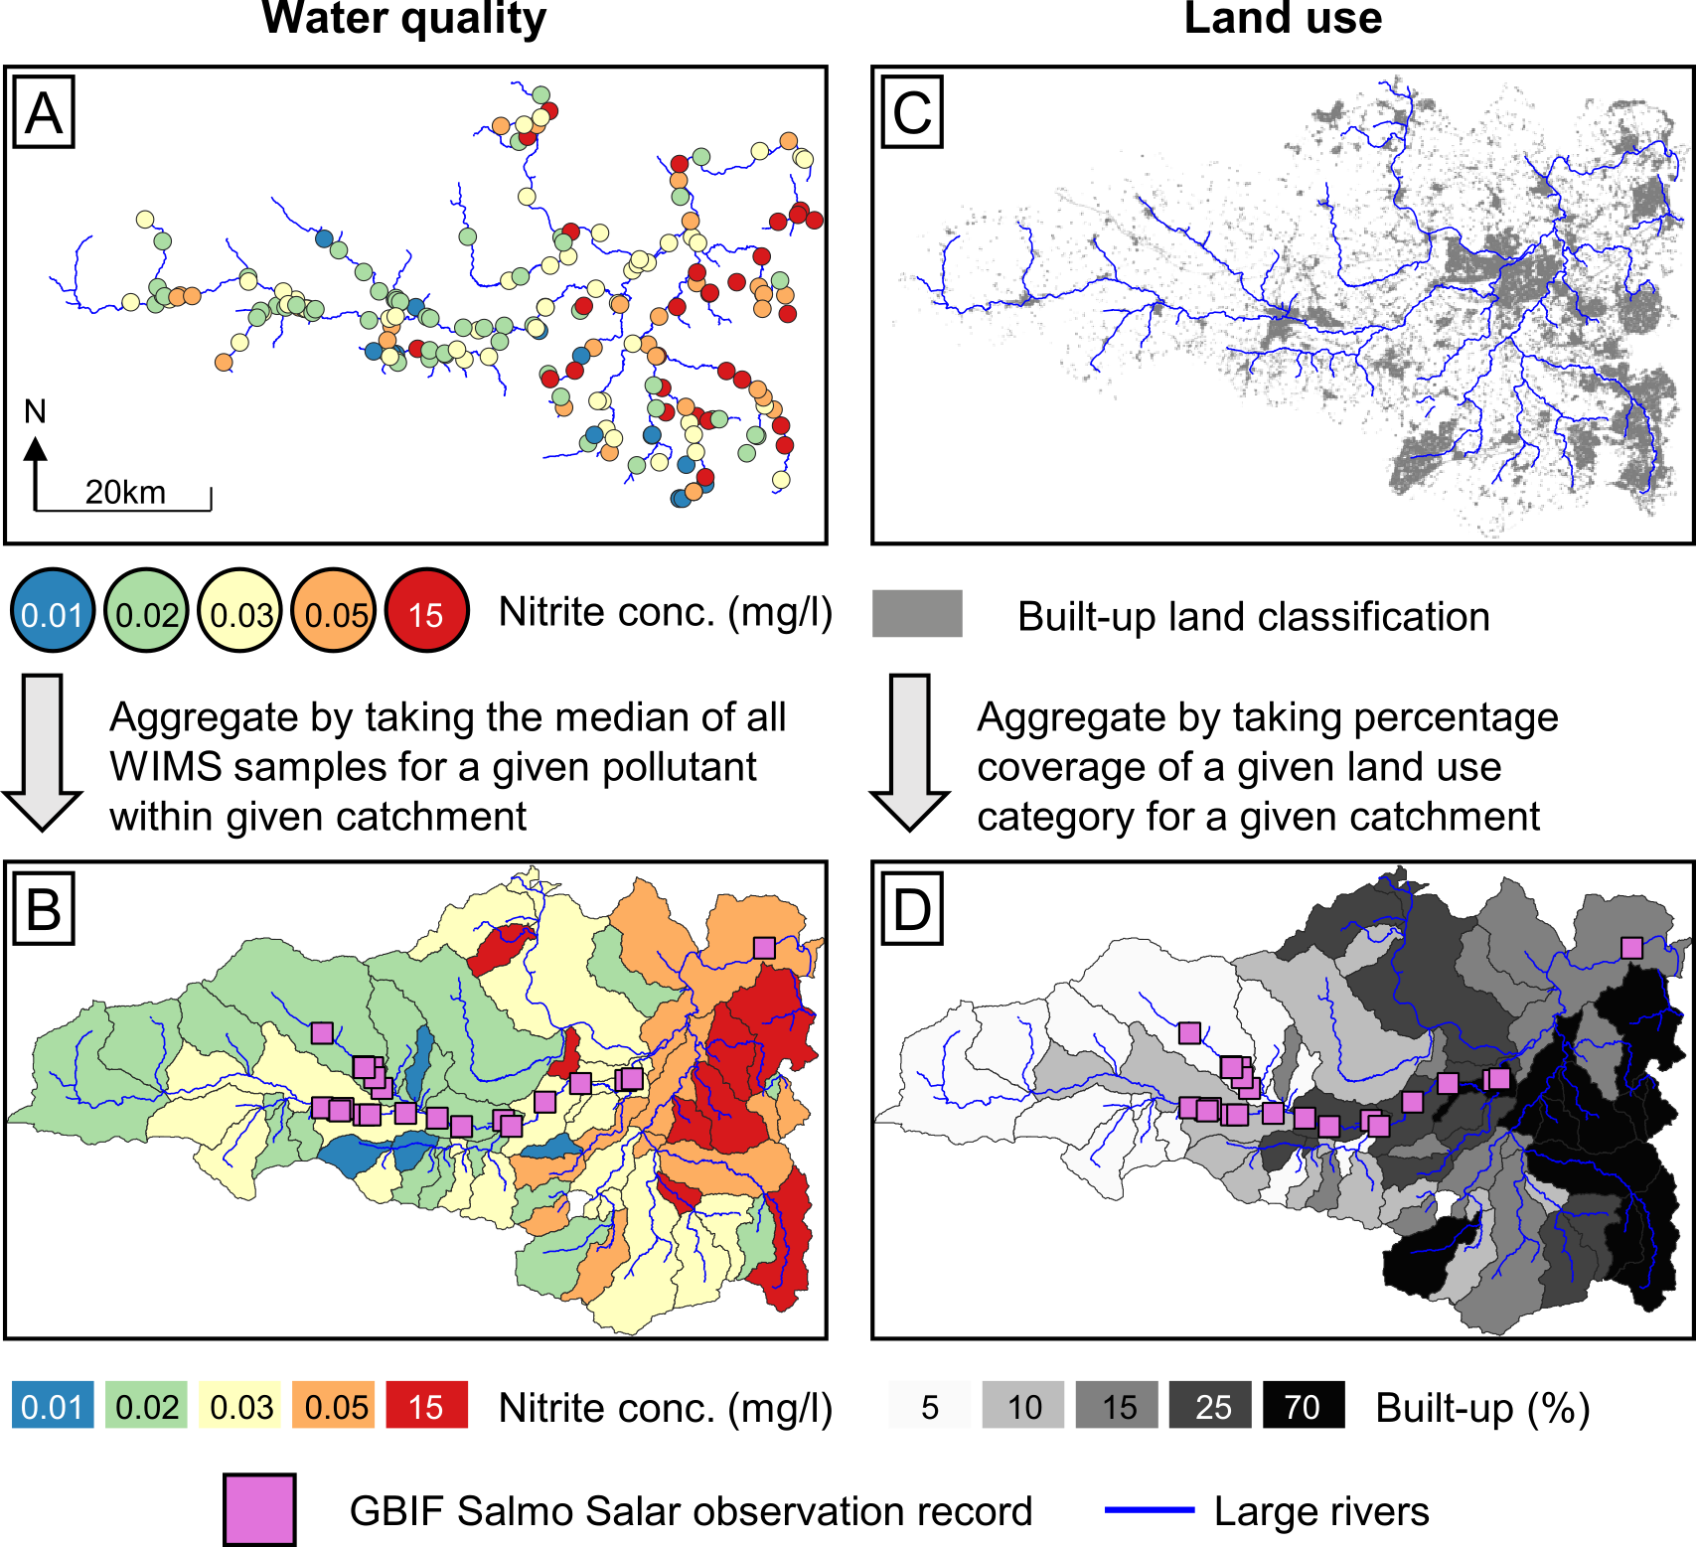
Can chemical water quality can predict biodiversity
In river water quality samples
Land cover
Aggregate this data to catchment scale
And compare against species observations

Slide 27
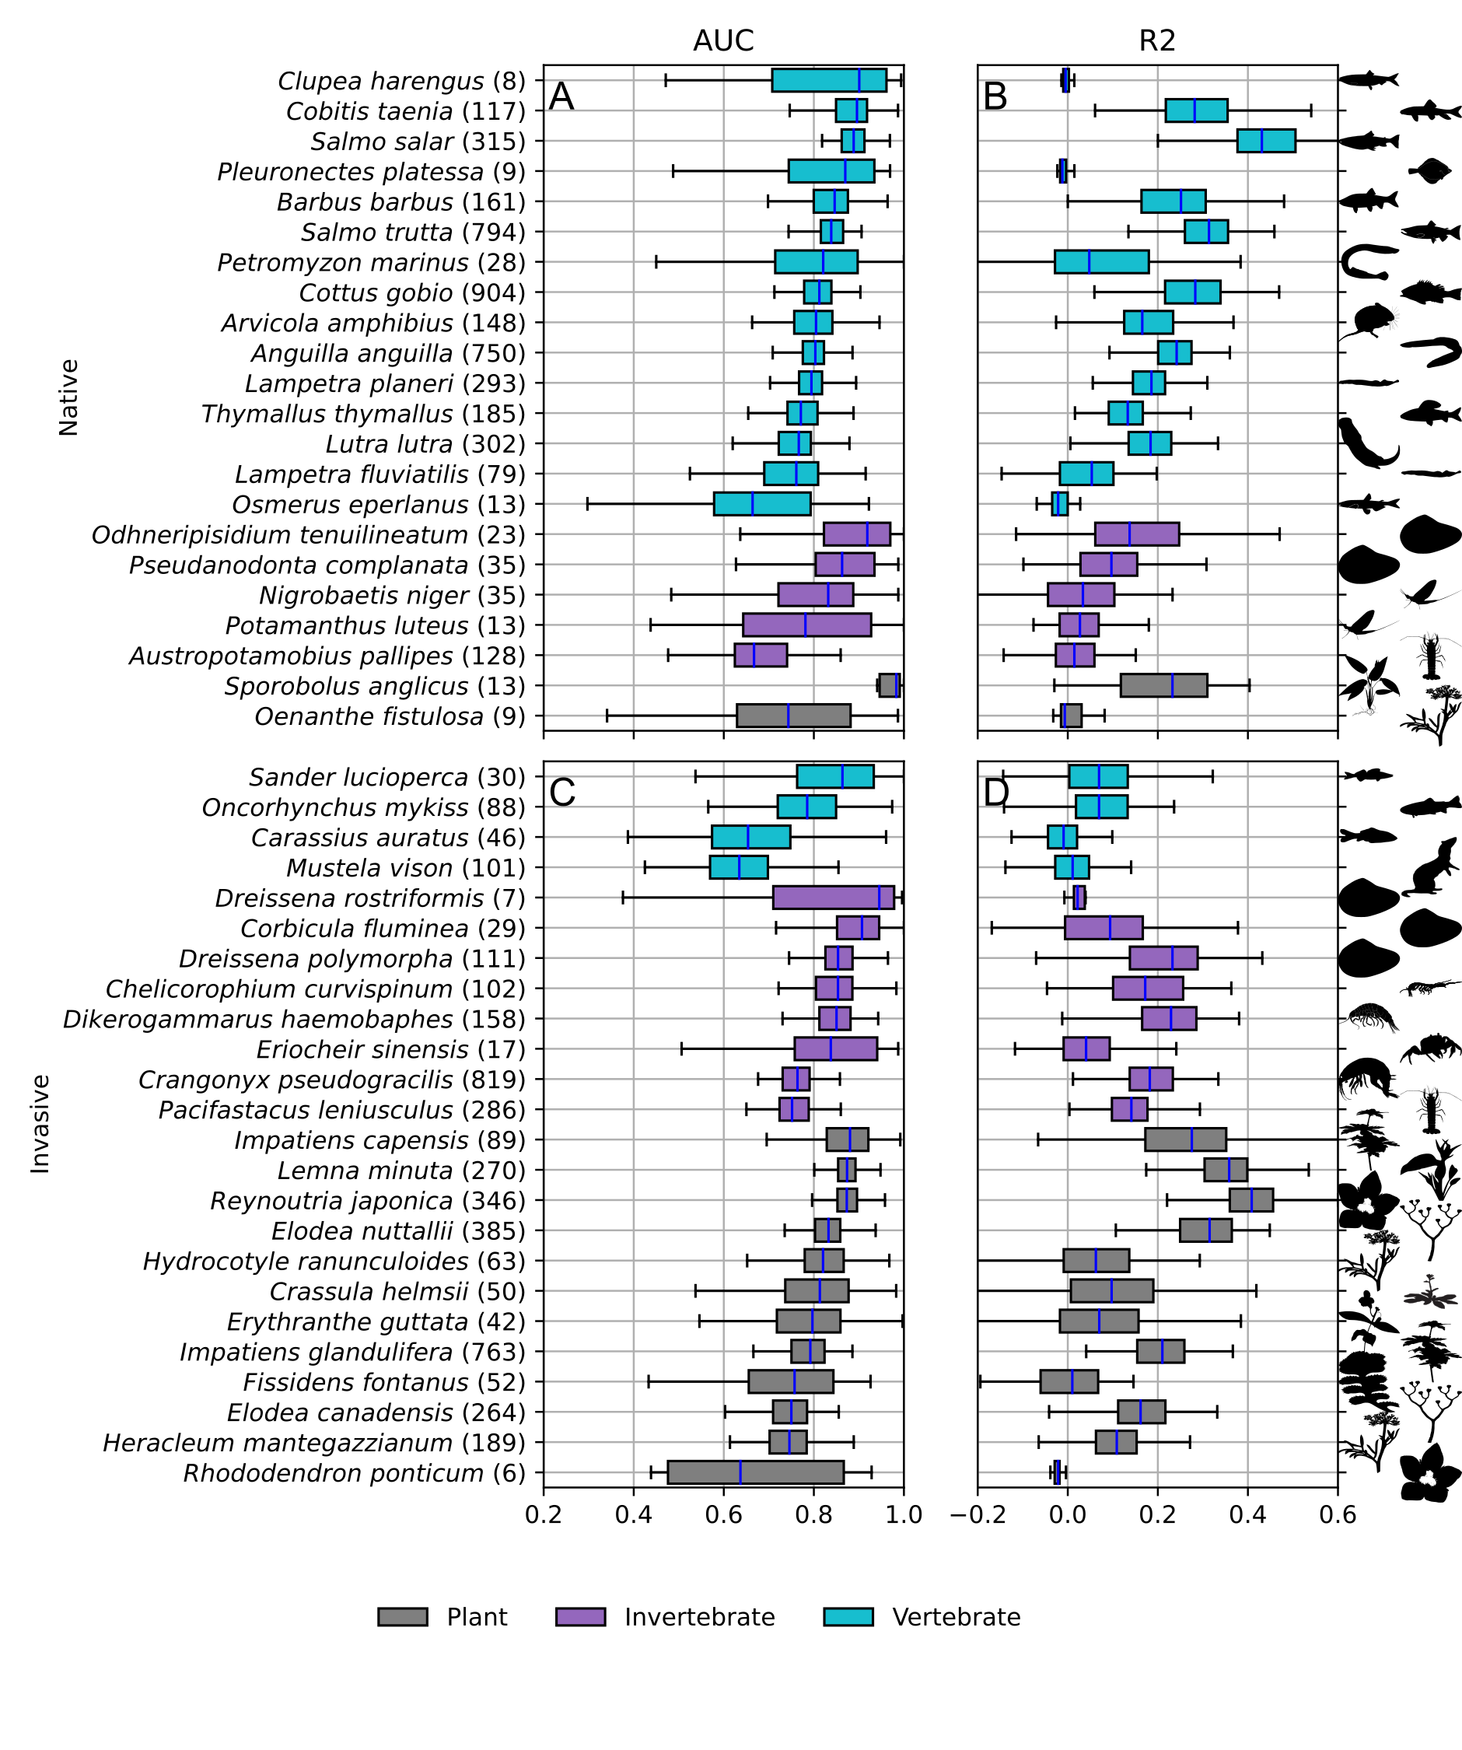
We can use chemical water quality (which WSIMOD simulates) to predict both native and invasive species with good accuracy!
We are piloting and seeking funding to dynamically pair WSIMOD with in-river biodiversity, thus enabling our ecological requirements determine how we should operate our water infrastructure

Slide 28
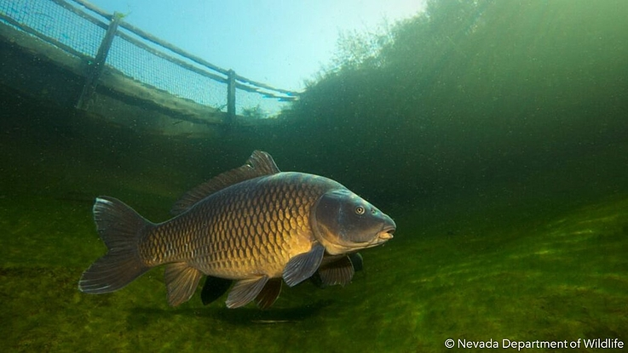
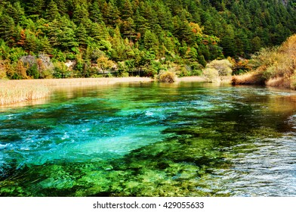
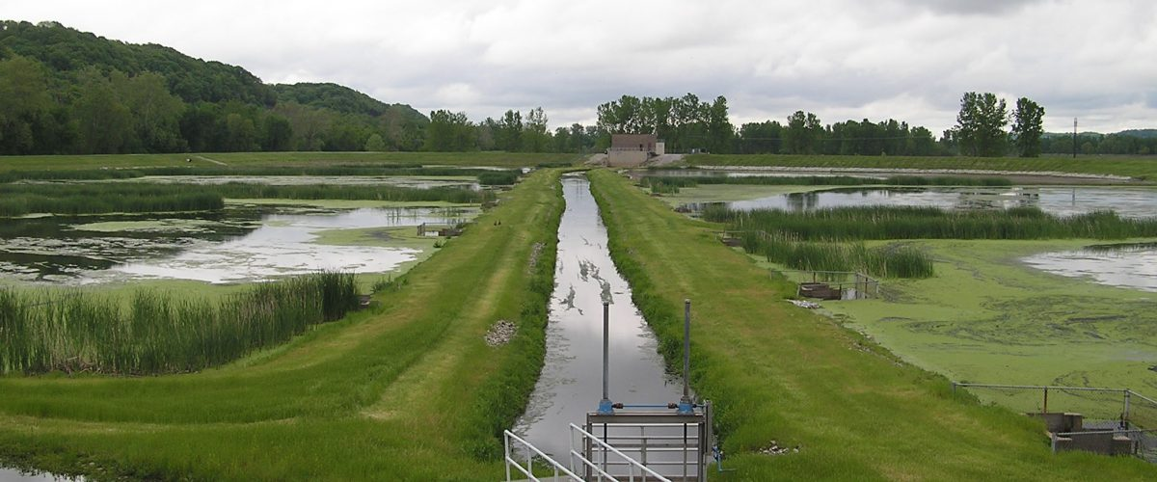
Happy biodiversity
Should determine what we define as
Happy water quality
Should determine what we define as
Happy infrastructure

Slide 29
Closing remarks

Slide 30
Practical applications of WSIMOD
Existing system / baseline
Changes to the system / impacts and outcomes
Pollution attribution
Bring together diverse stakeholders around a common model that probably represents everyone’s subsystem of interest
Sense checking other models
Impact of boundary assumptions
Scenario planning
Optioneering
Adaptive planning
Licence reform
Optimisation (choice of options, sizing of options, spatial distribution)

Slide 31
Key insights
Individual projects and interventions are key to translate planning into actions to make a real difference
But they are a part of a much larger, highly complex and uncertain system
Integrated modelling helps us understand how it all comes together
And how regional planning, regulation and management decisions impact flows and quality of our rivers
Which will help us understand, plan and improve, our water environment!

Slide 32
WSIMOD software
Documentation: https://barneydobson.github.io/wsi/
Water Systems Integrated Modelling framework, WSIMOD: A Python package for integrated modelling of water quality and quantity across the water cycle (2023) The Journal of Open Source Software. The Open Journal, 8(83), p. 4996.
WSIMOD publications
Dobson, B. and Mijic, A., 2020. Protecting rivers by integrating supply-wastewater infrastructure planning and coordinating operational decisions. Environmental Research Letters, 15(11), p.114025.
Puchol-Salort, P., Boskovic, S., Dobson, B., van Reeuwijk, M. and Mijic, A., 2022. Water Neutrality Framework for Systemic Design of New Urban Developments. Water Research, p.118583.
Dobson, B., Jovanovic, T., Chen, Y., Paschalis, A., Butler, A. and Mijic, A., 2021. Integrated modelling to support analysis of COVID-19 impacts on London's water system and in-river water quality. Frontiers in Water, 3, p.641462.
Muhandes, S., Dobson, B. and Mijic, A. 2022. The value of aggregated city scale models to rapidly assess SuDS in combined sewer systems. Frontiers in Water, p.206.
Dobson, B., Watson‐Hill, H., Muhandes, S., Borup, M. and Mijic, A., 2022. A reduced complexity model with graph partitioning for rapid hydraulic assessment of sewer networks. Water Resources Research, 58(1), p.e2021WR030778.
Liu, L., Dobson, B. and Mijic, A., 2022. Hierarchical systems integration for coordinated urban-rural water quality management at a catchment scale. Science of The Total Environment, 806, p.150642.
Liu, L., Dobson, B. and Mijic, A., 2023. Optimisation of urban-rural nature-based solutions for integrated catchment water management. Journal of Environmental Management, 329, p.117045.
WSIMOD industry documents
Mijic, A., Bromwich, B., Crilly, D., Dobson, B., Forrow, D., Giambona, J., Kirk, S., Liu, L. and MacDonald, R. 2022. Systems Approach to Regional Water Planning, Centre for Systems Engineering and Innovation, Working Paper Series, No. 1 (link)
Dobson, B., Liu, L., Giambona, J. and Mijic, A. 2022. OxCam Arc phase 1a: Demonstration modelling using the Water Systems Integration (WSIMOD) framework (link)
Biodiversity paper
Dobson, B., Barry, S., Maes-Prior, R., Mijic, A., Woodward, G. and Pearse, W.D., 2022. Predicting catchment suitability for biodiversity at national scales. Water Research, 221, p.118764.

