Slide 1
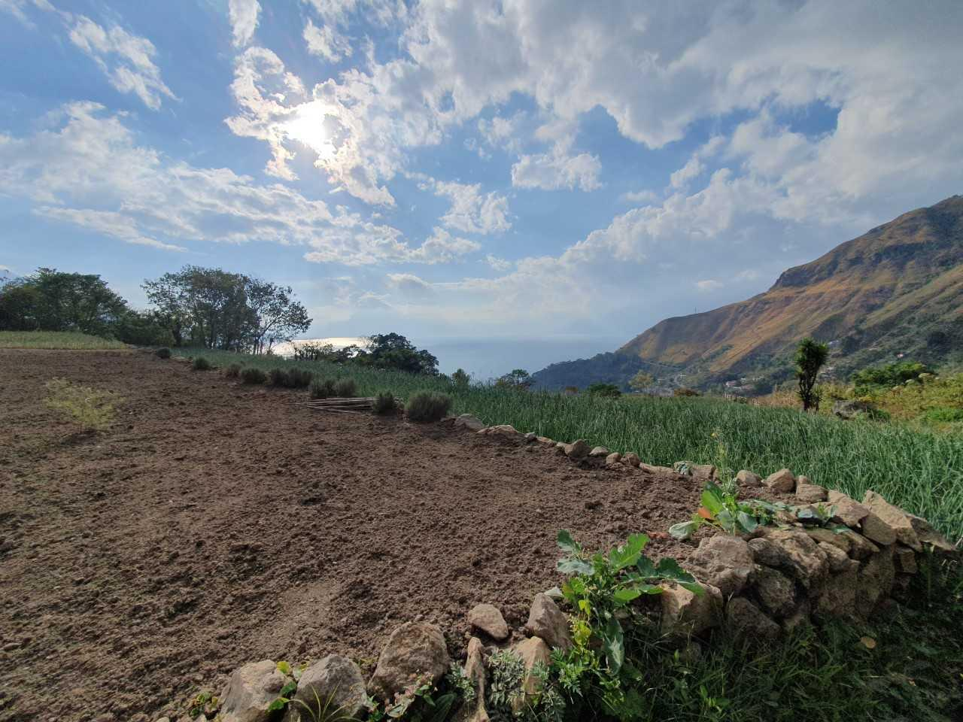
Human Excreta Biochar: An Evaluation of the Potential of Resource-Oriented Sanitation to Bridge the Metabolic Rift
CORNELL AAP
Benjamin C. Wilde
February 2024
1

Slide 2
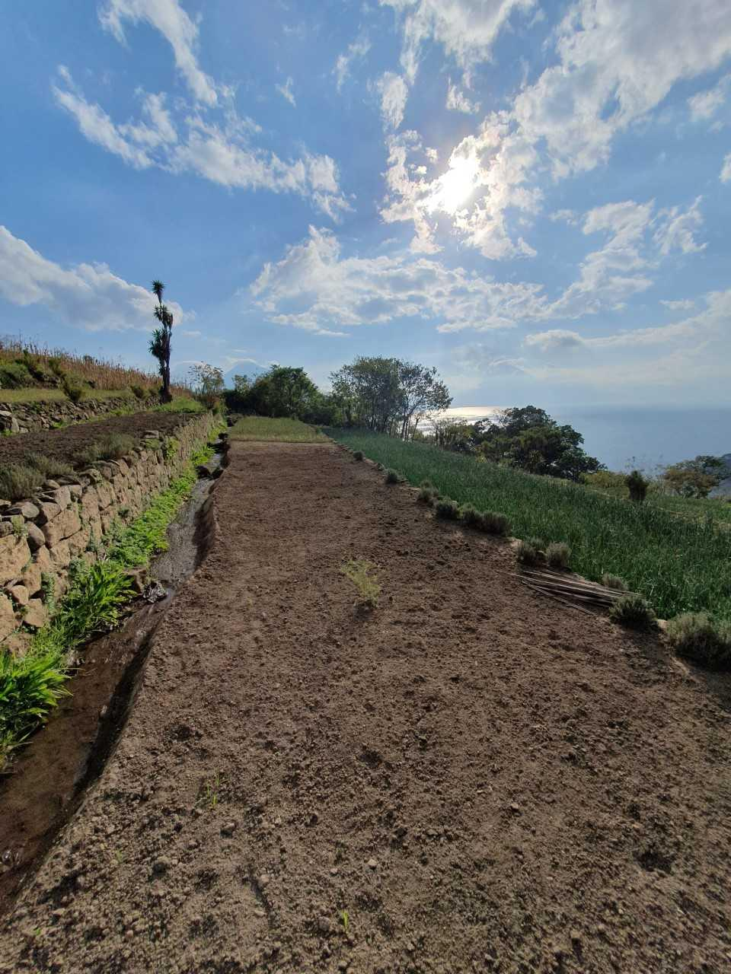
Agenda
Circular City-regions
Project Background
Production of urine enriched biochar
UEB quality assurance results and future
Agroecological results
Where shall we go now?
Image: Wilde, B.
2
Notes:
Integrated Water Ecosystems Management--Energy Efficient Waste Water Treatment and Integrated Water Resources, Recovery and Recycling Management for a Circular Climate Adaptation Economy

Slide 3
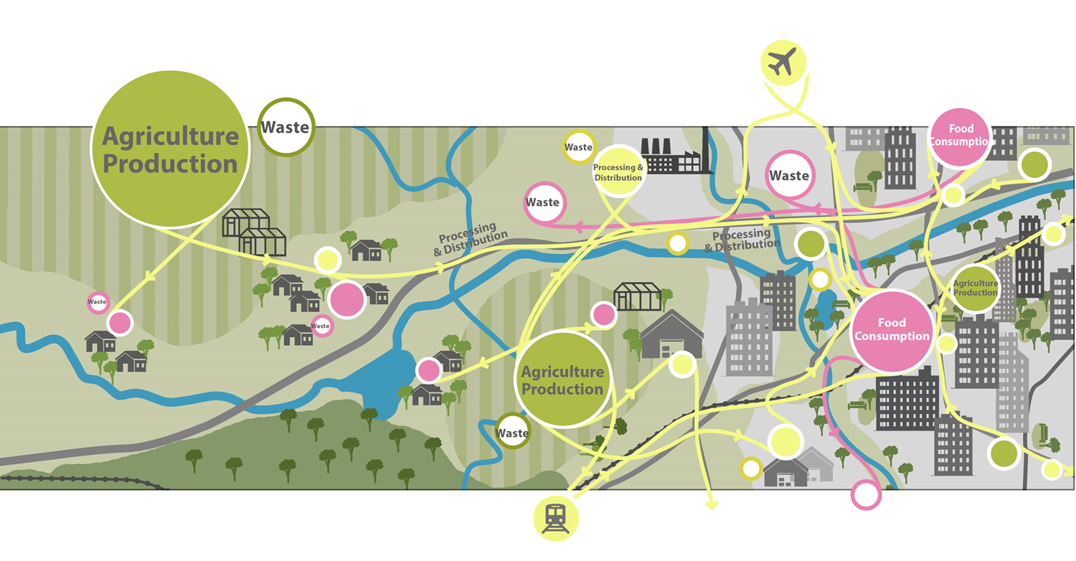
The Linear City-Region
Source: Agropolitan Territories
Helen Fan Lei, Jessica Diehl, Lu Yuhao

Slide 4
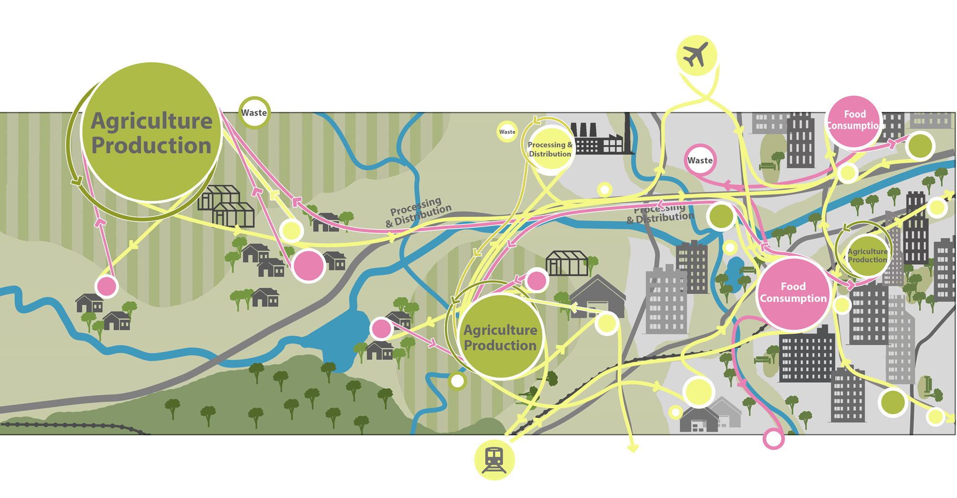
The Circular City-Region
Source: Agropolitan Territories
Helen Fan Lei, Jessica Diehl, Lu Yuhao

Slide 5
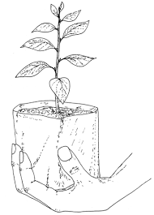
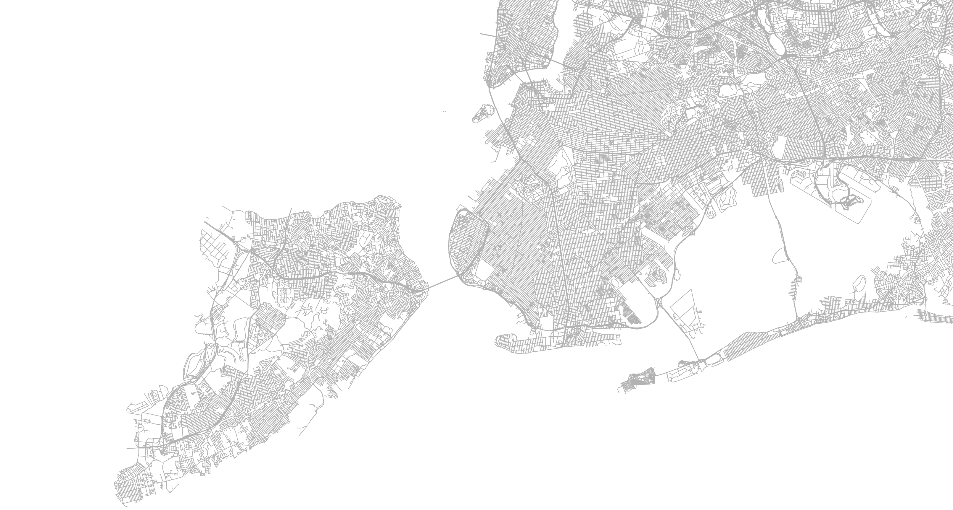
Circular City-Regions: Not New, Abandoned
"If it were practicable to collect, with the least loss, all the solid and fluid excrements of the inhabitants of the town and return to each farmer the portion arising from produce originally supplied by him to the town, the productiveness of the land might be maintained almost unimpaired for ages to come, and the existing store of mineral elements in every fertile field would be amply sufficient for the wants of increasing populations."
Von Liebig, 1863

Slide 6
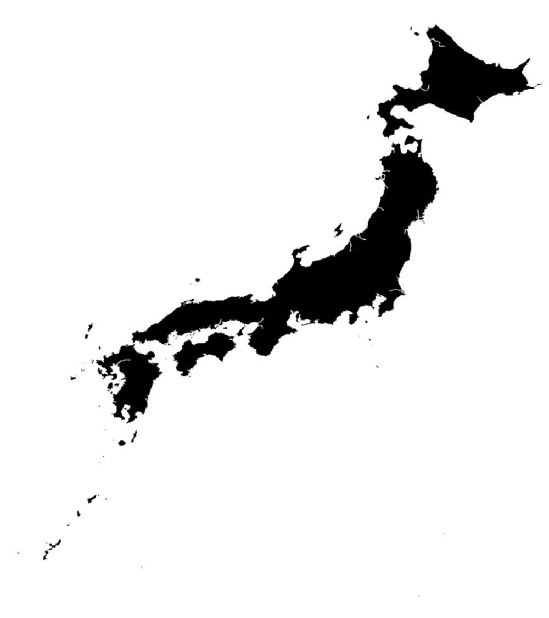
Circular City-Regions: Not New, Abandoned
“The superior farmer values shit as he values gold.”
Miyazaki Yasusada, 1697
Sources: Tajima, 2007; Howell, 2012

Slide 7
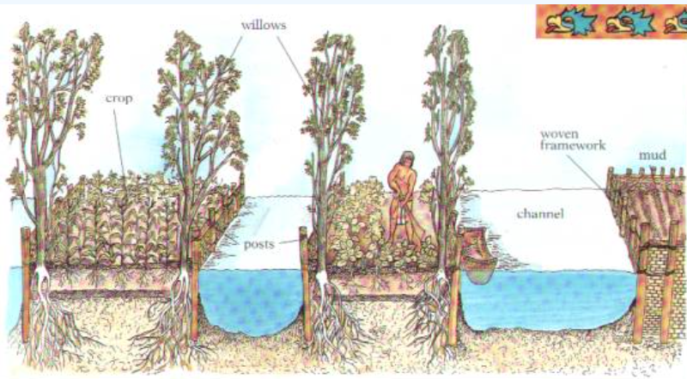
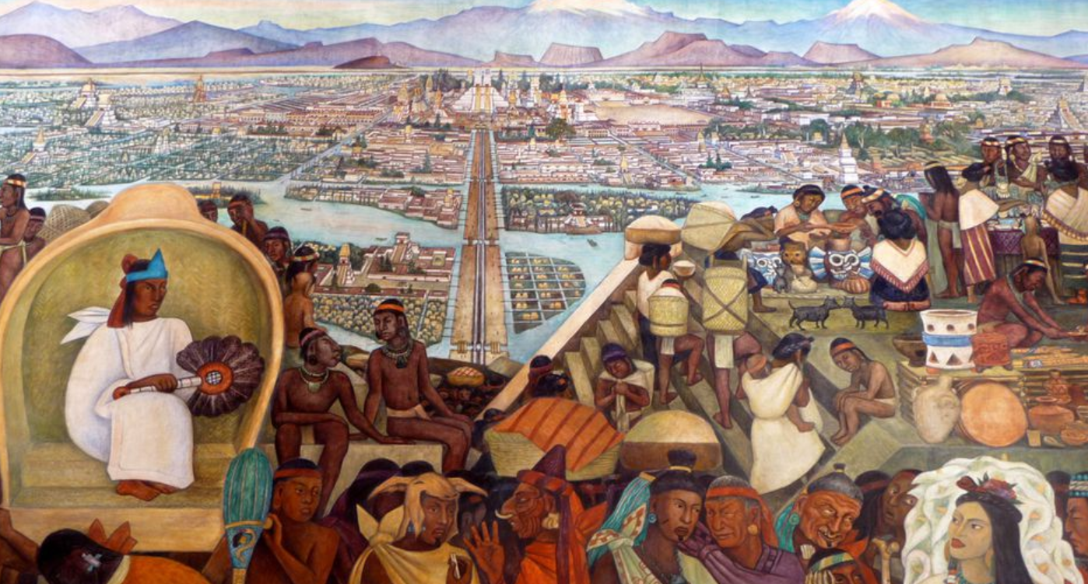
Circular City-Regions: Not New, Abandoned
Diego Rivera fresco.
Photo: Jen Wilton. Creative commons BY-NC 2.0
Midwestpermaculture.com

Slide 8
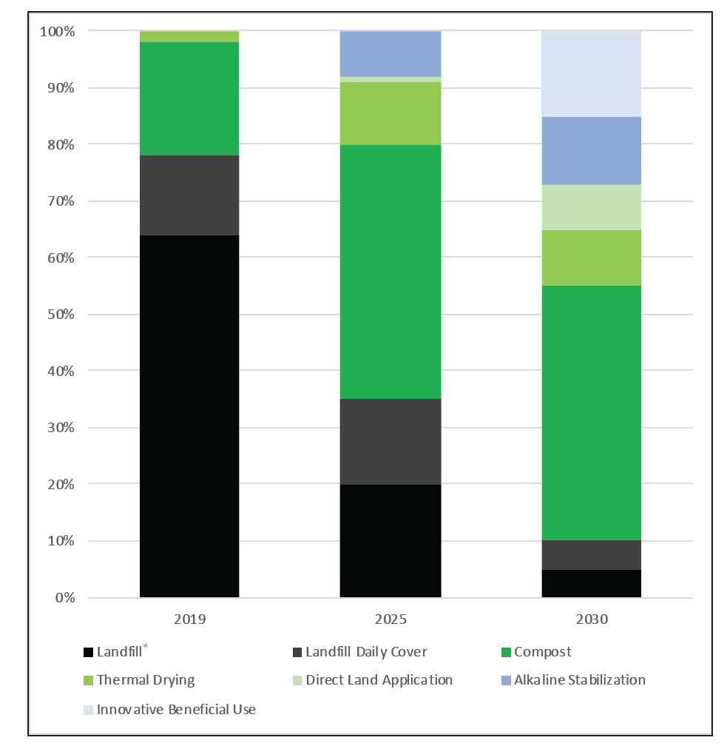
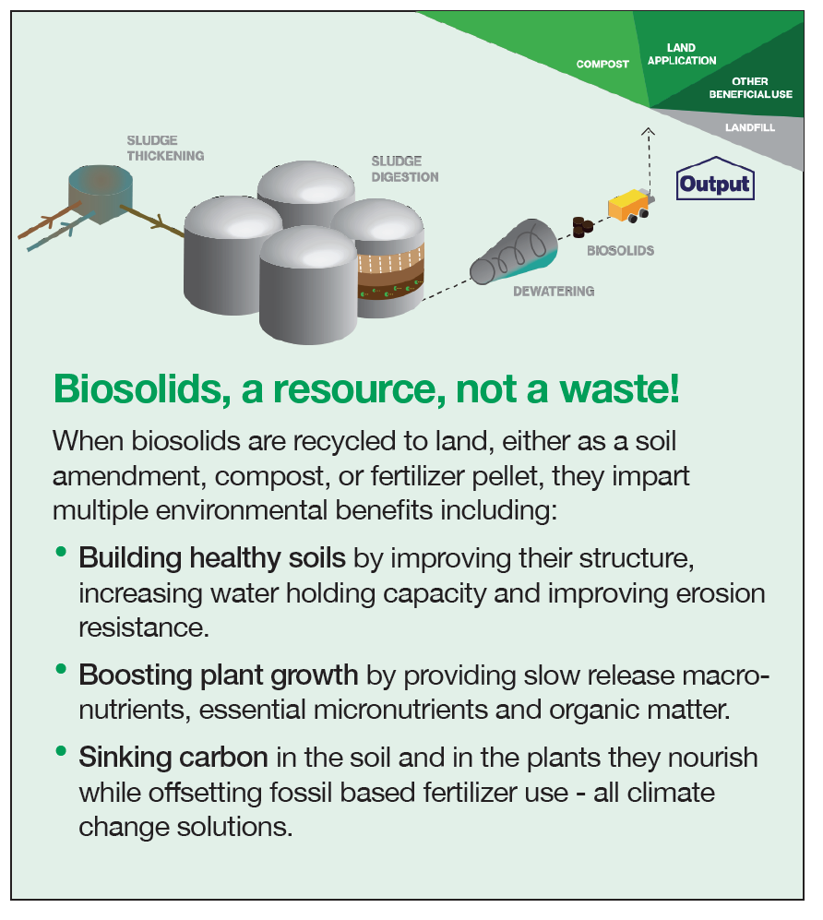
NYC: a shifting socio-technical landscape
“When taken together, the drastically rising cost of landfill disposal and the desire to reduce GHG emissions point to the fact that the current biosolids management strategy is not sustainable from both a financial and an environmental standpoint.”
Source: nyc.gov/dep

Slide 9
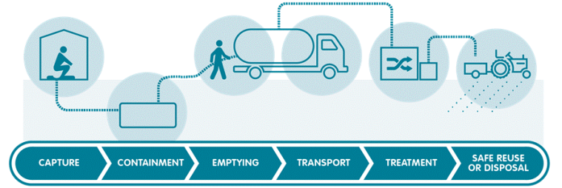
The Sanitation Service Chain
Source: Unicef.org

Slide 10
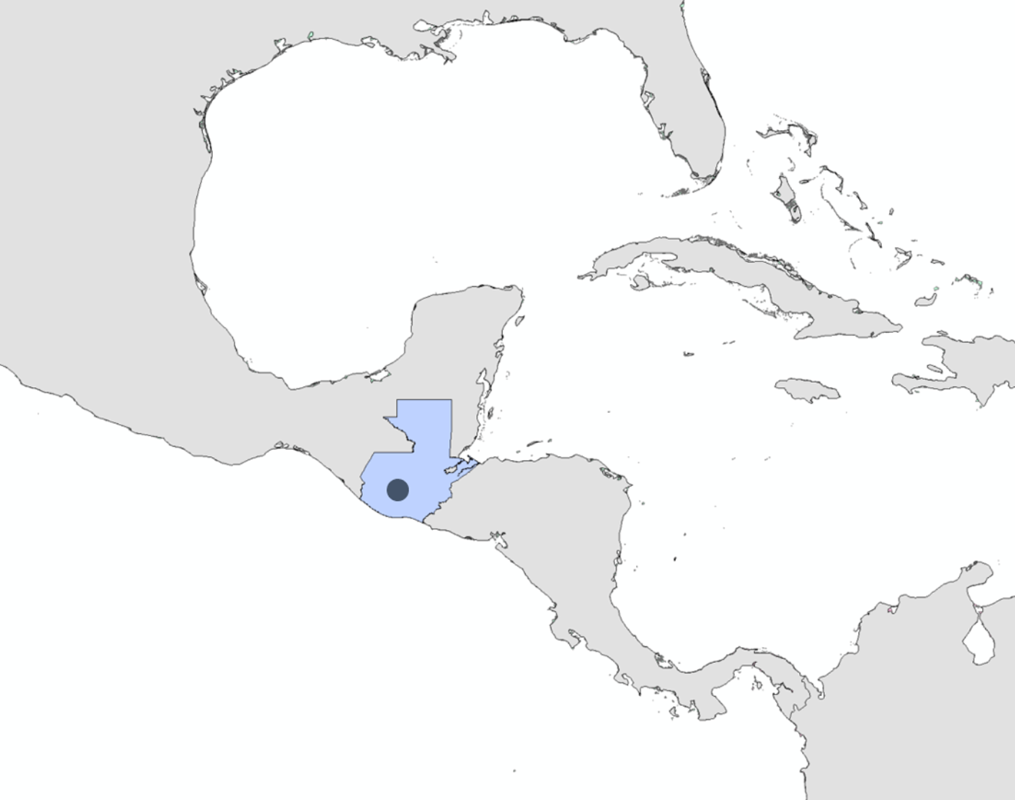
Lake Atitlan, Guatemala: Piloting resource oriented sanitation
Source: Unicef.org

Slide 11
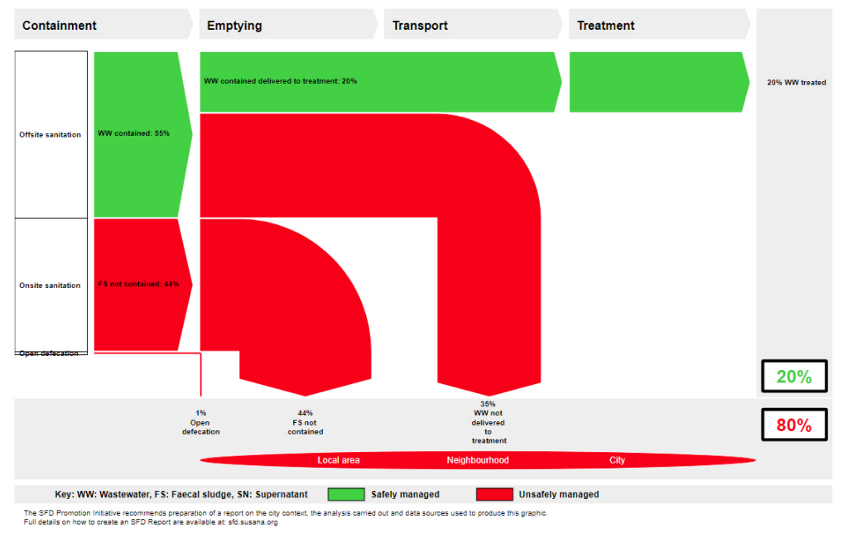
Lake Atitlan, Guatemala: Piloting resource oriented sanitation
Sources: Unicef.org; Ferrans, 2017
Image: Mosan

Slide 12
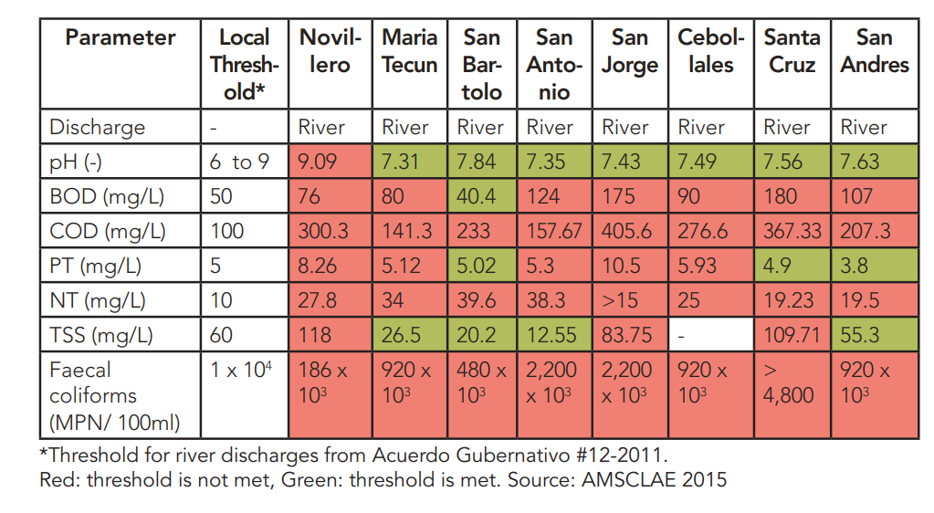
Lake Atitlan, Guatemala: Piloting resource oriented sanitation
Ferrans, 2017
Notes:
45,500 m³ wastewater day⁻¹
9,100 m³ treatment capacity day⁻¹

Slide 13
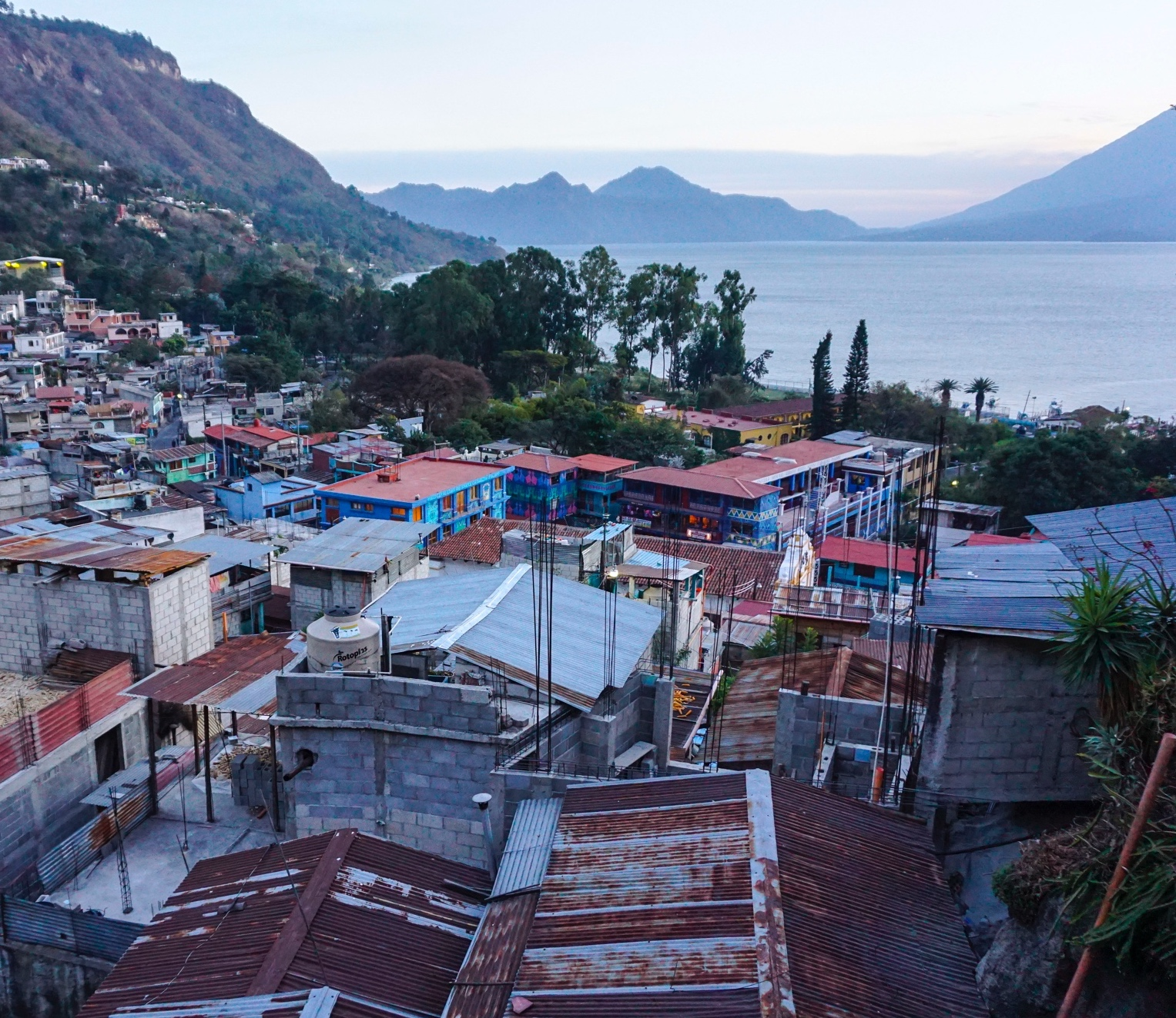
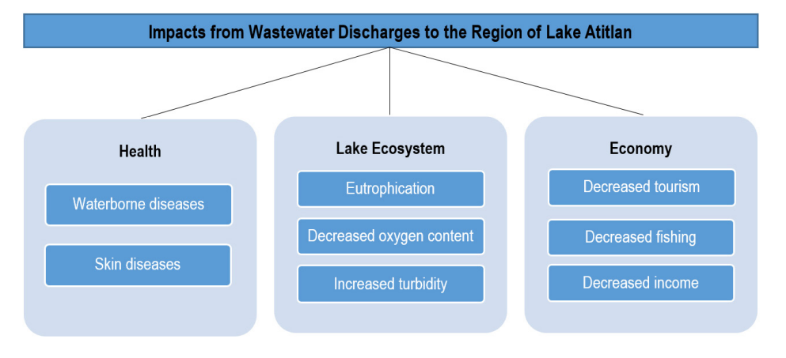
Impacts of ineffective sanitation
Ferrans, 2017
Image: Wilde, B.

Slide 14
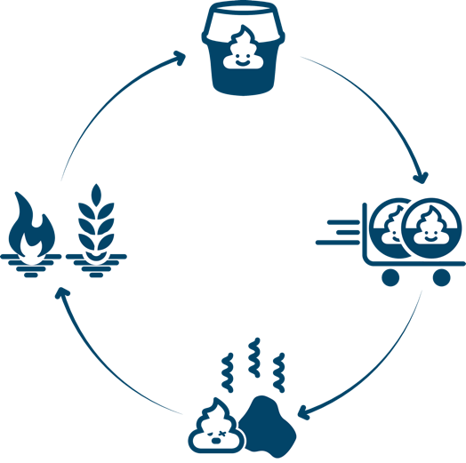
Container Based Sanitation
MOSAN

Slide 15
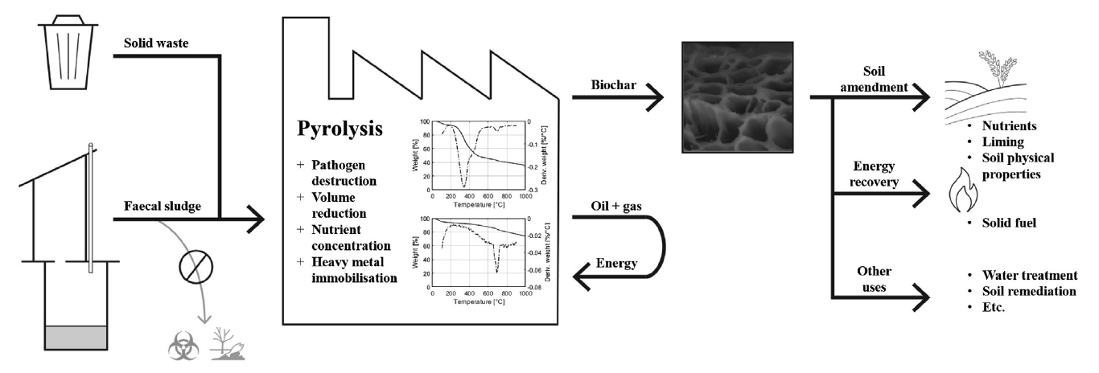
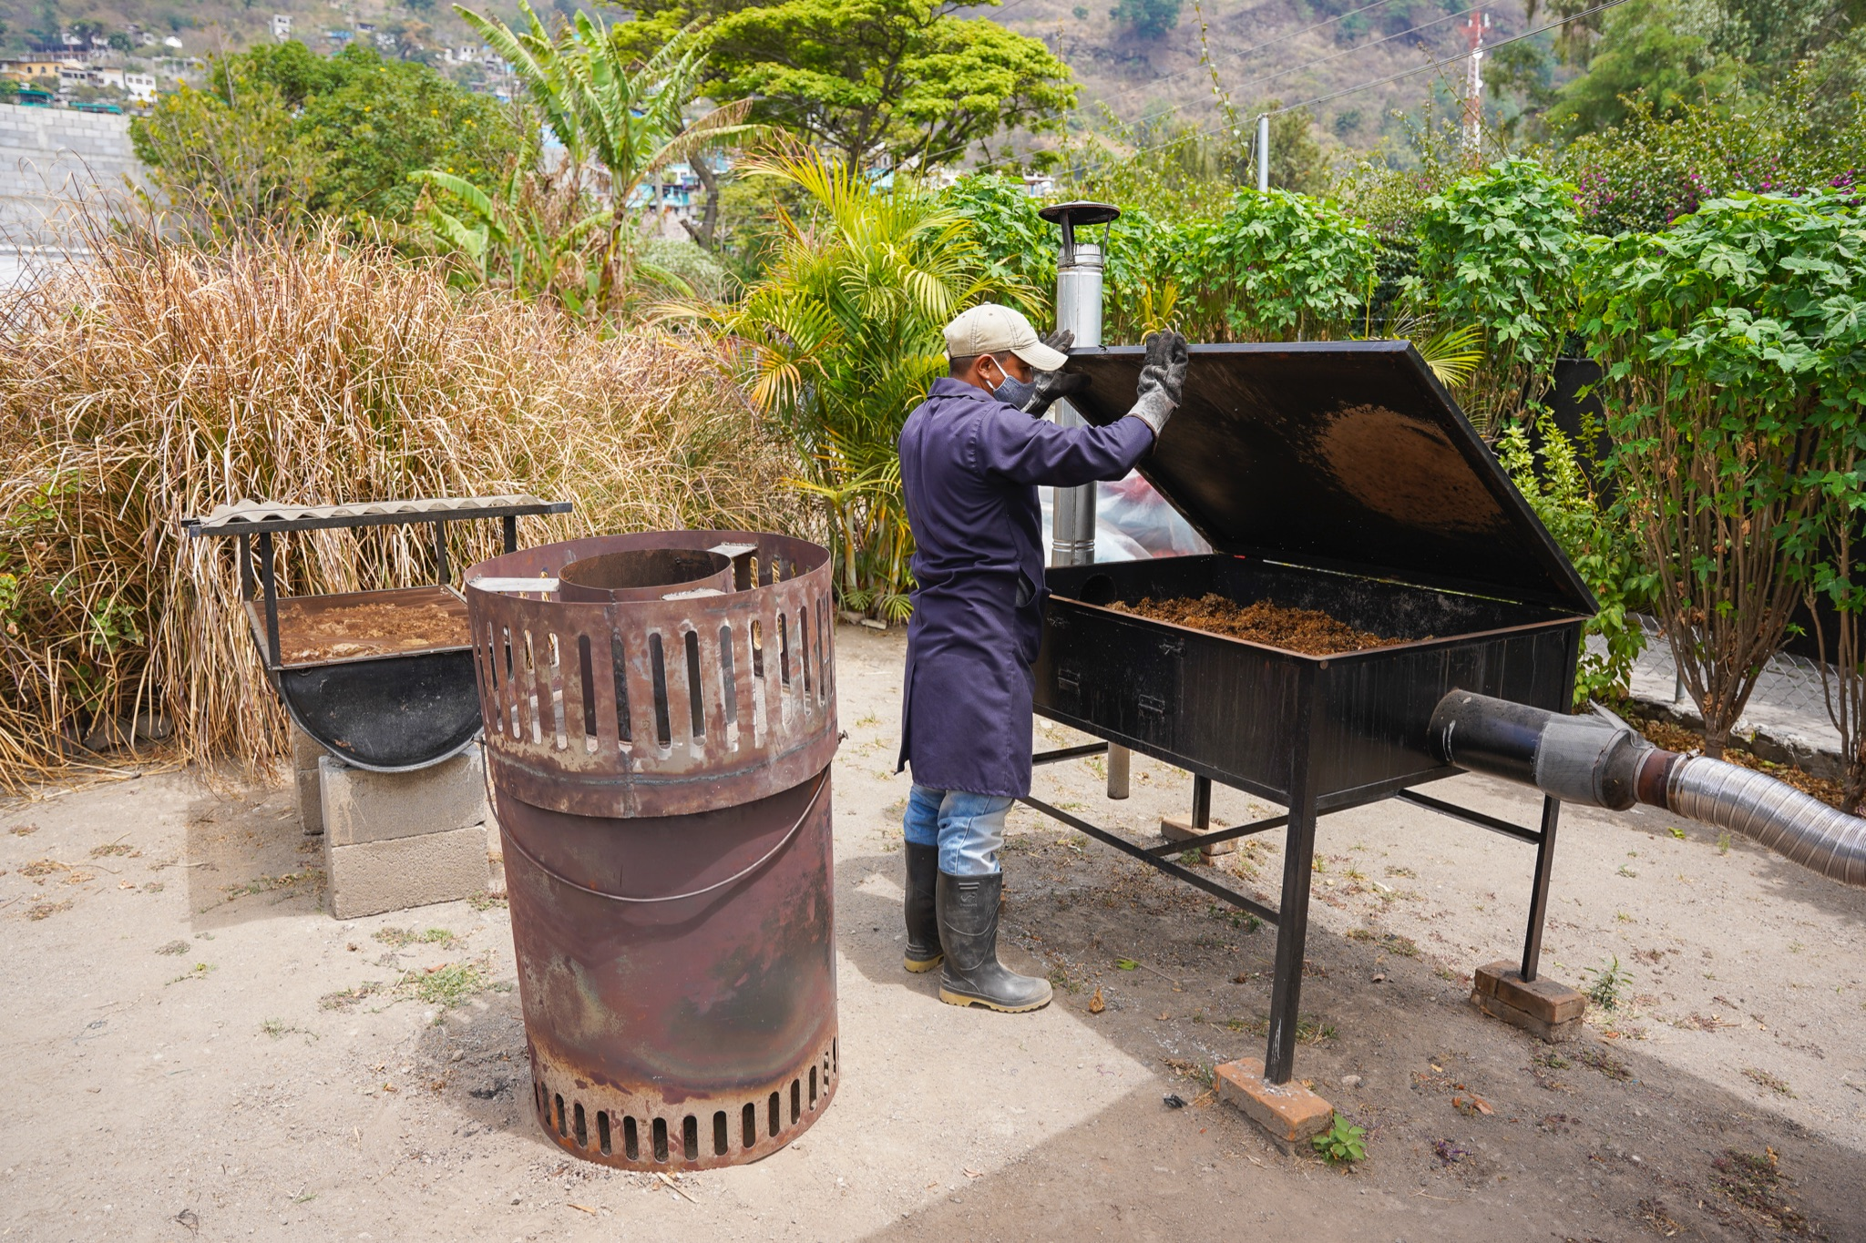
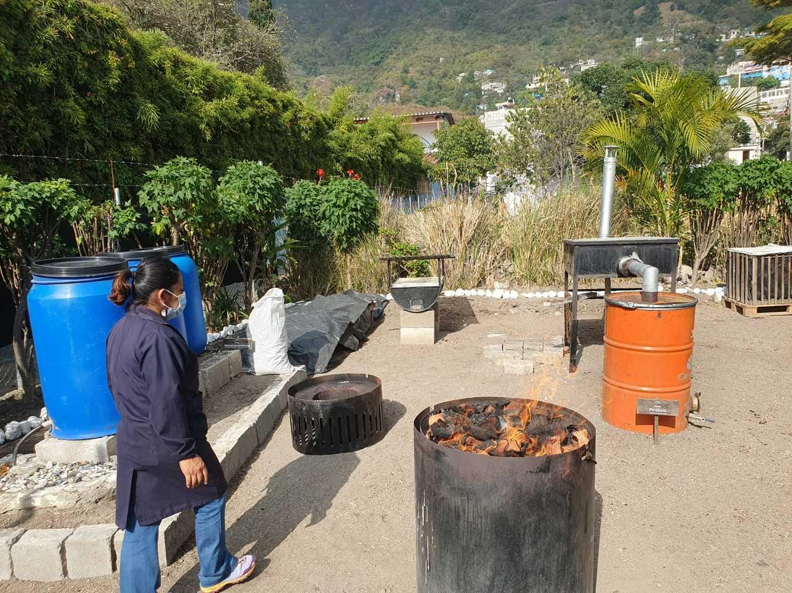
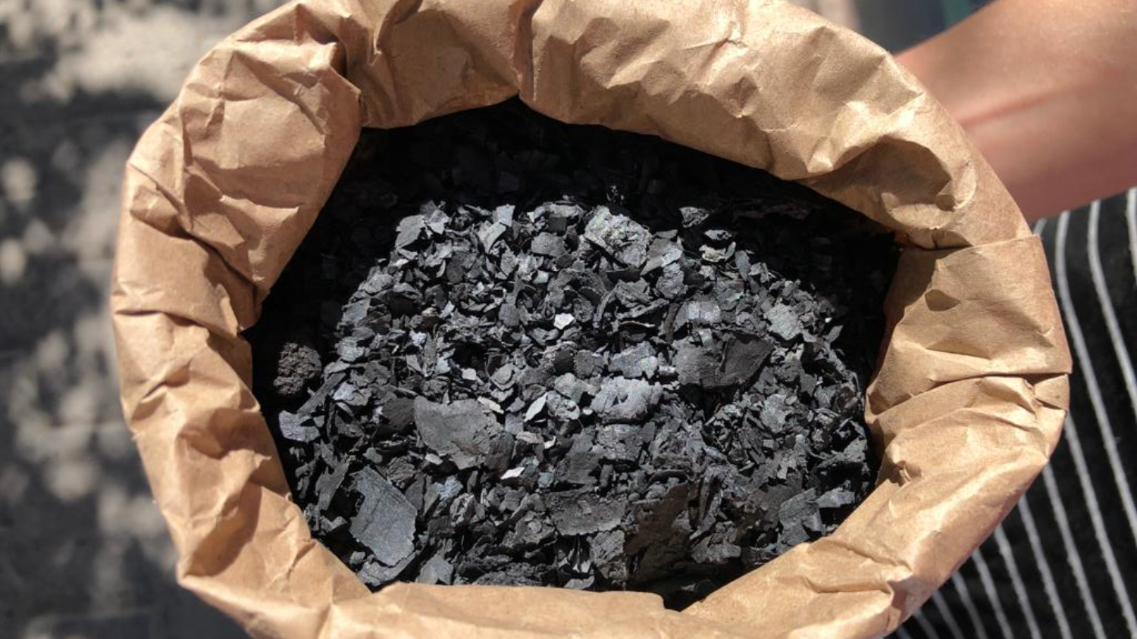
Container Based Sanitation
Krueger, et al., 2020

Slide 16
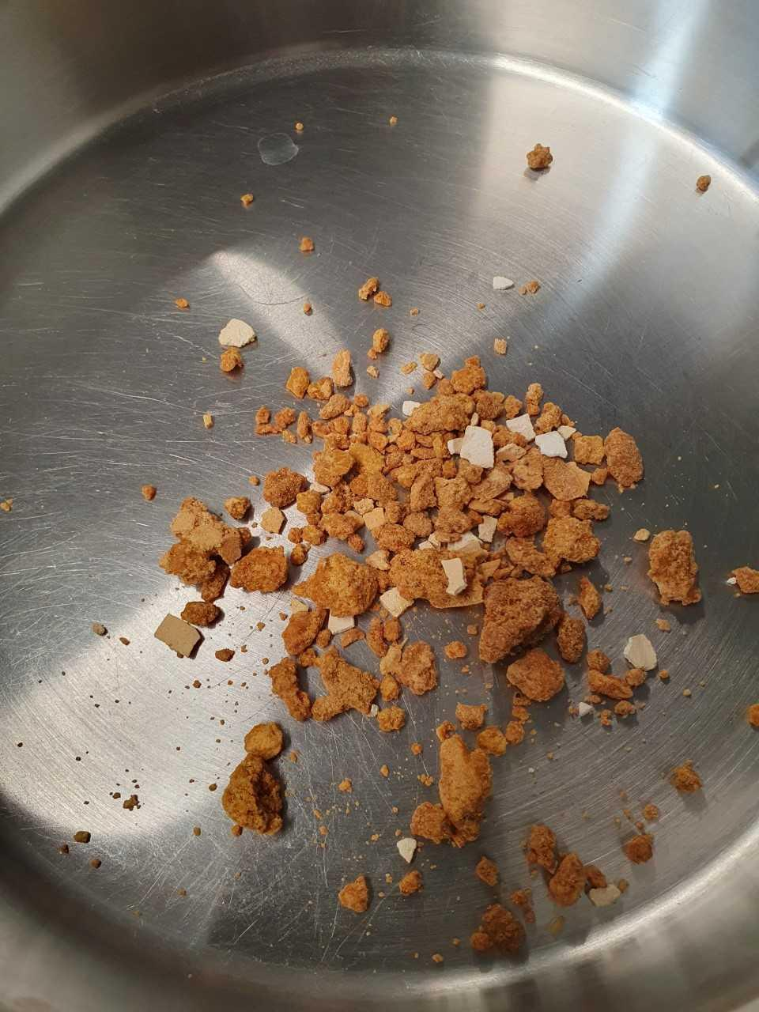
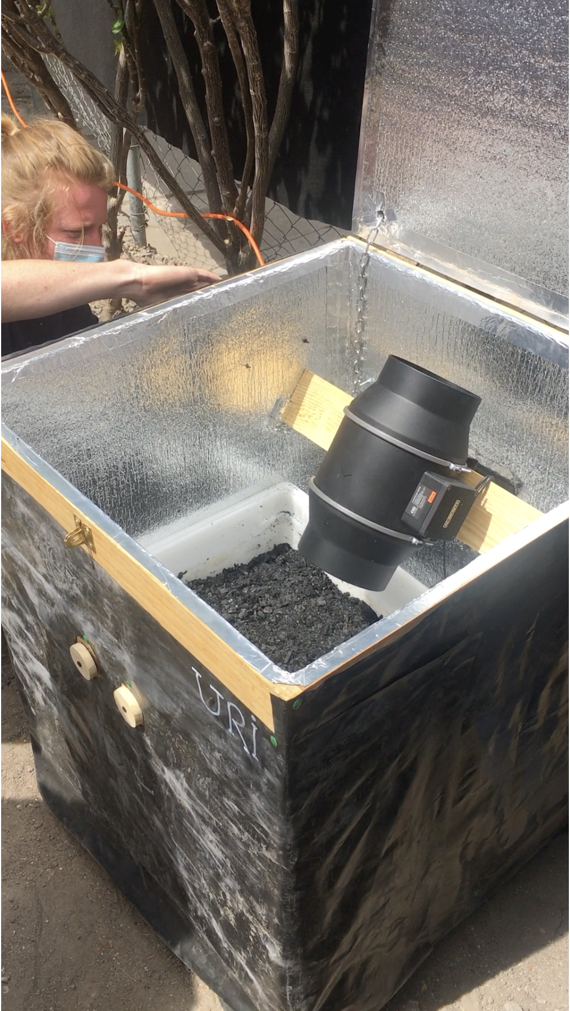
Urine Enriched Biochar
AGRONOMIC PARAMETER | FECES BIOCHAR | UEB
Moisture [%] | 28.0 | 19.3
EC [μS cm⁻¹] | 8.8 | 57.7
pH (H₂O) | 9.7 | 9.7
N_{tot} [g kg⁻¹] | 2.4 | 5.1
P_{tot} [g kg⁻¹] | 20.0 | 12.3
K_{tot} [g kg⁻¹] | 34.2 | 91.3
Mg_{tot} [g kg⁻¹] | 11.7 | 10.0
Ca_{tot} [g kg⁻¹] | 22.1 | 72.8
C:N ratio | 25:1 | 5:1
Image: Wilde, B.
Notes:
1 kg biochar mixed with 40 liters of pre-stabilized urine, dehydrated for 5-6 days. (potassium hydroxide KOH), (Calcium hydroxide)
Incorporation of a base (KOH) increases the pH in the urine. Driving the pH up inhibits enzymatic urea hydrolysis, which prevents ammonia volatilization. These results in higher N retention in the dehydrated product.
50 g KOH applied directly into the urine collection units (8L).
Upon collection, Ca(OH)2 and MgO added to the solution (10g/L)
40 L urine dehydrated into 1 kg biochar.
Current dehydration rate of 5-7 L day-1

Slide 17
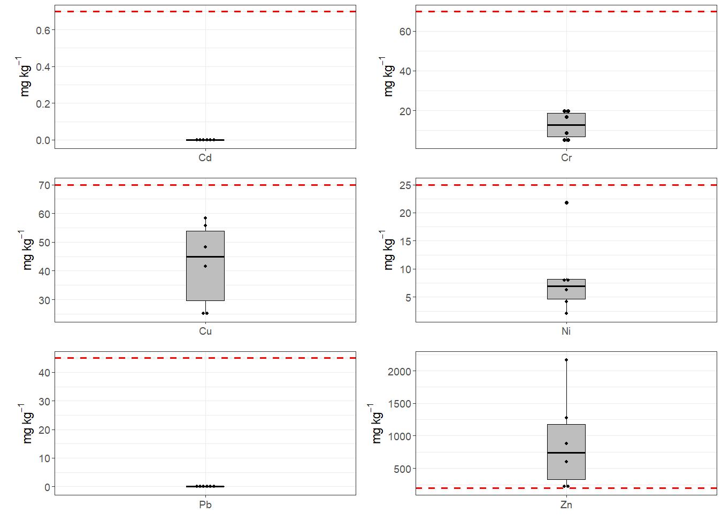
Regulatory Context

Slide 18
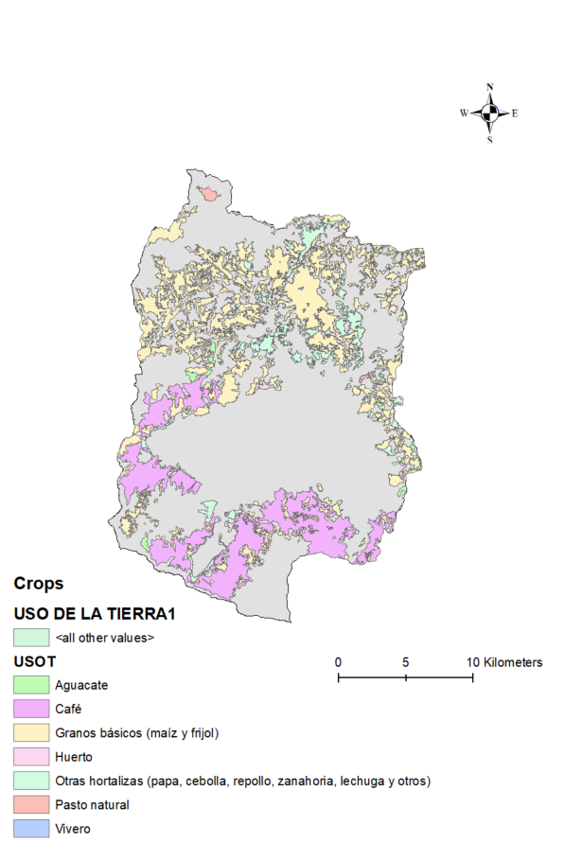
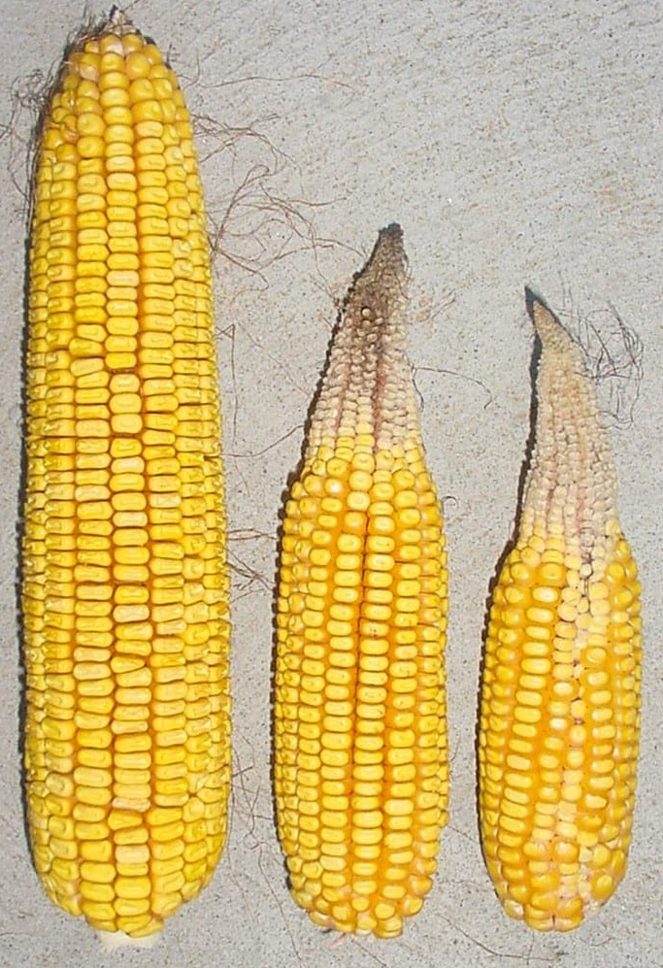
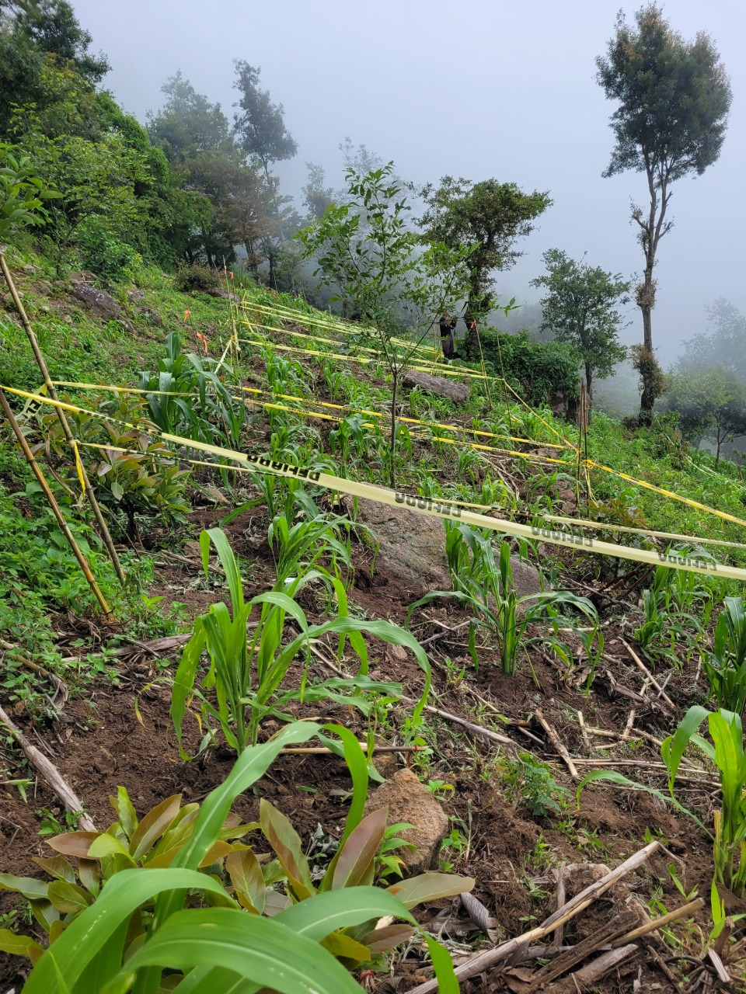
Bridging the metabolic rift
Images: Wilde, B

Slide 19
Testing Human Excreta Derived Fertilizer (HEDF)
Study Site
Santa Cruz La Laguna, Sololá
Don Santo’s land
2,375 MASL, subtropical montane forest
25° slope
1,500 – 2,500 mm precip year⁻¹
Study Design
RCBD
4 treatments replicated 4 times: negative control, commercial fertilizer, urine enriched biochar, biochar + commercial fertilizer.
All fertilized treatments were calculated for an application rate of 130 kg N ha⁻¹
Fertilizer was applied as a split dose application).
Planting stations spaced at 1x1 m, three seeds sown per planting station.
Image: CEDRAC

Slide 20
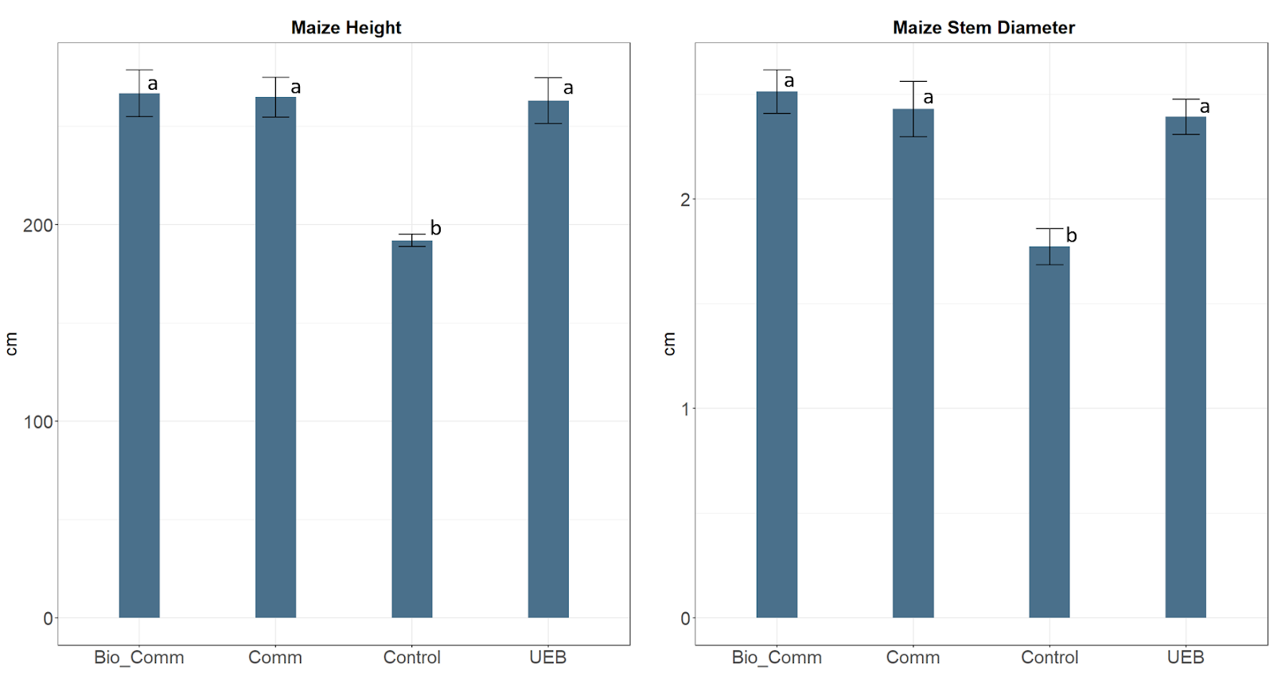
Bridging the metabolic rift

Slide 21
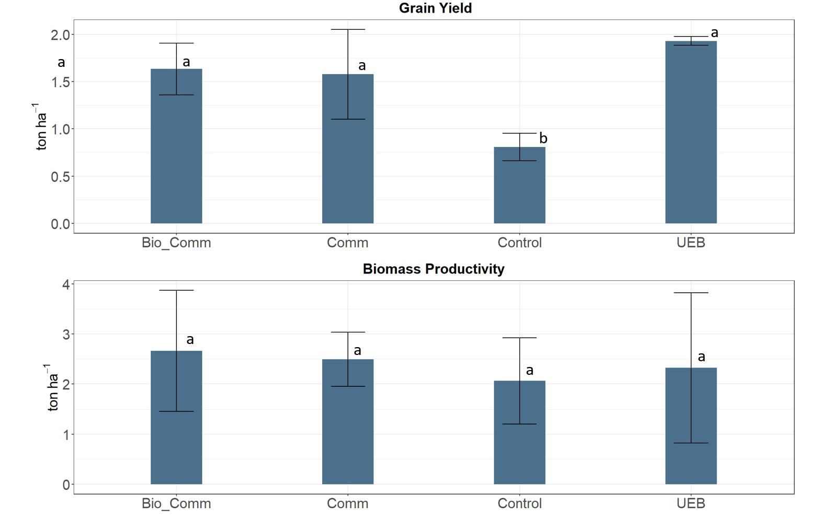
Bridging the metabolic rift

Slide 22
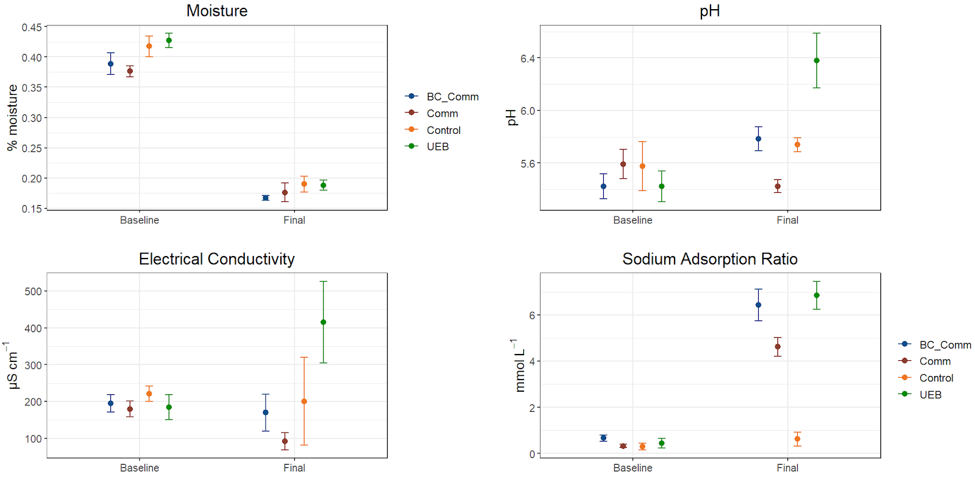
Soil Impacts

Slide 23
Barriers to scaling

Slide 24
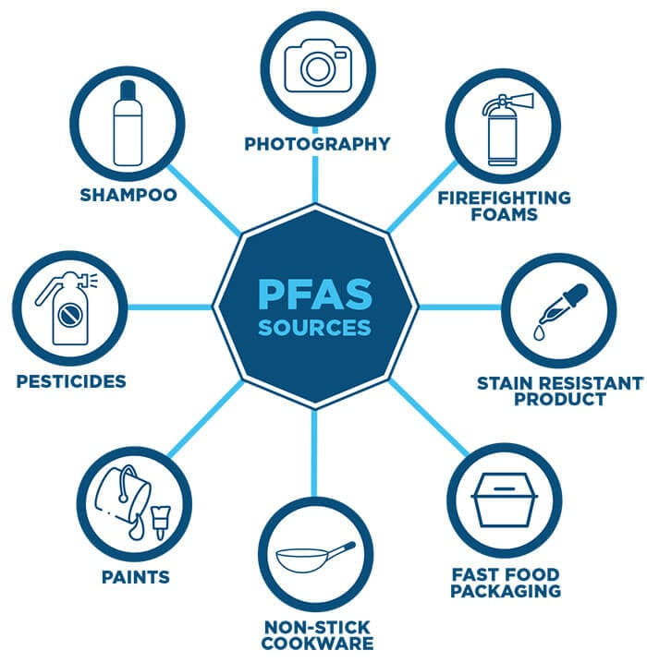
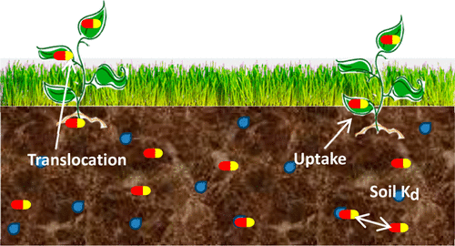
Further Research Needs
Images: Carter, 2014; Seacc.org
Notes:
Carter: evidence that pharmaceuticals (carbamazepine, diclofenac,fluoxetine, propranolol, sulfamethazine) translocated into edible parts of several crops.
Wepking, 2019: evidence that pharmaceuticals in dairy manure changed elemental cycling.

Slide 25
Thank you
Benjamin Wilde
Cornell Mui Ho Center for Cities
Benjamin.wilde@cornell.edu
Notes:
I would like to thank ETH4D for funding this research. The Sustainable Agroecosystems group at ETH Zurich for the opportunity to do this research. Mosan and Vivamos Mejor for their collaboration and support.

