Slide 1
NYC Town & Gown: Climate Vulnerability, Impact, and Adaptation Analysis (VIA)
Characterizing current and future extreme heavy rainfall in NYC
Franco Montalto and Bernice Rosenzweig (Task Co-Leads), Art DeGaetano, Colin Evans, Mobin Rahimi-Golkhandan, Patrick Gurian, Radley Horton, Joel Kaatz, Jerry Kleyman,
Rachel Lo, Philip Orton, Fernando Pasquel, Matina Shakya

Slide 2
Agenda
The use of precipitation information in New York City operations and planning
Observations of Historic Heavy Rain
Observed trends in subdaily precipitation in New York City: Results of nonparametric approach
Observed trends in subdaily precipitation in New York City: Results of parametric approach
Clausius Clapeyron scaling
Delta change factors

Slide 3
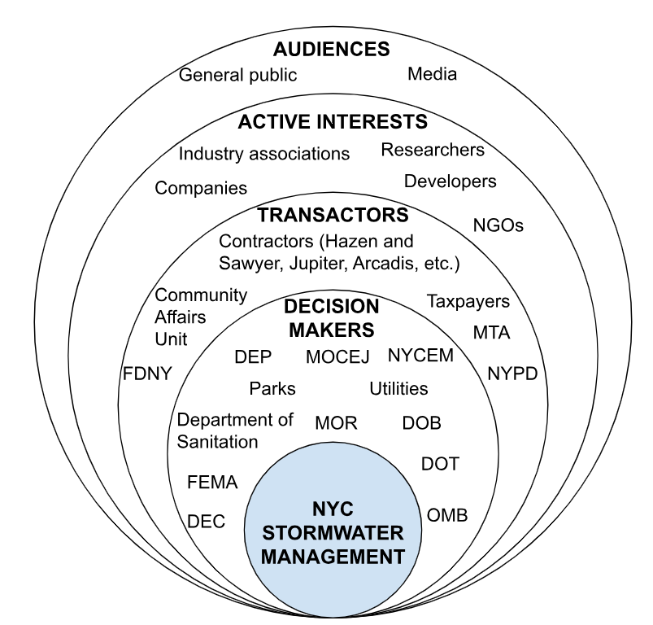
Stakeholders
Precipitation Information

Slide 4
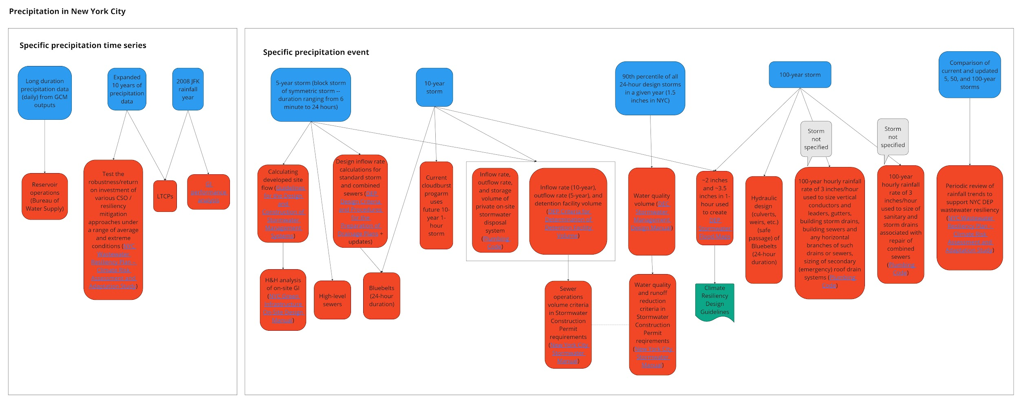
Information Flows

Slide 5
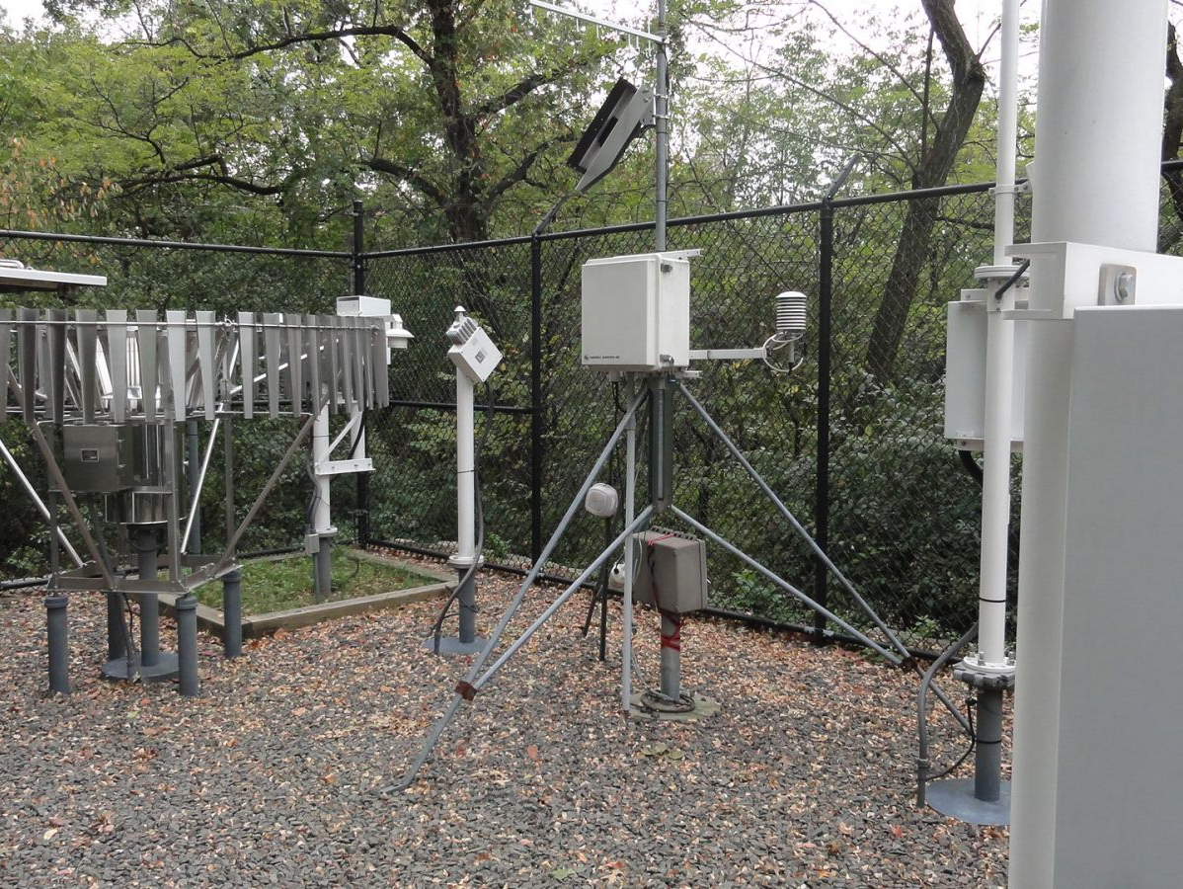
Observations of historic heavy rain

Slide 6
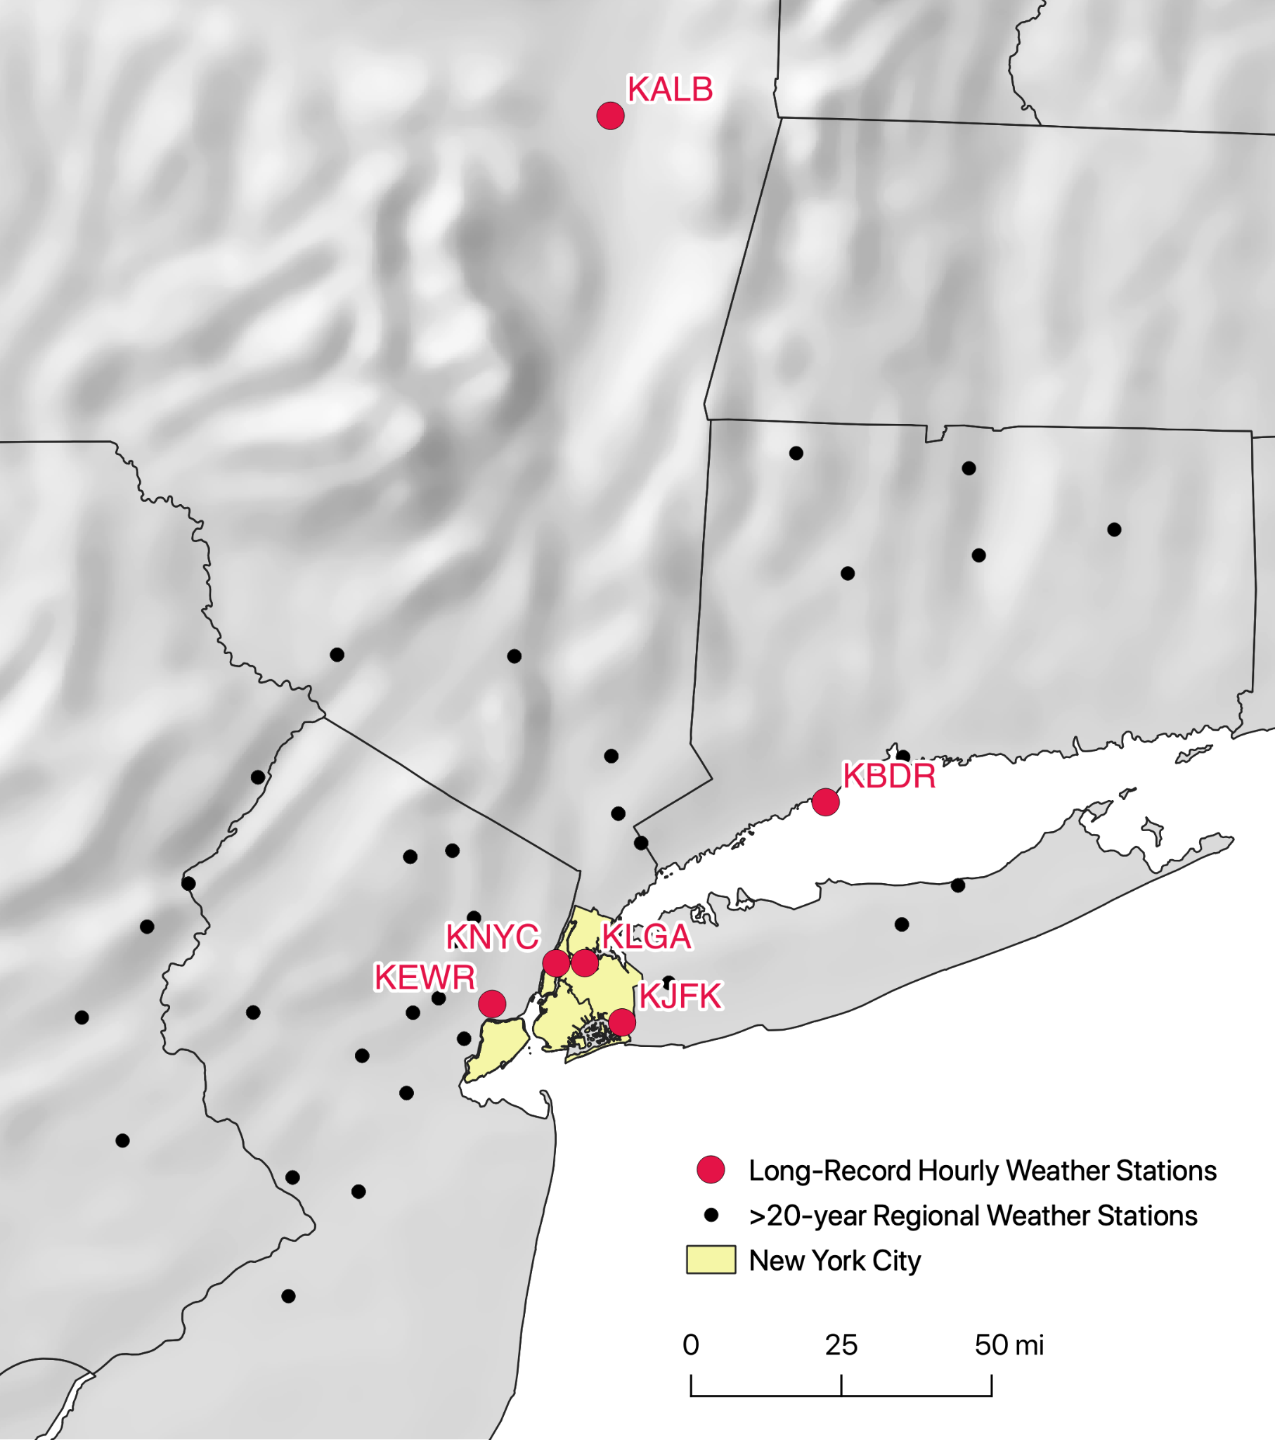
Rainfall Observation Sites (> 50-years of data)
New York City
KNYC: Central Park
KLGA: LaGuardia International Airport
KJFK: John F. Kennedy International Airport
NYC area
KEWR: Newark Liberty International Airport, NJ
KBDR: Sikorsky Airport, CT
Closest to Municipal Reservoir Watersheds
KALB: Albany International Airport

Slide 7
Highest Observed Hourly Rainfall (1950-2022)
Rank | Newark Liberty Airport (KEWR) |  | Central Park (KNYC) |  | LaGuardia Airport (KLGA) |  | Kennedy Airport (KJFK)
 | Time (EST) | Precip (in.) | Time (EST) | Precip (in.) | Time (EST) | Precip (in.) | Time (EST) | Precip (in.)
1 | 9/1/21 19:00 | 3.62 | 9/1/21 20:00 | 3.47 | 9/1/21 20:00 | 2.8 | 7/31/96 11:00 | 2.88
2 | 7/21/06 16:00 | 2.63 | 7/17/95 23:00 | 1.95 | 7/15/97 19:00 | 2.44 | 6/30/84 12:00 | 2.45
3 | 8/17/74 17:00 | 2.04 | 8/10/06 19:00 | 1.9 | 8/17/98 14:00 | 2.09 | 8/14/11 4:00 | 2.41
4 | 7/17/95 23:00 | 2.00 | 8/21/21 22:00 | 1.84 | 11/4/50 23:00 | 1.97 | 6/30/84 11:00 | 2.15
5 | 5/27/91 23:00 | 1.95 | 9/8/04 7:00 | 1.76 | 7/17/95 23:00 | 1.97 | 8/8/07 6:00 | 2.04
6 | 8/4/03 15:00 | 1.92 | 6/3/91 22:00 | 1.75 | 8/8/07 6:00 | 1.87 | 8/28/83 21:00 | 1.88
7 | 8/8/07 5:00 | 1.82 | 8/14/05 19:00 | 1.7 | 7/6/75 17:00 | 1.83 | 8/20/91 16:00 | 1.84
Key Messages:
Of the top 7 hourly accumulations, only 3 were ranked at the top for more than one station
Hourly rainfall extremes are highly localized

Slide 8
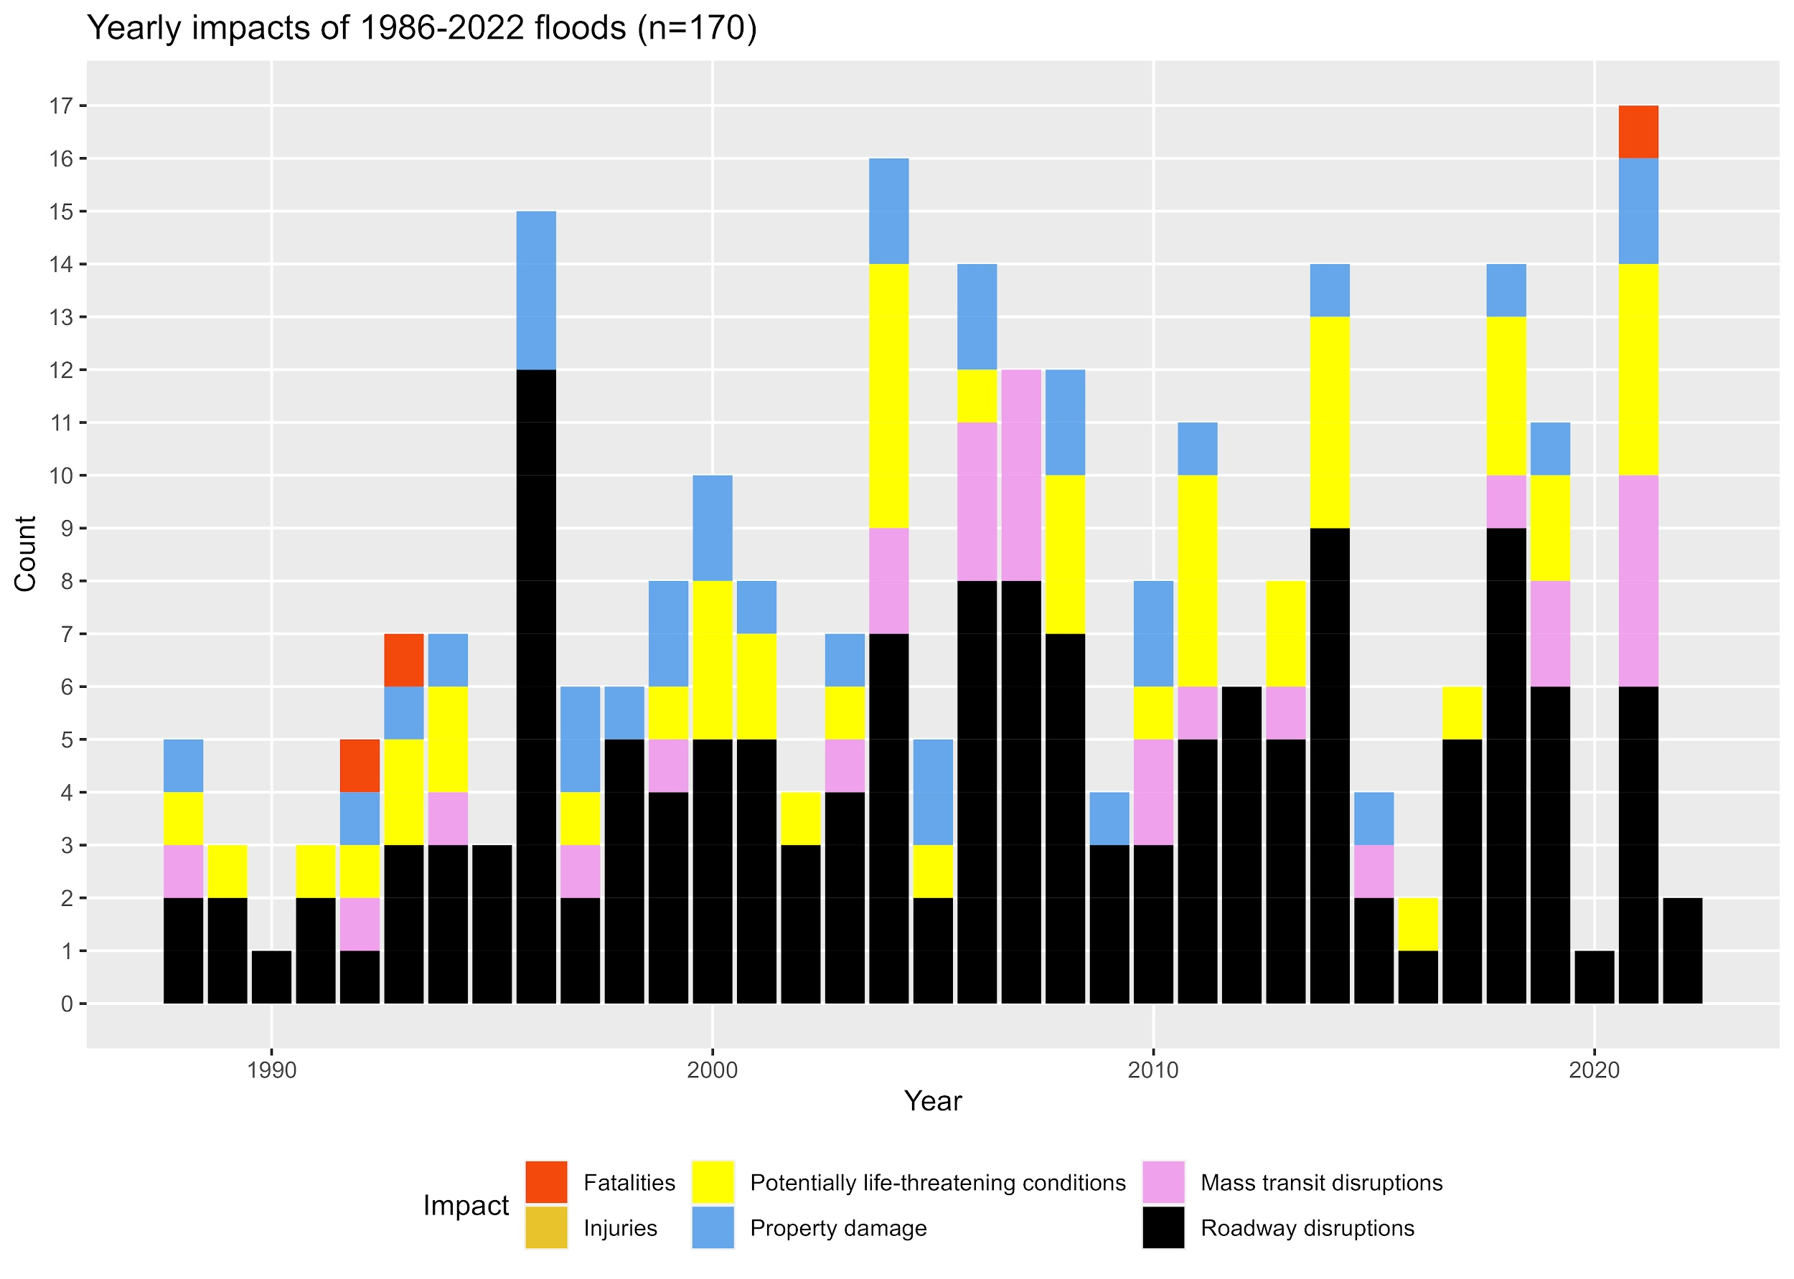
Time Series of National Weather Service Flooding Episodes
Key Messages:
There have been many impactful flooding events in NYC since 1986
Transit disruptions are the most common reported impact

Slide 9
Comparison of Observed Hourly Rainfall (1950-2022) with Historical Flooding Episodes
Rank | Newark Liberty Airport (KEWR) |  | Central Park (KNYC) |  | LaGuardia Airport (KLGA) |  | Kennedy Airport (KJFK)
 | Time (EST) | Precip (in.) | Time (EST) | Precip (in.) | Time (EST) | Precip (in.) | Time (EST) | Precip (in.)
1 | 9/1/21 19:00 | 3.62 | 9/1/21 20:00 | 3.47 | 9/1/21 20:00 | 2.8 | 7/31/96 11:00 | 2.88
2 | 7/21/06 16:00 | 2.63 | 7/17/95 23:00 | 1.95 | 7/15/97 19:00 | 2.44 | 6/30/84 12:00* | 2.45
3 | 8/17/74 17:00 | 2.04 | 8/10/06 19:00 | 1.9 | 8/17/98 14:00 | 2.09 | 8/14/11 4:00 | 2.41
4 | 7/17/95 23:00 | 2.00 | 8/21/21 22:00 | 1.84 | 11/4/50 23:00 | 1.97 | 6/30/84 11:00 | 2.15
5 | 5/27/91 23:00 | 1.95 | 9/8/04 7:00 | 1.76 | 7/17/95 23:00 | 1.97 | 8/8/07 6:00 | 2.04
6 | 8/4/03 15:00 | 1.92 | 6/3/91 22:00 | 1.75 | 8/8/07 6:00 | 1.87 | 8/28/83 21:00 | 1.88
7 | 8/8/07 5:00 | 1.82 | 8/14/05 19:00 | 1.7 | 7/6/75 17:00 | 1.83 | 8/20/91 16:00 | 1.84
NWS flood or flash flood episode
Pre-1986
Key Messages:
Most of the top 7 hourly accumulations triggered floods and occurred since 1986

Slide 10
Evaluation of historical trends in precipitation observations
Key considerations
Availability of quality controlled data
Duration of uninterrupted record
Sampling frequency
Sampling variability
Accumulation/intensity over sampling interval (e.g. hourly)
Accumulation/intensity over prescribed time clusters (e.g. 24-hour calendar day)
Accumulation/intensity within an event, defined with a specific separation period
Approach to statistical analysis
Non-parametric methods
Parametric methods

Slide 11
Evaluation of historical trends in precipitation observations
Nonparametric Approach
Utilizes discrete rain events (defined using a 4-hour interevent dry period)
Set #1: All events (1955-2022)
Sets #2 and #3: Events exceeding 95th and 99th percentile thresholds
For each set, we focused on four event attributes, and their frequencies
Total accumulation
Total duration
Peak hourly intensity
Average intensity
This approach does not assume any statistical distribution of the data, and is thus less sensitive and less likely to detect trends

Slide 12
Evaluation of historical trends in precipitation observations
Parametric Approach
Fits a Generalized Extreme Value (GEV) distribution to a Partial Duration Series (PDS)
Different PDS generated for precipitation accumulations over 1- 24 hr time clusters
Subject to tail variability
Can be heavily influenced by one or more extreme events (e.g. Post Tropical Cyclone Ida in Central Park)
Represents the classical methodology for developing IDF curves

Slide 13
Precipitation event characteristics

Slide 14
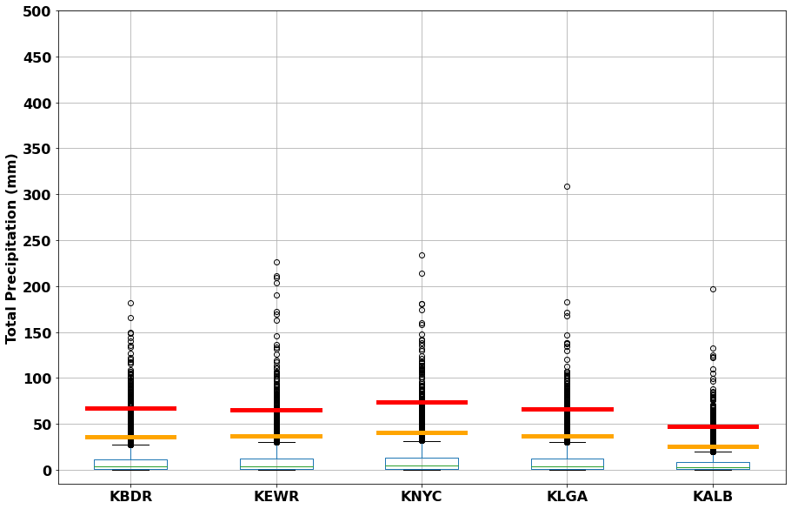
Total Event Precipitation

Slide 15
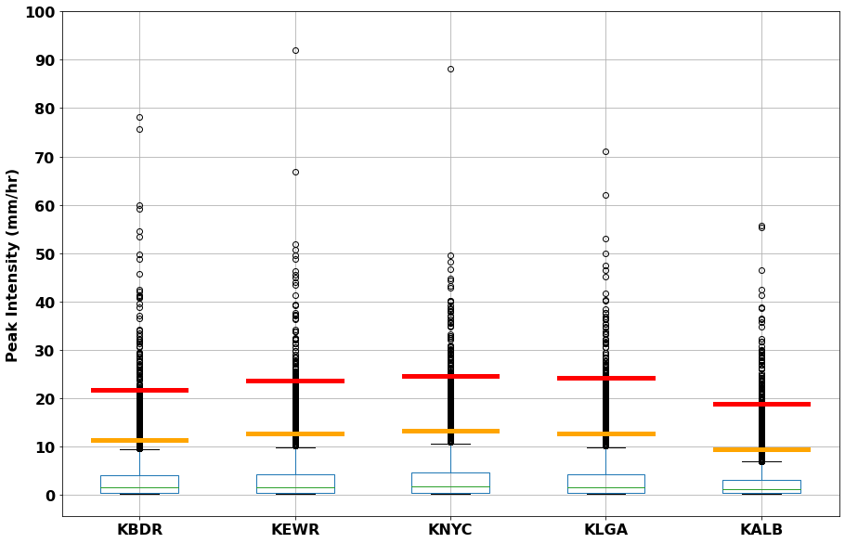
Peak Hourly Intensity

Slide 16
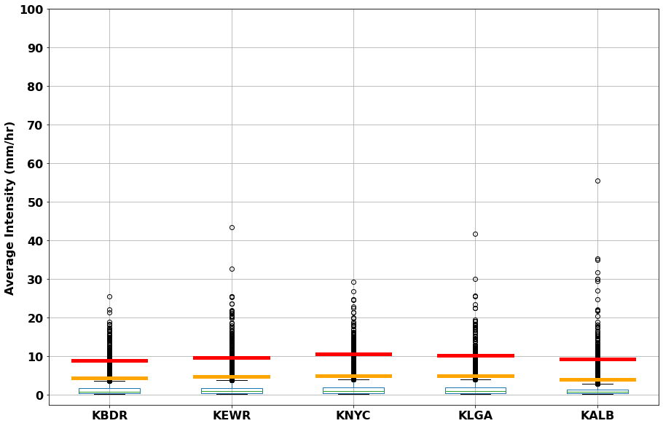
Event Average Intensity

Slide 17
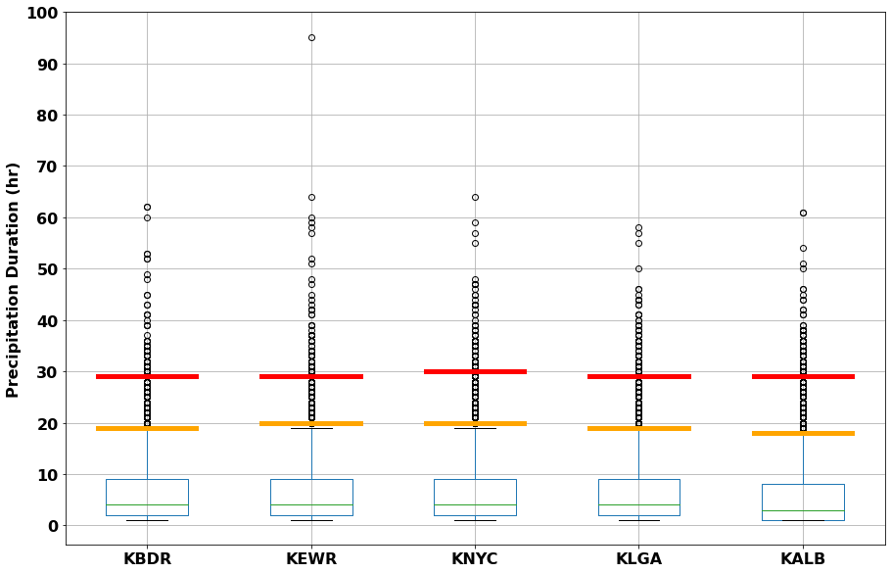
Event Duration

Slide 18
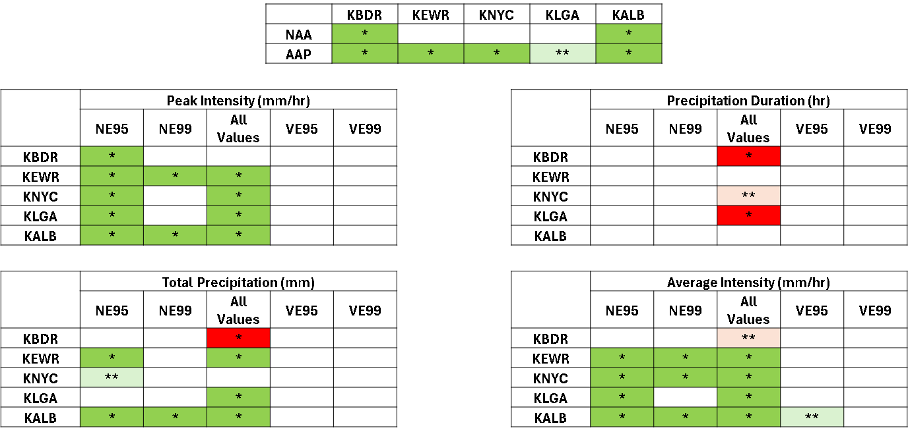
Evaluation of historical trends in precipitation observations: Nonparametric findings

Slide 19
Key Messages from the Nonparametric approach
Annual precip and event precipitation (all events) are increasing at all NYC gauges
Events with >95th percentile average and peak hourly intensities are getting more frequent at all NYC gauges
Could be due to a statistically significant shortening of event durations at some locations
Events with > 95th percentile event totals are getting more frequent at KEWR and KNYC
Extreme events do not seem to be getting larger, more intense, or longer

Slide 20
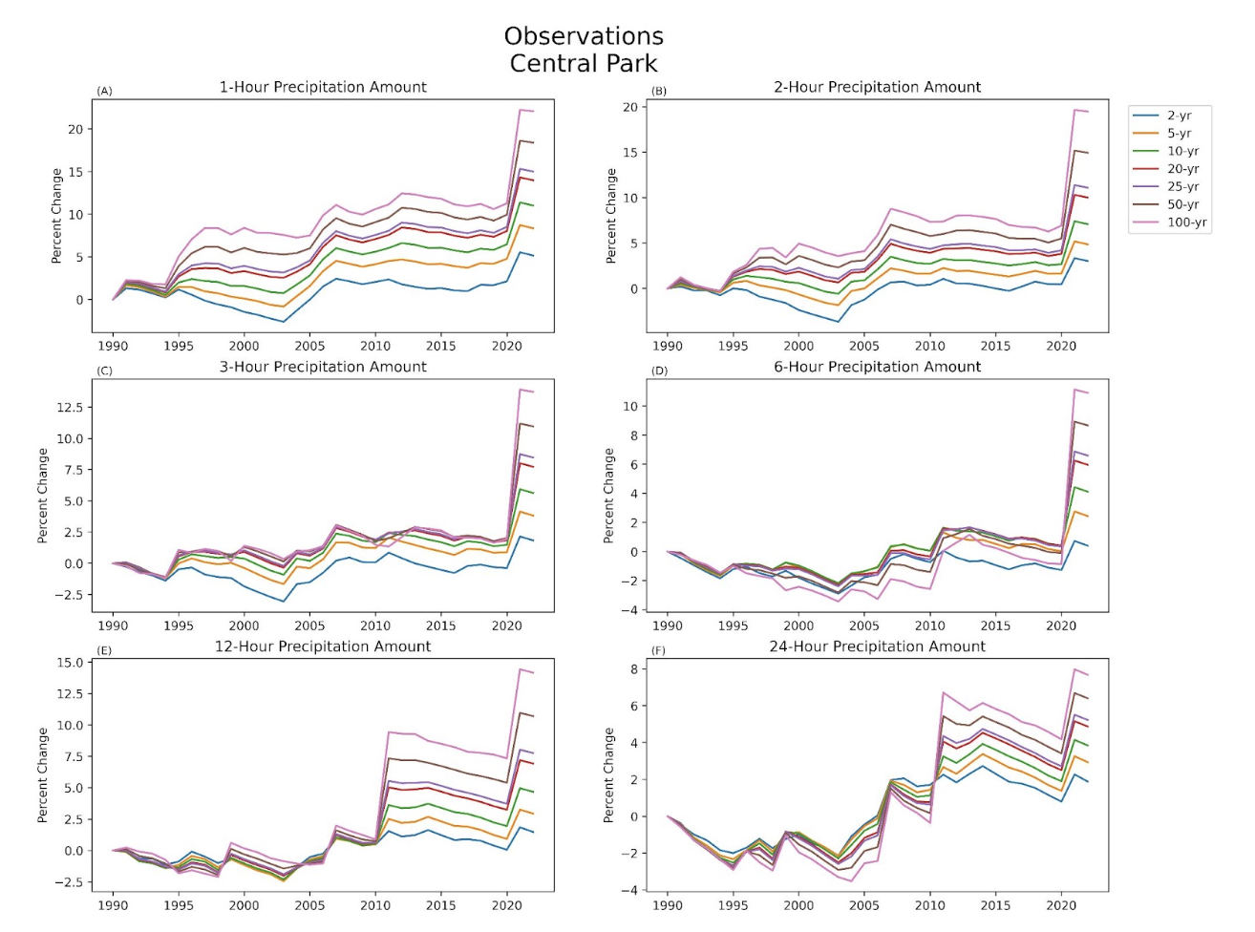
Evaluation of historical trends in precipitation observations: Parametric findings
Key Messages (Central Park):
We observed increases in the 2-, 5-, 10-, 25-, 50-, and 100-yr extreme rainfall events for durations of 1-hr through 24-hours at all stations, when the analyzed record includes data after 1990
There is a consistent pattern of increasing percent change for higher return periods
We see a decrease in percent change with precipitation duration
Increase is not smooth but influenced by specific events

Slide 21
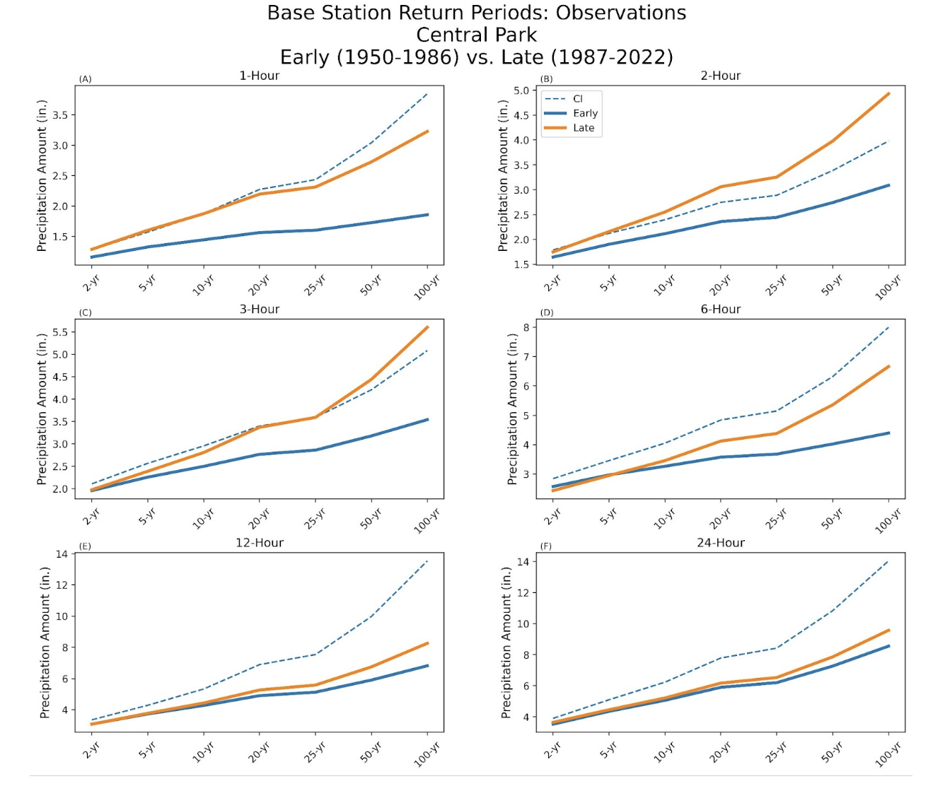
Evaluation of historical trends in precipitation observations: Parametric findings
Key Messages (Central Park):
Comparing early and late periods, we see smaller differences with longer durations
Some of the changes exceed the confidence interval, but this finding is inconsistent across stations

Slide 22
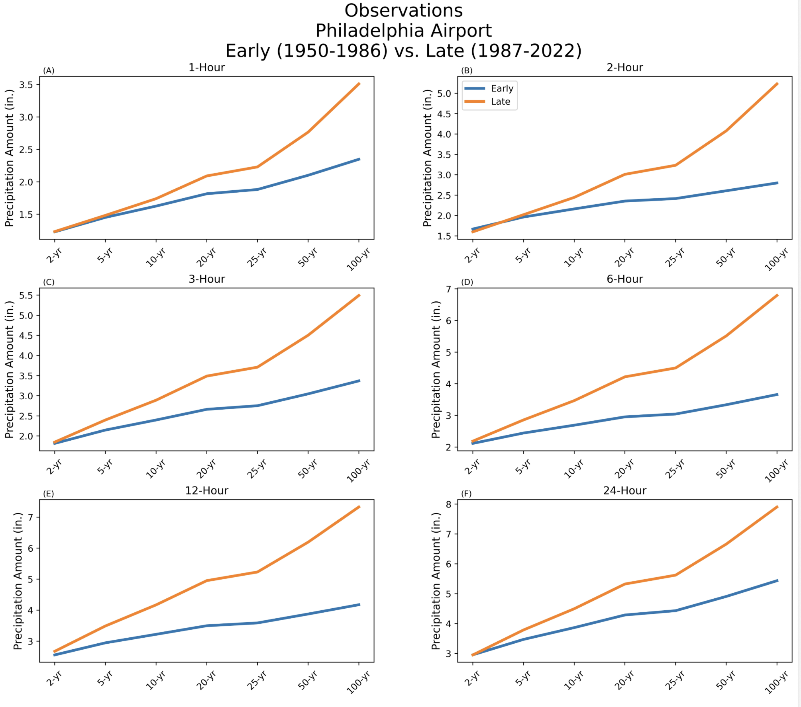
Evaluation of historical trends in precipitation observations: Parametric findings

Slide 23
Key Messages from the Parametric approach
At Central Park, the 2-year return period for 1-hour precipitation totals has increased by roughly 5% since 1950
Hourly precipitation totals have increased at a greater rate than daily totals during the latter half of the observational record, but this is not reflected across the larger region and it is not reflected in modeled data
Since 2000, the maximum percentage of the 24-hour PDS case rainfall totals that fell during one hour has increased.
Approximately 23% of the 1-hour PDS case rainfalls are also part of a 24-hour PDS case. There has been little change in this percentage across the period of record.

Slide 24
Clausius-Clapeyron Scaling - Methods
Goal: Check if hourly precipitation increases with dry buld and dew point temperature per thermodynamic relationships (6-7% / degree C)
Methods:
Conducted using hourly data at 4 regional gauges
Non-zero precipitation hours with dry bulb and dewpoint temperature
Analyzed 90th, 95th, and 99th percentile precipitation quantities for 2C bins
Produced relative frequency plots
Produced log-transformed precipitation vs temperature plots
Added lines depicting CC relationship for reference

Slide 25
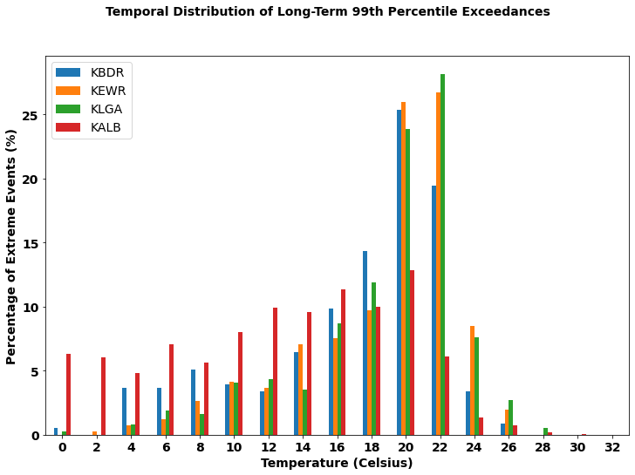
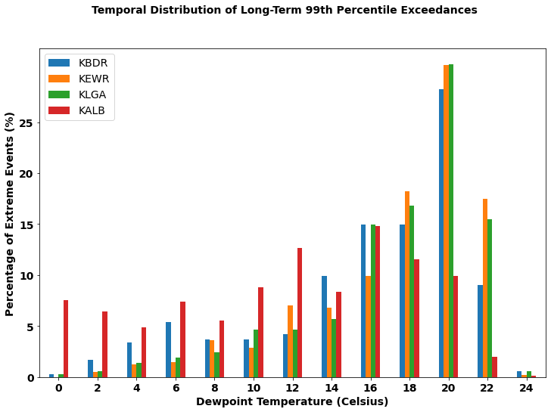
Clausius-Clapeyron Scaling - Temporal Distribution
Key Messages:
Most of the extreme events occurred between 20-22 C (all stations)

Slide 26
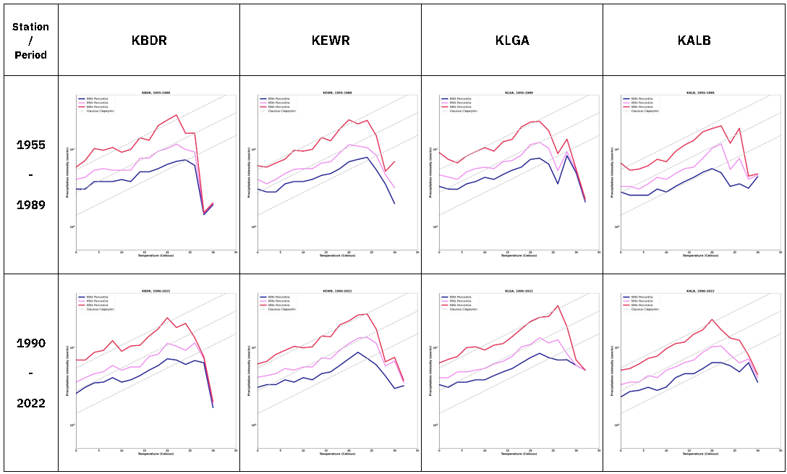
Clausius-Clapeyron Scaling - Dry-bulb Temperature
Key Messages:
Abrupt decline in slope after 20-24 C, attributed to the lesser number of low-probability extreme events at higher temperatures
No major differences between more distant and more recent past

Slide 27
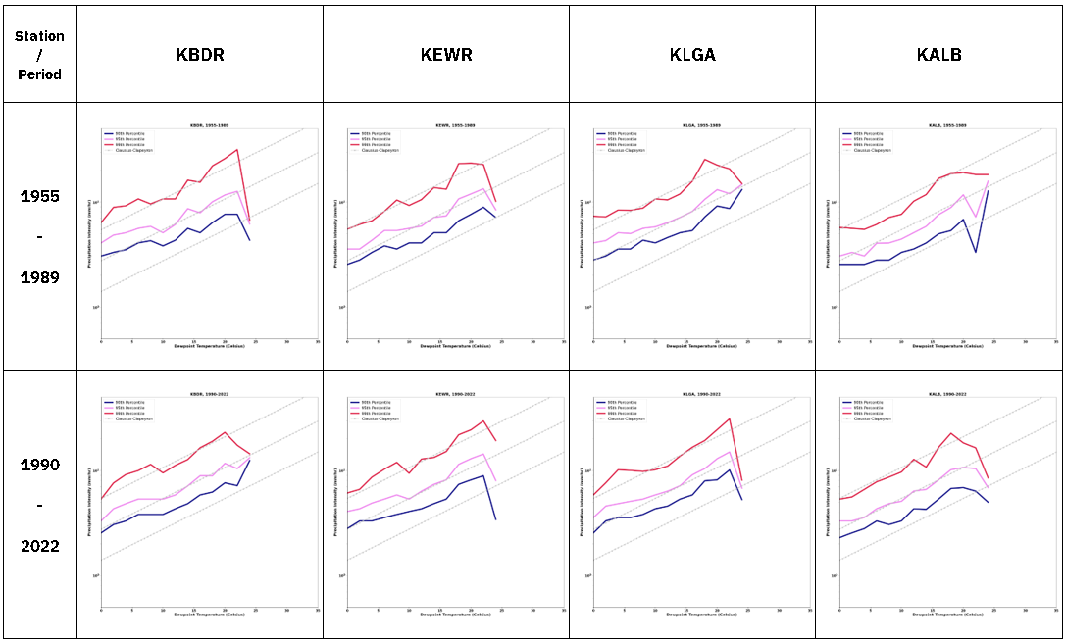
Clausius-Clapeyron Scaling - Dewpoint Temperature
Key Messages:
The curves representing more extreme precipitation (e.g., 99th percentile) follow the CC relationship more closely than the curves representing the less extreme precipitation

Slide 28
Expected Future Changes in Extreme Precipitation

Slide 29
Delta Change Factors
Represent the change signal between the historic and future period in climate projections
Computed based on the quantile delta method (QDM)

Slide 30
Delta Change Factors (low emissions SSP245)
SSP245 EARLY: | 2020-2069
PERCENTILE | 2-yr | 5-yr | 10-yr | 25-yr | 50-yr | 100-yr
10th | 1.04 | 1.02 | 0.97 | 0.85 | 0.84 | 0.84
25th | 1.09 | 1.07 | 1.08 | 1.02 | 0.94 | 0.95
Mean | 1.16 | 1.20 | 1.19 | 1.16 | 1.14 | 1.17
75th | 1.20 | 1.27 | 1.25 | 1.27 | 1.29 | 1.29
83rd | 1.26 | 1.35 | 1.34 | 1.37 | 1.35 | 1.39
90th | 1.32 | 1.44 | 1.44 | 1.46 | 1.44 | 1.58
Early (2020-2069)
SSP245 LATE: | 2050-2099
PERCENTILE | 2-yr | 5-yr | 10-yr | 25-yr | 50-yr | 100-yr
10th | 1.08 | 1.08 | 1.04 | 0.91 | 0.88 | 0.87
25th | 1.14 | 1.14 | 1.14 | 1.06 | 1.03 | 1.05
Mean | 1.22 | 1.28 | 1.28 | 1.23 | 1.24 | 1.26
75th | 1.28 | 1.40 | 1.37 | 1.35 | 1.36 | 1.40
83rd | 1.31 | 1.44 | 1.51 | 1.45 | 1.43 | 1.52
90th | 1.34 | 1.47 | 1.61 | 1.58 | 1.56 | 1.64
Late (2050-2099)

Slide 31
Delta Change Factors (high emissions SSP585)
SSP585 EARLY: | 2020-2069
PERCENTILE | 2-yr | 5-yr | 10-yr | 25-yr | 50-yr | 100-yr
10th | 1.04 | 1.00 | 0.93 | 0.82 | 0.79 | 0.84
25th | 1.11 | 1.08 | 1.09 | 1.02 | 1.06 | 0.98
Mean | 1.18 | 1.21 | 1.23 | 1.18 | 1.21 | 1.23
75th | 1.24 | 1.27 | 1.39 | 1.34 | 1.42 | 1.44
83rd | 1.27 | 1.35 | 1.42 | 1.40 | 1.46 | 1.53
90th | 1.35 | 1.46 | 1.45 | 1.43 | 1.52 | 1.64
Early (2020-2069)
SSP585 LATE: | 2050-2099
PERCENTILE | 2-yr | 5-yr | 10-yr | 25-yr | 50-yr | 100-yr
10th | 1.15 | 1.09 | 1.07 | 1.01 | 0.97 | 0.93
25th | 1.18 | 1.17 | 1.16 | 1.09 | 1.07 | 1.05
Mean | 1.28 | 1.32 | 1.35 | 1.32 | 1.30 | 1.30
75th | 1.39 | 1.46 | 1.59 | 1.53 | 1.47 | 1.56
83rd | 1.41 | 1.55 | 1.61 | 1.58 | 1.59 | 1.63
90th | 1.45 | 1.59 | 1.64 | 1.67 | 1.68 | 1.75
Late (2050-2099)

Slide 32
General Recommendations
Increase the spatial density of high temporal frequency precip gauges
Invest resources to centralize, quality control, warehouse, develop procedures to maintain and facilitate access to precipitation data for general accessibility and policy updates
Climate model projections constantly show increases in future design storms of 15-30 percent. Such changes should be factored into storm water design guidance.
More research needed in the types of weather systems responsible for different rainfall intensities

Slide 33
Thanks!
For follow up contact Dr. Franco Montalto, P.E. at fam26@drexel.edu

