Slide 1
Storm Water Filter Design
--Updates on Filter materials for N removal
Xinwei Mao, Ph.D
Civil Engineering Department, Stony Brook University
New York State Center for Clean Water Technology
Feb 15, 2024

Slide 2
Outline
Background
Stormwater Infiltration System
Filter design and performance

Slide 3
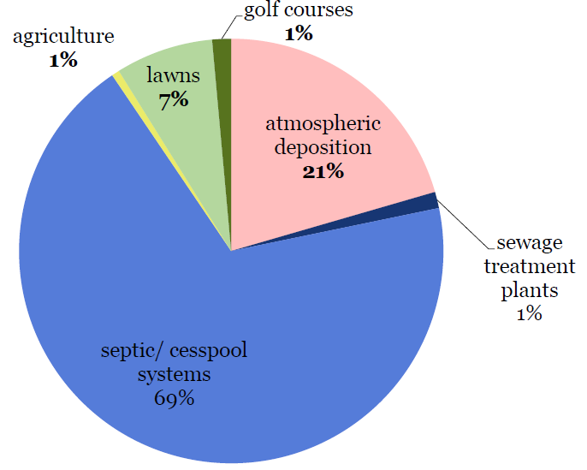
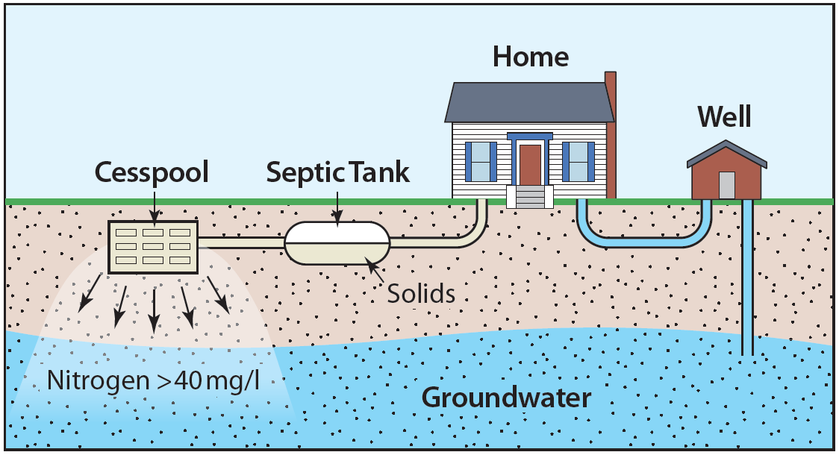
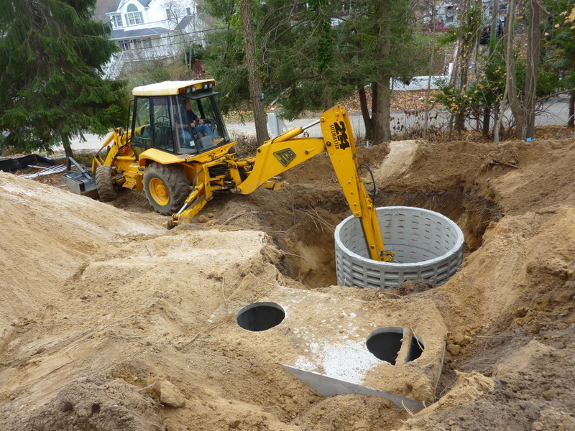
Onsite wastewater problem---- Long Island
SBU
Kinney and Valiela, 2011
~510,000 conventional onsite wastewater treatment systems (OWTS).
Notes:
A previous study indicated the N sources to the Great South Bay. Septic system is the major N source.
Current OWTSs comprises a septic tank and a following leaching ring. The leaching pool is made of concrete with holes on the side, and no bottom. Such septic systems removes little N and a limited level of Carbon.
Therefore, it is critical for us to upgrade these systems to sustainably and effectively removing N. And this is one of the essential goals of the center. On the other hand, we are also eager to understand how much of the N loading is from legacy N. Especially considering the shallow water table and the depth of the leaching pools.

Slide 4
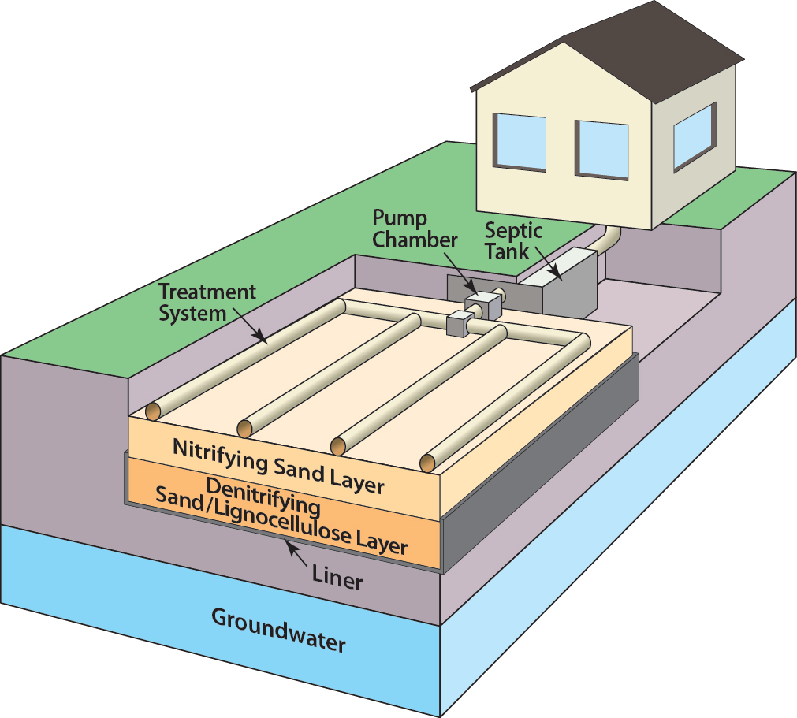
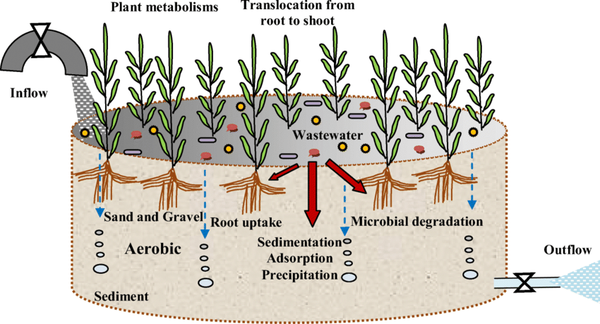
Background
New York State Center for Clean Water Technology
Engineered Nitrogen
Removing Biofilter
Bioretention system
Onsite Wastewater
Stormwater
Passive filtration
Remove contaminants
Nutrients
Metals
Micropollutants
Low-cost, sustainable
Ilyas and Hullebusch., 2020
Nitrification sand layer overlying denitrification lignocellulose layer.
80 – 90% N removal.
Low maintenance demand.
Engineered system which simulate the configuration and process of natural wetland.
20 – 75% N removal.

Slide 5
Outline
Background
Stormwater Infiltration System
Filter design and performance

Slide 6
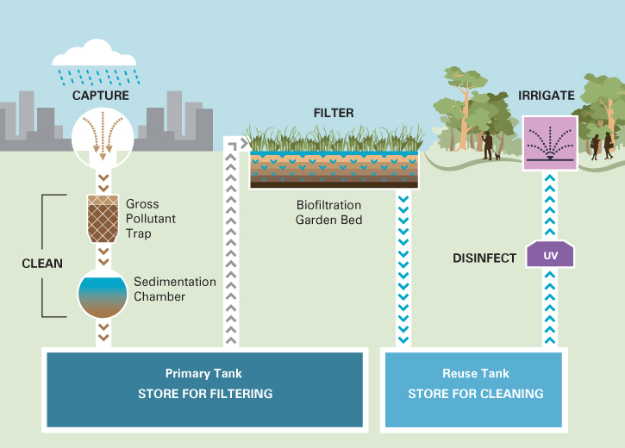
Stormwater Infiltration -- Overview
https://urbanwater.melbourne.vic.gov.au/industry/treatment-types/stormwater-and-rainwater-harvesting/

Slide 7
Contaminants in Stormwater
Metals
Nutrients
Metals
Pathogens
Micro-pollutants

Slide 8
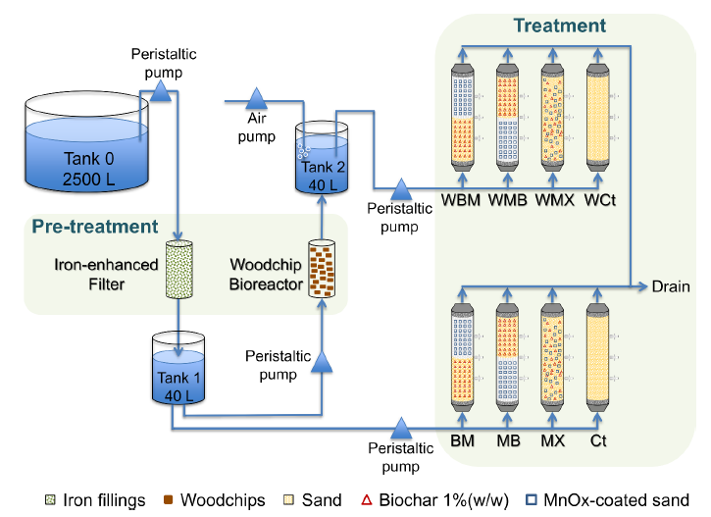
Stormwater filtration Configuration (example)
Pilot-scale testing of stormwater filtration system

Slide 9
Stormwater Filter Design
Engineered geomedia
  Carbonaceous materials (biochar)—organic & metal
  Manganese oxide-coated sands —organics & metal
  Woodchips and iron filings —nitrate & phosphate
Location (source, bioretention)
Configuration (unit, combination)
Hydraulics (long-term operation)
Field
(validate, monitoring, longevity)
Pilot
(continuous flow)
Bench
(proof-of concept)

Slide 10
Outline
Background
Stormwater Infiltration System
Filter design and performance
  Contamination levels in first flush
  Filter design and test

Slide 11
Stormwater filtration—first flush
“First Flush”: refers to the first few minutes or hours of a storm. The common perception is that during this initial time, the concentration of pollutants in the runoff is greater than during later parts of the storm.
https://urbanwater.melbourne.vic.gov.au/industry/treatment-types/stormwater-and-rainwater-harvesting/

Slide 12
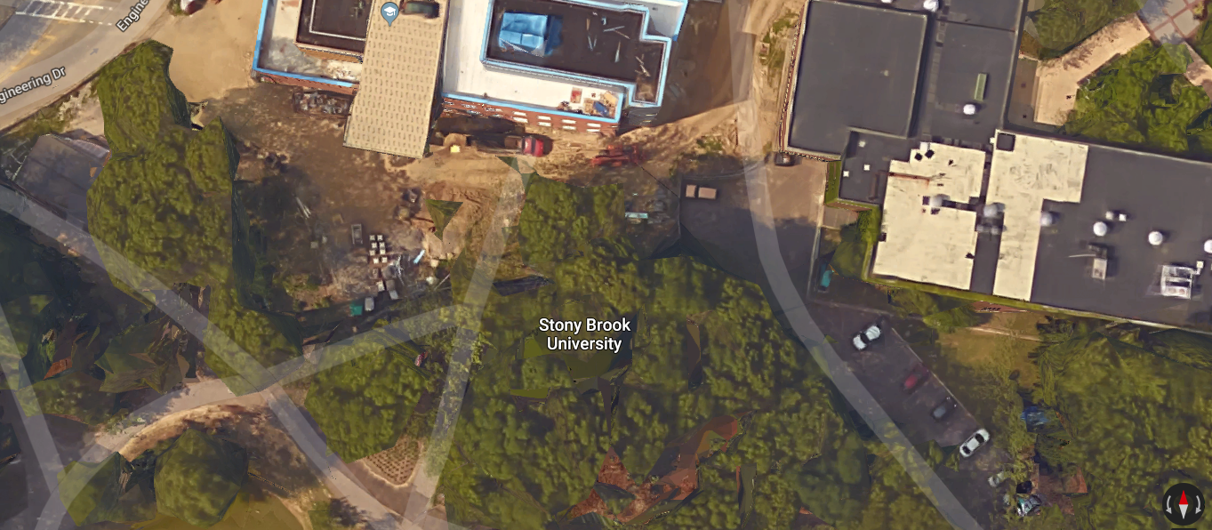
First Flush sampling during a storm
Samples
B-1
B-2
B-3
B-4
sample (A)
The first-flush storm water was collected at several locations in Stony Brook University.
Notes:
The concentrations of contaminants are much higher in the initial portions of the storm water. And the contaminants concentrations will decrease as the collected storm water volume increases.

Slide 13
Concentrations of contaminants in collected storm water
Sample Name | Volume (ml) | TSS (mg/L) | COD (mg/L) | TKN (mg-N/L) | pH | Total coliform (MPN/ 100 mL)
A | 500 ml | 230 | 298 | 12.3 | 6.75 | 9200
B-1 | 200 ml | 2760 | 320 | 25.5 | 6.50 | -
B-2 | 1 L | 780 | 139.3 | 1.85 | 6.93 | -
B-3 | 1 L | 470 | 123.9 | 1.80 | 7.06 | -
B-4 | 1 L | 725 | 81.2 | 0.716 | 7.16 | -
*a time-course samples were collected at site B (parking lot)
** TSS: total suspended solids (indicator of inorganic/organic contaminants)
COD: chemical oxygen demand (indicator of organic contaminants)
TkN: total keljdel nitrogen (indicator of nutrients for eutrophication)
The first-flush storm water contains the highest level of contaminants (comparable to that in domestic wastewater).

Slide 14
Time-course measurement of the selected contaminants concentrations
in the collected storm water

Slide 15
Outline
Background
Stormwater Infiltration System
Filter design and performance
  Contamination levels in first flush
  Filter design and test

Slide 16
Filter design consideration
Materials
Hydraulic capacity
Cost
Configuration
Compact
Mechanism
Physical/chemical
Biological
Locally availability
Easy to modify/change
Versatile
Goal: The designed filter module could be implemented to the stormwater drain to
remove contaminants from the “first flush” of stormwater.

Slide 17
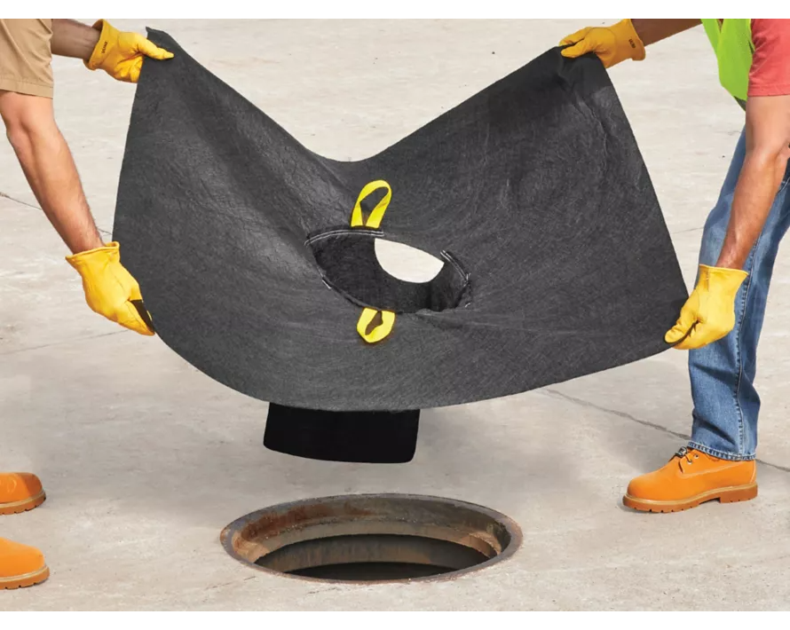
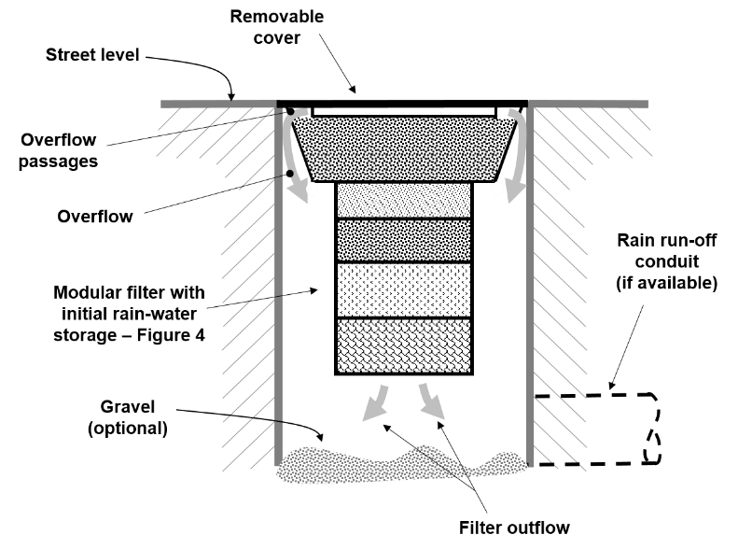
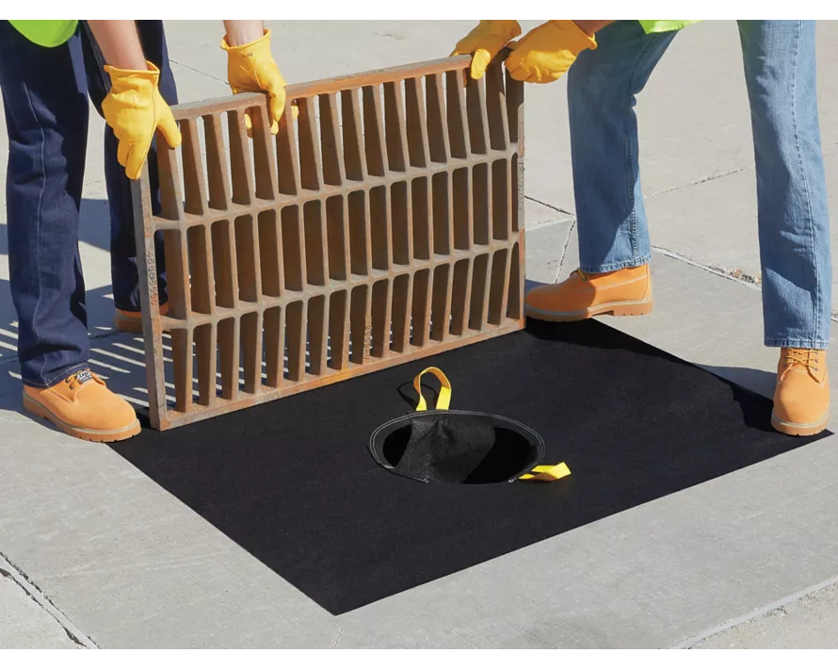
Configuration---- remove contaminants from the first flush
Passive flow
(overflow- clean)
Commercial storm drain filter
(sediment and debris)

Slide 18
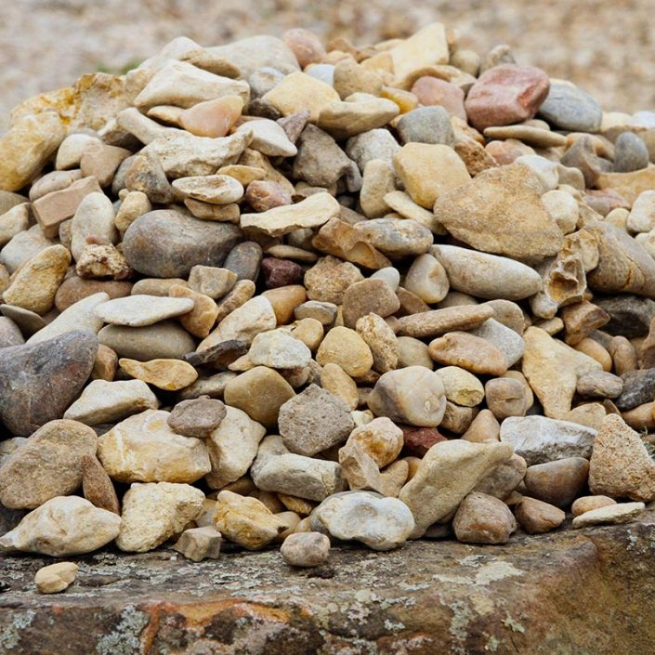
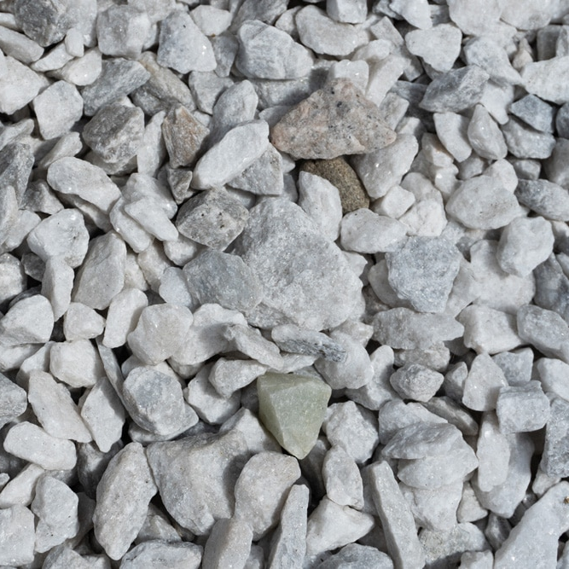
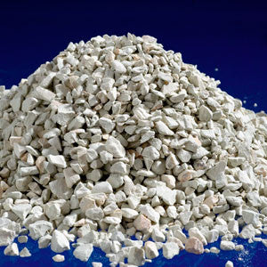
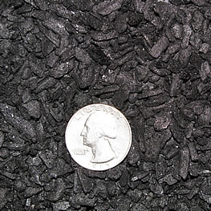
Filtration Materials
Goal: Alleviate the clogging potential and increase the hydraulic capacity of the system.
Explore alternative filtration materials with higher porosity and bigger particle size.
Gravel
Marble Chip
Zeolite
Biochar
Most common filtration material.
Wide accessibility and low cost.
Recycled material from industrial waste.
Majorly composed with CaCO₃.
Provide extra alkalinity.
Aluminosilicate mineral.
Strong cation exchange. capacity (NH₄⁺ removal).
Carbon-enriched biomaterial.
Strong adsorption capacity.
High specific surface area.
Facilitate better nitrification performance in column experiments.
Low mechanical strength.
This work was supported by New York State Center for Clean Water Technology (CCWT)

Slide 19
Filtration Materials Comparisons
based on N removal and cost
Packing Media | Size (mm) | Porosity | Nitrogen Loading Rate (NLR, g N m⁻² d⁻¹) | NH₄⁺Removal Rate (g N m⁻¹ d⁻¹) | NH₄⁺ Removal Efficiency (%) | Construction Cost ($/m³ nitrification chamber)
Gravel | 10 - 20 | 0.5 | 11.5 - 700 | 11 – 420 | 63 - 95 | 22 - 46
Zeolite | 3 - 6 | 0.4 - 0.5 | 6 - 50 | 5.8 - 36 | 72 - 92 | 80 - 140
Biochar | 5 - 10 | 0.5 - 0.7 | 37.5 - 700 | 35.6 - 560 | 60 - 95 | 210 - 360
Marble Chip | 5 - 20 | 0.5 – 0.6 | 0.6 – 2.4 | 0.5 – 2.3 | 93 – 95 | 63 - 97
Sand | 0.6 - 1 | 0.4 | 1.1 - 8.6 | 0.7 - 8.2 | 80 - 99 | 17.4

Slide 20
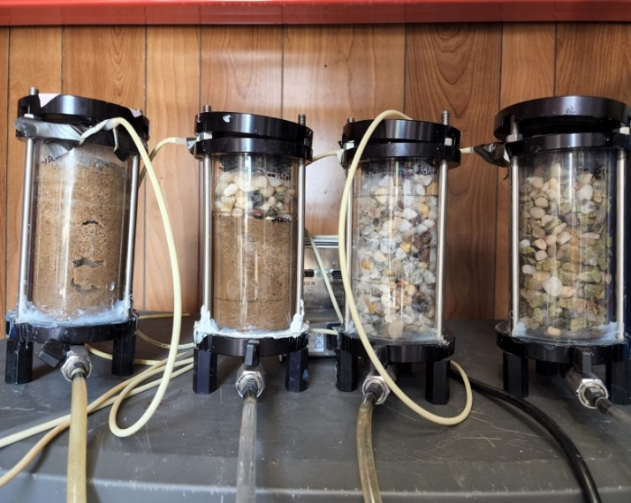
Selection of Major Filtration Material
Experiment Design
A
B
C
D
Column | Filling Material | Description
A | Sand | Control group for entire experiment
B | 5 cm gravel (upper) + 10 cm sand (lower) | Reduce the clogging potential of pure sand filter
C | 50 % marble chip (vol) + 50% gravel (vol) | Similar set-up with zeolite + gravel column
D | 50% zeolite (vol) + 50% gravel (vol) | Reduce the time to reach adsorption capacity for NH₄⁺

Slide 21
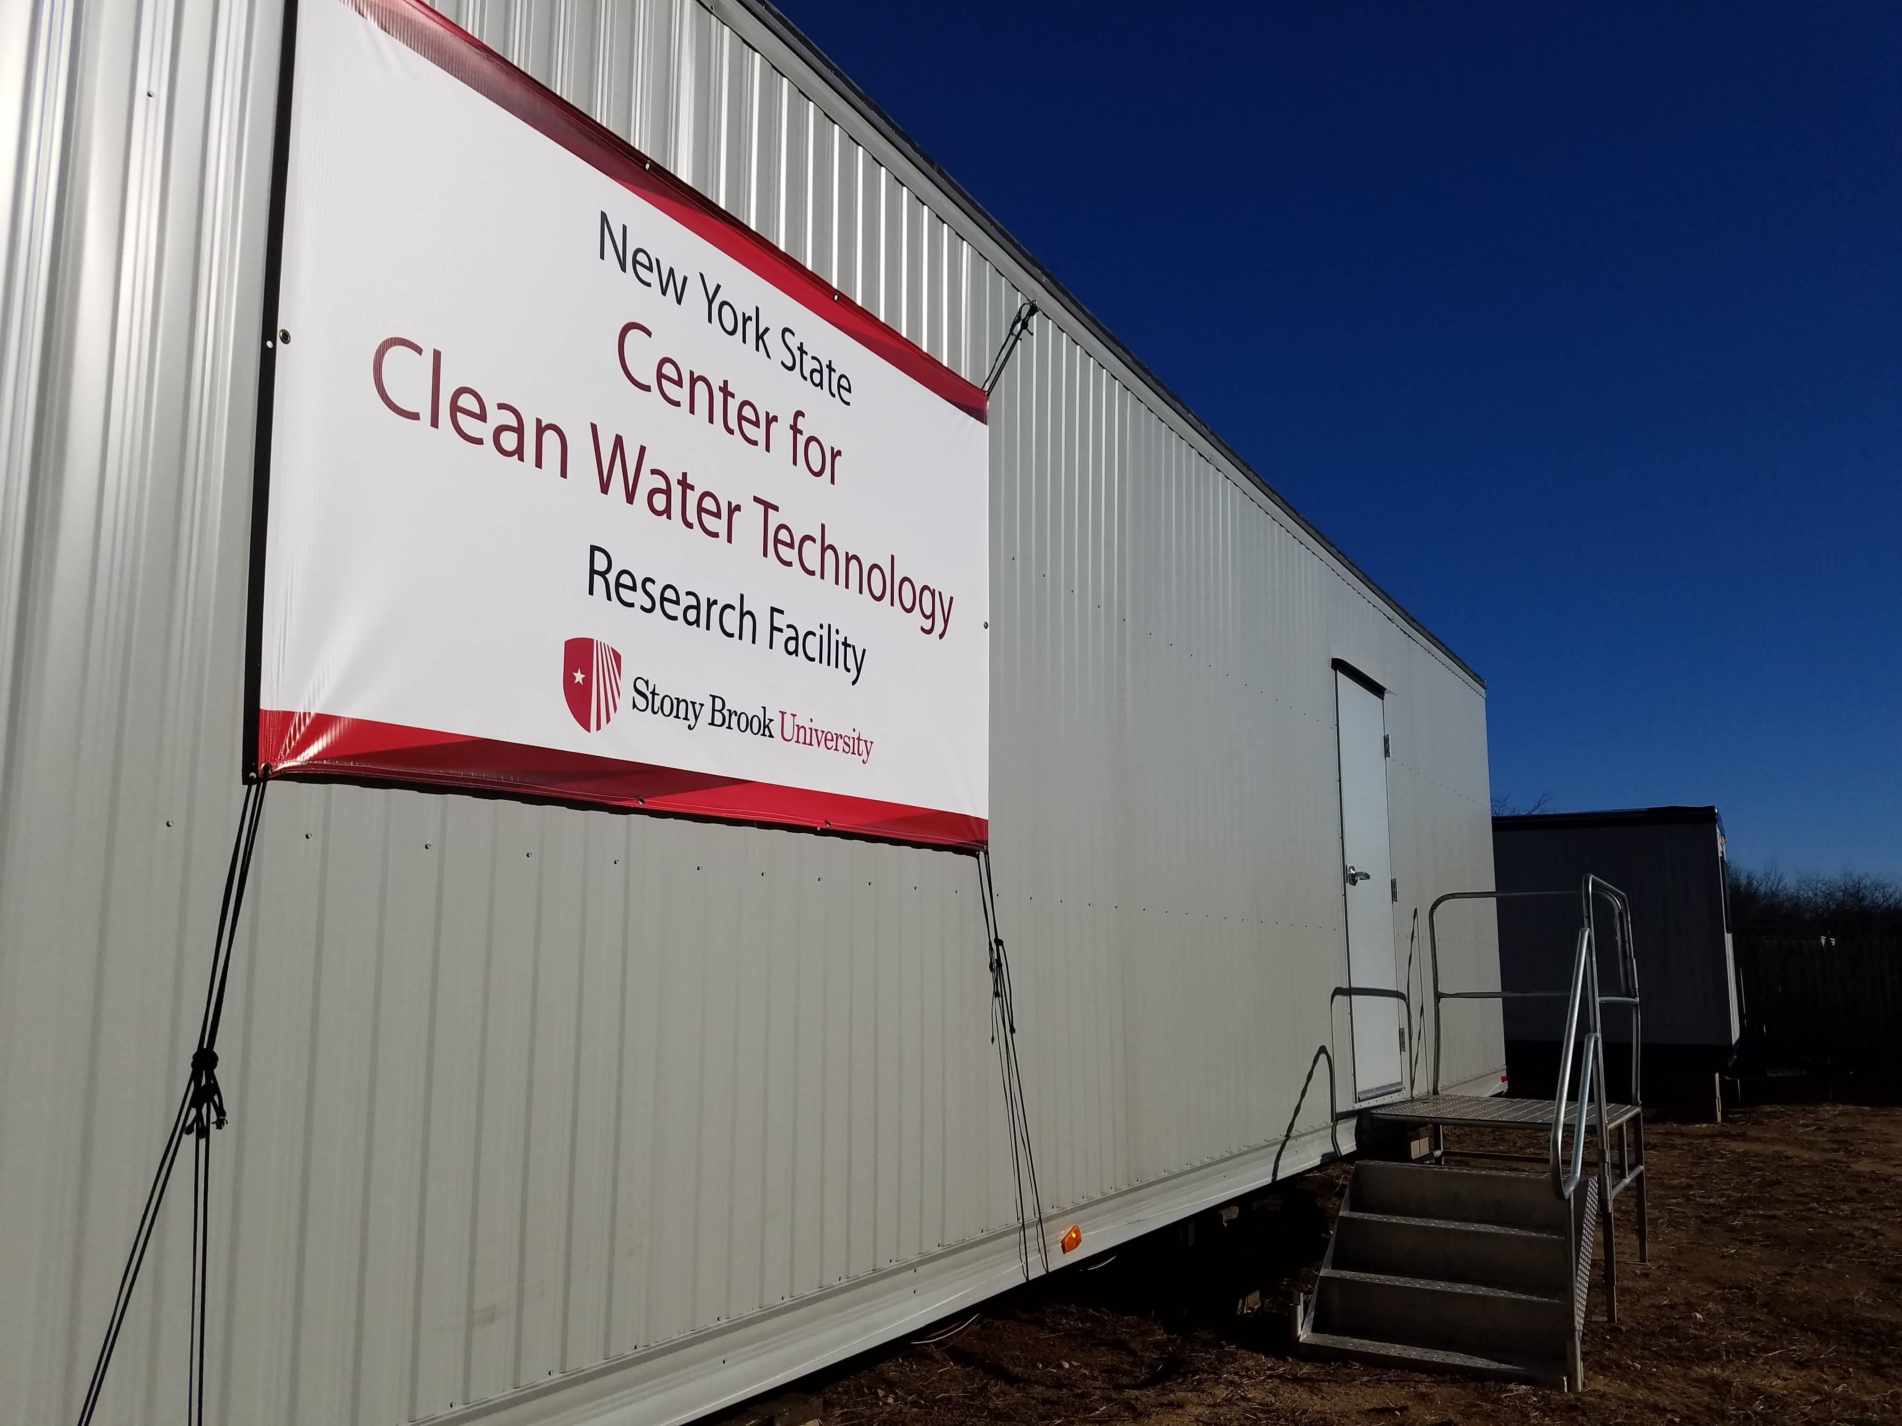
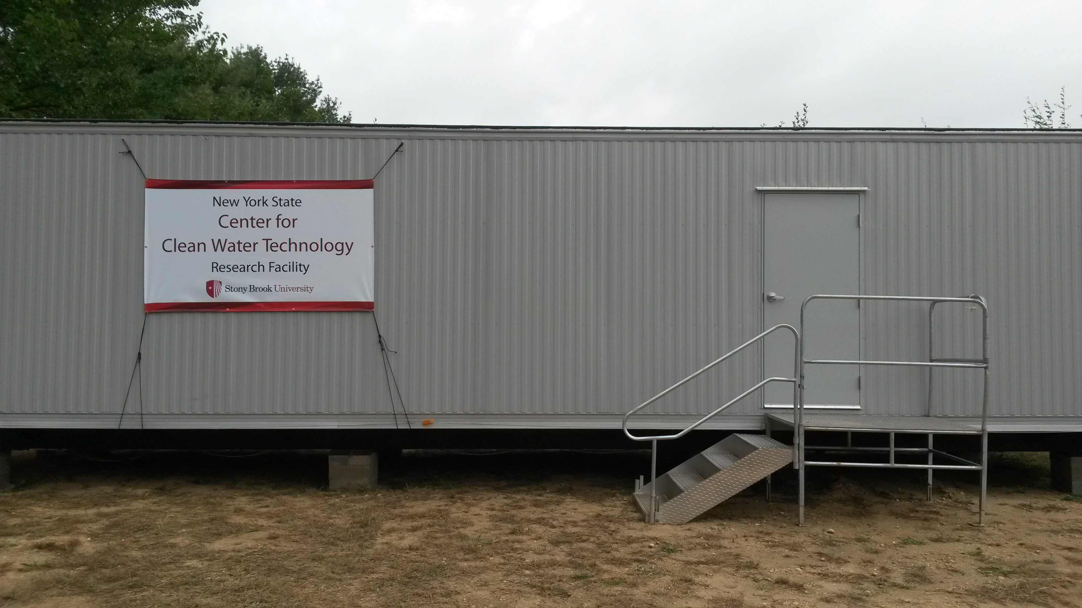
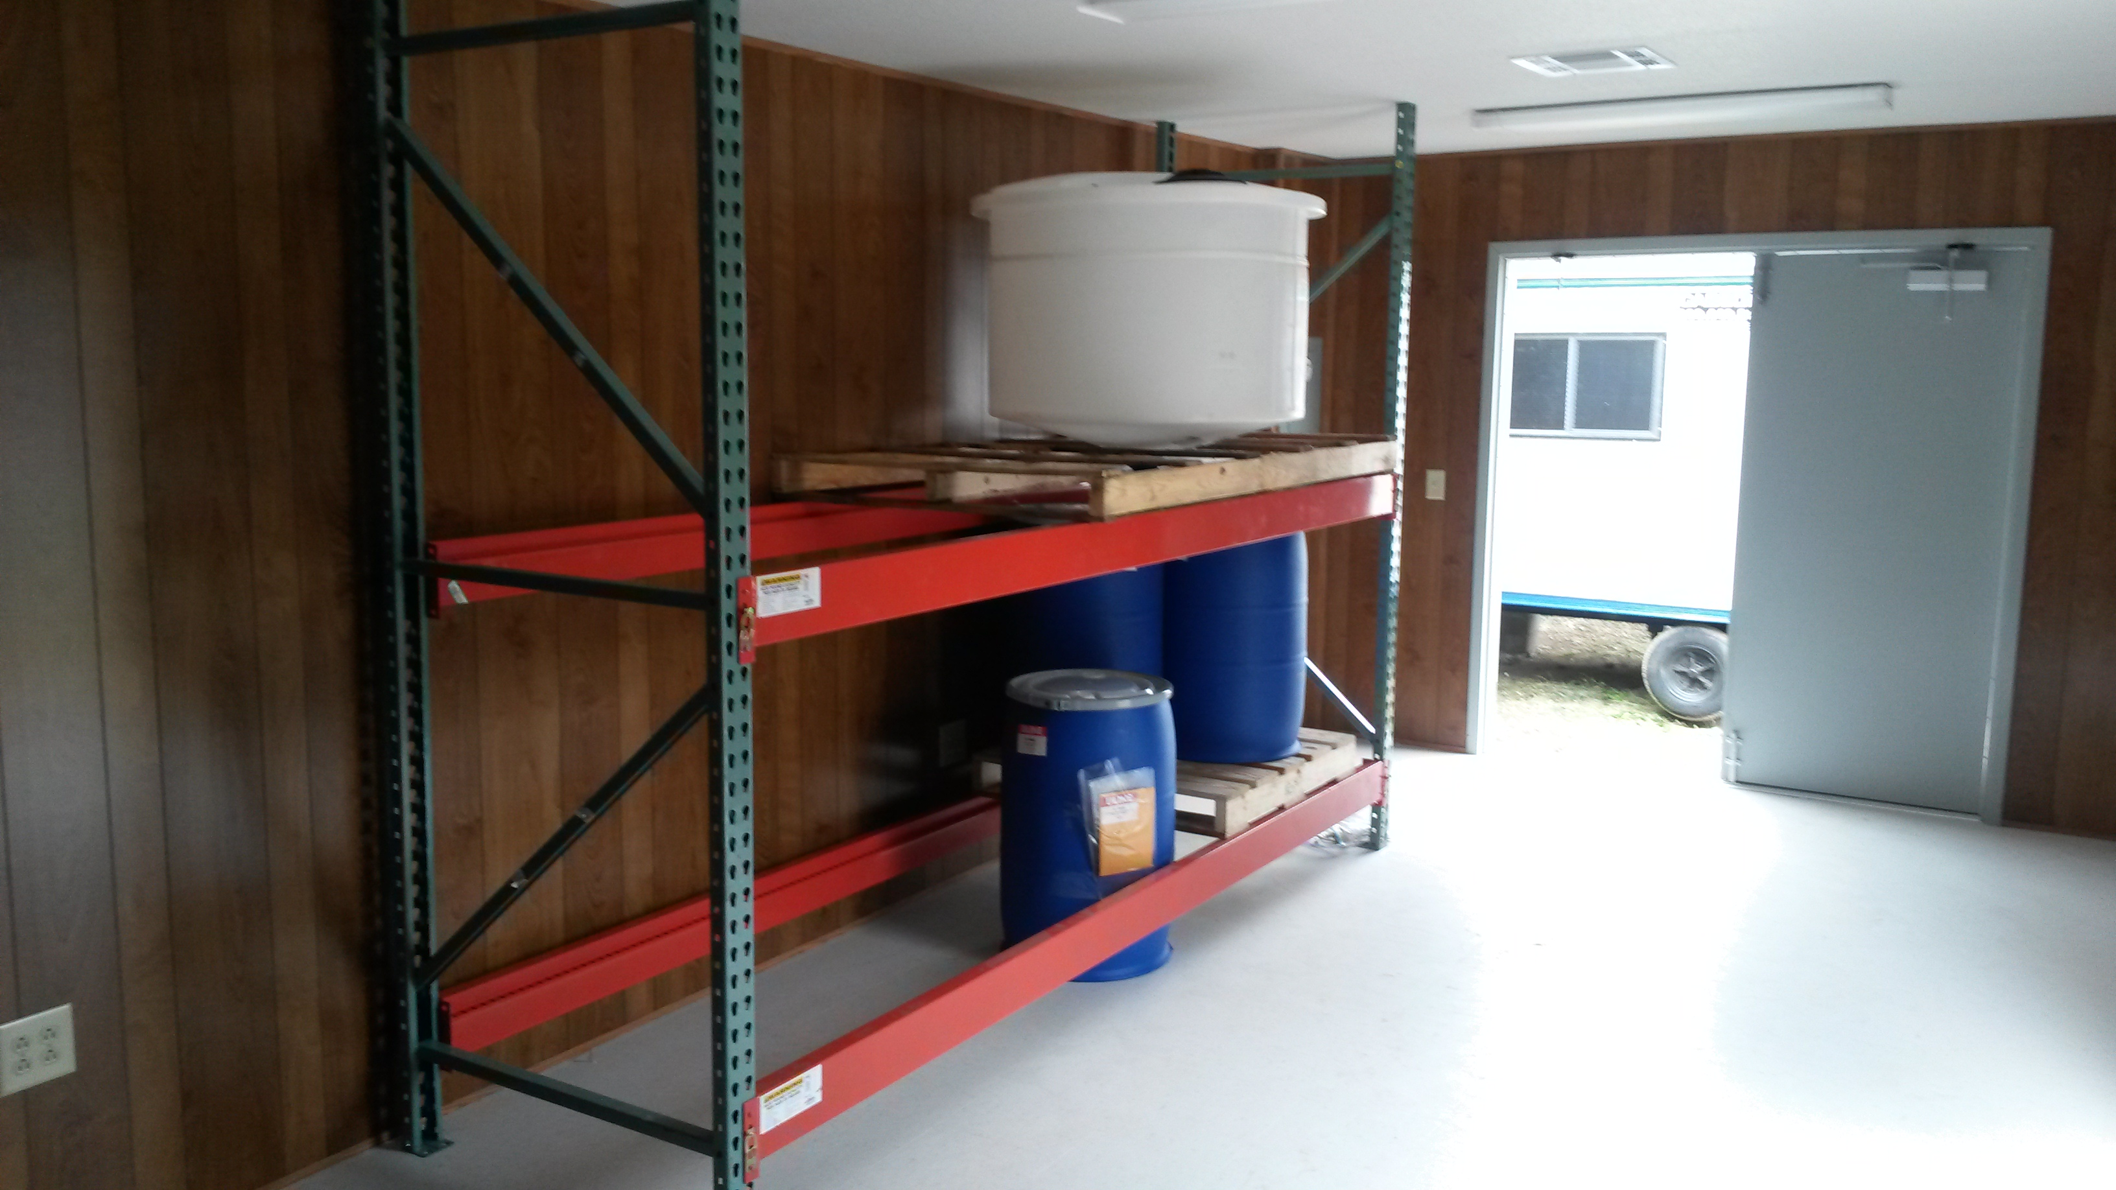
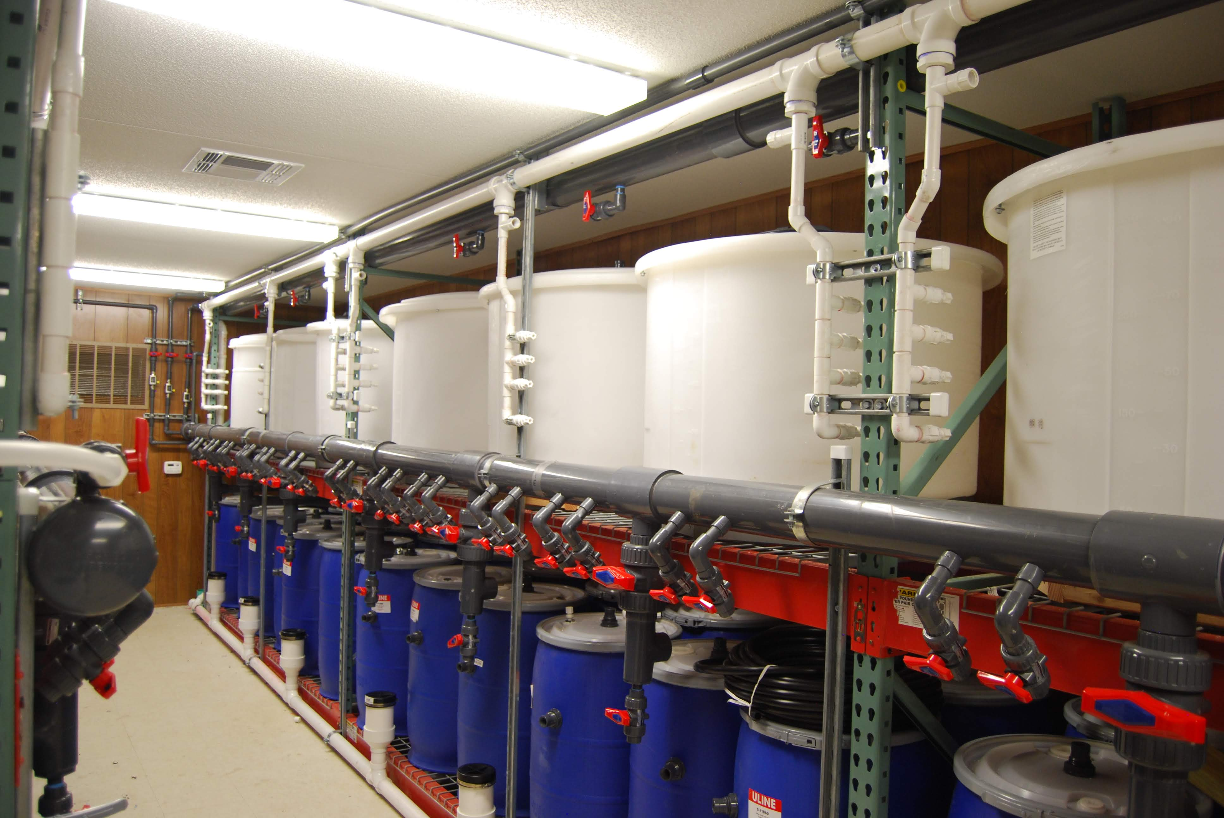
Wastewater Research & Innovation Facility
Pilot-testing facility that receives domestic wastewater & stormwater
https://www.stonybrook.edu/cleanwater/

Slide 22
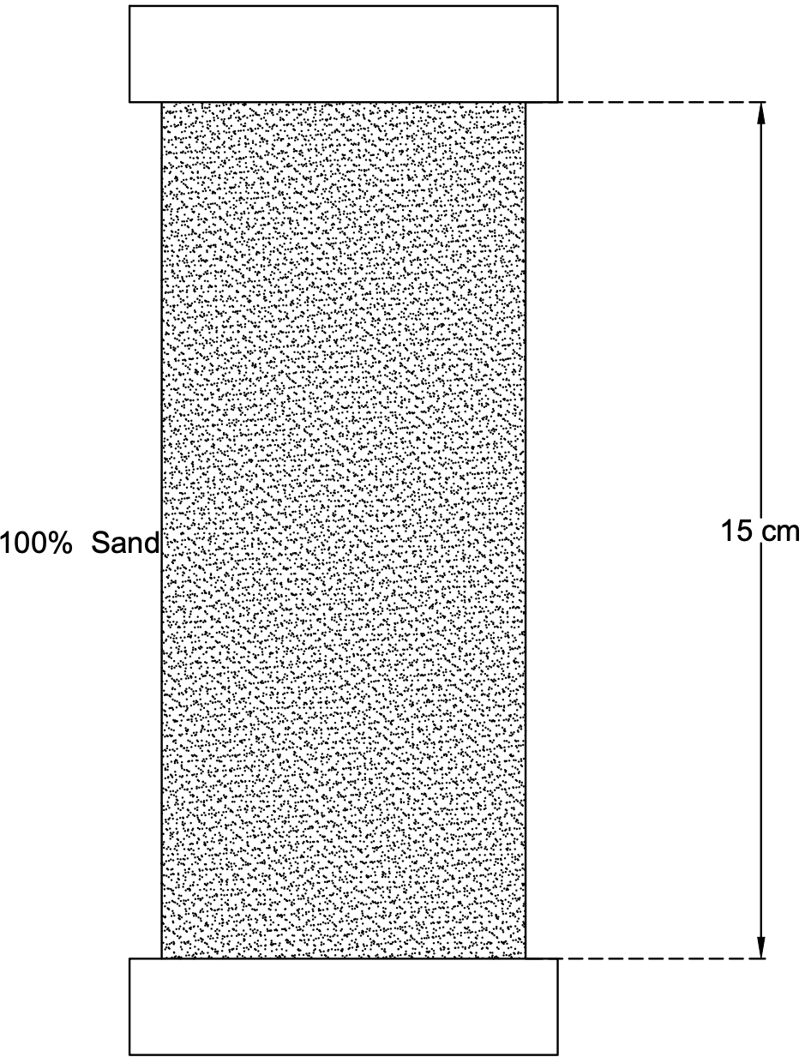
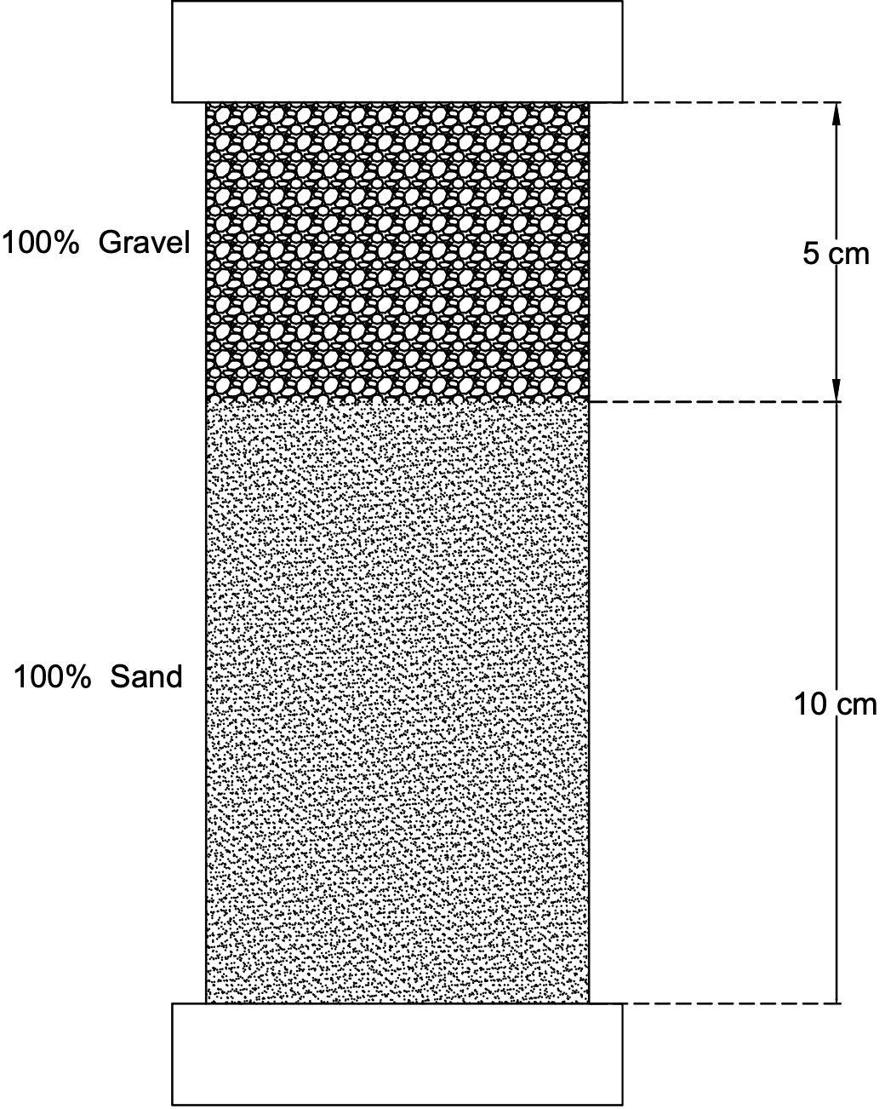
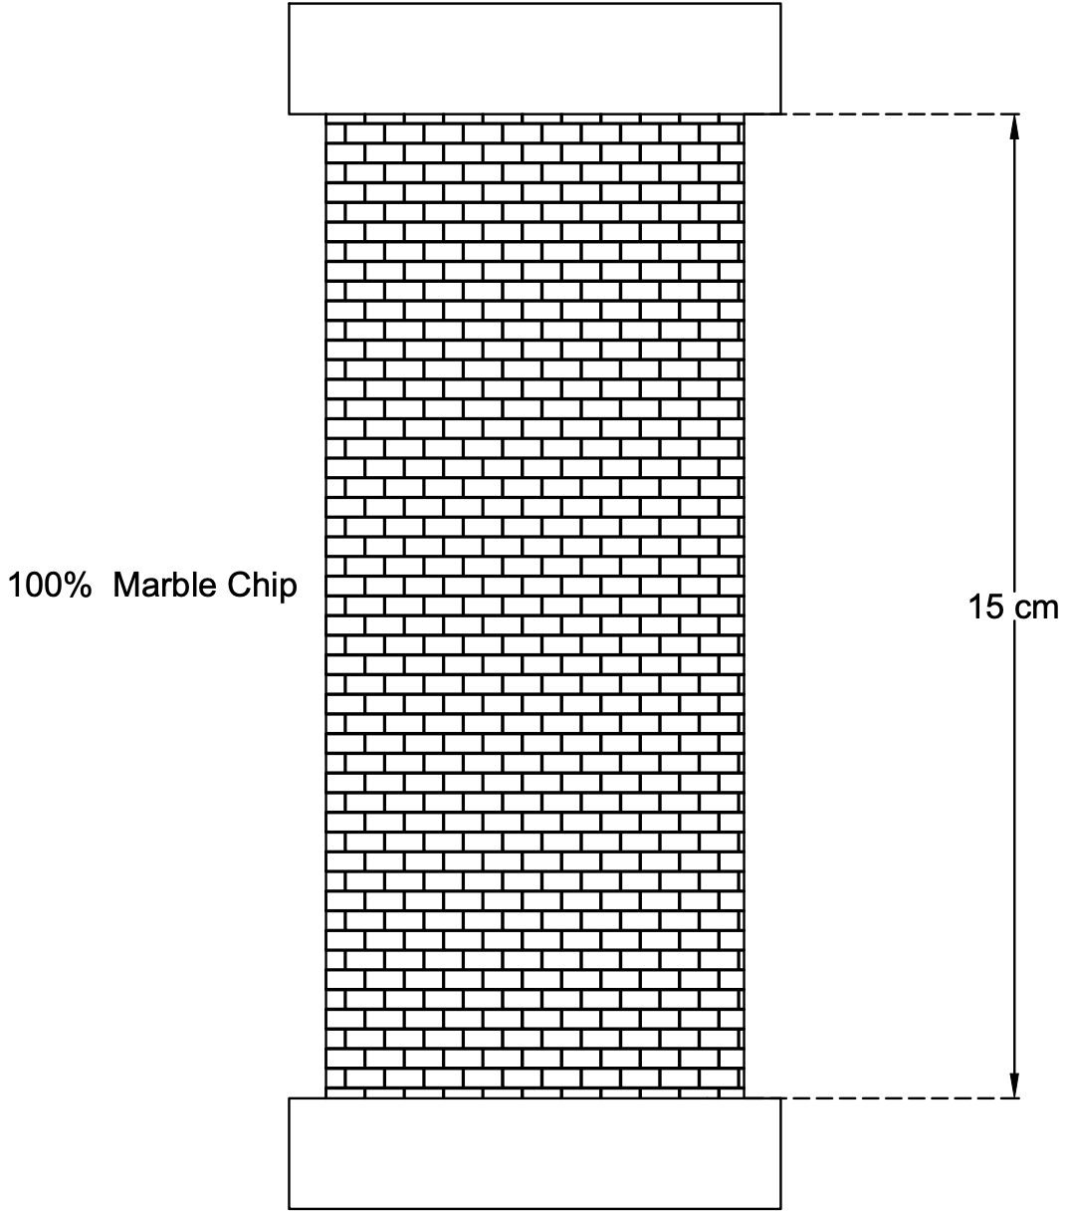
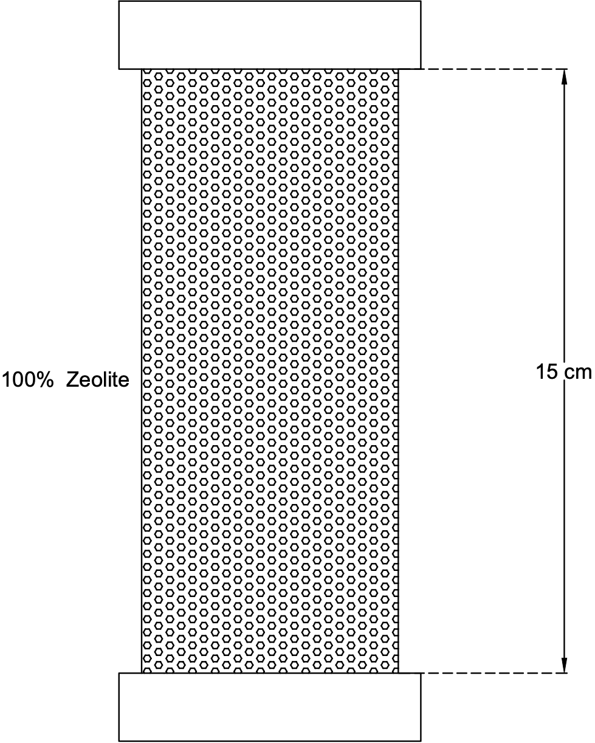
Selection of Major Filtration Material
Experimental Design
Diluted Domestic Wastewater (initial N level ~ in stormwater)
N species: NH₄⁺, NO_{x}⁻, TKN
Alkalinity
pH
temperature
5 cm
gravel
50%
marble chip
+
50% gravel
50%
zeolite
+
50% gravel
sand
15 cm
10 cm
sand
Stage | Description | HLR (gallons d⁻¹ ft⁻²) | HRT (hours)
1a | Start up columns with same HLR | 12 | 5.2
1b | Test the filter performance at higher HLR | 16 | 3.9

Slide 23
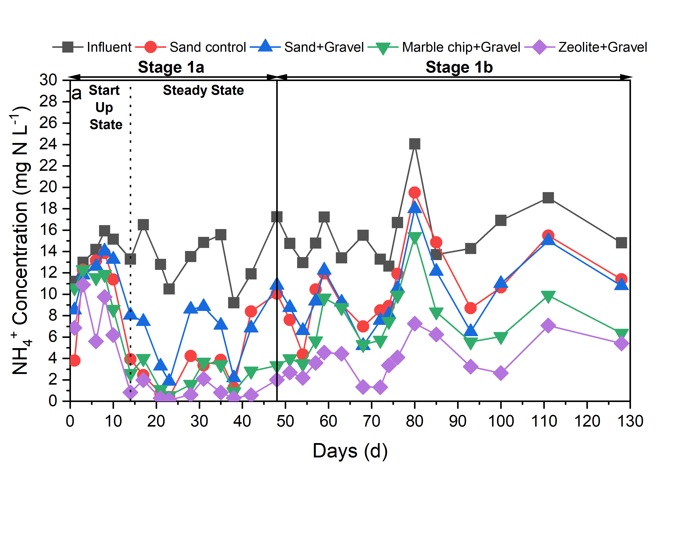
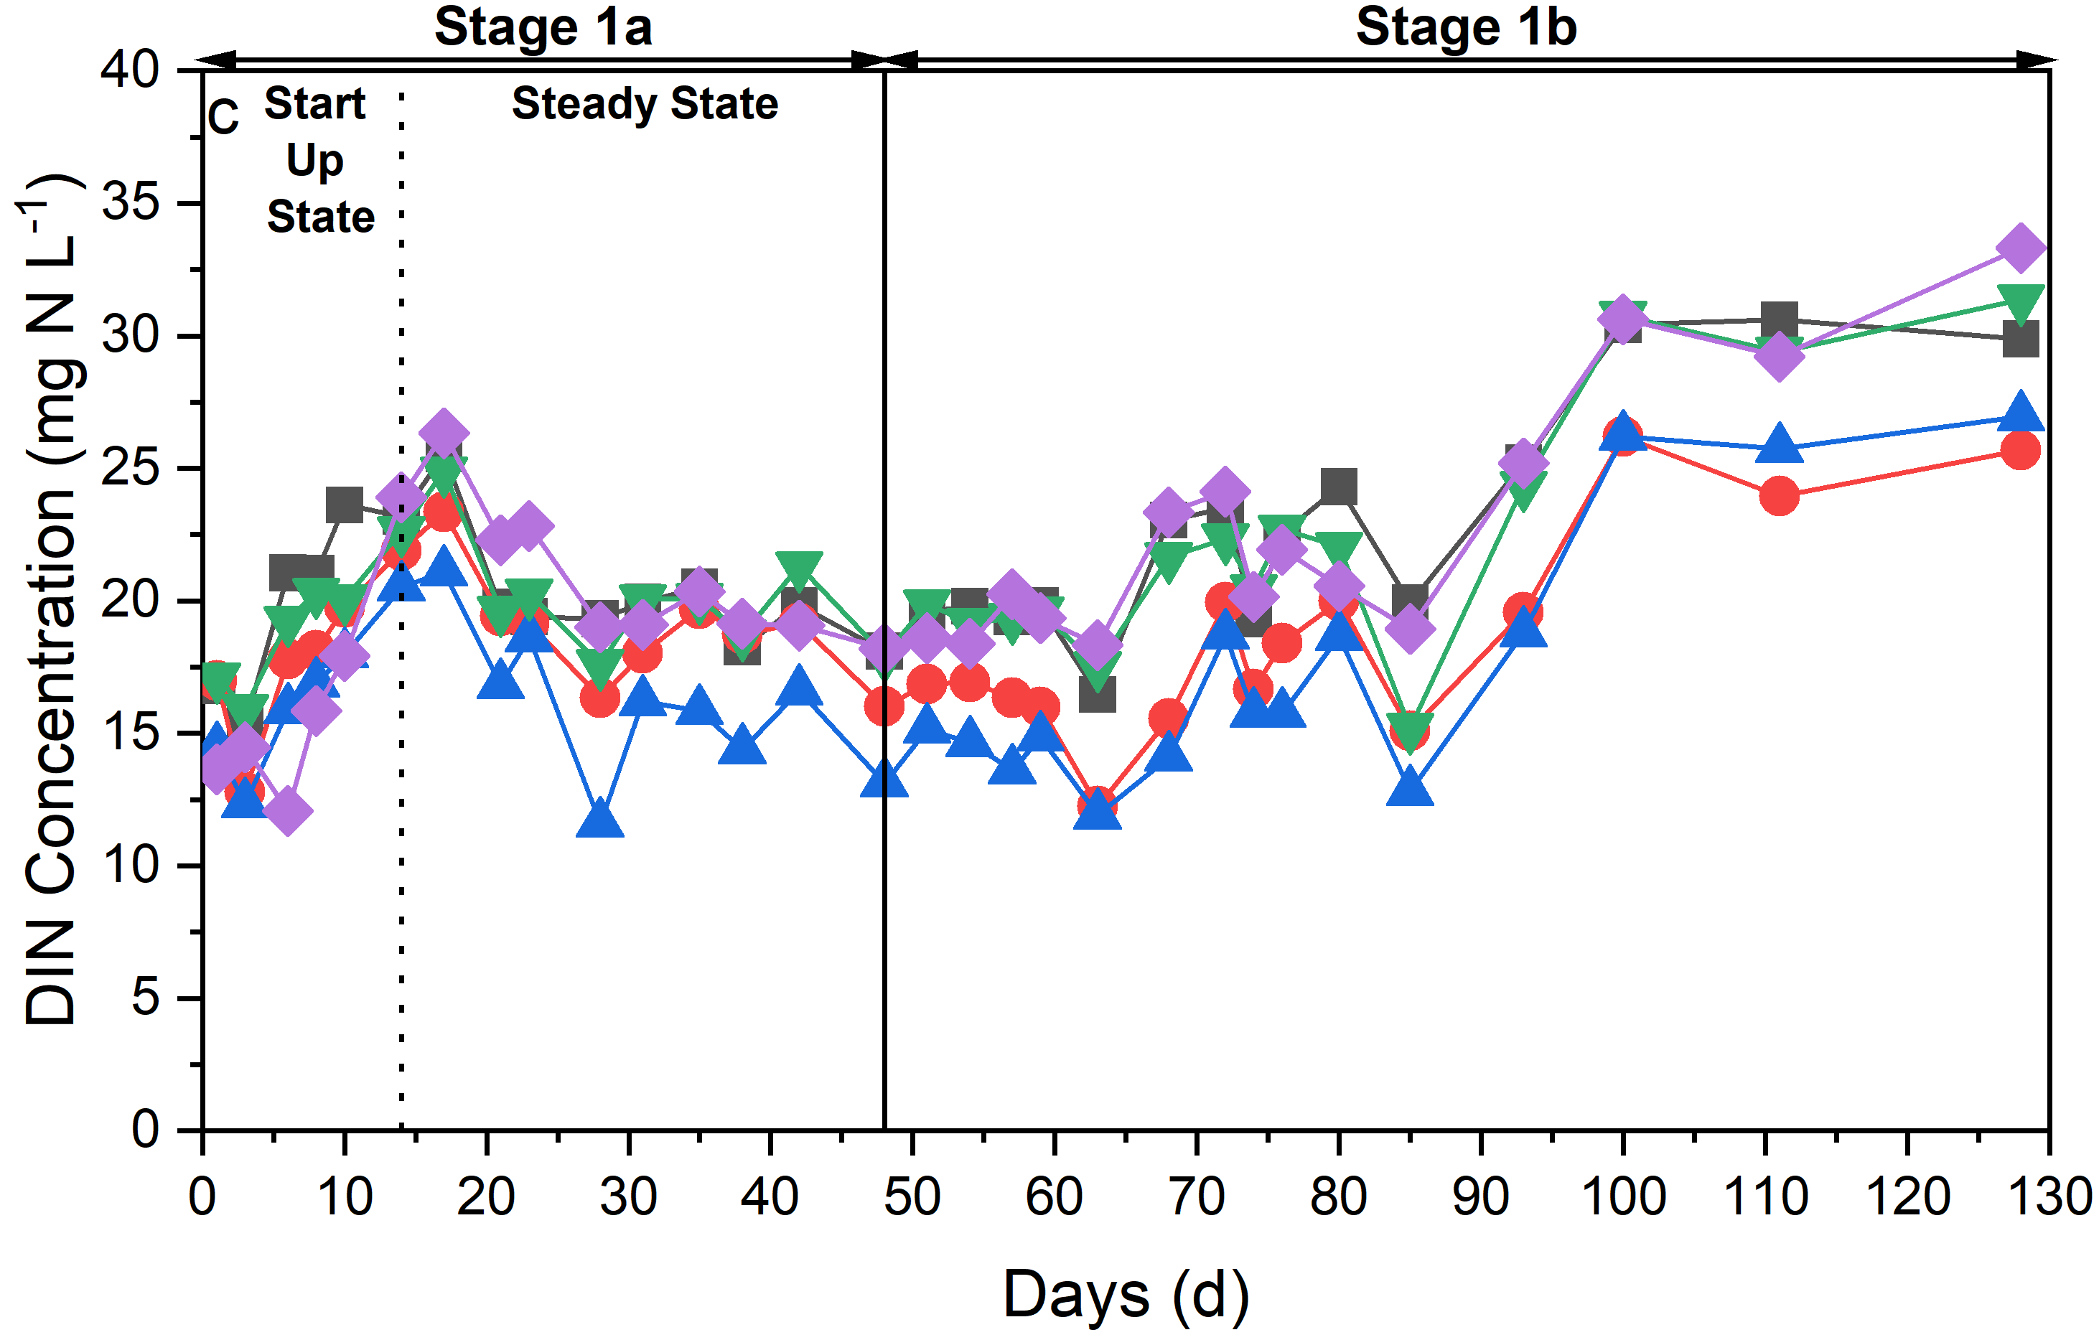
Selection of Major Filtration Material
Treatment Performance
Lower NH₄⁺ Levels were observed in zeolite and marble chip columns.
Nitrification (87%) was the major NH₄⁺ removal mechanism of zeolite.

Slide 24
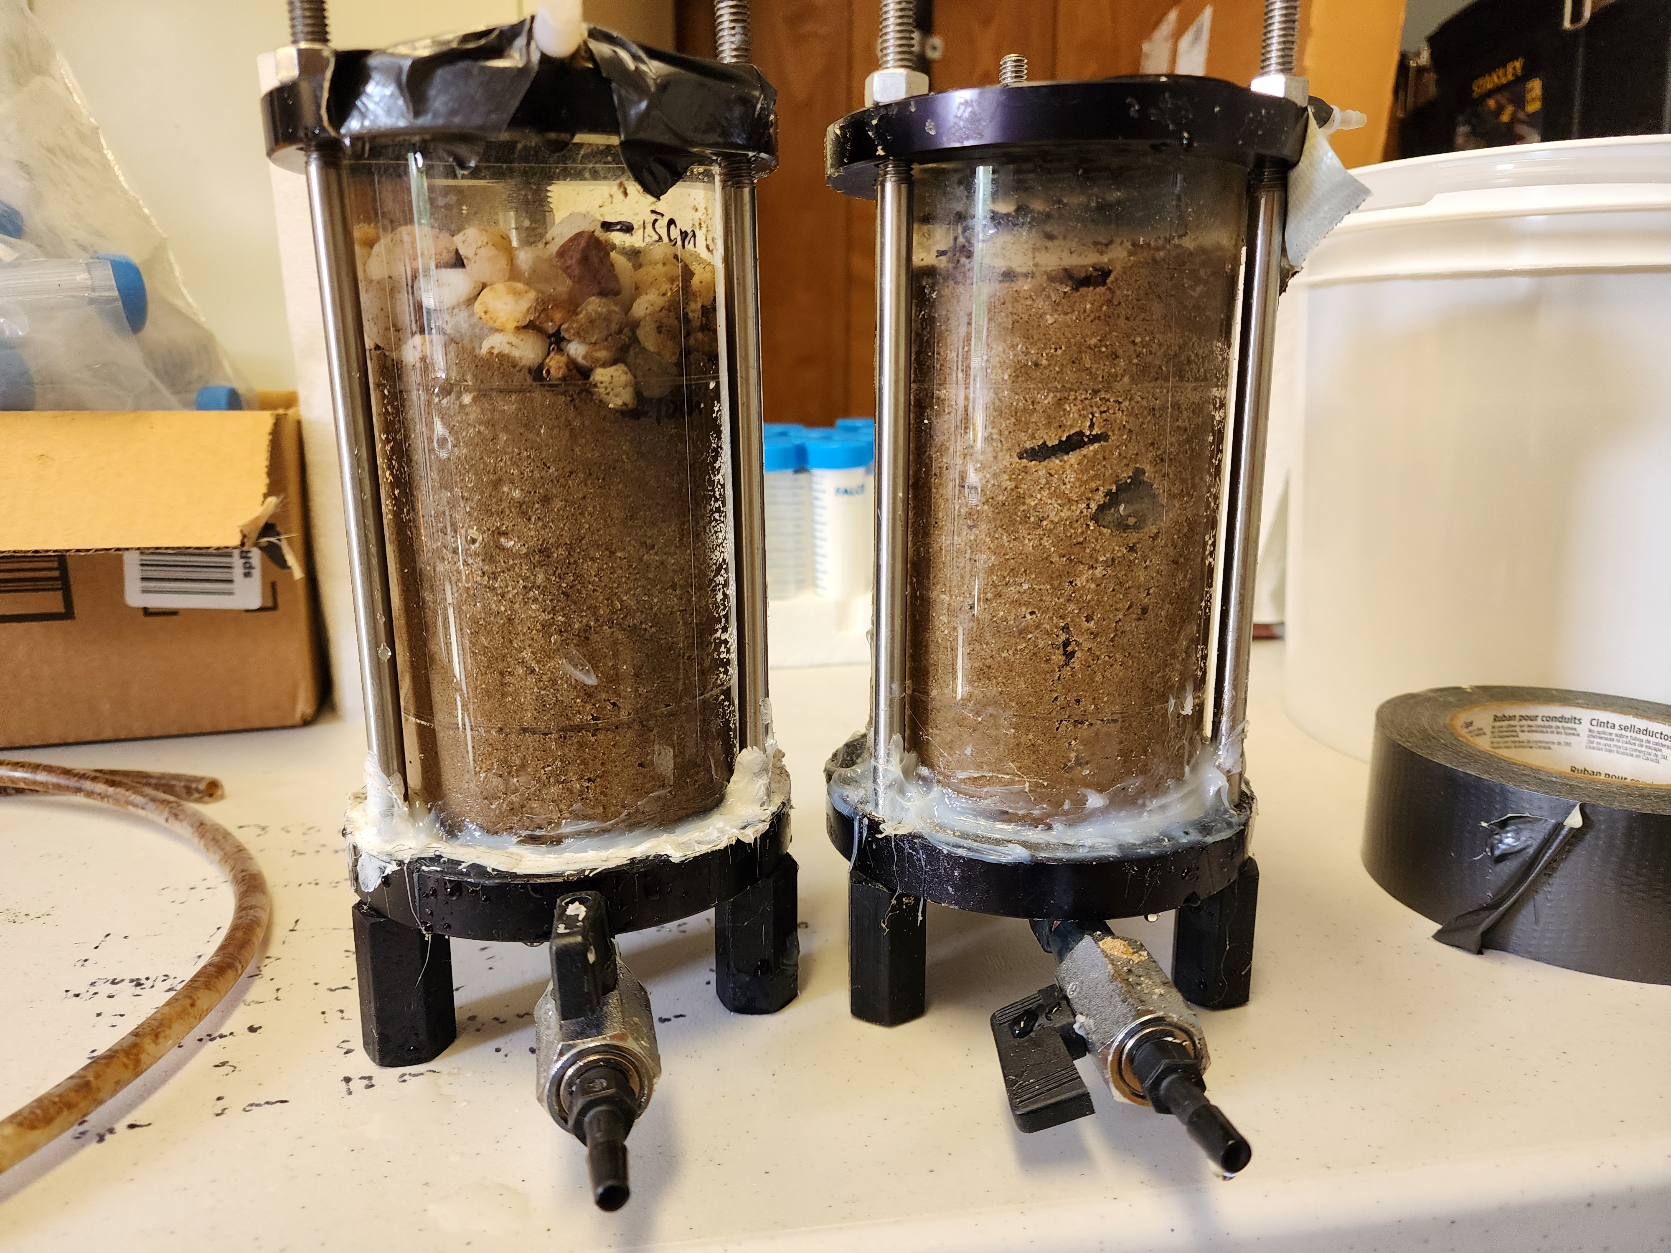
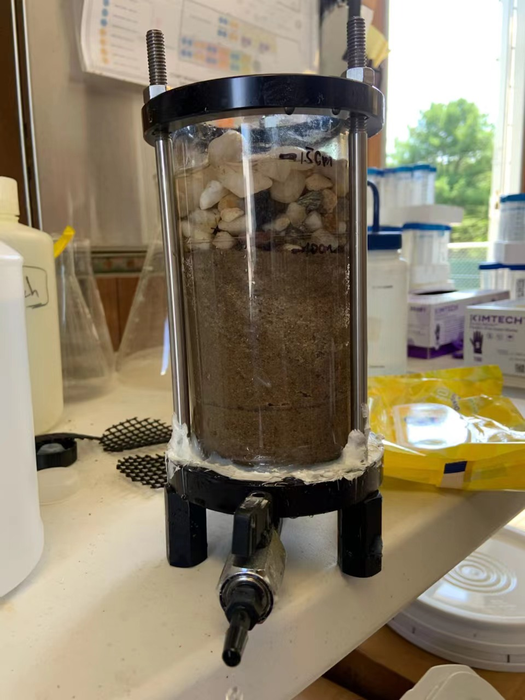
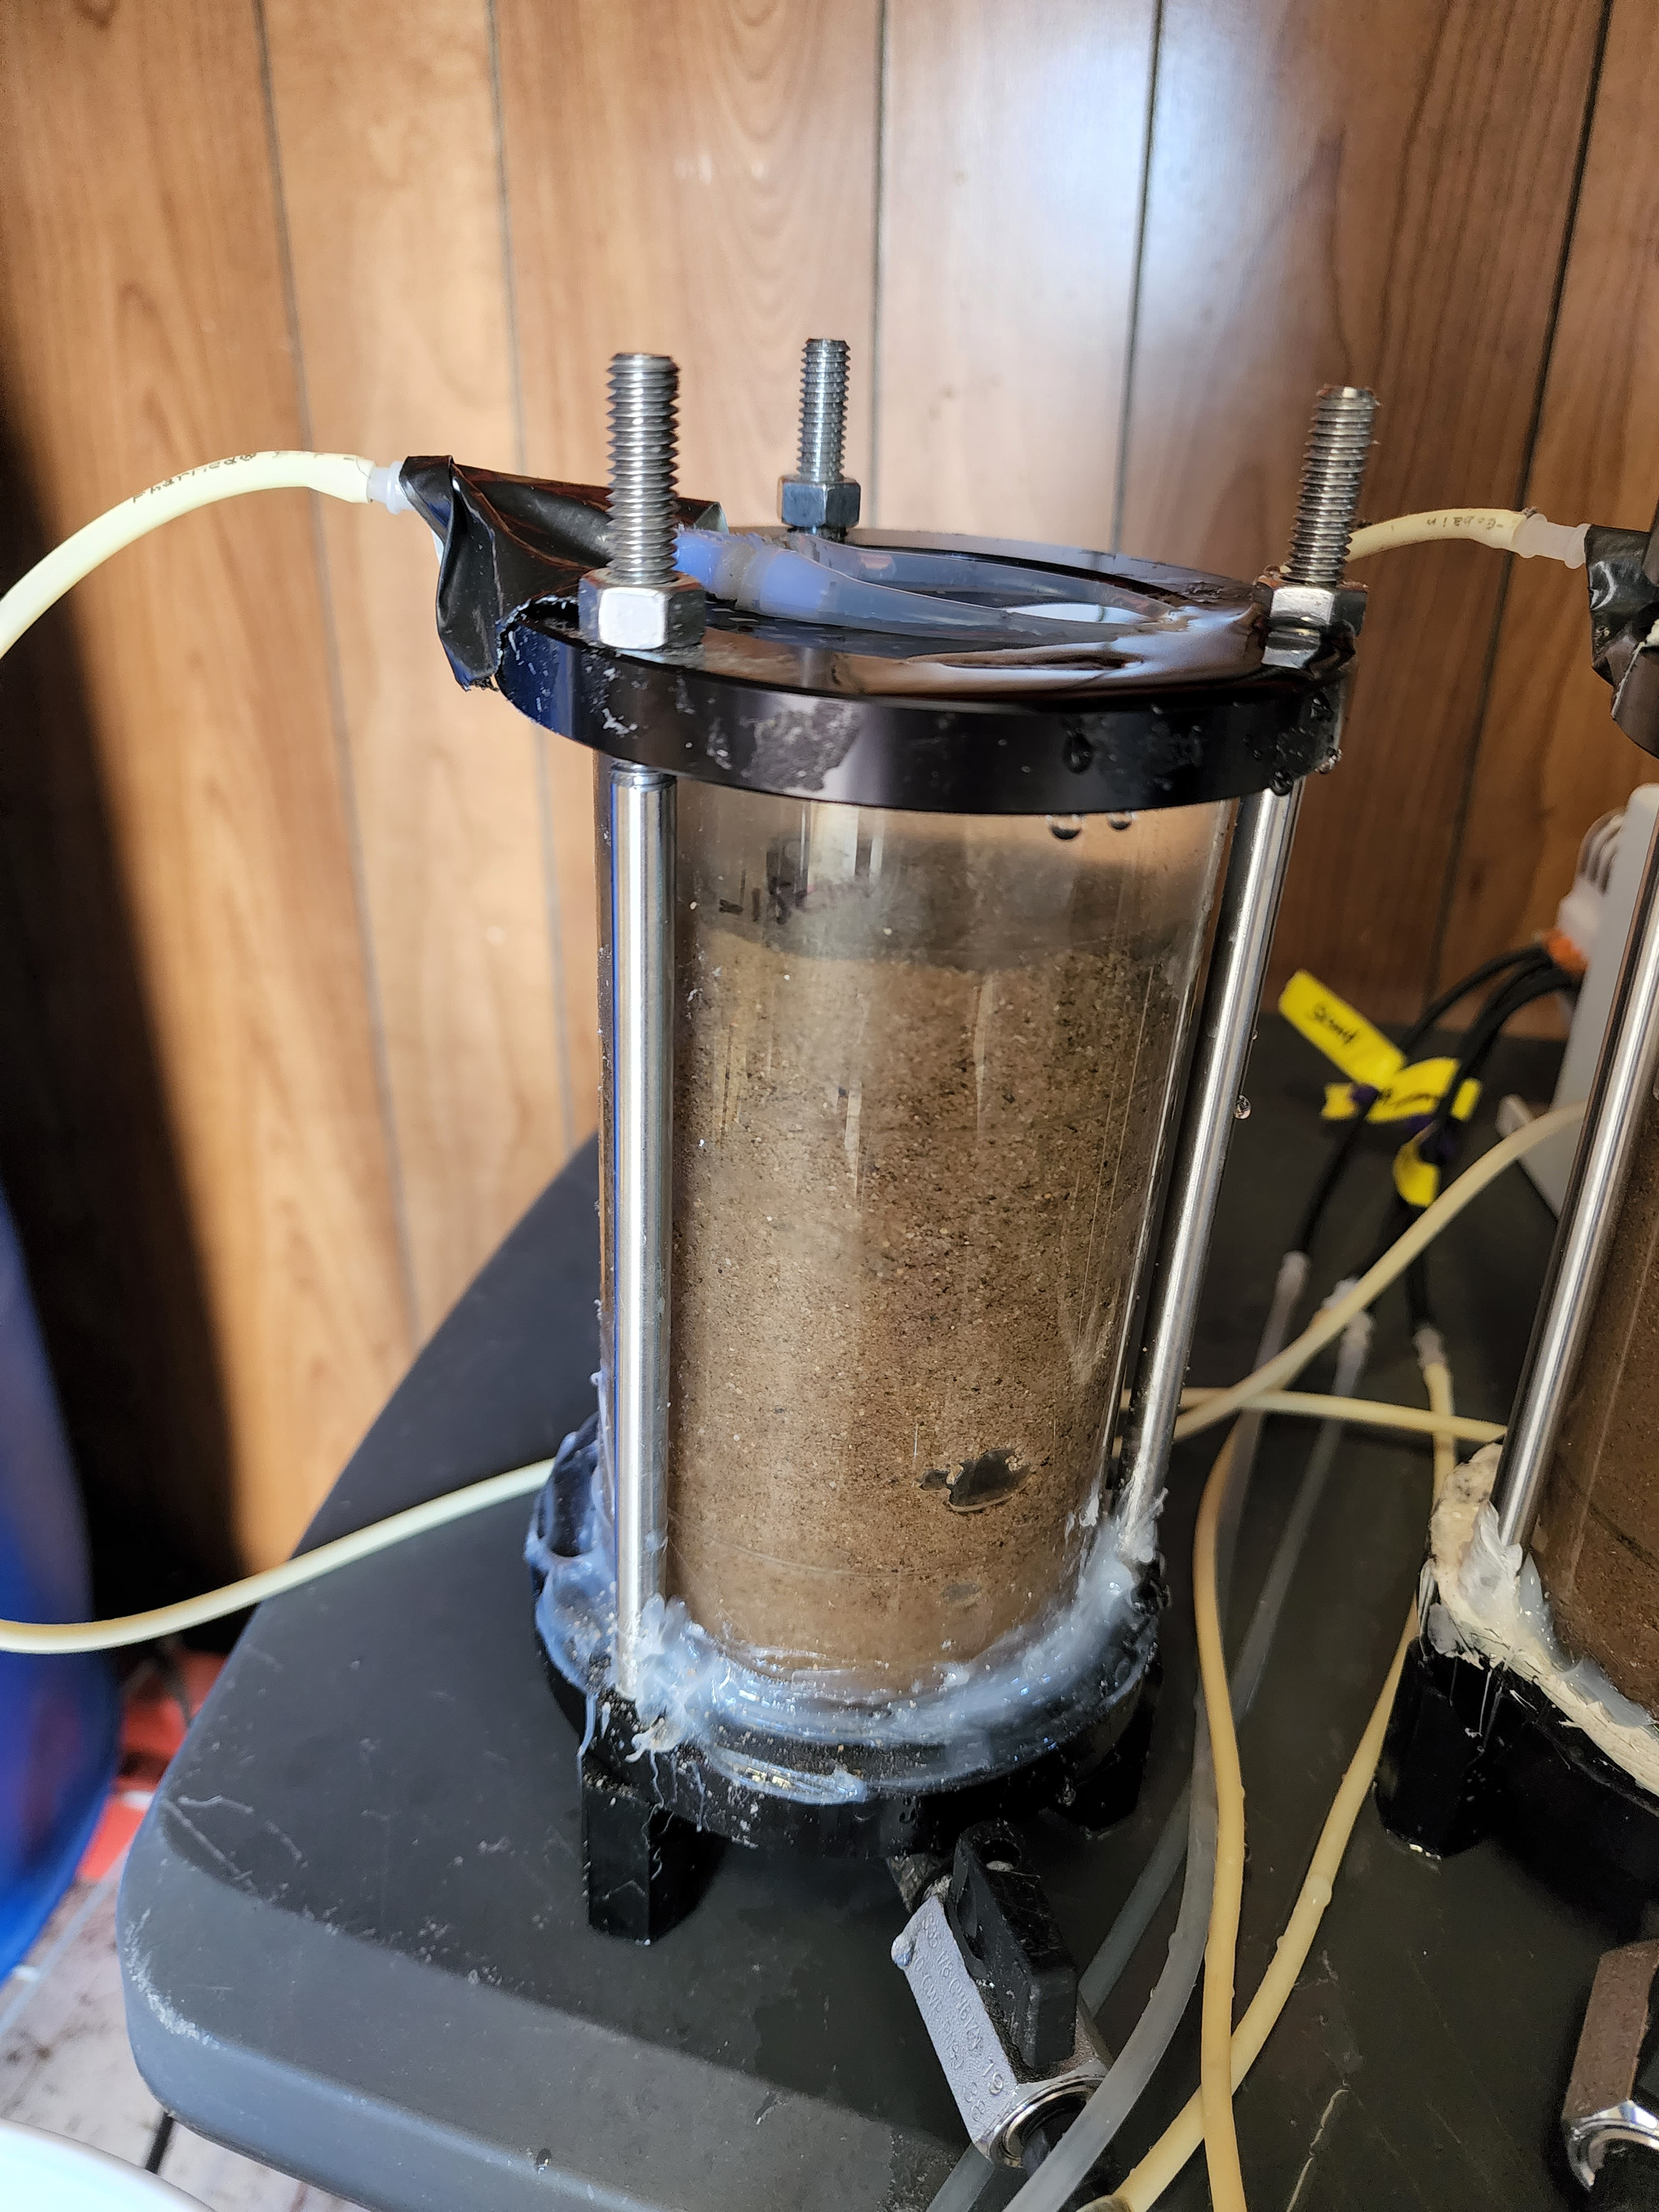
Selection of Major Filtration Material
Hydraulic Performance
Sand column and gravel amended column: clogged every 1-2 weeks.
Marble chip amended column and zeolite amended column: no clogging issue.

Slide 25
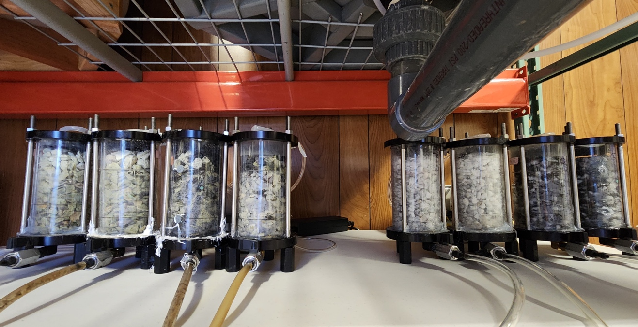
Impact of Biochar Amendment
Experimental Design
Zeolite
+
30% Biochar
Marble Chip
+
30% Biochar
Zeolite
Marble Chip
Stage | Description | HLR (gallons d⁻¹ ft⁻²) | HRT (hours)
2a | Start up columns with highest HLR tested at stage 1 | 16 | 3.9
2b | Test the impact of biochar amendment at lower HLR (higher HRT) | 12 | 5.2

Slide 26
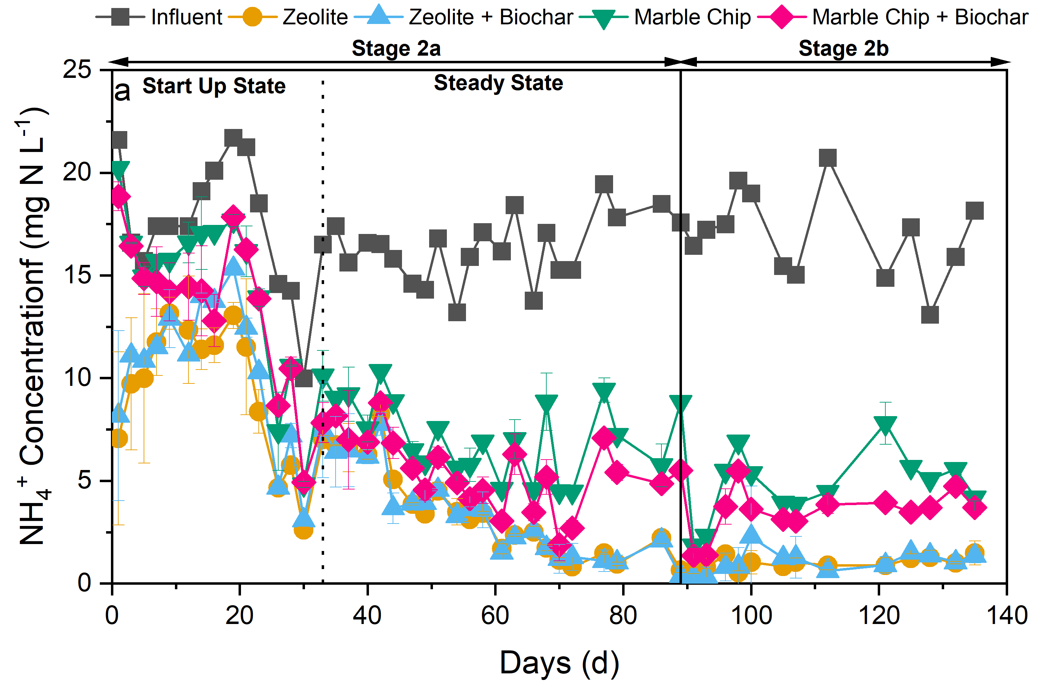
Impact of Biochar Amendment
Treatment Performance
HRT 3.9 hr
HRT 5.2 hr
Column | NH₄⁺-N Concentration (mg N L⁻¹)
 | Stage 2a | Stage 2b
Influent | 16.2 ± 1.8 | 17.0 ± 2.0
Zeolite | 2.6 ± 1.3 | 1.0 ± 0.3
Zeolite + Biochar | 2.6 ± 1.2 | 1.0 ± 0.5
Marble Chip | 6.3 ± 1.7 | 5.1 ± 1.9
Marble Chip + Biochar | 4.9 ± 1.6 | 3.6 ± 1.2
Increased NH₄⁺ removal was observed in biochar amended marble chip columns, while no significant change was observed in biochar amended zeolite column.
Extended HRT didn’t change the treatment performance of biochar amended columns.

Slide 27
Summary and Next Steps
Zeolite and marble chip columns (with bigger particle size and higher porosity) could overcome the hydraulic challenge (12– 16 gallons d⁻¹ ft⁻²) while similar or better NH₄⁺ removal performance (83.9 – 94.1%)was achieved.
Increased NH₄⁺ removal performance was observed in biochar amended marble chip columns, while no significant change was observed in biochar amended zeolite column.
Optimize and pilot-testing filter media combination to remove a suite of contaminants in the first-flush of stormwater.
Optimize the storm-drain filter configuration design and field-testing with identified sites.
To follow up: xinwei.mao@stonybrook.edu

