Slide 1
WRF Research: An Overview
Ashwin Dhanasekar
The Water Research Foundation
February 15th, 2024

Slide 2
ABOUT
MISSION
Advancing the science of water to improve the quality of life
VISION
To create the definitive research organization to advance the science of all things water to better meet the evolving needs of subscribers and the water sector
VALUES
Integrity • Leadership • Respect
Innovation • Collaboration

Slide 3
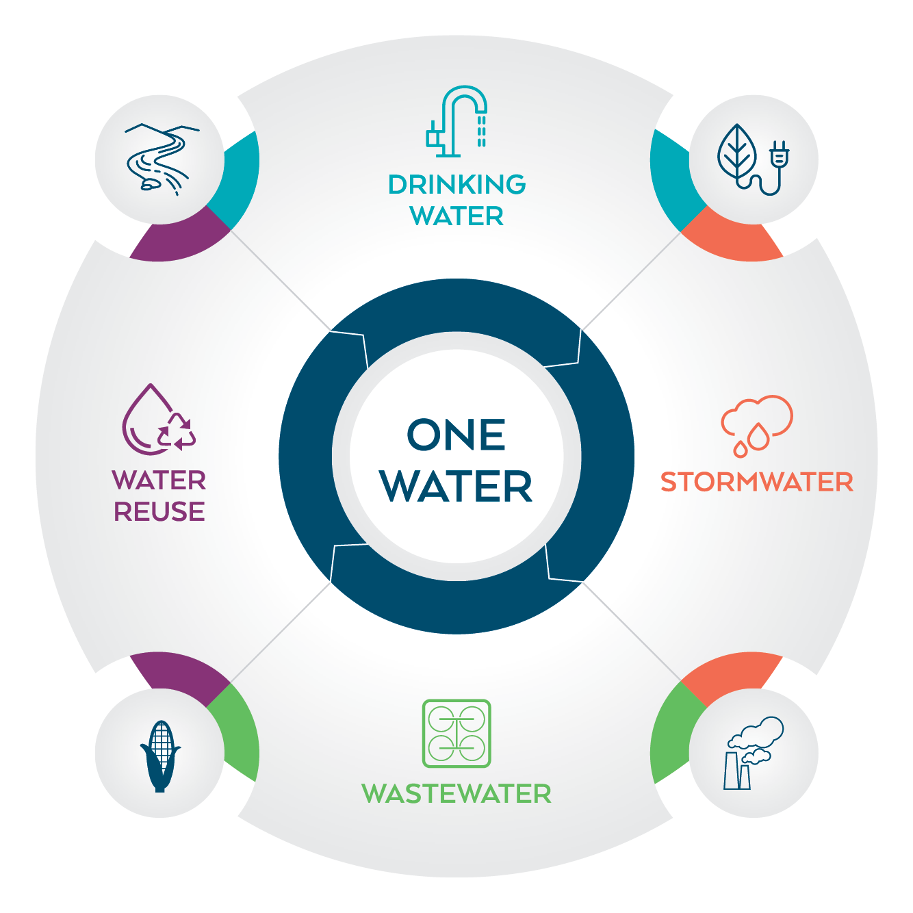
One Water
WRFs research benefits all areas of the water sector, as well as agriculture, energy, watershed management, and other commercial industries.

Slide 4
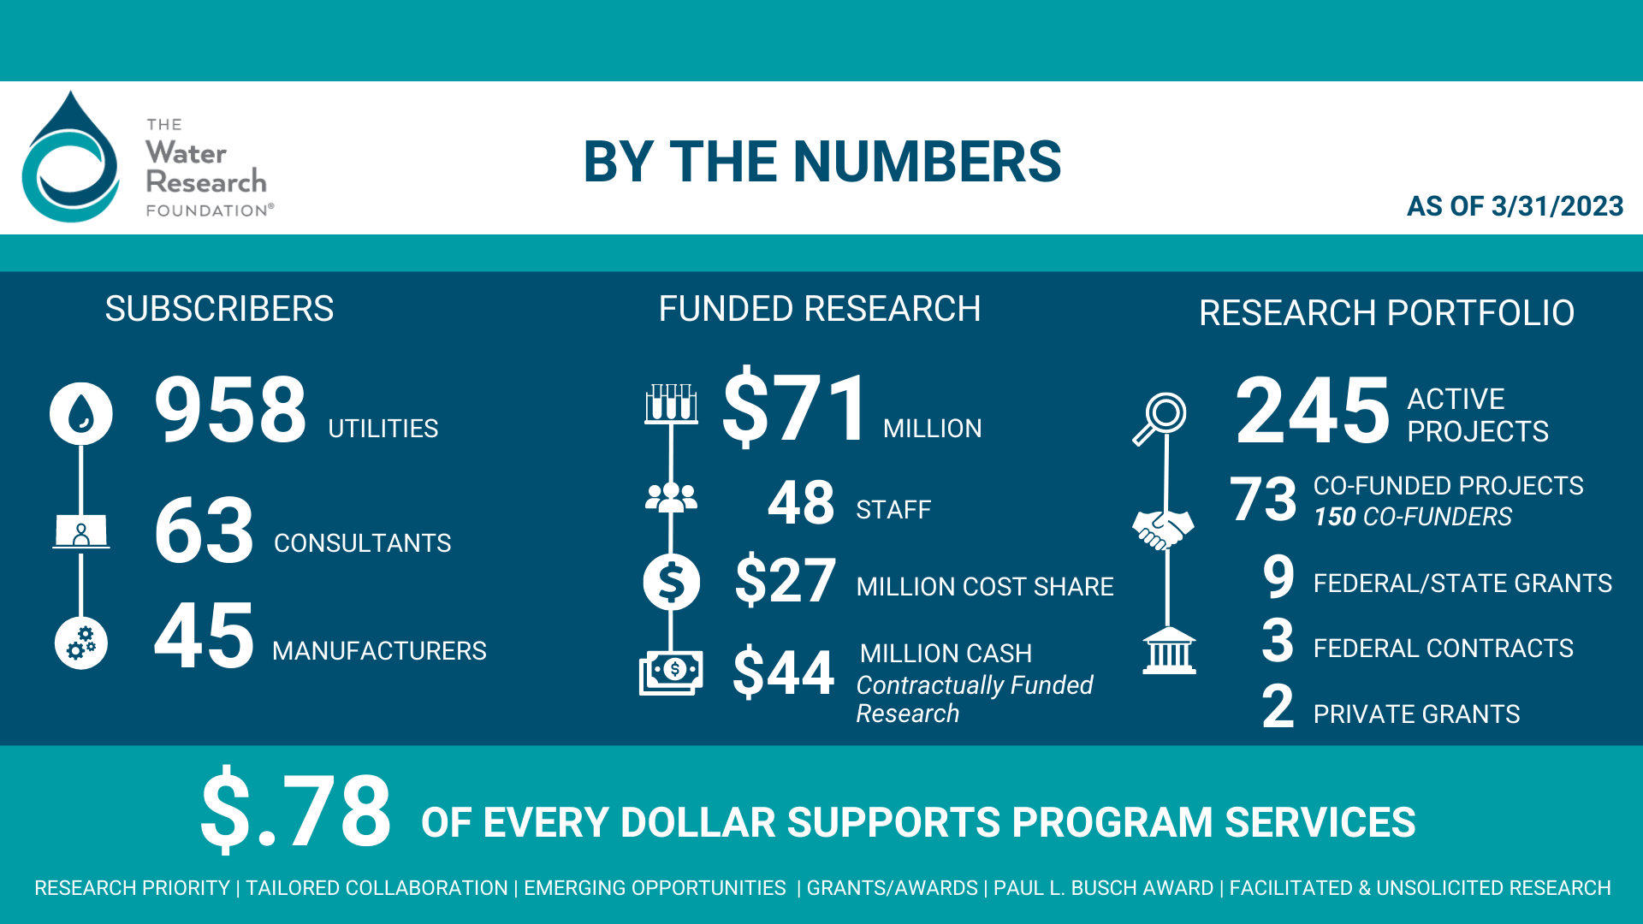

Slide 5


Research Programs
60%
of research budget
20%
of research budget
10%
of research budget
10%
of research budget
Grant Funded
$100,000
Endowment
Funded
Subscriber/
Partner
Funded
Unsolicited
Program
10%
Facilitated
Research
Program
Sponsored
Research
Research
Priority Program
Tailored
Collaboration
Program
Unsolicited
Program
Emerging Opportunities
Program
Emerging Opportunities
Program
Paul L. Busch
Award

Slide 6


Research Priority Program
2024 Budget $6,023,111

Slide 7
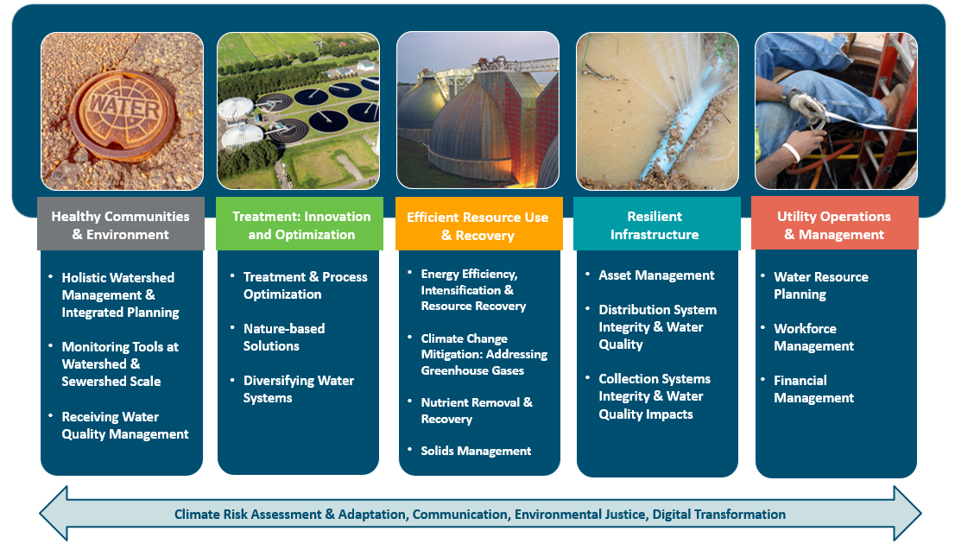

Slide 8
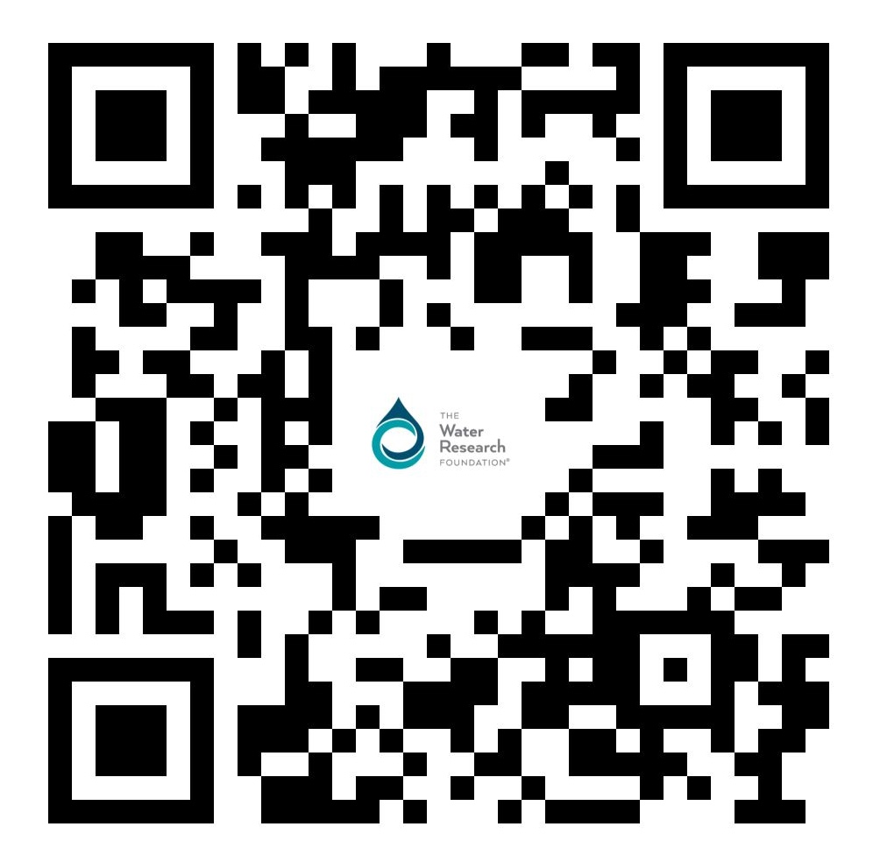

Open RFPs
www.waterrf.org/proposals

Slide 9

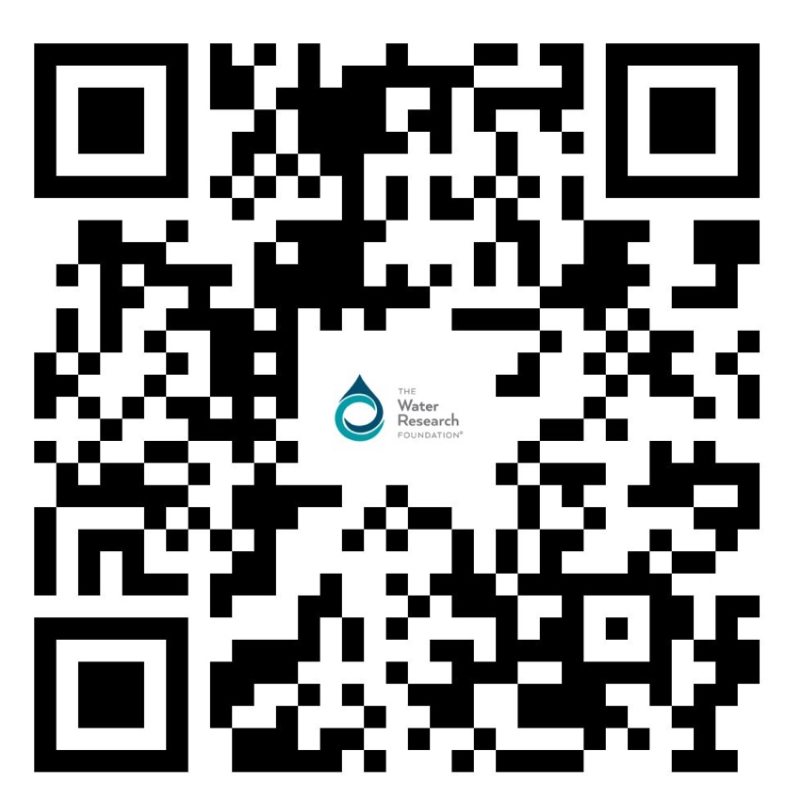
Tailored Collaboration Program
www.waterrf.org/tailored-collaboration-program

Slide 10
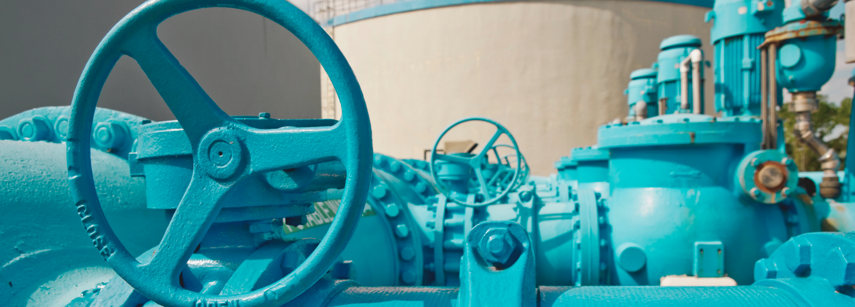
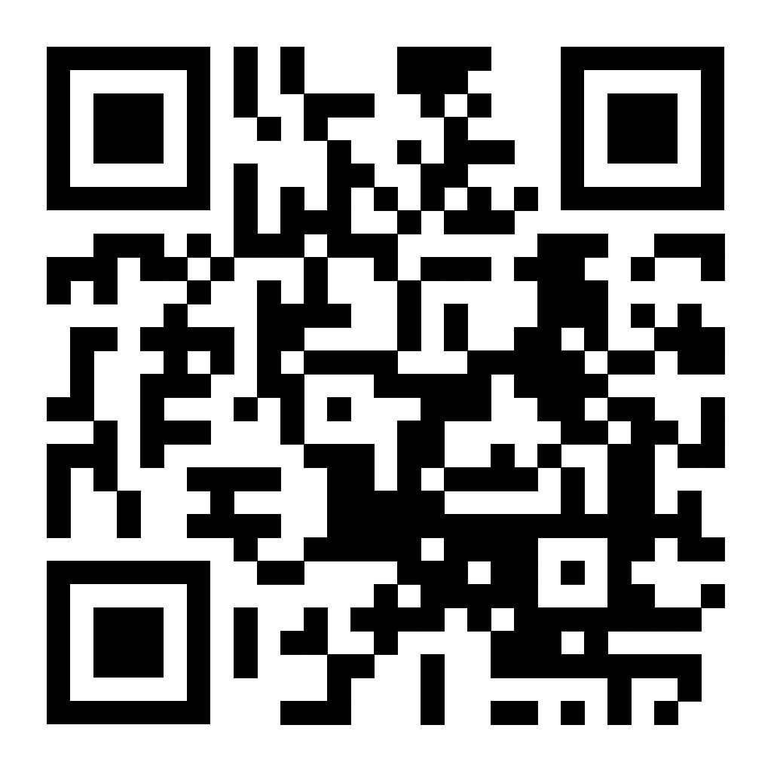
Unsolicited Research Program

Slide 11
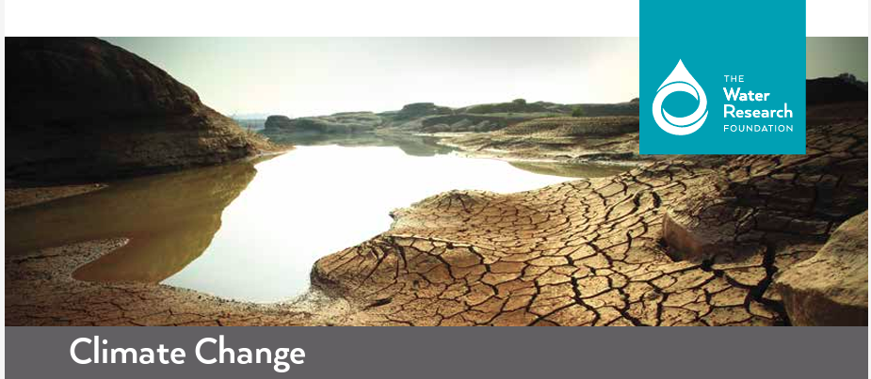
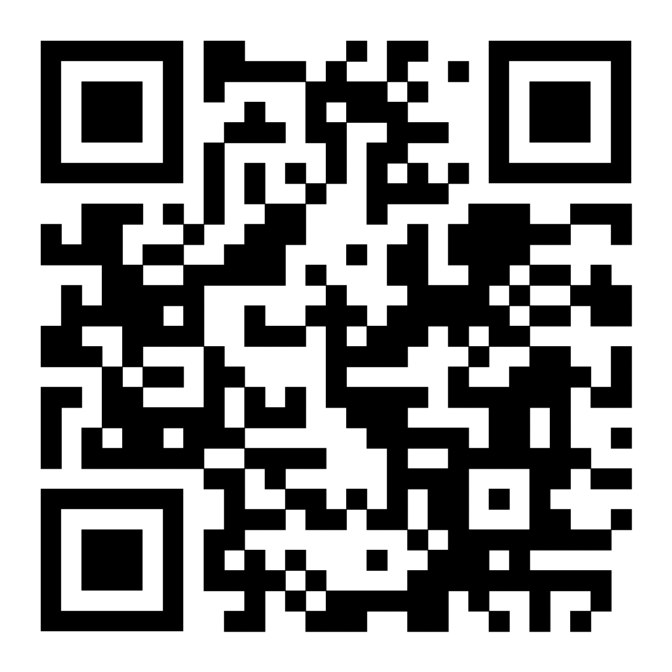
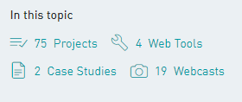
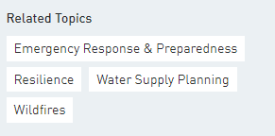
Topic Page: Climate Change

Slide 12
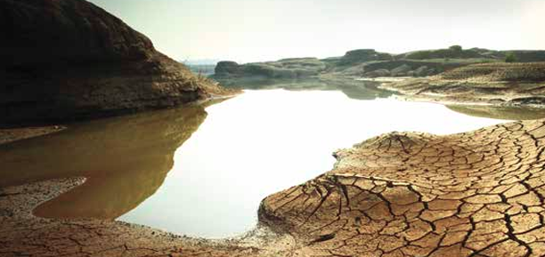
Climate Change Related Projects
Climate Adaptation
  Adaptation plans, severe weather response, infrastructure improvements
Climate Mitigation
  Energy efficiency and process optimization, renewable energy
Climate Risk Assessment
  Vulnerabilities in supplies, operations and infrastructure
Recent webcast available on demand: Multi-faceted Utility Climate Adaptation Strategies and Practices (6/20/23)
  Features four WRF climate adaptation projects that feature utility adaptation strategies and practices, with a focus on flooding, wildfire, drought, and risk mapping
Notes:
New list of projects on website categorized as adaptation, mitigation or risk assessment

Slide 13
Climate Change / Resilience / Water Supply Planning
Completed Projects
An Enhanced Climate-Related Risks and Opportunities Framework and Guidebook for Water Utilities Preparing for a Changing Climate (5056)
Using Climate Information in Water Utility Planning (5054)
Climate-Resilient Planning for Urban Stormwater and Wastewater Utilities: Workshop Proceedings (5001)
Modeling Future Residential Outdoor Water Demand in Aurora, CO (4966)
One Water Cities: Development of Guidance Documents and Assessment Metrics (4969)
Conveyance Asset Prediction System (CAPS): Modeling and Mitigation (4885)
Community-Enabled Lifecycle Analysis of Stormwater Infrastructure Costs (CLASIC) (4798)
Adapting to Change: Utility Systems and Declining Flows (4736)
Mapping Climate Exposure and Climate Information Needs to Water Utility Business Functions (4729)
Long Term Vulnerability Assessment and Adaptation Plan for the San Francisco Public Utilities Commission Water Enterprise - Phase I (4703)
Urban Landscape Water Use Research (4633)
An Integrated Modeling and Decision Framework to Evaluate Adaptation Strategies for Sustainable Drinking Water Utility Management Under Drought and Climate Change (4636)
Drought Management in a Changing Climate: Using Cost-Benefit Analyses to Assist Drinking Water Utilities (4546)
Advanced Techniques for Monitoring Changes in NOM and Controlling DBPs under Dynamic Weather Conditions (4422)
Water/Wastewater Utilities and Extreme Climate and Weather Events: Case Studies on Community Response, Lessons Learned, Adaptation, and Planning Needs for the Future (4416)
Opportunities for Managing Climate Change by Applying Adaptive Management (4380)
Dynamic Reservoir Operations: Managing for Climate Variability and Change (4306)
Changes in Water Use Under Regional Climate Change Scenarios (4263)
Water Utilities and Climate Change: A Research Workshop on Effective System Adaptation (4228)
Effects of Climate Change on Water Utility Planning Criteria and Design Standards (4154)

Slide 14
Climate Change / Resilience / Water Supply Planning
Climate Change / Resilience / Water Supply Planning
Ongoing Projects – Project updates and other deliverables may be available
Water Utility Resilience: A Case Study of the 2021 Marshall Fire (5192)
Incorporating Equity and Social Dimension into Community Climate Adaptation Planning and Watershed Management (5180)
Integrating Climate Change Impacts with Wet Weather Management, Capital Improvement, and Stream Network Enhancement (5176)
Enhancing Drinking Water Treatment Resilience to Wildfire Events (5168)
Holistic Wet Weather Management through Adaptive Volume and Pollutant Source Control at a Community Scale: Finding the Sweet Spot (5131)
Advancing Adaptive Wet Weather Management Approaches to Meet Emerging Challenges for Extreme Snowstorm Events and Cold Climate Impacts (5128)
Post-Wildfire Distribution System Water Quality Impacts & Potential Responses (5106)
Case Studies on Water Sector Interdependencies (5086)
Holistic and Innovative Approaches for Flood Mitigation Planning and Modeling under Extreme Wet Weather Events and Climate Impacts (5084)
Assessing the State of Knowledge and Research Needs for Stormwater Harvesting (4841)
Enhancement of Resilience to Extreme Weather and Climate Events: Proactive Flood Management (4842)

Slide 15
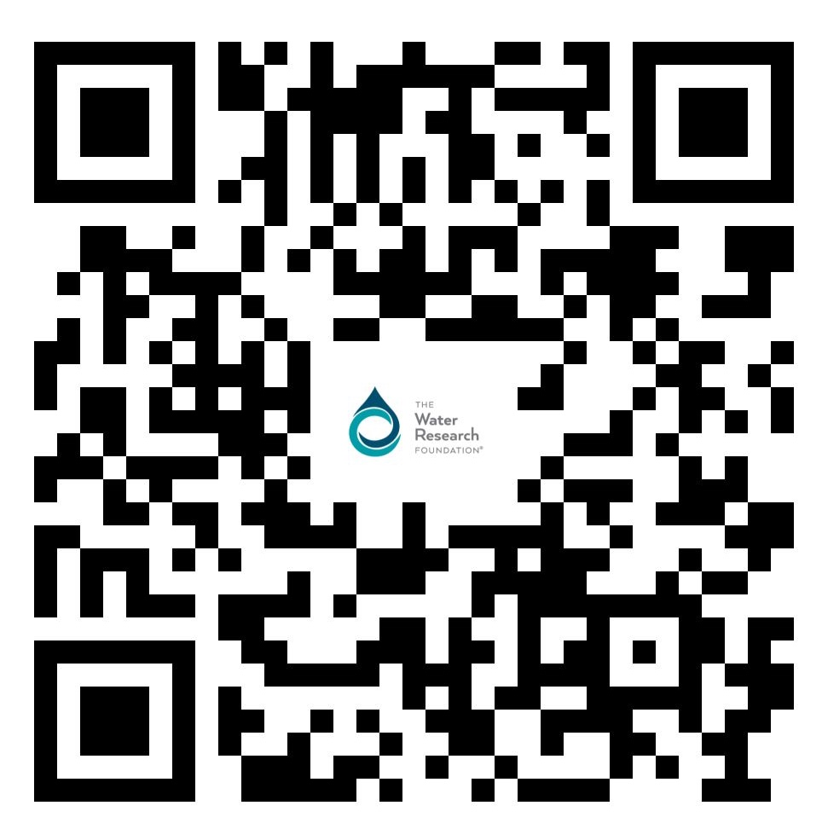
Get Involved in Research
  Project Advisory Committees (PAC)
  Utility Participant in Research (UPIR)
  Research Planning Committees
www.waterrf.org/participate-research

Slide 16
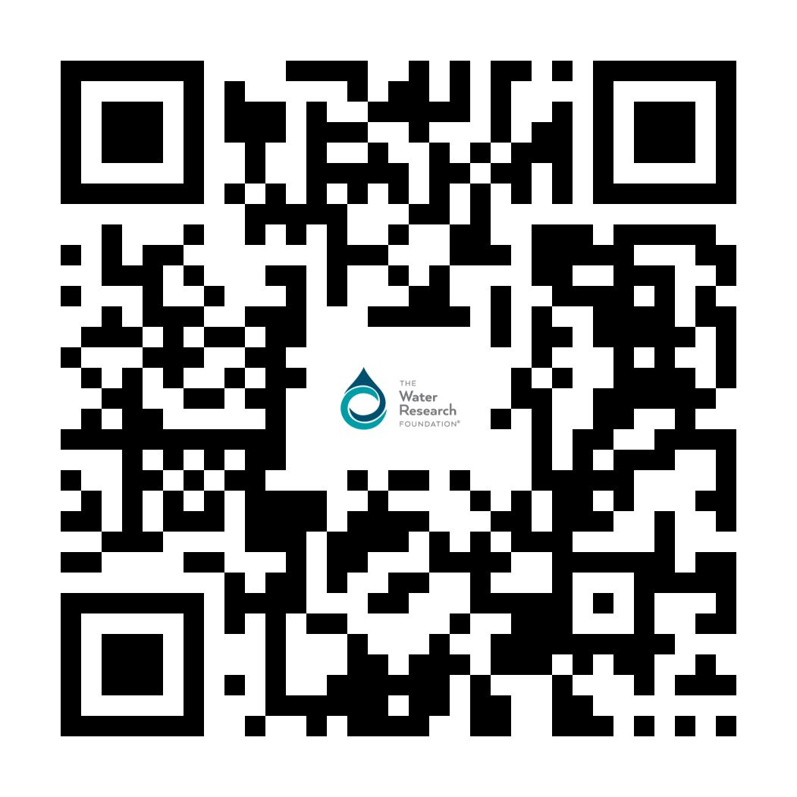
Thanks for listening!
Connect with us. Stay in touch with the latest on Water Research.
Ashwin Dhanasekar
adhanasekar@waterrf.org

