Slide 1
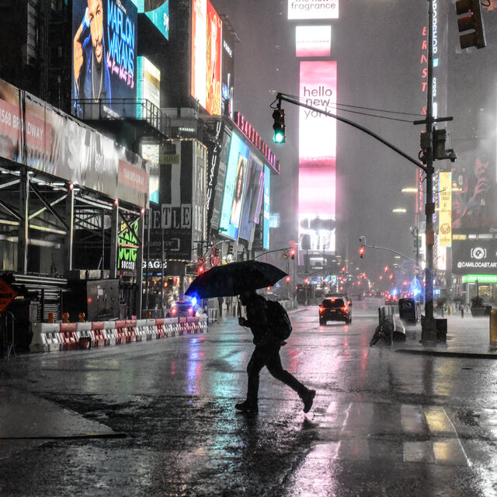




NYC Stormwater Resiliency Study Update & Next Steps
Jennifer Cherrier, PhD
Brooklyn College & Graduate Center
City University of New York
Assoc. Director, Integrated Water Research
Science & Resilience Institute@ Jamaica Bay
February 15, 2024
Water In Water Out-Innovative Water Research Symposium Event

Slide 2




New York City Stormwater Resiliency Study
$1.8 million awarded to Brooklyn College-CUNY (June 2018-Dec. 2019)
funded by NYC DEP and NYC Mayor’s Office via the DDC Town + Gown funding mechanism
multi-institutional collaboration

Slide 3
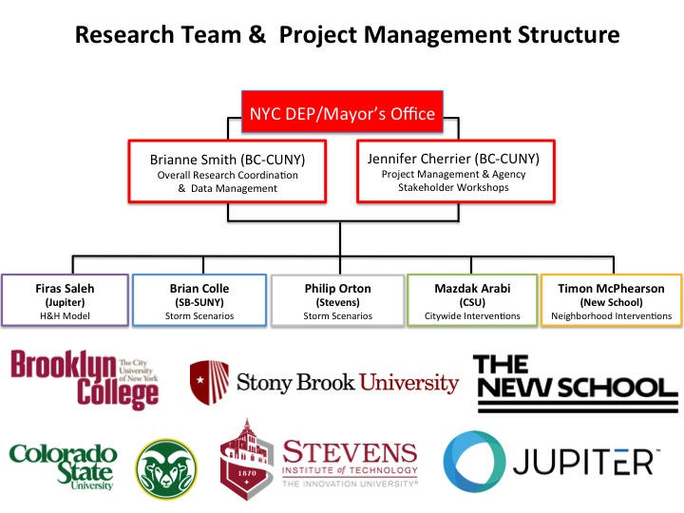





New York City Stormwater Resiliency Study: Teams
Stakeholder Team
Acacemic Team
JJennifer Cherrier
PI: Project Management, Research Coordination
& Agency Stakeholder Workshops
Stormwater Interventions
Neighborhood Vulnerability

Slide 4
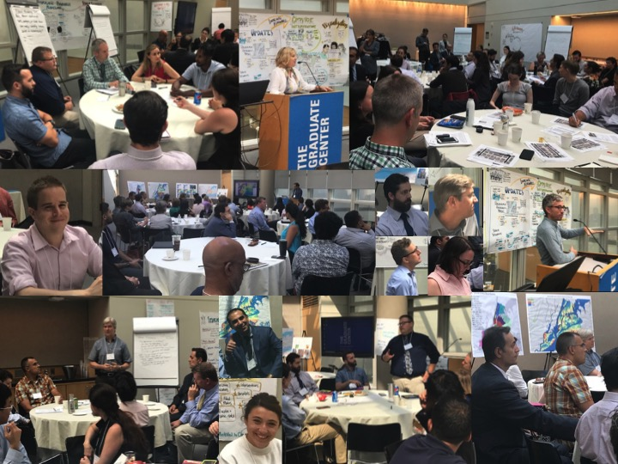
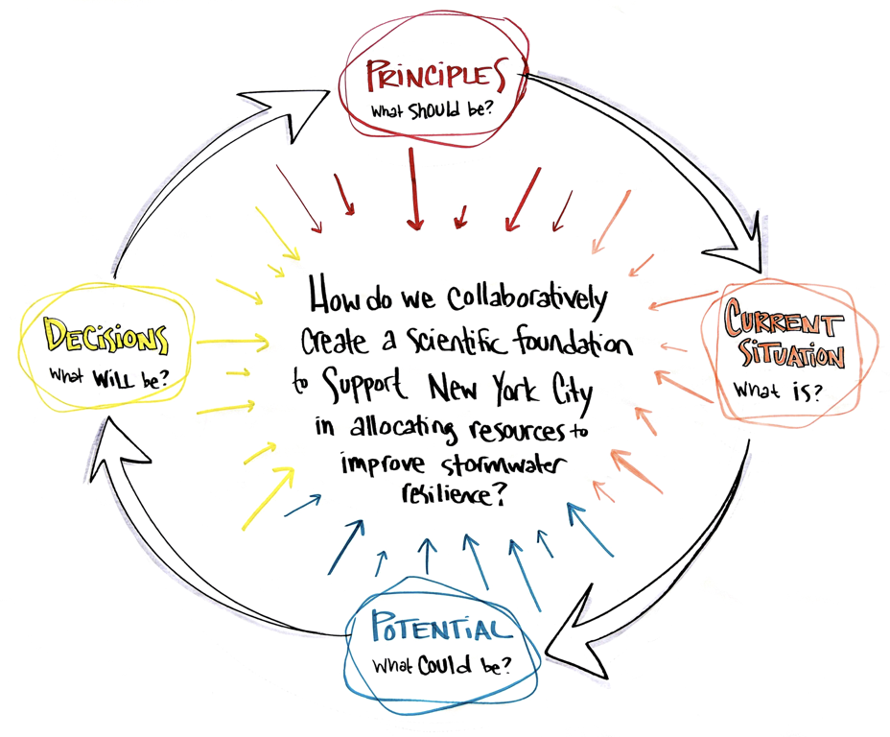
New York City Stormwater Resiliency Study: Goal
Goal: Work collaboratively with agency stakeholders to support City’s long-term vision and capacities for NYC resiliency to flooding from extreme and chronic storms

Slide 5
New York City Stormwater Resiliency Study: Research Objectives
Stakeholder Engagement- build and foster collaborative relationship between universities and city agencies for addressing stormwater resiliency challenges & create actionable science

Slide 6
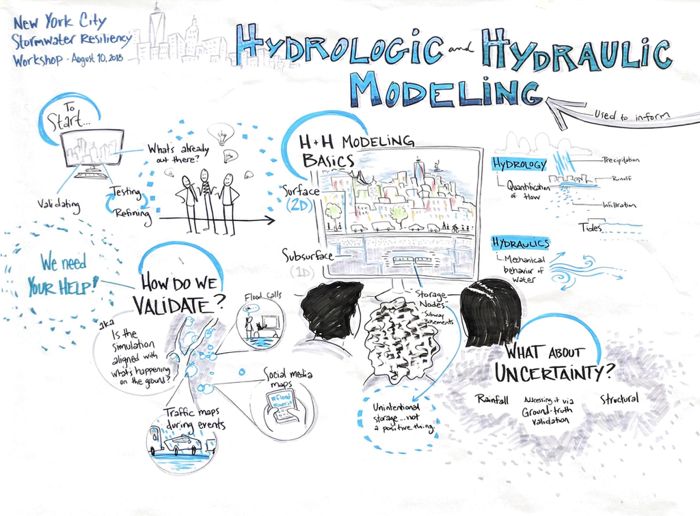
New York City Stormwater Resiliency Study: Research Objectives
Stakeholder Engagement- build and foster collaborative relationship between universities and city agencies for addressing stormwater resiliency challenges & create actionable science
Hydrologic+Hydraulic (H+H) Model- develop and test a comprehensive H&H model for City to identify priority at-risk areas for flooding

Slide 7
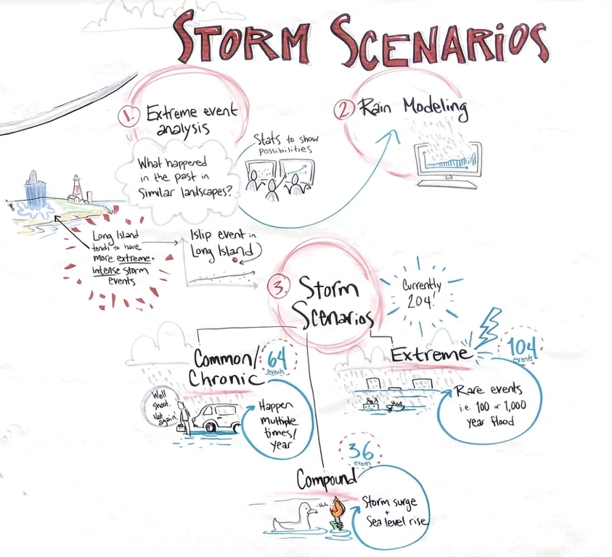
New York City Stormwater Resiliency Study: Research Objectives
Stakeholder Engagement- build and foster collaborative relationship between universities and city agencies for addressing stormwater resiliency challenges & create actionable science
Hydrologic+Hydraulic (H+H) Model- develop and test a comprehensive H&H model for City to identify priority at-risk areas for flooding
Storm Scenarios- identify suite storm scenarios for H+H model runs

Slide 8
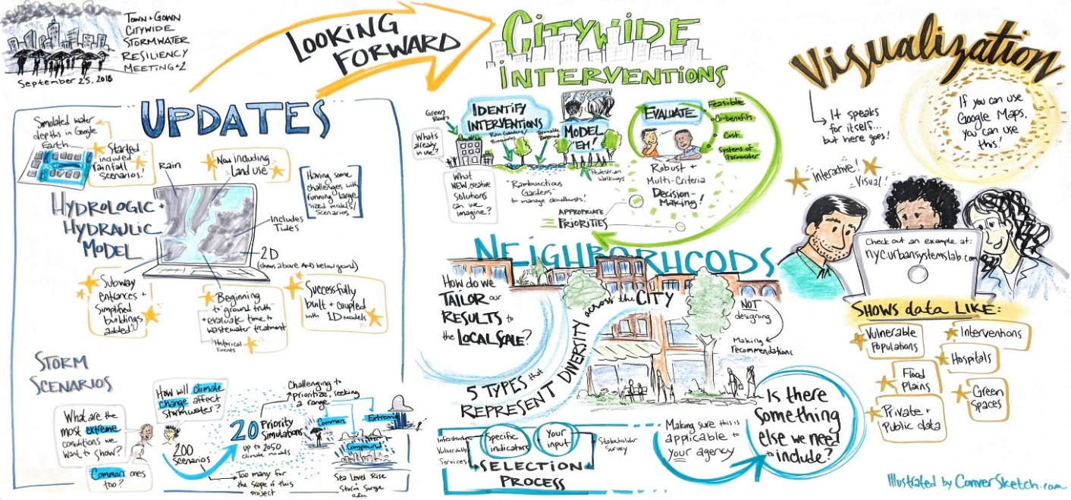
New York City Stormwater Resiliency Study: Research Objectives
Stakeholder Engagement- build and foster collaborative relationship between universities and city agencies for addressing stormwater resiliency challenges & create actionable science
Hydrologic+Hydraulic (H+H) Model- develop and test a comprehensive H&H model for City to identify priority at-risk areas for flooding
Storm Scenarios- identify suite storm scenarios for H+H model runs
Neighborhood Vulnerability Assessment- assess impacts of flooding at neighborhood scale via a list of specific indicators organized along unique dimensions relevant to flood vulnerability

Slide 9
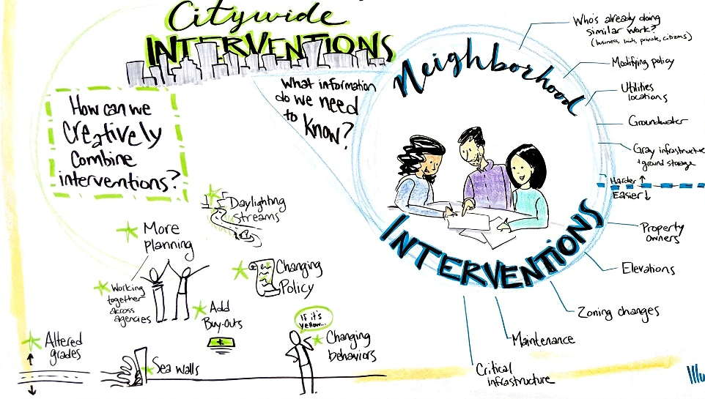
New York City Stormwater Resiliency Study: Research Objectives
Stakeholder Engagement- build and foster collaborative relationship between universities and city agencies for addressing stormwater resiliency challenges & create actionable science
Hydrologic+Hydraulic (H+H) Model- develop and test a comprehensive H&H model for City to identify priority at-risk areas for flooding
Storm Scenarios- identify suite storm scenarios for H+H model runs
Neighborhood Vulnerability Assessment- assess impacts of flooding at neighborhood scale via a list of specific indicators organized along unique dimensions relevant to flood vulnerability
Intervention Models- identify interventions for offsetting flood-related risks at both the citywide and neighborhood scales

Slide 10
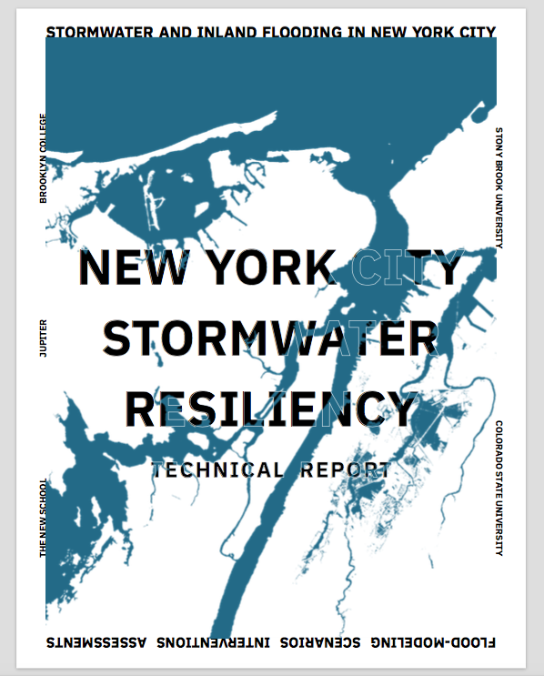
Study Outputs: 750-page Technical Report
3-D H&H models and citywide maps detailing NYC flood risks from current & future storm scenarios
community vulnerability assessments
modeled citywide and neighborhood scale grey/green/hybrid intervention scenarios for offsetting risks and vulnerabilities

Slide 11
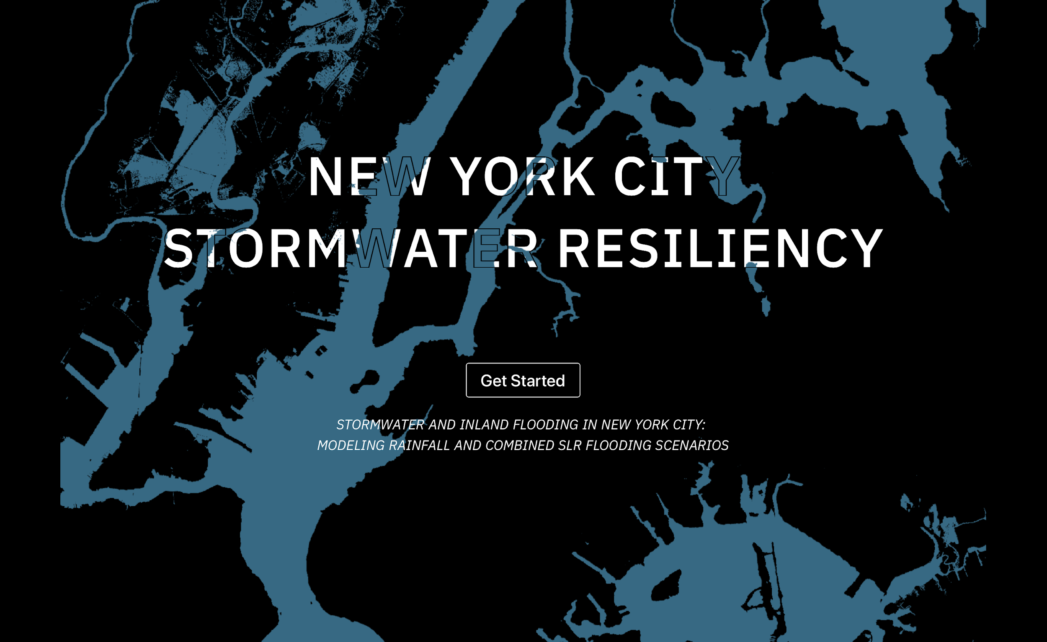
Study Outputs: 750-page Technical Report
3-D H&H models and citywide maps detailing NYC flood risks from current & future storm scenarios
community vulnerability assessments
modeled citywide and neighborhood scale grey/green/hybrid intervention scenarios for offsetting risks and vulnerabilities
(data viz: http://stormwater.nyc/ )

Slide 12
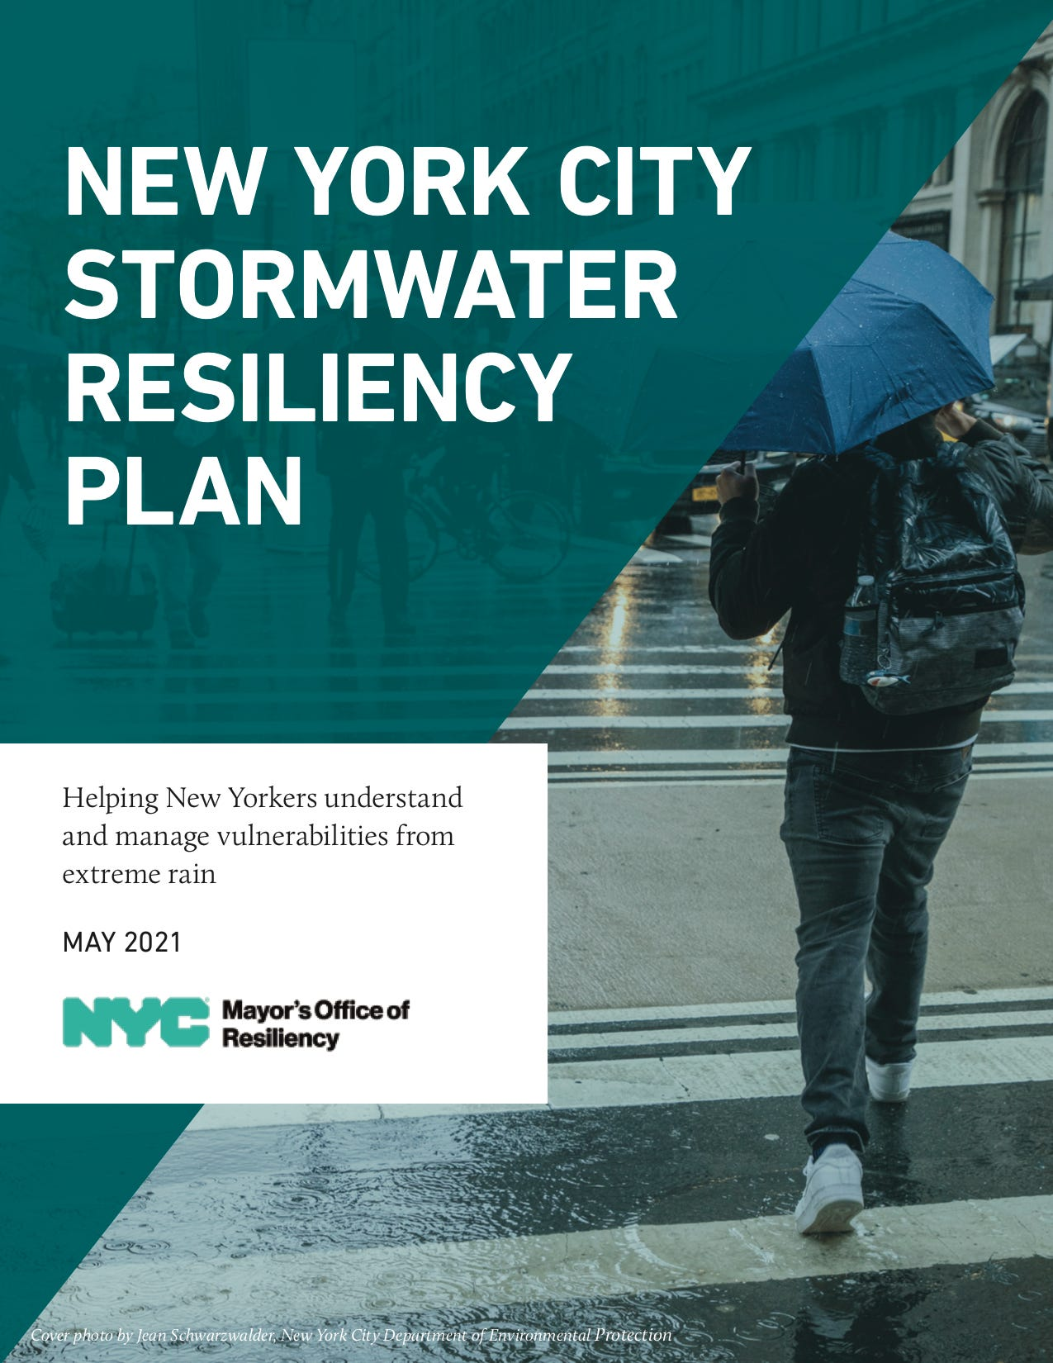
Study Outputs- Actionable Science: informed NYC Resiliency Plan
published May 2021
published Sept. 2021
*NYC Resiliency Study Outputs:
Flood Map Development- Phase 1

Slide 13
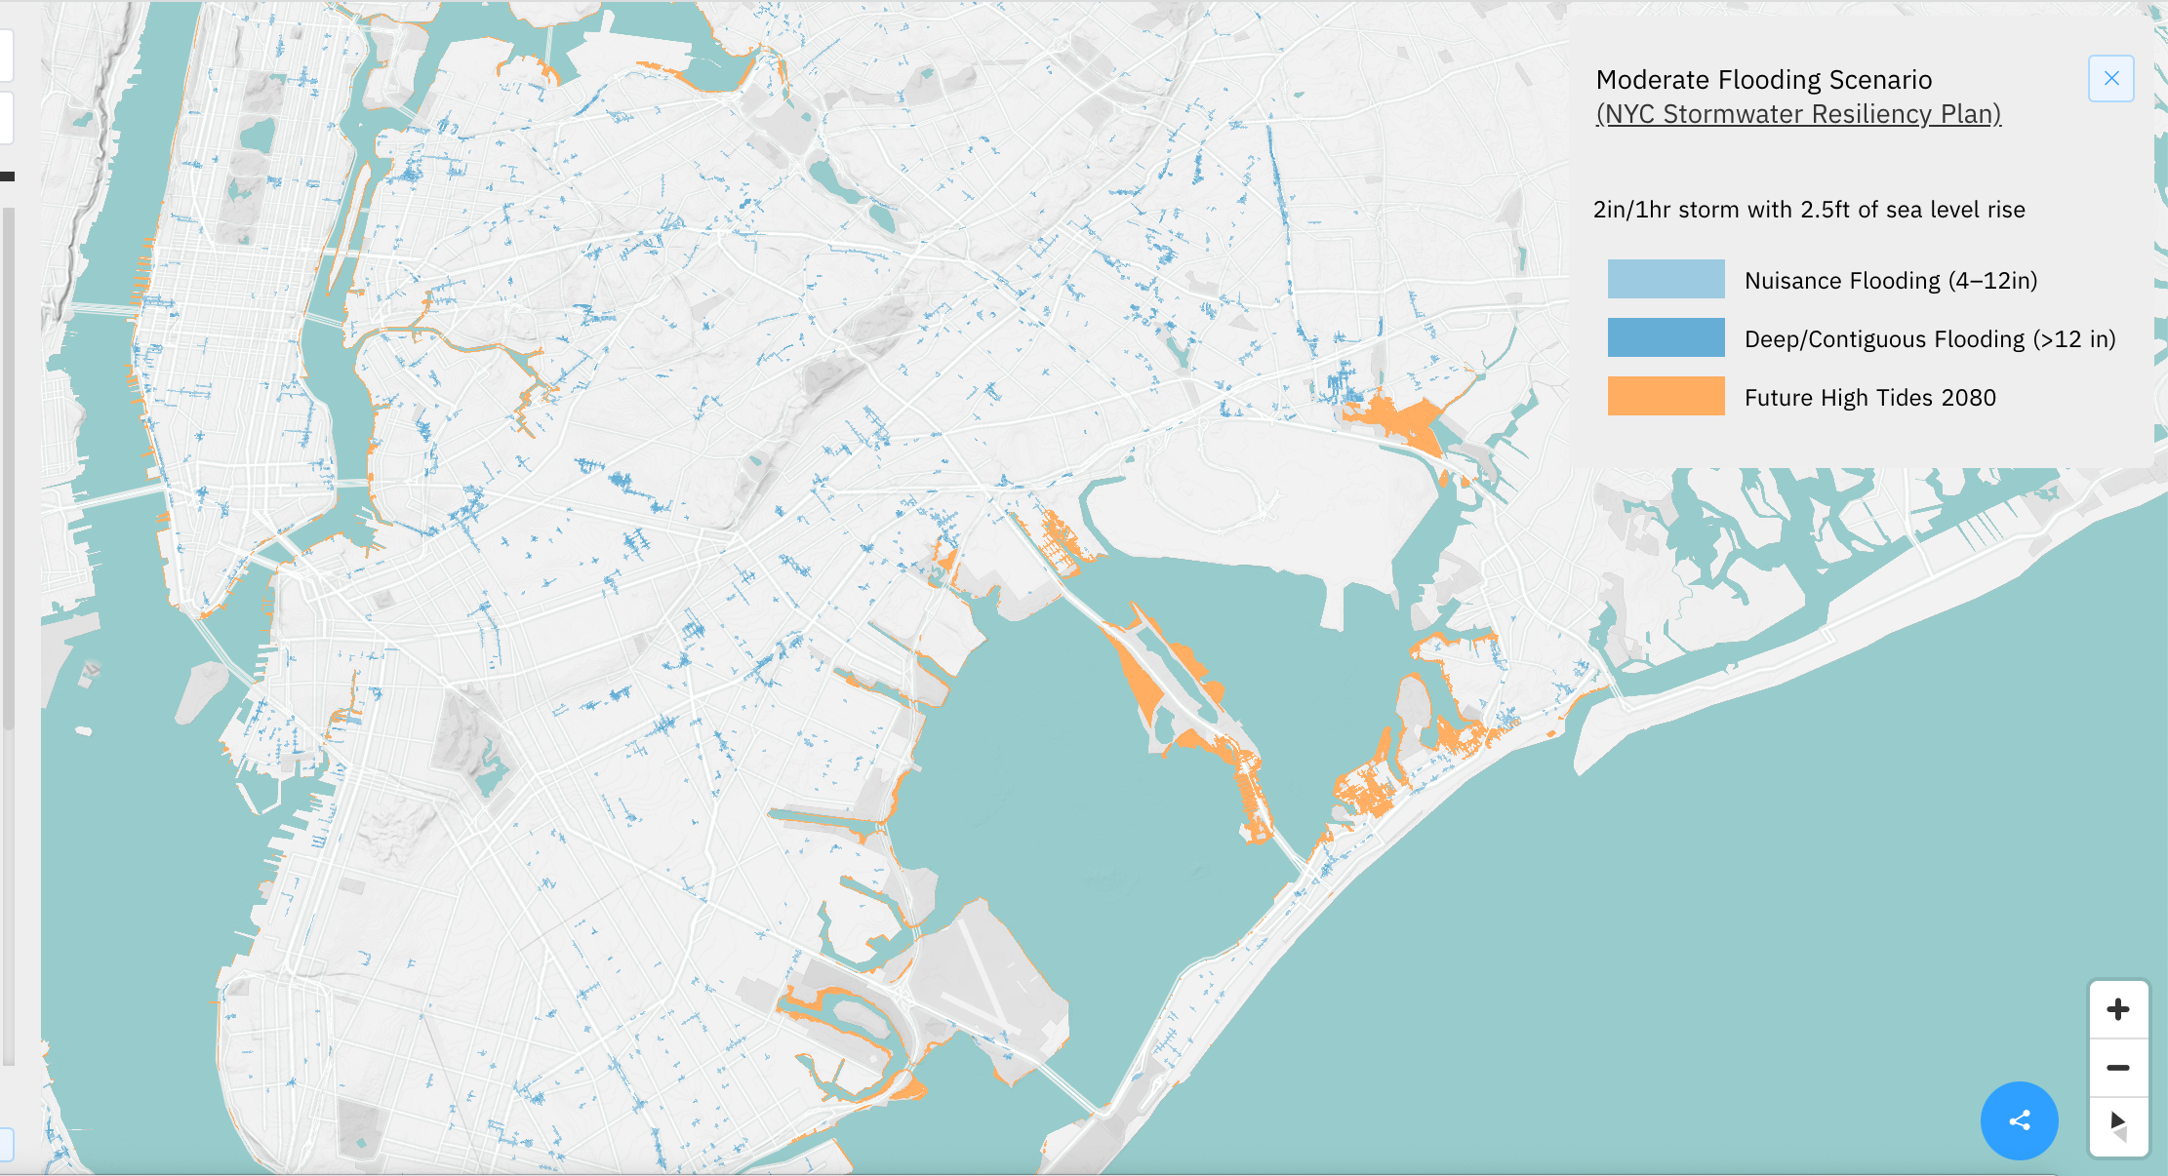
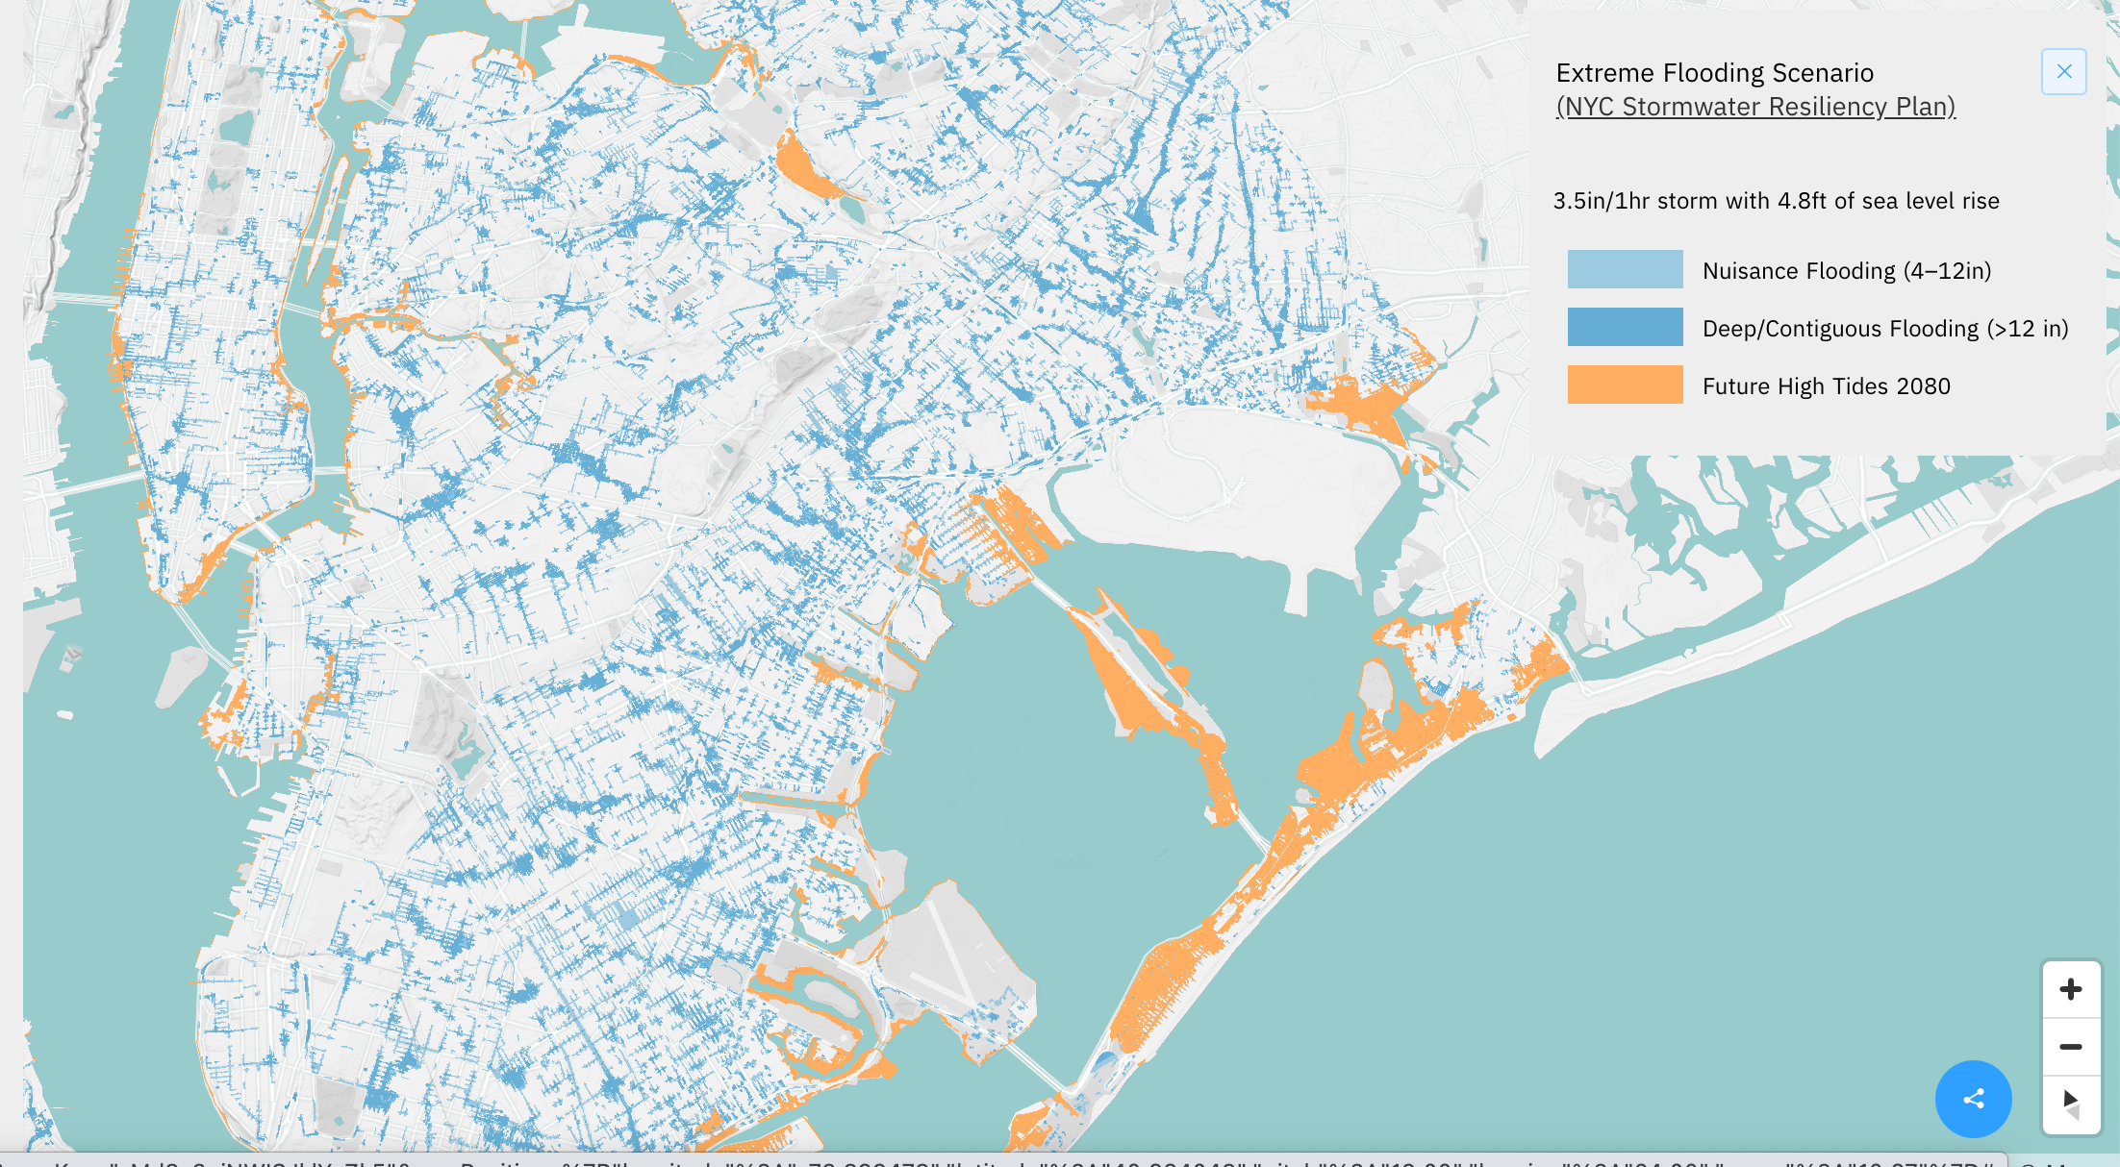
Study Outputs- Actionable Science: informed NYC Resiliency Plan
Moderate Flooding Scenario: 2 in rain in 1hr, w/ 2.5 ft SLR
published May 2021
published Sept. 2021
*NYC Resiliency Study Outputs:
Flood Map Development- Phase 1
Extreme Flooding Scenario: 3.5 in rain in 1hr, w/ 4.8 ft SLR

Slide 14
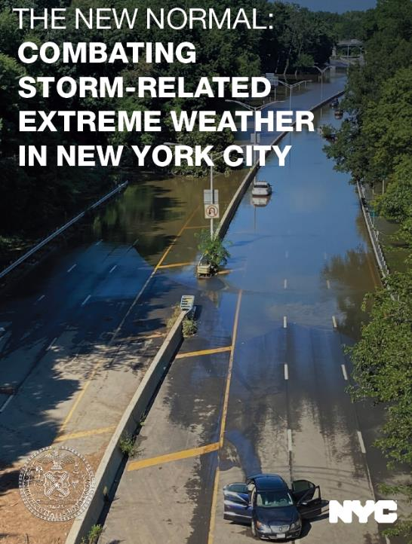
Study Outputs- Actionable Science: informed ‘The New Normal’ Report
published May 2021
published Sept. 2021
*NYC Resiliency Study Outputs:
Intervention Modeling (grey, green & cloudburst solutions)

Slide 15
Study Outputs- Actionable Science: informed ‘The New Normal’ Report
Moderate Flooding Scenario: 2 in rain in 1hr, w/ 2.5 ft SLR
published May 2021
published Sept. 2021
*NYC Resiliency Study Outputs:
Intervention Modeling (grey, green & cloudburst solutions)
Extreme Flooding Scenario: 3.5 in rain in 1hr, w/ 4.8 ft SLR

Slide 16

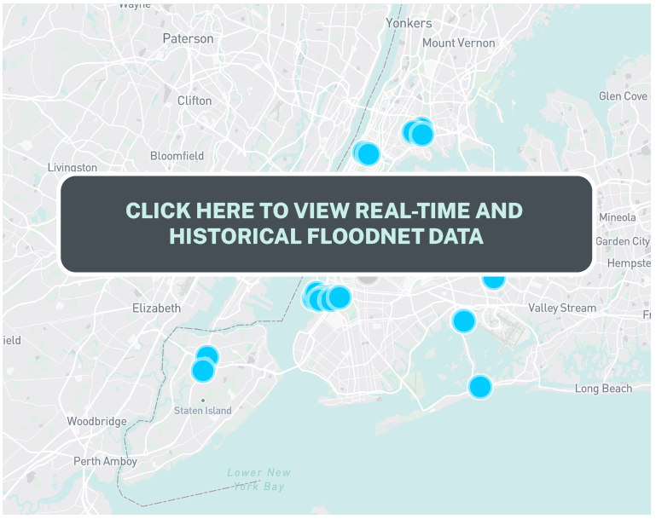
Study Outputs- Actionable Science: informed Floodnet sensor placement
Moderate Flooding Scenario: 2 in rain in 1hr, w/ 2.5 ft SLR
published May 2021
published Sept. 2021
Extreme Flooding Scenario: 3.5 in rain in 1hr, w/ 4.8 ft SLR

Slide 17
New York City Stormwater Resiliency Study: Next Steps
Stakeholder Engagement- build and foster collaborative relationship between universities and city agencies for addressing stormwater resiliency challenges & create actionable science *continued
Hydrologic+Hydraulic (H+H) Model- develop and test a comprehensive H&H model for City to identify priority at-risk areas for flooding
Storm Scenarios- identify suite storm scenarios for H+H model runs
Neighborhood Vulnerability Assessment- assess impacts of flooding at neighborhood scale via a list of specific indicators organized along unique dimensions relevant to flood vulnerability
Intervention Models- identify interventions for offsetting flood-related risks at both the citywide and neighborhood scales

Slide 18
How academic partners provide sustained support for New York City stormwater/climate resiliency efforts?
A Cross Sectoral Partnership Model for
Sister City Knowledge Exchange &
Project Level Research Support

Slide 19
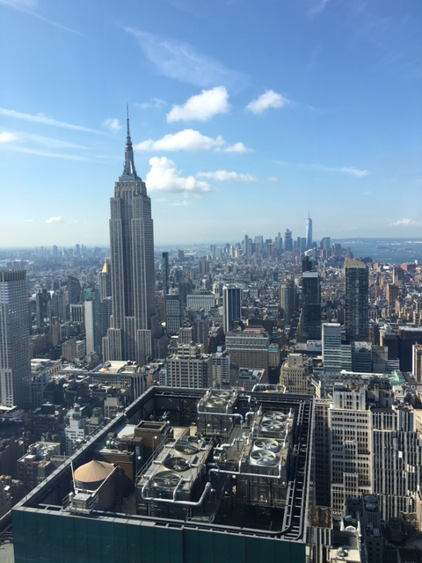

Stormwater & Climate Resiliency: NYC-CPH Sister City Collaboration
Memorandum of Collaboration between city municipalities
Since 2015
Knowledge Exchange
adaptation approaches
NYC Dept. of Env. Protection
Copenhagen Municipality

Slide 20
Stormwater & Climate Resiliency: NYC-CPH Sister City Collaboration
UPDATES: New Memorandum of Collaboration between city municipalities
signed in summer ‘22 but this time with a formal inclusion of academic partners
Knowledge Exchange
adaptation approaches
NYC Dept. of Env. Protection
Copenhagen Municipality

Slide 21
Stormwater & Climate Resiliency: NYC-CPH Sister City Collaboration
Knowledge Exchange
adaptation approaches
Challenge: how to a) enhance and b) make it cross sectoral??

Slide 22
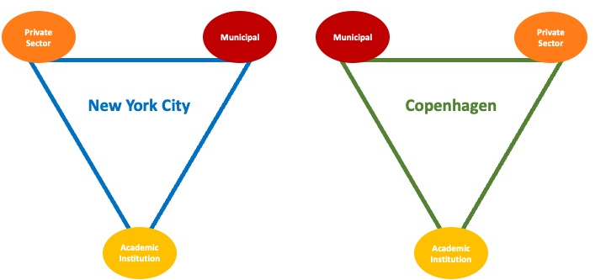
Stormwater & Climate Resiliency: NYC-CPH Sister City Collaboration
Knowledge Exchange
adaptation approaches
Challenge: how to a) enhance and b) make it cross sectoral??

Slide 23
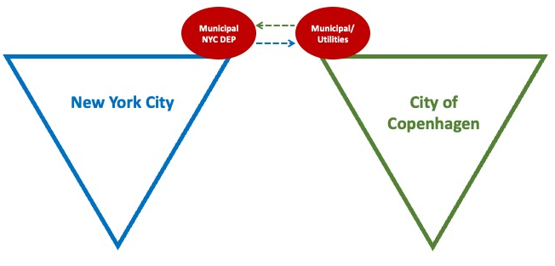
Stormwater & Climate Resiliency: NYC-CPH Sister City Collaboration
Knowledge Exchange
adaptation approaches

Slide 24
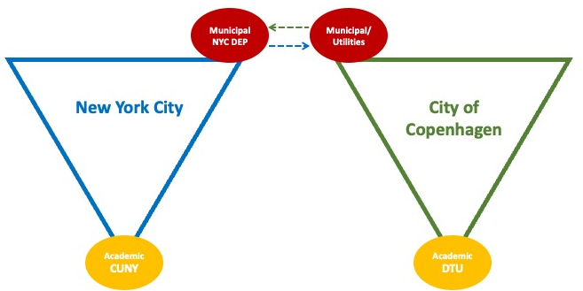
Stormwater & Climate Resiliency: NYC-CPH Sister City Collaboration
Knowledge Exchange
adaptation approaches

Slide 25
Stormwater & Climate Resiliency: NYC-CPH Sister City Collaboration
Knowledge Exchange
adaptation approaches

Slide 26
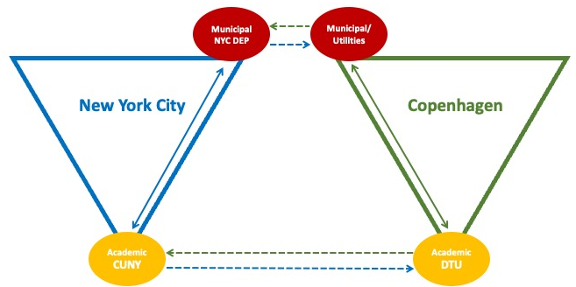
Stormwater & Climate Resiliency: NYC-CPH Sister City Collaboration
Knowledge Exchange
adaptation approaches
academic teams developing MOU agreements for funding between
their institutions & with their respective municipal/utility partners

Slide 27
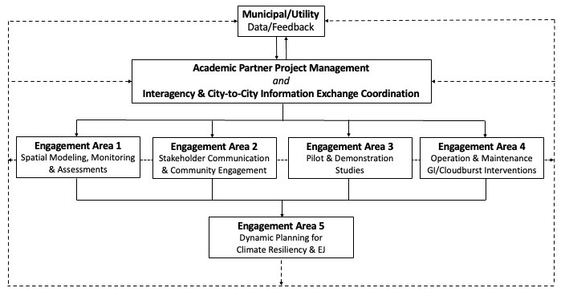
Sister City Municipality-Academic Partnership Engagement &
Project Level Research Support Workflow

Slide 28
Stormwater & Climate Resiliency: NYC-CPH Sister City Collaboration
NYC DEP- BC CUNY MOU
initiated 10/22 & almost finalized
CPH-DTU MOU discussions initiated summer 2023; using DEP –CUNY MOU as model
Knowledge Exchange
adaptation approaches

Slide 29
Stormwater & Climate Resiliency: NYC-CPH Sister City Collaboration
Sept. 2023: NYC-CHP Sister City Delegate Workshop
Knowledge Exchange
adaptation approaches

Slide 30
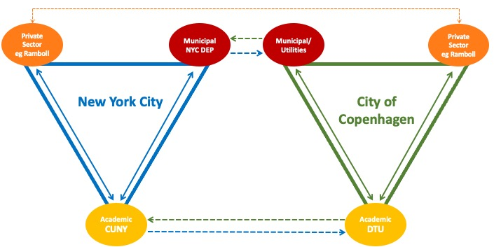
Stormwater & Climate Resiliency: NYC-CPH Sister City Collaboration
Knowledge Exchange
adaptation approaches
academic teams also establishing formal, long-term collaborations with private sector partners in
their respective cities to further support of sister city effort (eg. cross sectoral collaborations)

Slide 31
2022 MOC Stormwater & Climate Resiliency: NYC-CPH Sister City Collaboration
Ramboll- BC CUNY MOU
initiated 10/23 & almost finalized
Knowledge Exchange
adaptation approaches
academic teams also establishing formal, long-term collaborations with private sector partners in
their respective cities to further support of sister city effort (eg. cross sectoral collaborations)

Slide 32
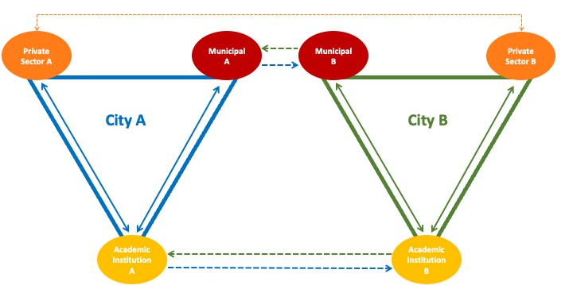
Model transferable for working with other Sister Cities

Slide 33
THANK YOU!
Jennifer Cherrier
jennifer.cherrier18@Brooklyn.cuny.edu

