Slide 1
Where Circular
Economy Can
Happen in NYC
Town + Gown:NYC | NYC DDC
Spring 2026
IBZs and M1-M3 NAICS Mapping
Seth Gordon

Slide 2
Town + Gown:NYC | NYC DDC
What is happening in our IBZs?
Spring 2026
What sectors are operating in the IBZs?
Who are the business owners operating there?
Is there spatial patterns that might shape future C&D policy?
What type of policy “carrots” can we use to encourage circular economy policy and practices?

Slide 3
Town + Gown:NYC | NYC DDC
Project roadmap
Goal
Step 1
Step 2
Step 3
Step 4
Spring 2026
Collect current operating business data
Map current businesses operating within IBZs
Conduct spatial and categorical analysis
Use findings to evaluate potential policy recommendations
Draft concrete policy recommendations for circular economy practices within IBZs

Slide 4
Town + Gown:NYC | NYC DDC
Data Sources for Mapping
Challenges:
NAICS registration list, from ReferenceUSA Historical Business Data
NAICS list is incomplete
Even with alternative data sources, patchwork data is still not the full picture
Crosswalking data is messy
Private proprietary knowledge (EDC, SBS, & IBZ trade groups)
Acts as a snapshot, not a live document
1
2
MWBE Directory in NYC, from NYC Open Data
Recent Contracted Businesses in NYC, from NYC Open Data
3
Spring 2026

Slide 5


Town + Gown:NYC | NYC DDC
Spring 2026

Slide 6
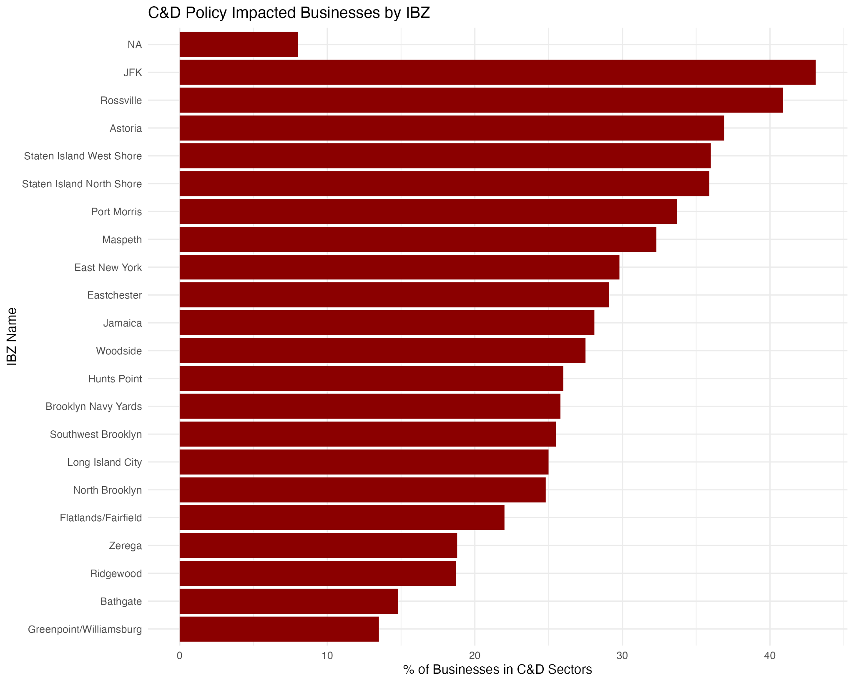
Town + Gown:NYC | NYC DDC
Spatial and Categorical Analysis
Spring 2026
What industries will be most affected by circular economy policies?
Manufacturing
Construction
Transportation
Mining, Quarrying, and Oil and Gas Extraction
Where are these industries located in IBZs?

Slide 7
Town + Gown:NYC | NYC DDC
Policy Proposal:
FAR Bonuses
Spring 2026
POPS + City of Yes Framework
Could something similar work in the IBZs?
Demand + Regulatory Body Needed
Benefits from one time policy adherence rather than continual compliance

Slide 8
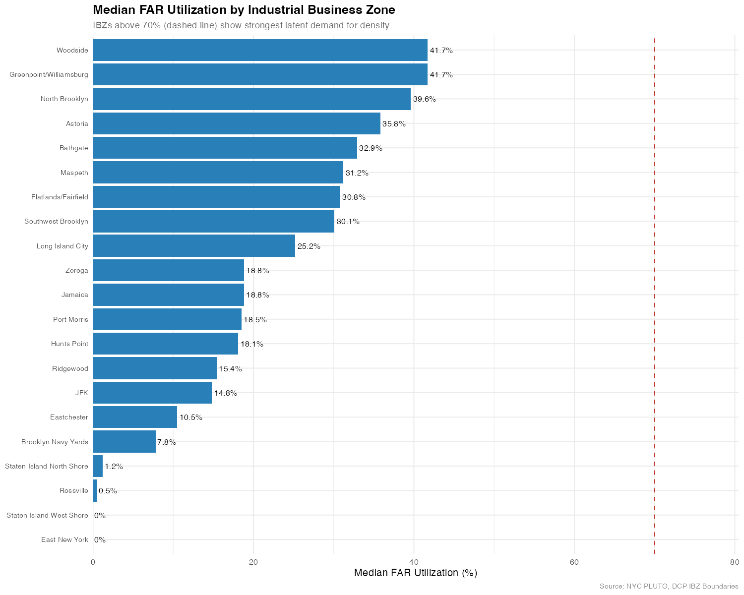
Town + Gown:NYC | NYC DDC
Demand tells a different story
Spring 2026

Slide 9
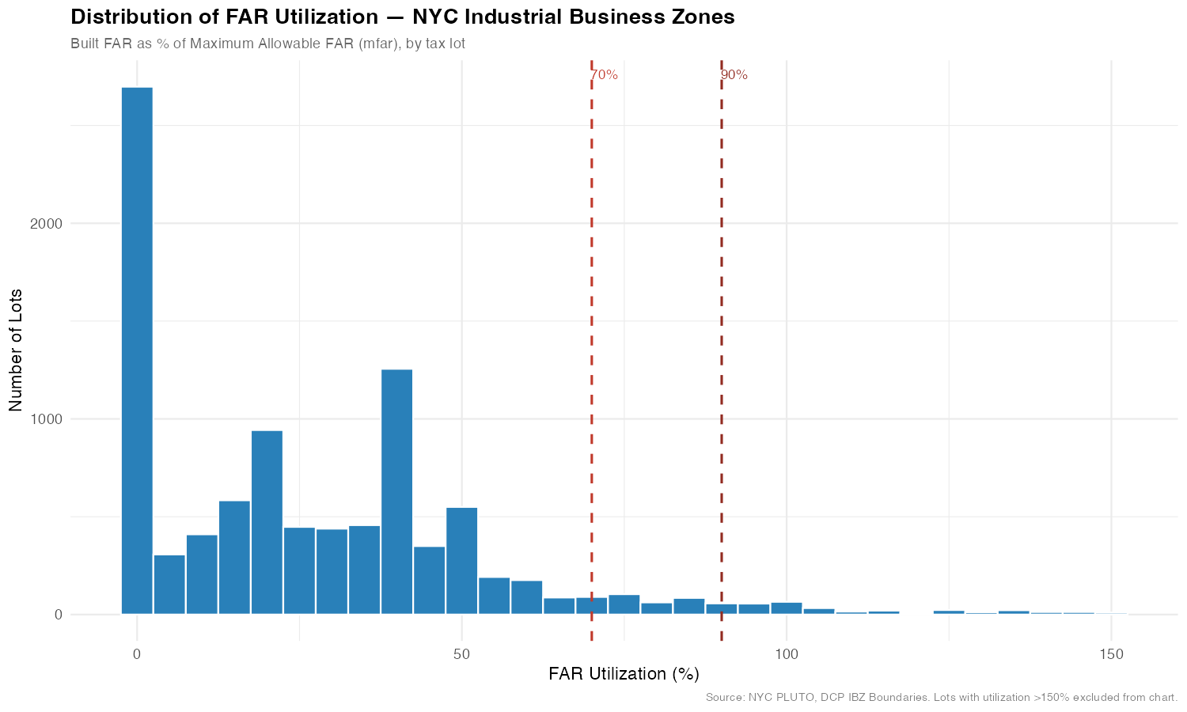
Town + Gown:NYC | NYC DDC
Minor Opportunity for FAR bonuses
Spring 2026

Slide 10
Town + Gown:NYC | NYC DDC
Alternative Policy Solutions
FAR + ELURP + LL97 funding
Industrial Development Bonds
Carbon Tax Credits
Spring 2026
Combining FAR bonuses with ELURP eligibility and LL97 funding for M1-M3 projects within IBZs that leverage adaptive re-use and/or recycled materials
NYC IDA can issue taraged IDBs to encourage development to lighten the fiscal burden of circular economy policies
Create embodied carbon taxes or credits that integrate construction waste into the State's Cap-and-Invest program

Slide 11
Town + Gown:NYC | NYC DDC
Thank you!
Spring 2026
Get in touch!
sethwhitegordon@gmail.com
https://www.linkedin.com/in/seth-gordon-nyc/
https://github.com/sgordon2000-cyber/tg-nyc-IBZ-mapping

