Slide 1


Enhancing New York City Utilidors Design Using Artificial Intelligence Tools
Alec Tristani, Chloé Arson
Based on the work of 17 motivated undergraduate and graduate students:
Royce Andrews, Junwon Hur, Yiksan Yu, Qinghe Xu, Tanvi Saxena, Ivy Quan, Matthew Zhang, Karen Chen, Andy Chen, Annelise Gross, Caroline Schell, Fatima Bah, Ian Grenda, Rachel Kan, Jessie Chen, Caitlyn Chen and Emi Matsumoto.
June 9th 2026

Slide 2
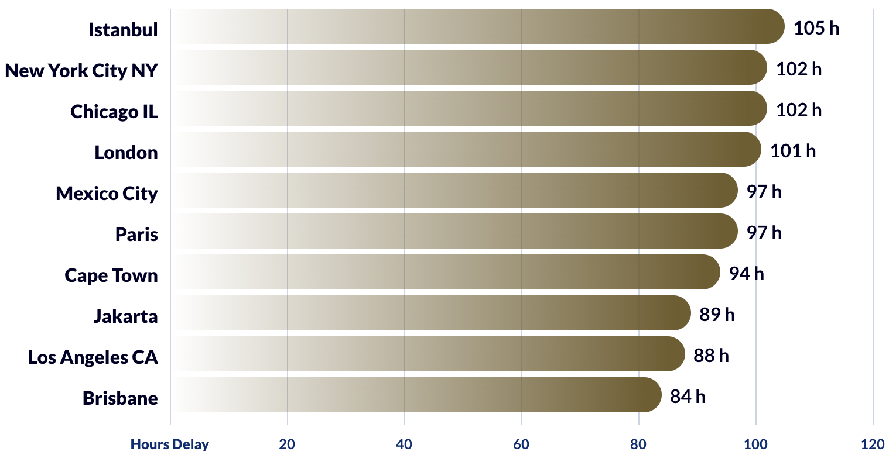
New York City traffic statistics
Highest traffic delay times by city – Worldwide (2024)

Slide 3
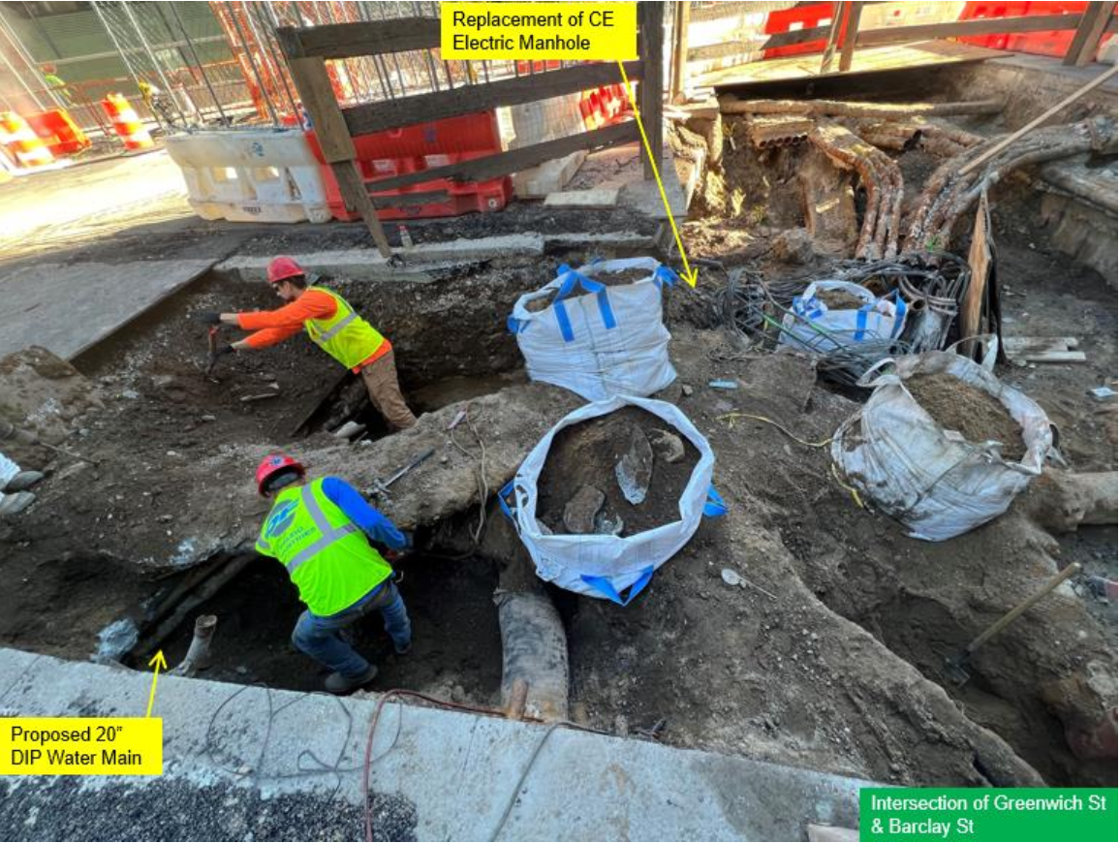
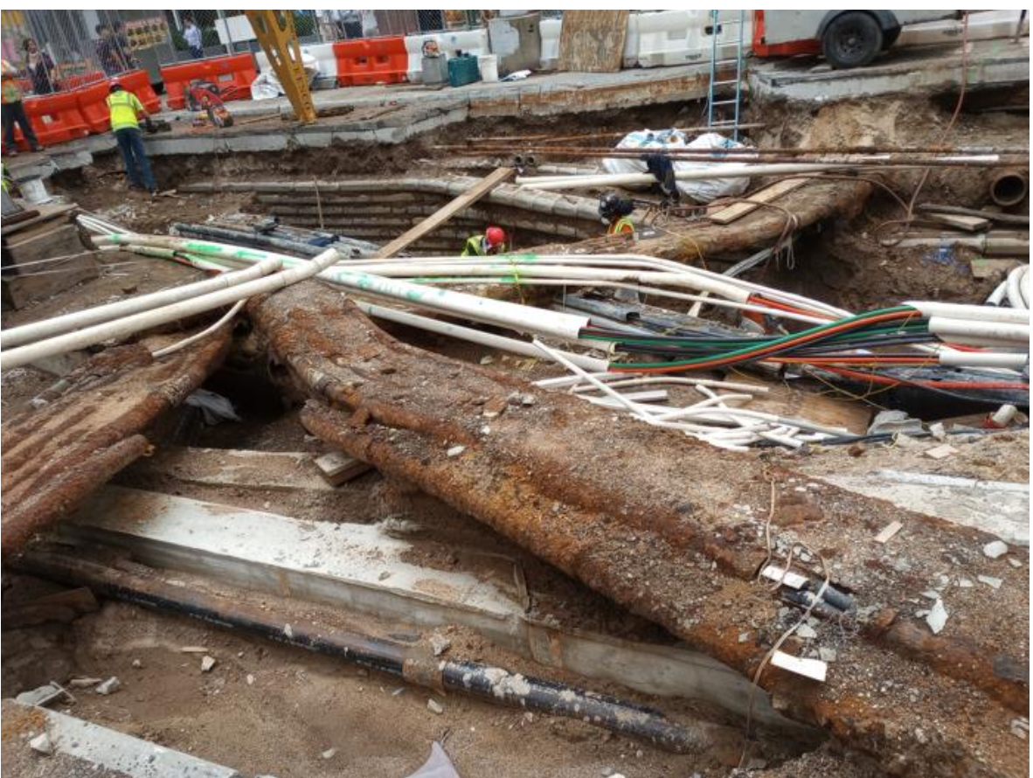
Why utilidors?
Benefits of utilidors:
Eﬀective use of ground level surface;
Long-term management, accessibility and productivity;
Less prone to wear and tear;
Long-term outlook outweighs the short-term costs.
Hand Excavation to expose the Interfering Telecom and Electrical Utilities Overlying the New Water Main Alignment
Exposed Telecom and Electrical Utilities with the start of Casing Removal

Slide 4
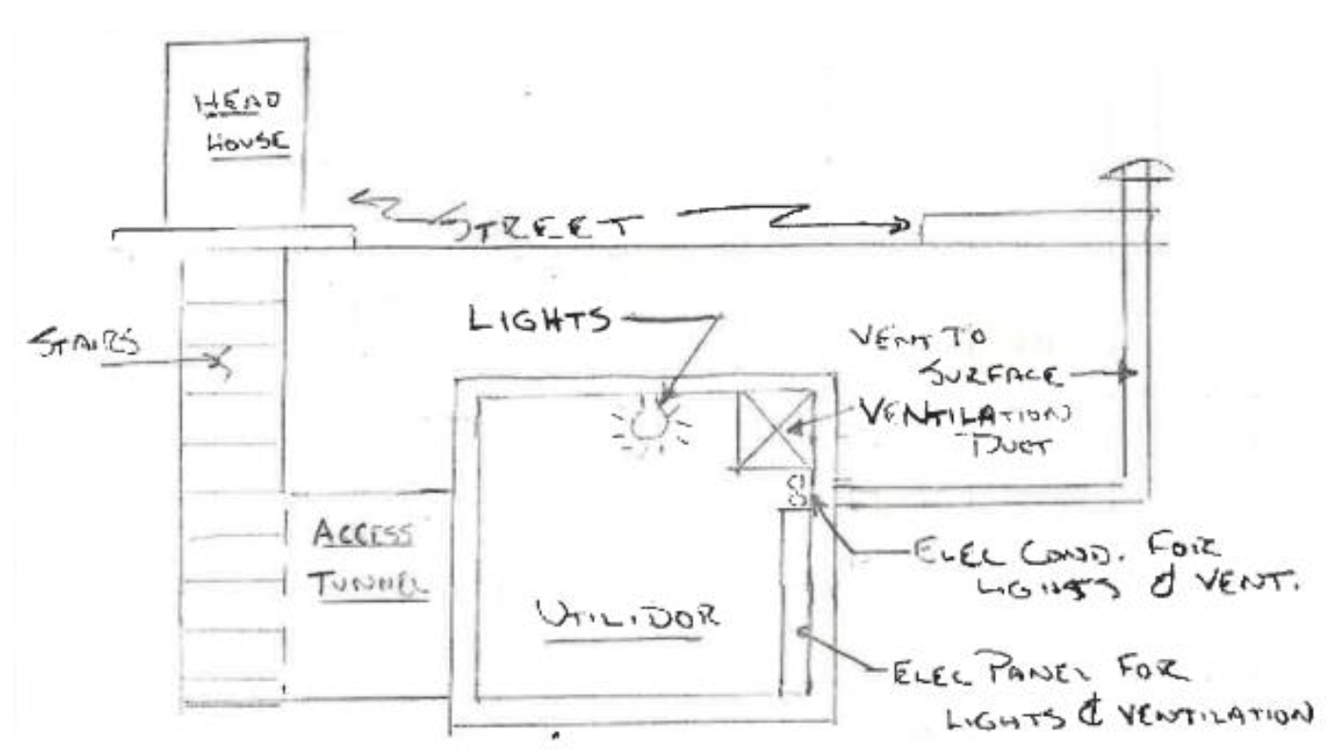
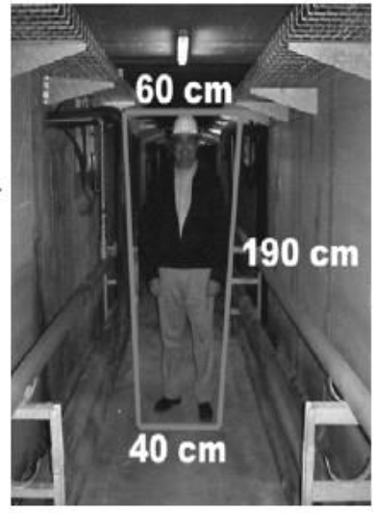
What are utilidors?
Conventional Access to a Utilidor
Inside utilidors
→ Electricity, gas, water & telecoms

Slide 5
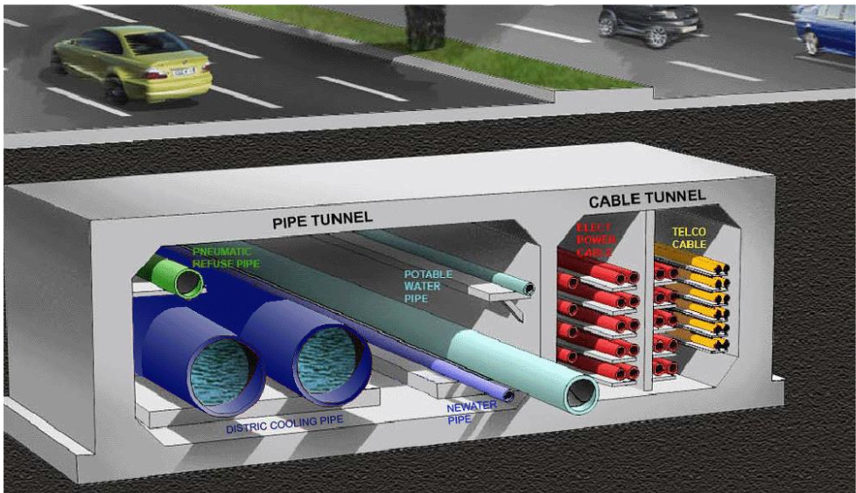
Plan of the presentation
I/ Practical design
Utilidors around the world
New York City’s geology
Connections with existing buildings and inside compartmentalization
II/ Numerical study
2D numerical model
Cross-section shapes & dimensional requirements
Provide design recommendations for the construction of utilidors across the city
III/ Machine learning surrogate model
Utilidor compartmentalization for access and security – Cross Section of Marina Bay Utility Tunnel
Artificial neural networks
Dataset generation
Online application

Slide 6
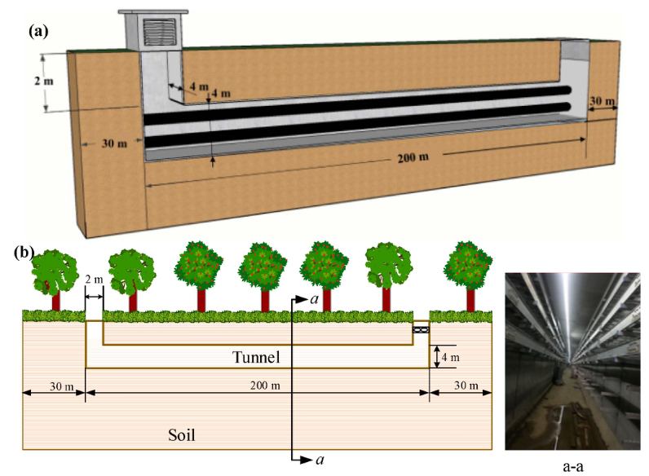
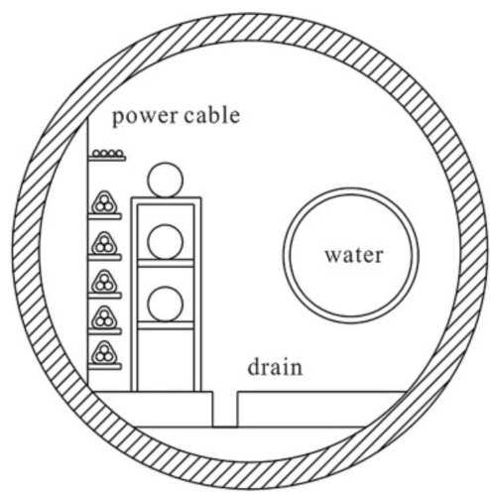
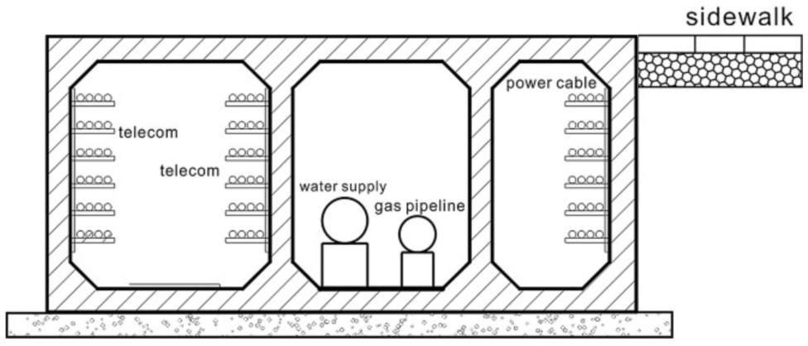
Utilidors in the world
Objective: Conduct a literature review to examine current worldwide practices in utilidor design.
Helsinki, Finland:
200 km of technical/maintenance, of which 60km dedicated to heating, cooling and electricity.
Located 20 m to 120 m below ground level
Beijing, Shanghai, China (Multi-Utility-Tunnels):
Shallow depth (3 m), large dimensions (> 6 m)
Rectangular and Circular cross sections
Currently existing utilidors in China with square and circular cross-sectional shapes.

Slide 7
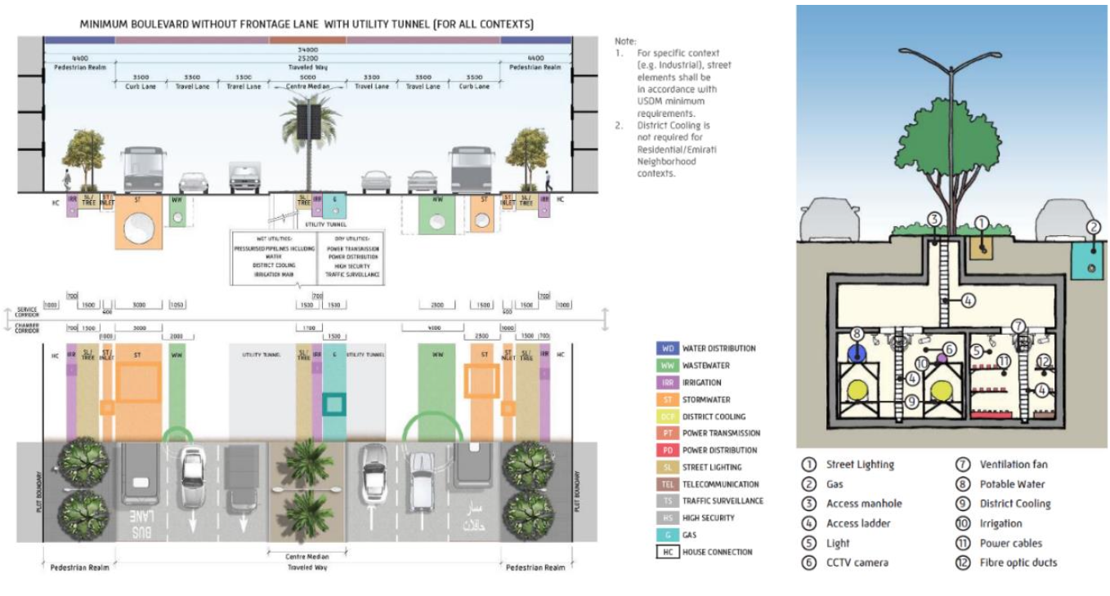
Example: Abu Dhabi

Slide 8
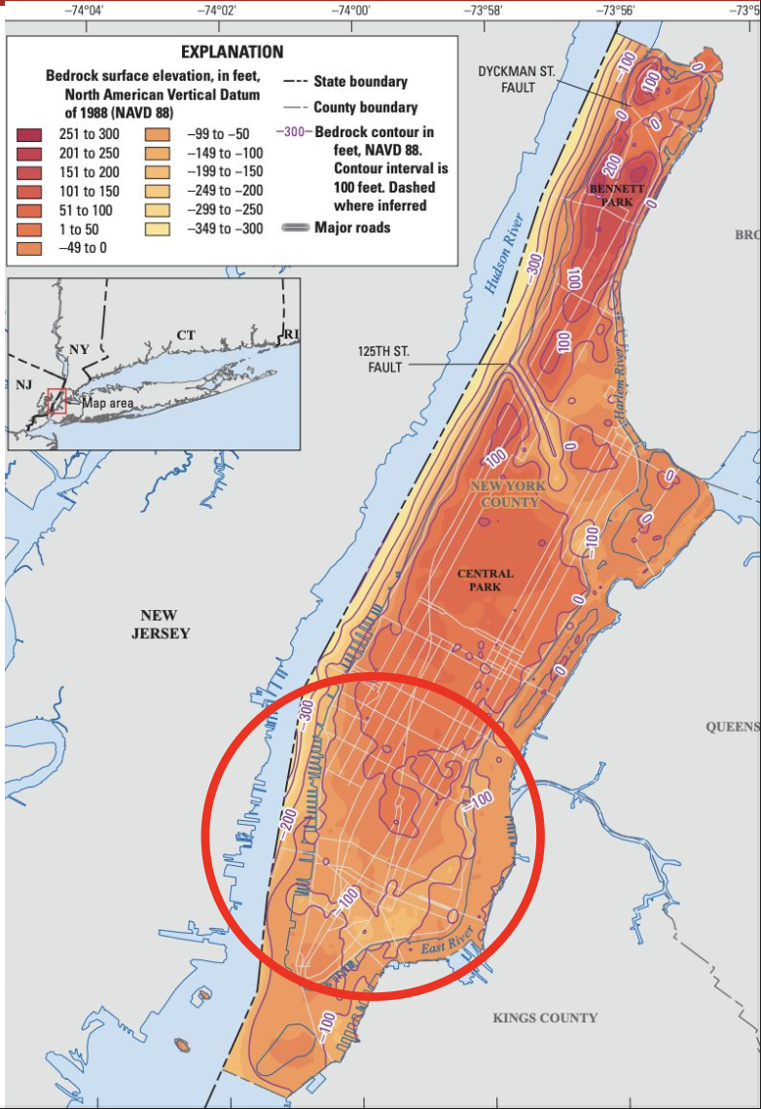
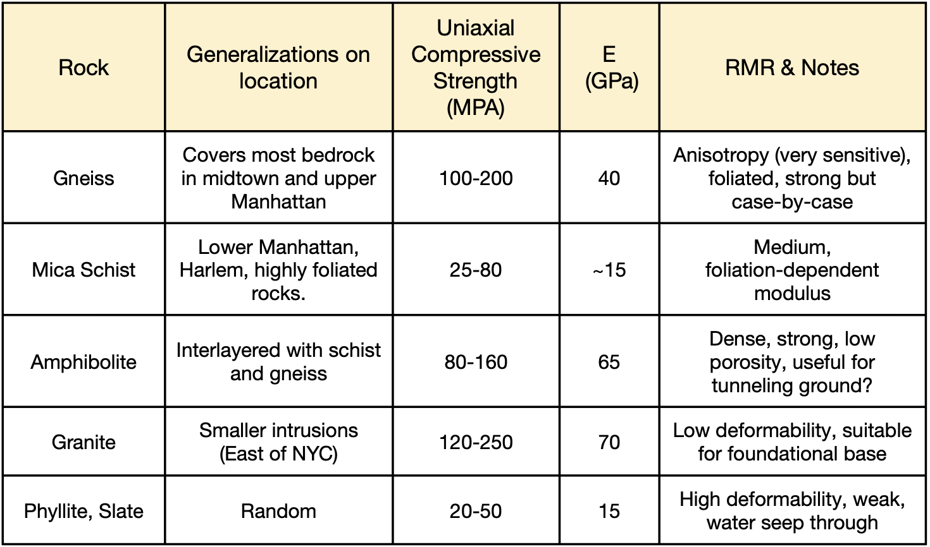
NYC Geology
Objective: Characterize the ground properties to enable accurate numerical simulations.
Rock Properties in New York City

Slide 9
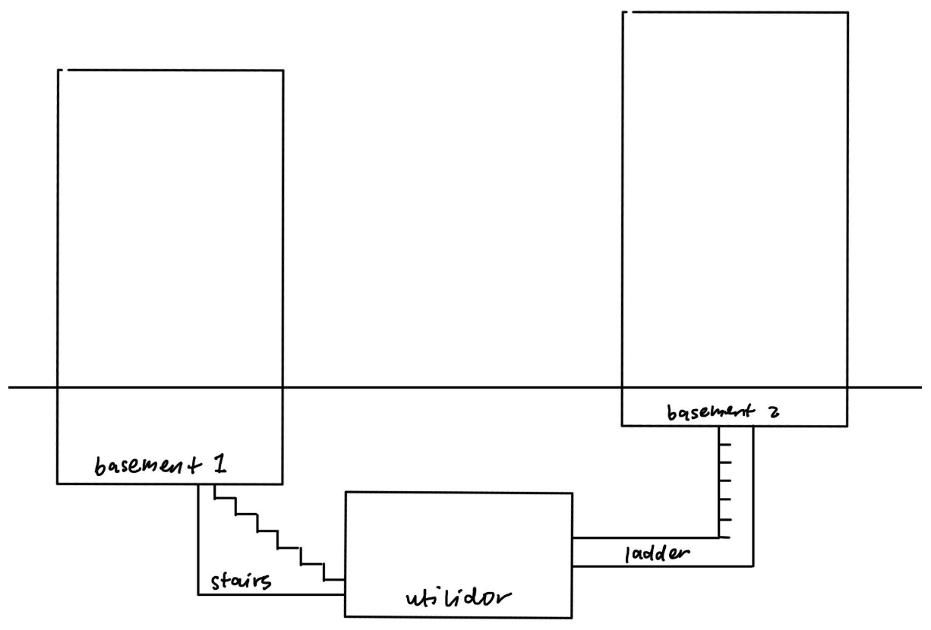
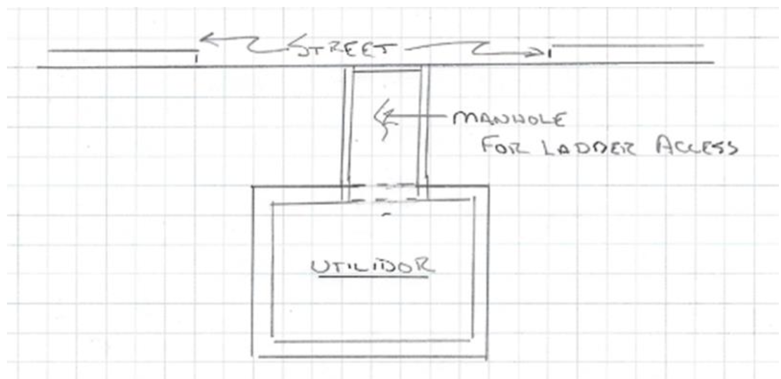
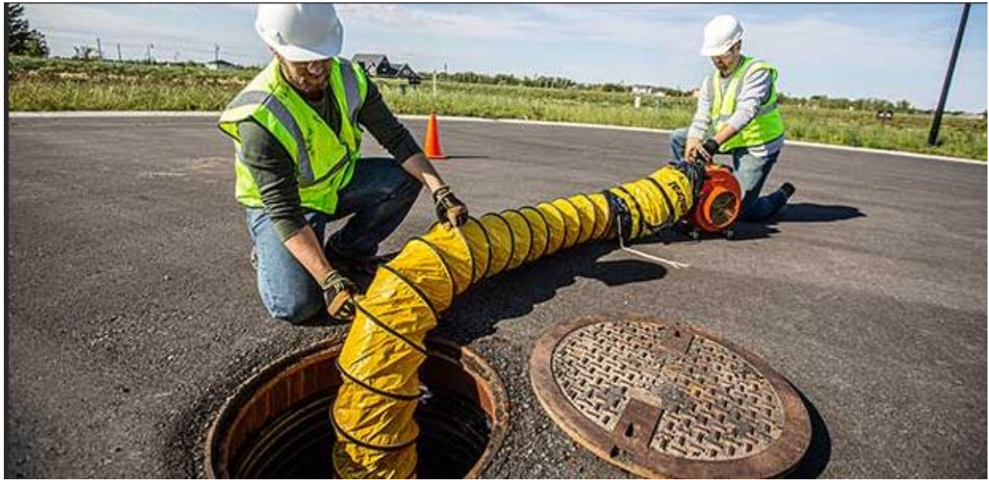
Access – From the street or from existing basements
Confined Space Access into a Utilidor
Conventional Access to a Utilidor

Slide 10
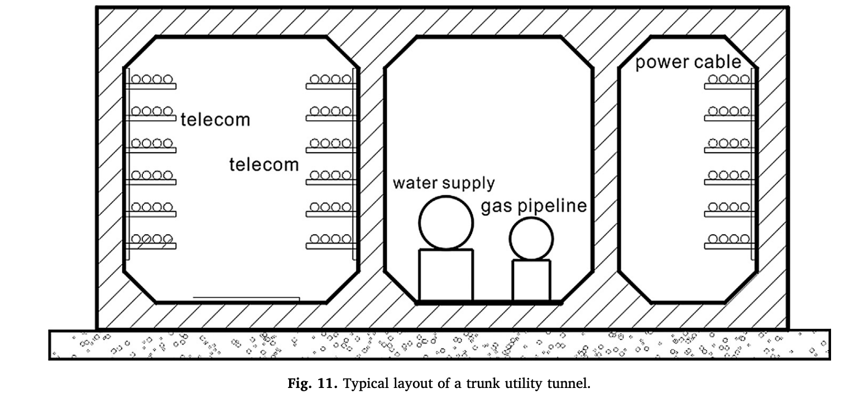
Compartmentalization
Purpose:
Isolate different types of utilities and reduce risk
Tailor environment for each compartment
Technical challenge: Connecting compartment to private buildings due to crossing
Solution:
Have lateral ducts for lines from one side of compartment to reach building on other side of sidewalk
Have one cut into chamber and connect chamber to buildings
Size:
Wide enough to walk through
Vertical space
Separate water, gas, telecommunications
Separate gas and electricity to avoid fire risk
Utilidor compartmentalization for access and security – Cross Section of Marina Bay Utility Tunnel

Slide 11
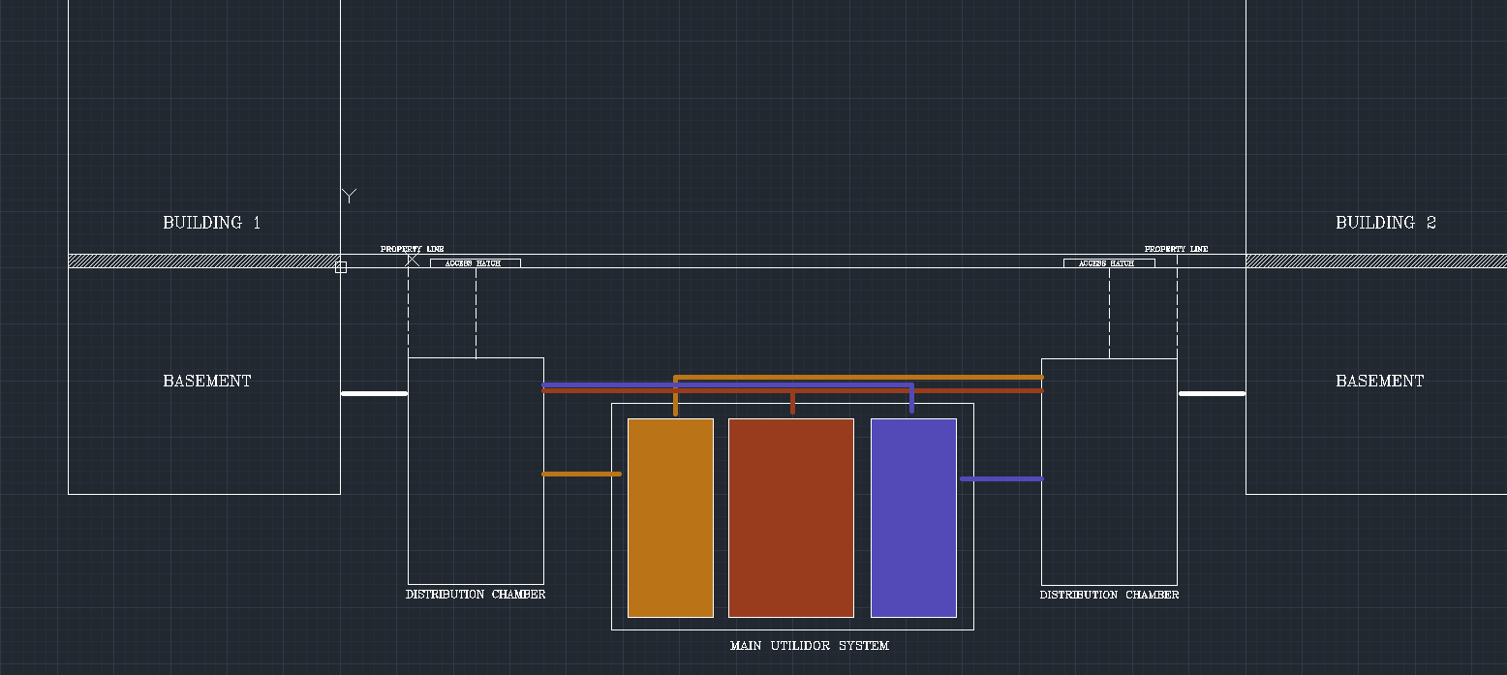
Connections – Distribution and transmission
Distribution chambers – 2D view

Slide 12
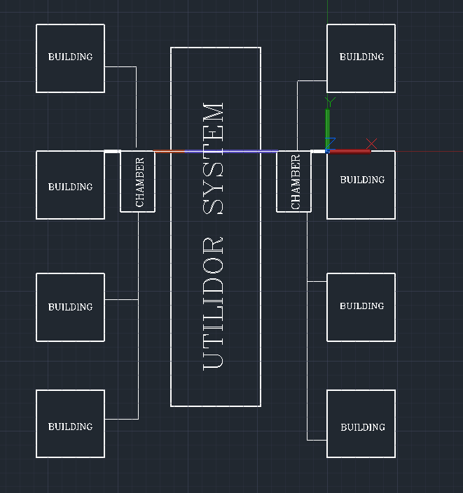
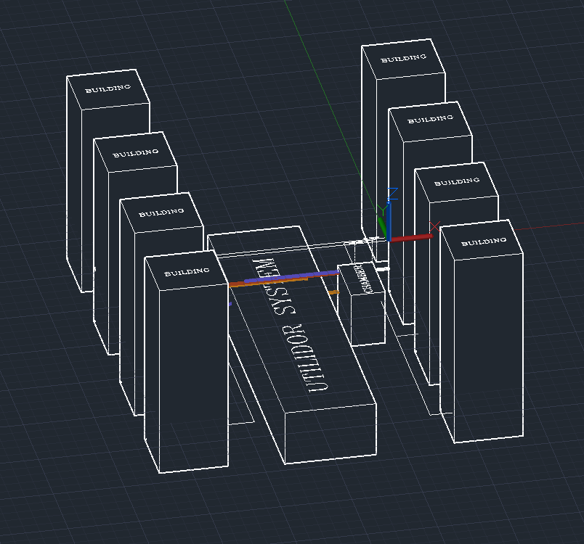
Visualization – Distribution and transmission
Distribution chambers – 3D view

Slide 13
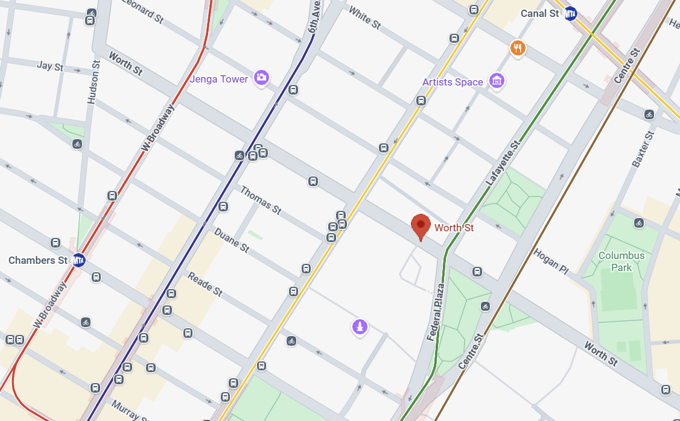
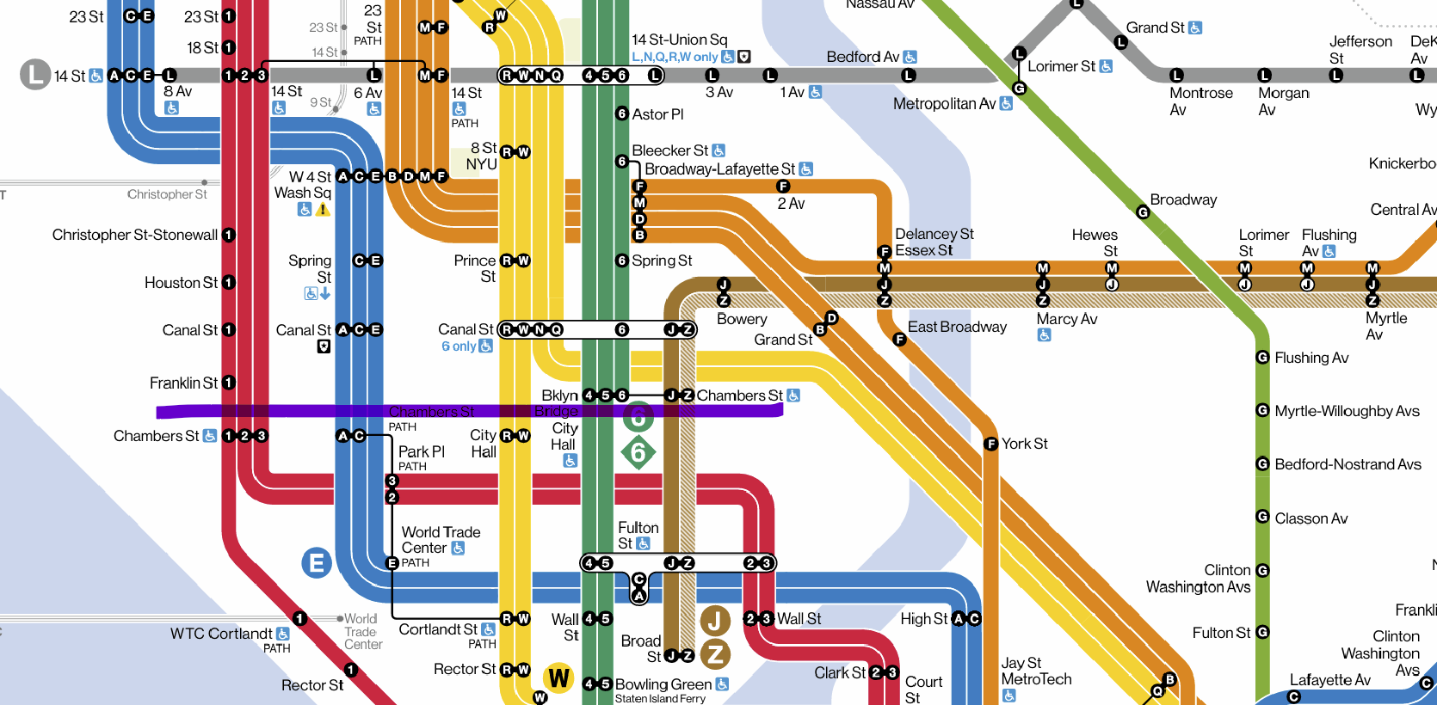
Application to Worth Street – Manhattan
View from the top
Current subway network

Slide 14
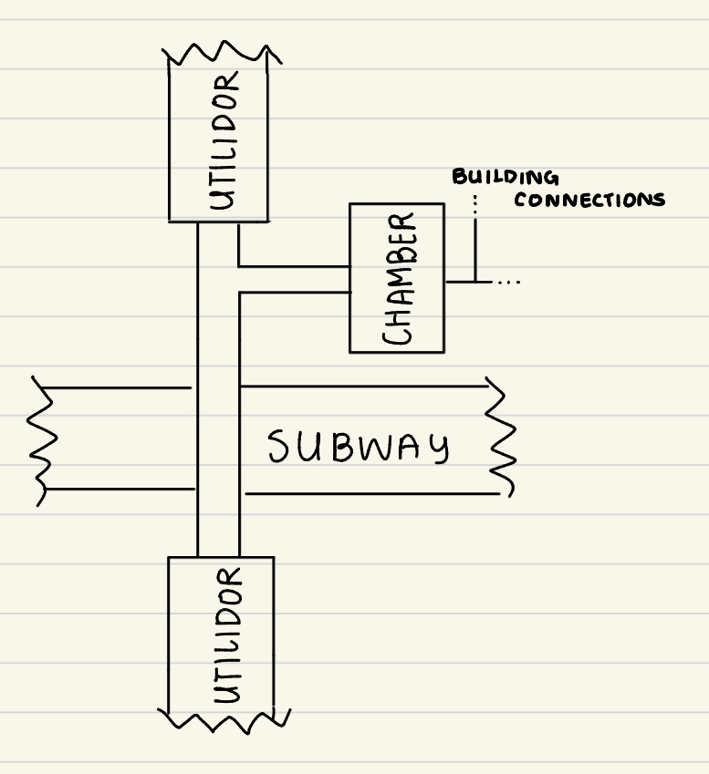
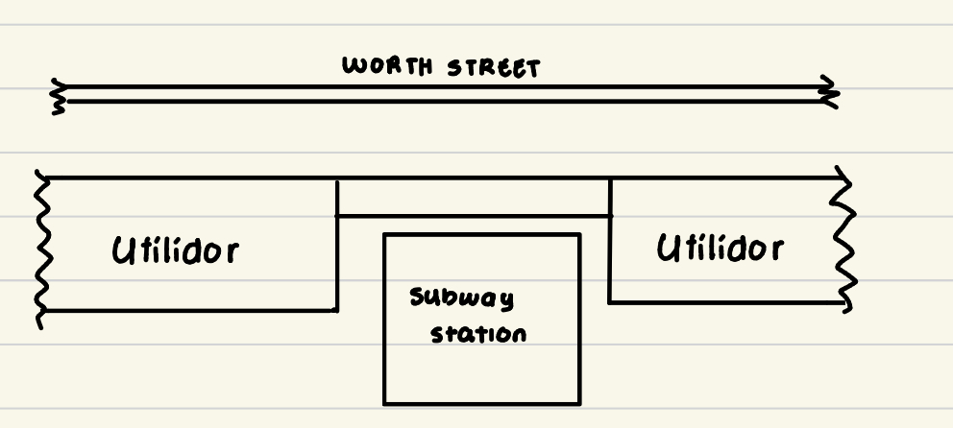
Visualization – Connections
Combination of hybrid system and utilidor-buildings connections
Service private buildings during utility segment
Connect to distribution chambers to reduce costs
Side view
View from the top

Slide 15








Numerical Modeling – Problem Setup
Objective: Perform 2D numerical simulations to evaluate structural stability under different geotechnical configurations.
$$y$$
$$σ_{s}$$
$$x$$
$$h$$
$$R$$
$$σ_{R}$$
$$σ_{h}$$
$$σ_{h}$$

Slide 16
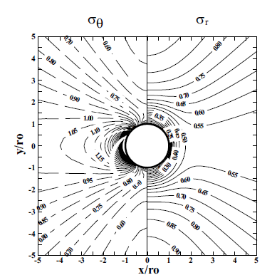
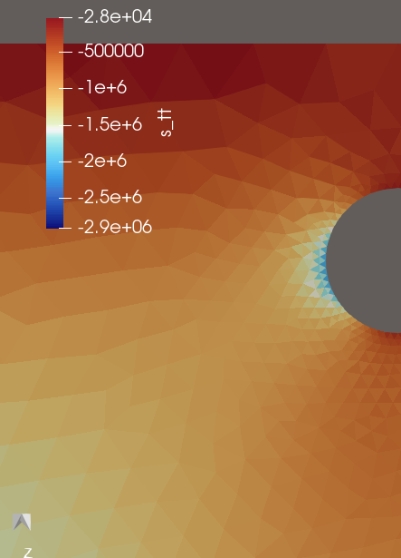
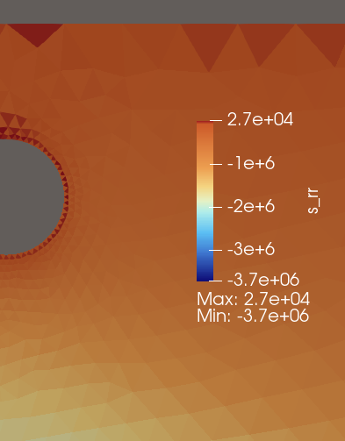
Parametric studies – Comparison with analytical solutions
Bobet and Einstein, “Tunnel Design Methods” Fig 4.6

Slide 17
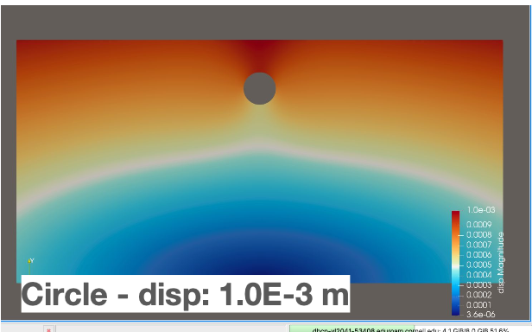
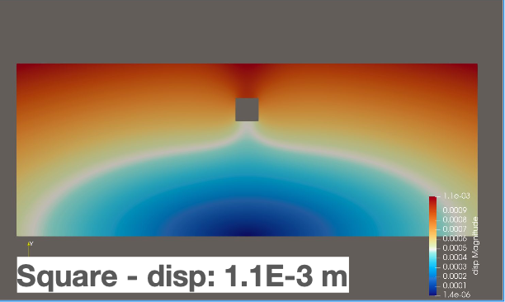
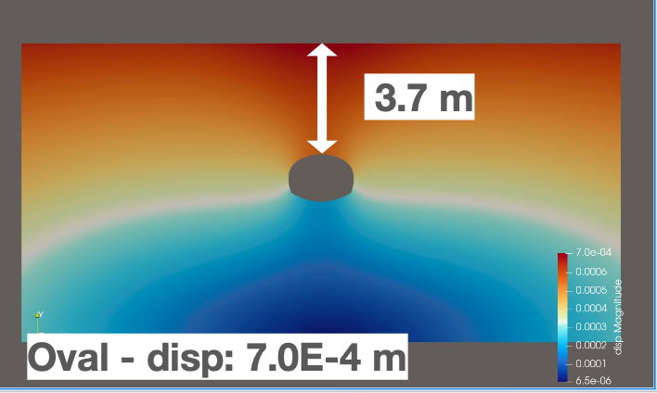
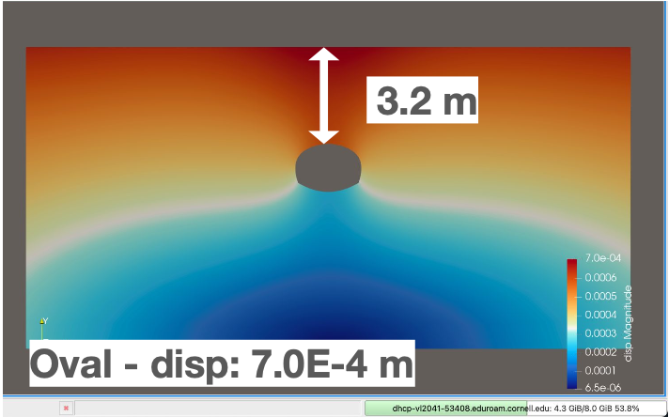
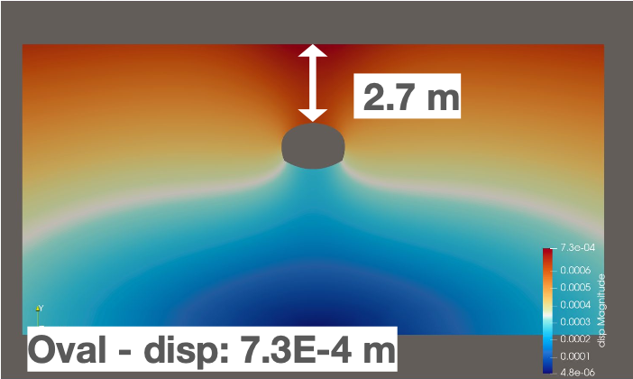
Parametric studies – Section shape and depth
Manhattan Schist parameters
Young’s modulus - E = 15 x GPa
Poisson’s ratio = 0.3
(coeﬀ. of earth pressure) K = 1
Unit weight - γ = 18 kN/m3

Slide 18
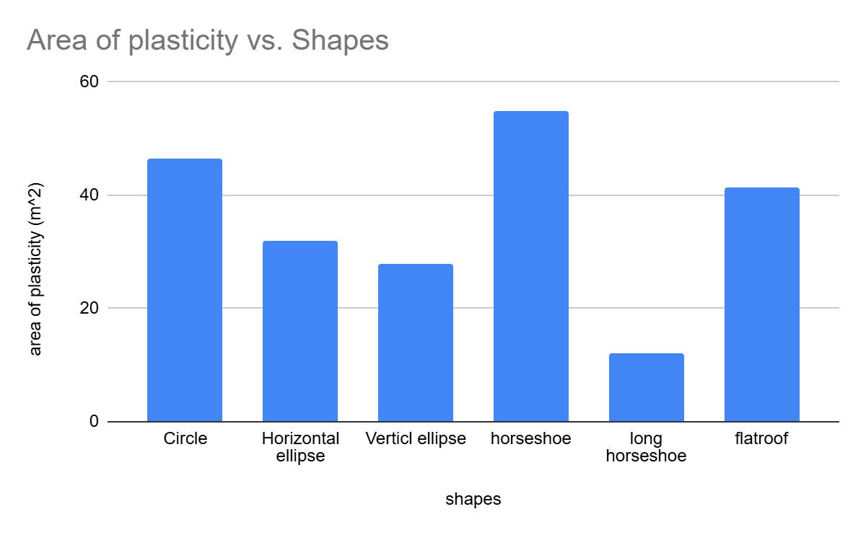
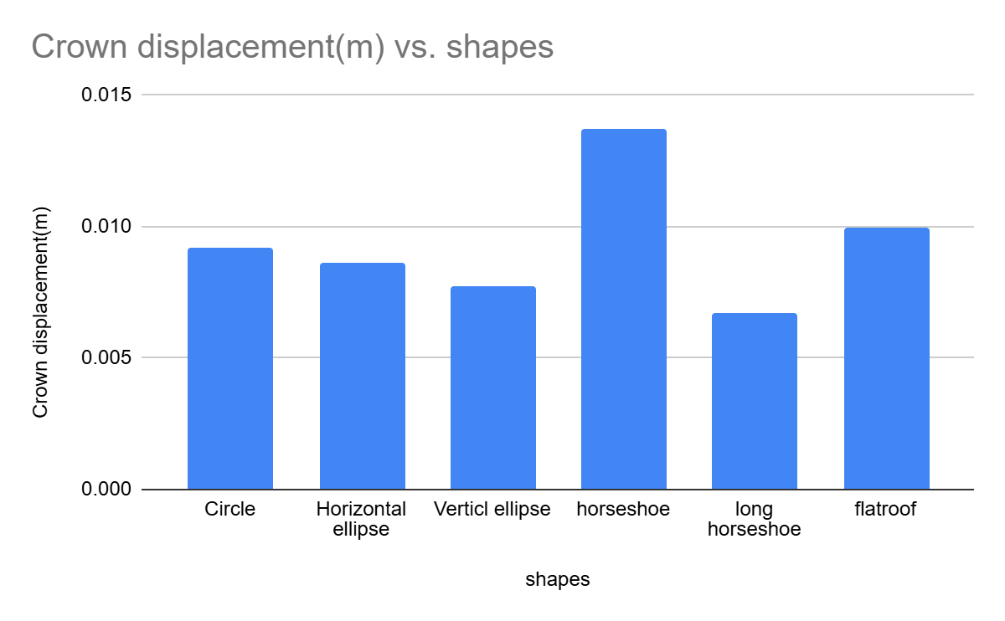
Parametric studies – Effects of depth, section shape and elastic parameters

Slide 19
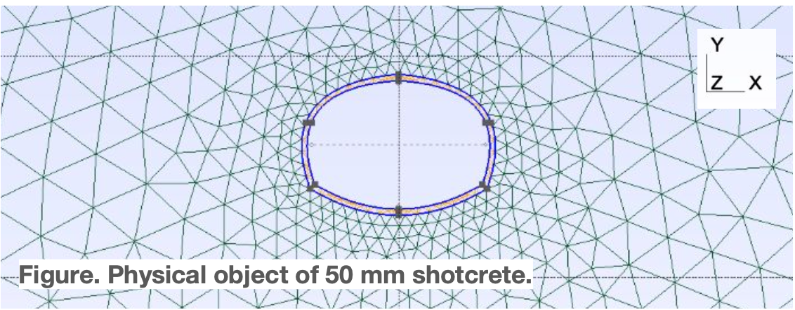
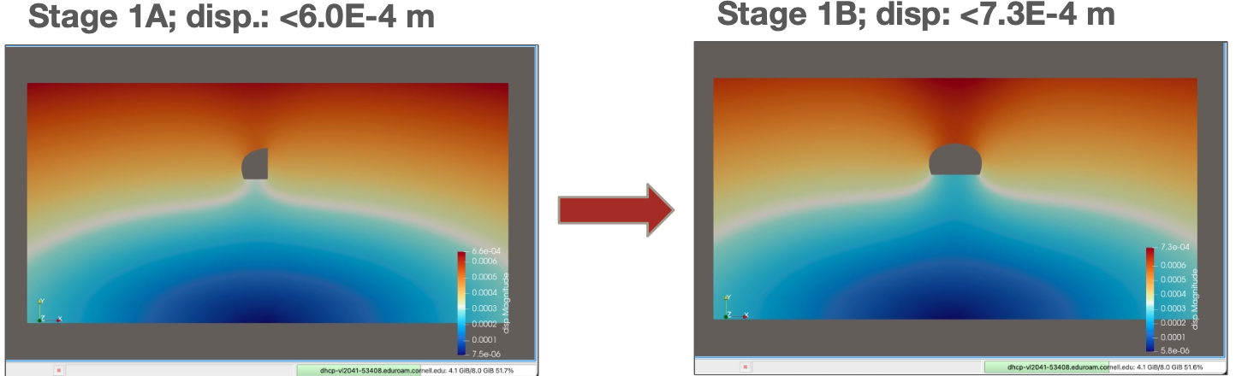
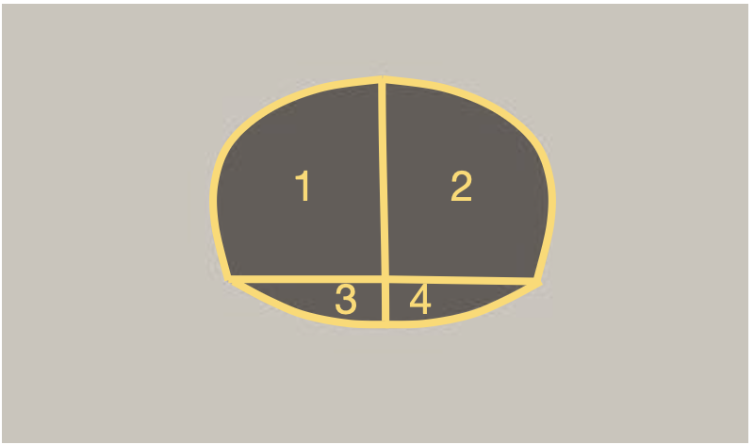
Parametric studies – Effect of the support and sequential excavation
Portland cement
E = 20 GPa
Poisson’s ratio = 0.2
Density = 2,400 kg/m3 (American Shotcrete Assoc.)

Slide 20
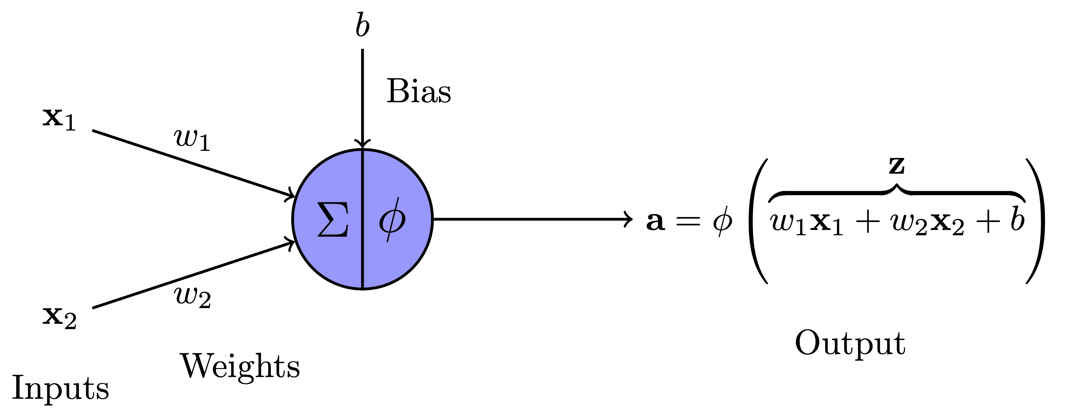
Neuron
Neuron representation

Slide 21
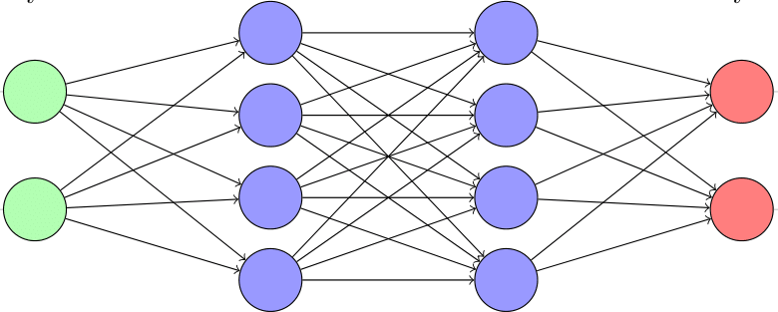





Feedforward neural network
$$x$$
$$y=𝒩𝒩(x,θ)$$
$$θ={\left(w_{1},…,w_{N_{w}},b_{1},…,b_{N_{b}}\right)}^{T}$$
$$ℒ(\hat{y},x,θ)=ℒ_{data}(\hat{y},x,θ)$$
$$ℒ_{data}\left(\hat{y},y\right)=MSE(\hat{y},y)=\frac{1}{n}{\left\|\hat{y}−y\right\|}_{2}^{2}$$
With:
n: number of data points in the batch

Slide 22
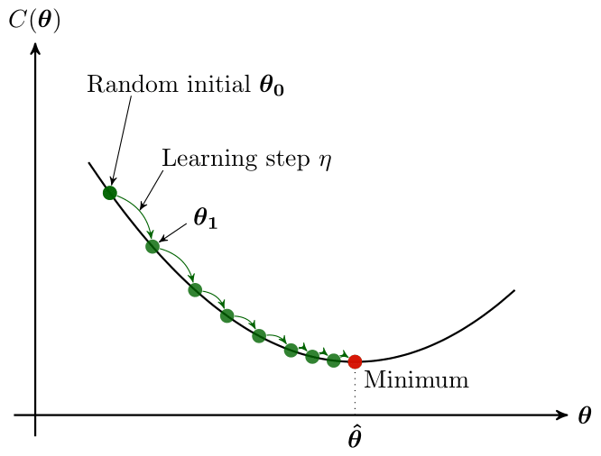


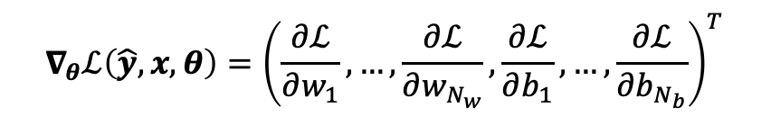


Neural network backpropagation – gradient descent
Classical neural network:
$$ℒ$$
$$ℒ(\hat{y},x,θ)=ℒ_{data}(\hat{y},x,θ)$$
$$∇_{θ}ℒ\left(\hat{y},x,θ\right)={\left(\frac{∂ℒ}{∂w_{1}},…,\frac{∂ℒ}{∂w_{N_{w}}},\frac{∂ℒ}{∂b_{1}},…,\frac{∂ℒ}{∂b_{N_{b}}}\right)}^{T}$$
$$θ_{l+1}=θ_{l}−η∇_{θ}ℒ\left(\hat{y},x, θ\right)$$
$η$: learning step

Slide 23
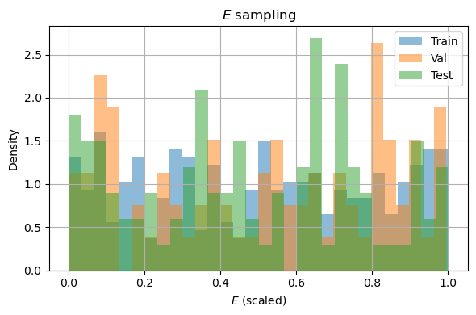
Dataset

Slide 24
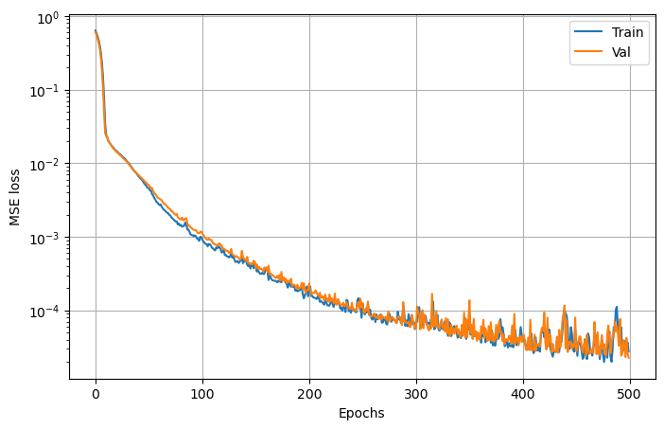
Training loss
24

Slide 25
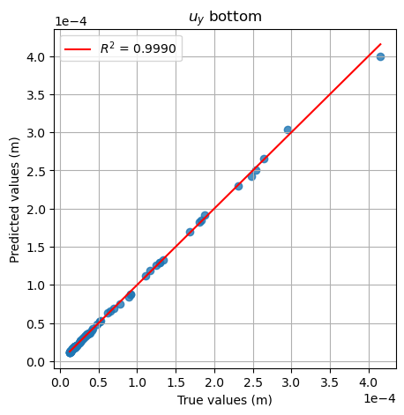
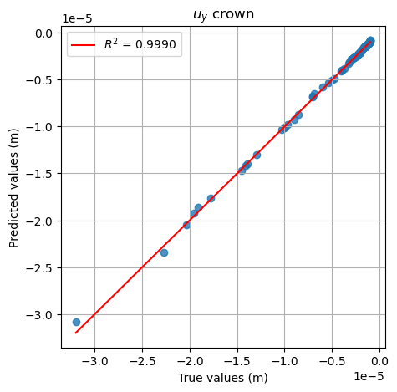
Performance
25

Slide 26
Conclusions and future work
Pedagogic conclusions:
Students were able to learn new concepts related to geotechnical engineering and urban design
Research skills: scientific literature review, self-learning, independence
Multidisciplinary work: geomechanics theory, infrastructure design, numerical modeling, scientific machine learning, visualization.
Technical conclusions:
Square cross section shapes at shallow depth and circular section for deeper tunnels
Recommend NYC include depth of tunnel/overburden pressure as important parameter
Distribution chambers to minimize construction costs
Future work:
Consider groundwater behavior, heterogeneities and account for plasticity
Complexify the geometry and account for side corridors
Extend the study to other areas besides Manhattan
Develop a tool readily applicable by practitioners based on machine learning

Slide 27
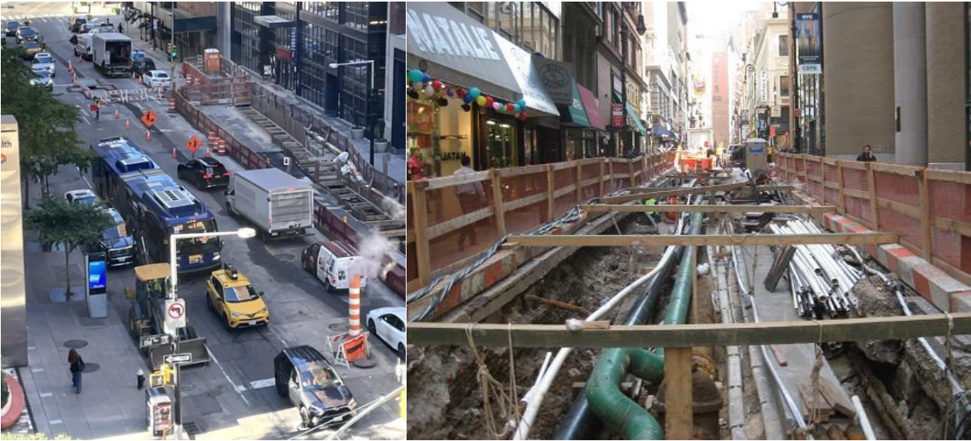
Long-term vision
Objective: Predictive maintenance and digital twins
→ Identify data sources that will be collected in practice
Generate synthetic data when necessary using analytical or numerical methods
Construct a virtual model, whether based on analytical or numerical approaches
Integrate data into the virtual model to complete a Digital Twin
Explore the use of machine learning techniques to enhance Digital Twin implementation
Typical congested condition at site of utility construction (Right) and close-up view exposed underground utilities (left)

Slide 28
Urban Engineering – Shallow tunnels – Rock Mechanics – Numerical modeling – Data Analysis – Predictive maintenance
Thank you for your attention!
Contacts:
Terri Matthews: matthewte@ddc.nyc.gov
Chloé Arson: cfa36@cornell.edu
Alec Tristani: ayt34@cornell.edu

Slide 29
PDF Question: 1 of 6
Q1: What is a utilidor?
  An aboveground corridor containing utilities
  An underground corridor containing utilities
  A secret passage for citizens?

Slide 30
PDF Question: 1 of 6
Q1: What is a utilidor?
  An aboveground corridor containing utilities
  An underground corridor containing utilities
  A secret passage for citizens?

Slide 31
PDF Question: 2 of 6
Q2: Why are utilidor systems especially challenging in New York City?
  The city has no underground infrastructure
  Dense urban conditions and limited underground space
  All utilities are located above ground
31

Slide 32
PDF Question: 2 of 6
Q2: Why are utilidor systems especially challenging in New York City?
  The city has no underground infrastructure
  Dense urban conditions and limited underground space
  All utilities are located above ground

Slide 33
PDF Question: 3 of 6
Q3: Do utilidors already exist in NYC?
  Yes
  No
33

Slide 34
PDF Question: 3 of 6
Q3: Do utilidors already exist in NYC?
  Yes
  No
34

Slide 35
PDF Question: 4 of 6
Q4: Which is the primary benefit of using AI in utilidor design?
  Improving design efficiency and optimization
  Increasing manual drafting time
  Eliminating the need for engineers entirely

Slide 36
PDF Question: 4 of 6
Q4: Which is the primary benefit of using AI in utilidor design?
  Improving design efficiency and optimization
  Increasing manual drafting time
  Eliminating the need for engineers entirely
36

Slide 37
PDF Question: 5 of 6
Q5: What is a major concern when applying AI to engineering projects?
  Too much handwritten documentation
  Lack of electricity underground
  Reliability and validation of AI-generated outputs
37

Slide 38
PDF Question: 5 of 6
Q5: What is a major concern when applying AI to engineering projects?
  Too much handwritten documentation
  Lack of electricity underground
  Reliability and validation of AI-generated outputs
38

Slide 39
PDF Question: 6 of 6
Q6: What role should engineers play when using AI design tools?
  Blindly accept all AI recommendations
  Eliminate human review processes
  Verify, interpret, and validate AI-generated results
39

Slide 40
PDF Question: 6 of 6
Q6: What role should engineers play when using AI design tools?
  Blindly accept all AI recommendations
  Eliminate human review processes
  Verify, interpret, and validate AI-generated results
40

