Slide 1

DDC/Town+Gown
Team Members:
Chun-Ting Lee, Keyi Huang, Qihan Fang, Shuangyue Li, Zehao Quan

Slide 2
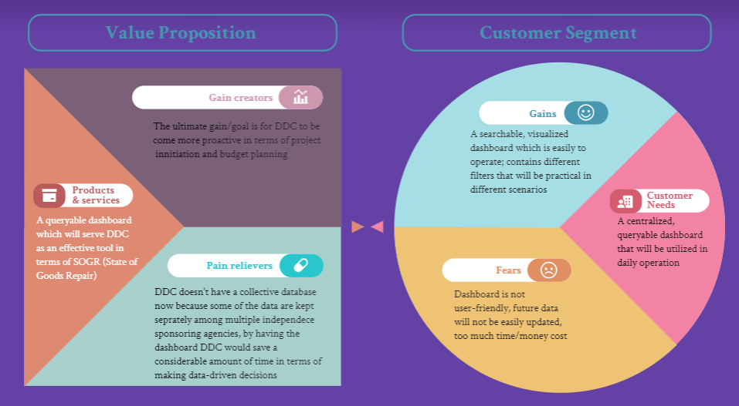

Slide 3
Why we need this project
Thousands of data about New York’s Public Buildings and Infrastructure condition with different format among different organizations
Complex process for sponsors to get access to data
Don't yet have quick access to a searchable database for NYC's Public Buildings

Slide 4
What we will bring to our sponsors
Sustainable Public Database
Geographical Dashboard Interface
Quick
Searching Engine
Capital
Cost Savings
Better collaboration with Sponsor Agencies by providing them access to data across Public Buildings portfolio
Integrate data on NYC Map with different categories & filter (address, agency,BBL, EUI) for user evaluate asset condition
Implement an searching engine on dashboard for users to get quick access to data & budget planning
Public resources are best spent with a clear picture of the work ahead.
We can better anticipate future projects by tracking historical data

Slide 5
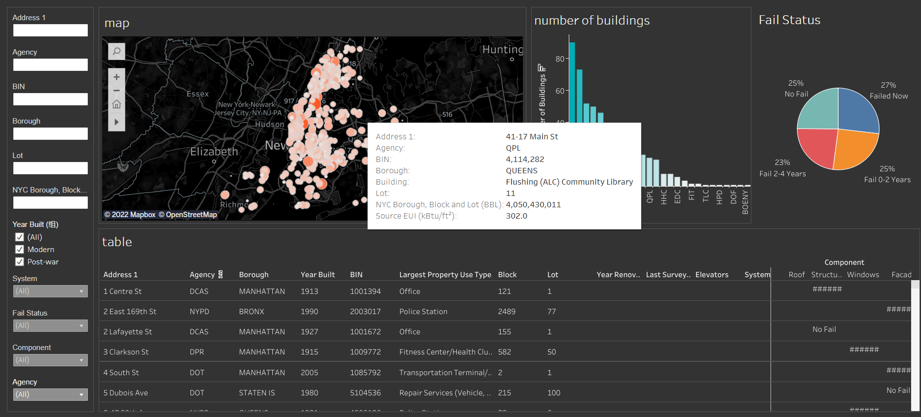
Sponsor End State Vision
“Time is of the essence to put the systems in place and make the institutional reforms necessary to allow DDC to remain a world-class provider of urban infrastructure” (2019 Strategic Plan)
“Transform the City’s Capital Delivery Process and expand toolbox of project delivery methods” (2022 Strategic Plan)
Centralized and Visualized data
Search and Filter functions implemented for multiple scenarios
Locate and examine a single building’s or a category of buildings’ condition assessment (i.e. components and systems)
EUI (Future sustainability)

Slide 6
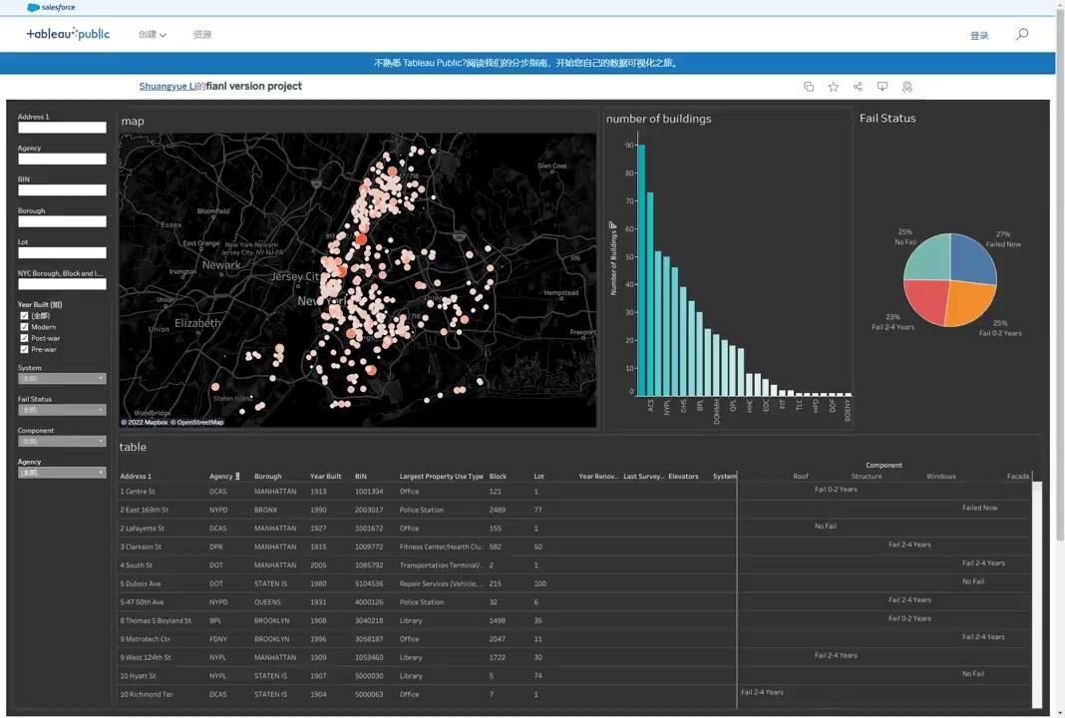
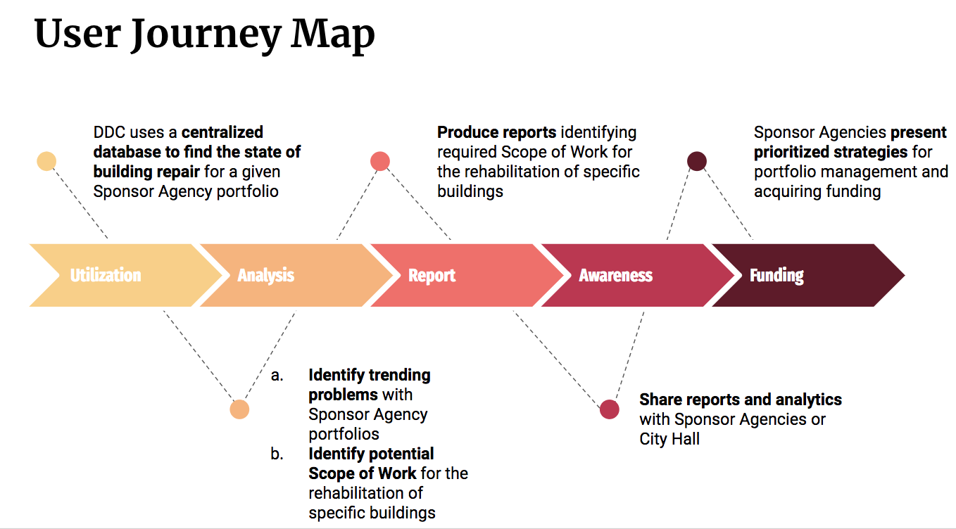
Customer Journey

Slide 7
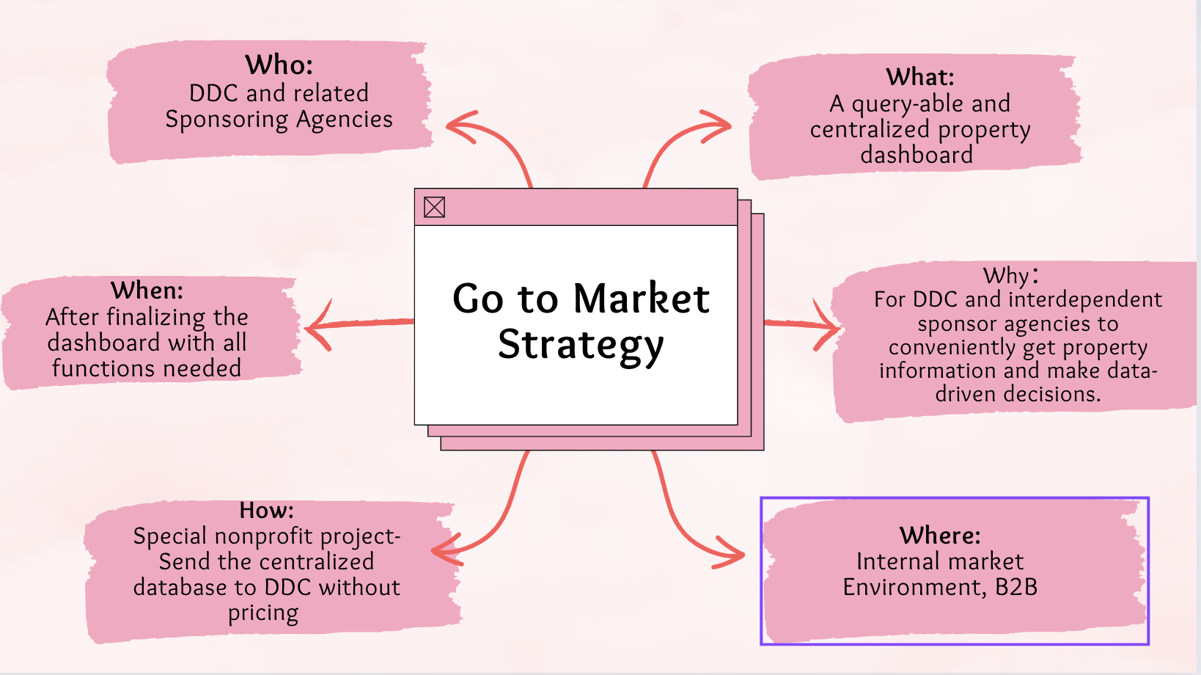
Go-to-Market Strategy

Slide 8
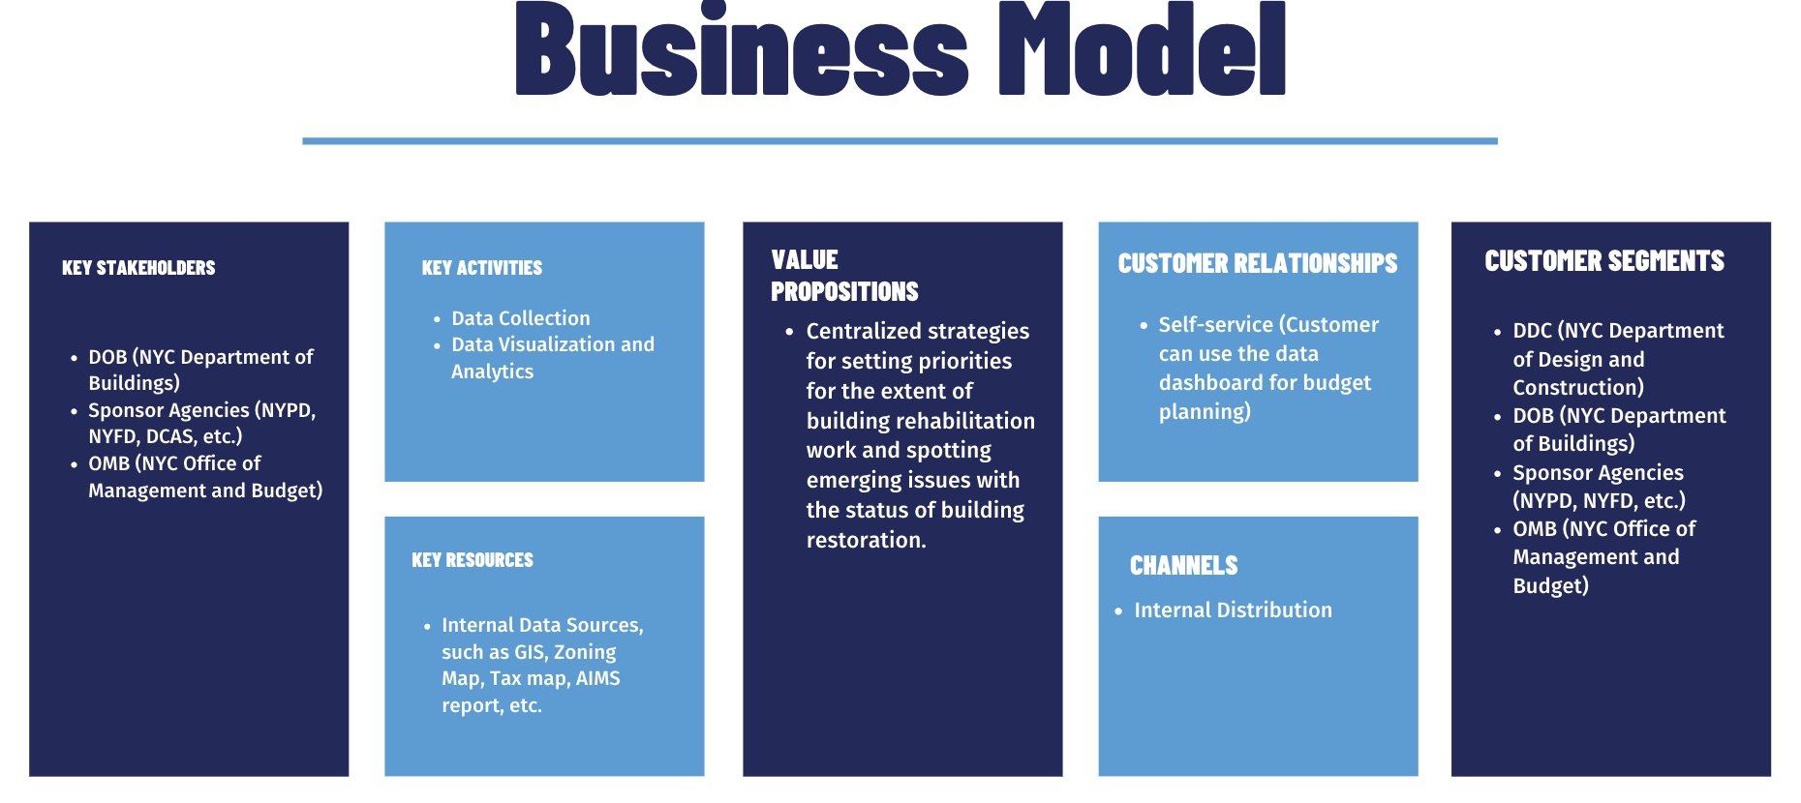
No Cost Structure and Revenue Stream due to speciality of the project

Slide 9
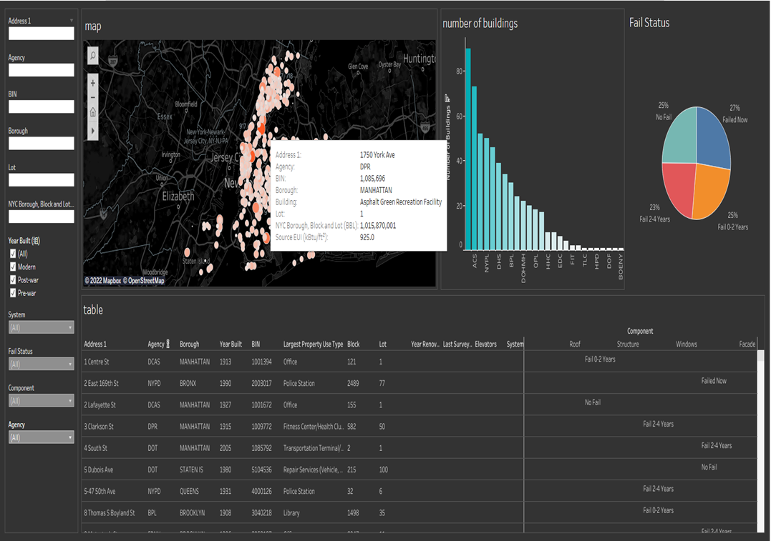

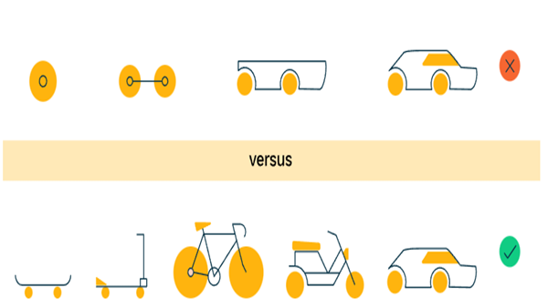
Recommended MVP Journey
Information for All Public Buildings
User-friendly Search Features + Filter Interface
Maintainable & Extendable Dataset

Slide 10
Reflections
Team Management:
Good communication, coordination & teamwork
High level of involvement
Sponsor Management:
Collaboration (offering resources & feedback)
Always remember to confirm
Project Execution:
Make progress weekly
Be prepared for changes
Notes:
From the team management perspective,
Good communication and coordination are necessary. (since it’s a busy semester for each team member)
Cover other’s parts when someone cannot show up at the meeting or presentation and help them catch up with updated information and new instructions.
Paying attention to the project progress, each team member’s work, and what the sponsor requires or prefers will help keep the project on the right track and also make the covering a little easier.
Offer ideas or make suggestions. Boost the morale. Remind each other. These are important as well.
From the sponsor management perspective,
Always remember to ask for help from the sponsor or professors or perhaps rediscuss the requirements, because we can’t find everything we need online or from limited resources at hand.
Always confirm new requirements, new add-ins, new agreements after weekly meetings by sending the minutes to make sure the project be on the right track.
Always attend to the feedback (from the sponsor after showing the prototype) and continue to improve it, because that is the only way to help us give the most satisfying product to our sponsor at the end of the project.
From the project execution perspective,
Make progress weekly so that we can get closer to the final goal little by little.
Sometimes, be prepared to embrace changes of plan and make modifications or take new actions.

Slide 11
Thank you!
&
Happy Graduation!

