Slide 1
Replacement of distribution water main & appurtenances in various locations in queens
PROJECT id: QED-1056
Eric Adams
Mayor
Thomas Foley P.E.
Commissioner
February 2024

Slide 2
agenda
About the Project
Data
Why the Project is Necessary
Community Benefits
Map
Locations
Construction Overview
Impacts and Mitigation
Outreach and Notification
Q & A
2

Slide 3
Project Data
Project ID: QED-1056
Notice to Proceed (NTP) November 4, 2024
Anticipated Start: Early 2025
Anticipated Completion: End of 2026
Contractor: Maspeth Supply Co., LLC
Contract Value: $13 Million
Typical Work Hours: 7AM to 4PM, Monday through Friday
8AM to 5PM, Saturday (as needed with community notification)
Holiday Embargo: Mid-November – January 2nd
3

Slide 4
Why Project is Necessary
Infrastructure is old and needs replacement of:
Old cast iron Water Main pipes with new ductile iron pipes – avoids breaks
Old fire hydrants within project limits
Lead service lines from Water Main to property meter (Where possible)
4

Slide 5
Benefits of Infrastructure Upgrades
Distribution Water main
Stable and secure supply of clean water
Improved water pressure
Fire Hydrants – (44 replacements within CBs 3, 4 and 7, Queens)
Improved Fire Safety Protection
Lead Service Lines – (Where possible)
Replaced with copper from Distribution Water Main to house connection
Roadways
Street reconstruction and resurfacing, as per contract
Green infrastructure (SWPPP– Stormwater Requirements)
Collects stormwater overflow from street and sidewalks
Improves health of local waterways

Slide 6
Project Locations Map
This contract has three (3) locations:
E. Elmhurst (CB3Q)
Corona (CB4Q)
Flushing (CB7Q)
3
1
2

Slide 7
Community Board #3 East Elmhurst, Queens
The General Contractor plans to begin work in CB3Q, next CB4Q, and CB7Q will be the last area.
LOCATIONS:
98th Street from 31st Avenue to 32nd Avenue
32nd Avenue from 95th Street to 102nd Street

Slide 8
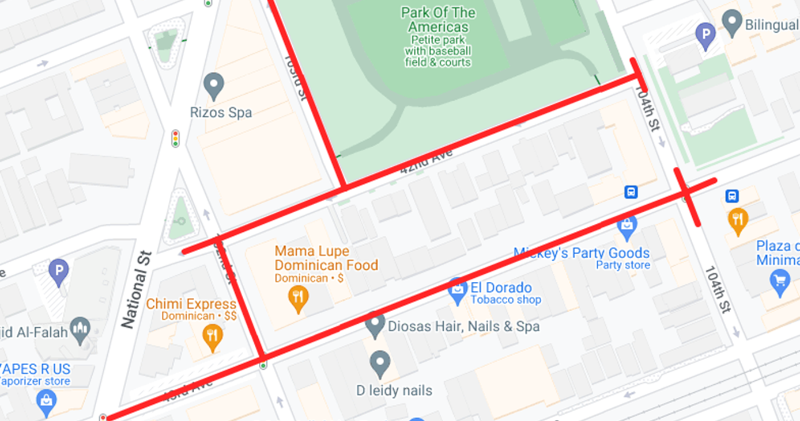
Community Board #4 Corona, Queens
LOCATIONS:
103rd Street from National Street to 42nd Street
102nd Street from 42nd Avenue to 43rd Avenue
43rd Avenue from National Street to 104th Street
42nd Avenue from National Street to 104th Street
8

Slide 9
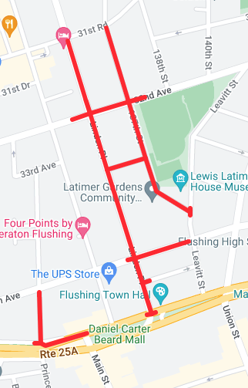
Community Board #7 Flushing, Queens
Locations:
Prince Street from 35th Avenue to Northern Blvd
Linden Place from 31st Road to Northern Blvd
35th Avenue from Linden Place to Leavitt Street
Northern Blvd from Prince Street to Farrington Street
137th Street from 31st Road to Leavitt Street
32nd Avenue from 137th Street to Linden Place
Lattimer Place from Linden Place to 137th Street
9

Slide 10
Construction Overview
Preliminary Work
In the ground
Above ground
Utilities
Outreach
Permits and Scheduling
Staging and Storage of Materials
Street Tree guards and Pruning
Test Pits and Street Markings
Soil Borings and Testing
Saw Cutting and Trench Setup
Water Main Installation Operation
Fire Hydrant Installation (44)
Lead Service Replacement (from Distribution Water Mains to house connection)
Disturbed Curb and Sidewalk Replacements
Water Main Trench (roadway cuts) Restoration
10

Slide 11
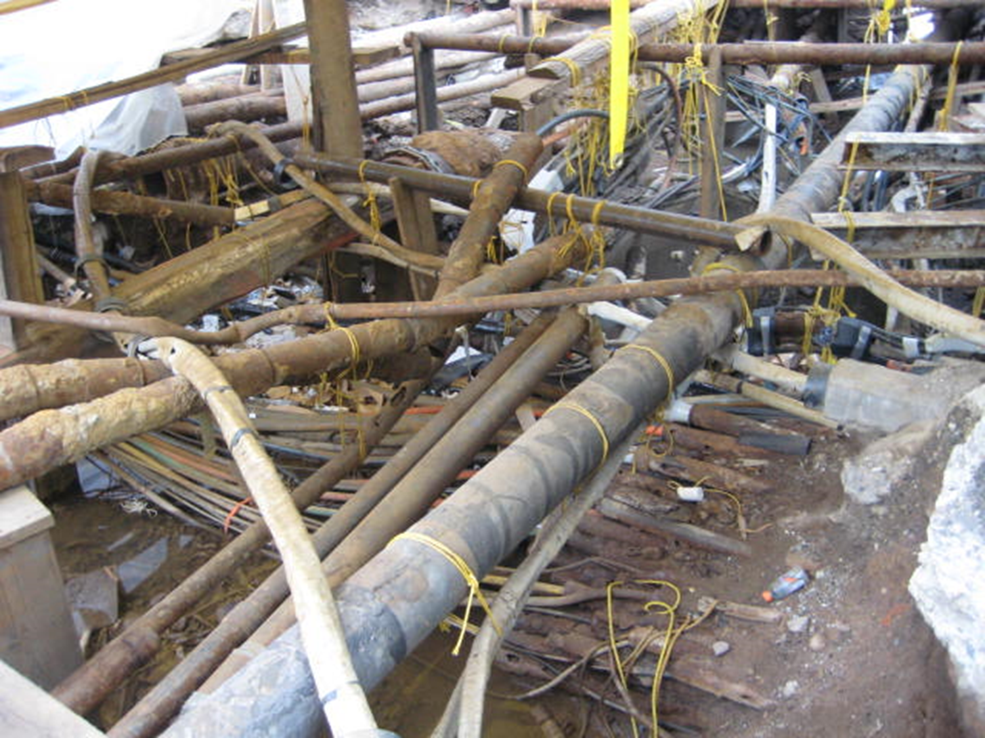
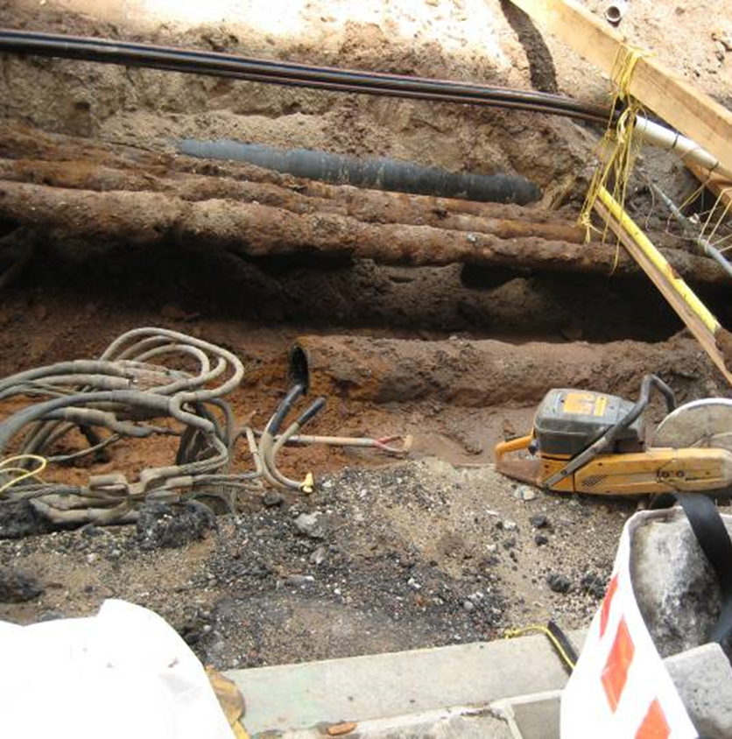
Excavated watermain to be replaced
Utilities: Gas, Cable, etc.

Slide 12
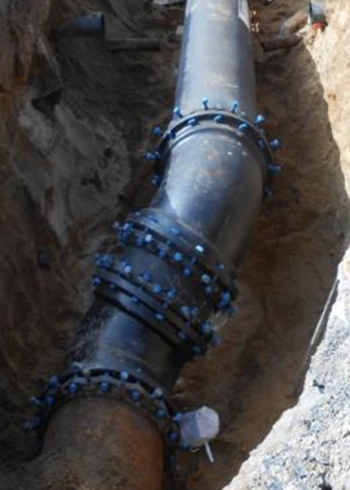
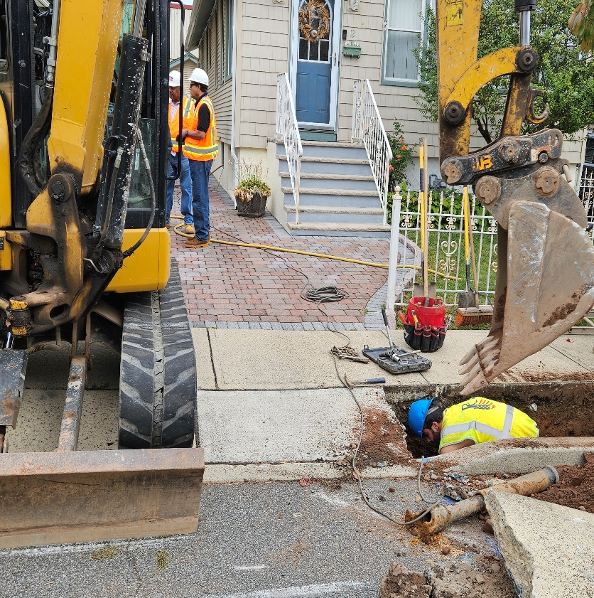
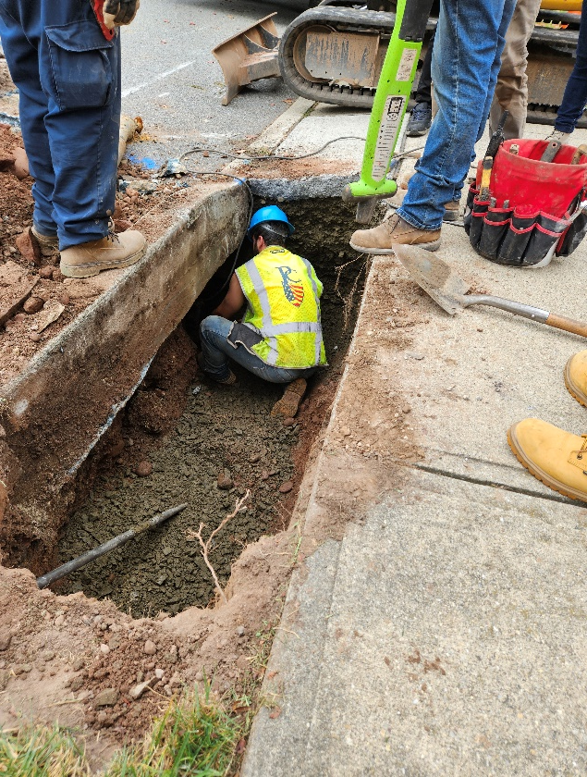
Water Main and Lead Pipe Installation

Slide 13
CLICK TO EDIT HEADLINE TEXT
Edit text
DEP LEAD PIPE REPLACEMENT Program Protocols
13
13

Slide 14
DEP Program
DEP website
has information about their Lead Pipe Replacement program.
DDC is managing this project on behalf of DEP’s capital work - implementing the pilot program within target areas and qualified properties only.

Slide 15
LEAD PIPE REPLACEMENT Program Protocols
Lead Service Replacement requires a signed consent form. The City will attempt to communicate with Residents (4x’s) with the following information:
Once DDC’s project begins – DEP will send the DEP Lead Line Notification Letter.
Once DEP letter is sent - DDC will follow with a Notification Letter stating consent form sign off is required.
Once Consent Form is provided – Project liaison (CCL) will door-knock to follow up with resident’s permission and retrieve the signed consent form.
Once the CCL follows up again with the consent form, after that fourth and final attempt, we will consider the resident opted out of program.
NOTE: DDC field staff will reconfirm with residents who signed consent form, if replacement is feasible based on field conditions.
Lead Service Replacement is limited to targeted areas and properties identified or suspected to have Lead lines. Replacement will only qualify for the following:
Only for confirmed lead lines on eligible properties.
Only with resident’s permission and signed consent form.
Only actual replacements – considered feasible based on field conditions.
NOTE: Lead service replacements may happen during actual GC’s water main (WM) operations and/or will return after the WM work to perform confirmed / signed-off lead services.

Slide 16
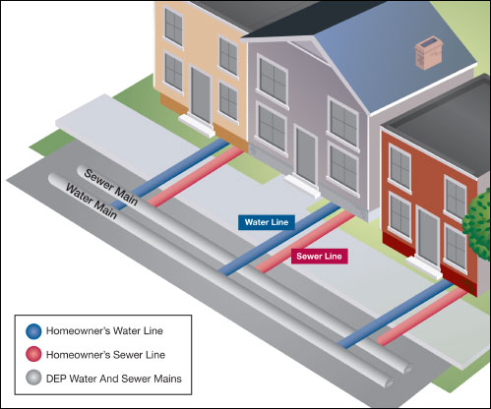
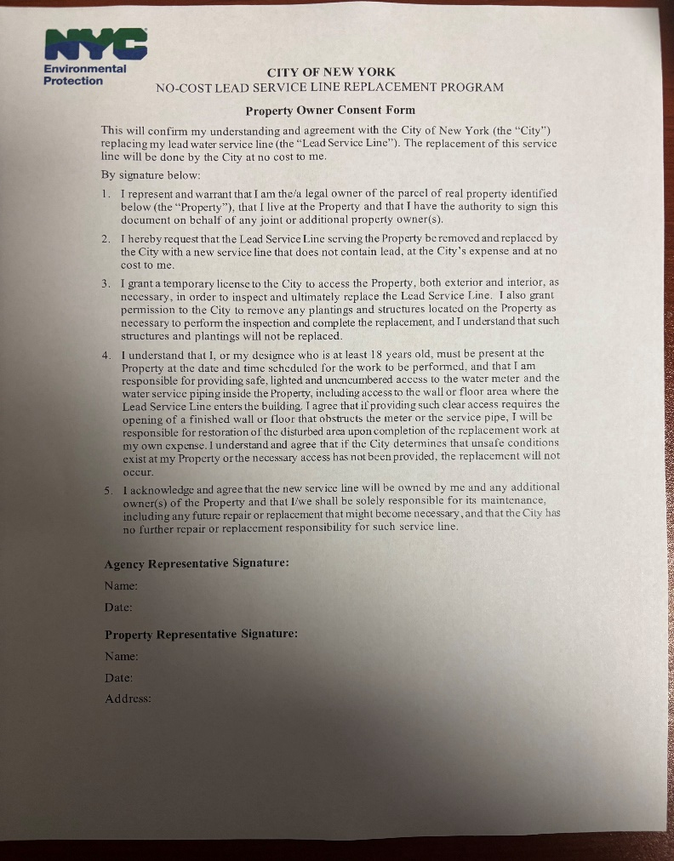
DDC / DEP Process & Protocols
Sample of Consent Form
For a consent form email: qed1056ccl@gmail.com

Slide 17
CLICK TO EDIT HEADLINE TEXT
Edit text
Community Impacts & mitigation
17
17

Slide 18
COMMUNITY IMPACTS & MITIGATIONS
Street work is coordinated with DOT OCMC – Permit Stipulations
Contractor shall:
Work within DEP Noise Code Regulations
Keep storage site area clean and safe
Cover trucks delivering fill material
Provide professional rodent control inspector to monitor/maintain Rodent Control Station
Garbage pick-up may be affected and will be coordinated with DSNY and appropriate stakeholders.
18

Slide 19
COMMUNITY IMPACTS & MITIGATIONS (cont.)
TRAFFIC PATTERNS
Contractors shall maintain the following:
Signage and personnel to ensure a safe work site for pedestrians and vehicles
Pedestrian access to sidewalks and crosswalks
Plate and open roadway traffic when site is unattended
Driveway access may be temporarily restricted during work hours but coordination is done case-by-case
Parking may be restricted when necessary; signs will be posted in advance
Full roadway closures – intermittent and when necessary
19

Slide 20
COMMUNITY IMPACTS & MITIGATIONS (cont.)
WATER SHUTDOWNS
A 72-hour Advance Advisory will be provided followed by a 24-hour confirmation or cancellation notice to impacted areas.
Specific instructions will be provided prior to water shutoff
Water shutdowns are scheduled during the day
During temporary water shutdowns, ensure area has enough access to water
If your water service is not restored within 3 hours of the indicated time on the shutoff notice, please contact the Community Construction Liaison (CCL).
20

Slide 21
COMMUNITY IMPACTS & MITIGATIONS (cont.)
INDIVIDUALS WITH ACCOMODATIONS
Anyone with special circumstances should contact the Community Construction Liaison (CCL).
DDC field staff will work with those individuals to minimize certain inconveniences when possible.
We strive to minimize construction impacts and maintain a safe and well kept project work site.
21

Slide 22
COMMUNITY OUTREACH (continued)
Community Construction Liaison (CCL) responsibilities are as follows:
First point of contact, maintain on-site presence and communications.
Identify, resolve, and/or proactively address issues and inquiries.
Distribute advisories and weekly construction activities newsletter.
Provide 72-hour and 24-hour (confirmation or cancellation) advisories for work impacts by email and door to door.
Attend community board monthly DSC meetings.
22

Slide 23
COMMUNITY OUTREACH
DDC’s Office of Community Outreach + Notification (OCON) works with CB’s, BID’s, local businesses, and other community stakeholders impacted by construction.
DDC has assigned Len’Niesha James of KC Engineering as the dedicated on-site Community Construction Liaison (CCL). The CCL can be reached at:
Email: QED1056CCL@gmail.com
Phone: 631-507-3180
Field Office Location: 25-26 50th Street, Woodside, NY, 11377
Field Office Hours: 7AM to 3:30PM
23

Slide 24
How we communicate with you
In addition to the on-site CCL, we will distribute printed materials that are updated continuously, prior and during the project, including:
Project information card
advisory
Look ahead Weekly bulletin
Quarterly newsletters
24

Slide 25
Thank you!
Q&A

