Slide 1




Construction of Sanitary & Storm Sewers and
Water Main in Willow Avenue
Project SER20079
Community meeting
Eric Adams
Mayor
Thomas Foley
Commissioner

Slide 2
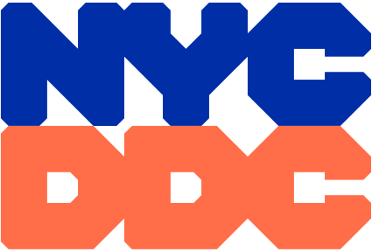
agenda
Project Details
Location
Construction Overview
During Construction
Community Impacts
Outreach and Notification
Q & A
2

Slide 3
Project Details
Notice To Proceed: 2/14/2022
Projected Start: Spring of 2022
Projected Completion: Fall of 2023
Contractor: HuiCatao Corp.
Total Budget: $11.68 Million
3

Slide 4

Locations
Willow Ave. from Tompkins Ave. to Bay St. including all intersections
Storm Sewer Installation
New 18”, 30”, 48” pipes and 4.5’X3.0’ Box Sewer.
Sanitary Sewer Replacement
New 10”, 15”, 18”, 24” replacing existing 8” pipe.
Distribution Water Main Replacement
New 8” and 12” DIP replacing existing 8” CIP.
Roadway Restoration
Trench width and cutbacks then full roadway width overlay

Slide 5
Water Main Replacement
Water Main

Slide 6
Sanitary Sewer Replacement
Sanitary Sewer

Slide 7
Storm Sewer Installation
Storm Sewer

Slide 8
How will this project benefit you?
COMMUNITY IMPROVEMENTS
To improve drainage by installing new storm sewers and catch basins in the area in accordance with NYCDEP’S drainage plan.
Replace and upgrade existing water main and hydrants to improve water distribution throughout the community.
Replace and upgrade the existing sanitary sewers.
8

Slide 9
CLICK TO EDIT HEADLINE TEXT
Edit text
Construction Overview
9
9

Slide 10
Construction Overview
Preliminary Work
In the ground (DEP Work)
Above ground (DOT Work)
Utilities
Community Outreach
Permits and scheduling
Street tree guards and pruning
Street markings, soil samples and test pits
Preconstruction Investigation
Installing erosion and sediment control measures
Street Cutting / Trench Set-up
Watermain Replacement
Fire Hydrant Installation
Storm & Sanitary Sewer Installation
Catch basin Installation
Curbs and sidewalks (As Needed)
Street reconstruction – Trench Width with Cutbacks and Overlay.
Pavement markings
10

Slide 11

WORKING HOURS DURING CONSTRUCTION
Construction work hours will be as follows:
Willow Avenue from Tompkins Avenue to Bay Street, including intersections: 8:00 PM – 6:00 AM
Working hours may be modified as warranted by DOT.

Slide 12
CLICK TO EDIT HEADLINE TEXT
Edit text
During construction
12
12

Slide 13
Traffic Patterns During Construction
Contractors will maintain the following:
Contractor will provide signage and implement a Maintenance and Protection of Traffic plan (MPT). The MPT plan is vital to establishing and maintaining a safe work site by directing pedestrian and vehicular traffic.
Flag persons/crossing guards may be assigned for traffic control.
Keep a minimum width of 5 feet for access to sidewalks and crosswalks.
Contractor is required to maintain pedestrian access to houses and sidewalks.
One 11 foot lane will be maintained for local and emergency traffic on Willow Avenue while one 11 foot travel lane in each direction shall be maintained on Bay Street.
When necessary, full roadway closures may occur and shall be coordinated with DOT.
13

Slide 14
CLICK TO EDIT HEADLINE TEXT
Edit text
Community Impacts
14
14

Slide 15
COMMUNITY IMPACTS & MITIGATIONS
Contractor shall:
Work within DEP Noise Code and Dust Control Regulations.
Post advance 24-hour notice to impacted areas for parking restrictions and confirmed water shutdowns.
Keep storage site and MPT area clean & safe.
Professional rodent control inspector to monitor/maintain Rodent Control Station.
15

Slide 16
COMMUNITY IMPACTS & MITIGATIONS (cont’d)
Parking may be temporarily restricted when necessary; signs to be posted in advance.
Garbage collection may be affected, the contractor and DDC field staff will coordinate for removal.
In order to expedite the completion of work, driveway access may be restricted during working hours. Advanced notice will be given.
Individuals with special needs should contact Jeffrey Carlson, the Community Construction Liaison (CCL). DDC field staff will work specifically with those individuals to minimize the inconvenience.
16

Slide 17
CLICK TO EDIT HEADLINE TEXT
Edit text
OutREach and notification
17
17

Slide 18
COMMUNITY OUTREACH
DCC’s Office of Community Outreach + Notification (OCON)
works with CB’s, BID’s, local businesses, and other community stakeholders impacted by construction.
Community Construction Liaison (CCL)
DDC has assigned Jeffrey Carlson of Hardesty & Hanover Construction Services as the dedicated on-site Community Construction Liaison. The CCL can be reached at:
Email: WillowaveCCL@gmail.com
Mobile: 718-938-9898
Field Office: 66 Willow Avenue Suite 205
Staten Island, NY 10305
18

Slide 19
COMMUNITY OUTREACH (cont’d)
CCL responsibilities are as follows:
First point of contact; maintain on-site presence and communication to the community.
Identify, resolve, and/or proactively address issues and inquiries.
Distribute advisory updates/weekly construction bulletin/quarterly newsletters.
Provide 72-hour and 24-hour community advisories for all work activities.
19

Slide 20
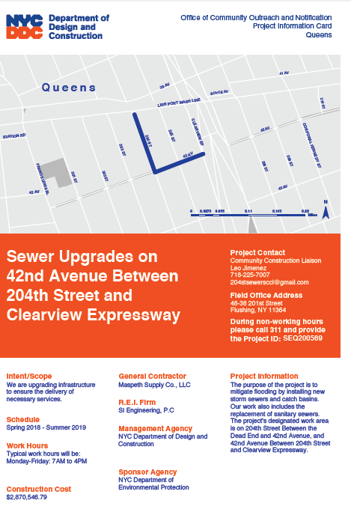
SAMPLE COMMUNICATIONS
Project
information card
advisory
newsletters
Look ahead Weekly bulletin
20

Slide 21
Thank you!
Q&A
CCL: Jeffrey Carlson
Email: WillowaveCCL@gmail.com

