Slide 1




Construction of Storm Sewers, Sanitary Sewers and Water Main Offsets in Alverson Avenue
Project # SER200258
Thomas Foley, P.E.
Commissioner
Community meeting
SEPTEMBER 26, 2022
Eric Adams
Mayor

Slide 2

agenda
About the Project
Location
Construction Overview
During Construction
Community Impacts
Outreach and Notification
Q & A
2

Slide 3
About the Project
Notice To Proceed: 07/18/2022
Projected Start: Fall 2022
Projected Completion: Summer 2024
Contractor: Inter-LaPeruta
Total Budget: $8.85 Million
3

Slide 4
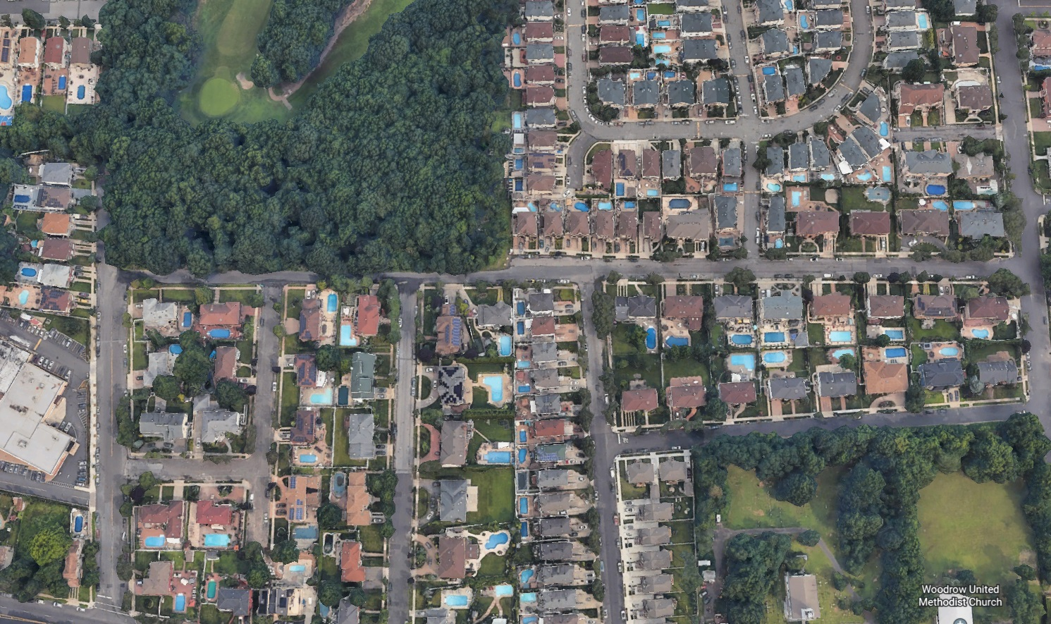
PROJECT LOCATION
MASON BLVD
ALVERSON AVENUE
WEST CASTOR PLACE
GILROY STREET
MARCY AVENUE
WOODROW ROAD

Slide 5

Project Locations

Slide 6
Project locations continued
Storm Sewer Installation
Alverson Avenue between McBaine Avenue and Alverson Loop
West Castor Place between Alverson Avenue and Wycliff Lane
Sanitary Sewer Installation
Alverson Avenue between Mason Boulevard and Woodrow Road
West Castor Place between Alverson Avenue and Powell Street
Gilroy Street between West Castor Place and Woodrow Road
Distribution Water Main Offsets
Alverson Ave at West Castor Place and West Castor Place at Gilroy Street

Slide 7
Project locations continued
STREET RESTORATION
The final restoration will consist of restoring the trenches with asphalt and then the installation of a 2” Overlay placed from curb to curb (or edge of roadway) throughout the site

Slide 8
How will this project benefit you?
COMMUNITY IMPROVEMENTS
The purpose of the project is:
Installing a new storm sewer system and the creation of a new BMP area to alleviate street flooding
Install new sanitary sewer system
Paving of roadways as per contract plans
8

Slide 9
CLICK TO EDIT HEADLINE TEXT
Edit text
Construction Overview
9
9

Slide 10
Construction Overview
Working Hours During Construction: Monday to Friday: 7:00 AM to 6:00 PM
Preliminary Work
In the ground (DEP Work)
Above ground (DOT Work)
Utilities
Community Outreach
Permits and scheduling
Street tree guards and pruning
Street markings, soil samples and test pits
Preconstruction Surveys & Photos
Street Cutting / Trench Set-up
Watermain Offsets
Sanitary Sewer
Storm Sewer
Catch basins
Street reconstruction and paving as per contract plans
Pavement markings
10

Slide 11
CLICK TO EDIT HEADLINE TEXT
Edit text
During construction
11
11

Slide 12
Traffic Patterns During Construction
Contractors will maintain the following:
Personnel, signage, and safe work site for pedestrians and vehicles
Pedestrian access to buildings and sidewalks
Keep a minimum width of 5 feet for access to sidewalks and crosswalks
Maintain one lane for local and emergency traffic
12

Slide 13
CLICK TO EDIT HEADLINE TEXT
Edit text
COMMUNITY Impacts
13
13

Slide 14
COMMUNITY IMPACTS & MITIGATIONS
Work within DEP Noise Code and Dust Control Regulations.
Provide 72-hour/24-hour notice to impacted areas of any water shutdowns.
Sewer Trap Survey will be conducted at homes receiving house connections to the new sanitary sewer. Appointment notifications will be distributed.
House Connection Forms will be distributed to residents receiving new sanitary sewers.
Keep storage site and MPT area clean & safe.
Professional rodent control inspector to monitor/maintain Rodent Control Station.
14

Slide 15
COMMUNITY IMPACTS & MITIGATIONS (cont’d)
Parking may be temporarily restricted when necessary; signs to be posted in advance.
Garbage pick-up may be affected and will be coordinated with appropriate stakeholders.
Individuals with special needs should contact the CCL. DDC field staff will work to minimize inconvenience.
In order to expedite the completion of work driveway access will be restricted during working hours.
15

Slide 16
CLICK TO EDIT HEADLINE TEXT
Edit text
OutREach and notification
16
16

Slide 17
COMMUNITY OUTREACH
DCC’s Office of Community Outreach + Notification (OCON)
works with CB’s, BID’s, local businesses, and other community stakeholders impacted by construction.
Community Construction Liaison (CCL)
DDC has assigned Mark Otten as the dedicated on-site Community Construction Liaison. The CCL can be reached at:
Email: alversonaveccl@gmail.com
Cell: 201-679-8049
Office: 718-554-4297
Field Office: 971 Rossville Avenue
Staten Island, NY 10309
17

Slide 18
COMMUNITY OUTREACH (continued)
CCL responsibilities are as follows:
First point of contact; maintain on-site presence and communication.
Identify, resolve, and/or proactively address issues and inquiries.
Distribute advisory updates/weekly construction activities newsletter.
Provide 72-hour and 24-hour (confirmation or cancellation) advisories for work impacts by email and door to door.
18

Slide 19
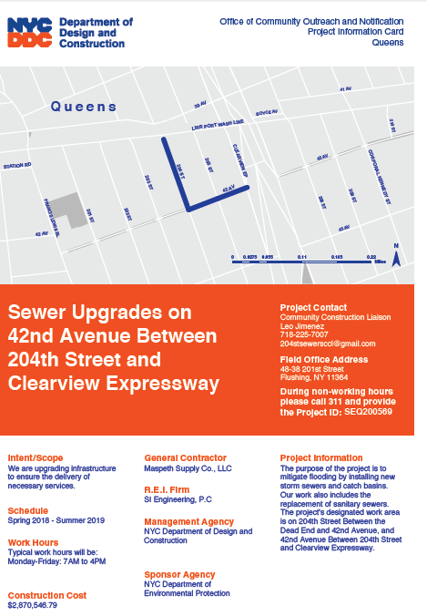
SAMPLE COMMUNICATIONS
Project
information card
advisory
newsletters
Look ahead Weekly bulletin
19

Slide 20
Thank you!
Q&A
CCL: Mark Otten
Email: alversonaveccl@gmail.com

