Slide 1




Reconstruction of Storm Sewers in North Avenue
including sanitary sewers, water main, street lighting & traffic work
Project SER200236
Community meeting
Eric Adams
Mayor
Thomas Foley
Acting Commissioner

Slide 2

agenda
Project Details
Location
Construction Overview
During Construction
Community Impacts
Outreach and Notification
Q & A
2

Slide 3
Project Details
Notice To Proceed: 12/16/2021
Projected Start: January 2022
Projected Completion: Fall 2023
Contractor: DiFazio Industries
Total Budget: $5.76 Million
3

Slide 4

Locations
Storm Sewer Installation
Forest Ave from Marianne St to Livermore Ave
Livermore Ave from Forest Ave to North Ave
North Ave from Livermore Ave to Neal Dow Ave
Sanitary Sewer Replacement
North Ave from Livermore Ave to Neal Dow Ave
Distribution Water Main Replacement
Forest Ave from Crystal Ave to Barret Ave (12”)
Forest Ave from Marianne St to Livermore Ave (20”)
Livermore Ave from Forest Ave to North Ave (8”)
North Ave from Livermore Ave to Neal Dow Ave (8”)

Slide 5
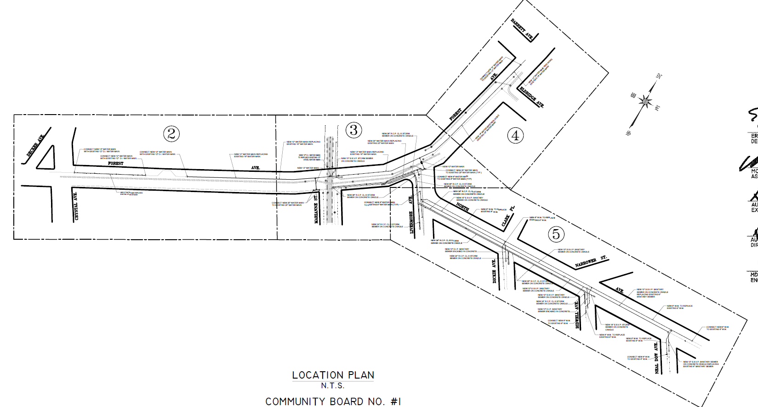
Water Main Replacement
Location
Barrett Ave
Forest Ave
Eldridge Ave
Decker Ave
Forest Ave
Forest Ave
Crystal Ave
Livermore Ave
Marianne Ave
North Ave
Dickie Ave
Water Main
Bidwell Ave
Neal Dow Ave

Slide 6
Sanitary Sewer Replacement
Barrett Ave
Forest Ave
Eldridge Ave
Decker Ave
Forest Ave
Forest Ave
Crystal Ave
Livermore Ave
Marianne Ave
North Ave
Dickie Ave
Sanitary Sewer
Bidwell Ave
Neal Dow Ave

Slide 7
Storm Sewer Installation
Barrett Ave
Forest Ave
Eldridge Ave
Decker Ave
Forest Ave
Forest Ave
Crystal Ave
Livermore Ave
Marianne Ave
North Ave
Dickie Ave
Storm Sewer
Bidwell Ave
Neal Dow Ave

Slide 8
Locations (cont’d)
Full Depth Roadway Reconstruction
Livermore Ave between Forest Ave and North Ave
North Ave between Livermore Ave and Neal Dow Ave
Forest Ave between Marianne St and Livermore Ave
Trench Restoration
Forest Ave between Crystal Ave and Marianne St
Forest Ave between Livermore Ave and Barrett Ave

Slide 9
How will this project benefit you?
COMMUNITY IMPROVEMENTS
To improve drainage by installing new storm sewers and catch basins in the area in accordance with NYCDEP’S drainage plan.
Replace and upgrade existing water main and hydrants to improve water distribution throughout the community.
Replace and upgrade the existing sanitary sewers.
9

Slide 10
CLICK TO EDIT HEADLINE TEXT
Edit text
Construction Overview
10
10

Slide 11
Construction Overview
Preliminary Work
In the ground (DEP Work)
Above ground (DOT Work)
Utilities
Community Outreach
Permits and scheduling
Street tree guards and pruning
Street markings, soil samples and test pits
Preconstruction Investigation
Installing erosion and sediment control measures
Street Cutting / Trench Set-up
Watermain Replacement
Fire Hydrant Installation
Storm & Sanitary Sewer Installation
Catch basin Installation
Curbs and sidewalks (As Needed)
Street reconstruction – full depth
Street lighting work
Pavement markings
Tree plantings and sodding
11

Slide 12

WORKING HOURS DURING CONSTRUCTION
Construction work hours will be as follows:
Forest Ave between Crystal Ave and Barrett Ave 9:00 PM – 5:00 AM, Monday – Friday
Livermore Ave between Forest Ave and North Ave 9:00 AM – 4:00 PM, Monday – Friday
North Ave between Livermore Ave and Lockwood Pl 7:00 AM – 6:00 PM, Monday – Friday

Slide 13
CLICK TO EDIT HEADLINE TEXT
Edit text
During construction
13
13

Slide 14
Traffic Patterns During Construction
Contractors will maintain the following:
Contractor will provide signage and implement a Maintenance and Protection of Traffic plan (MPT). The MPT plan is vital to establishing and maintaining a safe work site by directing pedestrian and vehicular traffic.
Flag persons/crossing guards may be assigned for traffic control.
Keep a minimum width of 5 feet for access to sidewalks and crosswalks.
Contractor is required to maintain pedestrian access to houses and sidewalks.
One travel lane in each direction shall be maintained on two-way streets. In some cases, contractor will provide one 12 foot lane for two-way traffic.
When necessary, full roadway closures may occur and shall be coordinated with DOT.
14

Slide 15
CLICK TO EDIT HEADLINE TEXT
Edit text
Community Impacts
15
15

Slide 16
COMMUNITY IMPACTS & MITIGATIONS
Contractor shall:
Work within DEP Noise Code and Dust Control Regulations.
Post advance 24-hour notice to impacted areas for parking restrictions and confirmed water shutdowns.
Keep storage site and MPT area clean & safe.
Professional rodent control inspector to monitor/maintain Rodent Control Station.
16

Slide 17
COMMUNITY IMPACTS & MITIGATIONS (cont’d)
Parking may be temporarily restricted when necessary; signs to be posted in advance.
Garbage collection may be affected, the contractor and DDC field staff will coordinate for removal.
In order to expedite the completion of work, driveway access may be restricted during working hours. Advanced notice will be given.
Individuals with special needs should contact the Carol Mieden the Community Construction Liaison (CCL). DDC field staff will work specifically with those individuals to minimize the inconvenience.
17

Slide 18
CLICK TO EDIT HEADLINE TEXT
Edit text
OutREach and notification
18
18

Slide 19
COMMUNITY OUTREACH
DCC’s Office of Community Outreach + Notification (OCON)
works with CB’s, BID’s, local businesses, and other community stakeholders impacted by construction.
Community Construction Liaison (CCL)
DDC has assigned Carol Mieden of Hershy Engineering & Consulting as the dedicated on-site Community Construction Liaison. The CCL can be reached at:
Email: NorthAveCCL@gmail.com
Mobile: 646.301.6362
Field Office: 260 Christopher Ln, 1st Floor Suite 104
Staten Island, NY 10312
19

Slide 20
COMMUNITY OUTREACH (cont’d)
CCL responsibilities are as follows:
First point of contact; maintain on-site presence and communication to the community.
Identify, resolve, and/or proactively address issues and inquiries.
Distribute advisory updates/weekly construction bulletin/quarterly newsletters.
Provide 72-hour and 24-hour community advisories for all work activities.
20

Slide 21
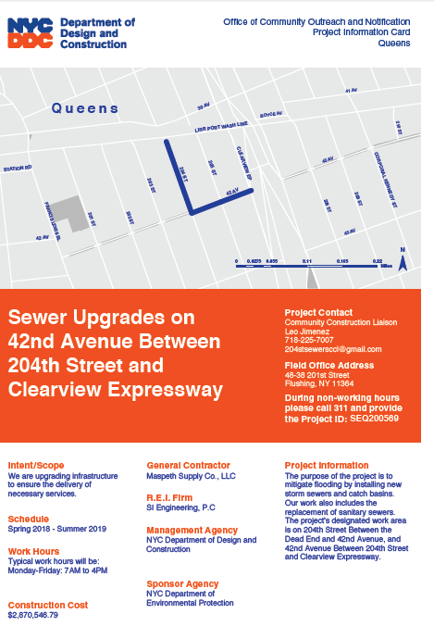
SAMPLE COMMUNICATIONS
Project
information card
advisory
newsletters
Look ahead Weekly bulletin
21

Slide 22
Thank you!
Q&A
CCL: Carol Mieden
Email: NorthAveCCL@gmail.com

