Slide 1
PACIFIC PARK PROJECT PHASE II
Combined Sewer Installation and Water Main Replacement
Dean Street between 6th Avenue & Vanderbilt Avenue, etc.
Project SEK002383
Presentation to
Community board 8K
March 7, 2023
Eric L. Adams
Mayor
Thomas J. Foley
Commissioner

Slide 2
agenda
About the Project
Locations
Benefits to the Community
Construction Overview
Community Impacts & Mitigation
Outreach and Notification
Q & A

Slide 3
About the Project
Notice To Proceed: September 13, 2022
Projected Start: November 14, 2022
Projected Completion: 36 Months
Contractor: DeBoe Construction Corp.
Total Budget: $15 Million

Slide 4
Benefits to the Community
DEP prioritized this project to:
Provide residents living in the newly constructed buildings with sufficient capacity for sanitary discharge and to convey storm water from the project area.
Upgrade water main sizes to provide for additional peak demands.
Improve fire safety protection.

Slide 5
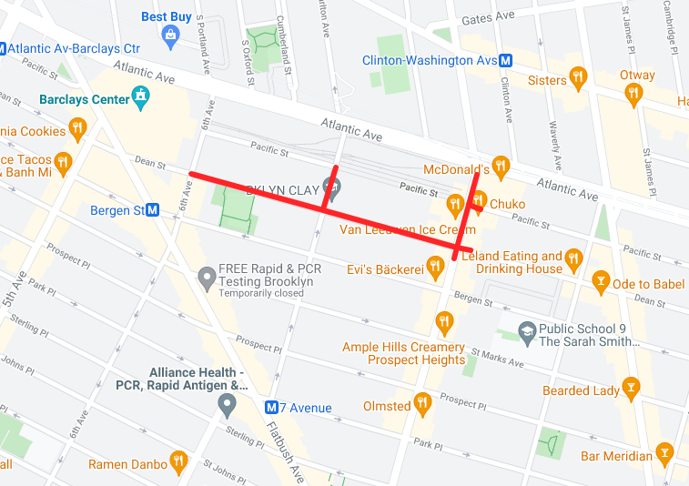
Project Locations
Combined Sewer Replacement
Dean Street bet. 6th and Vanderbilt Avenues
Vanderbilt Avenue bet. Dean and Pacific Streets
Distribution Water Main Replacement
Dean Street bet. Carlton and Vanderbilt Avenues
Vanderbilt Avenue bet. Dean and Atlantic Avenue
Carlton Avenue bet. Dean and Pacific Streets
Note:
There are two (2) watermains on Vanderbilt Avenue between Dean street and Pacific Street--one in the street and one in the eastern sidewalk which means digging up the sidewalk. The Lamp Post will be protected since it is within the Prospect Heights Historic District. Sidewalk replacement cement is also included for this area according to landmark preservation requirements. The curb will also be Granite.

Slide 6
Construction Overview
Preliminary Work
In the ground
Above ground
Utilities
Outreach
Permits and scheduling
Staging and storage of materials
Street tree guards and pruning
Test pits and street markings
Street furniture removal
Street Cutting / Trench Set-up
Watermain Installation
Combined Sewer Installation
Sewer System Support
Watermain House Connections
Sewer House Connections
Catch Basin Replacement
Trench Restoration
Street Overlay
Upgraded Pedestrian Ramps
Fire hydrant Replacement

Slide 7
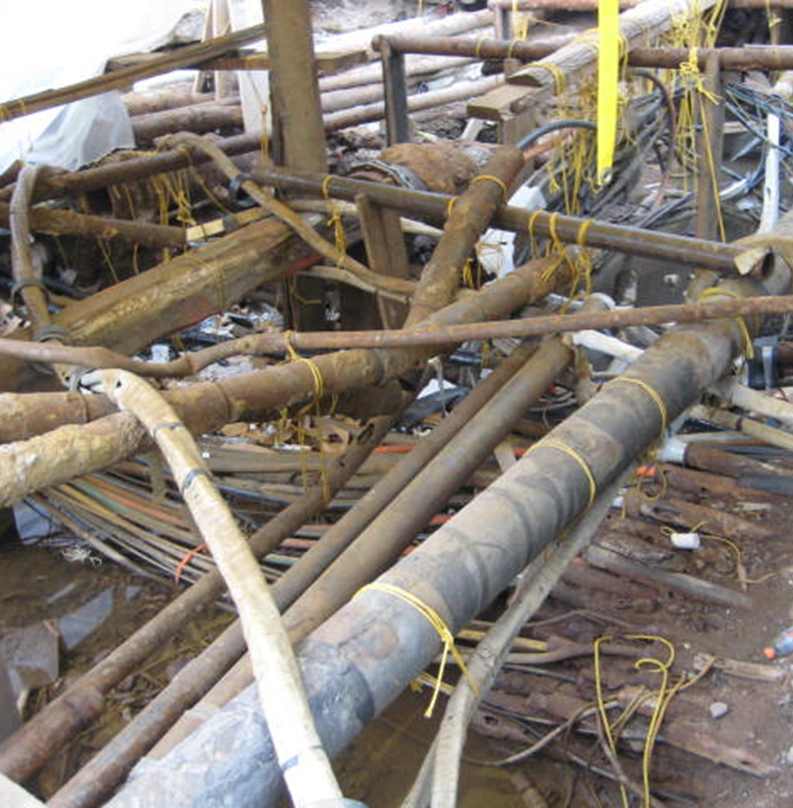
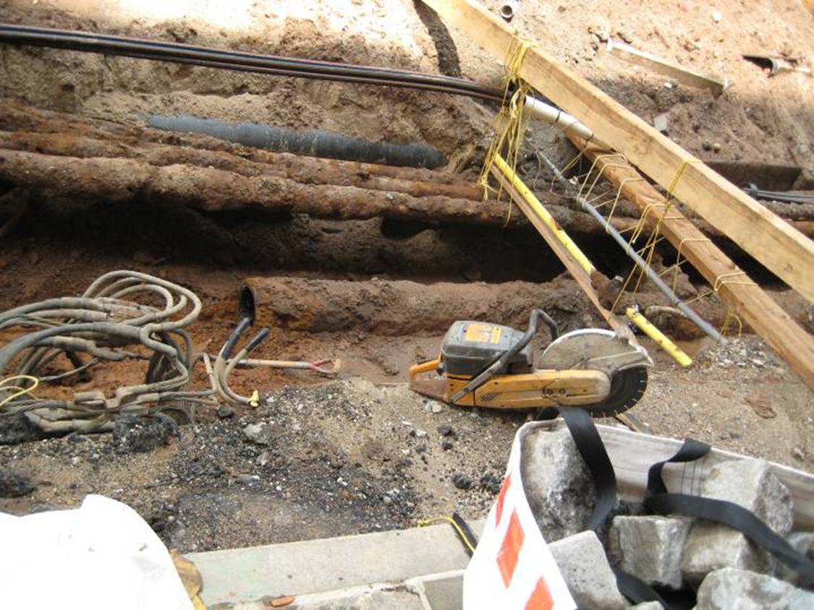
Example of Typical Underground
Excavated Water Main to be Replaced
Utilities

Slide 8
CLICK TO EDIT HEADLINE TEXT
Edit text
During construction
8

Slide 9
Work Hours During Construction
(As Per NYC DOT)
Monday to Friday: 9:00am - 4:00pm
Saturdays: 8:00am - 6:00pm (as necessary)
Contractor will follow all DOT & Street Activity Permit Office (SAPO) events and embargos.

Slide 10
Traffic Patterns During Construction
Contractor will be responsible for the following:
Personnel, signage, and safe work site for pedestrians and vehicles
Pedestrian access to buildings and sidewalks; notify bikers of work ahead
Keep a minimum width of 5’ access on sidewalks and crosswalks
Maintain travel lanes; intermittent reduction of travel lanes when necessary
Full roadway closure; intermittent when necessary

Slide 11
CLICK TO EDIT HEADLINE TEXT
Edit text
Impacts
11

Slide 12
COMMUNITY IMPACTS & MITIGATIONS
Contractor shall:
Obtain Pre-Construction Reports (which will be done by a separate entity).
Work within DEP Noise Code Regulations.
Ensure area has enough access to water during temporary water shutdowns. (Will coordinate with critical businesses in the area.)
Post advance Contractor’s 24-hour notice to impacted area.
Keep storage site and MPT area clean & safe.
Cover trucks delivering fill material.
Provide professional rodent control inspector to monitor/maintain Rodent Control Station

Slide 13
COMMUNITY IMPACTS & MITIGATIONS (cont’d)
Driveway access may be temporarily restricted during work hours, but coordination is done case-by-case.
Parking may be temporarily restricted when necessary; signs will be posted in advance.
Garbage pick-up may be affected and will be coordinated with appropriate stakeholders.
Individuals with special needs should contact the Community Construction Liaison (CCL). Field staff will work to minimize inconveniences.

Slide 14
COMMUNITY OUTREACH
OCON
DCC’s Office of Community Outreach and Notification (OCON) works with CBs, BID’s, local businesses, and other community stakeholders impacted by construction.
CCL
DDC will assign a Community Construction Liaison (CCL) as the dedicated on-site point person. Contact information for the CCL and field office will be provided to the community.

Slide 15
COMMUNITY OUTREACH (cont.)
CCL Responsibilities
First point of contact; maintain on-site presence and communication.
Identify, resolve, and/or proactively address issues and inquiries.
Distribute advisory updates/weekly construction activities newsletter.
Provide 72-hour and 24-hour (confirmation or cancellation) advisories for work impacts by email and door to door.
Attend community board monthly DSC meetings.

Slide 16
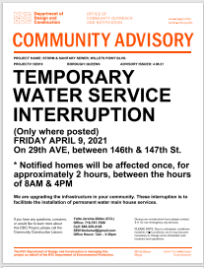
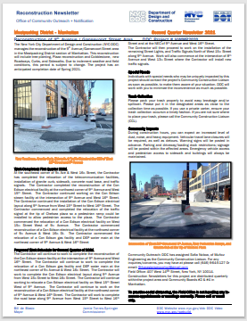
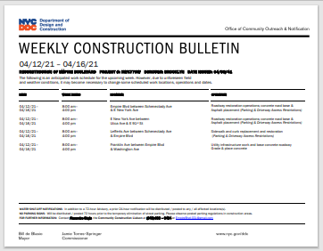
SAMPLE COMMUNICATIONS
Project information card
advisory
newsletters
Look ahead
Weekly bulletin

Slide 17
COMMUNITY OUTREACH (cont.)
CCL
Ian Thornell
Cell: 917-417-6463
Email: pacificparkprojectccl@gmail.com

Slide 18
Thank yoU!
Q&A

